Slide 1
CIS-620
Spring 2021
Learning in Few-Labels Settings
Dan Roth
Computer and Information Science
University of Pennsylvania
Meeting # 3
2/8/21

Slide 2
Admin
If you haven’t selected a paper to present, please do so.
  Papers for the 15th are on the spreadsheet. Please send me your draft presentation soon; no later than Friday night.
Recall that you need to be a discussant on two papers.
  Please send your questions/bullets by Sunday.
Please follow the presentation guidelines
Please follow the schedule on the website:
  February 15:
  Select a paper to reproduce
    Reproduction papers will be released today.
  First Critical Survey due
    Guidelines will be released later this week
    Do not survey papers that were already presented in class.

Slide 3
Today’s Papers
Zero-Shot Learning
  Zero-Shot Relation Extraction via Reading Comprehension (Kevin Xie)
Incidental Signals
  Learning Dependency-Based Compositional Semantics (Krunal Shah)
Knowledge as Supervision
  A Logic-Driven Framework for Consistency of Neural Models (Jiayao Zhang)
Zero-Shot + Knowledge
  Zero-shot Learning of Classifiers from Natural Language Quantification (Young-Min Cho)

Slide 4
Zero-Shot

Slide 5
Zero-Shot Learning
Protocols: Multiple protocols are referred to as Zero-Shot in the literature.
Assume that we are talking about multi-class classification
  The decision model has not seen any task-specific training examples
  The decision model has been trained on some of the labels and needs to predict also on unseen labels.
  [Yin et al. EMNLP’19] called these protocols: label-fully-unseen and label-partially-unseen
Methods:
  Representation-based: examples & labels are mapped to a common semantic space
    Sparse representations or Dense representations
  Transfer: a model that was trained on decision task T is being used (via some mapping) to support decisions on task T’.
    Typically, transfer is done from Textual Entailment or Questions Answering
  Learning from definitions (or other external sources)

Slide 6
Zero-Shot Paper
Zero-Shot Relation Extraction via Reading Comprehension (Kevin Xie)
  Transfer learning for relation extraction.
  Note that the standard relation extraction is defined as:
    Input: Sentence, mention₁, mention₂, taxonomy of relations {R₁, R₂, …R_{k}} (includes a no-relation)
    Learn a model that maps the mention pair into one of the relations R_{i}
  Example: Sanders’ wife is a native of North Carolina ➔ (born_in (sander’s wide, NC)

Slide 7
Incidental Signals
Learning from Responses

Slide 8

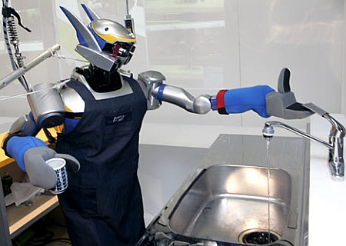

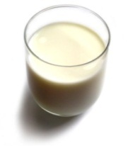
Understanding Language Requires (some) Feedback
Can I get a coffee with lots of sugar and no milk
Can we rely on this interaction to provide supervision (and eventually, recover meaning) ?
Great!
The Goal
Arggg
Meaning Representation:
MAKE(COFFEE,SUGAR=YES,MILK=NO)
How to recover meaning from text?
Standard “example based” ML: annotate text with meaning representation
  The teacher needs deep understanding of the agent ; not scalable.
Response Driven Learning (current name: learning from denotation): Exploit indirect signals in the interaction between the learner and the teacher/environment
[A lot of work in this direction, following Clarke et al. CoNLL’10: Driving Semantic Parsing from the World's Response]
Notes:
NLU: about recovering meaning from text – a lot of work aims directly at that or at some subtasks that might look like this:….

Slide 9
Response Based Learning
We want to learn a model that transforms a natural language sentence to some meaning representation.
Instead of training with (Sentence, Meaning Representation) pairs
Think about/invent behavioral derivative(s) of the models outputs
  Supervise the derivatives (easy!) and
  Propagate it to learn the complex, structured, transformation model
English Sentence
Model
Meaning Representation

Slide 10
Geoquery with Response based Learning
We want to learn a model to transform a natural language sentence to some formal representation.
“Guess” a semantic parse. Is [DB response == Expected response] ?
  Expected: Pennsylvania DB Returns: Pennsylvania→ Positive Response
  Expected: Pennsylvania DB Returns: NYC, or ???? → Negative Response
English Sentence
Model
Meaning Representation
What is the largest state that borders NY?
largest( state( next_to( const(NY))))
Simple derivatives of the model’s outputs
Query a GeoQuery Database.
The key challenge is computational. The space of possible semantic parses is huge. Approaches focused on trying to constrain this space.
If the response is “yes”, it could still be so for the wrong reason, despite the semantic parse being wrong.
If the response is “no”, the semantic parse must be wrong; how to supervise?

Slide 11
Incidental Supervision Paper
Learning Dependency-Based Compositional Semantics (Krunal Shah)
  Will present significant improvements over the original paper

Slide 12
Knowledge as Supervision

Slide 13
Joint Inference with General Constraint Structure [Roth&Yih’04,07,….]
Recognizing Entities and Relations
Joint inference gives good improvement
other | 0.05
per | 0.85
loc | 0.10
other | 0.05
per | 0.85
loc | 0.10
other | 0.10
per | 0.60
loc | 0.30
other | 0.10
per | 0.60
loc | 0.30
other | 0.05
per | 0.50
loc | 0.45
other | 0.05
per | 0.50
loc | 0.45
other | 0.05
per | 0.50
loc | 0.45
An Objective function that incorporates learned models with knowledge (output constraints)
A Constrained Conditional Model
  Bernie’s wife, Jane, is a native of Brooklyn
  E1 E2 E3
Key Questions:
How to learn the model(s)?
What is the source of the knowledge?
How to guide the global inference?
R₁₂
R₂₃
irrelevant | 0.05
spouse_of | 0.45
born_in | 0.50
irrelevant | 0.05
spouse_of | 0.45
born_in | 0.50
irrelevant | 0.05
spouse_of | 0.45
born_in | 0.50
irrelevant | 0.10
spouse_of | 0.05
born_in | 0.85
irrelevant | 0.10
spouse_of | 0.05
born_in | 0.85
Models could be learned separately/jointly; constraints may come up only at decision time.
Notes:
13
Let’s look at another example in more details.
We want to extract entities (person, location and organization) and relations between them (born in, spouse of).
Given a sentence, suppose the entity classifier and relation classifier have already given us their predictions along with the confidence values. The blue ones are the labels that have the highest confidence individually. However, this global assignment has some obvious mistakes. For example, the second argument of a born_in relation should be location instead of person. Since the classifiers are pretty confident on R23, but not on E3, so we should correct E3 to be location.
Similarly, we should change R12 from “born_in” to “spouse_of”

Slide 14
Constrained Conditional Models [Abductive Reasoning; Chang et al.’12]
ILP Formulation
Variables are models
Penalty for violating
the constraints.
Formulation goes back to (Roth & Yih 2004). Also related to PR (Ganchev et al. 2010)
y = argmax_{y} ∑ 1_{∅(x, y)} w_{x,y} subject to Constraints C(x,y)
    y = argmax_{y} $∈$ _{Y} w^{T}$∅$(x, y) + u^{T}C(x, y)
Knowledge component:
(Soft) constraints
A linear function over models – can be used to model any logical function
Features, Models, NN
(non-linearity comes here)
How far are the decisions (y) is from a “legal/expected” assignment
How to train models?
  Without the constraints; apply constraints only at decision time.
  With constraints
    More costly
  What to learn during training? The objective function (w, u)? Learning all the intermediate functions ∅(x, y)?
How to encode the constraints?
  Linear inequalities? Gives rise to LP/ILP
  Differentiable encoding of the linear constraints?

Slide 15
Knowledge as Supervision Paper
A Logic-Driven Framework for Consistency of Neural Models (Jiayao Zhang)
  Will present an interesting instance of this framework

Slide 16
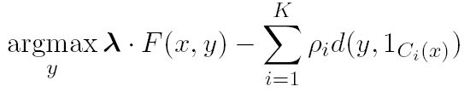
Information extraction [Chang et al. ACL’07, MLJ’12]
Lars Ole Andersen . Program analysis and specialization for the C Programming language. PhD thesis. DIKU , University of Copenhagen, May 1994 .
Prediction result of a trained HMM
Lars Ole Andersen . Program analysis and
specialization for the
C
Programming language
. PhD thesis .
DIKU , University of Copenhagen , May
1994 .
[AUTHOR]
[TITLE]
[EDITOR]
[BOOKTITLE]
[TECH-REPORT]
[INSTITUTION]
[DATE]
Violates lots of natural constraints!
Notes:
16
16

Slide 17
Strategies for Improving the Results
Increasing the model complexity
Increase difficulty of Learning
Can we keep the learned model simple and still make expressive decisions?
(Pure) Machine Learning Approaches
  Higher Order HMM/CRF?
  Increasing the window size?
  Use neural models
  Adding a lot of new features
    Requires a lot of labeled examples
  What if we only have a few labeled examples?
Other options?
  Constrain the output to make sense
  Push the (simple) model in a direction that makes sense
Notes:
17

Slide 18
Examples of Constraints
Each field must be a consecutive list of words and can appear at most once in a citation.
State transitions must occur on punctuation marks.
The citation can only start with AUTHOR or EDITOR.
The words pp., pages correspond to PAGE.
Four digits starting with 20xx and 19xx are DATE.
Quotations can appear only in TITLE
…….
Easy to express pieces of “knowledge”
Non Propositional; May use Quantifiers

Slide 19
Information Extraction with Constraints
Adding constraints, we get correct results!
  Without changing the model
[AUTHOR] Lars Ole Andersen .
[TITLE] Program analysis and specialization for the
C Programming language .
[TECH-REPORT] PhD thesis .
[INSTITUTION] DIKU , University of Copenhagen ,
[DATE] May, 1994 .
Notes:
19

Slide 20
Guiding (Semi-Supervised) Learning with Constraints
In traditional Semi-Supervised learning the model can drift away from the correct one.
Constraints can be used to generate better training data
  At training to improve labeling of un-labeled data (and thus improve the model)
  At decision time, to bias the objective function towards favoring constraint satisfaction.
Seed examples
Model
Constraints
Better Predictions
Better model-based labeled data
Un-labeled Data
Decision Time
Constraints

Slide 21

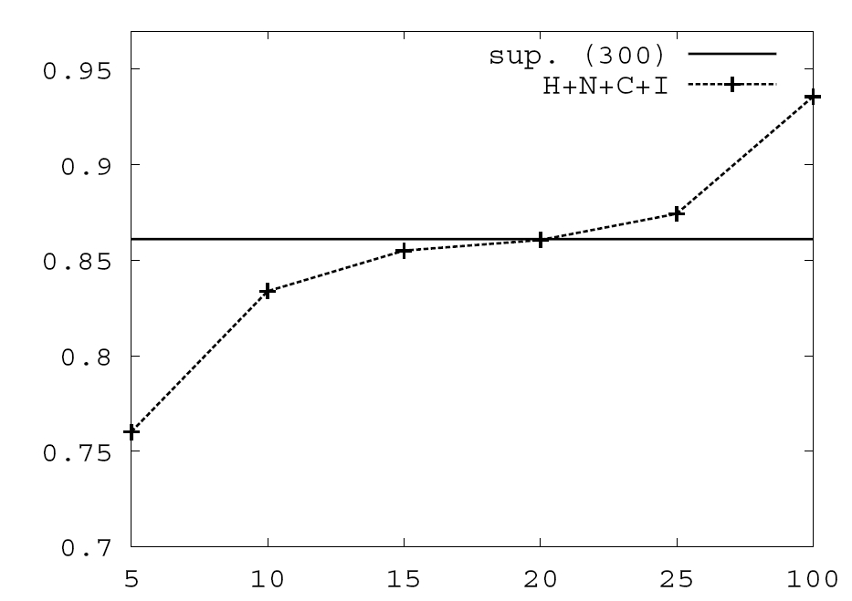
Value of Constraints in Semi-Supervised Learning
Objective function:
Learning w/o Constraints: 300 examples.
Constraints are used to Bootstrap a semi-supervised learner
Poor model + constraints used to annotate unlabeled data, which in turn is used to keep training the model.
Learning w 10 Constraints
# of available labeled examples

Slide 22
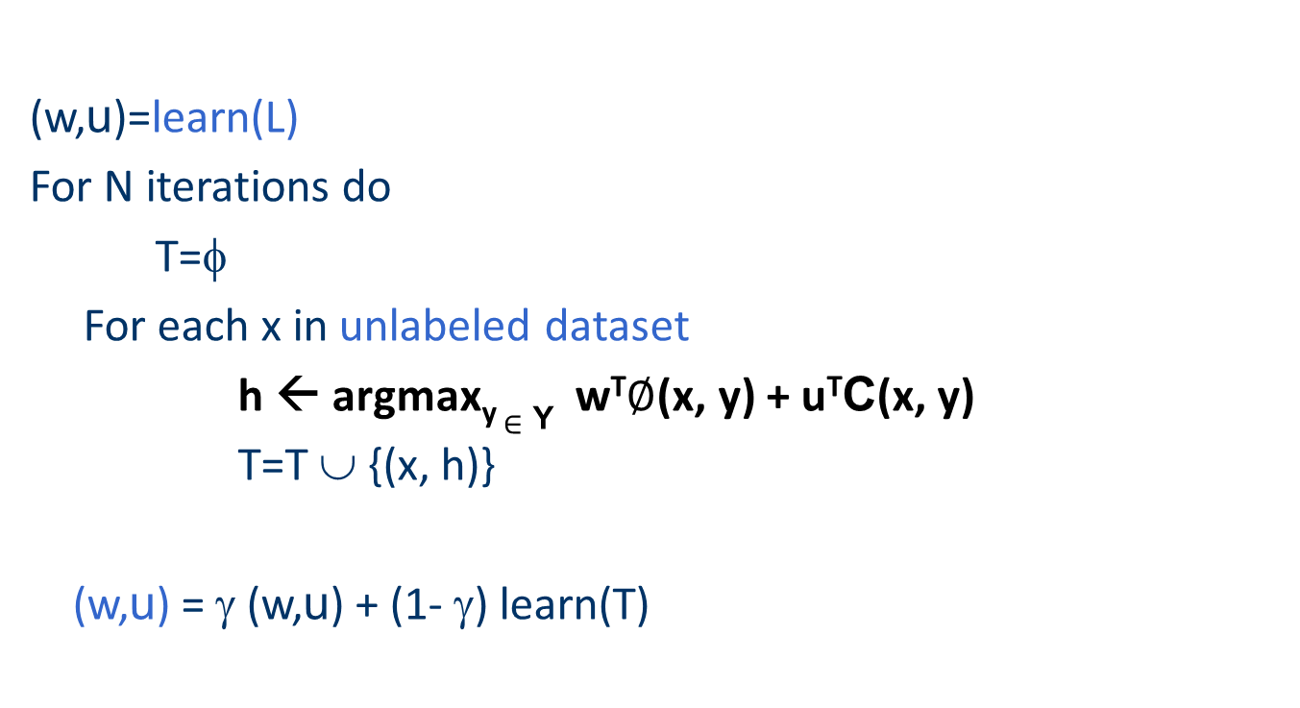
Constraints Driven Learning (CoDL)
Archetypical Semi/un-supervised learning: A constrained EM
[Chang, Ratinov, Roth, ACL’07;ICML’08,MLJ’12]
See also: Ganchev et. al. 10 (PR)
(w,u)=learn(L)‏
For N iterations do
T=φ
For each x in unlabeled dataset
h ← argmax_{y} $∈$ _{Y} w^{T}$∅$(x, y) + u^{T}C(x, y)
T=T ∪ {(x, h)}
(w,u) = γ (w,u) + (1- γ) learn(T)
Supervised learning algorithm
parameterized by (w,u).
(w,u) are latent variables
Inference with constraints:
(use the constraints to “correct” predictions)
Then augment the training set
Learn from new training data
Weigh supervised &
unsupervised models.
Notes:
22
22

Slide 23
CoDL as Constrained Hard EM
Hard EM is a popular variant of EM
While EM estimates a distribution over hidden variables in the E-step,
… Hard EM predicts the best output in the E-step
h= y*= argmax_{y} P_{w}(y|x)
Alternatively, hard EM predicts a peaked distribution
q(y) = 1_{[y=y*]}
Constrained-Driven Learning (CODL) – can be viewed as a constrained version of hard EM:
y*= argmax_{[y:Uy<b]} P_{w}(y|x)
Constraining the feasible set

Slide 24
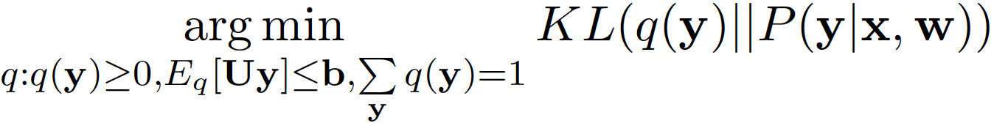
Constrained EM: Two Versions
While Constrained-Driven Learning [CODL; Chang et al, 07,12]
is a constrained version of hard EM:
y*= argmax_{[y:Uy<b]} P_{w}(y|x)
… It is possible to derive a constrained version of EM:
To do that, constraints are relaxed into expectation constraints on the posterior probability q:
E_{q}[Uy] <= b
The E-step now becomes: [Neal & Hinton ‘99 view of EM]
q’ =
This is Posterior Regularization [PR] [Ganchev et al, 10]
Constraining the y feasible set
Constraining a distribution over y
The CoDL paper and the PR papers are doing a good job comparing these frameworks;
also see Samdani & Roth, NAACL-12 for a unifying framework.

Slide 25
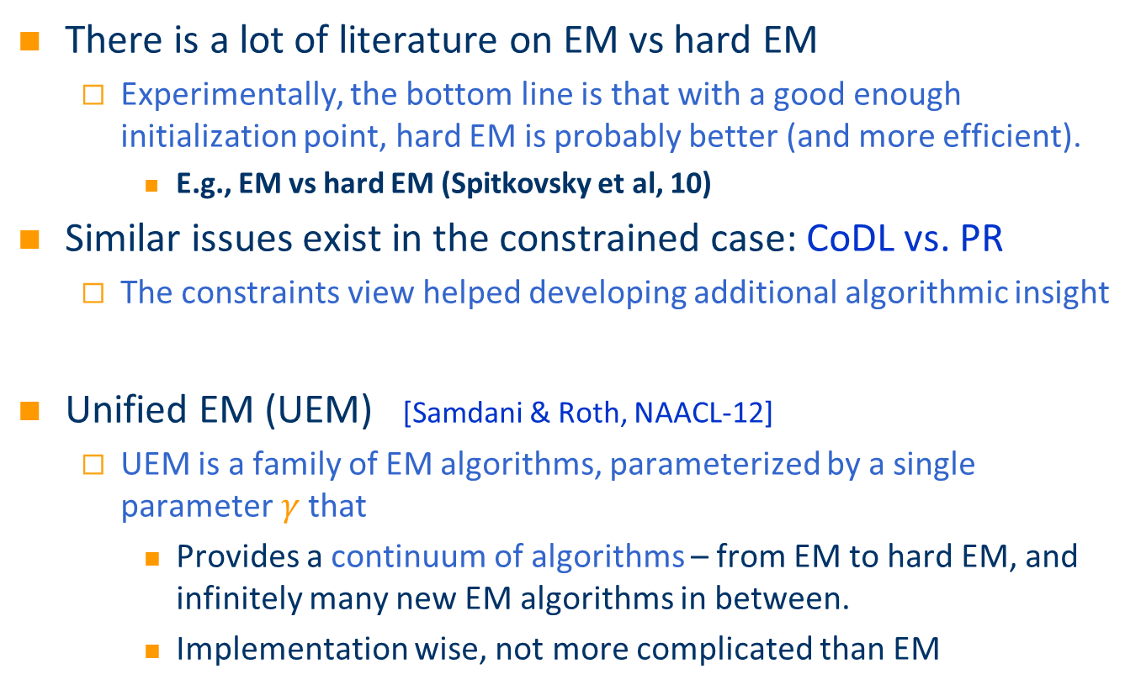
Which (Constrained) EM to use?
There is a lot of literature on EM vs hard EM
  Experimentally, the bottom line is that with a good enough initialization point, hard EM is probably better (and more efficient).
    E.g., EM vs hard EM (Spitkovsky et al, 10)
Similar issues exist in the constrained case: CoDL vs. PR
  The constraints view helped developing additional algorithmic insight
Unified EM (UEM) [Samdani & Roth, NAACL-12]
  UEM is a family of EM algorithms, parameterized by a single parameter$γ$that
    Provides a continuum of algorithms – from EM to hard EM, and infinitely many new EM algorithms in between.
    Implementation wise, not more complicated than EM

Slide 26


Unifying Existing EM Algorithms
EM minimizes the KL-Divergence:
KL(q, p, $γ$ ) = ∑_{y} $γ$q(y) log q(y) – q(y) log p(y)
Varying $γ$ results in different existing & new EM algorithms
Infinitely many new EM algorithms
No
Constraints
Deterministic Annealing (Smith and Eisner, 04; Hofmann, 99)
Hard EM
EM
-1
0
1
1
With Constraints
$γ$
CODL
(New)LP approx to CODL
PR
Notes:
Put a tick

Slide 27
Unsupervised POS tagging: Different EM instantiations
Introducing output expectations via constraints help guiding semi-supervised learning
Constrained hard EM (CoDL) – Constrained EM (PR) – UEM
Initialization with 40-80 examples
Initialization with 20 examples
Performance relative to EM
Initialization with 10 examples
Initialization with 5 examples
Uniform Initialization
EM
Gamma
Hard EM

Slide 28
Zero-Shot + Knowledge Paper
Zero-shot Learning of Classifiers from Natural Language Quantification (Young-Min Cho)
  Using definitions to understand the target labels
  Standard text classification problem.
  Input: Text Snippet, taxonomy of labels {l₁, l₂, …l_{k}} (includes a none)
  Learn a model that maps the text snippet into one of the labels.
Key technical question is how to use the knowledge given by the “definitions”
  Use of Posterior Regularization

