Slide 1
NaturalLI: Natural Logic Inference for Common Sense Reasoning
Gabor Angeli and Christopher D. Manning
EMNLP, 2014
Hangfeng He (hangfeng@seas.upenn.edu)
March 11, 2019

Slide 2
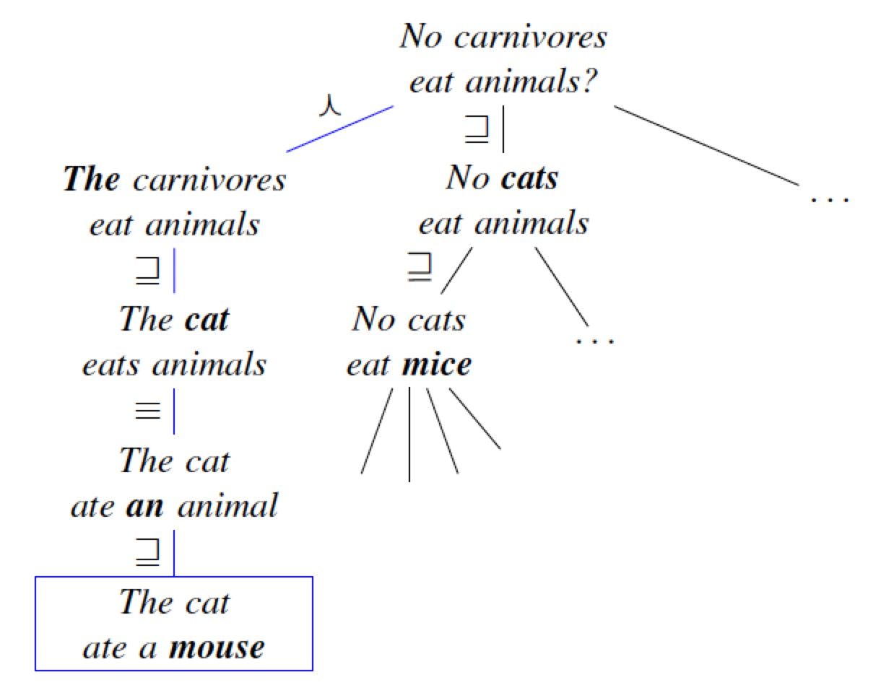
Problem
Common Sense Reasoning: Database Completion
  Given a database of true facts
  The task is to predict whether an unseen fact is true and should belong in the database
  It is an exploratory task
An Example
  Query: “no carnivores eat animals”
  Find a premise in the database to prove or disprove the query

Slide 3
Motivation
Challenges
  Natural Logic inference: a proof system built on the syntax of human language
  Maintain high recall, particularly for large scale open-domain tasks
  Generalize to arbitrary relations
Problems in Previous Works
  Prior work on Natural Logic has focused on inferences from a single relevant premise , making use of only formally valid inferences
  Standard IR methods easily miss small but semantically important lexical differences
  Many methods require explicitly modeling either the database, the query, or the both in a formal meaning representation
Question
  Can we have an inference system over unstructured text for a large set of candidate premises without aligning to any particular premise ?

Slide 4
Contents:
Introduction
MacCartney’s Natural Logic
Inference as a Finite State Machine
Inference as Search
Experiments
Discussion

Slide 5
Contributions of this work
Contributions in Database Completion
  It allows unstructured text as the input database without any assumptions about the schema or domain of the text
  It proposes Natural Logic for inference, rather than translating to a formal logic syntax
Contributions in Computational Natural Logic
  Operates over a very large set of candidate premises simultaneously
  Do not require explicit alignment between a premise and the query
  Allow imprecise inferences at an associated cost learned from data

Slide 6
MacCartney’s Natural Logic
Based on
  Theoretical work on Natural Logic and Monotonicity Calculus (van Benthem, 1986; Valencia, 1991)
  NatLog system (MacCartney and Manning, 2007; 2008; 2009)
Components
  Lexical Relations
  Monotonicity and Polarity
  Proof by Alignment

Slide 7
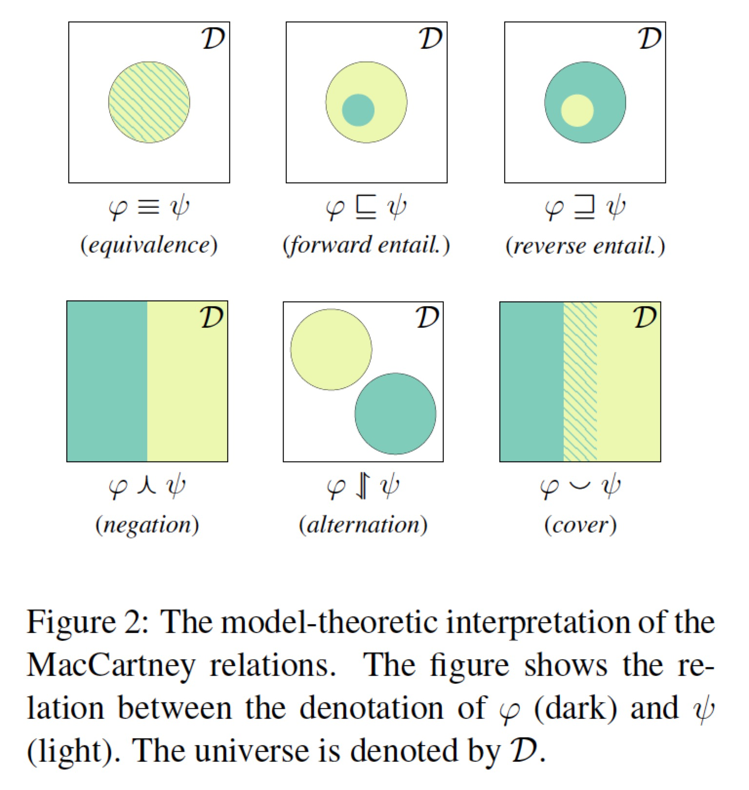
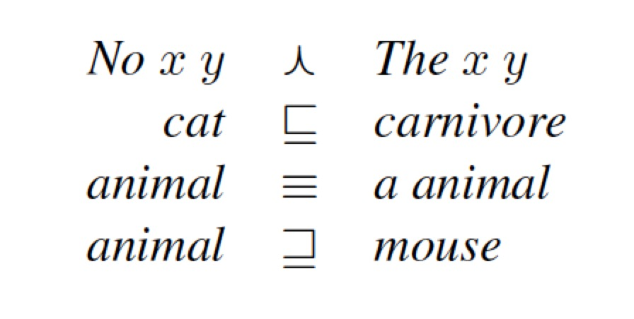
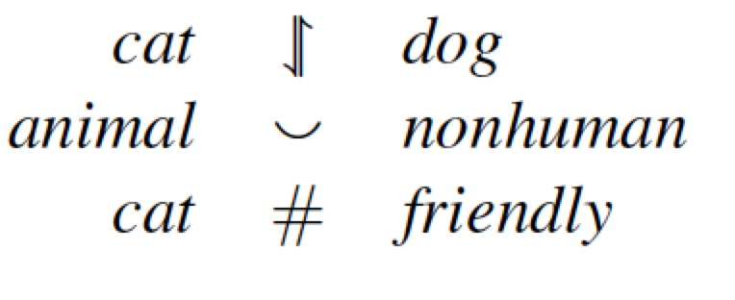
MacCartney’s Natural Logic
Lexical Relations
  Seven set-theoretic relations
  #: completely uninformative relation

Slide 8
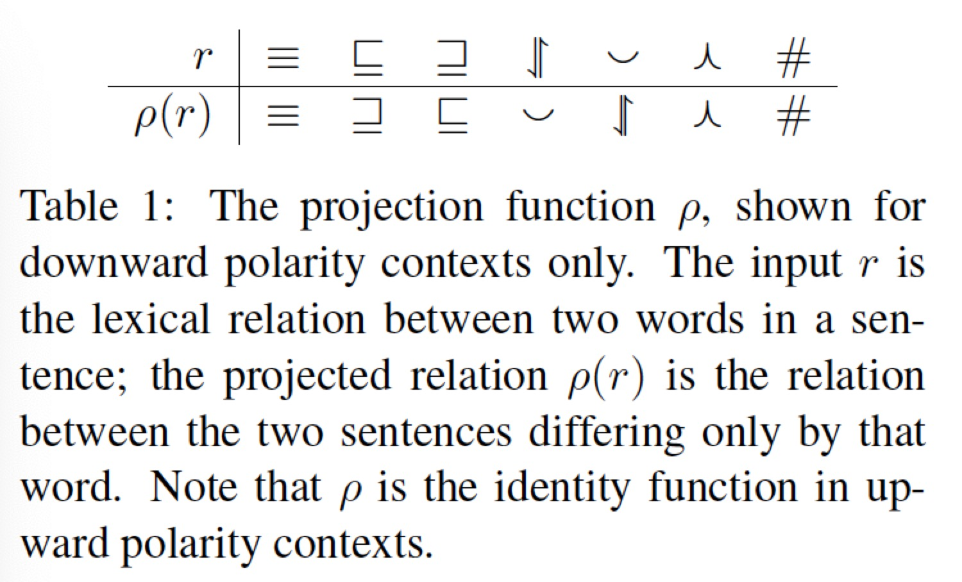
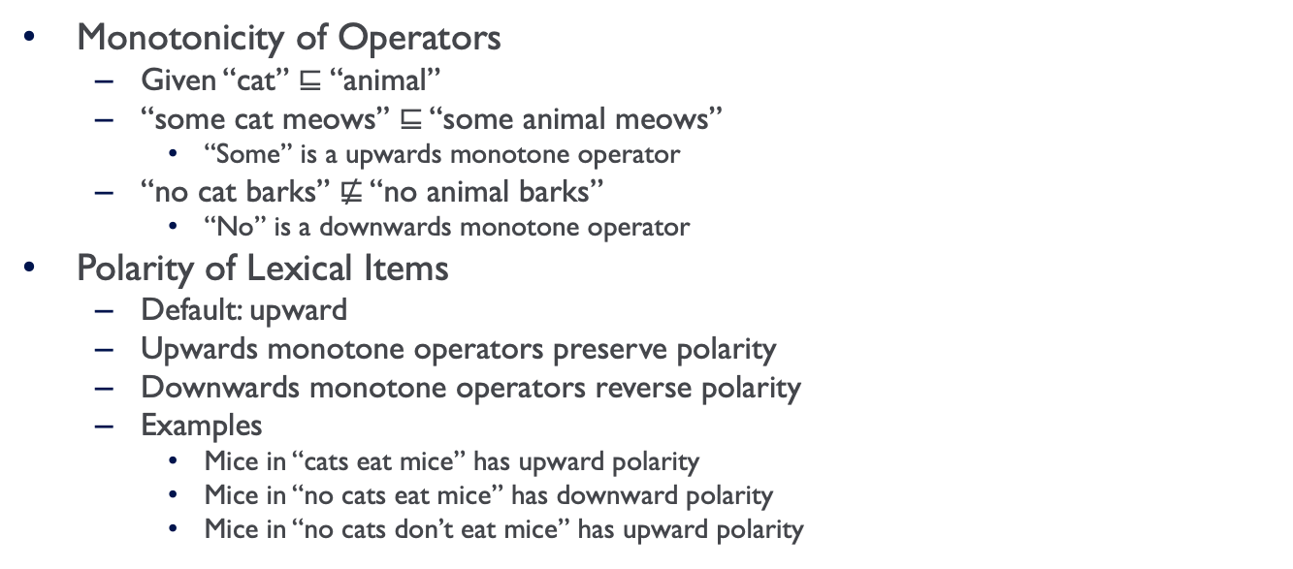
MacCartney’s Natural Logic
Monotonicity of Operators
  Given “cat” $⊑$“animal”
  “some cat meows” ⊑ “some animal meows”
    “Some” is a upwards monotone operator
  “no cat barks” ⋢ “no animal barks”
    “No” is a downwards monotone operator
Polarity of Lexical Items
  Default: upward
  Upwards monotone operators preserve polarity
  Downwards monotone operators reverse polarity
  Examples
    Mice in “cats eat mice” has upward polarity
    Mice in “no cats eat mice” has downward polarity
    Mice in “no cats don’t eat mice” has upward polarity

Slide 9
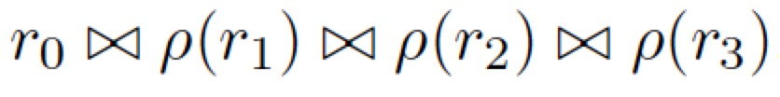
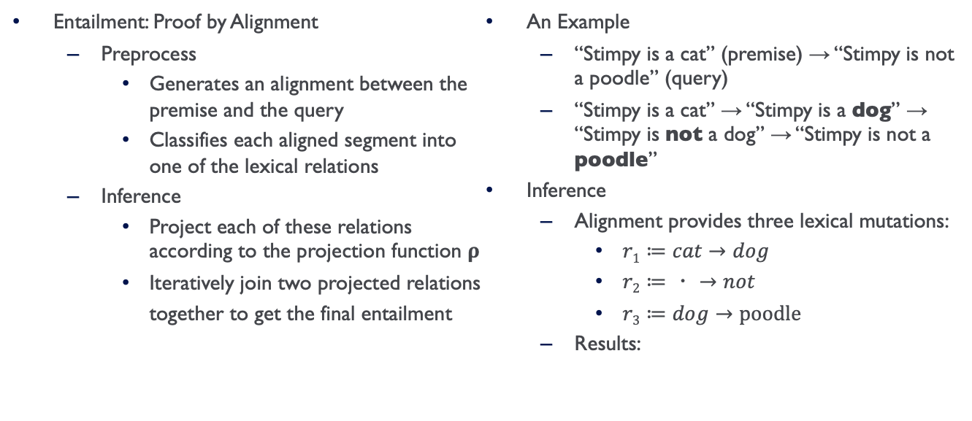
MacCartney’s Natural Logic
Entailment: Proof by Alignment
  Preprocess
    Generates an alignment between the premise and the query
    Classifies each aligned segment into one of the lexical relations
  Inference
    Project each of these relations according to the projection function 𝛒
    Iteratively join two projected relations together to get the final entailment
An Example
  “Stimpy is a cat” (premise) → “Stimpy is not a poodle” (query)
  “Stimpy is a cat” → “Stimpy is a dog” → “Stimpy is not a dog” → “Stimpy is not a poodle”
Inference
  Alignment provides three lexical mutations:
    $r1≔cat→dog$
    $r2≔・→not$
    $r3≔dog→poodle$
  Results:

Slide 10
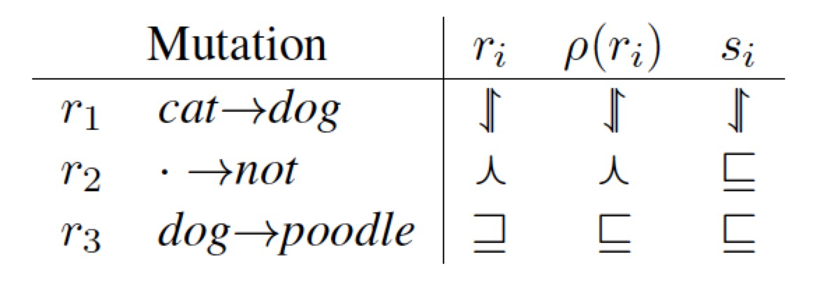
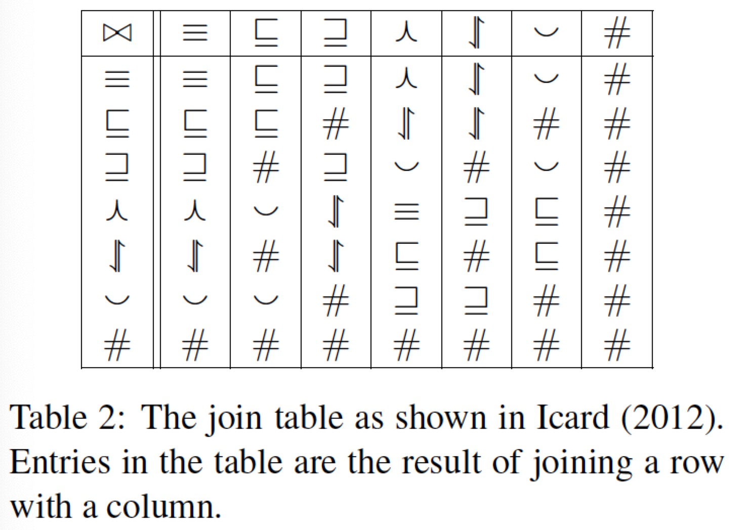

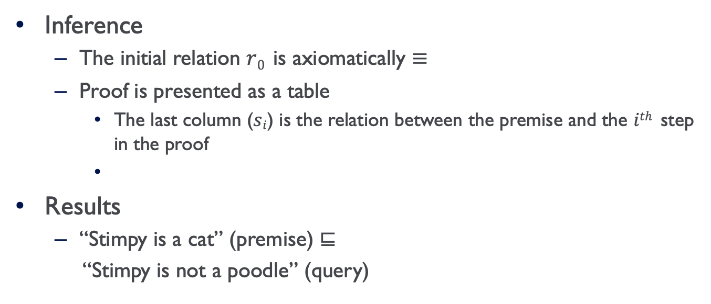
Proof By Alignment
Inference
  The initial relation $r0$ is axiomatically ≡
  Proof is presented as a table
    The last column ($si$) is the relation between the premise and the $ith$ step in the proof
Results
  “Stimpy is a cat” (premise) ⊑
  “Stimpy is not a poodle” (query)

Slide 11
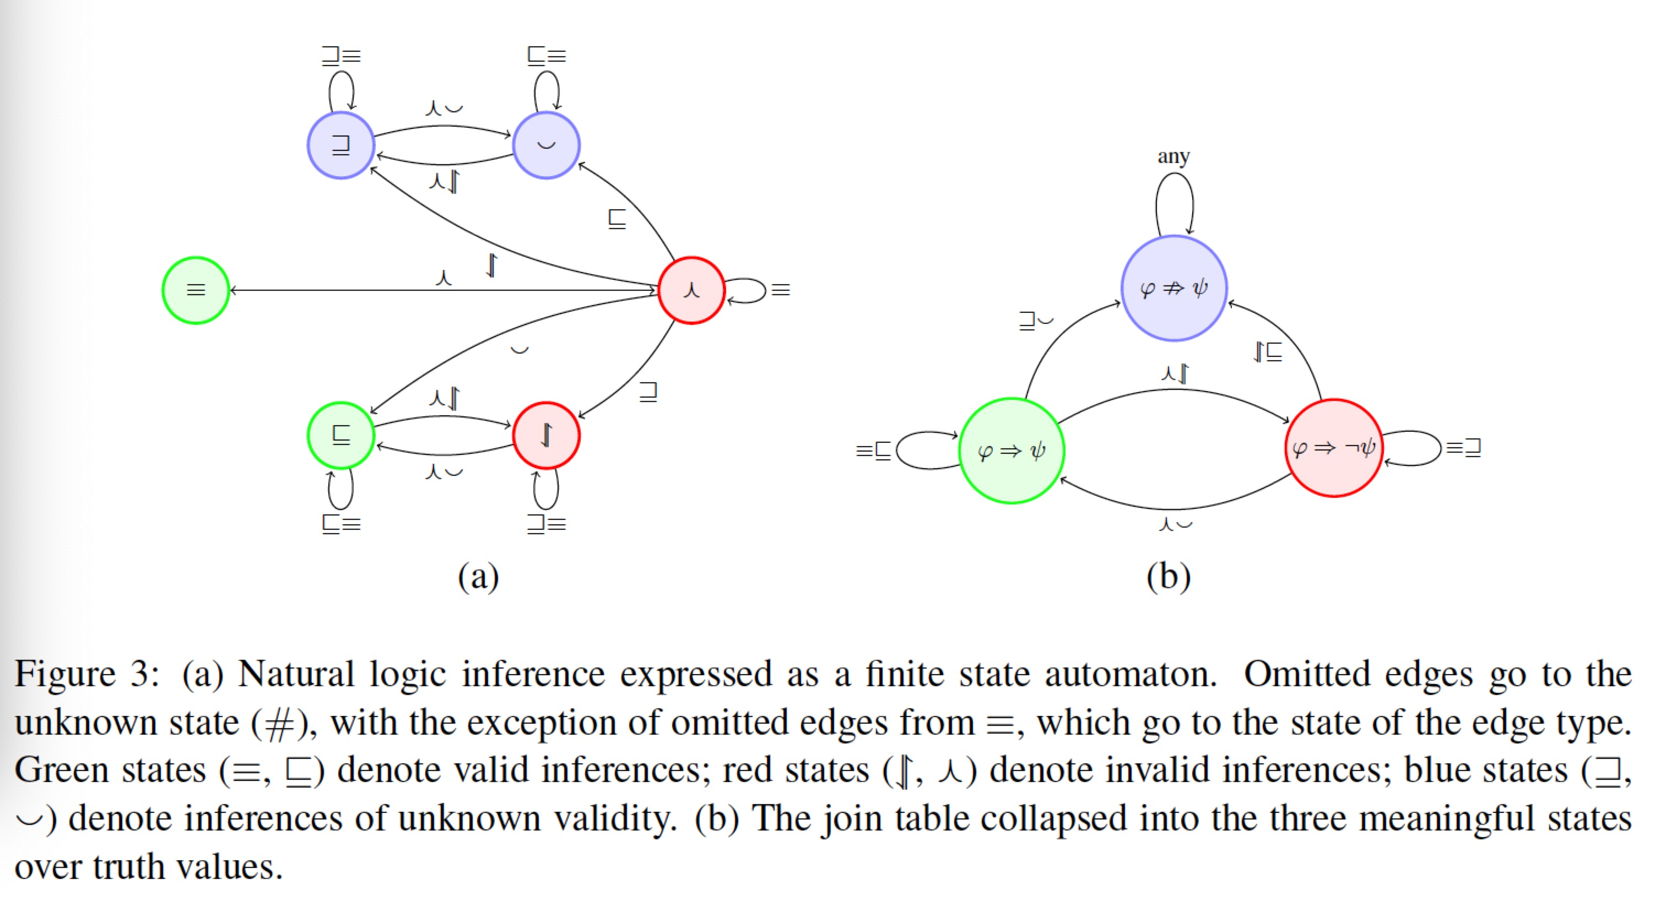
Inference as a Finite State Machine

Slide 12
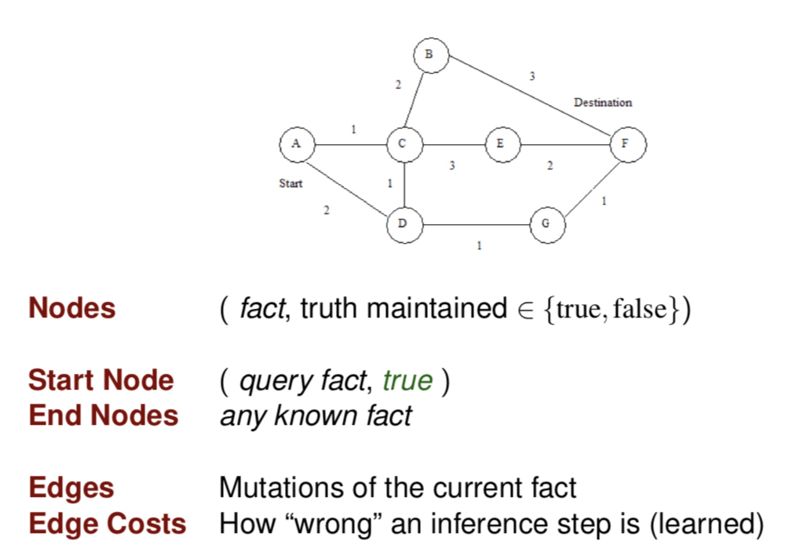
Inference As Search

Slide 13
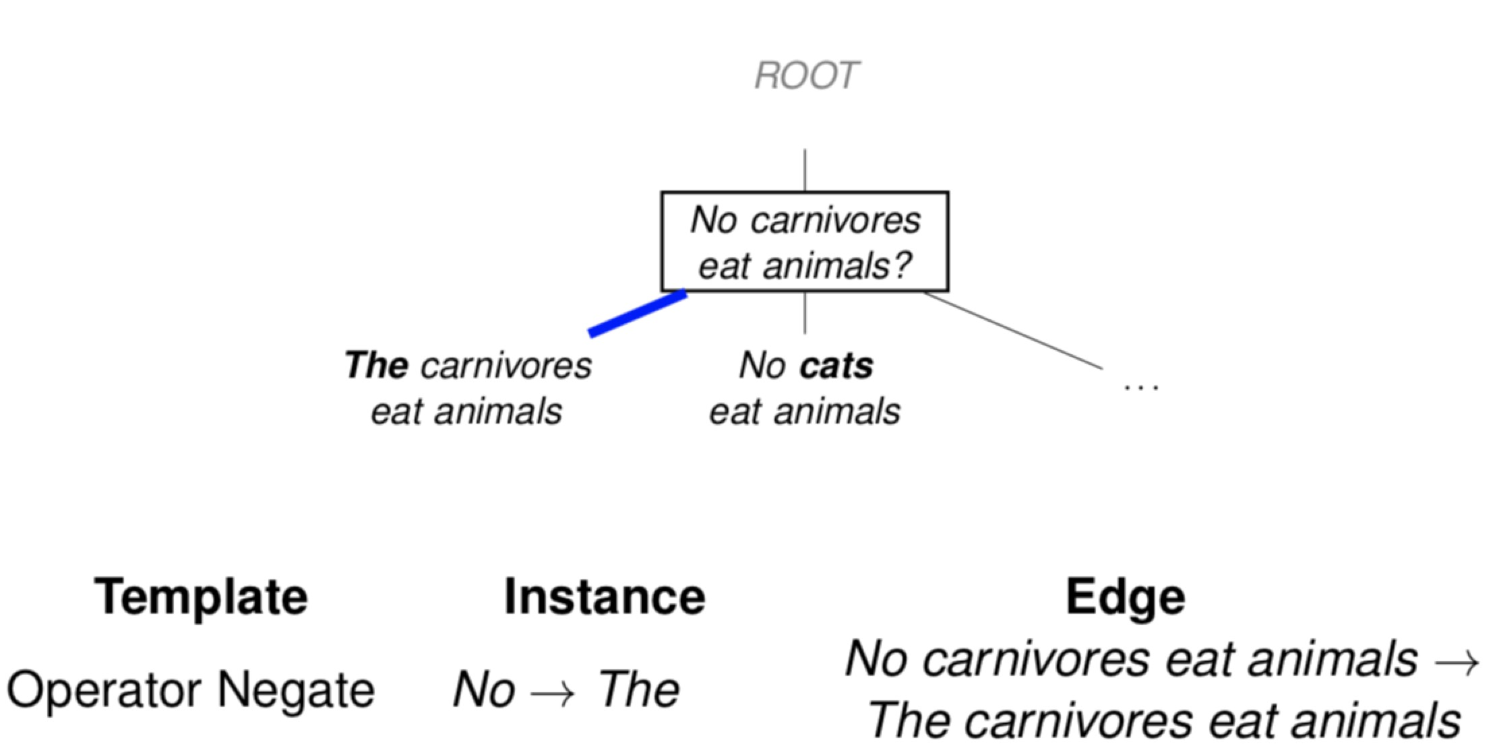
An Example Search

Slide 14
An Example Search

Slide 15
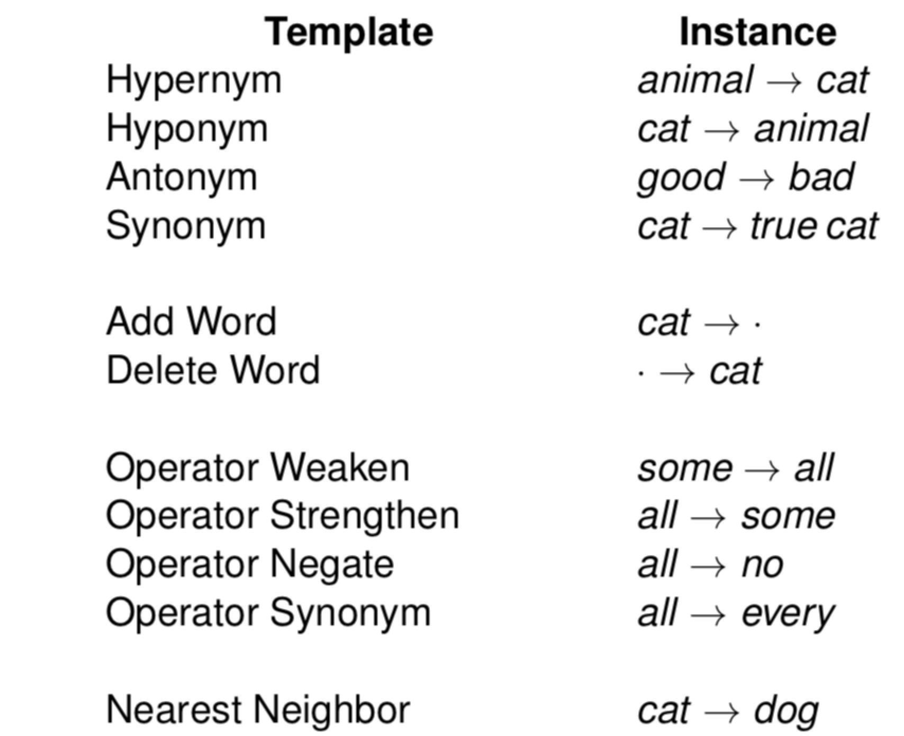
Edge Templates

Slide 16
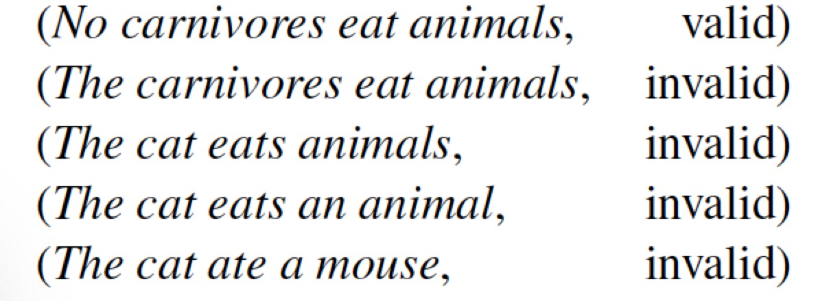
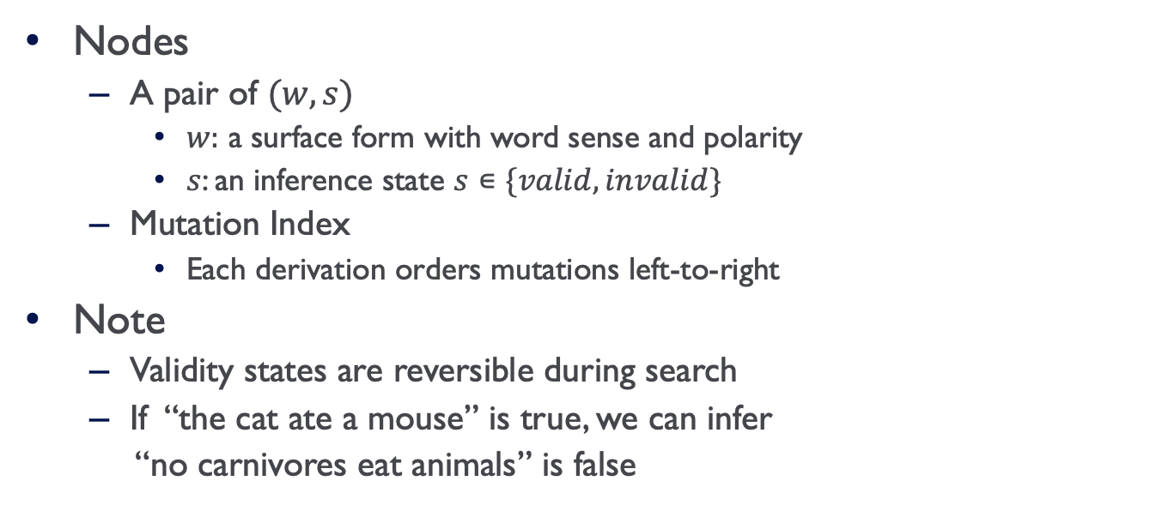
Inference As Search
Nodes
  A pair of $(w, s)$
    $w:$ a surface form with word sense and polarity
    $s$: an inference state $s∊\{valid, invalid\}$
  Mutation Index
    Each derivation orders mutations left-to-right
Note
  Validity states are reversible during search
  If “the cat ate a mouse” is true, we can infer
  “no carnivores eat animals” is false

Slide 17

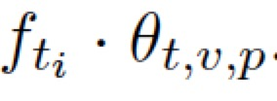

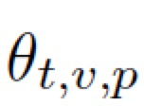
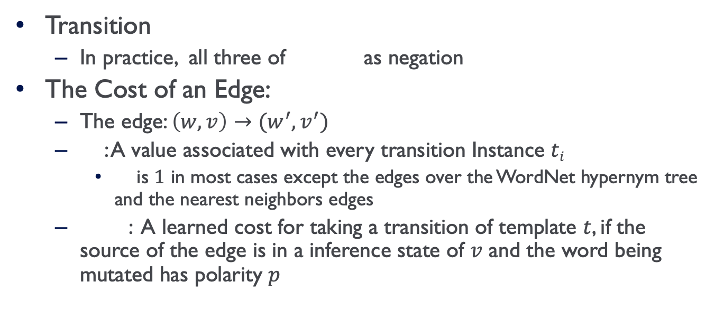
Inference As Search
Transition
  In practice, all three of as negation
The Cost of an Edge:
  The edge: $\left(w, v\right)→(w^{′}, v^{′})$
  : A value associated with every transition Instance $ti$
    is $1$ in most cases except the edges over the WordNet hypernym tree and the nearest neighbors edges
  : A learned cost for taking a transition of template $t$, if the source of the edge is in a inference state of $v$ and the word being mutated has polarity $p$

Slide 18
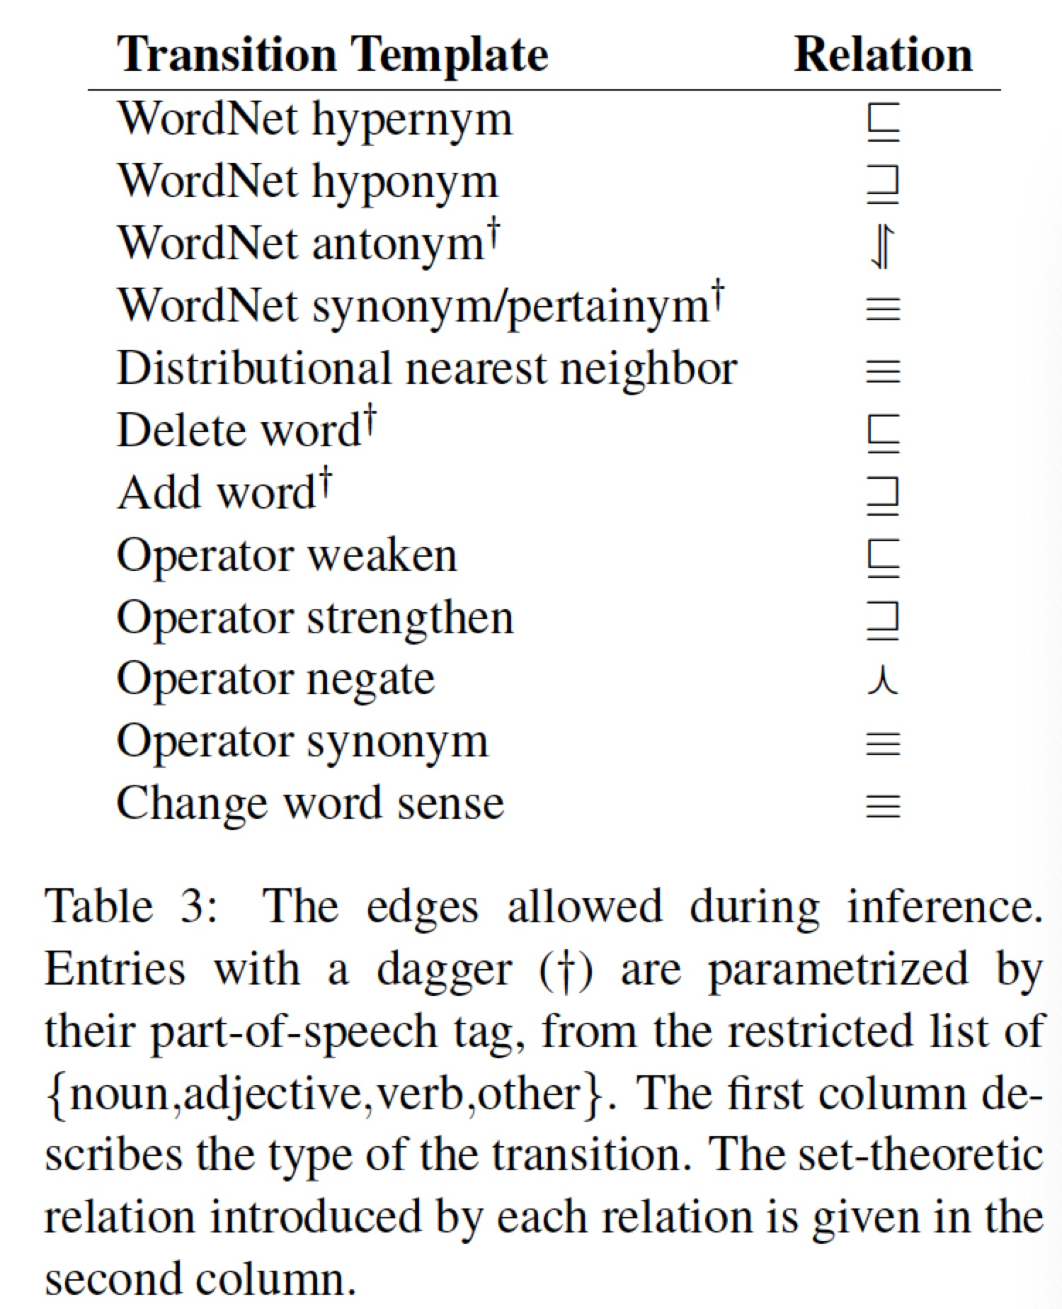
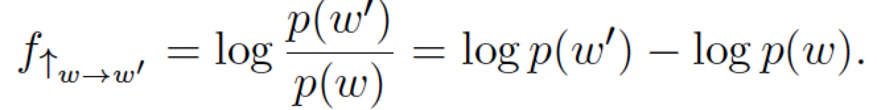
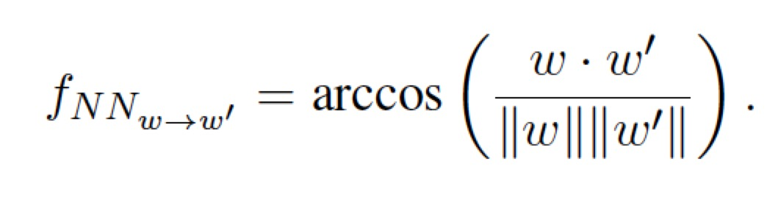


Transition
The Cost of an Edge
  The Hypernym edges
  The nearest neighbors edges
The Cost of a Search Path
  $θ∙f$
  $θ$ is the vector of values
  $f=$ and $fi$ is the feature vector for the $i$-th edge in the path

Slide 19
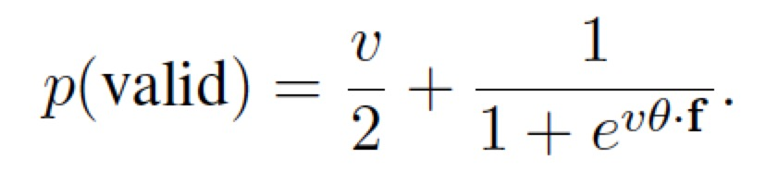
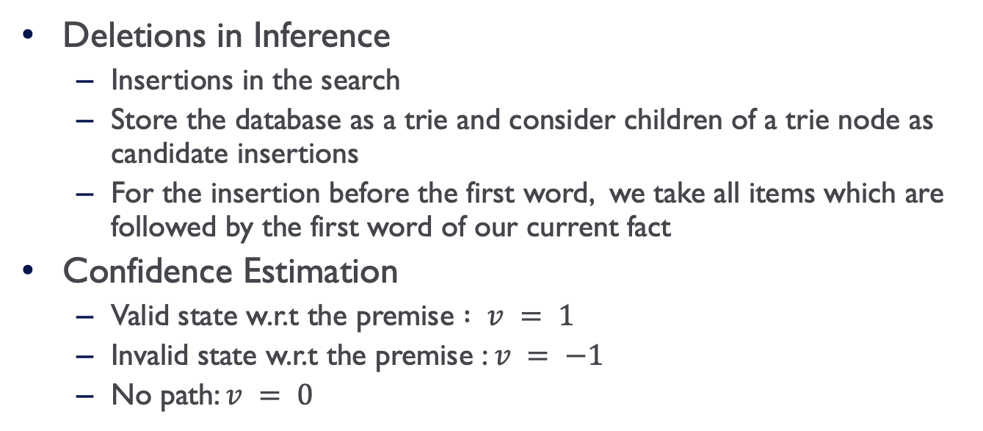
Inference As Search
Deletions in Inference
  Insertions in the search
  Store the database as a trie and consider children of a trie node as candidate insertions
  For the insertion before the first word, we take all items which are followed by the first word of our current fact
Confidence Estimation
  Valid state w.r.t the premise $: v = 1$
  Invalid state w.r.t the premise : $v = −1$
  No path: $v = 0$

Slide 20
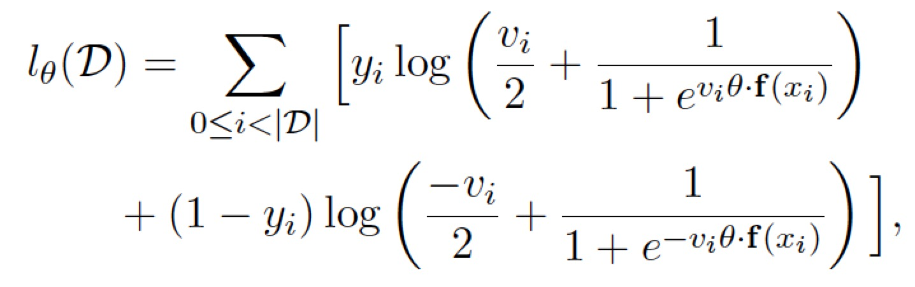
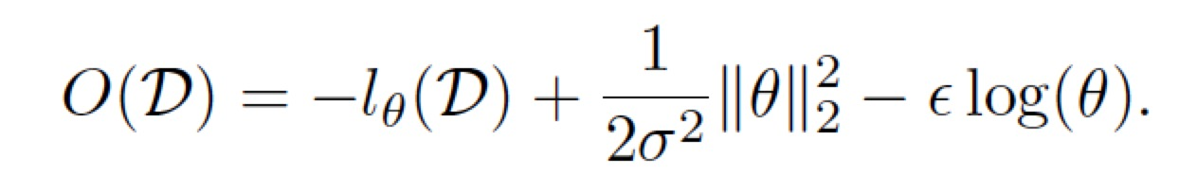
Learning Transition Costs
Objective Function
Positive Feedback Loop
  Search the best path
  Update the parameters

Slide 21
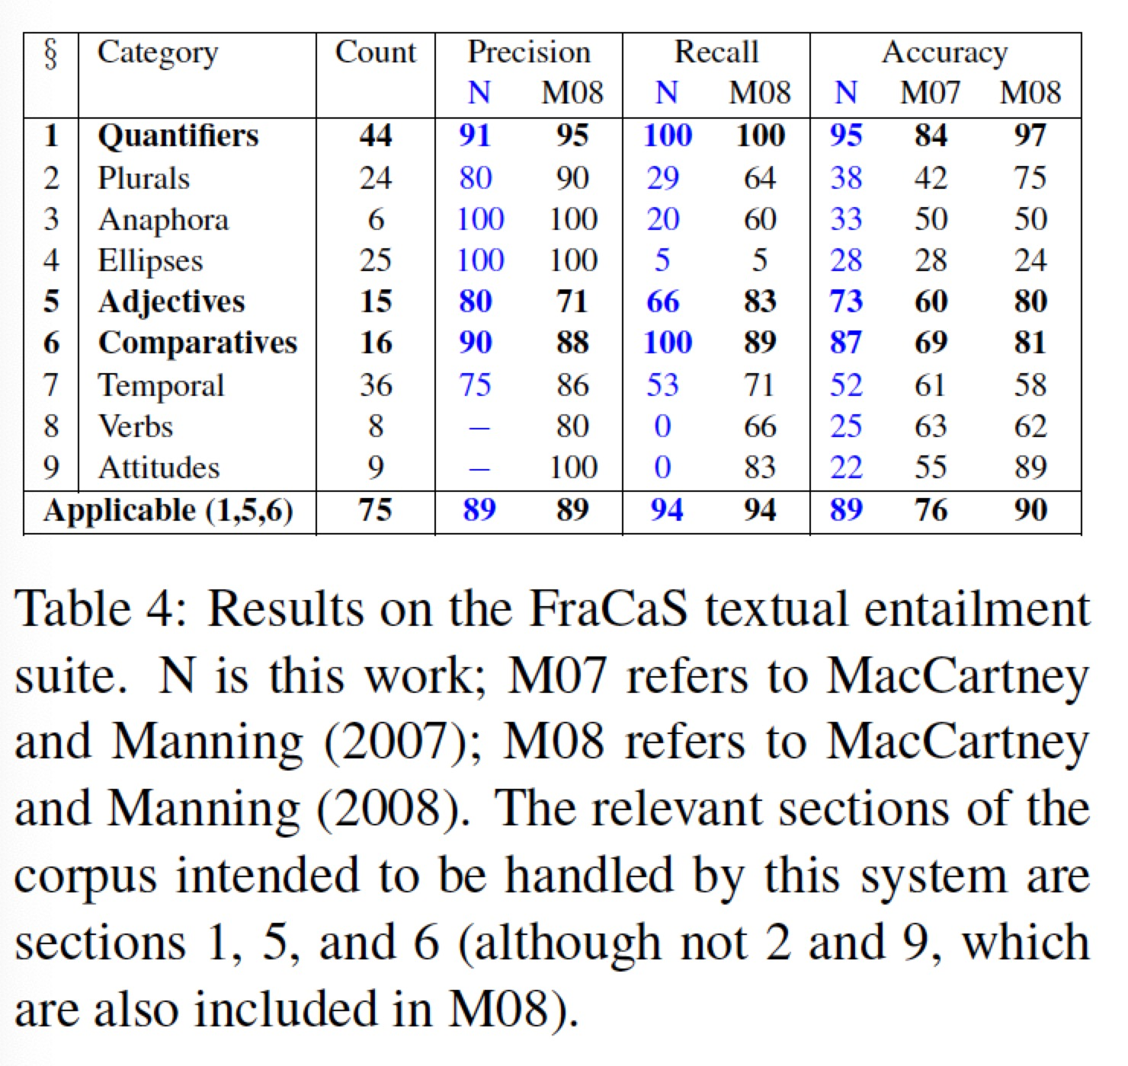
Experiments: Textual Entailment
Unfair Comparison
  It cannot appeal to the premise when constructing the search
  The derivation process itself does not have access to the full parse tree of the candidate fact

Slide 22
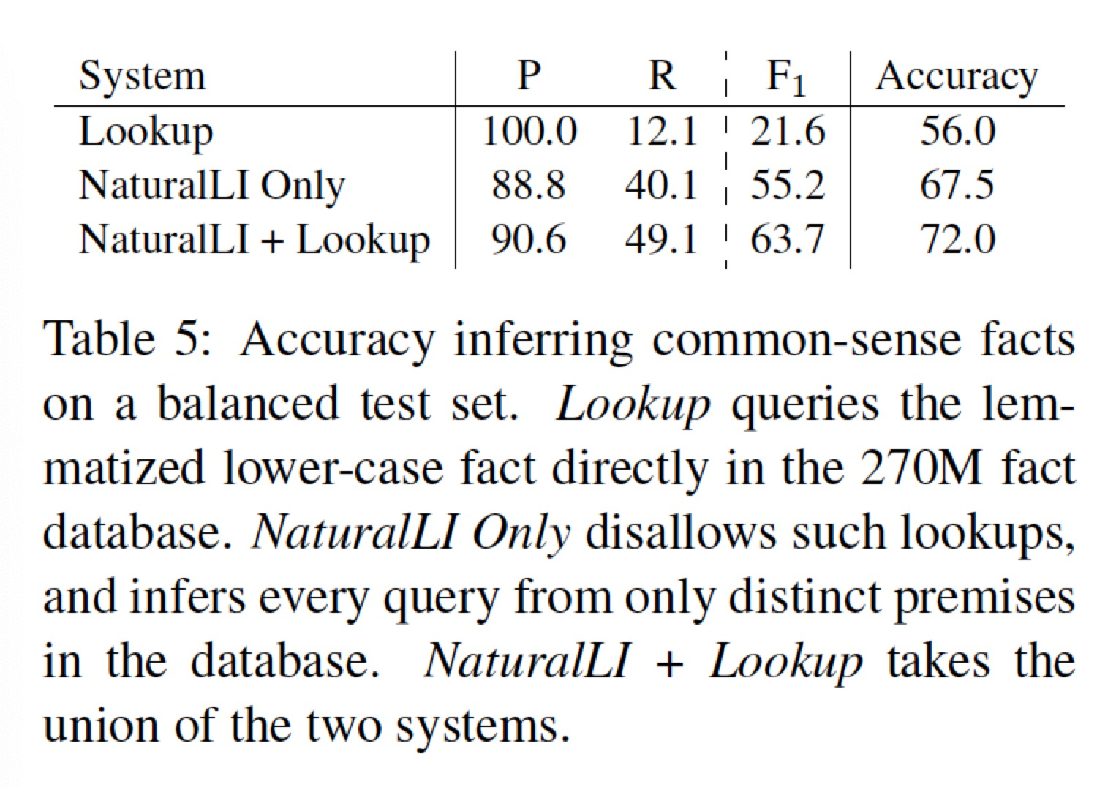
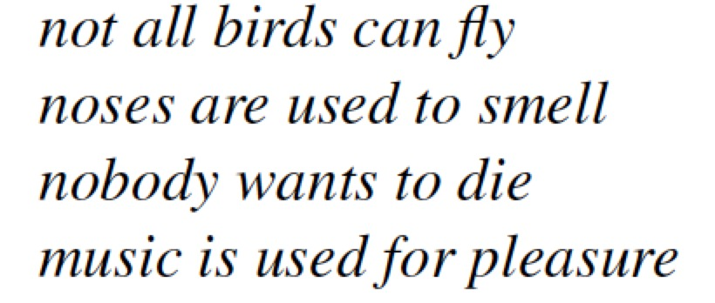
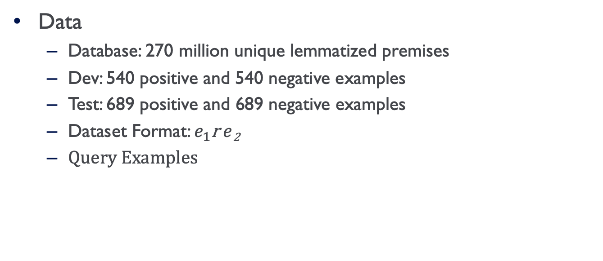
Experiments: Common Sense Reasoning
Data
  Database: 270 million unique lemmatized premises
  Dev: 540 positive and 540 negative examples
  Test: 689 positive and 689 negative examples
  Dataset Format: $e_{1}$r $e$₂
  Query Examples

Slide 23
Discussion
Take-aways
  NaturalLI: an inference system over unstructured text to infer common sense facts based on a large set of premises
  Use Natural Logic for textual entailment
  Search from the query rather than extend knowledge bases
Main Shortcomings
  The lookup baseline is weak
    Compare with more baselines
  Database with triple format premises is limited
    Experiment on more complicated dataset

