Slide 1
CIS-700
Spring 2020
Reasoning for Natural Language Understanding
Dan Roth
Computer and Information Science
University of Pennsylvania

Slide 2
This class
Understand early and current work on Reasoning
  (Learn to) read critically, present, and discuss papers
Understand some of the difficulties in NLU from the perspective of reasoning
  Conceptual and technical
Try some new ideas
How:
  Presenting/discussing papers
    Probably: 2 presentations each; 4 discussants
  Writing a few critical reviews
  “Small” individual project (reproducing);
  Large project (pairs)
  Tentative details are on the web site.
Machine Learning
  519/419
  520
  Other?
NLP
  Yoav Goldberg’s book
  Jurafsky and Martin
  Jacob Eisenstein
Attendance is mandatory
Participation is mandatory
Time of class?

Slide 3
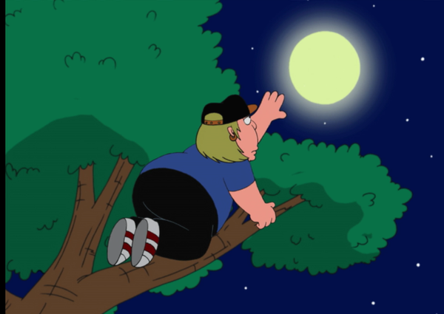
What’s Important in order to make progress in NLU
How to make progress towards natural language understanding
  Learning and Reasoning; knowledge
Dispel with [some] of the currently hot trends
  If we want to reach the moon…
What is Reasoning?
Reasoning in Natural Language Understanding
Today: Examples & Discussion
Notes:
This is my model for natural language comprehension – and I’d like to talk about some of the key issues we need to think about if we want to make progress in NLU
In doing it, I’ll dispel with some of the currently hot trends – they can help up clime trees, but we want to reach the moon.
I will use it to pay tribute to John McCarthy – many of you, I hope, know that he thought a lot about representations and Reasoning, I will discuss some of his thoughts about natural language stories
And I’ll use it to give you a brief tour of some of the relevant, hopefully important, ideas came from my work in these directions, and were we should go.

Slide 4


Natural Language Understanding
visitors
killed
No connective
At least 14 people have been killed in southern Sri Lanka, police said. The telecoms minister was among about 35 injured in the blast site at the town of Akuressa, 160km (100 miles) south of the capital, Colombo. Government officials were attending a function at a mosque to celebrate an Islamic holiday at the time. The minister said later that the suicide attack was carried out by ….
  ➔ 49 people were hit by a suicide bomber in Akuressa.
Requires dealing with a large number of phenomena
  lexical, quantitative, co-reference, semantic types, discourse convention, knowledge…
  But, this discussion indicates that we “think” when we understand a story.
Understanding is telling ourselves a story about the story
This is an Inference Problem
Reasoning is about providing Reasons
Notes:
I read this story; but a small part of it got wet; so you will help me figure out if what I heard on National Public Radio is correct given this story, and also, what’s behind this black ink.
Where? …..How do you know?
Cannot be pumpkins -- the minister cannot be a pumpkin; and I cannot add it to people (semantic type);
but can be killed from the semantic types perspective (even though “killed” is a verb), but you probably infer that the argument is missing and can go on.
Killed does not make sense since we think that the seconds sentence elaborates on the first sentence rather than contradicts it – this is part of a convention that we buy into when we read a story – we have some expectations.
It would not fit into our equation – 35 + 14 = 49;
And, this is the telecom minister, and the minister here might be the same one….
Visitors – makes sense since he talked about it later – but doesn’t fit the math.
Injured is good;
But he probably wasn’t injured too seriously, since he was talking about it later.
There is a lot of “what if” when we read a story like that – even at the very low level …..
More than anything else, understanding is telling ourselves a story about the story….

Slide 5
No Magic Box
At least 14 people have been killed in southern Sri Lanka, police say. The telecoms minister was among about 35 injured in the blast site at the town of Akuressa, 160km (100 miles) south of the capital, Colombo. Government officials were attending a function at a mosque to celebrate an Islamic holiday at the time. The minister said later that the suicide attack was carried out by
A lot of “magic boxes” are needed to address NLU.
  Induced different ways, at different times, using different resources
  Some via learning from examples, some by being told declaratively, by being read, or inferred.
Not everything is an input-output problem
  And there is a need to reason over the “boxes”

Slide 6
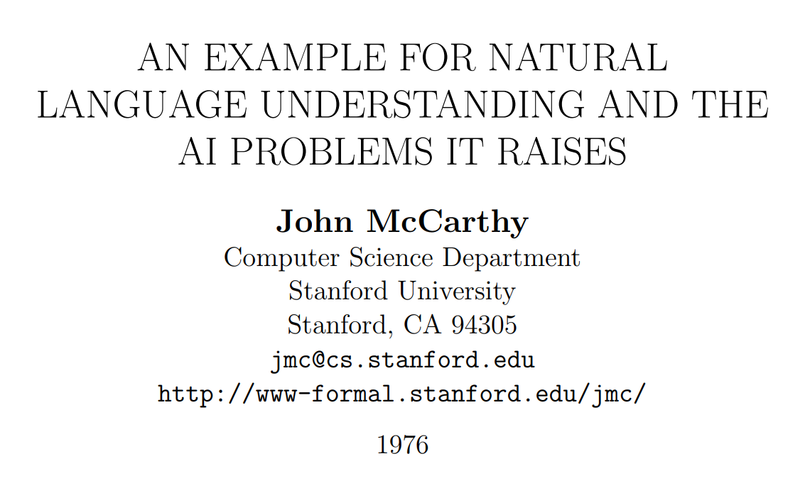
John McCarthy on Natural Language Understanding

Slide 7
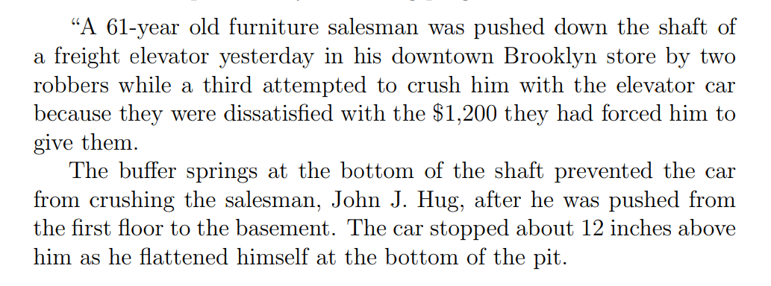
A New York Times Story

Slide 8
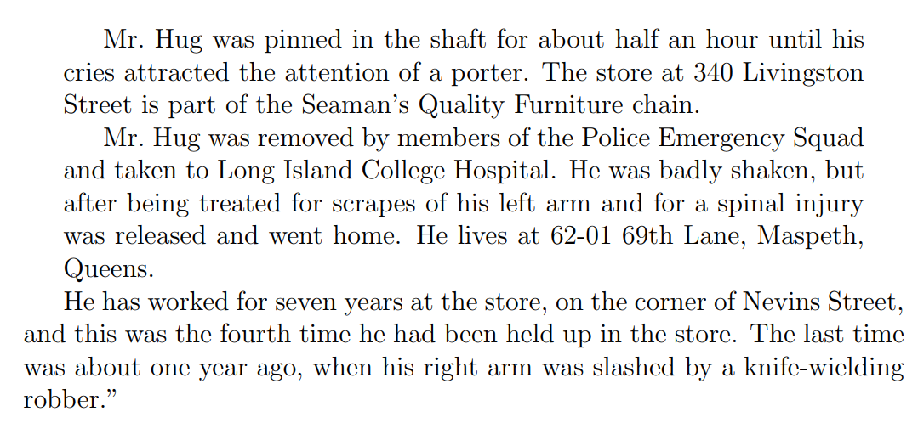
A New York Times Story (Cont.)

Slide 9
New York Times Story: Questions
An intelligent person or program should be able to answer the following questions based on the information in the story:
  The article proceeds with 22 questions:
1. Who was in the store when the events began?
  Probably Mr. Hug alone, although the robbers might have been waiting for him, but if so, this would have been stated.
2. What did the porter say to the robbers?
  Nothing, because the robbers left before he came.
20. Why did Mr. Hug yell from the bottom of the elevator shaft?
  So as to attract the attention of someone who would rescue him.
“The above list of questions is rather random. I doubt it covers all facets of understanding the story.”

Slide 10
McCarthy’s Challenges
The QA module is not being trained Once the program knows English, and has the relevant background knowledge, it should answer the questions
A formalism capable of expressing the assertion of the sentences free from dependence on the grammar of the English language. (“Artificial Natural Language”, ANL)
  Semantic Parser
An “understander” that constructs the “facts” from the text.
  Information Extraction: Entities, Relations, Temporal, Quantities,…
Expression of the “general information” about the world that could allow getting the answers to the questions from the “facts” and the “general information”
  Background Knowledge
A “problem solver” that could answer the above questions on the basis of the “facts”.
  Question Answering Engine

Slide 11
Lessons
What can we learn from this example?
  Difficulties of NLU
  Importance of reasoning
    Part of Reasoning here seems to be “providing the reasons”, not only the “answers”
  Decoupling learning from reasoning
    McCarthy thinks that there is a need for some level of abstraction – an abstract representation of the text and the relevant knowledge so that a generic module can work on it and “do the reasoning”.
Is this important/Essential?

Slide 12
Cognitive Psychology of Reasoning
McCarthy's argument starts with “most people should…”
There have been many studies by cognitive psychologists that try to identify the types of reasoning people can do, and how.
Earlier theories:
  “human reasoning depended on formal rules of inference akin to those of a logical calculus”
Philip N. Johnson-Laird: Mental models and human reasoning
  http://www.modeltheory.org/papers/2010mms&human-reasoning.pdf

Slide 13
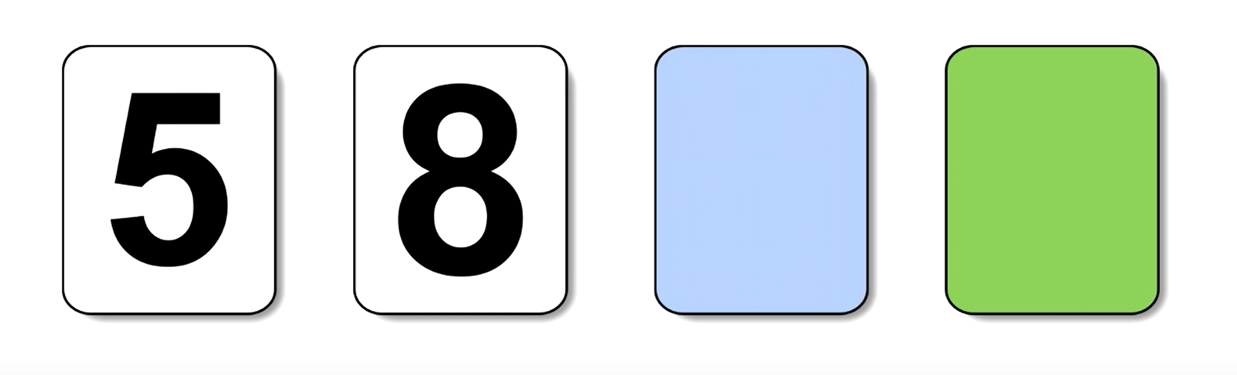
Can you Reason?
(30 seconds; write it down; don’t communicate)
You are shown 4 cards; each one has a number on one face and a color on the other.
You are asked to determine the truth value of the following statement:
  “If a card shows an even number on one face then its opposite face is blue.”
  Your goal: to turn over the minimal # or cards to allow you to determine if this statement is true.
  Which card(s) should you turned over?
  (30 seconds; write it down)

Slide 14
Can you Reason?
Most people that are not trained in logic get it wrong.
But, when given equivalent tests that are grounded in some familiar situations, they get it right.
  “If a student scores less than 650 in a quantitative GRE test they cannot get into a top CS program”
    Cards with scores and programs the student is enrolled in.
  “If a student is younger than 21 they cannot buy beer in the US”
    Cards with age and buy/cannot buy statements
  Your goal: to turn over the minimal # or cards to allow you to determine if this statement is true.
  Which card(s) should you turned over?
  (30 seconds; write it down)
If a card shows an even number on one face then its opposite face is blue

Slide 15
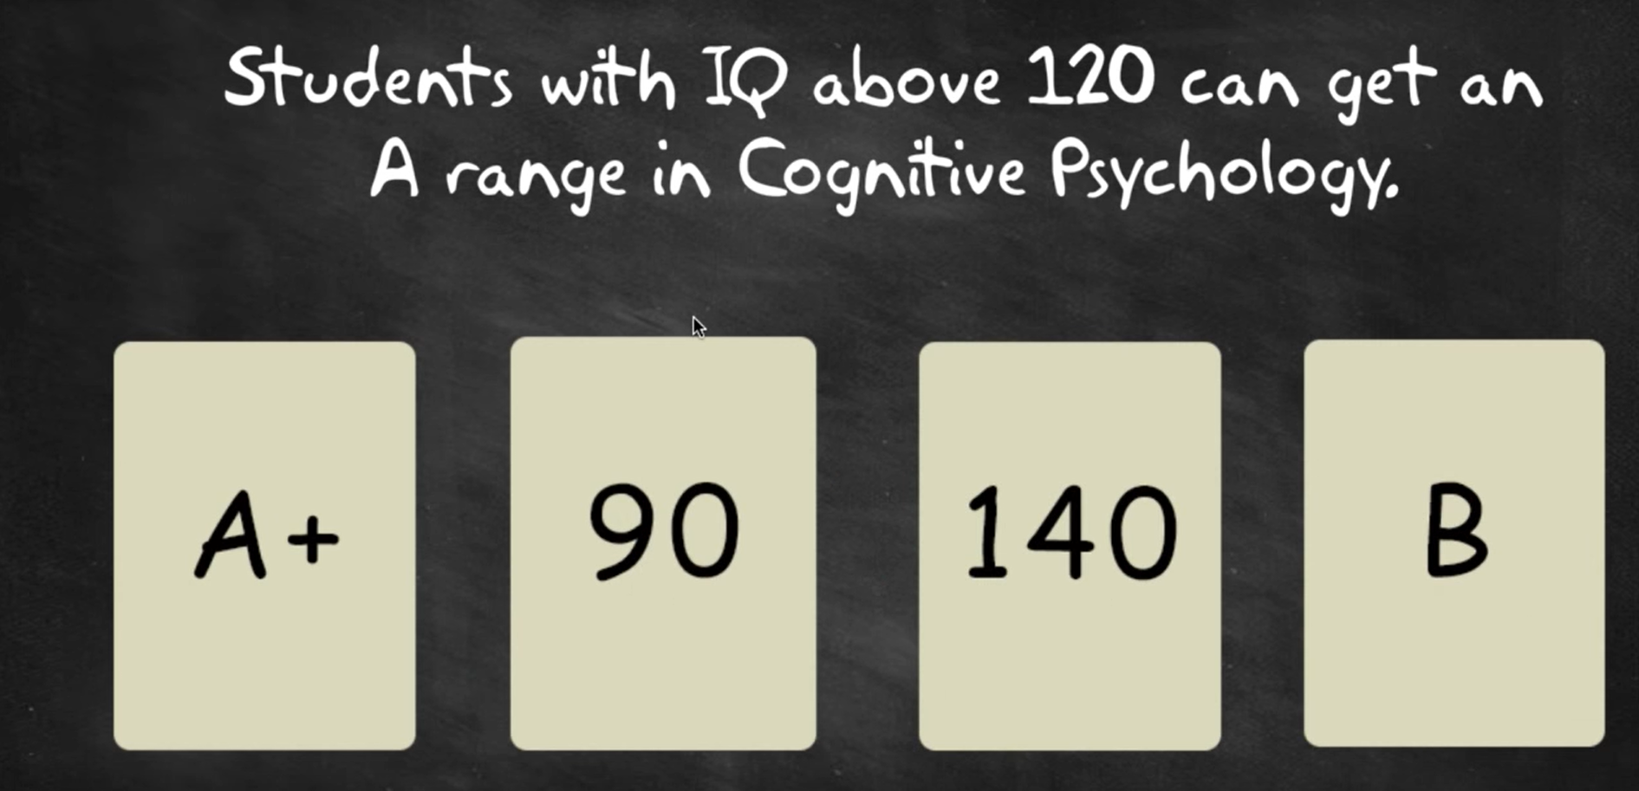
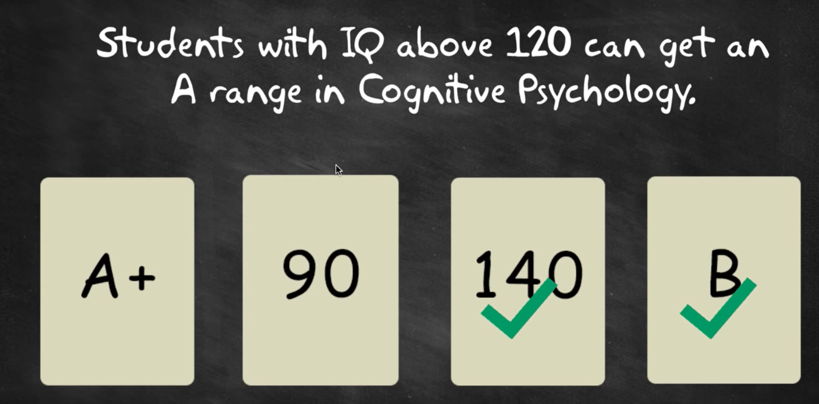
Reasoning in Explicit Situations
These experiments were part of the development of a theory of Mental models:
https://www.researchgate.net/publication/228408902_Mental_models_a_gentle_guide_for_outsiders
These tests have probabilistic analogies, by Amos Tversky and Daniel Kahneman
  Check: The Undoing Project: A Friendship That Changed Our Minds, by Michael Lewis.

Slide 16
Should We Care?
Mr. Micawber’s famous advice (in Dickens’s, David Copperfield):
  Annual income twenty pounds, annual expenditure nineteen pounds nineteen and six, result happiness. Annual income twenty pounds, annual expenditure twenty pounds ought and six, result misery
What is its logical form?
  Do we need to work it out?
  Do we need to do it for all everyday assertions?
Clearly, converting into a “logical form” requires more than just syntax.
  It depends on knowledge.
Here:
  nineteen pounds nineteen (shillings) and six (pence) is less than twenty pounds.
  happiness and misery are inconsistent properties.
  Possibly other contextual cues.

Slide 17
Should We Care (2)?
Do we need a “formal” abstractions to support reasoning?
Developmental psychologists think that there is merit to this.
  That “reasoning is commonsense”
  A toddler knows that a cloth dropped into a bucket of water comes out wet (deduction), and that
  A dry cloth that is put into a bucket and comes out wet probably means that the bucket contains water (abduction).
But, what does that mean to the computational theories we need to develop to pursue AI, and NLU?
Perhaps a more basic question is that of “what representations could support this level of behavior/reasoning”?

Slide 18
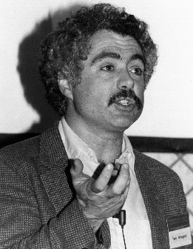
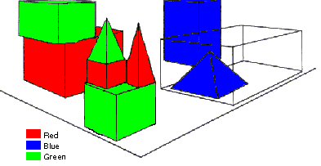
SHRDLU (Terry Winograd, 1968)
Person: Pick up a big red block.
Computer: OK.
Person: Grasp the pyramid.
Computer: I DON'T UNDERSTAND WHICH PYRAMID YOU MEAN.
Person: Find a taller block than the one you are holding and put it into the box.
Computer: BY "IT", I ASSUME YOU MEAN…..
Computer: OK.
Person: What does the box contain?
Computer: THE BLUE PYRAMID AND THE BLUE BLOCK.
Person: What is the pyramid supported by?
Computer: **What do you mean by “supported”?
……….
Person: How many blocks are not in the box?
Computer: FOUR OF THEM.
Understanding, executing and interacting requires language understanding & reasoning
to recognize goals and advance the task
Notes:
SHRDLU, Computer program that has conversation with user, via Natural Language interface
-> About “block world”, virtual box filled with different blocks, different shapes, sizes and colors: e.g. Red block, white box, blue pyramid
The robot can pick the objects, move them, count them ..
Combination of a few principles made the simulation of robot behavior very realistic
SHRDLU's world was so simple that the entire set of objects and locations could be described by including as few as perhaps 50 words:
nouns like "block" and "cone", verbs like "place on" and "move to", and adjectives like "big" and "blue".
The possible combinations of these basic language building blocks were quite simple, and the program was fairly adept at figuring out what the user meant.
SHRDLU also included a basic memory to supply context. One could ask SHRDLU to "put the green cone on the red block" and then "take the cone off"; "the cone" would be taken to mean the green cone one had just talked about. SHRDLU could search back further through the interactions to find the proper context in most cases when additional adjectives were supplied. One could also ask questions about the history, for instance one could ask "did you pick up anything before the cone?“
Deduction rules: Could deduce that blocks could be stacked by looking for examples, but would realize that triangles couldn't be stacked
Learn new names: For instance one could say "a steeple is a small triangle on top of a tall rectangle"; SHRDLU could then answer questions about steeples in the blocks world, and build new ones.

Slide 19
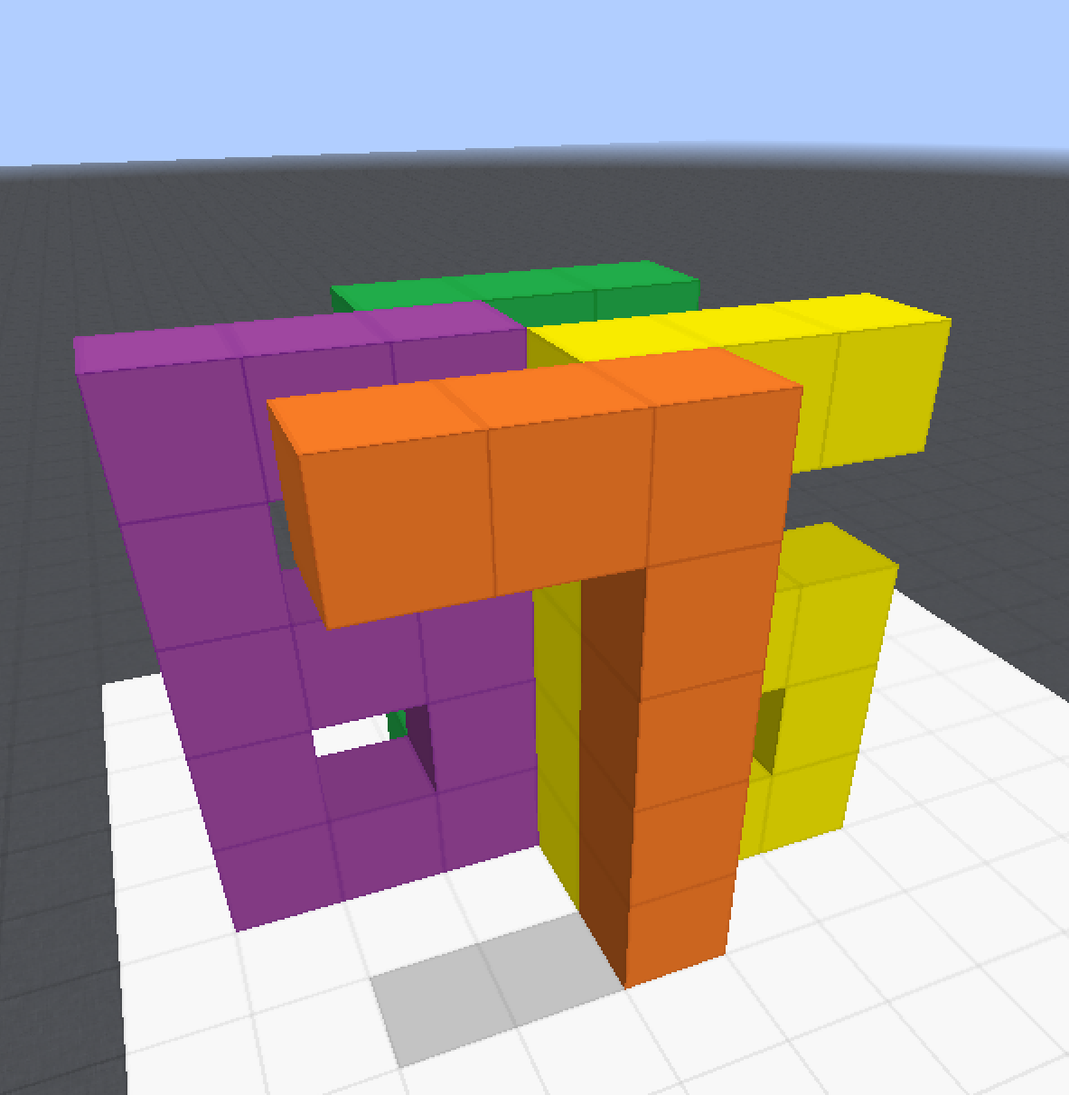
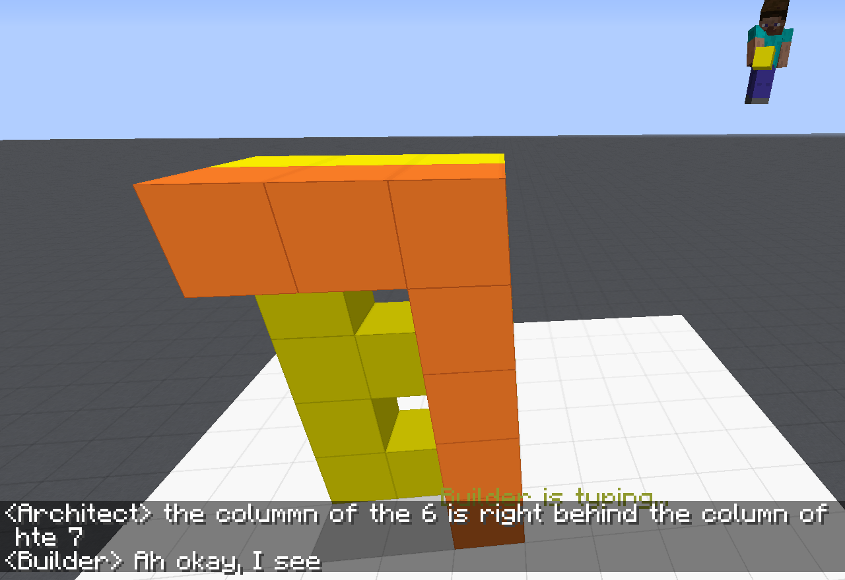
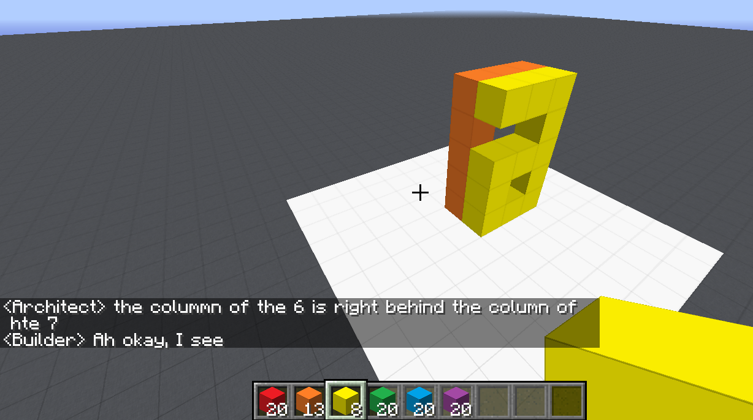
Communication (CwC Project, 2017-2019)
ARCHITECT
CHAT INTERFACE
Architect: | in about the middle build a column five tall
(Builder puts down five orange blocks)
Architect: | then two more to the left of the top to make a 7
(Builder puts down two orange blocks)
Architect: | now a yellow 6
Architect: | the long edge of the 6 aligns with the stem of the 7 and faces right
Builder: | Where does the 6 start?
Architect: | behind the 7 from your perspective
Builder: | Is it directly adjacent?
Architect: | yes directly behind it. touches it
(Builder puts down twelve yellow blocks, in the shape of a 6)
Architect: | too much overlap unfortunately
Architect: | the colummn of the 6 is right behind the column of hte 7
Target Structure
Build Region
BUILDER
[Minecraft example from Julia Hockenmaier]

Slide 20
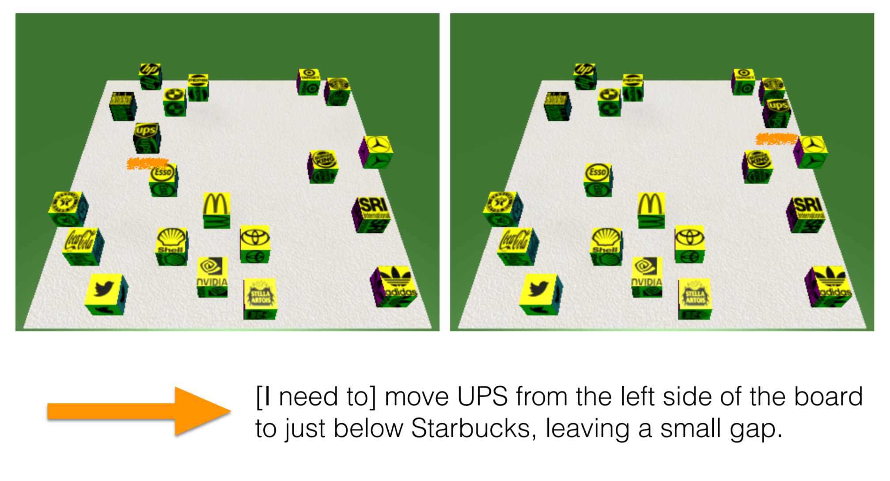
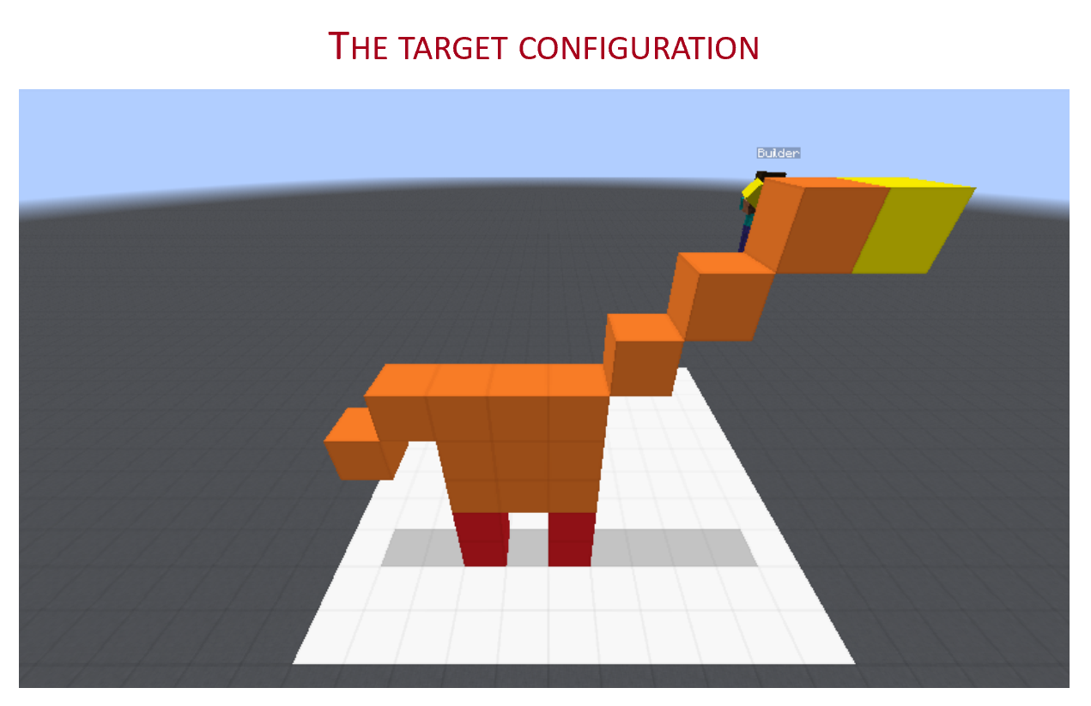
Communication (CwC Project, 2017-2019)
Consider the following explanation:
  [Example from Yonatan Bisk]
  Imagine that this is a chess board
  Place the UPS in H2, and McDonald in G6.
Can you follow these instructions?
  What’s needed for us to be able to write programs that can do it?

Slide 21
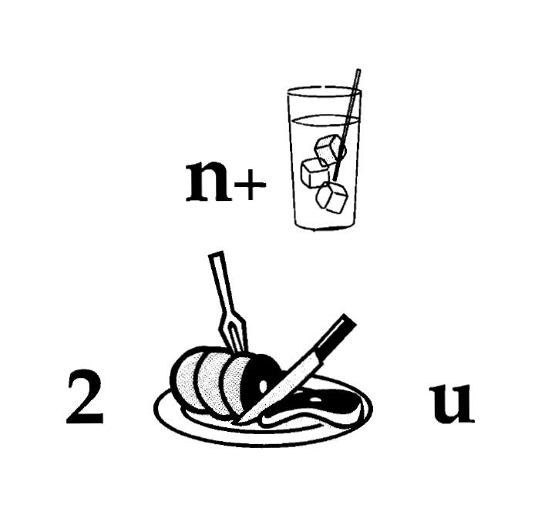
Nice to Meet You
Identify units
Consider multiple
representations & interpretations
  Pictures, text, layout, spelling, phonetics
Put it all together:
  Determine “best” global interpretation
Satisfy expectations
  Slide; puzzle
Computational Problem:
Assigning values to multiple variables, accounting for interdependencies among them

Slide 22
Natural Language Understanding
Natural language understanding decisions are global decisions that require
  Making (local) predictions driven by different models trained in different ways, at different times/conditions/scenarios
  The ability to put these predictions together coherently
  Knowledge, that guides the decisions so they satisfy our expectations
Not all that our programs need in order to understand and communicate in natural language
  but it exemplifies one important aspect – “discrete reasoning”.
Expectation is a knowledge intensive component
Notes:
22
Give examples for what’s not abductive reasoning
Focus on abductive reasoning
Show the formulation – talk about the boxes
Talk about multiple ways of training – decoupling – relate to abstraction
Examples: semantic parsing (do verb + Prep + commas together; lack of jointly annotated data)
Wikification – Relations (but also add geographical coherence; topical coherence; all interrelated signal that are acquired at different times, different contexts, etc.

Slide 23

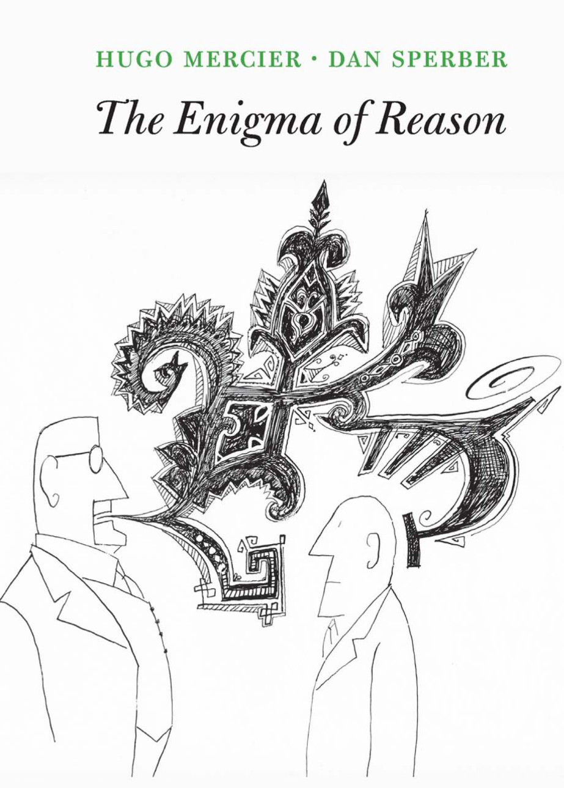
Symbolic Reasoning?
Some people think that symbols is an evil invention of old AI people.
It’s not.
Language is a symbolic system
  Table is a collection of things in world.
Even though we communicate via speech, gestures, writing, which are continuous, symbols are the invariants of this communication.
  Harari: Language – the ability to assign symbols to “things” and “reason” about them is key to human cognitive revolution
  Kripke: “Naming” things is key to communication and to cognition
  The Enigma of Reason: “Reasoning is about giving reasons”

Slide 24
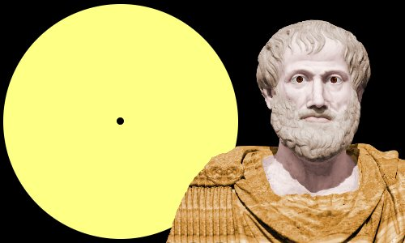
Aristotle’s Logic https://www.famousscientists.org/aristotle/
Aristotle founded the study of formal logic, systematizing logical arguments – he is famous for the syllogism, a method by which known information can be used to prove a point.
Here is a famous example, from Aristotle himself, of a simple syllogism:
  All men are mortal.
  Socrates is a man.
  Therefore, Socrates is mortal.
So, did Aristotle have a laptop?
  [Example due to Les Valiant]
Notes:
Google will say yes!

Slide 25
Key Challenges to NLU Researchers
Today’s NLP addresses well-defined tasks for which we have a lot of training data, but:
Who asks the questions?
  ~~ When did Aristotle die?
  ~~ When was the laptop invented?
  What happened first?
The question isn’t if we need reasoning, but rather:
  How to do it?
    E.g., how to determine “strategies” on the fly?
  How to train for it?
    How can we supervise for these “sparse” events? [A different talk: On Incidental Supervision]
    Should we learn “everything” together? When/how should we decouple/decompose tasks?
Of course, AI has thought about Reasoning a lot…
  In most cases, in a way that decuples reasoning from learning
    And often, commits to a representation that is independent of the task

Slide 26
A Biased View of Reasoning
Hayes&McCarthy
Frame Problem
Brooks
Subsumption
Quillian
Semantic Networks
ConceptNet
Minsky, Filmore
Frames
McCarthy
Formalizing Commonsense
Pearl
Probabilistic Reasoning
Description Logic
Bobrow
STUDENT
Simon&Newell
General Problem Solver
Lenat
Cyc
Winograd
SHRDLU
2000 1990 1980 1970 1960 1950 1940
Common Sense Reasoning was formulated
traditionally as a “reasoning” process, irrespective of learning and the resulting knowledge representation.
Khardon & Roth
Learning to Reason

Slide 27
Learning to Reason I[Khardon & Roth JACM’96; 1994—2000]
Proposed in reaction to the standard of complete decoupling of Learning and Reasoning
A unifying computational theory of Learning and Reasoning.
  Reasoning should be studied together with Learning and the representation it produces.
Formally showing the benefits in jointly studying Learning and Reasoning
  Some hard reasoning tasks become tractable if done on top of learning into an appropriate knowledge representation.
  [Khardon & Roth JACM’96; 1994—2000]
This is now called End-to-End….
But, understanding when to decompose learning and when to decouple it from reasoning is also (still) very important.
  At the heart of supporting transfer, compositionality, and reasoning.
No better domain to think about this than Natural Language

Slide 28
A Few More Examples

Slide 29
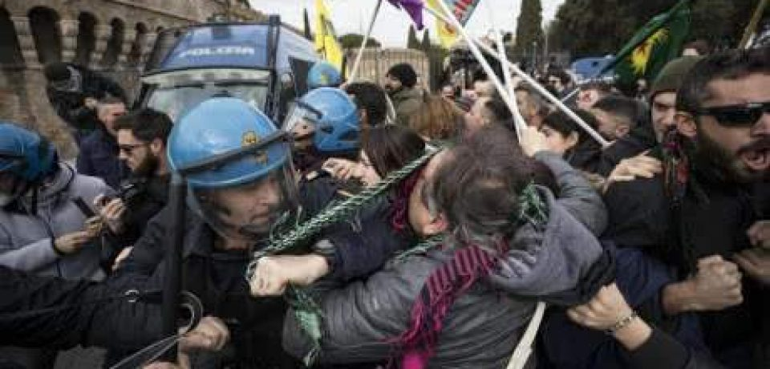

Two Events
People were angry
Police used tear gas
Time
People were angry at something (which ended in violent conflicts with the police)…The police finally used tear gas (to restore order).
Notes:
Now let's try to understand two events: people were angry and police used tear gas. If people were angry happened first, the understanding would be people ended in violent conflicts with the police, and the police used tear gas to restore order.

Slide 30
Two Events
Police used tear gas
People were angry
Time
Police used tear gas…People were angry at the police.
Notes:
If we simply reverse the order of these events, we get a new story, which says that police used tear gas and then people were angry at the police. We can see that time is crucial if we want to understand what’s going on in a situation.

Slide 31
Two Events
Police used tear gas
People were angry
Time
In natural language, we rarely see explicit timestamps, so we have to figure out the temporal order from cues in the text.
Notes:
But in natural language, we never have timestamps like here telling us which one is earlier and which one is later. That leads to “temporal relations”

Slide 32
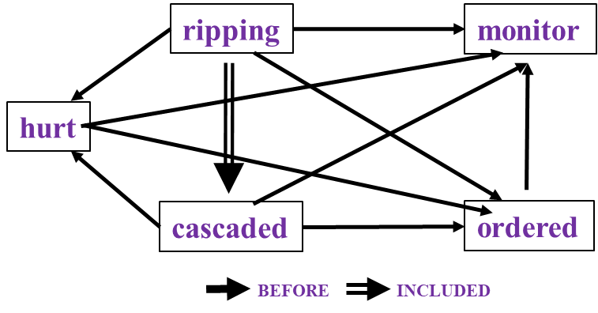
Time and Events [Ning et al. *SEM’2018; ACL’18, EMNLP’18, EMNLP’19]
In Los Angeles that lesson was brought home today when tons of earth cascaded down a hillside, ripping two houses from their foundations. No one was hurt, but firefighters ordered the evacuation of nearby homes and said they'll monitor the shifting ground until March 23rd.
Very difficult task— hinders exhaustive annotation (O(N²) edges)
But, it’s rather easy to get partial annotation – some relations.
And, we have strong expectations from the output
  Transitivity
  Some events tend to precede others, or follow others
How does this knowledge impacts how we support these types of decisions?

Slide 33
Recap
Modified version of a question for AI2’s DROP dataset
Coming off a road win over the Cowboys, the Redskins traveled to Lincoln Financial Field for a Week 5 NFC East duel with the Philadelphia Eagles. In the first quarter, the Redskins trailed early as RB Brian Westbrook scored on a 9-yard TD run and the Eagles DeSean Jackson returned a punt 68 yards for a touchdown. Washington still trailed at half time 14:9, with field goals from Shaun Suisham. In the third quarter, the Redskins took the lead on a trick play as WR Antwaan Randle El threw an 18-yard TD pass to TE Chris Cooley. In the fourth quarter, the Redskins increased their lead when Clinton Portis scored on a 4-yard TD run. The Eagles managed one more score in the final quarter for a final score of 17:23.
What are the computational tasks that we should think about?
How many touchdowns did the Eagles score in the first quarter?
Answer: 2
How many field goals did Washington score?
Answer: 3
→ Need a resource – the rules of the game.
How many field goals did the Eagles score?
Answer: 1

Slide 34

CliffsNotes
Multiple natural language documents
  Small units of text or large units of texts
  Reading news about an event/situation over time and/or from multiple sources
  Reading a book
  The novel features the character David Copperfield, his journey of change and growth from infancy to maturity, as many people enter and leave his life and he passes through the stages of his development. (Fiction, and you know it)
  London and England in the 19-th century; socio-economic state, child exploitation; schools, prisons, emigration to Australia (true historical facts)
What are the computational tasks that we should think about?

Slide 35
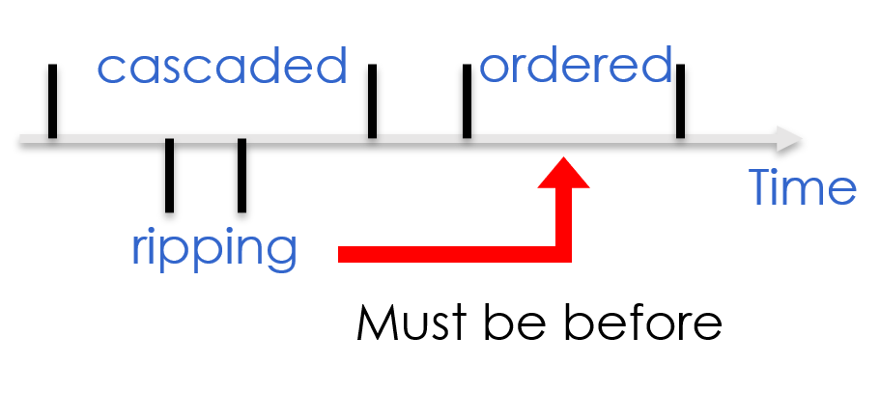
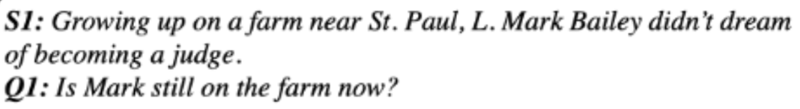
What is Reasoning (today)?
Assigning values to multiple interrelated variables
  Given observations and knowledge
  Most likely assignment: Abduction
  Example: a graph
Computing a function over multiple interrelated variables
  Last; longest, most frequent, etc.
Decisions over a dynamic set of interrelated variables
  The Aristotle example
    Need a strategy to decide what the variables are & a function computed over it
  MC-Taco [EMNLP’19]
Who scored the last field goal for the Eagles?
[given a recap of the game]
Will we make it to dinner before the movie?

Slide 36
This Class
I’d like to address all the questions brought up in the previous discussion, and more.
  What is Reasoning?
  What reasoning is needed to advance NLU?
  What levels of abstractions are needed (if at all)?
  If we need to abstract to “formal theories” – do we care about neural representations of these?
    Actually, this is an old question…
  What NLP tasks should we look at to advance our abilities in these directions?
We will read a lot of papers
  Feel free to propose additional papers that you think should be on our reading list.

Slide 37
This class
We will open the reading list for bids in a few days
  You will choose two papers to present and 4 to be a discussant on
We will provide a small set of papers and ask that you choose one to reproduce
Please feel free to suggest additional papers to the reading list.
Understand early and current work on Reasoning
  (Learn to) read critically, present, and discuss papers
Understand some of the difficulties in NLU from the perspective of reasoning
  Conceptual and technical
Try some new ideas
How:
  Presenting/discussing papers
    Probably: 2 presentations each; 4 discussants
  Writing a few critical reviews
  “Small” individual project (reproducing);
  Large project (pairs)
  Tentative details are on the web site.
Machine Learning
  519/419
  520
  Other?
NLP
  Yoav Goldberg’s book
  Jurafsky and Martin
  Jacob Eisenstein
Attendance is mandatory
Participation is mandatory
Time of class?

Slide 38
Questions?

