Slide 1
CIS-700
Spring 2020
Reasoning for Natural Language Understanding
Dan Roth
Computer and Information Science
University of Pennsylvania
Introduction Part II

Slide 2
This class
Understand early and current work on Reasoning
  (Learn to) read critically, present, and discuss papers
Understand some of the difficulties in NLU from the perspective of reasoning
  Conceptual and technical
Try some new ideas
How:
  Presenting/discussing papers
    Probably: 2 presentations each; 4 discussants
  Writing a few critical reviews
  “Small” individual project (reproducing);
  Large project (pairs)
  Tentative details are on the web site.
Machine Learning
  519/419
  520
  Other?
NLP
  Yoav Goldberg’s book
  Jurafsky and Martin
  Jacob Eisenstein
Attendance is mandatory
Participation is mandatory
Time of class?
Expectations?

Slide 3
This Class (2)
Most of this class will be technical – reading, discussing, trying to understand current literature in this area (and some earlier literature).
Before we get there, I’d like to spend the next two meetings on:
  What are the questions we should ask in this area (and why)?
  What were the earlier foci of the relevant research communities (and why)?

Slide 4
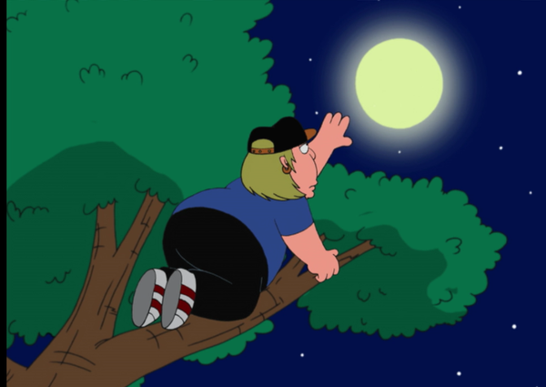
What’s Important in order to make progress in NLU
How to make progress towards natural language understanding
  Learning and Reasoning; knowledge
Dispel with [some] of the currently hot trends
  If we want to reach the moon…
What is Reasoning?
Reasoning for Natural Language Understanding
Today: Examples & Discussion
Notes:
This is my model for natural language comprehension – and I’d like to talk about some of the key issues we need to think about if we want to make progress in NLU
In doing it, I’ll dispel with some of the currently hot trends – they can help up clime trees, but we want to reach the moon.
I will use it to pay tribute to John McCarthy – many of you, I hope, know that he thought a lot about representations and Reasoning, I will discuss some of his thoughts about natural language stories
And I’ll use it to give you a brief tour of some of the relevant, hopefully important, ideas came from my work in these directions, and were we should go.

Slide 5
Questions
What is Reasoning?
  Do we do reasoning? Yes, we do.

Slide 6
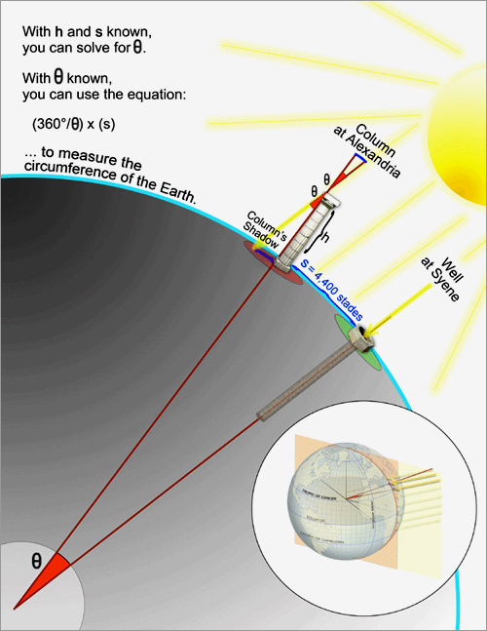
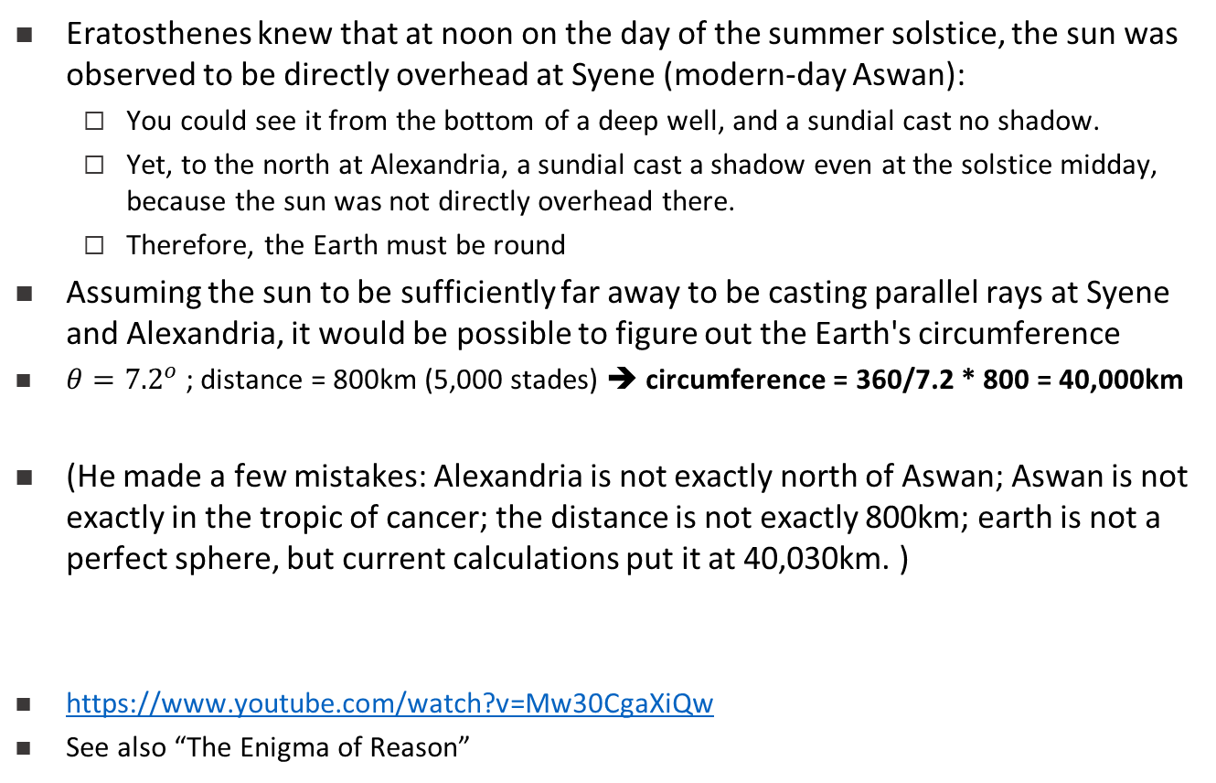
June 21, 240 B.C.: The Earth Is Round, and It's This Big
Eratosthenes knew that at noon on the day of the summer solstice, the sun was observed to be directly overhead at Syene (modern-day Aswan):
  You could see it from the bottom of a deep well, and a sundial cast no shadow.
  Yet, to the north at Alexandria, a sundial cast a shadow even at the solstice midday, because the sun was not directly overhead there.
  Therefore, the Earth must be round
Assuming the sun to be sufficiently far away to be casting parallel rays at Syene and Alexandria, it would be possible to figure out the Earth's circumference
$θ={7.2}^{o}$ ; distance = 800km (5,000 stades) ➔ circumference = 360/7.2 * 800 = 40,000km
(He made a few mistakes: Alexandria is not exactly north of Aswan; Aswan is not exactly in the tropic of cancer; the distance is not exactly 800km; earth is not a perfect sphere, but current calculations put it at 40,030km. )
https://www.youtube.com/watch?v=Mw30CgaXiQw
See also “The Enigma of Reason”

Slide 7
Questions
What is Reasoning?
  Do we do reasoning? Yes, we do.
  How can we formulate it?
Reasoning requires knowledge
  How do we represent it?
  What types of knowledge
  What types of representations?
We want to think about these in the context of natural language understanding
  In what ways does it change the game?
  Is Reasoning for/in NLU different than “Reasoning”?

Slide 8
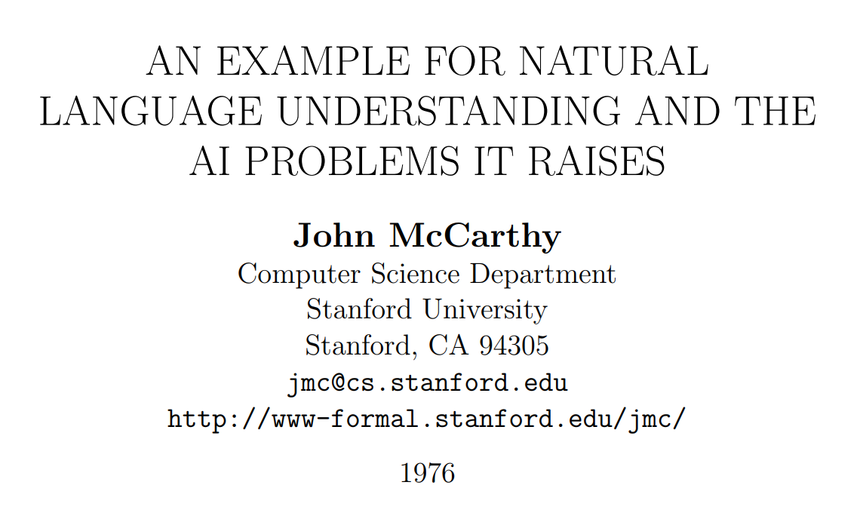
John McCarthy on Natural Language Understanding

Slide 9
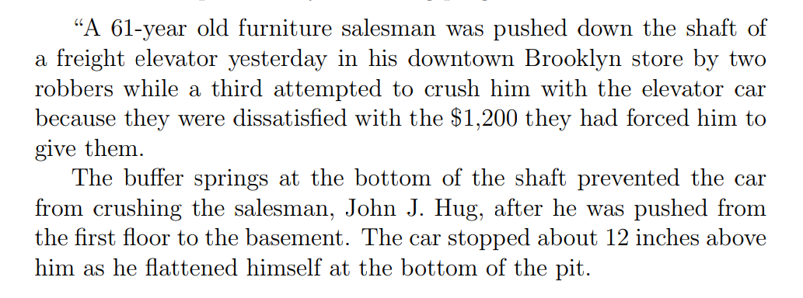
A New York Times Story

Slide 10
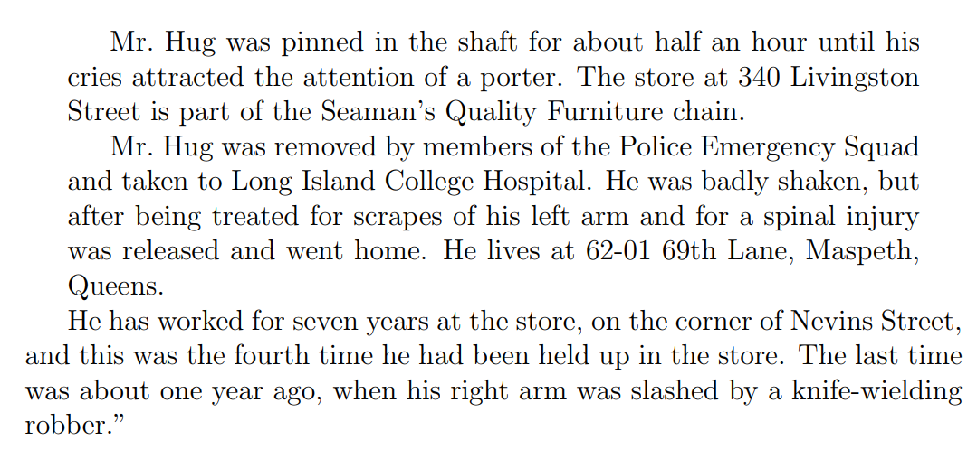
A New York Times Story (Cont.)

Slide 11
New York Times Story: Questions
An intelligent person or program should be able to answer the following questions based on the information in the story:
  The article proceeds with 22 questions:
1. Who was in the store when the events began?
  Probably Mr. Hug alone, although the robbers might have been waiting for him, but if so, this would have been stated.
2. What did the porter say to the robbers?
  Nothing, because the robbers left before he came.
20. Why did Mr. Hug yell from the bottom of the elevator shaft?
  So as to attract the attention of someone who would rescue him.
“The above list of questions is rather random. I doubt it covers all facets of understanding the story.”

Slide 12
McCarthy’s Challenges
The QA module is not being trained Once the program knows English, and has the relevant background knowledge, it should answer the questions
A formalism capable of expressing the assertion of the sentences free from dependence on the grammar of the English language. (“Artificial Natural Language”, ANL)
  Semantic Parser
An “understander” that constructs the “facts” from the text.
  Information Extraction: Entities, Relations, Temporal, Quantities,…
Expression of the “general information” about the world that could allow getting the answers to the questions from the “facts” and the “general information”
  Background Knowledge
A “problem solver” that could answer the above questions on the basis of the “facts”.
  Question Answering Engine

Slide 13
Lessons
What can we learn from this example?
  Difficulties of NLU
  Importance of reasoning
    Part of Reasoning here seems to be “providing the reasons”, not only the “answers”
  Decoupling learning from reasoning
    McCarthy thinks that there is a need for some level of abstraction – an abstract representation of the text and the relevant knowledge so that a generic module can work on it and “do the reasoning”.
Is this important/Essential?

Slide 14
Class Discussion
You will spend the next 10 minutes on:
  Suggest a reasoning problem.
    Describe it
    Suggest a way to formulate it so that you can write a program that solves it
  Think about knowledge needed
    Describe the type of knowledge you think is needed and why/when
    Suggests ways to formulate it: represent it and use it

Slide 15
More Examples

Slide 16

(1) I Have Some Questions About….
Scenario:
  You are reading the book, but left it for a couple of weeks.
  You need a refresher: some of the events, entities, the current relationships between David and James Steerforth.
Conversing about it is challenging:
  Many chapters, multiple voices, long periods of time,…
  The novel features the character David Copperfield, his journey of change and growth from infancy to maturity, as many people enter and leave his life and he passes through the stages of his development. (Fiction, and you know it)
  London and England in the 19-th century; socio-economic state, child exploitation; schools, prisons, emigration to Australia (true historical facts)
What computational tasks should we think about?

Slide 17





(2) I Want to Talk about this News Story
Who was in the store when the events began?
  The story doesn’t say.
  Probably Mr. Hug alone, although the robbers might have been waiting for him, but if so, this would have been stated.
Why was he crying?
  Maybe he was scared.
  Maybe he was injured.
  Maybe he called for help.
Understanding the story and conversing about it require Situated Reasoning: Model-based Reasoning
  [Example due to John McCarthy]

Slide 18
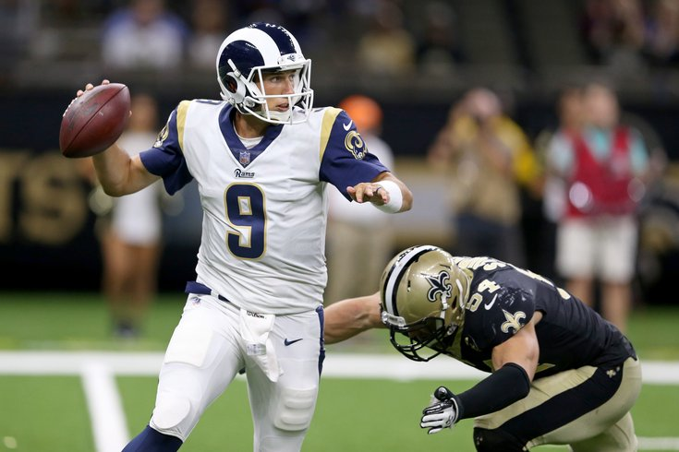
(3) Some questions to my Sports’ Assistant
Modified version of a question for AI2’s DROP dataset
Coming off a road win over the Cowboys, the Redskins traveled to Lincoln Financial Field for a Week 5 NFC East duel with the Philadelphia Eagles. In the first quarter, the Redskins trailed early as RB Brian Westbrook scored on a 9-yard TD run and the Eagles DeSean Jackson returned a punt 68 yards for a touchdown. Washington still trailed at half time 14:9, with field goals from Shaun Suisham. In the third quarter, the Redskins took the lead on a trick play as WR Antwaan Randle El threw an 18-yard TD pass to TE Chris Cooley. In the fourth quarter, the Redskins increased their lead when Clinton Portis scored on a 4-yard TD run. The Eagles managed one more score in the final quarter for a final score of 17:23.
How many touchdowns did the Eagles score in the first quarter?
Answer: 2
How many field goals did Washington score?
Answer: 3
→ Need a resource – the rules of the game.
How many field goals did the Eagles score?
Answer: 1
Football Scoring Rule Book:
TD could be 6, 7, or 8 points.
  Kick….
Field goal is worth 3 points
…..
General rules that are to be instantiated….
The answer isn’t available in any KB, but can be gleaned from the recap.
Semantic parsing is harder: it involves executing programs on the text
  Count(scoring team=Eagles (identify TD, scoring team))
How do we train such models? Some decomposition is necessary.
What computational tasks should we think about?

Slide 19
(4) Let’s Talk about Dinner
But, there is another big difference between these two scenarios.
The first applies only today.
The second is a general rule that I’d like the Assistant to remember.
→ Let’s talk about dinner.
  A: Where do you want to go?
→ I had a big lunch
  [This is not an answer; can the Assistant figure it out? ]
  It’s probably just a hint that we should go for a light dinner
→ I don’t like crowds
  [This is not an answer; can the Assistant figure it out? ]
  Perhaps a preference for small venues?
→ I had a lot of pizza the last few weeks
  [Again; not a direct; how do we understand it? How do we represent it?

Slide 20
Models
These reasoning problems are best thought of as abductive reasoning problems:
  Reasoning for the best explanation, given the observations and the knowledge available.
Formulating it as a constraint optimization problems provides a way to incorporate learned models (as variables) along with knowledge (Boolean Fns; Logical; Constraints)
.
Learning formulations such as Posterior Regularization [Ganchev et al. 10] and CoDL [Chang et al. 07, 12] provide ways to learn such objectives [but are not sufficient]
  Users have expectation from the output behavior, and they communicate to clarify it. It is imposed on the posterior
Variables are models
Penalty for violating
the constraint.
y = argmax_{y} ∑ 1_{∅(x, y)} w_{x,y} subject to Constraints C(x,y)
    y = argmax_{y} $∈$ _{Y} w^{T}$∅$(x, y) + u^{T}C(x, y)
Knowledge component:
(Soft) constraints
A linear objective over models – can be used to model any logical function
Features, Models, NN
(non-linearity comes here)
How far y is from
a “legal/expected” assignment

Slide 21
Formulation
What is the role of formal theories of reasoning and representation?
  They assume that we can map text and world knowledge to a “symbolic” representation; given that, the problem is solved (so people think).
    Note that this is true even when people use neural networks for all/part of the computation
  If this is wrong – where is it wrong?
    Is it the infeasibility of the mapping?
    Is it that our formal theories of reasoning are missing something?
Think also about the statements I expressed last time
  Reasoning is about giving reasons
What are the implications of this (whether you agree with it or not) on the need to have “symbols”?

Slide 22
Formulation (cont.)
Eventually, we may want to think about a neural implementation of Reasoning
  Is it necessary? Is this where the challenge is?
    Note that neuro-symbolic AI goes back many years
  Is it ok to first think about formal theories, and then encode them in neural architectures?
  Or, there is an advantage to directly thinking about neural representations.
    This latter view means that there is no other representation of what neural architectures are doing.
      E.g., is an embedding of a sentence different than other representations of it in some principled way?
      Or is it just a more compact representation?
Next, we will describe things from the perspective of Learning to Reason.
  The presentation will mostly focus on the logical approach, but similar ideas can be extended to other formalisms.
  This will hopefully serve as introduction to formalisms,

