Slide 1
CIS-700
Spring 2020
Reasoning for Natural Language Understanding
Dan Roth
Computer and Information Science
University of Pennsylvania
Introduction Part II

Slide 2
This class
Today: discuss first project
  Content + Timetable
Tomorrow: release list of papers
  Timetable
Understand early and current work on Reasoning
  (Learn to) read critically, present, and discuss papers
Understand some of the difficulties in NLU from the perspective of reasoning
  Conceptual and technical
Try some new ideas
How:
  Presenting/discussing papers
    Probably: 2 presentations each; 4 discussants
  Writing a few critical reviews
  “Small” individual project (reproducing);
  Large project (pairs)
  Tentative details are on the web site.
Machine Learning
  519/419
  520
  Other?
NLP
  Yoav Goldberg’s book
  Jurafsky and Martin
  Jacob Eisenstein
Attendance is mandatory
Participation is mandatory
Time of class?
Expectations?

Slide 3
This Class (2)
Most of this class will be technical – reading, discussing, trying to understand current literature in this area (and some earlier literature).
Before we get there, I’d like to spend the next two meetings on:
  What are the questions we should ask in this area (and why)?
  What were the earlier foci of the relevant research communities (and why)?

Slide 4
Questions
What is Reasoning?
  Do we do reasoning? Yes, we do.
  How can we formulate it?
Reasoning requires knowledge
  How do we represent it?
  What types of knowledge
  What types of representations?
We want to think about these in the context of natural language understanding
  In what ways does it change the game?
  Is Reasoning for/in NLU different than “Reasoning”?

Slide 5
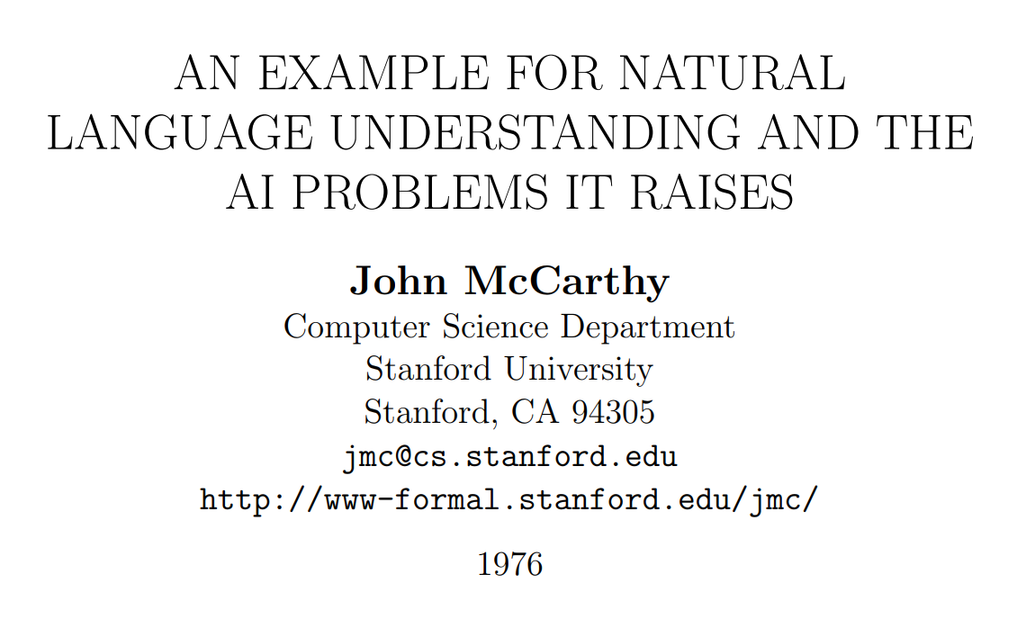
John McCarthy on Natural Language Understanding

Slide 6
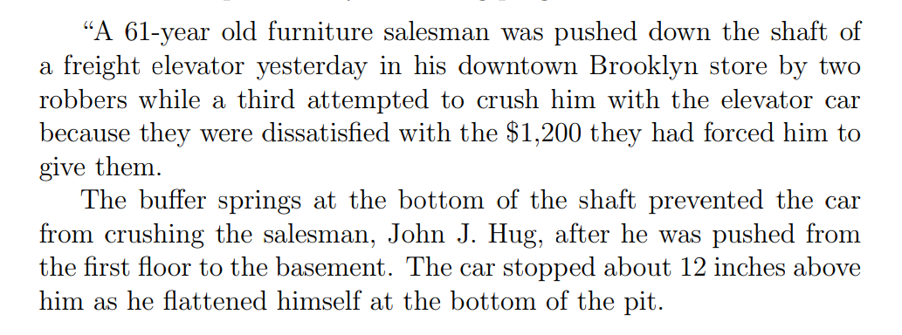
A New York Times Story

Slide 7
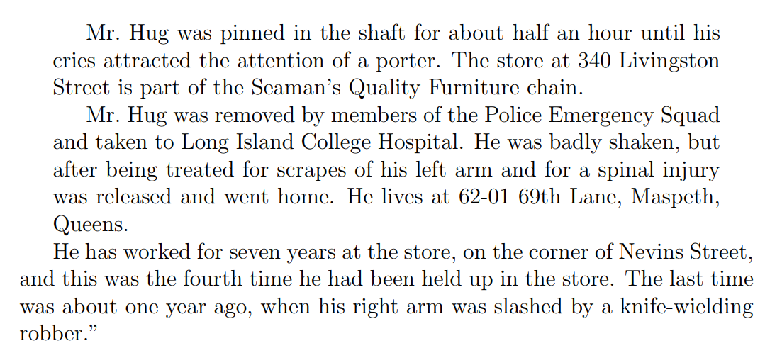
A New York Times Story (Cont.)

Slide 8
New York Times Story: Questions
An intelligent person or program should be able to answer the following questions based on the information in the story:
  The article proceeds with 22 questions:
1. Who was in the store when the events began?
  Probably Mr. Hug alone, although the robbers might have been waiting for him, but if so, this would have been stated.
2. What did the porter say to the robbers?
  Nothing, because the robbers left before he came.
20. Why did Mr. Hug yell from the bottom of the elevator shaft?
  So as to attract the attention of someone who would rescue him.
“The above list of questions is rather random. I doubt it covers all facets of understanding the story.”

Slide 9
McCarthy’s Challenges
The QA module is not being trained Once the program knows English, and has the relevant background knowledge, it should answer the questions
A formalism capable of expressing the assertion of the sentences free from dependence on the grammar of the English language. (“Artificial Natural Language”, ANL)
  Semantic Parser
An “understander” that constructs the “facts” from the text.
  Information Extraction: Entities, Relations, Temporal, Quantities,…
Expression of the “general information” about the world that could allow getting the answers to the questions from the “facts” and the “general information”
  Background Knowledge
A “problem solver” that could answer the above questions on the basis of the “facts”.
  Question Answering Engine

Slide 10
Lessons
What can we learn from this example?
  Difficulties of NLU
  Importance of reasoning
    Part of Reasoning here seems to be “providing the reasons”, not only the “answers”
  Decoupling learning from reasoning
    McCarthy thinks that there is a need for some level of abstraction – an abstract representation of the text and the relevant knowledge so that a generic module can work on it and “do the reasoning”.
Is this important/Essential?

Slide 11
Class Discussion
You will spend the next 10 minutes on:
  Suggest a reasoning problem.
    Describe it
    Suggest a way to formulate it so that you can write a program that solves it
  Think about knowledge needed
    Describe the type of knowledge you think is needed and why/when
    Suggests ways to formulate it: represent it and use it

Slide 12
More Examples
Skip

Slide 13

(1) I Have Some Questions About….
Scenario:
  You are reading the book, but left it for a couple of weeks.
  You need a refresher: some of the events, entities, the current relationships between David and James Steerforth.
Conversing about it is challenging:
  Many chapters, multiple voices, long periods of time,…
  The novel features the character David Copperfield, his journey of change and growth from infancy to maturity, as many people enter and leave his life and he passes through the stages of his development. (Fiction, and you know it)
  London and England in the 19-th century; socio-economic state, child exploitation; schools, prisons, emigration to Australia (true historical facts)
What computational tasks should we think about?

Slide 14




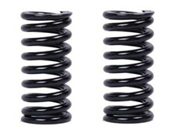
(2) I Want to Talk about this News Story
Who was in the store when the events began?
  The story doesn’t say.
  Probably Mr. Hug alone, although the robbers might have been waiting for him, but if so, this would have been stated.
Why was he crying?
  Maybe he was scared.
  Maybe he was injured.
  Maybe he called for help.
Understanding the story and conversing about it require Situated Reasoning: Model-based Reasoning
  [Example due to John McCarthy]

Slide 15
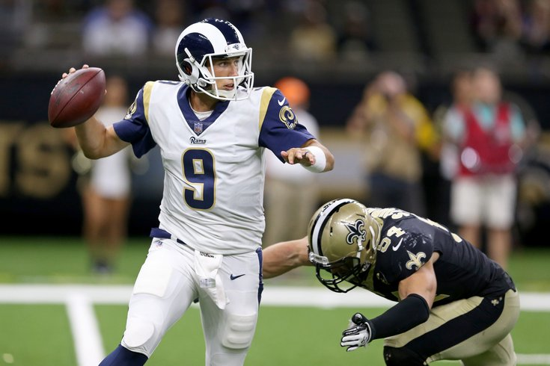
(3) Some questions to my Sports’ Assistant
Modified version of a question for AI2’s DROP dataset
Coming off a road win over the Cowboys, the Redskins traveled to Lincoln Financial Field for a Week 5 NFC East duel with the Philadelphia Eagles. In the first quarter, the Redskins trailed early as RB Brian Westbrook scored on a 9-yard TD run and the Eagles DeSean Jackson returned a punt 68 yards for a touchdown. Washington still trailed at half time 14:9, with field goals from Shaun Suisham. In the third quarter, the Redskins took the lead on a trick play as WR Antwaan Randle El threw an 18-yard TD pass to TE Chris Cooley. In the fourth quarter, the Redskins increased their lead when Clinton Portis scored on a 4-yard TD run. The Eagles managed one more score in the final quarter for a final score of 17:23.
How many touchdowns did the Eagles score in the first quarter?
Answer: 2
How many field goals did Washington score?
Answer: 3
→ Need a resource – the rules of the game.
How many field goals did the Eagles score?
Answer: 1
Football Scoring Rule Book:
TD could be 6, 7, or 8 points.
  Kick….
Field goal is worth 3 points
…..
General rules that are to be instantiated….
The answer isn’t available in any KB, but can be gleaned from the recap.
Semantic parsing is harder: it involves executing programs on the text
  Count(scoring team=Eagles (identify TD, scoring team))
How do we train such models? Some decomposition is necessary.
What computational tasks should we think about?

Slide 16
(4) Let’s Talk about Dinner
But, there is another big difference between these two scenarios.
The first applies only today.
The second is a general rule that I’d like the Assistant to remember.
→ Let’s talk about dinner.
  A: Where do you want to go?
→ I had a big lunch
  [This is not an answer; can the Assistant figure it out? ]
  It’s probably just a hint that we should go for a light dinner
→ I don’t like crowds
  [This is not an answer; can the Assistant figure it out? ]
  Perhaps a preference for small venues?
→ I had a lot of pizza the last few weeks
  [Again; not a direct; how do we understand it? How do we represent it?

Slide 17
Models
These reasoning problems are best thought of as abductive reasoning problems:
  Reasoning for the best explanation, given the observations and the knowledge available.
Formulating it as a constraint optimization problems provides a way to incorporate learned models (as variables) along with knowledge (Boolean Fns; Logical; Constraints)
.
Learning formulations such as Posterior Regularization [Ganchev et al. 10] and CoDL [Chang et al. 07, 12] provide ways to learn such objectives [but are not sufficient]
  Users have expectation from the output behavior, and they communicate to clarify it. It is imposed on the posterior
Variables are models
Penalty for violating
the constraint.
y = argmax_{y} ∑ 1_{∅(x, y)} w_{x,y} subject to Constraints C(x,y)
    y = argmax_{y} $∈$ _{Y} w^{T}$∅$(x, y) + u^{T}C(x, y)
Knowledge component:
(Soft) constraints
A linear objective over models – can be used to model any logical function
Features, Models, NN
(non-linearity comes here)
How far y is from
a “legal/expected” assignment

Slide 18
Formulation
What is the role of formal theories of reasoning and representation?
  They assume that we can map text and world knowledge to a “symbolic” representation; given that, the problem is solved (so people think).
    Note that this is true even when people use neural networks for all/part of the computation
  If this is wrong – where is it wrong?
    Is it the infeasibility of the mapping?
    Is it that our formal theories of reasoning are missing something?
Think also about the statements I expressed last time
  Reasoning is about giving reasons
What are the implications of this (whether you agree with it or not) on the need to have “symbols”?

Slide 19
Formulation (cont.)
Eventually, we may want to think about a neural implementation of Reasoning
  Is it necessary? Is this where the challenge is?
    Note that neuro-symbolic AI goes back many years
  Is it ok to first think about formal theories, and then encode them in neural architectures?
  Or, there is an advantage to directly thinking about neural representations.
    This latter view means that there is no other representation of what neural architectures are doing.
      E.g., is an embedding of a sentence different than other representations of it in some principled way?
      Or is it just a more compact representation?
Next, we will describe things from the perspective of Learning to Reason.
  The presentation will mostly focus on the logical approach, but similar ideas can be extended to other formalisms.
  This will hopefully serve as introduction to formalisms,

Slide 20
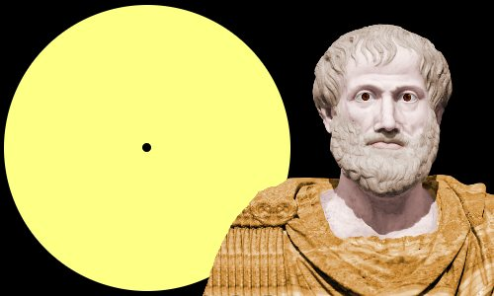
It’s Time for Reasoning: Outline
Reasoning about events and time in natural language
  Temporal ordering of events
    Learning & Inference paradigms to support reasoning
  Temporal common sense
  Reasoning & Supervision paradigms
More about Temporal Common Sense
Initial thoughts on additional Reasoning paradigms
  Decomposition, and computing functions over sets of variables
Reflects an important move in NLU from sentence level to situation level
Addresses issues in combining learning and reasoning, and supervision.
Did Aristotle have a laptop?

Slide 21
Constrained Conditional Models [Abductive Reasoning; Chang et al.’12]
Supporting structured, knowledge intensive, NLP decisions
Variables are models
Penalty for violating
the constraints.
Formulation goes back to (Roth & Yih 2004). Also related to PR (Ganchev et al. 2010)
y = argmax_{y} ∑ 1_{∅(x, y)} w_{x,y} subject to Constraints C(x,y)
    y = argmax_{y} $∈$ _{Y} w^{T}$∅$(x, y) + u^{T}C(x, y)
Knowledge component:
(Soft) constraints
A linear function over models – can be used to model any logical function
Features, Models, NN
(non-linearity comes here)
How far are the decisions (y) is from a “legal/expected” assignment
Is it needed/useful in the NN era? Yes [Deutsch et al. CoNLL’19] ; later: a neural implementation of CCMs
  But, it’s not sufficient to support all types or reasoning we care about.
It has been used extensively and successfully used in many NLU tasks from IE to discourse to summarization.
A good starting point for thinking about further progress in natural language understanding.
What are the variables? How to represent knowledge?
Is it expressive enough?
  All Boolean functions can be represented as sets of linear constrains.
  Any MAP problem w.r.t. any probabilistic model, can be formulated as an ILP [Roth&Yih 04, Taskar 04]
Training: Learning the objective function (w, u)? Learning all the intermediate functions ∅(x, y)?
  Joint? Decoupled? Learned/provided constraints? Hard/soft?
  There is some understanding for when to do what [IJCAI’05]
Reasoning: A way to push a function over learned models to satisfy output expectations
  (can also think about expectations from a latent representation)

Slide 22
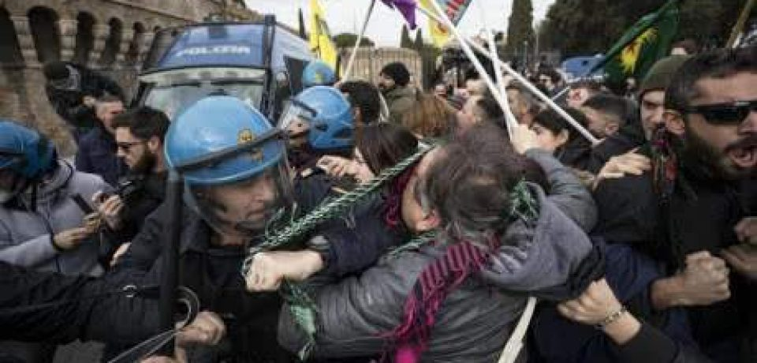
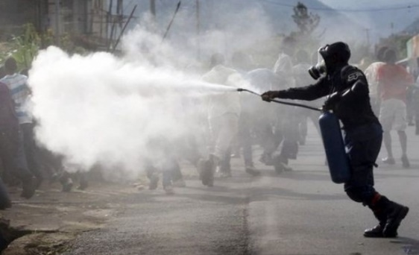
Two Events
People were angry
Police used tear gas
Time
People were angry at something (which ended in violent conflicts with the police)…The police finally used tear gas (to restore order).
Notes:
Now let's try to understand two events: people were angry and police used tear gas. If people were angry happened first, the understanding would be people ended in violent conflicts with the police, and the police used tear gas to restore order.

Slide 23
Two Events
Police used tear gas
People were angry
Time
Police used tear gas…People were angry at the police.
Notes:
If we simply reverse the order of these events, we get a new story, which says that police used tear gas and then people were angry at the police. We can see that time is crucial if we want to understand what’s going on in a situation.

Slide 24
Two Events
Police used tear gas
People were angry
Time
In natural language, we rarely see explicit timestamps, so we have to figure out the temporal order from cues in the text.
Notes:
But in natural language, we never have timestamps like here telling us which one is earlier and which one is later. That leads to “temporal relations”

Slide 25
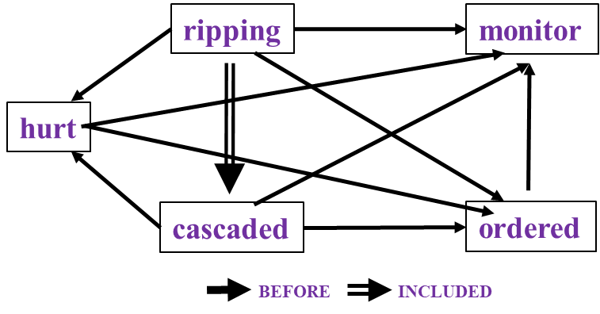
Time and Events [Ning et al. *SEM’2018; ACL’18, EMNLP’18, EMNLP’19]
In Los Angeles that lesson was brought home today when tons of earth cascaded down a hillside, ripping two houses from their foundations. No one was hurt, but firefighters ordered the evacuation of nearby homes and said they'll monitor the shifting ground until March 23rd.
Very difficult task— hinders exhaustive annotation (O(N²) edges)
But, it’s rather easy to get partial annotation – some relations.
And, we have strong expectations from the output
  Transitivity
  Some events tend to precede others, or follow others

Slide 26
Multiple Events Form a Situation
The task: label the edges of the temporal graphs.
In Los Angeles that lesson was brought home Friday when tons of earth cascaded down a hillside, ripping two houses from their foundations. No one was hurt, but firefighters ordered the evacuation of nearby homes and said they'll monitor the shifting ground until March 23rd.
ripping
monitor
This task is difficult:
Temporal relation extraction | Literature F1 (%)
w/ gold events | low 50’s
w/o gold events | low 30’s
hurt
cascaded
ordered
2015 results
BEFORE
BE_INCLUDED
Notes:
When we have multiple events, they form a situation.(read snippet) If we draw all the temprels in this situation, it would form a graph, which we call a temporal graph. In other words, we want to label those edges in a consistent way. This task is difficult and the literature F1's with or without gold events are both very low, which also reflects the difficulty of understanding a situation.

Slide 27
Temporal graphs are structured
Due to transitivity, TempRels are not independent
First step: global inference
ripping
monitor
ripping
monitor
ripping
ripping
monitor
monitor
monitor
cascaded
ordered
?
hurt
hurt
hurt
Time
ripping
ordered
ordered
cascaded
ordered
cascaded
cascaded
cascaded
cascaded
Must be before
BEFORE
INCLUDED
Notes:
The motivation is that temporal graphs are structured, or in other words, temporal relations are not independent. In the previous graph, assume that we are looking at ripping, cascaded, and ordered. Then because ripping is inside cascaded and cascaded is before ordered, the relation between ripping and ordered must be before. Existing methods are all local learning plus global inference. That is
(40 sec)

Slide 28
I. Global inference (a toy example)
monitor
0.6
0.7
0.4
0.3
cascaded
0.8
ordered
0.2
Resulting temporal graph is not feasible
Notes:
Here's a toy example of how we solve for the final graph. The naive way is to select the best score for each edge. And we get a loop! However, time cannot be a loop. How should we avoid this situation?

Slide 29
Global inference (a toy example)
Option 1
Option 2
Option 3
monitor
monitor
monitor
0.6
0.7
0.4
0.7
0.6
0.3
cascaded
ordered
cascaded
ordered
cascaded
ordered
0.2
0.8
0.8
0.6+0.2+0.7=1.5
0.4+0.8+0.7=1.9
0.6+0.3+0.8=1.7
We should not only select the assignment with the best score, but also one that does not violate our constraints (here: transitivity). Formulated as an ILP (Roth & Yih 2004)
Notes:
To do that, we actually have three options, as shown here.

Slide 30
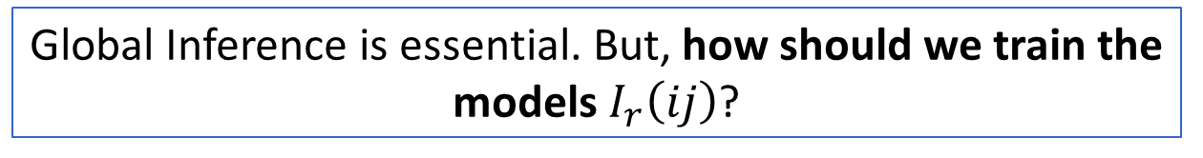
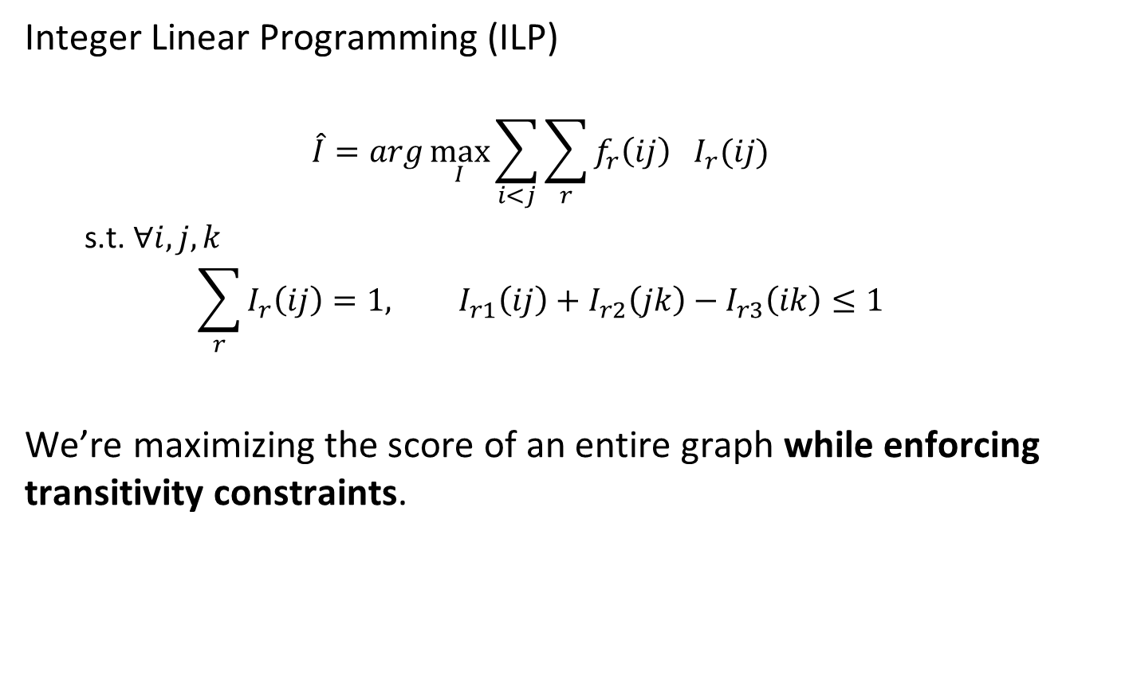




Global inference via ILP
$$I_{→}\left(ij\right)=1$$
$$f_{→}\left(ij\right)=0.6$$
Integer Linear Programming (ILP)
  $$\hat{I}=arg\max_{I}{\sum_{i<j}{\sum_{r}{f_{r}\left(ij\right){ I}_{r}(ij)}}}$$
  s.t. $∀i,j,k$
  $$\sum_{r}{I_{r}\left(ij\right)}=1, I_{r1}\left(ij\right)+I_{r2}\left(jk\right)−I_{r3}\left(ik\right)≤1$$
We’re maximizing the score of an entire graph while enforcing transitivity constraints.
j
Event i
real variable
$$f_{←}\left(ij\right)=0.4$$
$$I_{←}\left(ij\right)=1$$
Boolean variable
Uniqueness
Transitivity (no loops)
Global Inference is essential. But, how should we train the models $I_{r}\left(ij\right)$?
Notes:
ILP stands for...We have two types of variables. Boolean variable I, indicating the relation between event i and event j. And real variable f, representing the confidence scores for each relation. We sum them up, enforce the no-loop constraint, and that's our mathematical formulation for this problem.
(30 sec)

Slide 31
II. Local learning is not sufficient
tons of earth cascaded down a hillside,
…ripping two houses…firefighters ordered the evacuation of nearby homes…
Q: (ripping, ordered)=? (difficult even for humans)
Annotation says “before”, but training this way without accounting for the other labels – eg., the relation to “cascaded” misleads the model and leads to overfitting
Jointly training the relations is essential
  Structured Learning
cascaded
ordered
Time
ripping
Must be before
Notes:
But our argument is: local learning is not sufficient. In the previous example, imagine a learning algorithm is looking at this pair: ripping and ordered. Even for humans, when we only look at the local context, we don't know the relation between ripping and ordered. But annotation says the label is "before", so the algorithm will simply update the local model to fit it, which leads to overfitting. If we bring in a third event, "cascaded", and since we know (ripping,cascaded)=included and (cascaded,ordered)=before, we immediately know (ripping,ordered)=before, and we don't rely on the local model itself to overfit this decision. That's why global information is specifically needed in this task. Again, the question is, how should we formulate it?
(1min)

Slide 32
III. Temporal Common Sense
More than 10 people have (event1: died), police said. A car (event2: exploded) on Friday in a group of men.
Which event came first, event1 or event2?
Hard to tell.
What about now?
  Context is important, but not sufficient
  Humans have good priors about which event “usually” happens before another.
We would like to acquire it, and use it to enhance our temporal relation identification
Notes:
This means, when the event content is missing, the problem is very difficult even for humans.

Slide 33
TemProb: Temporal Relation Probabilistic Knowledge Base
Run initial system on New York Times 1987-2007, #Articles~1M
Identify events; identify temporal order
80M temporal relations
Noisy statistics is sufficient to give good priors.
Example pairs |  | Temporal Before (%) | Temporal After (%)
Text Before | Text After
Ask | Help | 86 | 9
Attend | Schedule | 1 | 82
Accept | Propose | 10 | 77
Die | Explode | 14 | 83
Priors on order are often different than order of occurrence in text
Notes:
In NAACL'18, we proposed TemProb, short for ... The intuition is that humans get common sense through lots of life experience. We want to mimic this, so we collected over 1 million articles from new york times. We ran our system on top of it to imitate human's reading experience. To accelerate it, we used 100 AWS instances in parallel and finished it within one day. We find that simply by counting, we could get many interesting statistics. For example, we find ask before help, attend after schedule, accept after propose, and die after explode.
(1min)

Slide 34
Event distributions from TemProb
Notes:
We also plotted the distribution of events that usually precede or follow specific events, of course, in terms of time. Although we only have the verbs here, we can still get some intuitive answers.

Slide 35
Event distributions from TemProb
Notes:
For example, before bomb, there is fire; after bomb, there are kill, destroy, and people get wound.

Slide 36
Event distributions from TemProb

Slide 37
Event distributions from TemProb
Notes:
This is what I like the most. I have a long list of such examples, and of course, there can be errors in it. But the good thing is, we mined these automatically and no more human annotations were used, so it's pretty nice. Imagine that if we could incorporate the common sense knowledge in TemProb into the temporal relation extraction task, then we can further improve the performance. The only question is how to apply TemProb in our task.
(1 min 20 sec)

Slide 38
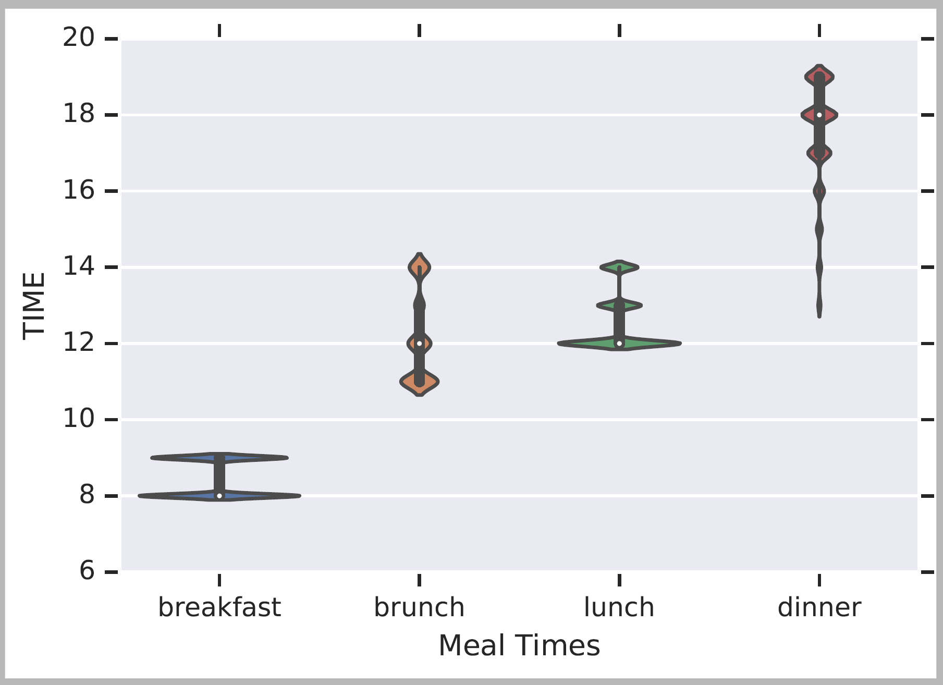
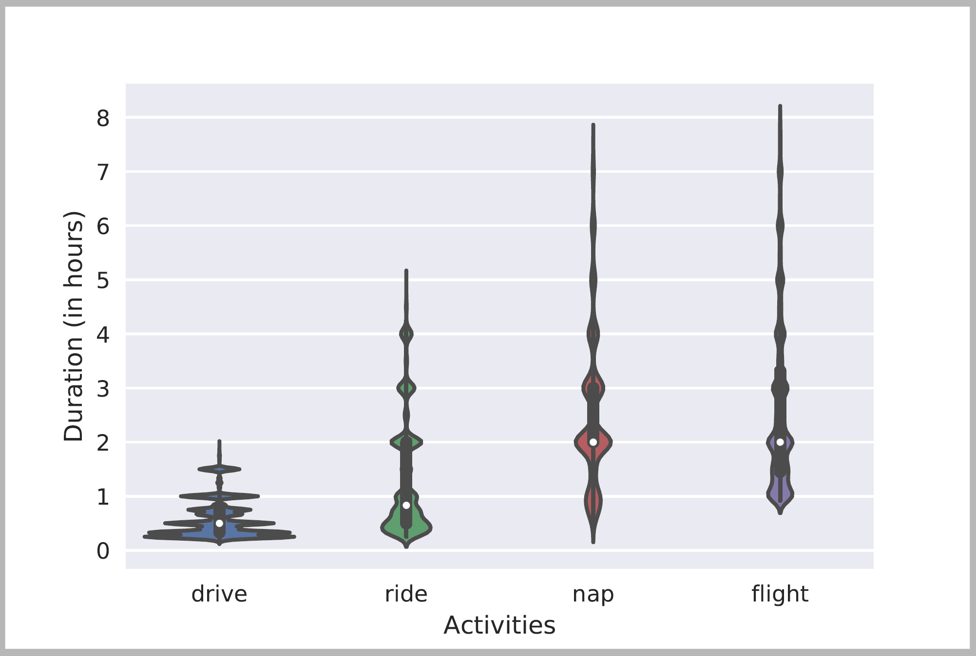
Many Forms of Temporal Common Sense
Frequency, Periodicity [ACL’19]
Not being used in this talk
Typical Time
Duration

Slide 39
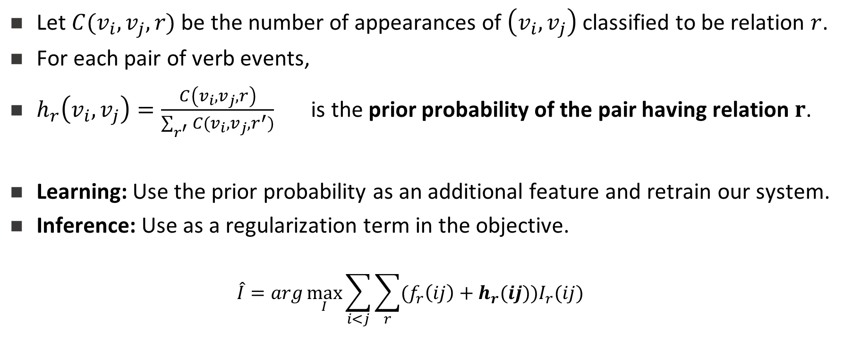
III. Making use of TemProb
Let $C(v_{i},v_{j},r)$ be the number of appearances of $\left(v_{i},v_{j}\right)$ classified to be relation $r$.
For each pair of verb events,
$h_{r}\left(v_{i},v_{j}\right)=\frac{C\left(v_{i},v_{j},r\right)}{\sum_{r^{′}}{C(v_{i},v_{j},r^{′})}}$ is the prior probability of the pair having relation $r$.
Learning: Use the prior probability as an additional feature and retrain our system.
Inference: Use as a regularization term in the objective.
  $$\hat{I}=arg\max_{I}{\sum_{i<j}{\sum_{r}{(f_{r}\left(ij\right)+h_{r}(ij))I_{r}(ij)}}}$$
Notes:
Again, I tried to use TemProb in both learning and inference. During learning, we can add the prior obtained in TemProb as an addition feature, so that we should simply retrain the system.
During inference, we can further add the prior as regularization terms, to drive the prediction to favor our common sense. Here the grey part was the ILP formulation we used earlier, and the red part is the newly added common sense regularizations.
These are pretty convenient modifications to our old system. My research philosophy is, if one is doing it right, the solution should not be complicated in most cases.
(40 sec)

Slide 40
It’s Time for Reasoning: Outline
Reasoning about events and time in natural language
  Temporal ordering of events
    Learning & Inference paradigms to support reasoning
  Temporal common sense
  Reasoning & Supervision paradigms
More about Temporal Common Sense
Initial thoughts on additional Reasoning paradigms
  Decomposition, and computing functions over sets of variables
Reflects an important move in NLU from sentence level to situation level
Addresses issues in combining learning and reasoning, and supervision.
Did Aristotle have a laptop?

Slide 41
Putting it all together: A Neural Approach
LSTM
+
Feed-Forward NN (+ ILP Inference)
+
Siamese
Siamese network
Common sense
Long short-term memory network
Structured learning
Feedforward network
Trained on new data
Notes:
Our proposal is to use long short-term memory network (LSTM) to represent structured learning, a feedforward neural net to get supervision from our new dataset, and a Siamese network to represent common sense. Let me quickly go through the high-level ideas behind it.

Slide 42
Putting it all together: A Neural Approach
LSTM takes word embeddings as input
Hidden vectors represent events
FFNN predicts the labels of temporal relations (followed by ILP inference)
Siamese network is a generalized TemProb
Siamese network
(Common sense)
LSTM
Feedforward network
(Trained on new data)
word embeddings
t₀ t₁ t₂ t_{n}
LSTM w/ concatenations of two hidden states
Notes:
Specifically, LSTM takes a sequence of word embeddings as input

Slide 43
Putting it all together: A Neural Approach
LSTM takes word embeddings as input
Hidden vectors represent events
FFNN predicts the labels of temporal relations (followed by ILP inference)
Siamese network is a generalized TemProb
Siamese network
(Common sense)
h_{e1}
LSTM
128
word embeddings
h_{e2}
128
t₀ t₁ t₂ t_{n}
LSTM w/ concatenations of two hidden states
Notes:
And generates hidden vectors to represent those events

Slide 44
Putting it all together: A Neural Approach
  Put all pieces together
: a neural approach
LSTM takes word embeddings as input
Hidden vectors represent events
FFNN predicts the labels of temporal relations (followed by ILP inference)
Siamese network is a generalized TemProb
Siamese network
(Common sense)
h_{e1}
LSTM
128
output
before
after
equal
vague
word embeddings
h_{e2}
64
128
t₀ t₁ t₂ t_{n}
LSTM w/ concatenations of two hidden states
Output confidence scores
Notes:
The event representations are stacked as input to the feedforward neural net, which generates the final temporal relation label

Slide 45
Putting it all together: A Neural Approach
LSTM takes word embeddings as input
Hidden vectors represent events
FFNN predicts the labels of temporal relations (followed by ILP inference)
Siamese network is a generalized TemProb
Siamese network trained on TemProb
v₁
v₂
500
500
150
dropout 0.3
45
dropout 0.3
h_{e1}
LSTM
128
output
before
after
equal
vague
word embeddings
h_{e2}
64
128
t₀ t₁ t₂ t_{n}
LSTM w/ concatenations of two hidden states
Output confidence scores
Notes:
In addition, a separate Siamese network fits the statistics in TemProb

Slide 46
Putting it all together: A Neural Approach
LSTM takes word embeddings as input
Hidden vectors represent events
FFNN predicts the labels of temporal relations (followed by ILP inference)
Siamese network is a generalized TemProb
Siamese network trained on TemProb
v₁
v₂
500
500
150
dropout 0.3
45
dropout 0.3
h_{e1}
LSTM
128
output
before
after
equal
vague
word embeddings
h_{e2}
64
128
t₀ t₁ t₂ t_{n}
LSTM w/ concatenations of two hidden states
Output confidence scores
Notes:
And provides additional embeddings that can be used in the feedforward neural net.

Slide 47
A Revolution in Temporal Reasoning
Generalized common sense
BERT
Neural + ILP
+3%
Axes dataset
+4%
Common sense
+3%
Structured learning
+11%*
Previous SOTA
+4%
+2%
2015
2017
2019
Thesis work of Qiang Ning (2019)
Notes:
This is a final summary for our progress on this task. CAEVO is the previous SOTA, structured learning 2%, common sense 4%, new dataset 11%, LSTM with standard word embeddings 3%, LSTM with BERT embeddings 4% (BERT is the most recent word embedding), and Siamese another 3%.

Slide 48
Multi-Axis View of Events [ACL’18]
The improvements involves another conceptually important step:
  We suggest that not all events are comparable
  Events reside on multiple axes.
Police tried to eliminate the pro-independence army and restore order. At least 51 people were killed in clashes between police and citizens in the troubled region.
Events could be actual, hypothetical, intentions,..
  Not all events are comparable.
Result: inter-annotator agreements are much higher.
Higher quality training data, with significant improvement in temporal relation identification
Intention axis
restore order
✓
to eliminate army
✓
police tried
51 people killed
Main axis
✓
Notes:
In this particular example, we used intention axis. We also define other axes, such as opinion and hypothesis.

Slide 49
Proposed Solution: Multi-axis
We complete a set of definitions for axes
Event Type | Axis Type | %
intention, opinion | orthogonal axis | ~20
hypothesis, generic | parallel axis | ~10
negation | not on any axis
static, recurrent | not considered now
main | main axis | ~70
  Part III: Data annotation
Notes:
In this particular example, we used intention axis. We also define other axes, such as opinion and hypothesis.

Slide 50
It’s Time for Reasoning: Outline
Reasoning about events and time in natural language
  Temporal ordering of events
    Learning & Inference paradigms to support reasoning
  Temporal common sense
  Reasoning & Supervision paradigms
More about Temporal Common Sense
Initial thoughts on additional Reasoning paradigms
  Decomposition, and computing functions over sets of variables
Reflects an important move in NLU from sentence level to situation level
Addresses issues in combining learning and reasoning, and supervision.
Did Aristotle have a laptop?
What kinds of supervision signals do can we get/need?

Slide 51
Inducing Semantics
Inducing semantic representations and making decisions that depend on it require learning and, in turn, supervision.
Standard machine learning methodology:
  Given a task
  Collect data for the task and annotate it
  Learn a model [doesn’t matter how]
We will never have enough annotated data to train all the models, for all the tasks we need, this way.
  We don’t even know what are “all the tasks”
  Most of what we learn we don’t learn by “training” on many examples
Current methodology is not scalable and, often, makes no sense
  Annotating for complex tasks is difficult, costly, and sometimes impossible.
    Most decisions we care about are too sparse to be trained for directly
It’s ok to do supervised learning.
But what about tasks that cannot be supervised directly?
In most interesting cases, learning should be (and is) driven by incidental supervision signals [Roth AAAI’17]
Incidental supervision: How to understand, acquire and use signals that were not put there to help a specific target task.
Today: how does the ability to reason (a little bit) helps supervision?
Notes:
Key challenge, to facilitate reasoning, is to induce semantics
Move to the importance of supervision

Slide 52
Incidental Supervision
Data exists independent of the task(s) at hand.
  Data provides hints
  These are often sufficient to infer supervision signals (even for tasks we haven’t defined)
    E.g., current work on QA-AMR (ask me later)
Utilizing these hints
  Can be substantially less costly than producing explicit annotation
  More realistic – provides signals for tasks we haven’t defined
    Is often used only at decision time
  Can be used for transfer across languages and domains
  Expectations from the output can be used to amplify week signals to high quality signals
  Yes, pre-training is a step in the right direction
Notes:
Key challenge, to facilitate reasoning, is to induce semantics

Slide 53
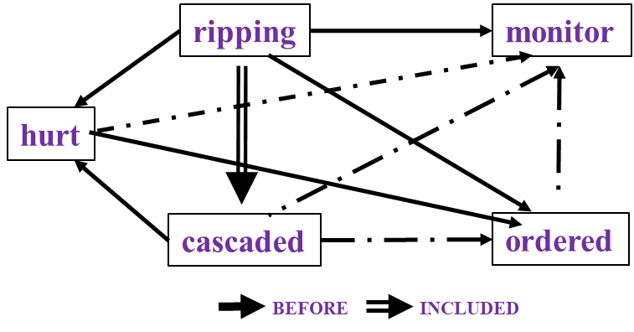
Temporal Relations [Ning et al. *SEM’2018; ACL’18, EMNLP’18]
Two key questions: (i) What level of supervision is really needed?
(ii) Algorithmic Approach: how to gain from it?
In Los Angeles that lesson was brought home today when tons of earth cascaded down a hillside, ripping two houses from their foundations. No one was hurt, but firefighters ordered the evacuation of nearby homes and said they'll monitor the shifting ground until March 23rd.
Very difficult task— hinders exhaustive annotation (O(N²) edges)
But, it’s rather easy to get partial annotation – some relations.
And, we have strong expectations from the output
  Transitivity
  Some events tend to precede others, or follow others [Ning et. al., NAACL’18]
Intuition:
If the structure is tight, there is no need to annotate all the variables.
A partial set of signals can supervise all.

Slide 54
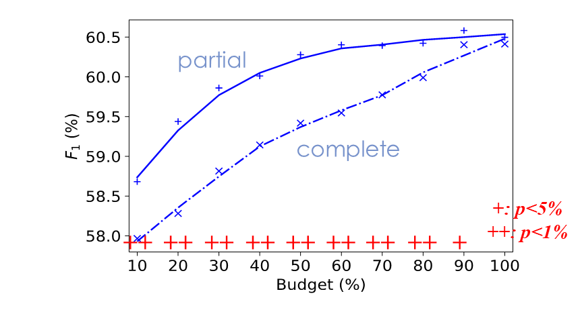
Partial or complete, that’s the question [NAACL’19]
Training Phase
When we have a fixed budget, partial structures indeed lead to better performance.
How should we quantify the quality of “partial”?
(a) Complete
(b) Partial
same budget
same budget
$$𝒯_{test}$$
$$𝒯_{test}$$
Testing Phase

Slide 55
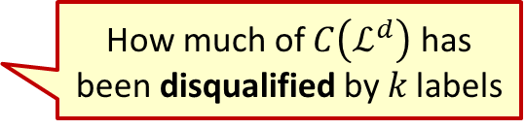
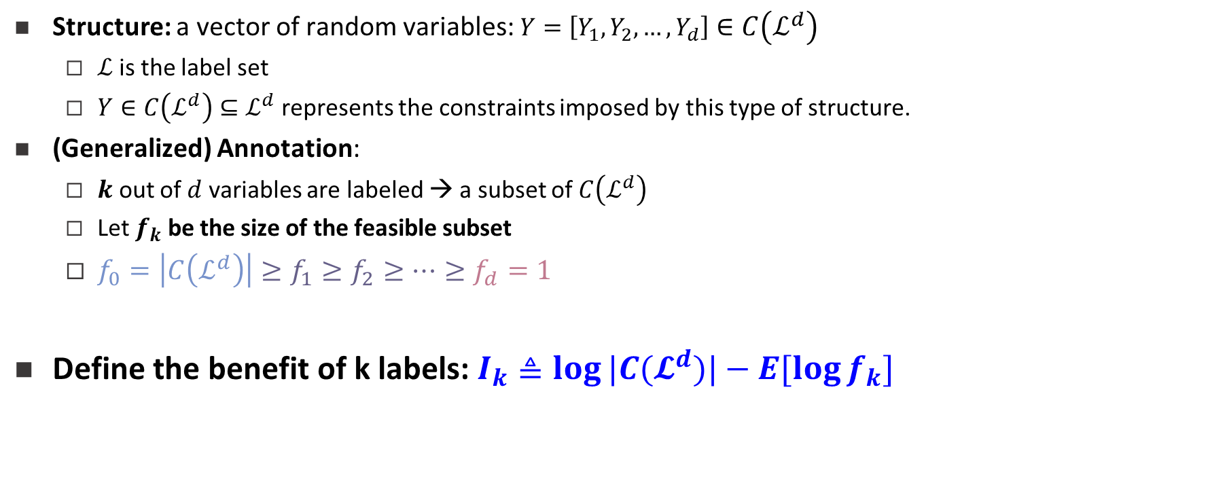

Structure
Structure: a vector of random variables: $Y=\left[Y_{1},Y_{2},…,Y_{d}\right]∈C\left(ℒ^{d}\right)$
  $ℒ$is the label set
  $Y∈C\left(ℒ^{d}\right)⊆ℒ^{d}$represents the constraints imposed by this type of structure.
(Generalized) Annotation:
  $k$ out of $d$ variables are labeled → a subset of $C\left(ℒ^{d}\right)$
  Let $f_{k}$ be the size of the feasible subset
  $f_{0}=\left|C\left(ℒ^{d}\right)\right|≥f_{1}≥f_{2}≥⋯≥f_{d}=1$
Define the benefit of k labels: $I_{k}≜\log{|C(𝓛^{d})|}−E[\log{f_{k}}]$
Constrained output; not all assignments are possible.
Intuition:
If the structure is tight, there is no need to annotate all the variables.
A partial set of signals can supervise all.
No annotation
Complete annotation
How much of $C\left(ℒ^{d}\right)$ has been disqualified by 𝑘 labels
1
1→2→3→4
Or
1→3→2→4
2
3
$$f_{k}=2$$
Partial order
4

Slide 56
Diminishing Return of New Labels
$$I_{k}:\text{The} \text{benefit} \text{of} \text{k} \text{labels} \text{is} \text{concave}$$
$$Δ_{k}=I_{k}−I_{k−1} \text{: }\text{The} \text{benefit} \text{of} \text{a} \text{new} \text{label} \text{is} \text{diminishing}$$

Slide 57
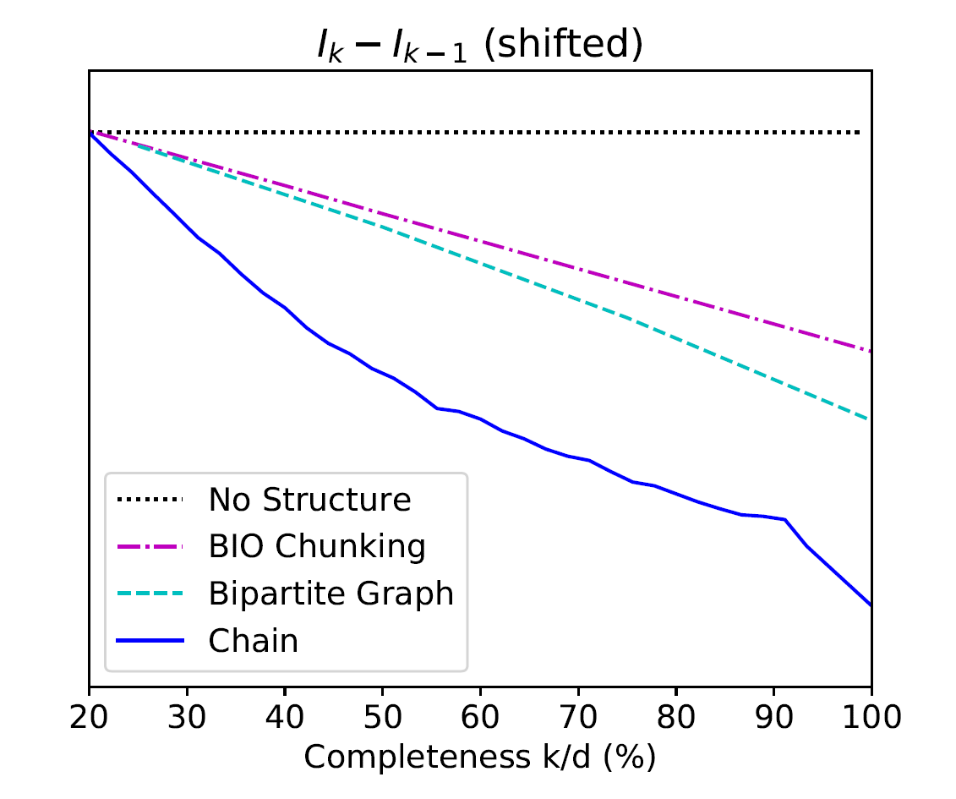
Improvement Consistent With Tightness Analysis By $I_{k}$
$$Δ_{k}=I_{k}−I_{k−1} \text{: }\text{The} \text{benefit} \text{of} \text{a} \text{new} \text{label}$$
Chain:
Temporal Relation Extraction
Algorithmically:
Results are consistent with tightness of the structure
A version of the Constraint-Driven Learning (CoDL) Algorithm [Chang et al. 2012]
+: p<5%
++: p<1%
++
++
++
++
++
++
++
++
+
more concave
Bipartite Graph:
Semantic Role Classification
Seq Tagging
Shallow Parsing
Indeed:
If the structure is tight, there is no need to annotate all the variables.
A partial set of signals can supervise all.
++
++
++
++
++
++

Slide 58

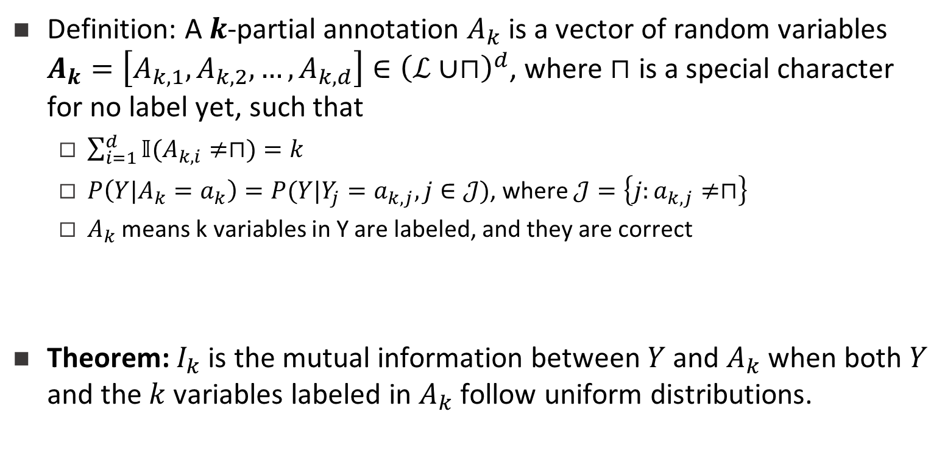
What is $I_{k}$ Actually?
Definition: A $k$-partial annotation $A_{k}$ is a vector of random variables $A_{k}=\left[A_{k,1},A_{k,2},…,A_{k,d}\right]∈{\left(ℒ∪⊓\right)}^{d}$, where $⊓$ is a special character for no label yet, such that
  $\sum_{i=1}^{d}{𝕀(A_{k,i}≠⊓)}=k$
  $P\left(Y|A_{k}=a_{k}\right)=P(Y|Y_{j}=a_{k,j},j∈𝒥)$, where $𝒥=\left\{j:a_{k,j}≠⊓\right\}$
  $A_{k}$ means k variables in Y are labeled, and they are correct
Theorem: $I_{k}$ is the mutual information between $Y$ and $A_{k}$ when both $Y$ and the $k$ variables labeled in $A_{k}$ follow uniform distributions.
Notes:
If we define k-partial annotation as a vector of random variables A_k. You don’t need to read the formulations below. The translation is: A_k means k variables are labeled in Y. Then actually we can prove, that I_k is the mutual information between structure Y and the k-partial annotation A_k, when they follow certain uniform distributions. This is a very interesting finding.
(30 sec)

Slide 59
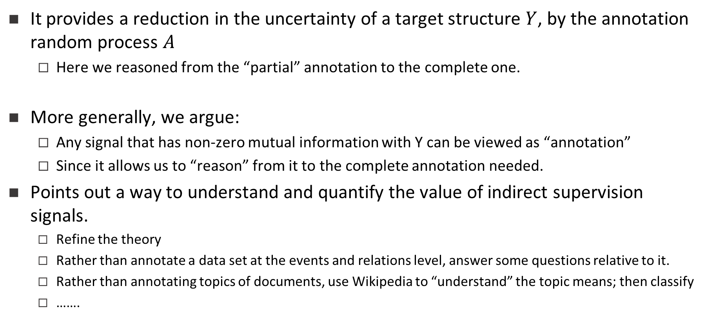
How Reasoning Helps Learning
It provides a reduction in the uncertainty of a target structure $Y$, by the annotation random process $A$
  Here we reasoned from the “partial” annotation to the complete one.
More generally, we argue:
  Any signal that has non-zero mutual information with Y can be viewed as “annotation”
  Since it allows us to “reason” from it to the complete annotation needed.
Points out a way to understand and quantify the value of indirect supervision signals.
  Refine the theory
  Rather than annotate a data set at the events and relations level, answer some questions relative to it.
  Rather than annotating topics of documents, use Wikipedia to “understand” the topic means; then classify
  …….
Work in Progress
Notes:
(partial 5 min)

Slide 60
It’s Time for Reasoning: Outline
Reasoning about events and time in natural language
  Temporal ordering of events
    Learning & Inference paradigms to support reasoning
  Temporal common sense
  Reasoning & Supervision paradigms
More about Temporal Common Sense
Initial thoughts on additional Reasoning paradigms
  Decomposition, and computing functions over sets of variables
Reflects an important move in NLU from sentence level to situation level
Addresses issues in combining learning and reasoning, and supervision.
Did Aristotle have a laptop?

Slide 61
Temporal Common Sense [EMNLP’19 + In Progress]
My friend Bill went to Duke University in North Carolina. With a degree in CS, he joined Google MTV as a software engineer. As a huge basketball fan, he has attended all 3 NBA finals since then. He also plans to visit Duke regularly as an alumnus to attend their home games.

Slide 62
Temporal Common Sense
My friend Bill went to Duke University in North Carolina. With a degree in CS, he joined Google MTV as a software engineer. As a huge basketball fan, he has attended all 3 NBA finals since then. He also plans to visit Duke regularly as an alumnus to attend their home games.
College: about 4 years, start at the age of 18
Duration
Typical Time
Bill in North Carolina: about 4 years
Duration
Stationarity
Duke in North Carolina: always
Stationarity

Slide 63
Temporal Common Sense
My friend Bill went to Duke University in North Carolina. With a degree in CS, he joined Google MTV as a software engineer. As a huge basketball fan, he has attended all 3 NBA finals since then. He also plans to visit Duke regularly as an alumnus to attend their home games.
College: about 4 years, start at the age of 18
Duration
Typical Time
Bill in North Carolina: about 4 years
Duration
Stationarity
Duke in North Carolina: always (expected)
Stationarity
Join Google: after college graduation
Ordering

Slide 64
Temporal Common Sense
My friend Bill went to Duke University in North Carolina. With a degree in CS, he joined Google MTV as a software engineer. As a huge basketball fan, he has attended all 3 NBA finals since then. He also plans to visit Duke regularly as an alumnus to attend their home games.
College: about 4 years, start at the age of 18
Duration
Typical Time
Bill in North Carolina: about 4 years
Duration
Stationarity
Duke in North Carolina: always (expected)
Stationarity
Join Google: after college graduation
Ordering
NBA Finals: every year
Frequency

Slide 65
Temporal Common Sense
My friend Bill went to Duke University in North Carolina. With a degree in CS, he joined Google MTV as a software engineer. As a huge basketball fan, he has attended all 3 NBA finals since then. He also plans to visit Duke regularly as an alumnus to attend their home games.
College: about 4 years, start at the age of 18
Duration
Typical Time
Bill in North Carolina: about 4 years
Duration
Stationarity
Duke in North Carolina: always (expected)
Stationarity
Join Google: after college graduation
Ordering
NBA Finals: every year
Frequency
Visit Alma Mater: 0-2 times per year, 0-2 days each time
Frequency
Duration
Attend basketball games: a few hours
Duration

Slide 66
Temporal Commonsense
My friend Bill went to Duke University in North Carolina. With a degree in CS, he joined Google MTV as a software engineer. As a huge basketball fan, he has attended all 3 NBA finals since then. He also plans to visit Duke regularly as an alumnus to attend their home games.
Q: How old is Bill?
A: Around 25.
R: 3 + 4 + 18
Q: How long will take Bill to fly to Duke?
A: A few (1-5) hours.
R: Duke is always in NC, Bill is now in CA
Q: How often would he visit Duke in the future?
A: A few (<5) times a year.
Q: Which one happened first, went or joined?
A: Went.
Human infer temporal common sense that helps them to better understand the story.
This is reflected in the ability to answer questions about temporal aspects.

Slide 67
MC-TACO🌮: A Temporal Common Sense Dataset
MC-TACO 🌮 (multiple choice temporal common-sense) :
  In a given scenario – addressing multiple aspects/options of temporal commons sense
  Input:
  Task: Decide whether each answer is plausible.
  Metrics:
    Exact Match: the percentage of question of which all candidates are predicted correctly
    F1: The F1 score of “plausible”
  Statistics:
    1,893 questions
    13,225 question-answer pairs
Gold
Prediction
He went to Duke University.
How long did it take him to graduate?
4 years
✔
He went to Duke University.
How long did it take him to graduate?
10 days
✔
3.5 years
✗
16 hours
✔
1 century
✔
F1: 66.7
Exact Match: 0.0

Slide 68
Results: We are Far
13% difference
40% difference
ESIM: Enhanced LSTM for Natural Language Inference (Chen et al., 2016)
GloVe: Global Vectors for Word Representation (Pennington et al., 2014)
ELMo: Deep contextualized word representations (Peters et al., 2018)
BERT: BERT: Pre-training of Deep Bidirectional Transformers for Language Understanding (Devlin et al., 2019)
RoBERTa: A Robustly Optimized BERT Pretraining Approach (Liu et al., 2019)

Slide 69
What Do We Know?
We can estimate some temporal aspects well
But we don’t know if Aristotle had a laptop
  Not even if “we can make it to dinner before the movie”.
Decompose or not decompose?
  The strategy: What do we need to know in order to answer
  What functions are to be computed over components?
How/What to learn?
But, we have made significant progress in reasoning about time, and a few additional reasoning tasks in NLP
[ACL’19 + In Progress]
Did Aristotle have a laptop?
Duration
Typical Time

Slide 70
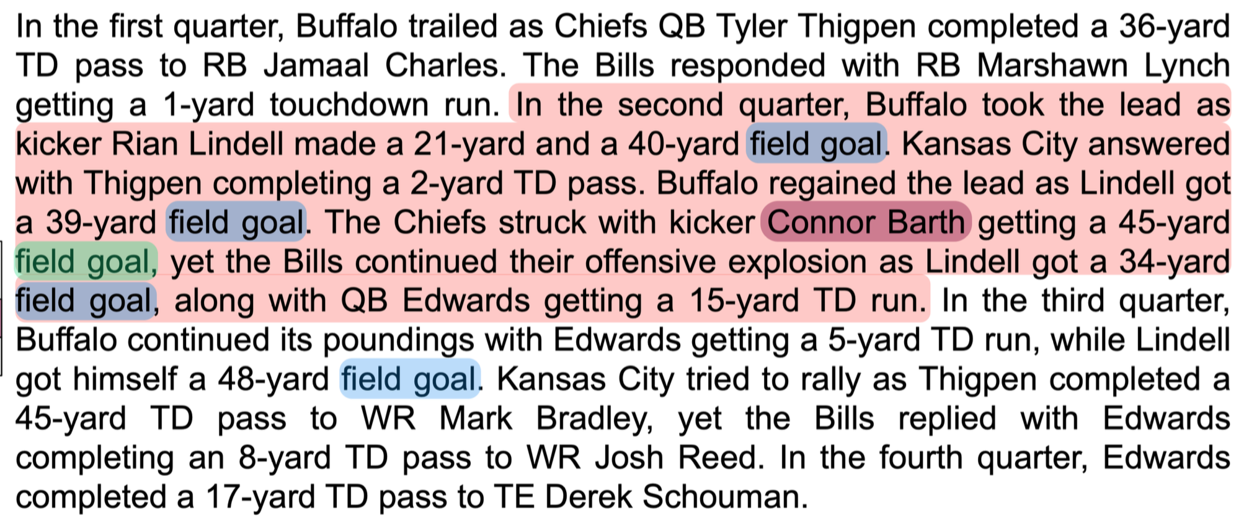
Reasoning over paragraphs

Slide 71
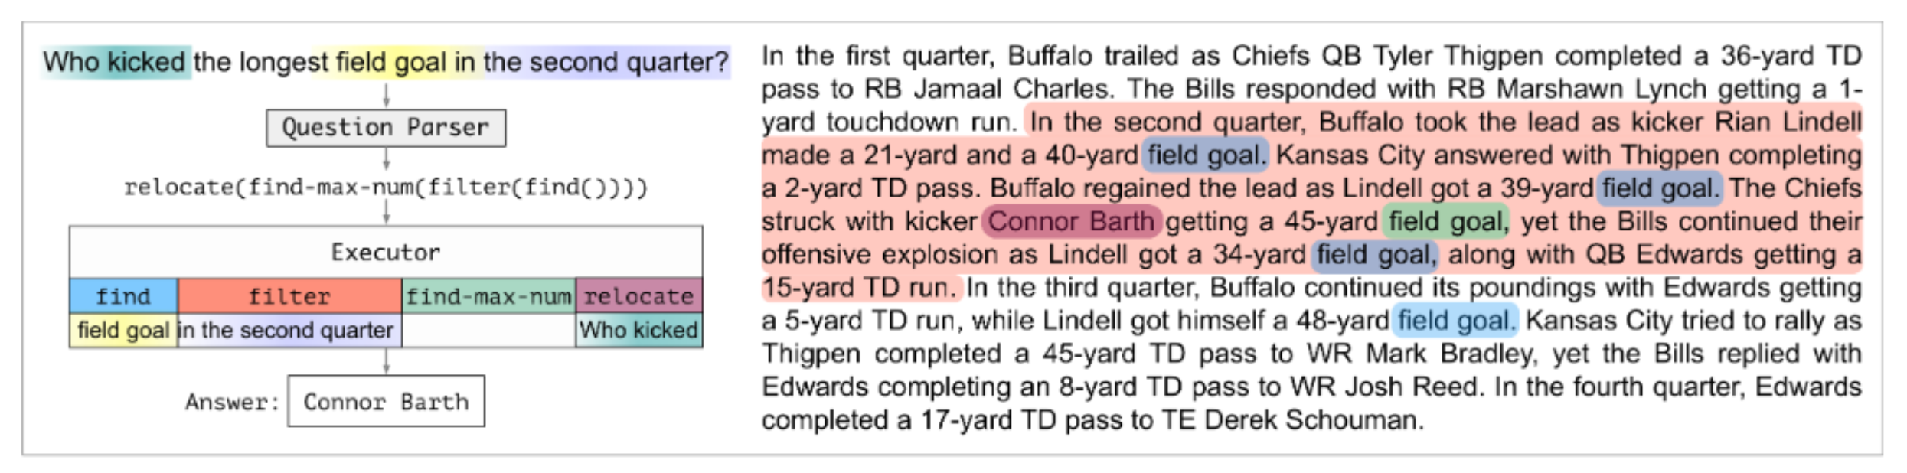
Decomposition for Reasoning about Text[In Submission]
We need to induce a program, with some executable modules at the leaves
  “This phrase” indicates a field goal
  “This player” scored it; “this is the team” that scored it
  “This is the length” of the field goal
Reason symbolically over it.
  Imagine more expressive functions
Colors represent levels of attention over phrases

Slide 72
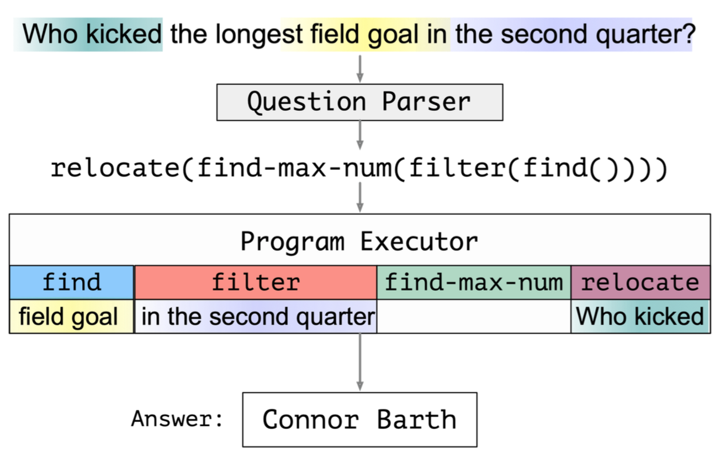
Neural Module Networks for Text
Trainable parameters
Differentiable modules

Slide 73
Challenges
Training:
End-to-End Learning in this context is challenging
You have to know something
  A limited amount of heuristically-obtained modules provides sufficient inductive bias for accurate learning
Reasoning
We introduce modules that perform symbolic reasoning (such as arithmetic, sorting, counting) over numbers in a probabilistic and differentiable manner.
But how to extend it to more functions?
At this point, we can get state-of-the art and interpretable results on a relevant fraction of the DROP dataset.

Slide 74
Recap
Modified version of a question for AI2’s DROP dataset
Coming off a road win over the Cowboys, the Redskins traveled to Lincoln Financial Field for a Week 5 NFC East duel with the Philadelphia Eagles. In the first quarter, the Redskins trailed early as RB Brian Westbrook scored on a 9-yard TD run and the Eagles DeSean Jackson returned a punt 68 yards for a touchdown. Washington still trailed at half time 14:9, with field goals from Shaun Suisham. In the third quarter, the Redskins took the lead on a trick play as WR Antwaan Randle El threw an 18-yard TD pass to TE Chris Cooley. In the fourth quarter, the Redskins increased their lead when Clinton Portis scored on a 4-yard TD run. The Eagles managed one more score in the final quarter for a final score of 17:23.
What are the computational tasks that we should think about?
How many touchdowns did the Eagles score in the first quarter?
Answer: 2
How many field goals did Washington score?
Answer: 3
→ Need a resource – the rules of the game.
How many field goals did the Eagles score?
Answer: 1

Slide 75
CliffsNotes
Multiple natural language documents
  Small units of text or large units of texts
  Reading news about an event/situation over time and/or from multiple sources
  Reading a book
  The novel features the character David Copperfield, his journey of change and growth from infancy to maturity, as many people enter and leave his life and he passes through the stages of his development. (Fiction, and you know it)
  London and England in the 19-th century; socio-economic state, child exploitation; schools, prisons, emigration to Australia (true historical facts)
What are the computational tasks that we should think about?

Slide 76
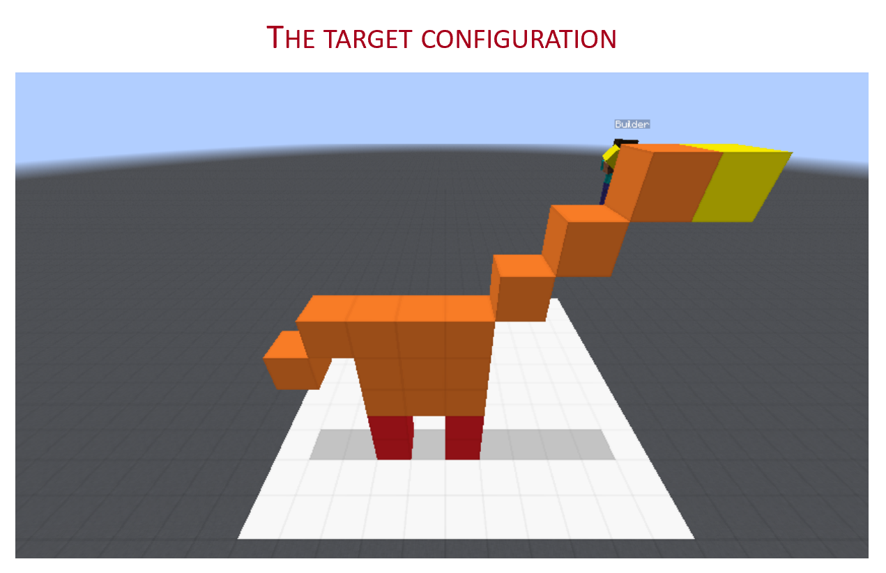
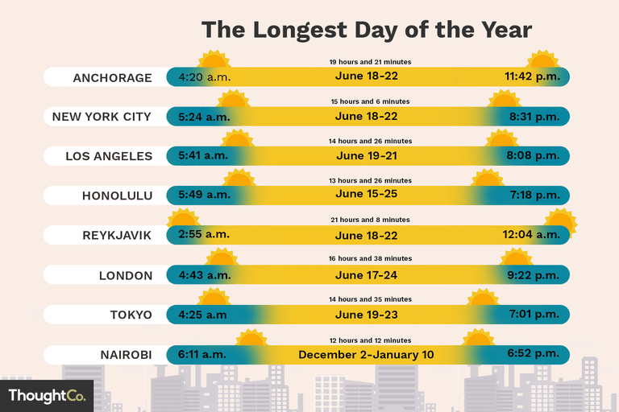
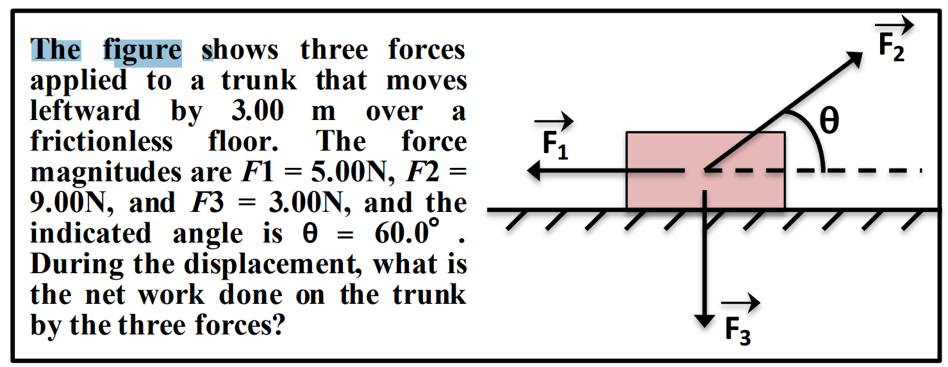
Conclusion
What is Reasoning?
Who is doing the Reasoning?

