Slide 1
CIS-700
Spring 2020
Reasoning for Natural Language Understanding
Dan Roth
Computer and Information Science
University of Pennsylvania
Introduction Part III: Knowledge Representation and Reasoning – Classical View

Slide 2
This class
Today: discuss first project
  Content + Timetable
Today: release list of papers
  Timetable
Understand early and current work on Reasoning
  (Learn to) read critically, present, and discuss papers
Understand some of the difficulties in NLU from the perspective of reasoning
  Conceptual and technical
Try some new ideas
How:
  Presenting/discussing papers
    Probably: 2 presentations each; 4 discussants
  Writing a few critical reviews
  “Small” individual project (reproducing);
  Large project (pairs)
  Tentative details are on the web site.
Machine Learning
  519/419
  520
  Other?
NLP
  Yoav Goldberg’s book
  Jurafsky and Martin
  Jacob Eisenstein
Attendance is mandatory
Participation is mandatory
Time of class?
Expectations?

Slide 3
Reasoning
The classical view of reasoning:
  Deriving conclusions from a corpus of explicitly stored information, as a mean to solve a range of problems.
An ideal reasoning system will produce:
  All-and-only the correct answer to every possible query
  Produce answers that are as specific as possible
  Be expressive enough to permit any possible fact to be stored and and query to be asked
  Be efficient
Probably impossible for many reasons (?)
Most of the classical research focused on tradeoffs:
  As correct systems become more expressive, they can become less efficient
This was studied both in the context of logic- and of probability-based reasoning.
Less effort was devoted to connecting things to applications where reasoning is needed
  Representation (and Mapping) – are these realistic?
  Formulation – is it satisfactory?

Slide 4
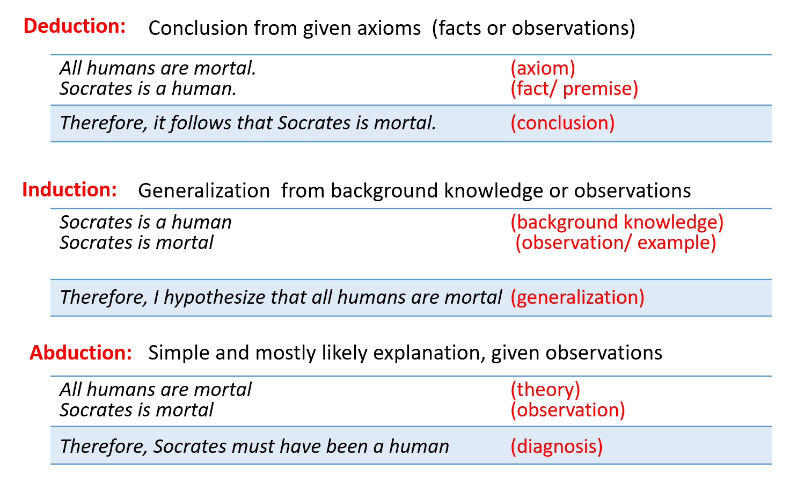
Towards a Formulation
  Of these, abduction might be the most useful (?) in many situations.
  But, we need to formalize these.
  And, maybe think about the relations to Induction
  And, always ask, are these forms of reasoning sufficient?

Slide 5
Representation and Reasoning
Propositions (p, q, …). Connectives (∧, ¬, …).
  Implications: φ ⇒ x. Equivalences: φ ⇔ x.
Reasoning semantics through entailment ⊨.
Proof procedures ⊢ to compute entailment.
Given formulas in KB and an input O, deduce whether a result R is entailed (KB ⋃ O ⊨ R).
Given formulas in KB and an input O, abduce an explanation E that entails O (KB ⋃ E ⊨ O).
  The question of how to compute deduction (and abduction) is also an interesting question here.

Slide 6
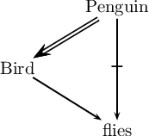
Non-Monotonic Reasoning
Non-monotonicity typically viewed as property of extending input O for fixed KB,
and having result R become “smaller”.
    Birds fly
    Tweedy is a bird; does Tweedy fly?
    Tweedy is a penguin
  This is a problem to most formalisms
  Involving learning in the process provides ways to address these difficulties.

Slide 7
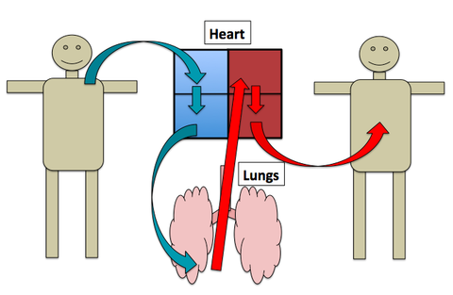
Analogy
The heart is a pump
Is this an important reasoning setting?

Slide 8
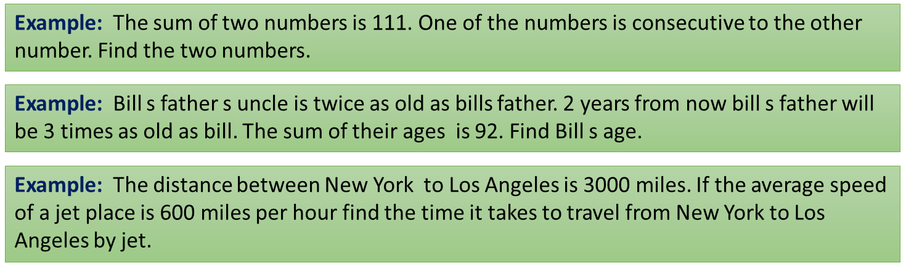
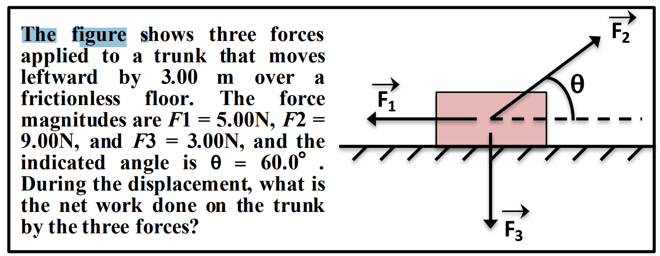
Quantitative Reasoning

Slide 9
The many faces of reasoning
Reasoning is often studied in a very narrow sense.
  But probably has many forms
  Realistic examples typically span multiple reasoning aspects.
quantitative reasoning
paraphrasing
temporal
deductive
inductive
causal (cause to effect)
causal (effect to cause)
abductive
analogy
exemplar (learn. by ex.s)
conditional
non-monotonic
coref
....

Slide 10
The many faces of reasoning
Abductive reasoning
There is overlap between all of them.
In language, things are not clearly disjoint.
⇒ An instance might have elements of both phenomena.
Incomplete
Observations
Best conclusion (maybe true)
Space of all the reasoning phenomena
The grass is wet, …
It must have rained.
Someone has watered them
Abductive reasoning
Inductive reasoning
What a linguist would interpret “reasoning”
(Bayesian Nets; Fuzzy Logic; Dampster-Shafer Theory)
Co-reference
Resolution
Q: When did Jack pass out?
What a logician would interpret as “reasoning”
Temporal
Learning
theory
(Valiant,84)
The sunlight hit Jack and he passed out.
Options: morning, noon, night
Spatial
⇒ Abduction: (probably) morning
Deductive reasoning
Jack passed out after dinner.
Options: morning, noon, night
Very little understanding
⇒ Deduction: night
Deductive reasoning
Generalization bounds
General Rule
Specific conclusion
(always true)
When it rains, objects get wet.
It rained.
The grass must be wet.
(modus ponens; modus tollens)
Notes:
...
We have very little understanding about elements of this diagram, and how different theories are connected to each other.
future idea: We can include “presupposition” as well.

Slide 11
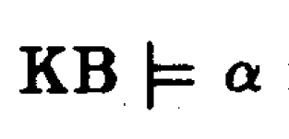
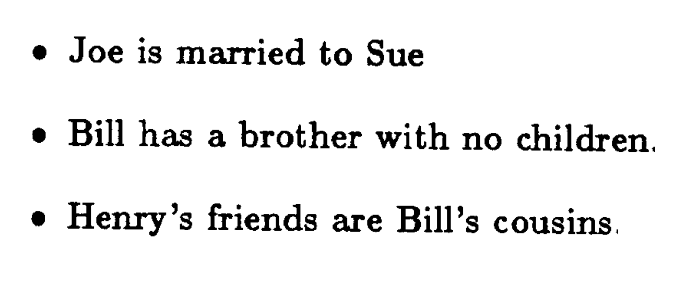
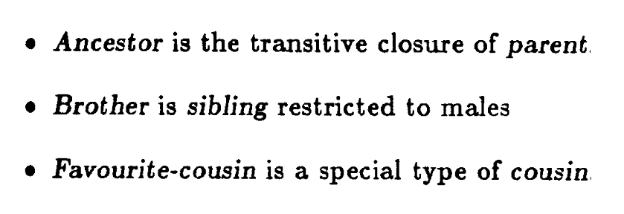
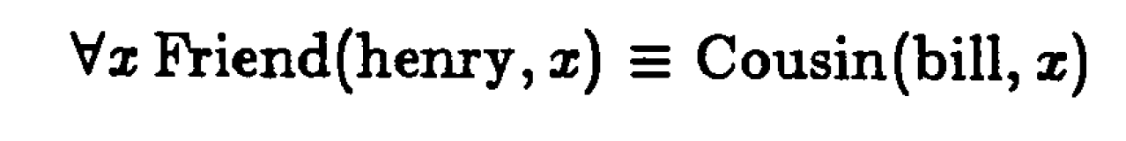
Flow of Ideas
Idea: represent all your knowledge in First Order Logic (KB).
Given a query α, determine whether it holds in the KB: (KB implies α)
For efficiency reasons:
  FOL (too complex to compute with) → Propositional Logic
Problem I: complexity of inference.
  Key solution: relax expressivity.
(but of, course, there were many other problems – incomplete knowledge, uncertainty)
  E.g., what if the knowledge is not given, but rather learned?
Facts: (Declarative) Knowledge:
Representation:

Slide 12
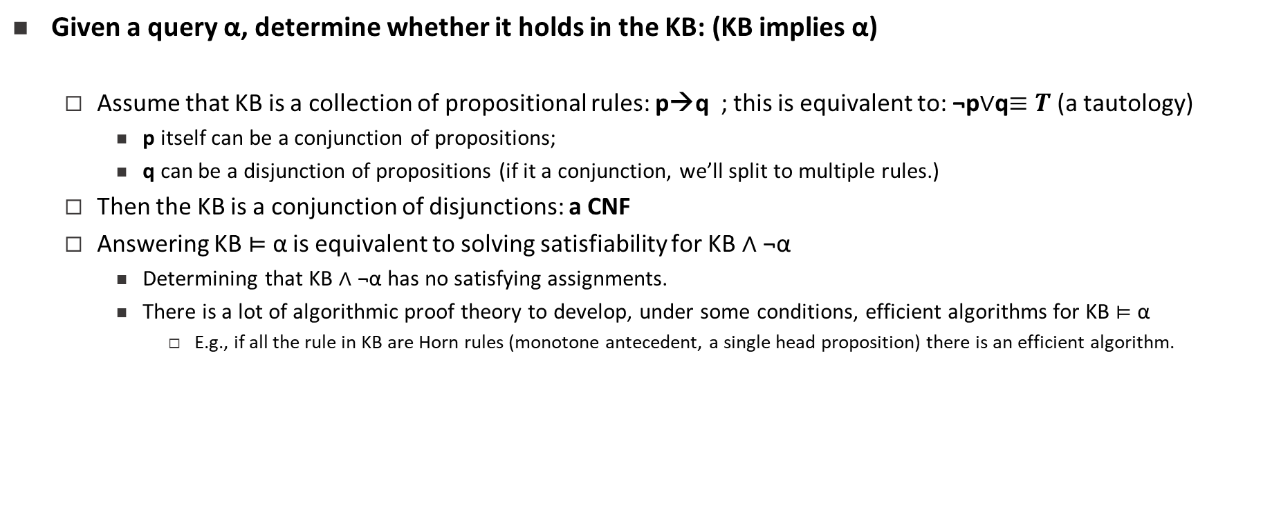
Proof Systems
Given a query α, determine whether it holds in the KB: (KB implies α)
  Assume that KB is a collection of propositional rules: p→q ; this is equivalent to: ¬p$∨$q$≡T$ (a tautology)
    p itself can be a conjunction of propositions;
    q can be a disjunction of propositions (if it a conjunction, we’ll split to multiple rules.)
  Then the KB is a conjunction of disjunctions: a CNF
  Answering KB $⊨$ α is equivalent to solving satisfiability for KB $∧$ ¬α
    Determining that KB $∧$ ¬α has no satisfying assignments.
    There is a lot of algorithmic proof theory to develop, under some conditions, efficient algorithms for KB $⊨$ α
      E.g., if all the rule in KB are Horn rules (monotone antecedent, a single head proposition) there is an efficient algorithm.

Slide 13
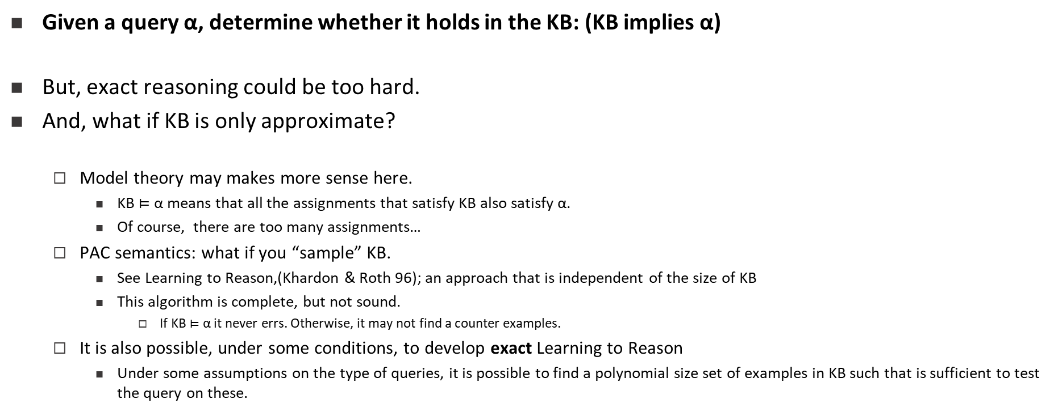
Proof Systems
Given a query α, determine whether it holds in the KB: (KB implies α)
But, exact reasoning could be too hard.
And, what if KB is only approximate?
  Model theory may makes more sense here.
    KB $⊨$ α means that all the assignments that satisfy KB also satisfy α.
    Of course, there are too many assignments…
  PAC semantics: what if you “sample” KB.
    See Learning to Reason,(Khardon & Roth 96); an approach that is independent of the size of KB
    This algorithm is complete, but not sound.
      If KB $⊨$ α it never errs. Otherwise, it may not find a counter examples.
  It is also possible, under some conditions, to develop exact Learning to Reason
    Under some assumptions on the type of queries, it is possible to find a polynomial size set of examples in KB such that is sufficient to test the query on these.

Slide 14
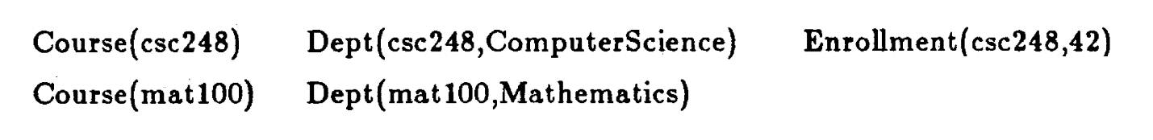
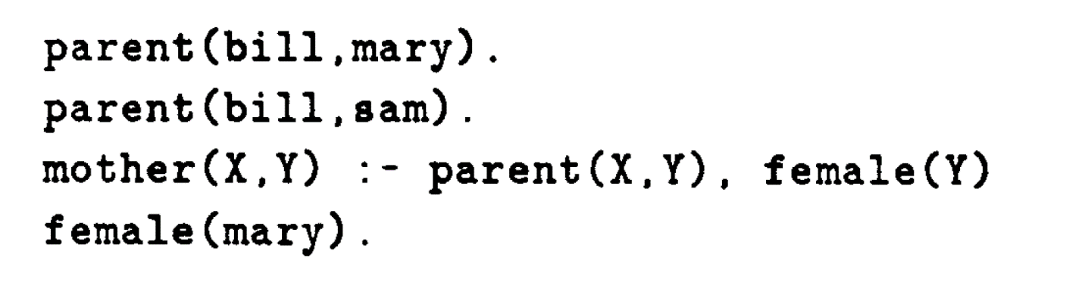
Many Other Representations
Limited Forms of FOL
Relational Databases:
  And the hope is that you can address questions such as:
  Many other representations were developed, some along with inference systems.
    Logic Programs (Prolog): a collection of Horn sentences
    For example:
    Now I can infer who is the Mother of Bill (if I execute the program)

Slide 15
Relational Models
Knowledge:
  0.7 Actor(a) ⇒ ￢Director(a)
  1.2 Director(a) ⇒ ￢WorkedFor(a,b)
  1.4 InMovie(m,a) ∧ WorkedFor(a,b) ⇒ InMovie(m,b)
Input:
  Actor(Brando), Actor(Cruise), Director(Coppola),
  WorkedFor(Brando, Coppola), etc.
Query:
  is (InMovie(GodFather, Brando)) ?
  is (what is the probability that: Pr(InMovie(GodFather, Brando)) = ?
Abductive version:
  What is the most likely table for InMovie?

Slide 16
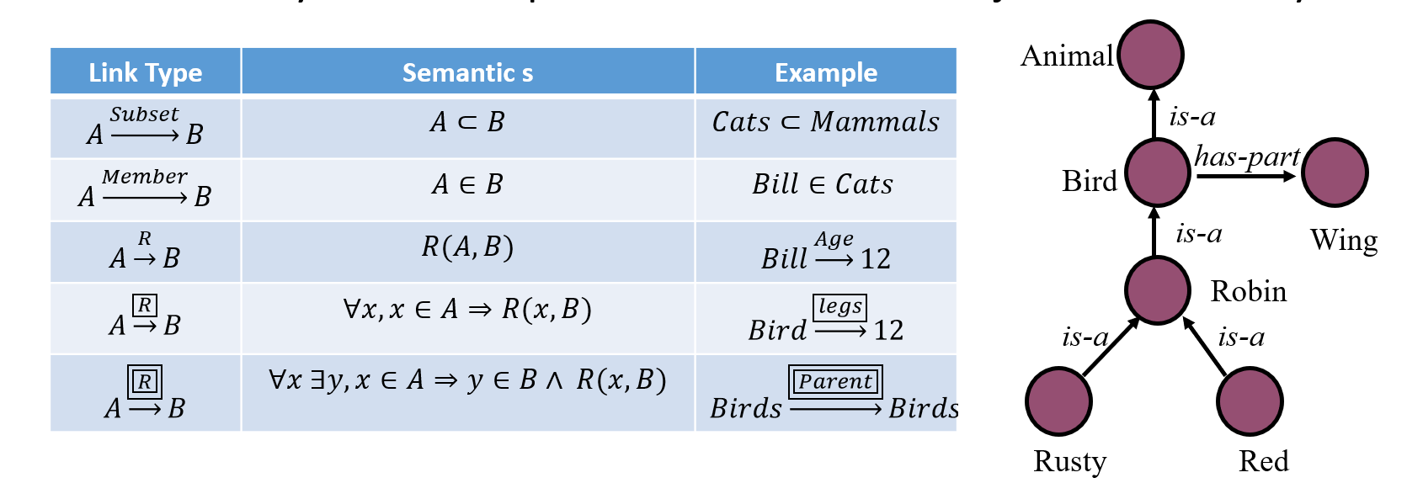
Semantic Networks
Semantic Networks: allows the use of more expressive predicates, and more “intuitive inference”.
  People talked about inference as a form of “spreading activation”
    A graph of labeled nodes and labeled, directed arcs
    Arcs define relationships that hold between objects denoted by the nodes.

Slide 17
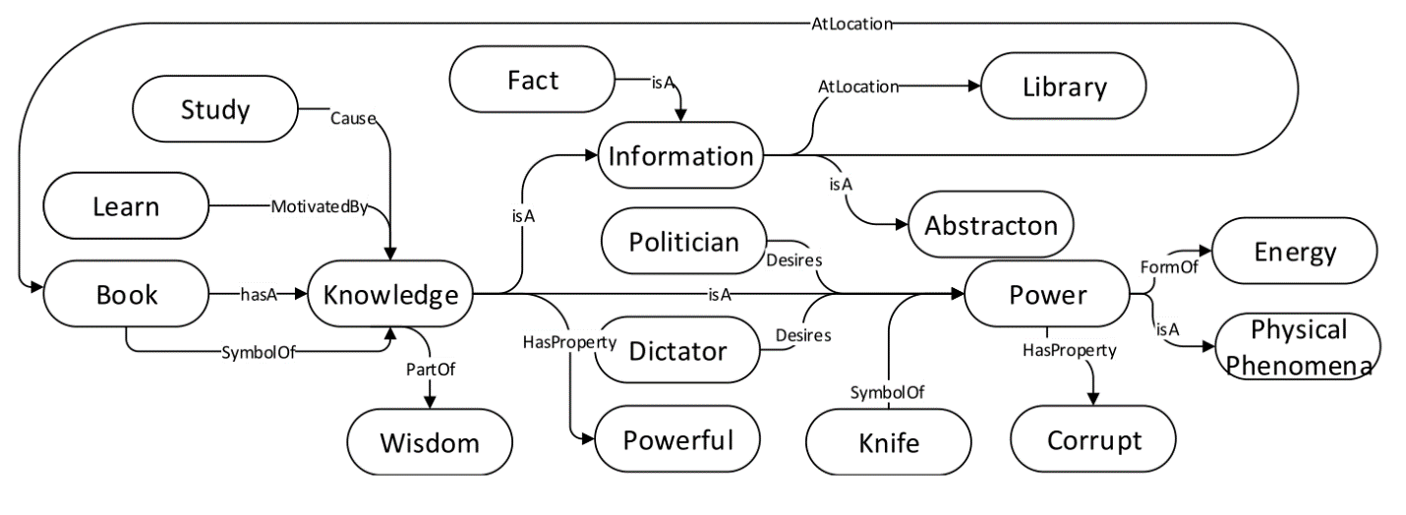
More Networks
This led to two directions:
(1) Concept nets:
  Based on Open Mind Common Sense (OMCS)
  Intended to serve as a large commonsense knowledge base
  Built on contributions of many people across the Web.

Slide 18
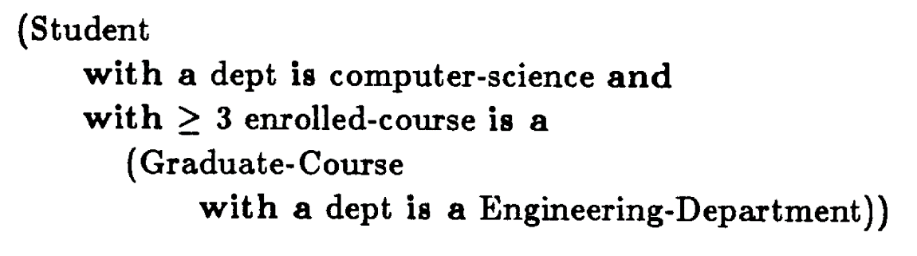
More Networks
(2) Formalization efforts:
  These networks were formalized in terms of Description Logics, and then elaborated into Frame Description Forms.
  Frames were used to describe types and their attributes: values, Restrictions, attached procedures (how an attribute should be used).
  Eventually, this led to theories of Frames (Minsky), and Scripts (Schank)
    There are beginning to be influential again, where people think more about Events

Slide 19
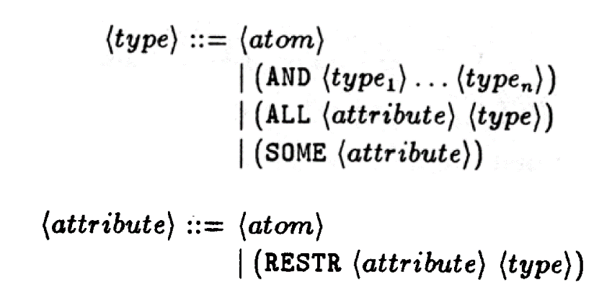
More Networks
More generally, these languages had expressive grammars:
  Example: The set of all people the all their male friends are doctors with some specialty.
And it came with inference algorithms – subsumption, and was extremely influential – all systems built in the 80-ith and later, were built on these languages.
  It was also influential in areas such as Feature Extraction for machine learning, and theories of grammar.

Slide 20
Relational Models
Knowledge:
  0.7 Actor(a) ⇒ ￢Director(a)
  1.2 Director(a) ⇒ ￢WorkedFor(a,b)
  1.4 InMovie(m,a) ∧ WorkedFor(a,b) ⇒ InMovie(m,b)
Input:
  Actor(Brando), Actor(Cruise), Director(Coppola),
  WorkedFor(Brando, Coppola), etc.
Query:
  is (InMovie(GodFather, Brando)) ?
  is (what is the probability that: Pr(InMovie(GodFather, Brando)) = ?
Abductive version:
  What is the most likely table for InMovie?

Slide 21
Probabilities
In parallel to the progress on the logical representations, people argued that we need to deal with uncertainly, and need to move to probabilistic representations.
Progress here proceeded in two camps
  (Propositional) representation of distributions
    Bayesian Networks (Pearl 1988)
  Probabilistic extensions of the FOL/Prolog representations. (Haddawy 1993)
    Problog
    Markov Logic Network
Two important comments:
  The latter direction is presented today as fusing probabilities with declarative (logical) knowledge. This, in fact, was studies much earlier (in the 60—ies), but without practical implementations.
  Fusing Probabilities with Declarative information is different from fusing Learning with Declarative Information. In fact, none of the bullets above came with a native approach for learning.
  Fusing learning with declarative knowledge came later in the context of Structured Learning, e.g., ILP Formulations, Roth & Yih 2004, and following works.

Slide 22
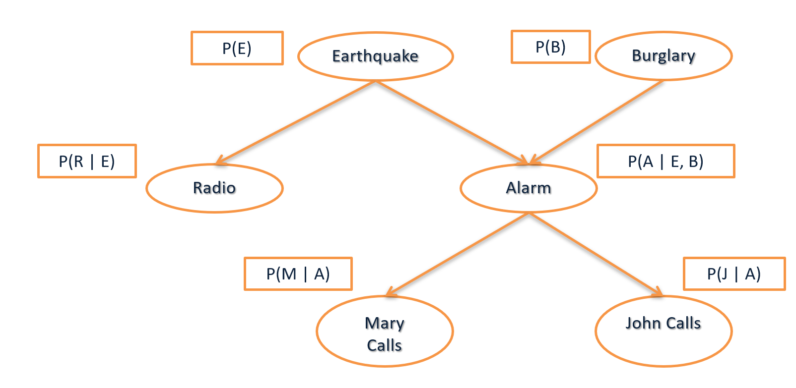
Bayes Nets
Nodes are random variables
Edges represent causal influences
Each node is associated with a conditional Probability distribution
Computational Problems (Inference):
  Computing the probability of an event:
  Given structure and parameters
  Given an observation E, what is the probability of assignment Y?
  P(R=off, A=off | E=e) =? (E, Y are sets of instantiated variables)
Most likely explanation (Maximum A Posteriori assignment, MAP, MPE)
  Given structure and parameters
  Given an observation E, what is the most likely assignment to Y?
  Argmax_{y} P(Y=y | E=e) (Say, Y = (R, A))
  (E, Y are sets of instantiated variables)

Slide 23
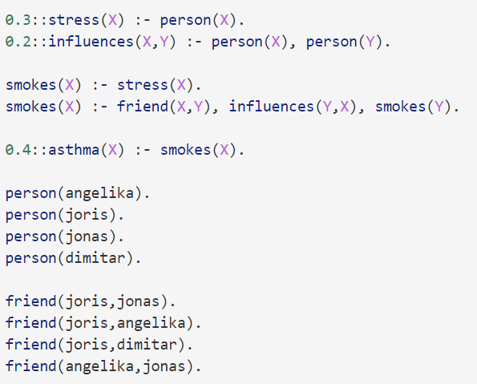
Probabilistic Relational Representations
Representation of distributions over relations, as opposed to propositional variables.
Ability to build programs that do not only encode complex interactions between variables but also express inherent uncertainty.
Inference: Becoming much harder. For the most part, done by propositionalizing relational representations (that is, substitution of all domain variables, and blowing up the representations to get a propositional BN).
But, there are other ways, e.g., lifted inference.

