Slide 1
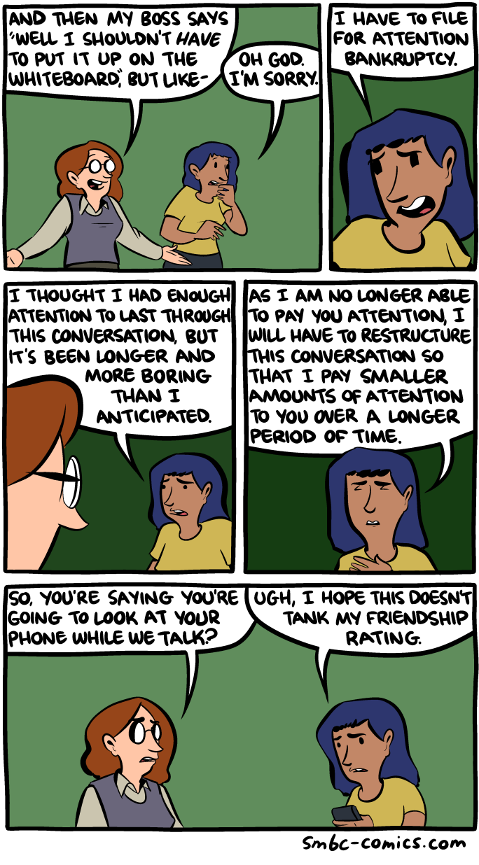
Notes:
https://www.smbc-comics.com/comic/attention-bankruptcy

Slide 2
NLP in a nutshell.
WHAT DO WE WANT?
Natural language processing!
WHEN DO WE WANT IT?
Sorry, when do we want what?
Notes:
Ambiguous antecedents

Slide 3
CIS 700-004: Lecture 10M
Attention
03/18/19
Notes:
Done

Slide 4
Today's Agenda
Review of NLP, RNNs, LSTMs
Motivating attention
Intuition for attention
The attention model
Self-attention
Attention implementations

Slide 5
Review of NLP

Slide 6
Review: word embeddings
True / False: Word2Vec embeddings crash if given an unknown word.
True / False: Word2Vec embeddings lemmatize (sing, sang are the same vector)
True / False: Word2Vec embeddings can handle homonyms (mouse the animal and mouse the cursor device).
True / False: Word2Vec embeddings can handle context-dependent meaning.

Slide 7
Review: word embeddings
True / False: Word2Vec embeddings crash if given an unknown word.
True / False: Word2Vec embeddings lemmatize (sing, sang are the same vector)
True / False: Word2Vec embeddings can intelligently handle homonyms (mouse the animal and mouse the cursor device).
True / False: Word2Vec embeddings can handle context-dependent meaning.

Slide 8
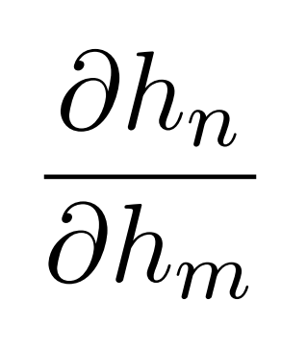
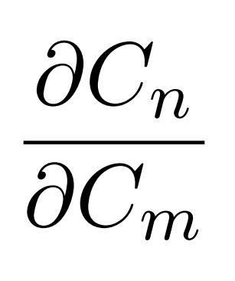
Review: vanishing gradients
Compute the following gradient for an RNN.
Compute the following gradient for an LSTM.

Slide 9
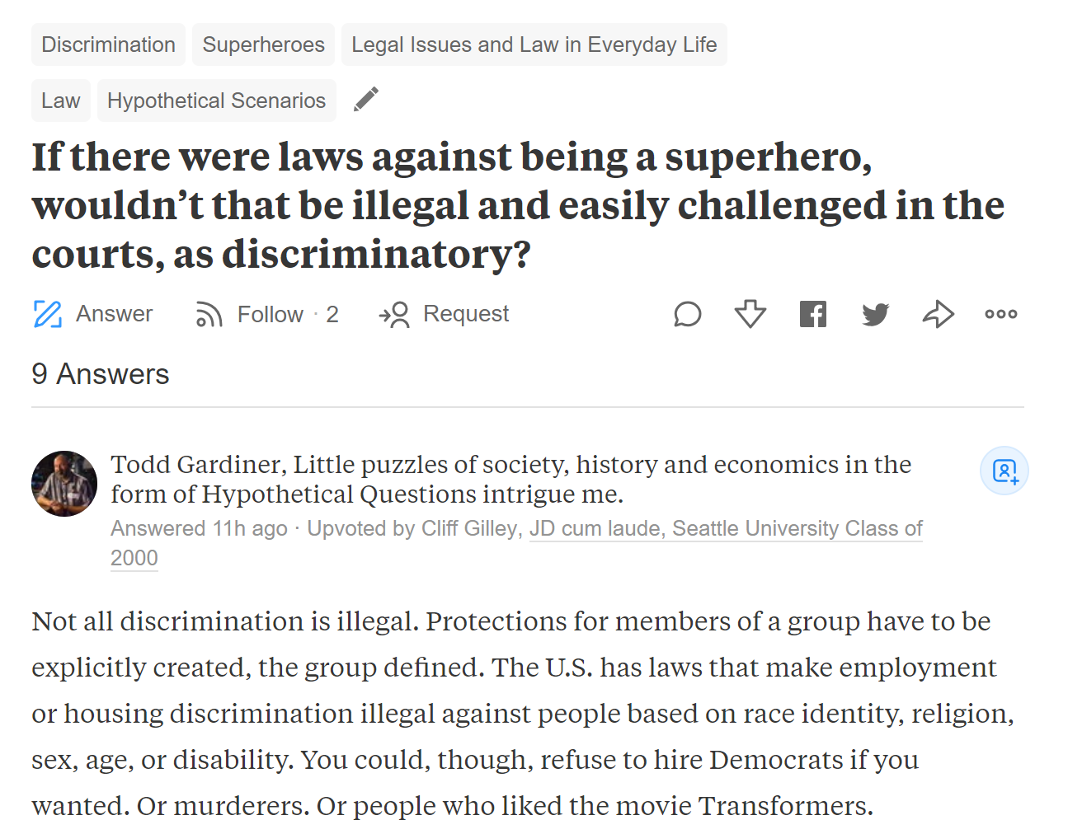
Problem context: Quora questions

Slide 10
Review: NLP exercise #1
For a question q, we have:
x := a variable-length list of topics
y:= a indicator r.v. for whether the question is related to ML
We want to train a supervised model on (x,y). What model do we select?

Slide 11
Review: NLP exercise #1
For a question q, we have:
x := a variable-length list of topics
y:= a indicator r.v. for whether the question is related to ML
We want to train a supervised model on (x,y). What model do we select?
Given a vocab of m topics, we could create m-dimensional features with bagging, then train any classification model (logistic regression, random forest, MLP, etc.)
Or we could just use an LSTM.

Slide 12
Review: NLP exercise #2
For a question q, we have:
x := a variable-length pair of tuples: (topic, probability of relevance)
Each question is required to have at least 3 topics.
y:= a indicator r.v. for whether the question is related to ML
We want to train a supervised model on (x,y). What model do we select?

Slide 13
Review: NLP exercise #2
For a question q, we have:
x := a variable-length pair of tuples: (topic, probability of relevance)
Each question is required to have at least 3 topics.
y:= a indicator r.v. for whether the question is related to ML
We want to train a supervised model on (x,y). What model do we select?
We could reuse the bagging approach and substitute the count for a probability.
We could sort by probability of relevance and pass the 3 most relevant features.
Or we could just use an LSTM.

Slide 14
Review: NLP exercise #3
For a question q, we have:
x := a variable-length text of the question
y:= a indicator r.v. for whether the question is related to ML
We want to train a supervised model on (x,y). What model do we select?

Slide 15
Review: NLP exercise #3
How might I determine whether the best model in this instance is Support Vector Machines? I feel that there are a number of viable options, and I am confused as to how this model differs from other approaches in performance.
Notes:
Humans read at 200 wpm. This is 3 words per second.

Slide 16
Review: NLP exercise #3
For a question q, we have:
x := a variable-length text of the question
y:= a indicator r.v. for whether the question is related to ML
We want to train a supervised model on (x,y). What model do we select?
We could manually try an n-gram model, which would be painful.
We could use a 1-dimensional CNN.
Or we could just use an LSTM.

Slide 17
Review: NLP exercise #4
For a question q, we have:
x := a variable-length answer to a question
y:= a indicator r.v. for whether the question satisfies BNBR (be nice, be respectful)
We want to train a supervised model on (x,y). What model do we select?
Notes:
"You are a bad person with not much value." "You are about as smart as a dog."

Slide 18
Review: NLP exercise #4
For a question q, we have:
x := a variable-length answer to a question
y:= a indicator r.v. for whether the question satisfies BNBR (be nice, be respectful)
We want to train a supervised model on (x,y). What model do we select?

Slide 19
Review: NLP exercise #4
I'm pretty sure that none of these examples will get picked up by an n-gram model.
"You are a bad person with not much value."
"You are about as smart as a dog."
"More of your conversation would infect my brain."
"Your brain is as dry as the remainder biscuit after voyage."
"I do desire that we may be better strangers."
"Poisonous bunch-backed toad!"

Slide 20
Review: NLP exercise #4
For a question q, we have:
x := a variable-length answer to a question
y:= a indicator r.v. for whether the question satisfies BNBR (be nice, be respectful)
We want to train a supervised model on (x,y). What model do we select?
We could just use an LSTM.

Slide 21
Review: NLP exercise #5
How do we translate from a variable-length sequence of length m to a variable length-sequence of length n?

Slide 22
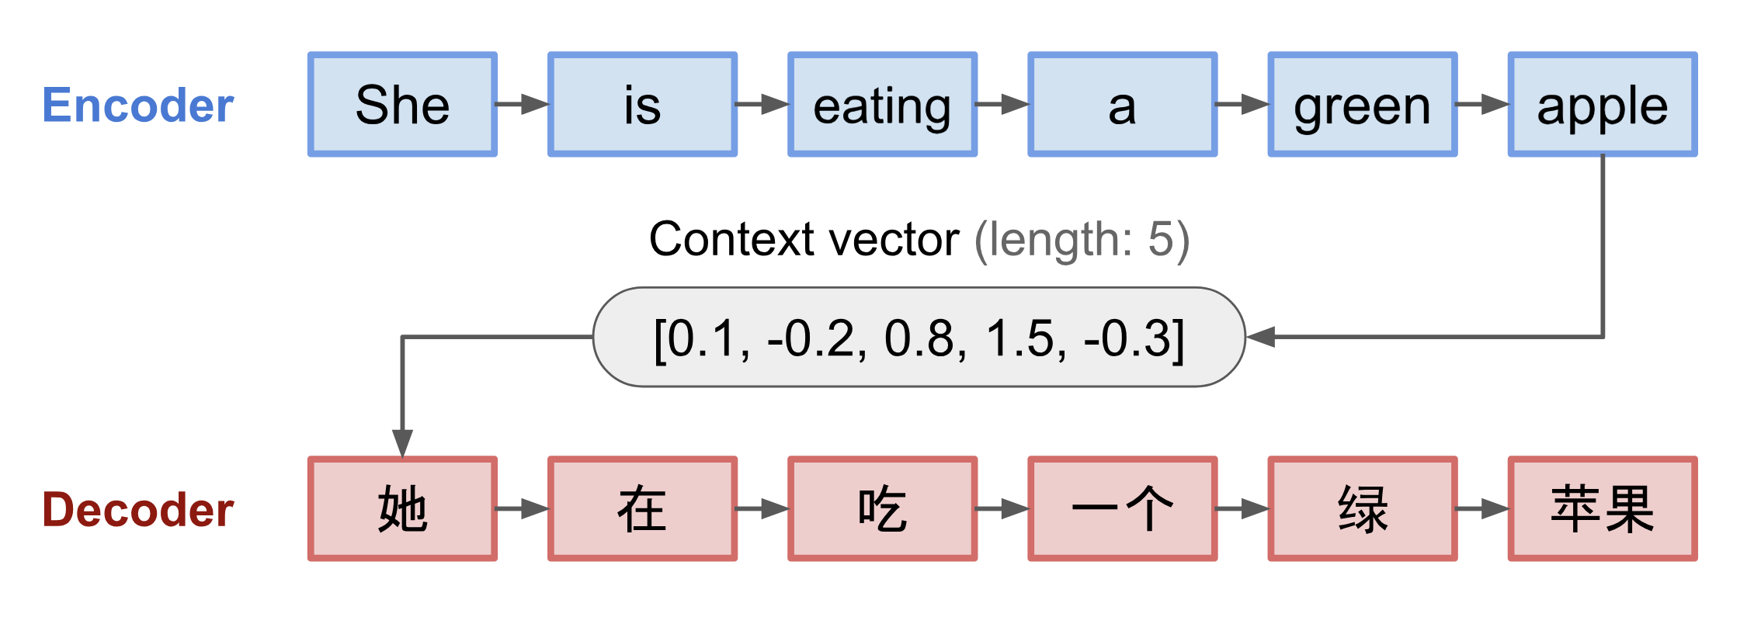
Review: NLP exercise #5
How do we translate from a variable-length sequence of length m to a variable length-sequence of length n?

Slide 23
Ilya Sutskever
PhD under Geoffrey Hinton
Postdoc under Andrew Ng
Co-inventor of AlexNet
Inventor of seq2seq learning
Co-inventor of AlphaGo and Tensorflow
Chief scientist at OpenAI

Slide 24
LSTMs are pretty flexible. Can we do better?

Slide 25
NLP basis of attention

Slide 26
RNNs have a bad implicit prior.
…
…
Notes:
https://medium.com/explore-artificial-intelligence/an-introduction-to-recurrent-neural-networks-72c97bf0912

Slide 27
The weight sharing from temporal invariance is good.
…
…
Notes:
https://medium.com/explore-artificial-intelligence/an-introduction-to-recurrent-neural-networks-72c97bf0912

Slide 28
But the flow on the right is drawn in sequence. Bad!
…
…
Notes:
https://medium.com/explore-artificial-intelligence/an-introduction-to-recurrent-neural-networks-72c97bf0912

Slide 29
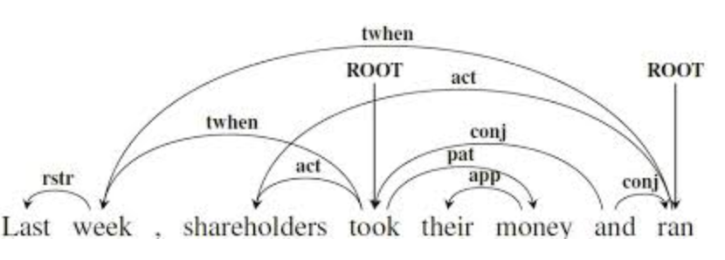
Natural language is not entirely linear.

Slide 30
Natural language is not entirely linear.
An LSTM will always process sequentially.
A biLSTM will always process in sequence and in reverse sequence.

Slide 31
Natural language is long.
“My very photogenic mother died in a freak accident (picnic, lightning) when I was three, and, save for a pocket of warmth in the darkest past, nothing of her subsists within the hollows and dells of memory, over which, if you can still stand my style (I am writing under observation), the sun of my infancy had set: surely, you all know those redolent remnants of day suspended, with the midges, about some hedge in bloom or suddenly entered and traversed by the rambler, at the bottom of a hill, in the summer dusk; a furry warmth, golden midges.”

Slide 32
Natural language is long. We don't process entire sequences.
“My very photogenic mother died in a freak accident (picnic, lightning) when I was three, and, save for a pocket of warmth in the darkest past, nothing of her subsists within the hollows and dells of memory, over which, if you can still stand my style (I am writing under observation), the sun of my infancy had set: surely, you all know those redolent remnants of day suspended, with the midges, about some hedge in bloom or suddenly entered and traversed by the rambler, at the bottom of a hill, in the summer dusk; a furry warmth, golden midges.”

Slide 33
Natural language is long. We don't process entire sequences.
“My very photogenic mother died in a freak accident (picnic, lightning) when I was three, and, save for a pocket of warmth in the darkest past, nothing of her subsists within the hollows and dells of memory, over which, if you can still stand my style (I am writing under observation), the sun of my infancy had set: surely, you all know those redolent remnants of day suspended, with the midges, about some hedge in bloom or suddenly entered and traversed by the rambler, at the bottom of a hill, in the summer dusk; a furry warmth, golden midges.”
Vladimir Nabokov, “Lolita.” 99 words.

Slide 34
We can't parallelize a sequential forward pass!

Slide 35
Cognitive findings on attention

Slide 36
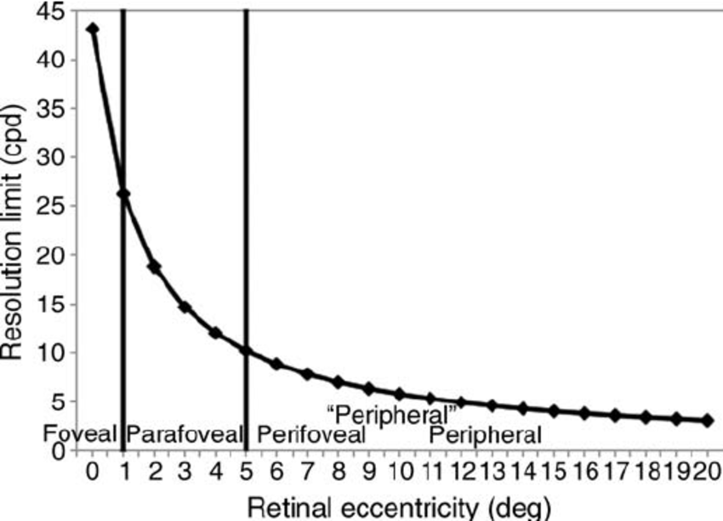
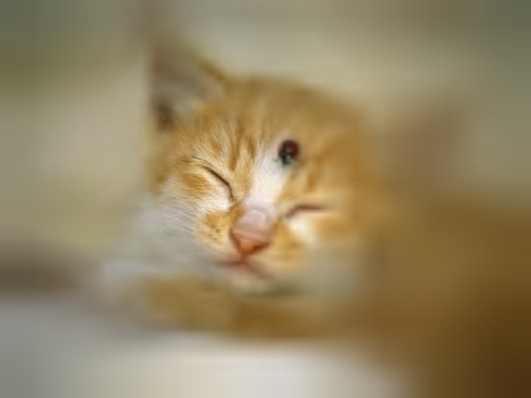
Overt attention

Slide 37
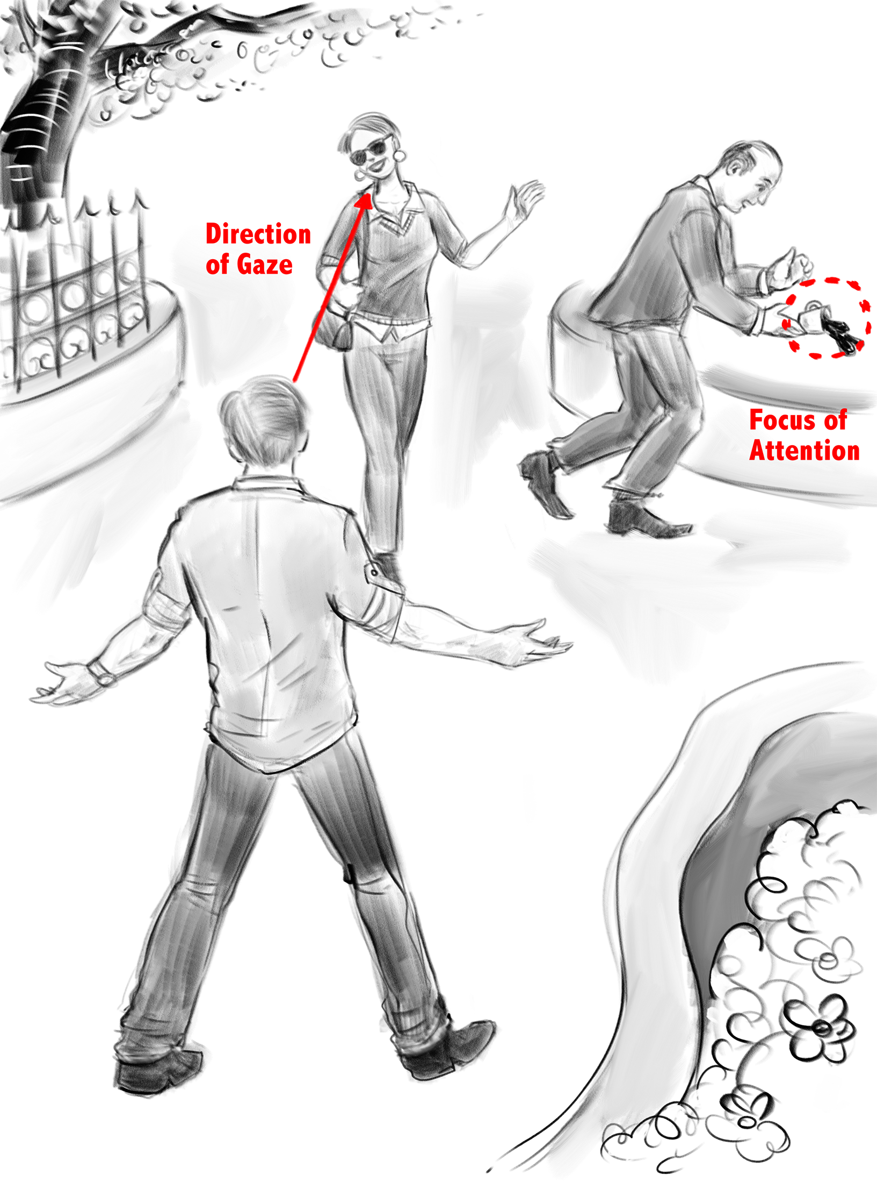
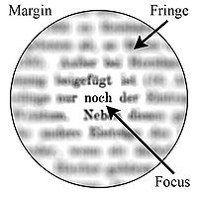
Covert attention

Slide 38
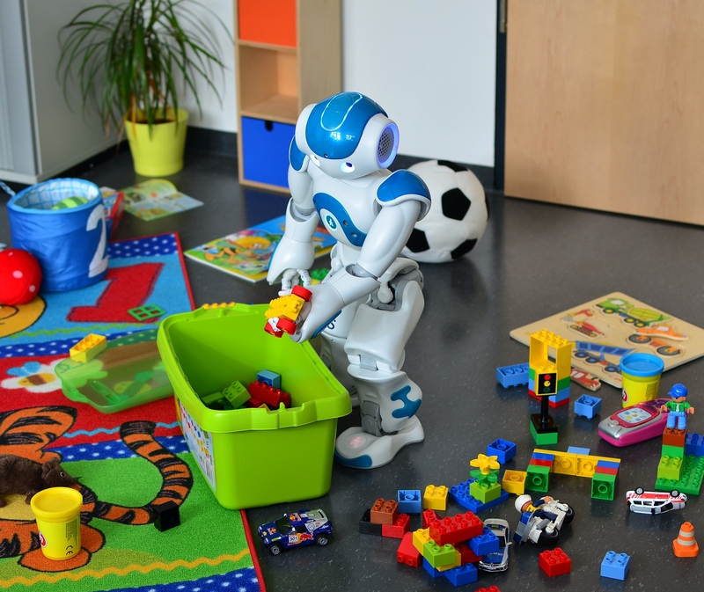
Object based attention

Slide 39
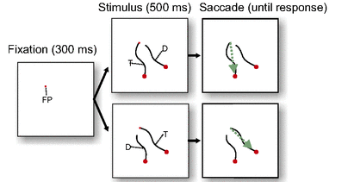
Neural object based attention
Pooresmaeili, et al 2014
Notes:
We use attention for generative NLP.

Slide 40
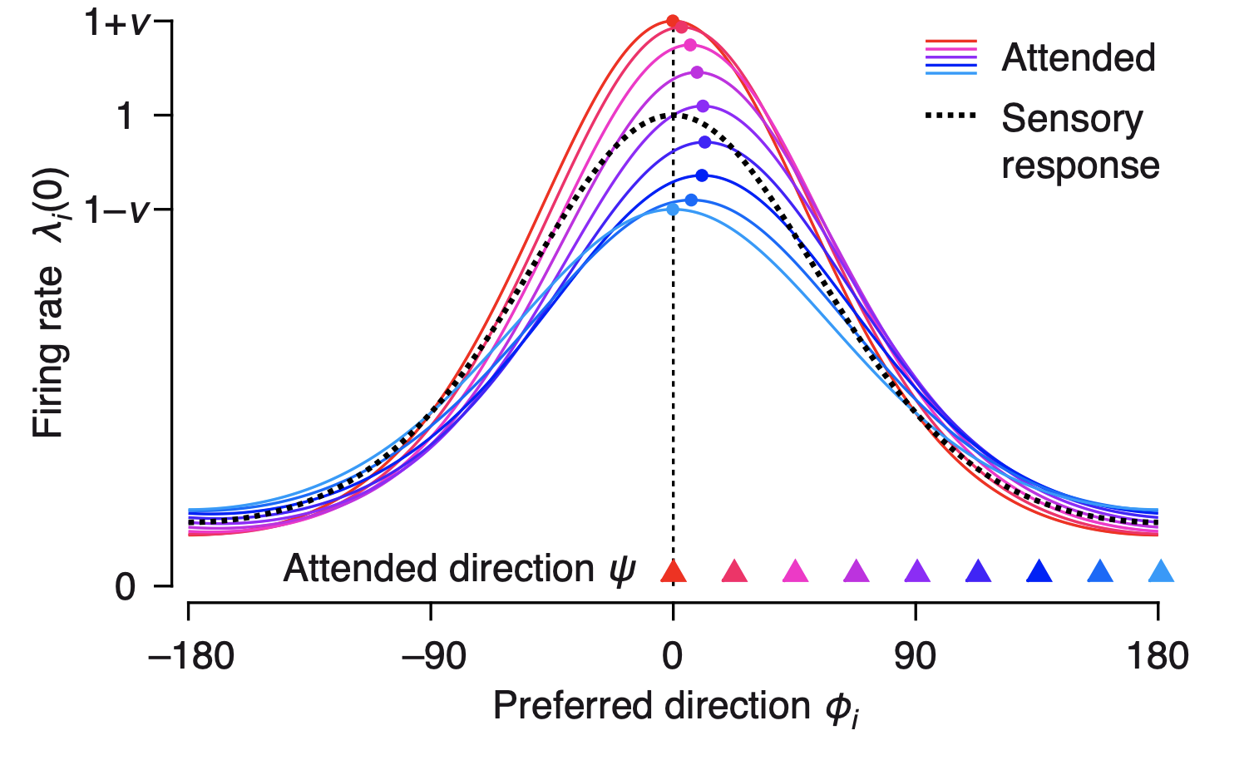
Spotlight
Eckert, et al
2015

Slide 41
Attention

Slide 42
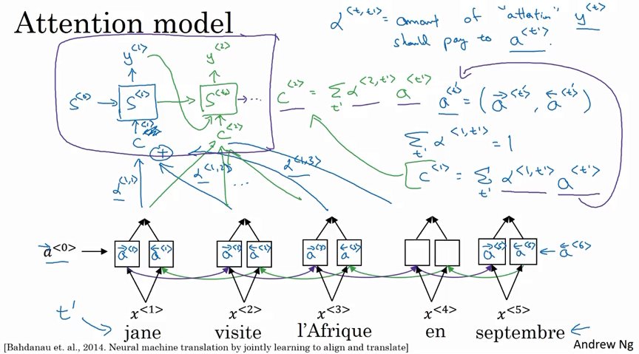

Slide 43
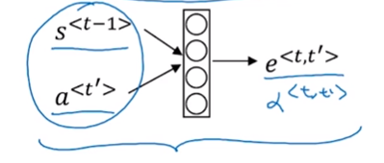
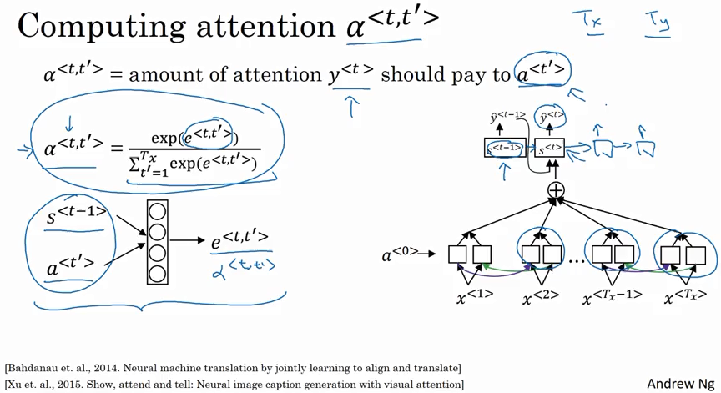

Slide 44
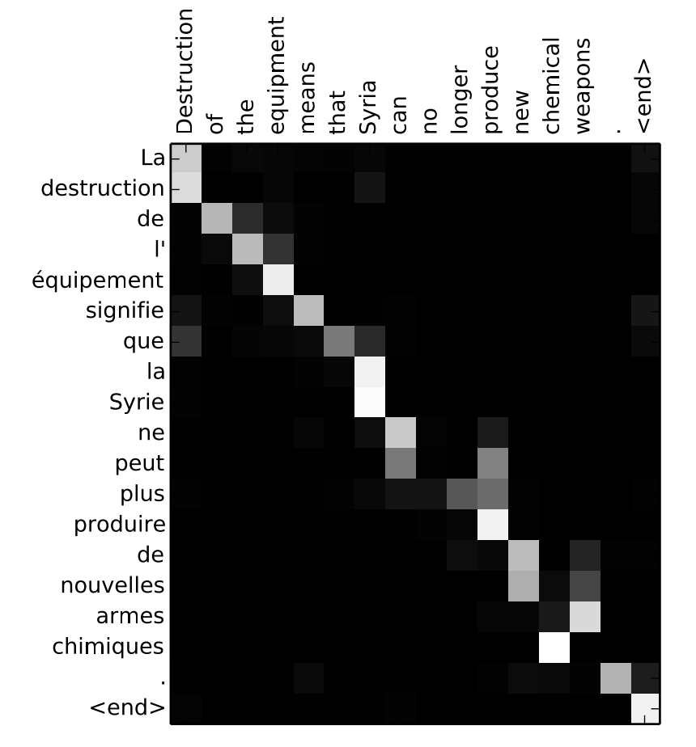
Attention is interpretable. We can see the associations.

Slide 45
PyTorch implementation of attention
https://pytorch.org/tutorials/intermediate/seq2seq_translation_tutorial.html

Slide 46
Self-attention

Slide 47
Self-attention creates attention layers mapping from a sequence to itself.

Slide 48
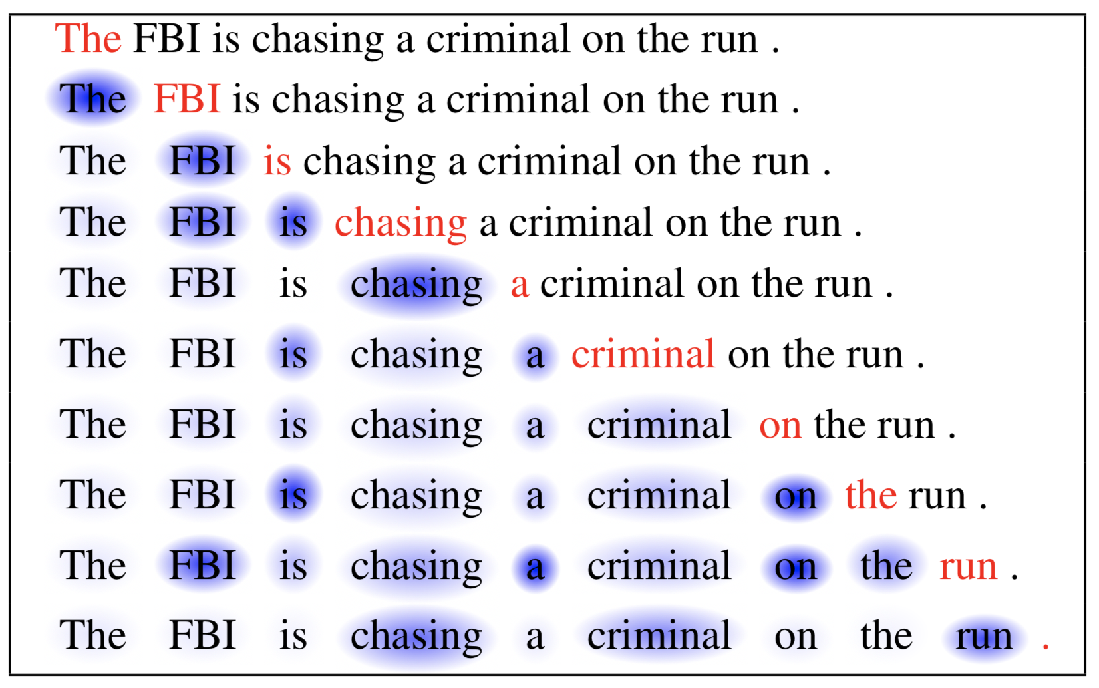
Self-attention creates attention layers mapping from a sequence to itself.

Slide 49
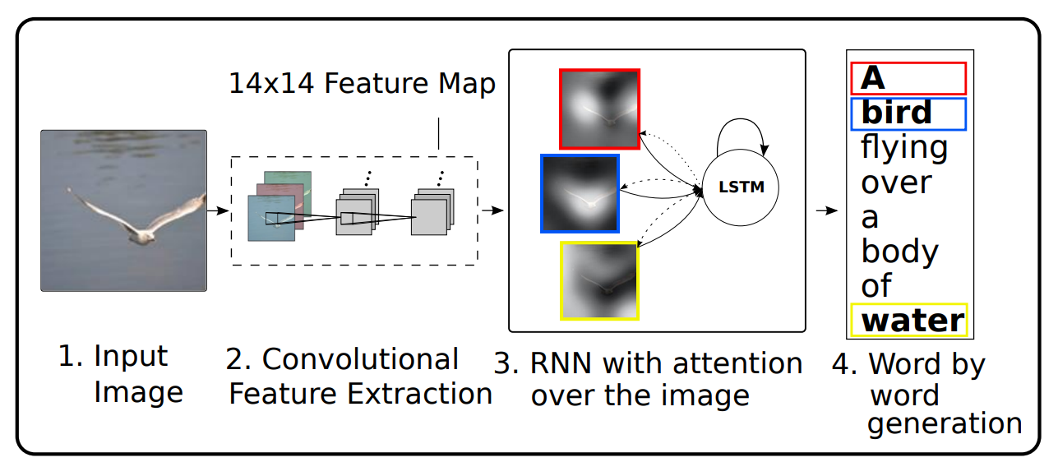
Show, attend, and tell: we need not attend over language.
Notes:
http://proceedings.mlr.press/v37/xuc15.pdf

Slide 50
Show, attend, and tell: still interpretable.
Notes:
http://proceedings.mlr.press/v37/xuc15.pdf

Slide 51
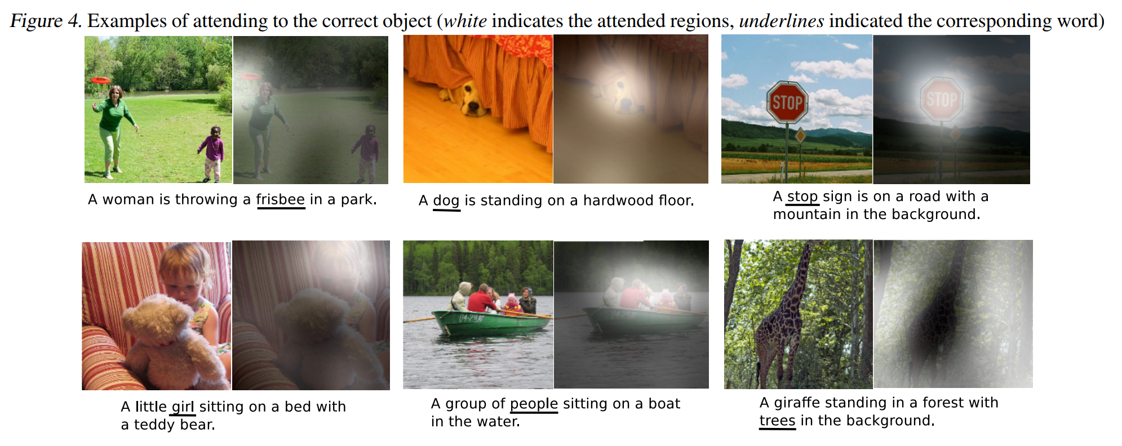
Show, attend, and tell: still interpretable.
Notes:
http://proceedings.mlr.press/v37/xuc15.pdf

Slide 52
Show, attend, and tell: still interpretable.
Notes:
http://proceedings.mlr.press/v37/xuc15.pdf

Slide 53
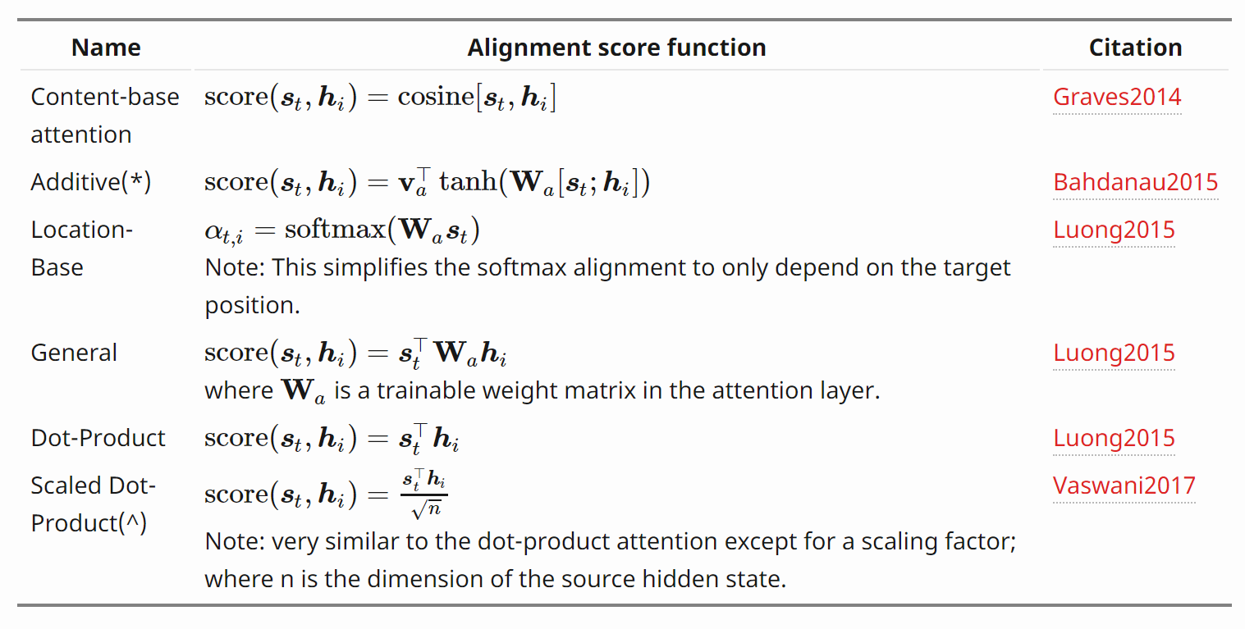
Types of attention
Notes:
https://lilianweng.github.io/lil-log/2018/06/24/attention-attention.html#whats-wrong-with-seq2seq-model

Slide 54
Looking forward
Homework #2 (CV) is coming out soon.
Project proposals are due on Friday. Come to our OH this week!
On Wednesday: transformers.

