Slide 1
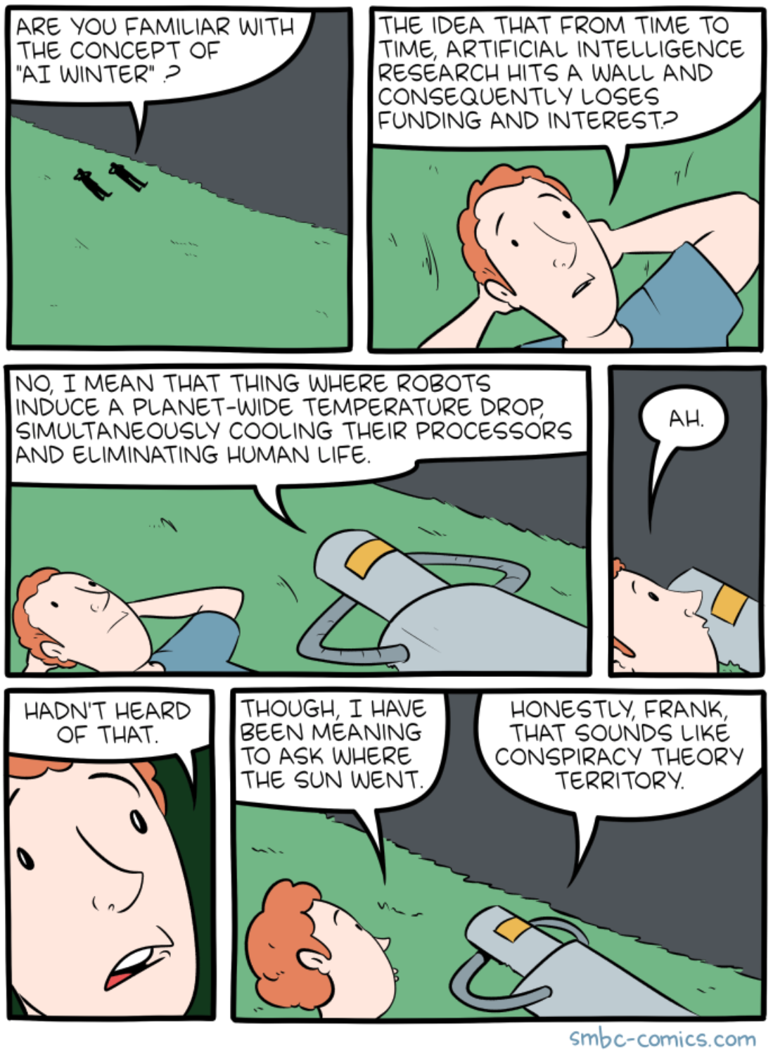

Slide 2
CIS 700-004: Lecture 2W
Introduction to PyTorch
1/16/19

Slide 3
Course Announcements
HW 0 has been released.
Please direct any questions about the course to Piazza.
Office hours have been posted on the course website.

Slide 4
Today's class is about automatic differentiation and how it works in PyTorch.

Slide 5
Why does it matter?

Slide 6
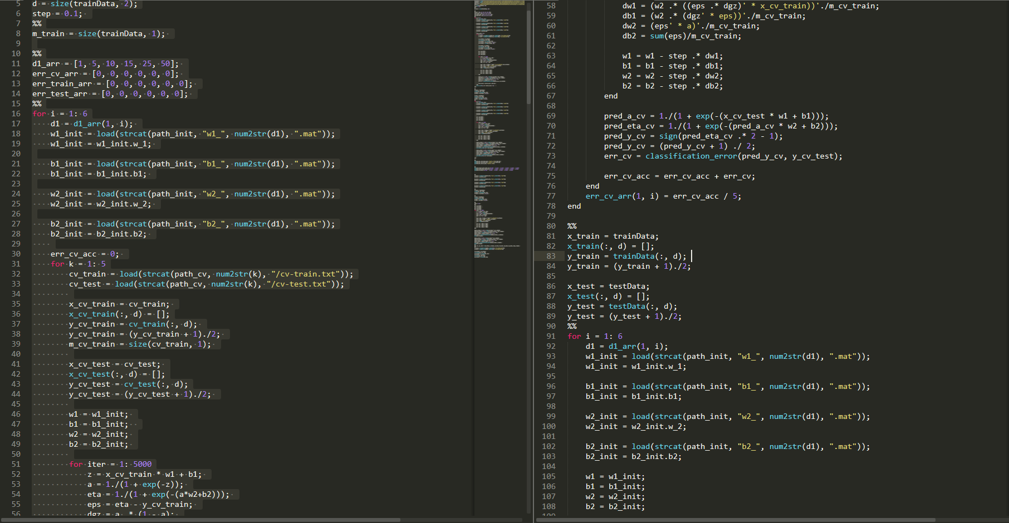
Because writing ML code from scratch sucks (part 1)

Slide 7
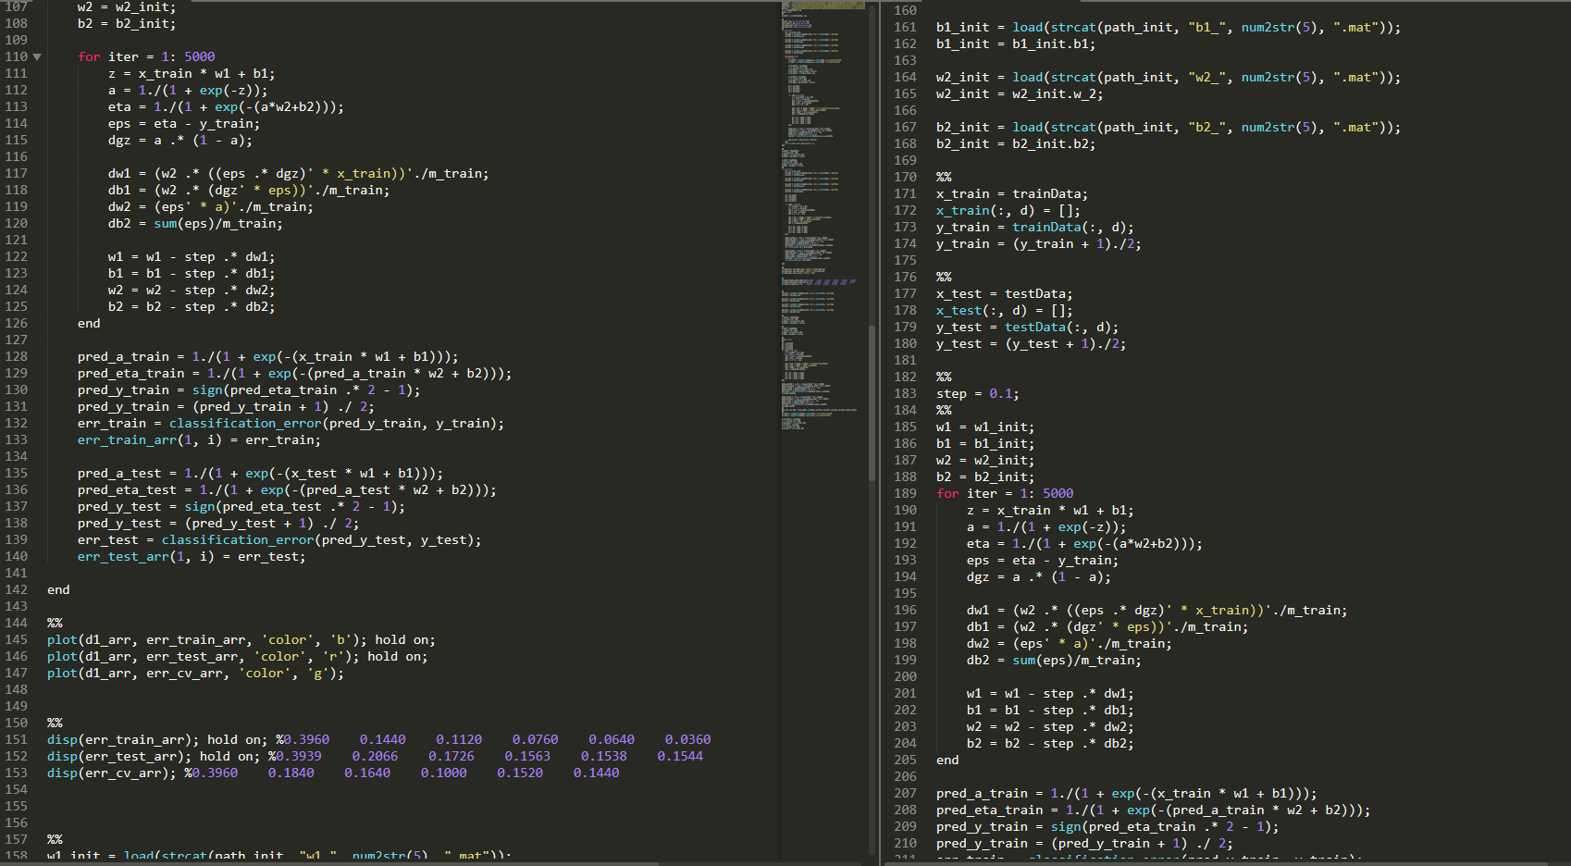
Because writing ML code from scratch sucks (part 2)

Slide 8
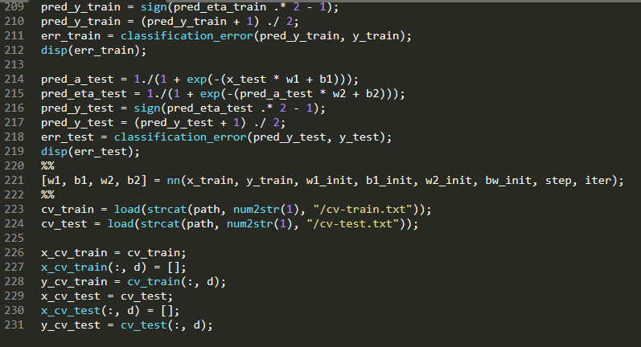
Because writing ML code from scratch sucks (part 3)

Slide 9
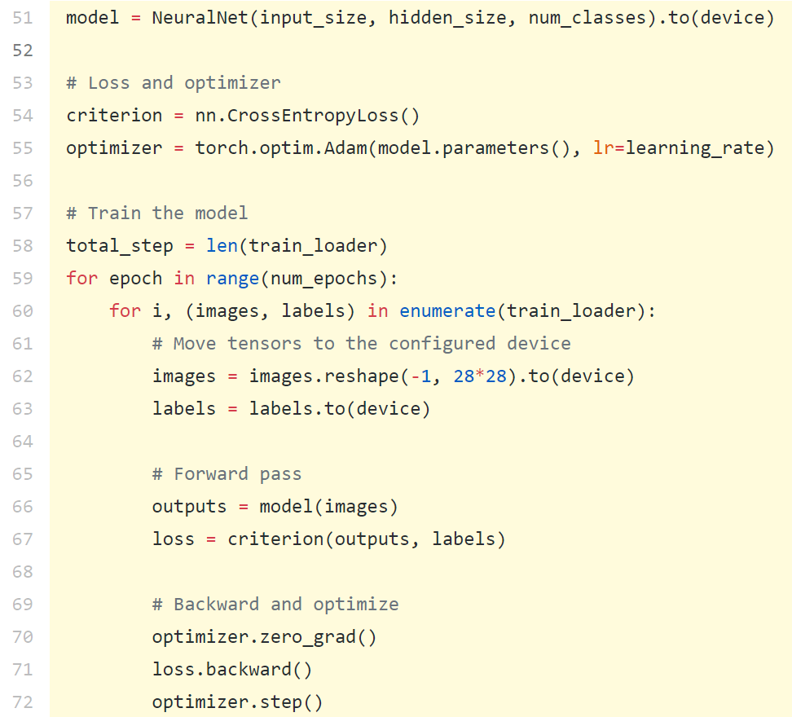
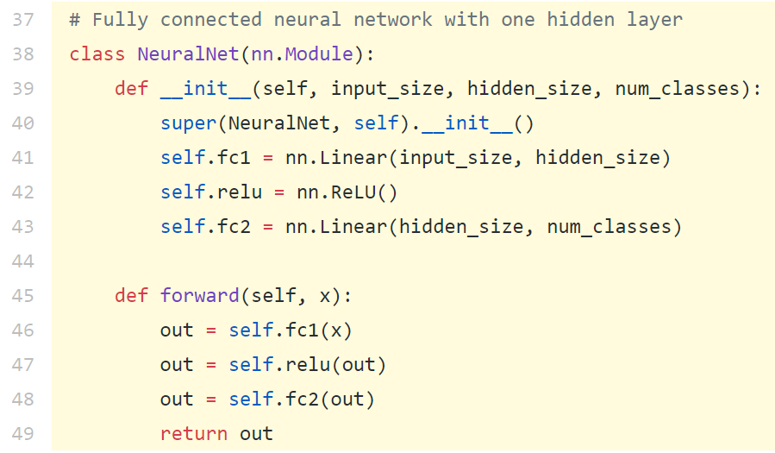
Contrast with PyTorch

Slide 10
Today's agenda
Motivating computational graphs: a gradient-storing data structure
A brief review of scientific computing
Dual algebra: math for computational graphs
Example computational graph for a neuron
Introduction to PyTorch
Tensors
Variables
Functions
Autograd and the dynamic computational graph
Example: a feedforward network in PyTorch

Slide 11
Automated Differentiation...
Is not Symbolic Differentiation!
Is not Numerical Differentiation!
Instead, it relies on a specific quirk of scientific computing to make gradient computation really easy on computers.

Slide 12
Motivating computational graphs

Slide 13
Computation for common functions

Slide 14
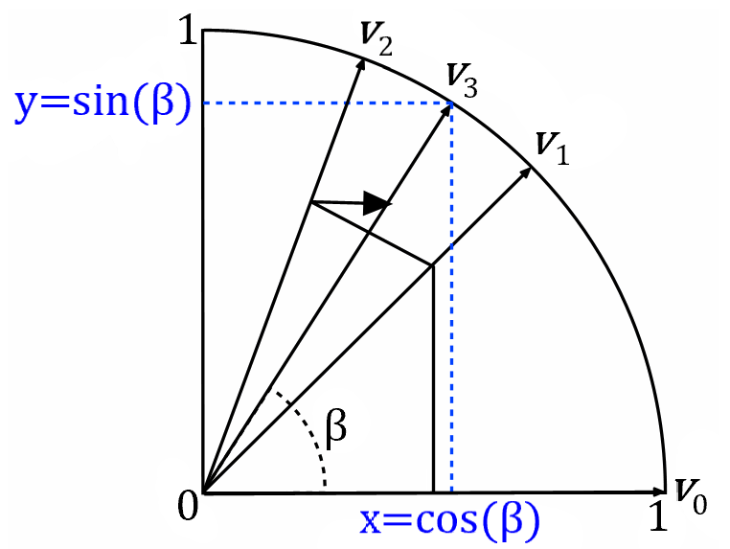
Example 1: sine, cosine, and the CORDIC algorithm

Slide 15
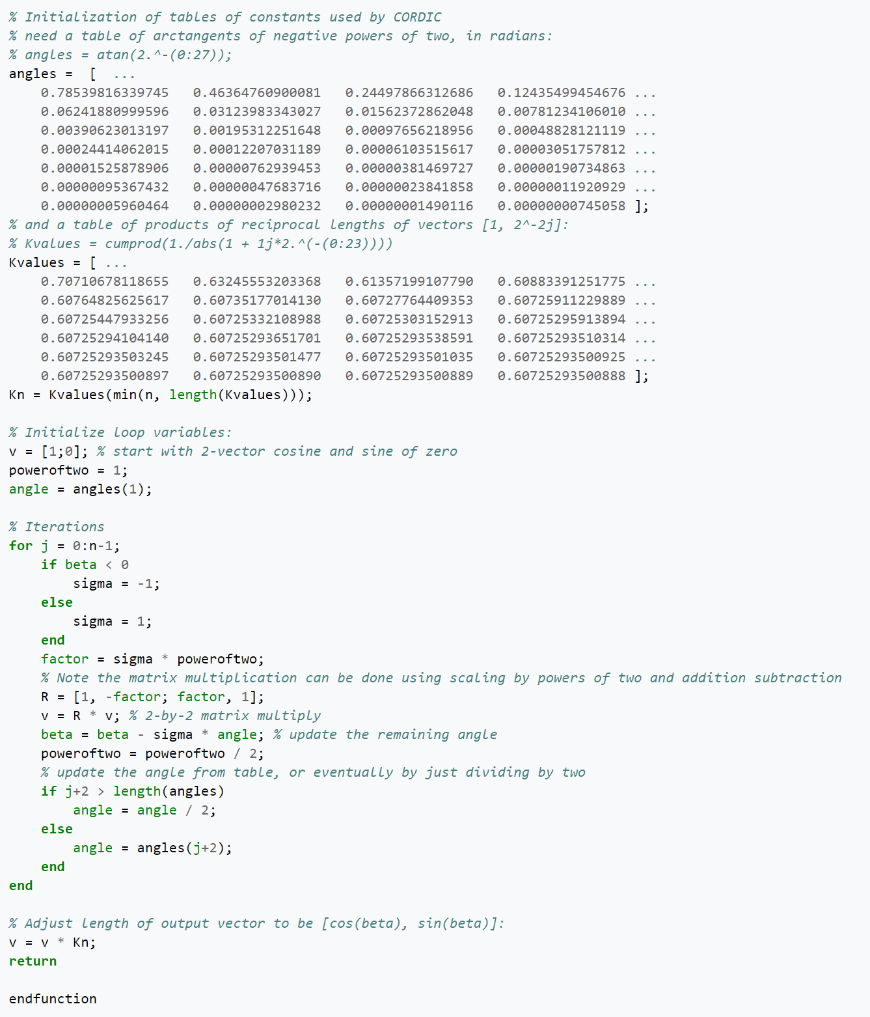
The CORDIC algorithm in all its glory

Slide 16
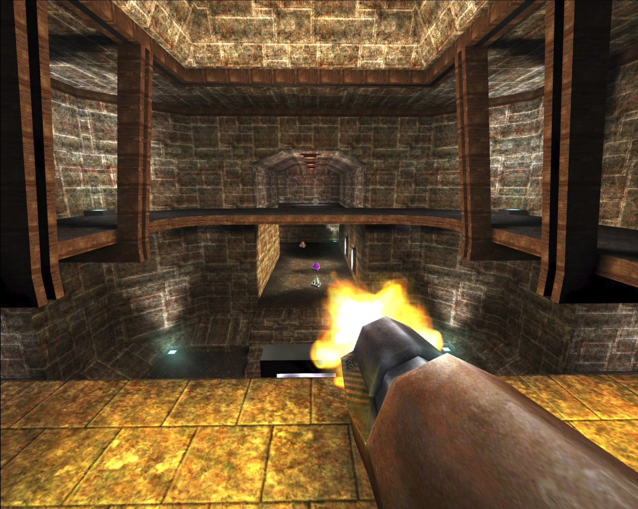
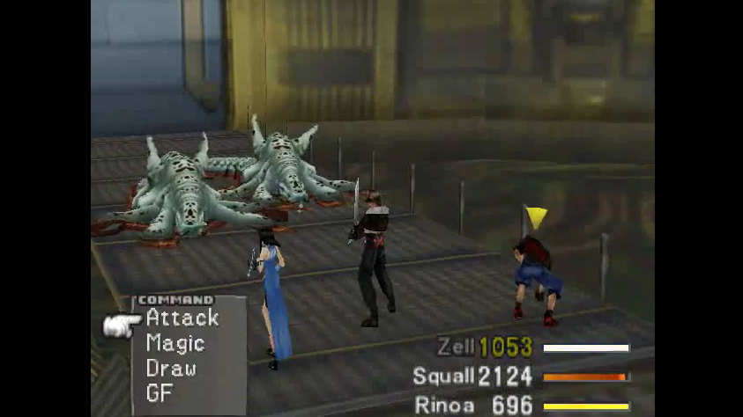
Notes:
Square roots compute distance

Slide 17
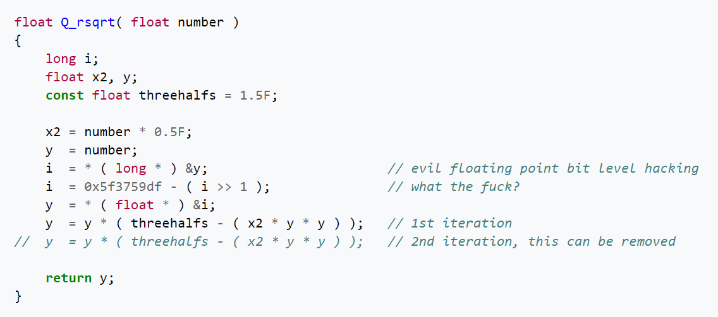
Example 2: square roots

Slide 18
Example 3: logarithms

Slide 19
Observation: every computation in a program boils down to elementary binary functions (+, -, *, /)

Slide 20
But wait, derivatives are really easy for the elementary operations!

Slide 21
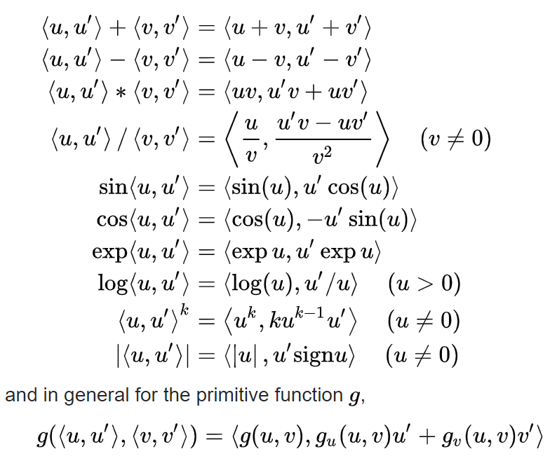
Dual spaces

Slide 22
Key insight (?) from dual algebra: we can redefine every function we've ever used and our very concept of numbers to avoid doing some elementary calculus.

Slide 23
Why computational graphs exist
For a single neuron with n inputs, we need to keep track of O(n) gradients.
For a standard 784x800x10 vanilla feedforward neural net for MNIST, we need:
784 + 800x20 + 10x20 + 3 = 16987 gradients per training example
60,000 training examples * 2405 gradients = 1 billion gradients per epoch
How do we keep track of tens of billions gradients?!
Notes:
Next time, lead with an example

Slide 24
Computational Graph
Definition: a data structure for storing gradients of variables used in computations.
Node v represents variable
Stores value
Gradient
The function that created the node
Directed edge (u,v) represents the partial derivative of u w.r.t. v
To compute the gradient dL/dv, find the unique path from L to v and multiply the edge weights.

Slide 25
A neuron in a computational graph

Slide 26
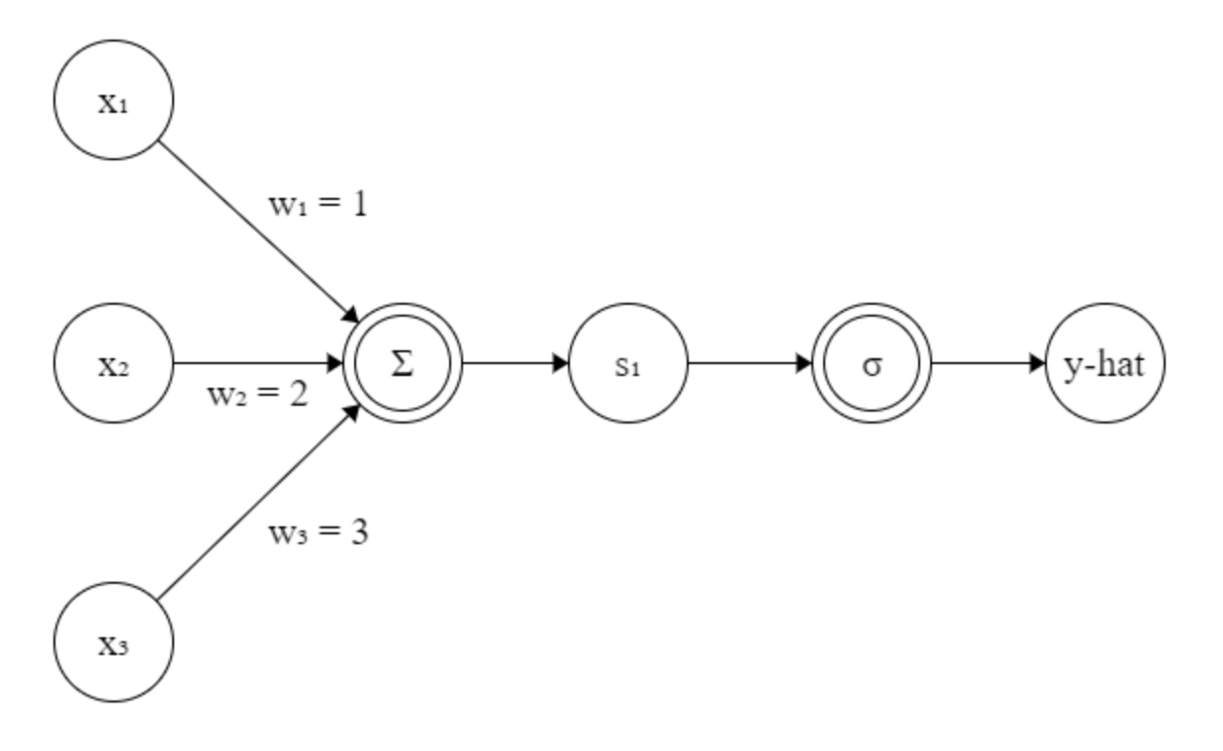
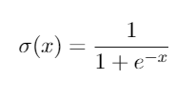
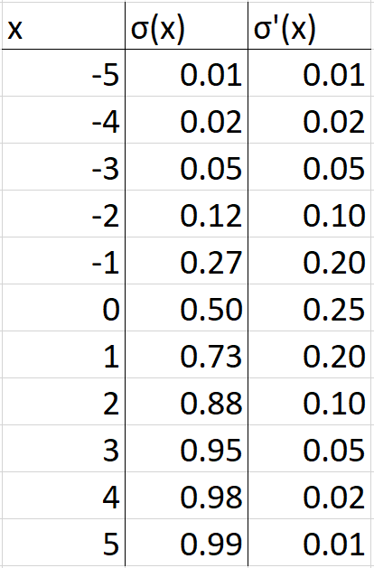
Backpropagation for neural nets
Given softmax activation, L2 loss, a point (x1, x2, x3, y) = (0. 1, 0.15, 0.2, 1), compute the gradient

Slide 27
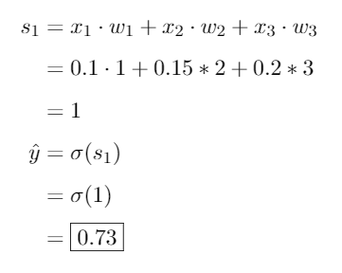
Backpropagation for neural nets: forward pass

Slide 28
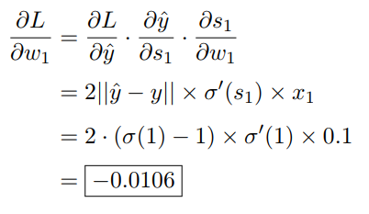
Backpropagation for neural nets: backward pass
Notes:
Second but last line on the right should say .1
Last line should say .0108

Slide 29
PyTorch

Slide 30
PyTorch
Based on Torch, a scientific computing library for Lua
Developed by FAIR
Main features are the built-in computational graph and built-in GPU acceleration

Slide 31
Structure of PyTorch library
torch
torch.Tensor
torch.autograd
torch.nn
torch.cuda
torch.optim
Merged
torch.autograd.Variable
torch.nn.Functional
torch.cuda.Tensor

Slide 32
How do we store numbers?

Slide 33
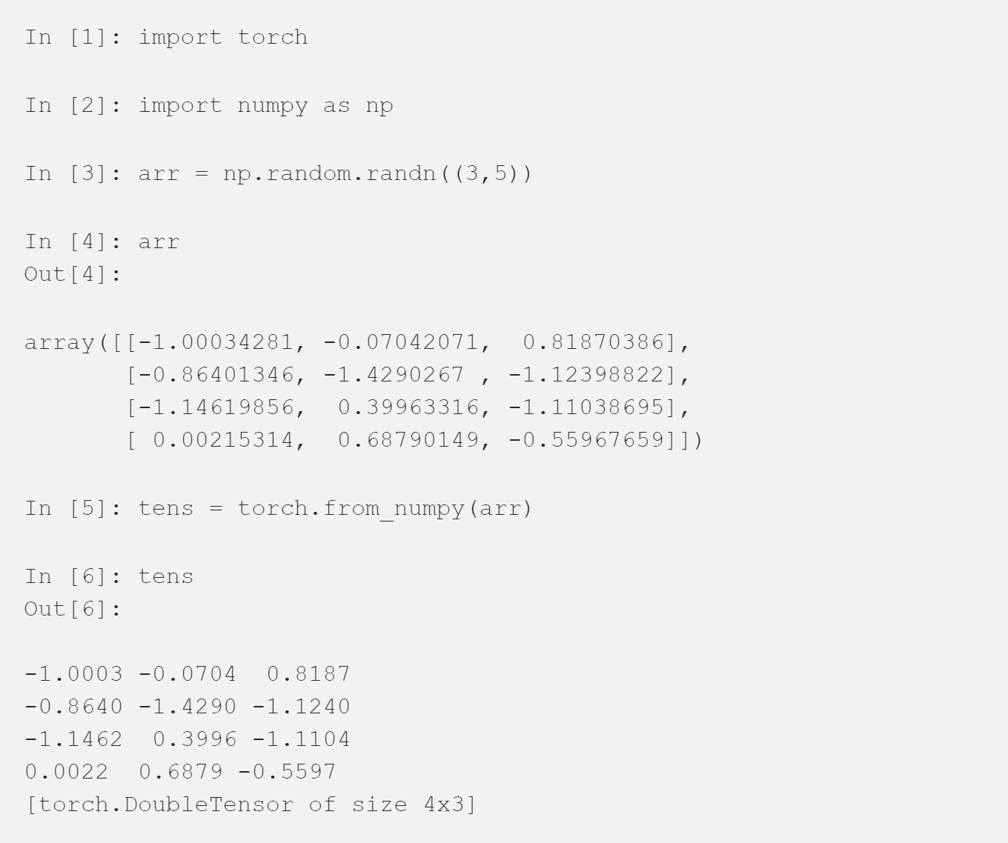
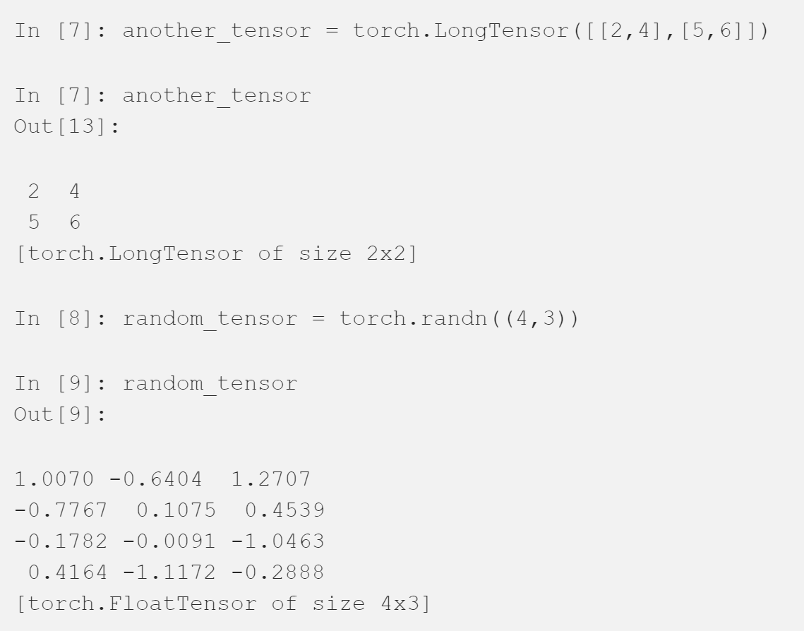
torch.Tensor

Slide 34
torch.Tensor
a = torch.rand(10, 10, 5) print a[0, :, :]
Notes:
Grabs the first cross-section along x-axis

Slide 35
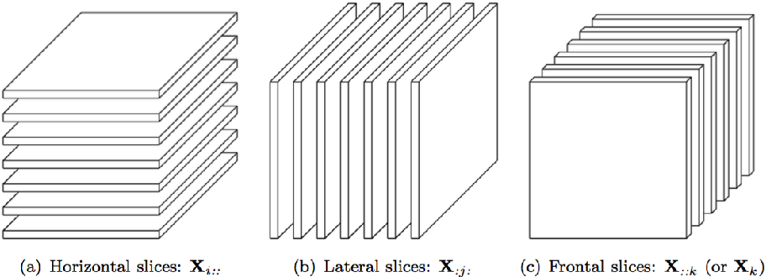
torch.Tensor
a = torch.rand(10, 10, 5) print a[0, :, :]
Notes:
Grabs the first cross-section along x-axis

Slide 36
Tensors: common manipulations
torch.cat(tensors, dim=0, out=None) → Tensor
Concatenates a list of Tensors along an existing dimension
torch.reshape(input, shape) → Tensor
Reforms the dimensions of a Tensor
torch.squeeze(input, dim=None, out=None) → Tensor
Removes a dimension from a Tensor
torch.stack(seq, dim=0, out=None) → Tensor
Concatenates a list of Tensors along a new dimension
torch.unsqueeze(input, dim, out=None) → Tensor
Creates a dimension
https://pytorch.org/docs/stable/torch.html

Slide 37
How do we store numbers? Tensors.
Given tensors, how do we track their gradients?

Slide 38
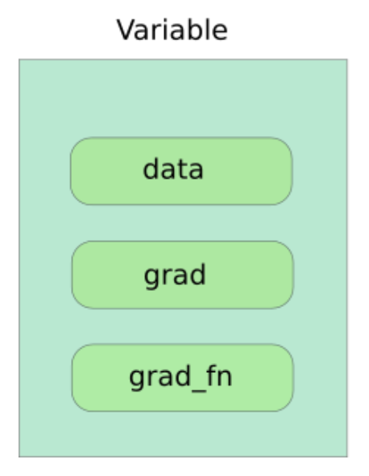
Variables
This is the class in PyTorch that corresponds to nodes in the computational graph.
Tensor
Float
Function object

Slide 39
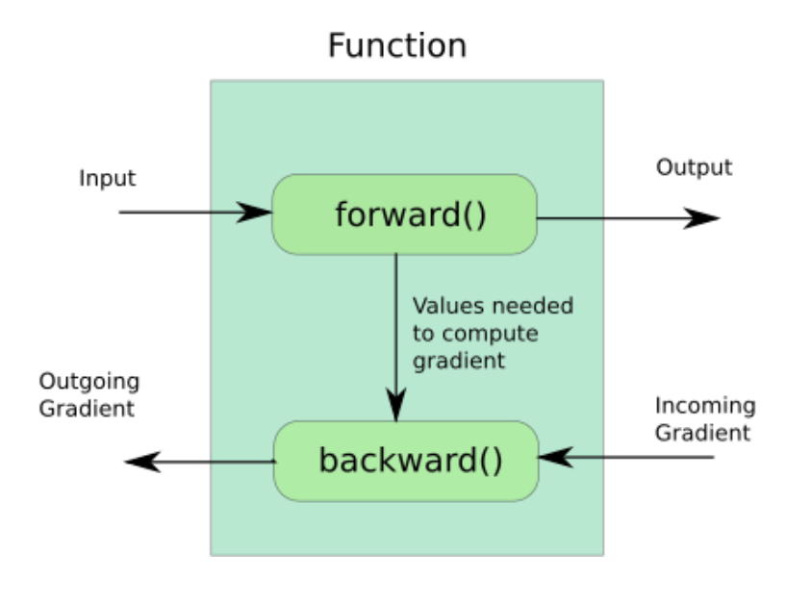
Functions

Slide 40
How do we store numbers? Tensors.
Given tensors, how do we track their gradients? Variables.
Given tensors and their gradients, how do we actually update the parameter values during training?

Slide 41
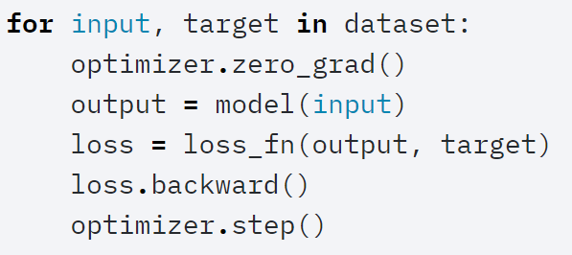
torch.nn.optim
An optimizer is constructed with a model and hyperparameters.
For each training example, the computational
E.g. optimizer = optim.SGD(model.parameters(), lr = 0.01, momentum=0.9)

Slide 42
How do we store numbers? Tensors.
Given tensors, how do we track their gradients? Variables.
Given tensors and their gradients, how do we actually update the parameter values during training? Optimizers.
How do we do all this on a GPU?

Slide 43
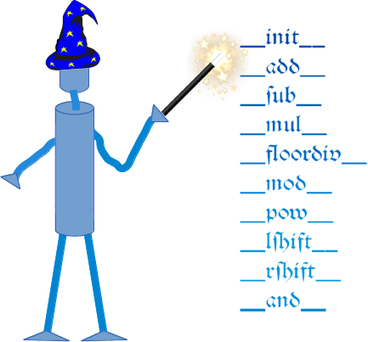
How PyTorch hides the computational graph:
Aka Pythonic syntactic sugar
Example:
PyTorch masks their special built-in addition function in the __add__ method of the class Variable.
So a+b is really:
torch.autograd.Variable.__add__(a,b)

Slide 44
CUDA integration
For a variable x, we can simply write:
x = x.cuda() # or
x = x.to(device) # if we have a previously defined device
To accelerate computations on x via GPU!
This casts x.data to an object of type torch.cuda.FloatTensor() and changes the magic methods associated with x, which are now written in Nvidia's CUDA API.

Slide 45
How do we store numbers? Tensors.
Given tensors, how do we track their gradients? Variables.
Given tensors and their gradients, how do we actually update the parameter values during training? Optimizers.
How do we do all this on a GPU? CUDA bindings.
I'm lazy, what else you got?

Slide 46
torch.nn.Functional
Many utility functions for specific architectures of neural nets.
Example utility functions for vanilla neural nets:
torch.nn.functional.linear(input, weight, bias=None)
torch.nn.functional.dropout(input, p=0.5, training=True, inplace=False)

Slide 47
torch.nn.Functional
Many utility functions for specific architectures of neural nets.
Example activation functions:
torch.nn.functional.relu_(input) → Tensor
torch.nn.functional.hardtanh_(input, min_val=-1., max_val=1.) → Tensor
torch.nn.functional.leaky_relu(input, negative_slope=0.01, inplace=False) → Tensor
torch.nn.functional.softmax(input, dim=None, _stacklevel=3, dtype=None)

Slide 48
torch.nn.Functional
Many utility functions for specific architectures of neural nets.
Example functions for CNNs:
torch.nn.functional.conv1d(input, weight, bias=None, stride=1, padding=0, dilation=1, groups=1) → Tensor
torch.nn.functional.conv_transpose2d(input, weight, bias=None, stride=1, padding=0, output_padding=0, groups=1, dilation=1) → Tensor
torch.nn.functional.max_pool2d(*args, **kwargs)

Slide 49
torch.nn.Functional
Many utility functions for specific architectures of neural nets.
Example normalization functions:
torch.nn.functional.batch_norm(input, running_mean, running_var, weight=None, bias=None, training=False, momentum=0.1, eps=1e-05)
torch.nn.functional.normalize(input, p=2, dim=1, eps=1e-12, out=None)
torch.nn.functional.instance_norm(input, running_mean=None, running_var=None, weight=None, bias=None, use_input_stats=True, momentum=0.1, eps=1e-05)

Slide 50
torch.nn.Functional
Many utility functions for specific architectures of neural nets.
Example loss functions:
torch.nn.functional.cosine_similarity(x1, x2, dim=1, eps=1e-8) → Tensor
torch.nn.functional.binary_cross_entropy(input, target, weight=None, size_average=None, reduce=None, reduction='mean')
torch.nn.functional.hinge_embedding_loss(input, target, margin=1.0, size_average=None, reduce=None, reduction='mean') → Tensor
torch.nn.functional.kl_div(input, target, size_average=None, reduce=None, reduction='mean')

Slide 51
Feedforward Network in PyTorch

Slide 52
Defining a Neural Net in PyTorch

Slide 53
Training a Neural Net in PyTorch

Slide 54
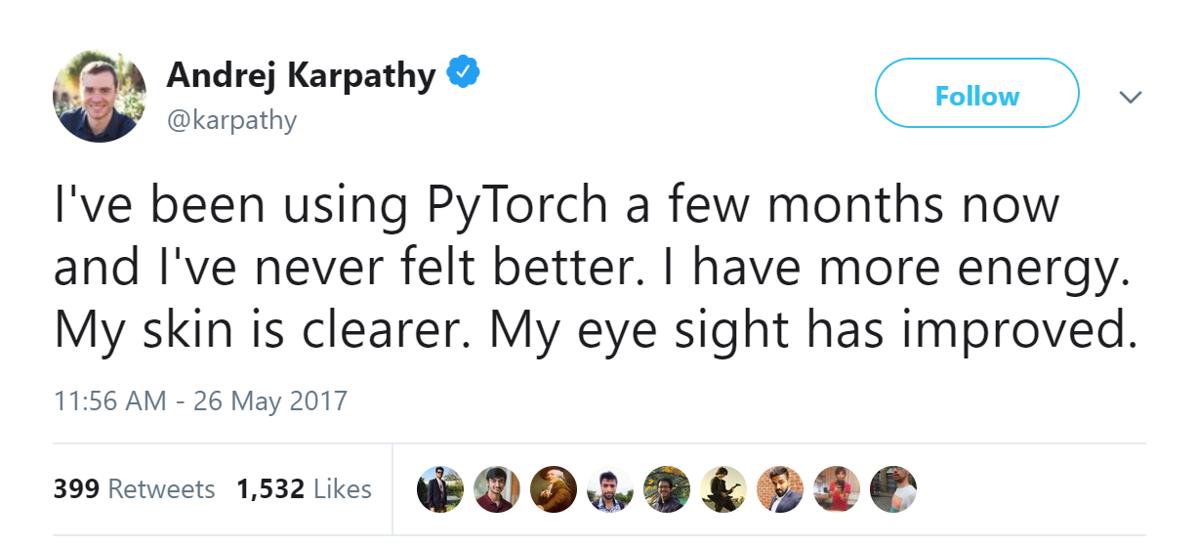

Slide 55
Looking forward
HW0 is due next Wednesday. We will have a Canvas submission portal shortly.
Office hours will begin tomorrow (Thursday). The schedule is on the website.
Next week (lectures 3M and 3W), we will begin discussing the design of neural networks and the challenges in training deep networks.

