Slide 1
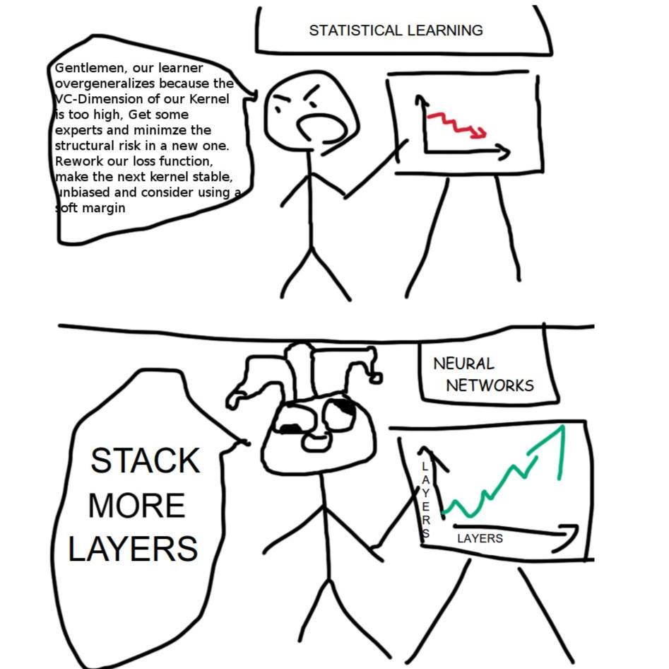
Source:
Somewhere on Reddit
Notes:
Done

Slide 2
CIS 700-004: Lecture 3W
Challenges in training neural nets
01/30/19
Notes:
Done

Slide 3
Course Announcements
HW0 is due tonight.
Reminder to make a private Piazza post if you'd like Canvas access to submit the homework as an auditor. We have 10 additional spots for enrollment available to people who submit the homework.

Slide 4
Today, we pretend to be doctors!

Slide 5
Today's agenda
Finish up the anatomy of a neural net
Loss functions
Universal approximation
Tensorboard: a data scientist's best friend
Challenges in training neural nets
Initialization challenges
Gradient challenges
Magnitude problems
Direction problems

Slide 6
Loss functions
Notes:
Done

Slide 7
Mean squared error
Often used if the network is predicting a scalar.
Notes:
Done

Slide 8
Cross-entropy
Most common loss function for classification tasks.
It is a measure of distance between two probability distributions.
For classification, generally the target vector is one-hot encoded, which means that is 1 where belongs to class j, and is otherwise 0.
Be careful to apply cross-entropy loss only to probabilities! (e.g. after softmax)
In PyTorch, softmax and cross-entropy can be applied in a single step.
Be careful in that case not to apply it twice :)

Slide 9
Cosine similarity
Computes similarity between directions of two vectors.
Often used in NLP contexts. For example, the two vectors might be the frequencies of different words.
Notes:
Done

Slide 10
Universal Approximation

Slide 11
No Free Lunch Theorem
“If an algorithm performs better than random search on some class of problems then in must perform worse than random search on the remaining problems.”
Aka "A superior black-box optimisation strategy is impossible."
Aka "If our feature space is unstructured, we can do no better than random."

Slide 12
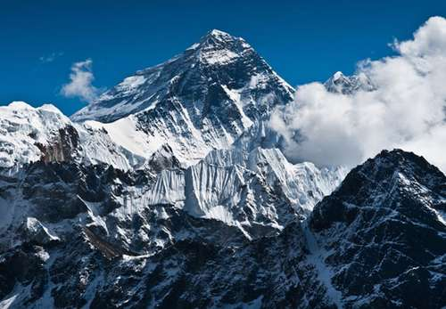
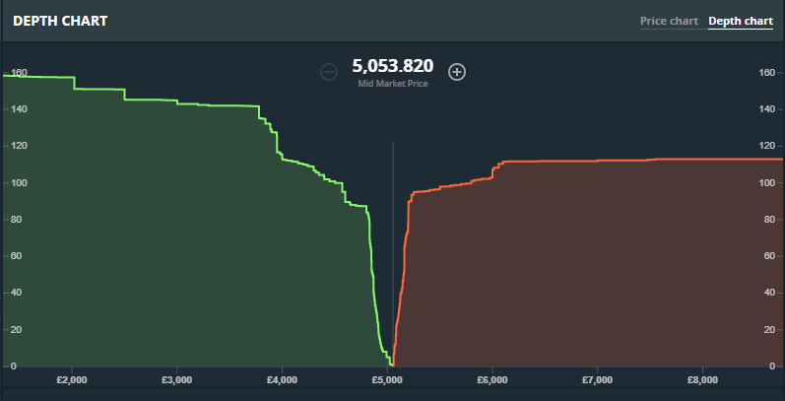
No Free Lunch Theorem

Slide 13
Some problems are harder than others.
Linearly separable problems
Continuous problems
Real-life problems
Problems with no structure
xor
Easy
Hard
Solved by perceptron
Unsolvable by No Free Lunch Theorem

Slide 14
Some problems are harder than others.
Linearly separable problems
Continuous problems
Real-life problems
Problems with no structure
xor
Easy
Hard
Solved by perceptron
Unsolvable by No Free Lunch Theorem
Loosely, UAT says that neural nets can solve these problems

Slide 15
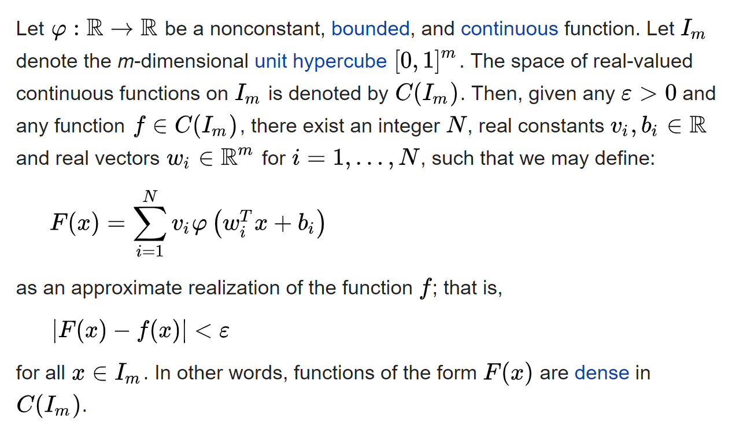
Universal Approximation Theorem

Slide 16
Cybenko's construction
Suppose we want to approximate the following function:
y
x

Slide 17
Cybenko's construction
Suppose we want to approximate the following function:
y
x
1
2
3
4
We can approximate it as a piecewise-constant function.

Slide 18
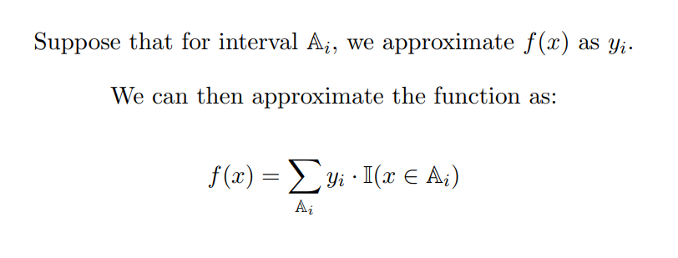
Cybenko's construction
Let's make a neural net that represents the indicator function for the interval [2, 3].

Slide 19
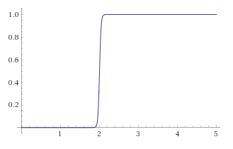
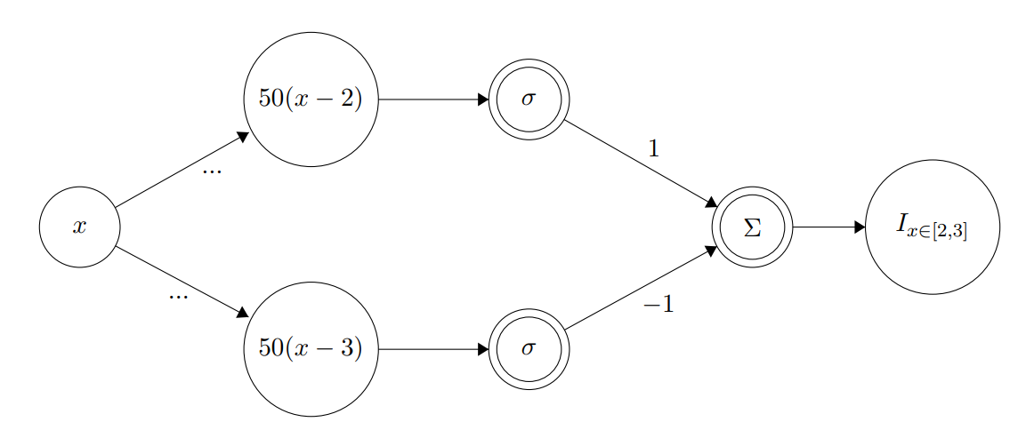
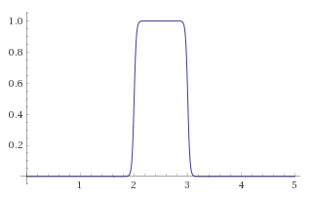
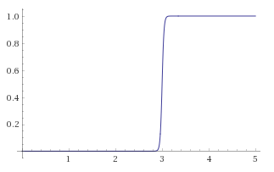
Cybenko's construction: the indicator function

Slide 20
Cybenko's construction
Interval a1
y1
Σ
y
...
Interval an
yn
Indicator approximators

Slide 21
UAT insight: any nonconstant, bounded, continuous transfer function could generate a class of universal approximators.

Slide 22
Training Challenges

Slide 23
Training Challenges: Initialization

Slide 24
How do we initialize our weights?
Most models work best when normalized around zero.
All of our choices of activation functions inflect about zero.
What is the simplest possible initialization strategy?

Slide 25
Zero initialization
We set all weights and biases to be zero in every element.
How will this perform?

Slide 26
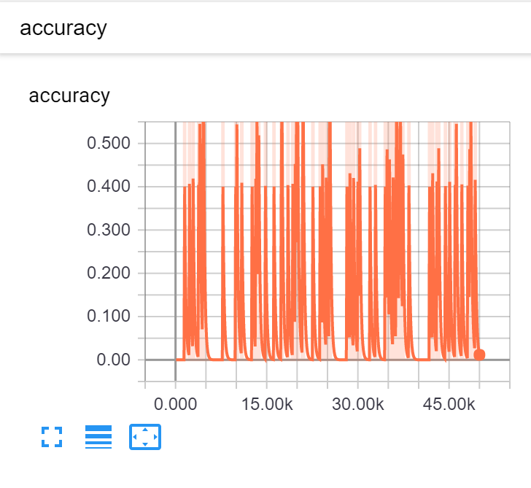
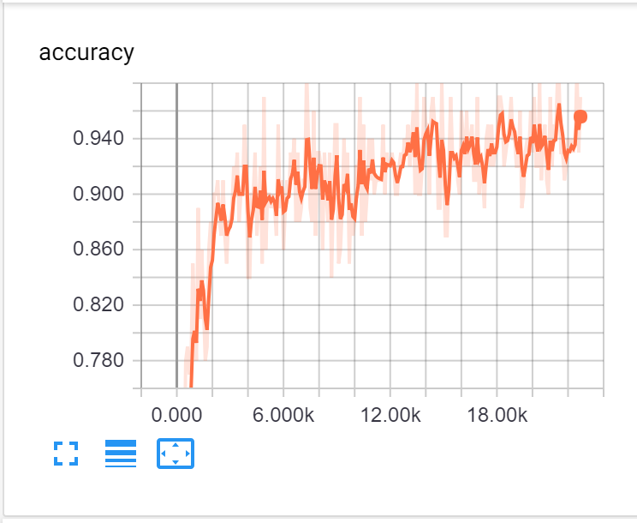
Zero initialization: is horrible.
Zero initialization
Vanilla

Slide 27
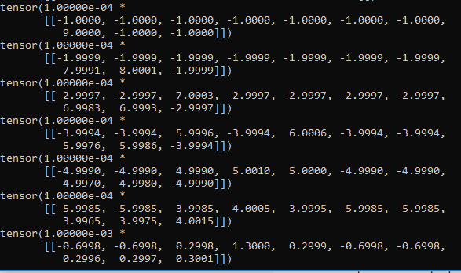
Zero initialization: debugging why it's so horrible
Outputs

Slide 28
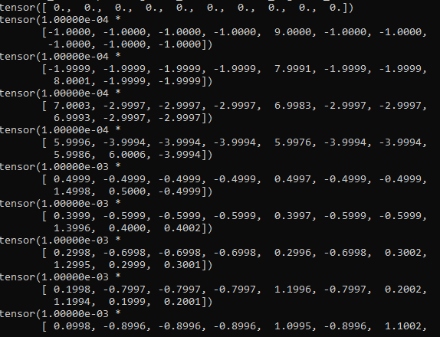
Zero initialization: debugging why it's so horrible
Parameters

Slide 29
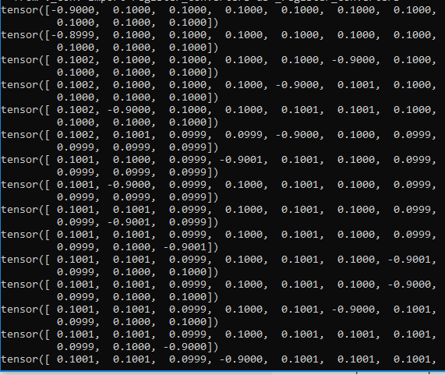
Zero initialization: debugging why it's so horrible
Gradients

Slide 30
Zero initialization gives you an effective layer width of one. Don't use it. Ever.

Slide 31
The next simplest thing: random initialization
We select all weights and biases uniformly from the interval [0,1]
How will this perform?

Slide 32
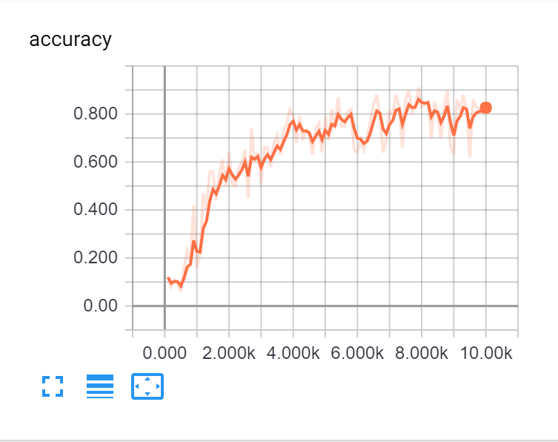
Random initialization: slightly better.
Random initialization
Vanilla

Slide 33
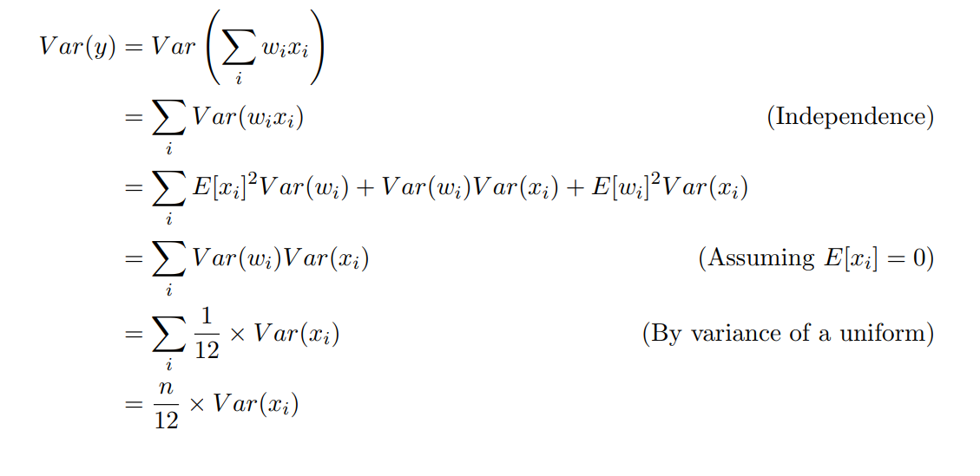
Random initialization scales poorly with layers.

Slide 34
Smart initializations
The variance of a single weight should scale inversely with width.
Correction - He et al.: variance = 2/n, not 1/2n

Slide 35
Xavier initialization: good. Also familiar.
Xavier initialization
Vanilla

Slide 36
PyTorch uses Xavier initialization.

Slide 37
Training Challenges: Gradient Flow

Slide 38
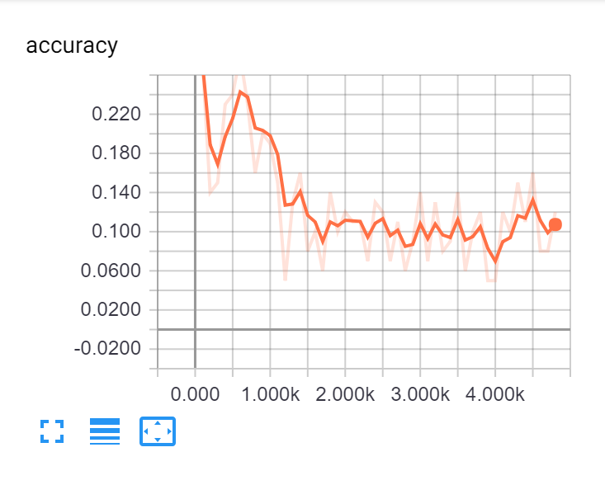
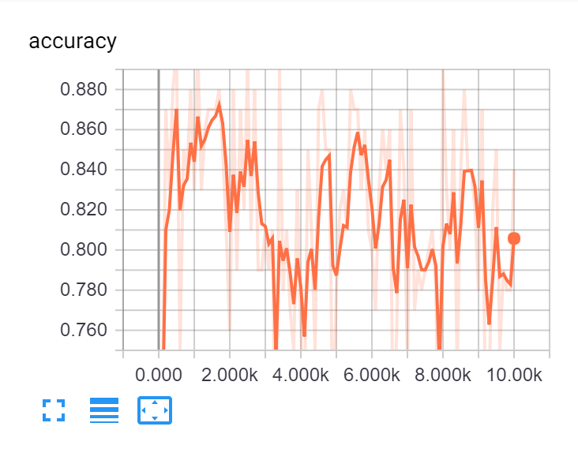
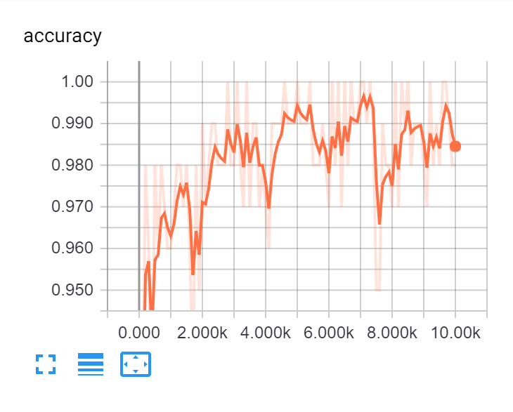
Various learning curves demonstrating problems.

Slide 39
Training Challenges: Gradient Magnitude

Slide 40
Rate tuning

Slide 41
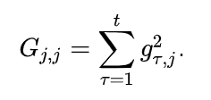
Advanced optimizers: Adagrad
"Adaptive gradient algorithm"
Adapts a learning rate for each parameter based on size of previous gradients.

Slide 42
Advanced optimizers: RMSprop
"Root mean square prop"
Adapts a learning rate for each parameter based on size of previous gradients.

Slide 43
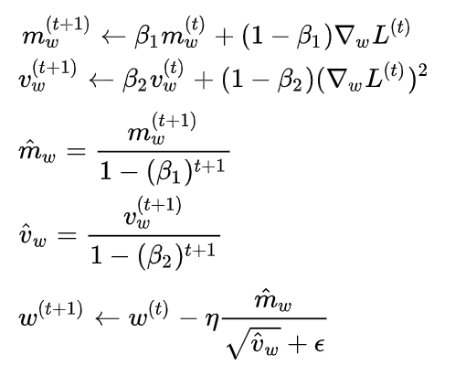
Advanced optimizers: Adam
"Adaptive moment estimation"
Similar to RMSprop, but with both the first and second moments of the gradients

Slide 44
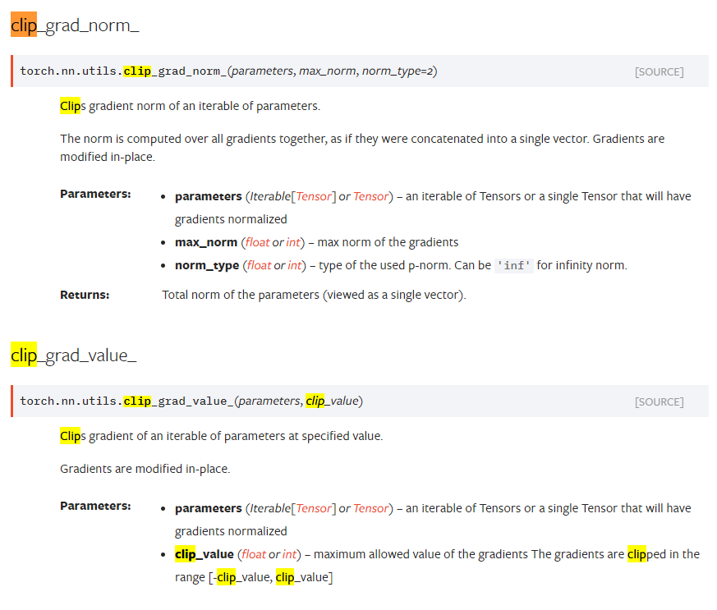
What to do when your gradients are still enormous

Slide 45
What to do when your gradients are too small
Find a better activation?
Find a better architecture?
Find a better initialization?
Find a better career?

Slide 46
Training Challenges: Gradient Direction

Slide 47
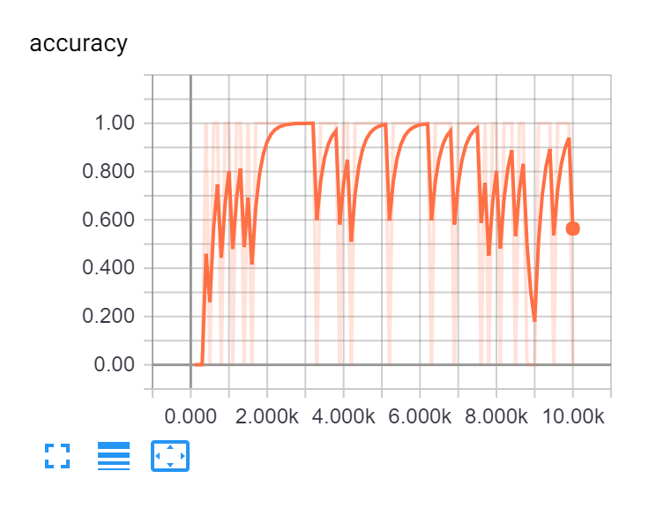

Slide 48
A brief interlude on algorithms
A batch algorithm does a computation all in one go given an entire dataset
Closed-form solution to linear regression
Selection sort
Quicksort
Pretty much anything involving gradient descent.
An online algorithm incrementally computes as new data becomes available
Heap algorithm for the kth largest element in a stream
Perceptron algorithm
Insertion sort
Greedy algorithms

Slide 49
Minibatching
A minibatch is a small subset of a large dataset.
In order to perform gradient descent, we need an accurate measure of the gradient of the loss with respect to the parameters. The best measure is the average gradient over all of the examples (gradient descent is a batch algorithm).
Computing over 60K examples on MNIST for a single (extremely accurate) update is stupidly expensive.
We use minibatches (say, 50 examples) to compute a noisy estimate of the true gradient. The gradient updates are worse, but there are many of them. This converts the neural net training into an online algorithm.

Slide 50
How PyTorch handles batching
# MNIST Dataset
dataset = dsets.MNIST(root='./data',
train=True,
transform=transforms.ToTensor(),
download=True)
# Data Loader (Input Pipeline)
data_loader = torch.utils.data.DataLoader(dataset=dataset,
batch_size=100,
shuffle=True)

Slide 51
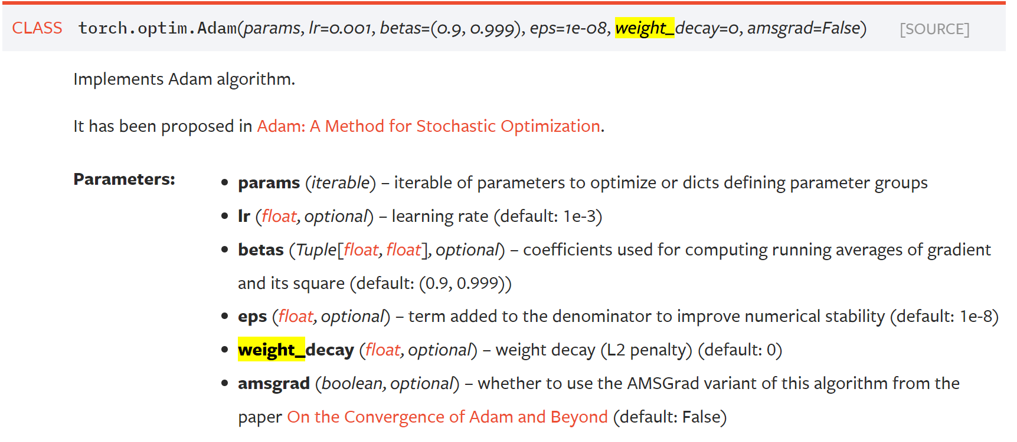
Classical regularization

Slide 52
Dropout

Slide 53
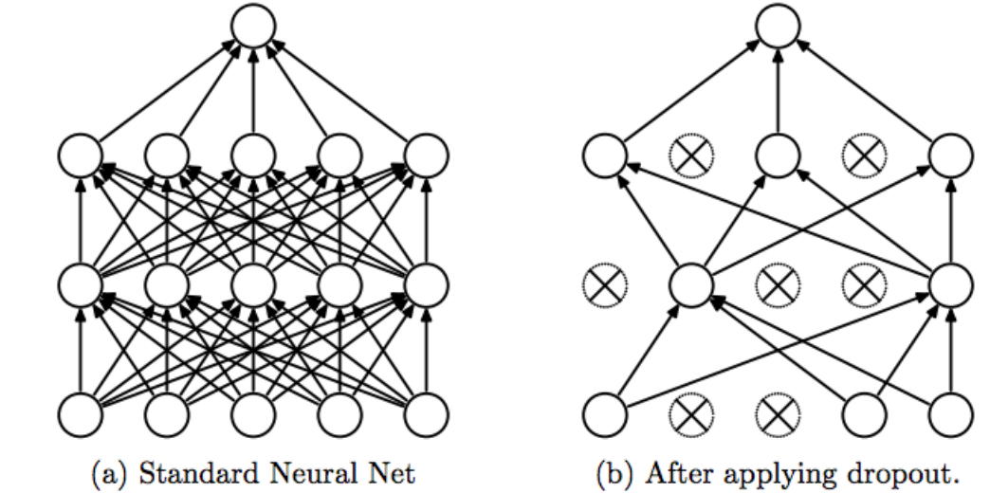
Dropout
Prevents overfitting by preventing co-adaptations
Forces "dead branches" to learn
Developed by Geoffrey Hinton, patented by Google

Slide 54
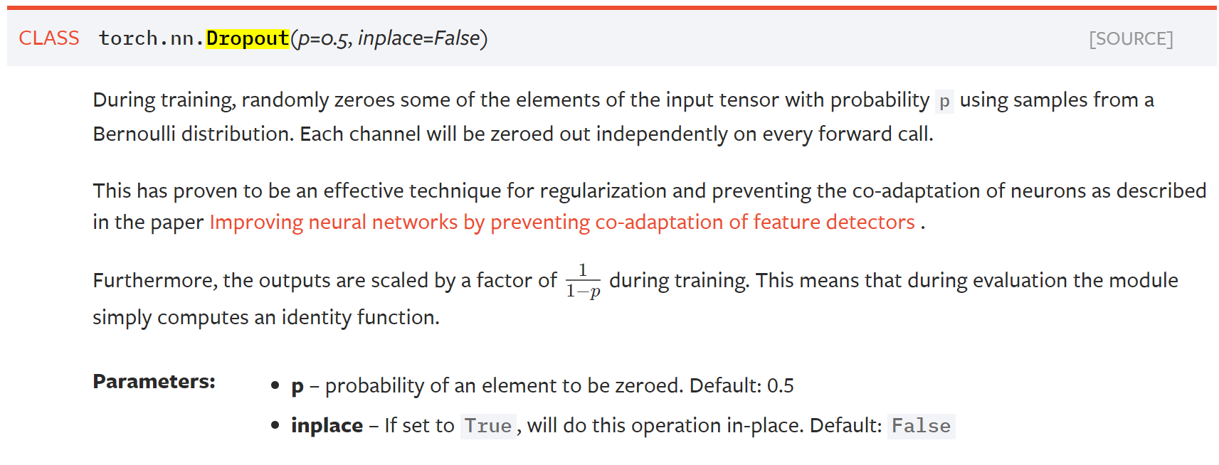
Dropout

Slide 55
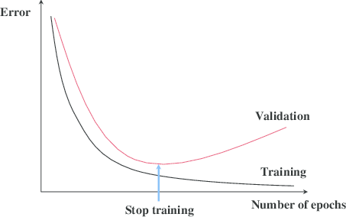
Early stopping*
*not built-in. Oh, the horror.

Slide 56
So why do we have all this machinery?

Slide 57
So why is training a deep neural net hard?
Universal approximation theorem doesn't help us learn a good approximator.
Neural nets do not have a closed form solution.
Neural nets do not have a convex loss function.
Neural nets are really expressive.

Slide 58
The awful, awful VC-dimension of neural nets

Slide 59
The optimization problem is hard, and there are no guarantees on learnability.
We invented methods for manipulating gradient flow to get good parametrizations despite tricky loss landscapes.

Slide 60
Looking forward
HW0 is due tonight.
HW1 will be released later this week.
Next week, we discuss architecture tradeoffs and begin computer vision.

