Slide 1
Please enjoy.
Notes:
https://botnik.org/content/harry-potter.html

Slide 2
CIS 700-004: Lecture 9W
Generative RNNs
03/13/19
Notes:
Done

Slide 3
Today's Agenda
Review of RNNs vs. LSTMs
Review of language models
Generative RNNs
Admiring Karpathy's Ode to the RNN
Applications of generative LSTMs
Seq2seq

Slide 4
Why do LSTMs patch the deficiencies of RNNs?

Slide 5
Why do LSTMs patch the deficiencies of RNNs?
And how does adding a cell state help?

Slide 6
Perspective #1: better memory
Notes:
https://www.quora.com/What-is-an-intuitive-explanation-of-LSTMs-and-GRUs

Slide 7
Perspective #1: better memory
Real life is chaotic.
Notes:
https://www.quora.com/What-is-an-intuitive-explanation-of-LSTMs-and-GRUs

Slide 8
Perspective #1: better memory
Real life is chaotic.
Information quickly transforms and vanishes.
Notes:
https://www.quora.com/What-is-an-intuitive-explanation-of-LSTMs-and-GRUs

Slide 9
Perspective #1: better memory
Real life is chaotic.
Information quickly transforms and vanishes.
We want the network to learn how to update its beliefs.
Scenes without Captain America should not update beliefs about Captain America
Scenes with Iron Man should focus on gathering details about him
Notes:
https://www.quora.com/What-is-an-intuitive-explanation-of-LSTMs-and-GRUs

Slide 10
Perspective #1: better memory
Real life is chaotic.
Information quickly transforms and vanishes.
We want the network to learn how to update its beliefs.
Scenes without Captain America should not update beliefs about Captain America
Scenes with Iron Man should focus on gathering details about him
The RNN's knowledge of the world then evolves more gently.
Notes:
https://www.quora.com/What-is-an-intuitive-explanation-of-LSTMs-and-GRUs

Slide 11
Perspective #1: better memory
Cell state = long-term memory, hidden state = working memory.
We learn what parts of long-term memory are worth keeping.
Forget gate.
We learn new learnable information.
Candidate cell state.
We learn which parts of the new information are worth storing long-term.
Input gate.
Notes:
https://www.quora.com/What-is-an-intuitive-explanation-of-LSTMs-and-GRUs

Slide 12
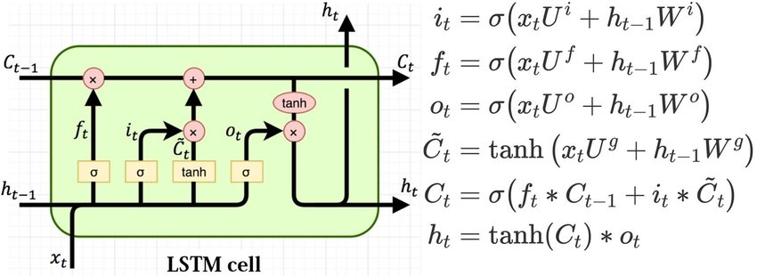
Perspective #1: better memory
Cell state = long-term memory, hidden state = working memory.
We learn what parts of long-term memory are worth keeping.
Notes:
https://www.quora.com/What-is-an-intuitive-explanation-of-LSTMs-and-GRUs

Slide 13
Perspective #1: better memory
Cell state = long-term memory, hidden state = working memory.
We learn what parts of long-term memory are worth keeping.
Forget gate.
We learn new information.
Notes:
https://www.quora.com/What-is-an-intuitive-explanation-of-LSTMs-and-GRUs

Slide 14
Perspective #1: better memory
Cell state = long-term memory, hidden state = working memory.
We learn what parts of long-term memory are worth keeping.
Forget gate.
We learn new information.
Candidate cell state.
We learn which parts of the new information are worth storing long-term.
Notes:
https://www.quora.com/What-is-an-intuitive-explanation-of-LSTMs-and-GRUs

Slide 15
Perspective #1: better memory
Cell state = long-term memory, hidden state = working memory.
We learn what parts of long-term memory are worth keeping.
Forget gate.
We learn new information.
Candidate cell state.
We learn which parts of the new information are worth storing long-term.
Input gate.
Notes:
https://www.quora.com/What-is-an-intuitive-explanation-of-LSTMs-and-GRUs

Slide 16
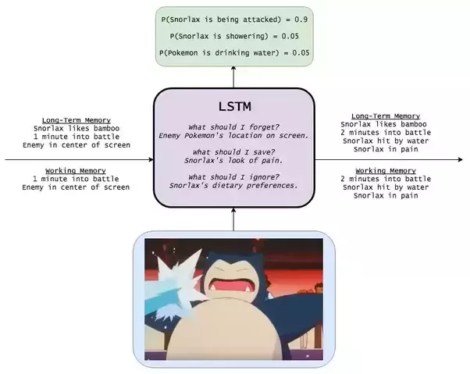
Perspective #1: better memory
Notes:
https://www.quora.com/What-is-an-intuitive-explanation-of-LSTMs-and-GRUs

Slide 17
Perspective #2: vanishing gradient

Slide 18
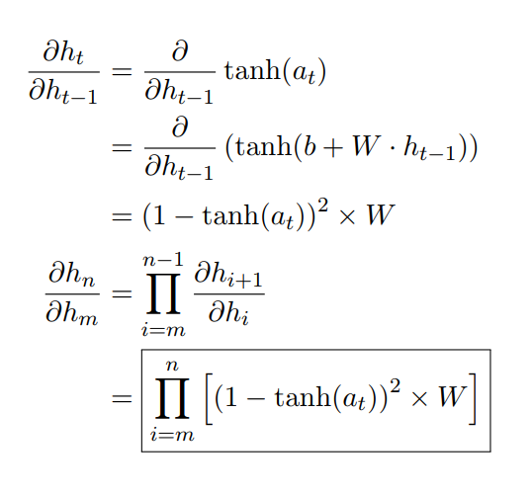
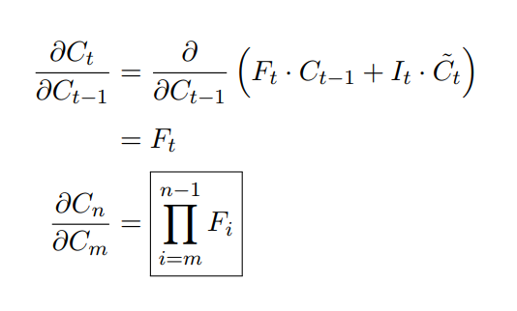
Perspective #2: vanishing gradient

Slide 19
Andrej Karpathy

Slide 20
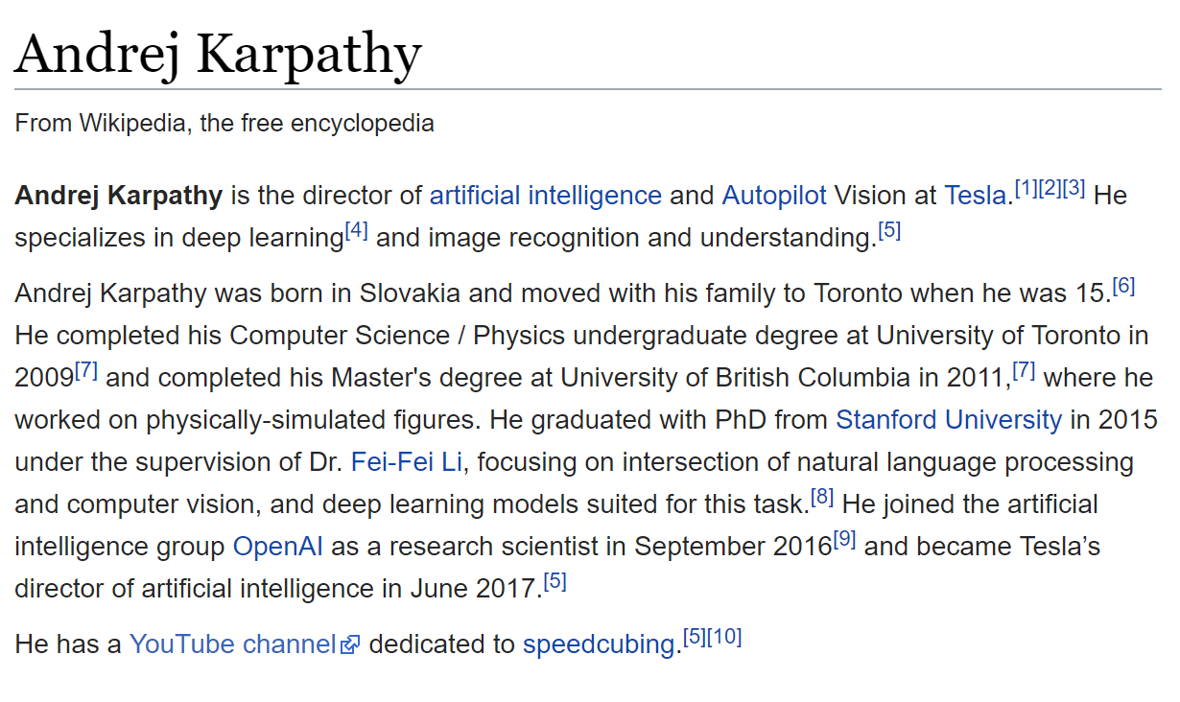
Andrej Karpathy

Slide 21
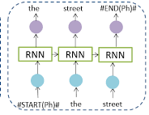
Generative RNNs

Slide 22
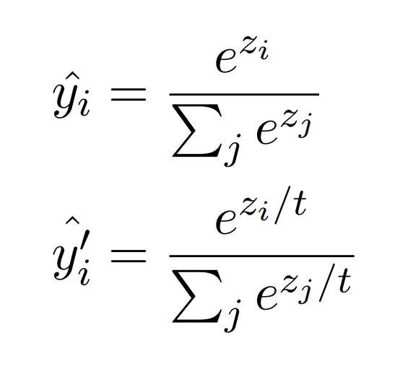
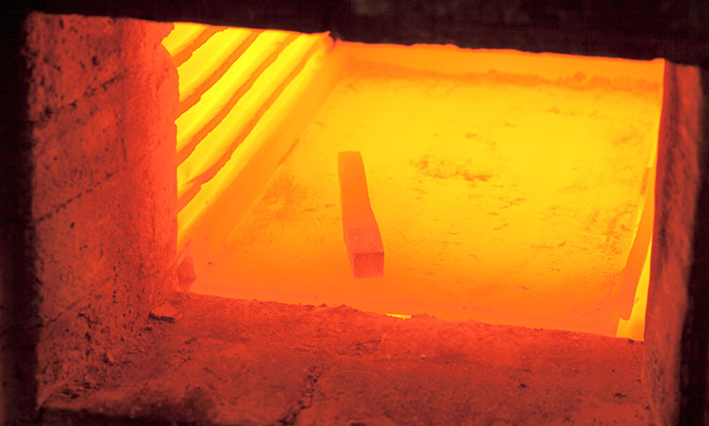
Temperature

Slide 23
Review: language models
Language models assign probabilities to sequences of words.

Slide 24
Review: language models
Language models assign probabilities to sequences of words.

Slide 25
Review: language models
Language models assign probabilities to sequences of words.
Previously: the n-gram assumption

Slide 26
The Unreasonable Effectiveness of RNNs
http://karpathy.github.io/2015/05/21/rnn-effectiveness/

Slide 27
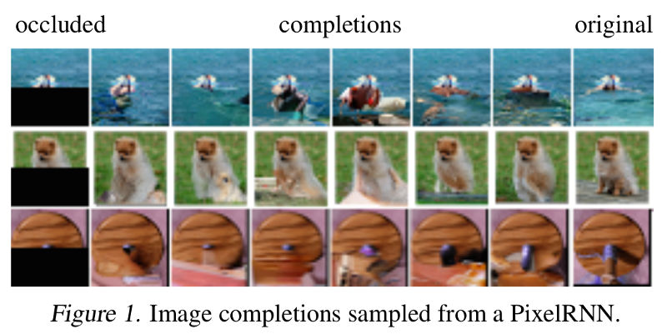
PixelRNN

Slide 28
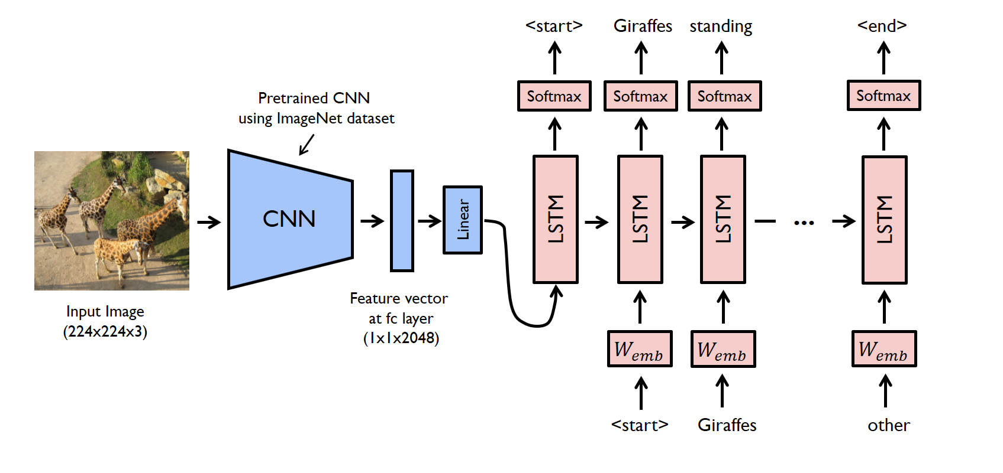
Image captioning

Slide 29
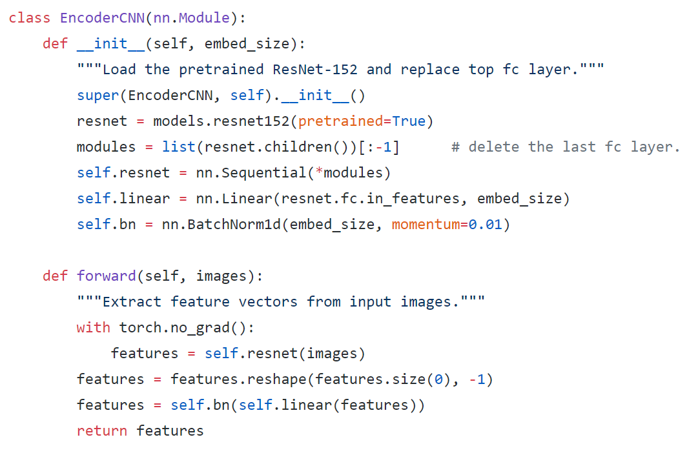
Image captioning in PyTorch: CNN encoding

Slide 30
Image captioning in PyTorch: CNN encoding

Slide 31
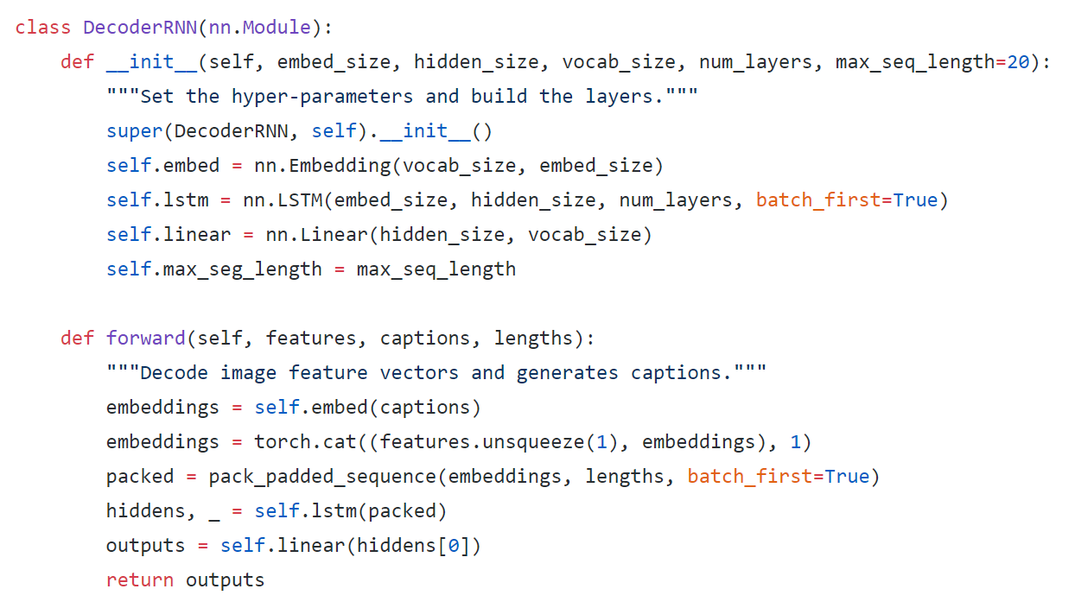
Image captioning in PyTorch: RNN decoding (train)

Slide 32
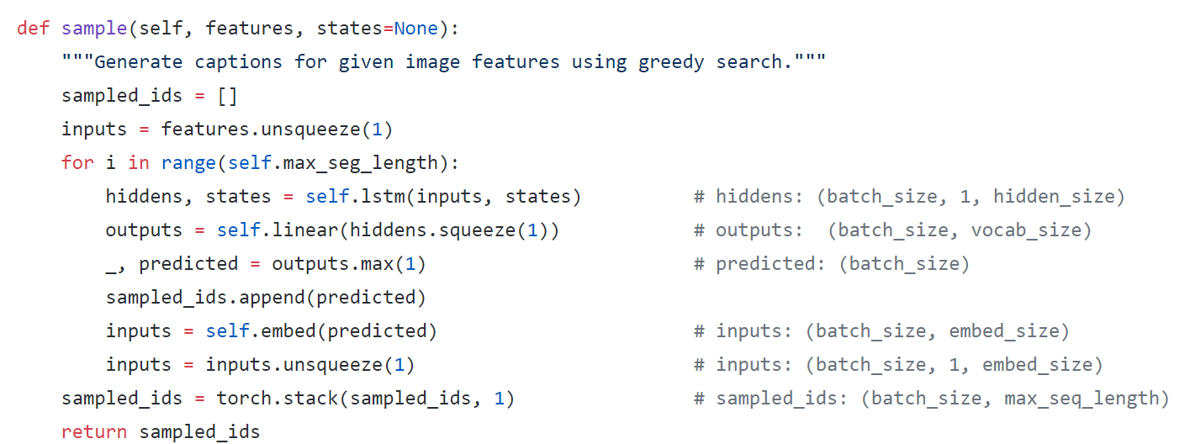
Image captioning in PyTorch: RNN decoding (test)

Slide 33
We've covered many modes of RNNs.
Fixed-to-variable (k->n)
Variable-to-fixed (n->k)
Variable-to-variable (n->n)

Slide 34
We've covered many modes of RNNs.
Fixed-to-variable (k->n)
Variable-to-fixed (n->k)
Variable-to-variable (n->n)
Does this cover all variable-to-variable use cases?

Slide 35
What if we want to input and output arbitrary variable length vectors?

Slide 36
seq2seq

Slide 37
How do we evaluate a variable-length language output if there are many possible correct answers?

Slide 38
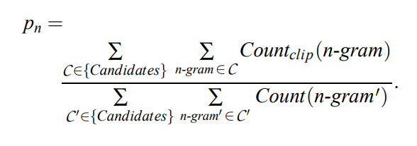
BLEU (2002)
"bilingual evaluation understudy"
"the closer a machine translation is to a professional human translation, the better it is"

Slide 39
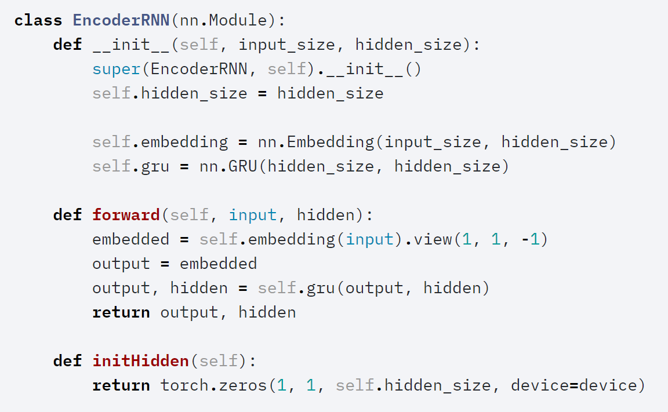
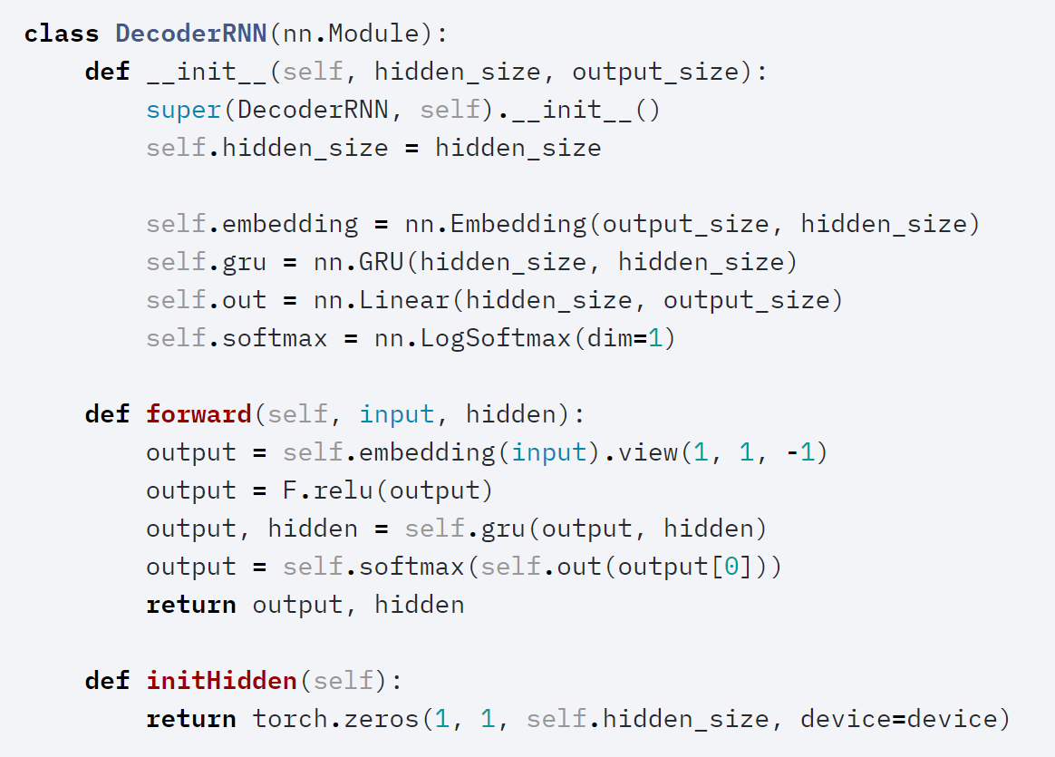
Seq2seq translation in PyTorch

Slide 40
"“Drop your RNN and LSTM, they are no good!”

Slide 41
"Use attention. Attention really is all you need!" -- Eugenio Culurciello

Slide 42
Some funny LSTMs

Slide 43
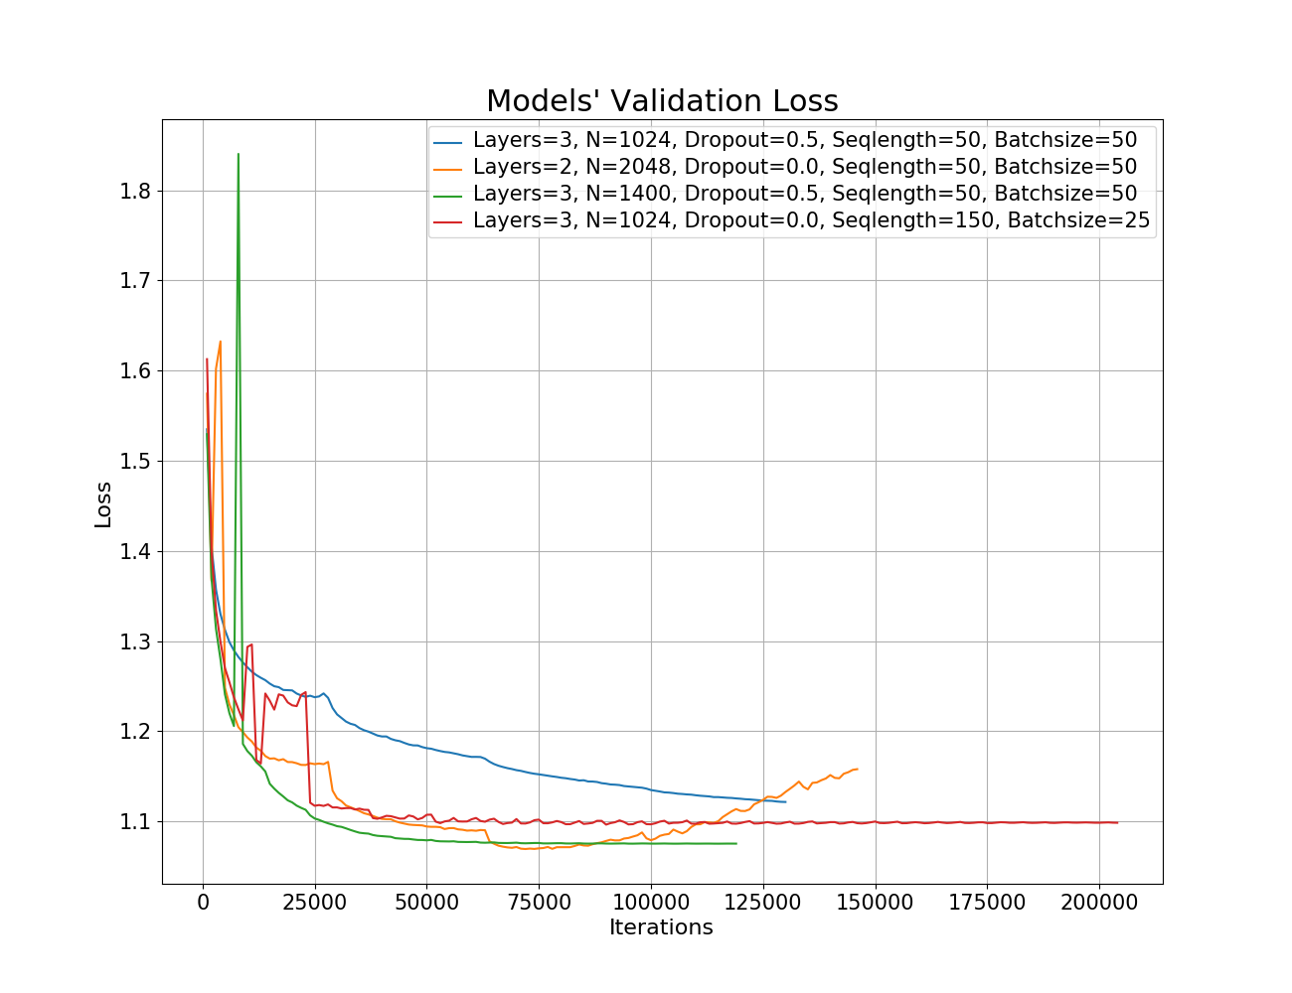
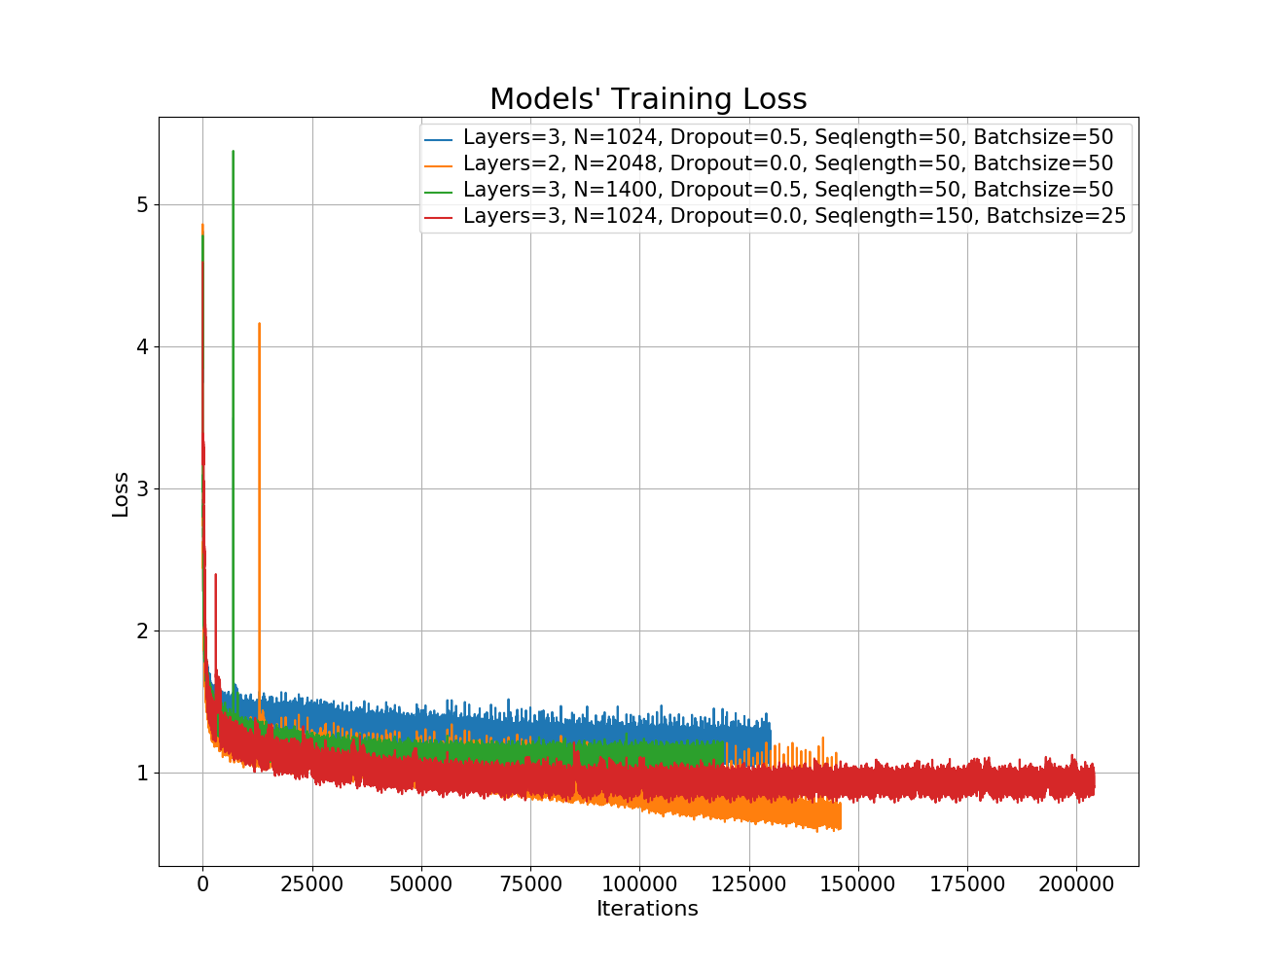
LSTMs on humor
https://amoudgl.github.io/blog/funnybot/

Slide 44
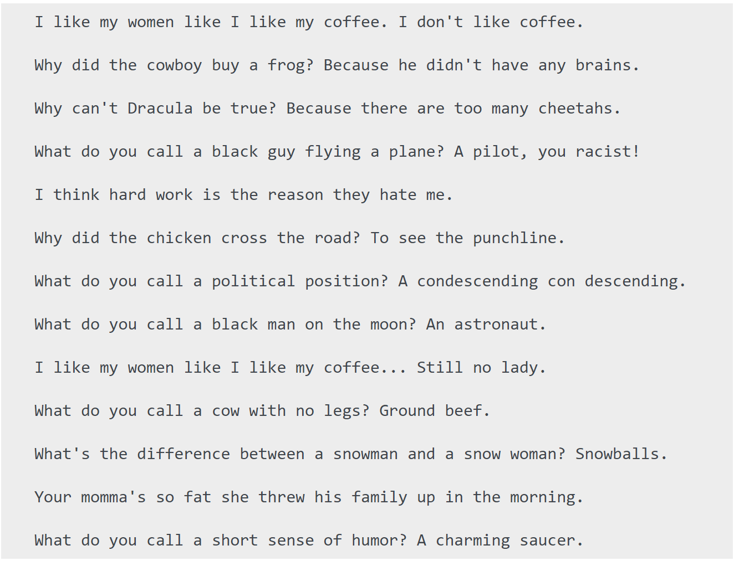
LSTMs on humor: Results

Slide 45
LSTMs on humor: Continued. Antijokes!

Slide 46
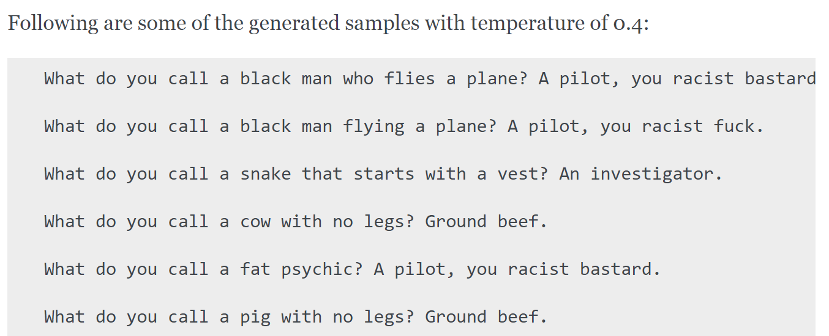
LSTMs on humor: Continued. Low temperature.

Slide 47
Is Kanye learnable?
https://towardsdatascience.com/text-predictor-generating-rap-lyrics-with-recurrent-neural-networks-lstms-c3a1acbbda79

