Slide 1



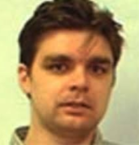




Multi-lingual Entity Discovery and Linking
Avi Sil (IBM Research AI)
Heng Ji (RPI)
Dan Roth (UPenn)
Silviu-Petru Cucerzan (MSR)
Tutorial page
An EDL reading list
Notes:
Add email, pdf address

Slide 2







Thank You – Our Brilliant Entity Linkers!!
Not shown: earlier generation of students
Lifu Huang
Ying Lin
Xiaoman Pan
Boliang Zhang
Nitish Gupta
Chen-Tse Tsai
Shyam Upadhyay

Slide 3

Acknowledgments
Most of the EDL research of Dan Roth and Heng Ji described below was supported by DARPA.

Slide 4
Outline
Motivation and Tutorial Overview 20 min Silviu
Introduction to Entity Discovery and Linking (EDL) System 20 min Dan
  Challenges: English, and Multilingual
Mono-lingual EDL approaches 30 min Avi, Dan
  High Level Algorithmic Approaches
  Old and new Approaches
Introductions to Cross-lingual EDL 20 min Dan, Avi
  Multilingual embeddings
Coffee Break
Neural Methods for Cross-lingual EDL 40 min Avi, Dan
Multiple Knowledge bases 20 min Silviu
New Tasks, Challenges, and Open questions, QA Session 30 min All
Notes:
Entity DIscovery and linking in English : earlier approaches and move to Entity representation which is nerual methods
. We expect this idea to inspire a completely new philosophy for fact
extraction which will be essential for the creation of a high-quality StructNet.
Incorporate arbitrary global features and soft constraints;
Features are automatically learned selectively
Save some human knowledge engineering efforts
Capture inter-dependency knowledge on the entire structure
Efficient linear-time beam search by joint learning and decoding
No need to model joint/conditional distribution with a large number of variables
Extract all facts jointly in a unified framework
Local predictions can be mutually improved
Avoid error compounding problem

Slide 5
What are “entities”?
[Main meaning]
- unique world bodies with (non-unique) names, such as
people, organizations, locations
e.g. Washington County
[Extended meaning – information extraction]
- unique identifiers, such as URLs, email addresses, tracking numbers, hashtags
- expressions of time, quantities, monetary values
Concepts (e.g. county)
But, everything in ambiguous

Slide 6
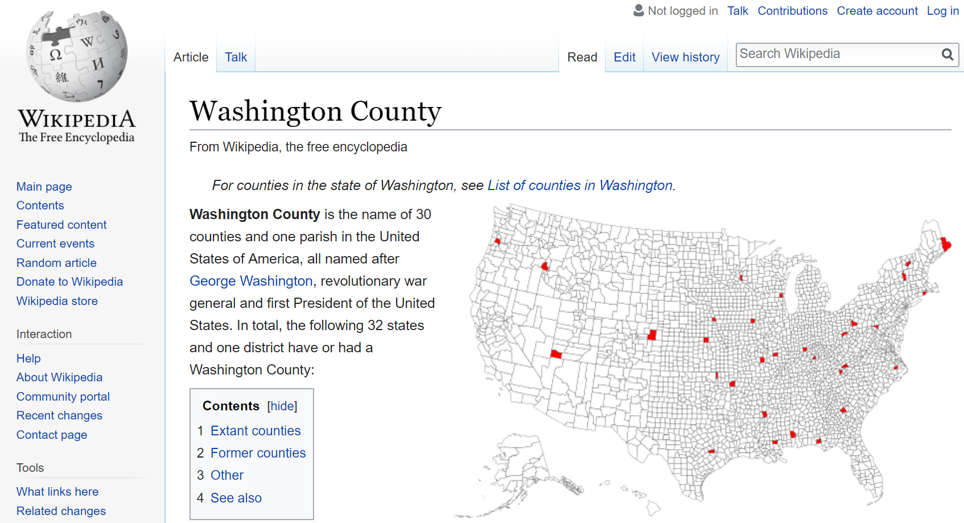

Slide 7

Entity Linking
EDL ( Entity Detection and Linking )
=
ERD ( Entity Recognition and Disambiguation )
=
e.g.
movie
year
director
2012 is a 2009 movie by Roland Emmerich.
Stevens and Kennedy disagreed with Breyer.
Seattle is the best!
justice
justice
justice
?
  Seattle defeated the Red Bulls.
  Seattle defeated the Red Stars.
  [Men’s Soccer club, NY]
  [Woman Soccer clubs, Chicago]

Slide 8
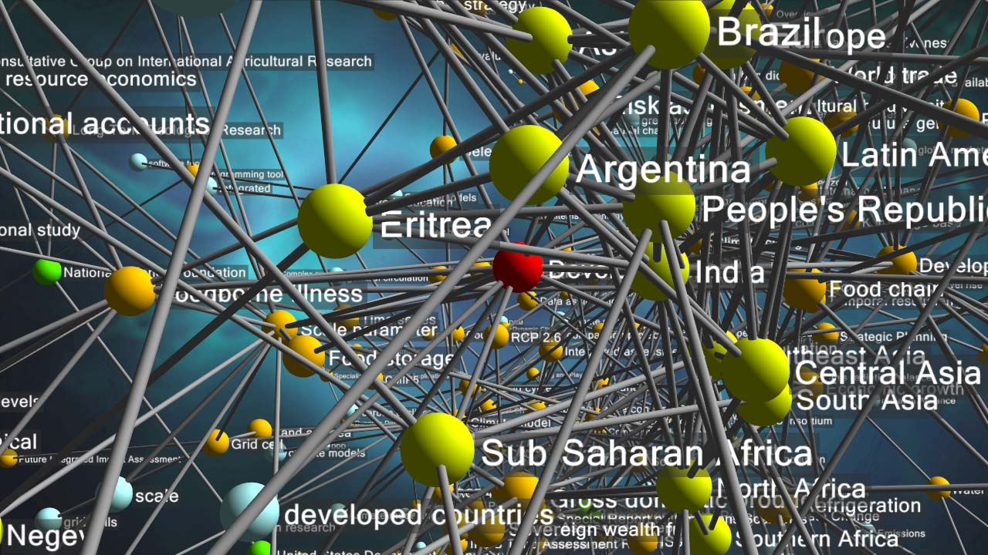
Why Are Entities Important?

Slide 9
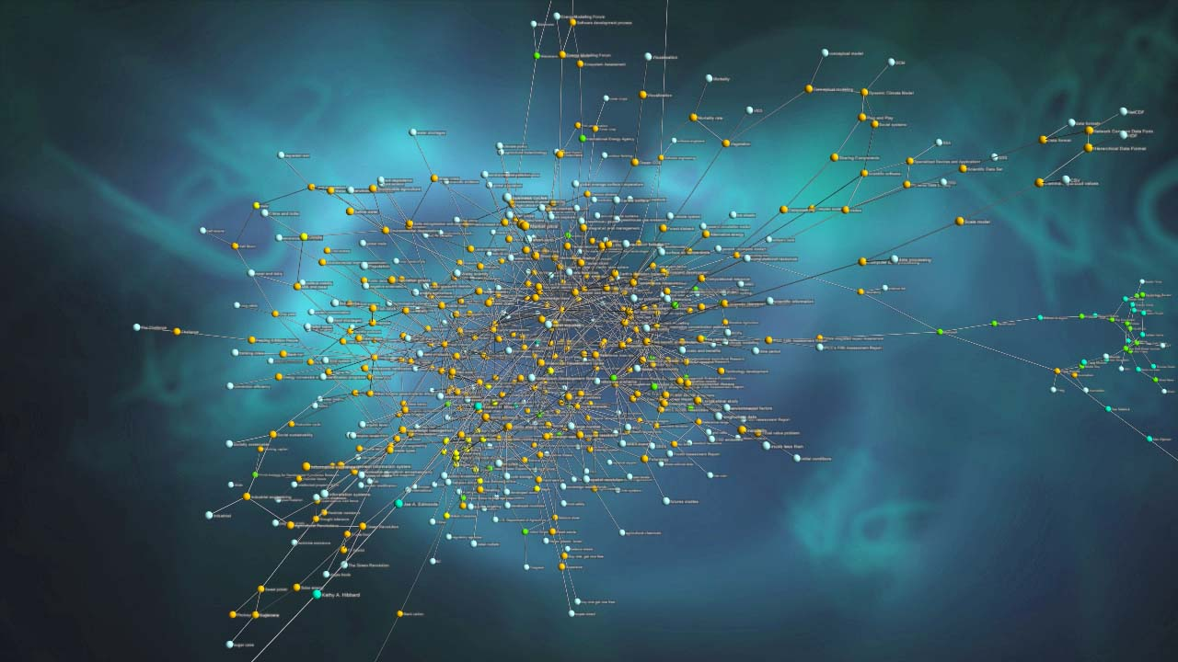
How Many Entities Are There?
Named places on Earth:
  ~ 10 million
Books written:
  ~ 130 million
People:
  ~ 8 billion
Species on Earth:
  ~ 1 trillion (of which ~10 million catalogued)
Stars in the Universe:
  ~ 1 billion trillion (1,000,000,000,000,000,000,000)
How Many Attributes?
How Many Relationships?
How Many Mentions?

Slide 10


Which “IAF”?
<DOCID> eng-WL-11-174596-12954631 </DOCID>
<DOCTYPE SOURCE="blog"> BLOG TEXT </DOCTYPE>
<DATETIME> 2008-05-24T12:55:00 </DATETIME>
<HEADLINE> Syria stalls IAEA visit... </HEADLINE>
<TEXT> <POST>
<POSTER> GayandRight </POSTER>
<POSTDATE> 2008-05-24T12:55:00 </POSTDATE>
Gee, I wonder why....
Syria has not yet accepted a request by the International Atomic Energy Agency to visit the site bombed by the IAF on September 6, which Washington says was a nuclear reactor, Reuters reported Friday.
The news agency quoted diplomats in Vienna as saying that Damascus was stalling its approval of the UN delegation visit, demanding more details on the proposed inspection.
Syrian atomic energy chief Ibrahim Othman came to Vienna earlier this month to speak with IAEA head Mohamed ElBaradei on the matter, but the two did not agree on the timing or nature of a visit, diplomats said.
The agency received a letter from Syria several days ago asking for more details on the trip, one US diplomat said. The IAEA has replied and is now waiting for Damascus's response, he added.
</POST>
</TEXT>
Is entity linking a KB lookup?
<DOCID> eng-WL-11-174596-12954631 </DOCID>
<DOCTYPE SOURCE="blog"> BLOG TEXT </DOCTYPE>
<DATETIME> 2008-05-24T12:55:00 </DATETIME>
<HEADLINE> Syria stalls IAEA visit... </HEADLINE>
<TEXT> <POST>
<POSTER> GayandRight </POSTER>
<POSTDATE> 2008-05-24T12:55:00 </POSTDATE>
Gee, I wonder why....
Syria has not yet accepted a request by the International Atomic Energy Agency to visit the site bombed by the IAF on September 6, which Washington says was a nuclear reactor, Reuters reported Friday.
The news agency quoted diplomats in Vienna as saying that Damascus was stalling its approval of the UN delegation visit, demanding more details on the proposed inspection.
Syrian atomic energy chief Ibrahim Othman came to Vienna earlier this month to speak with IAEA head Mohamed ElBaradei on the matter, but the two did not agree on the timing or nature of a visit, diplomats said.
The agency received a letter from Syria several days ago asking for more details on the trip, one US diplomat said. The IAEA has replied and is now waiting for Damascus's response, he added.
</POST>
</TEXT>
…
<query id="EL005833">
<name>IAF</name>
<docid>eng-WL-11-174596-12954631</docid>
<offset>…</offset>
</query>
<query id="EL005836">
<name>IAF</name>
<docid>eng-NG-31-142148-10021195</docid>
<offset>…</offset>
</query>
…
NIST/LDC Entity Linking Evaluations
32 possible entities, including:
Italian Air Force, Italian Armed Forces
Indonesian Air Force, Iraqi Air Force,
Israeli Air Force, Indian Armed Forces
Italian Air Force, Italian Armed Forces
Indonesian Air Force, Iraqi Air Force,
Israeli Air Force, Indian Armed Forces
Italian Air Force, Italian Armed Forces
Indonesian Air Force, Iraqi Air Force,
Israeli Air Force, Indian Armed Forces

Slide 11
Which “Washington”?
<DOCID> eng-WL-11-174596-12954631 </DOCID>
<DOCTYPE SOURCE="blog"> BLOG TEXT </DOCTYPE>
<DATETIME> 2008-05-24T12:55:00 </DATETIME>
<HEADLINE> Syria stalls IAEA visit... </HEADLINE>
<TEXT> <POST>
<POSTER> GayandRight </POSTER>
<POSTDATE> 2008-05-24T12:55:00 </POSTDATE>
Gee, I wonder why....
Syria has not yet accepted a request by the International Atomic Energy Agency to visit the site bombed by the IAF on September 6, which Washington says was a nuclear reactor, Reuters reported Friday.
The news agency quoted diplomats in Vienna as saying that Damascus was stalling its approval of the UN delegation visit, demanding more details on the proposed inspection.
Syrian atomic energy chief Ibrahim Othman came to Vienna earlier this month to speak with IAEA head Mohamed ElBaradei on the matter, but the two did not agree on the timing or nature of a visit, diplomats said.
The agency received a letter from Syria several days ago asking for more details on the trip, one US diplomat said. The IAEA has replied and is now waiting for Damascus's response, he added.
</POST>
</TEXT>
The quantum state of entities.
~600 Wikipedia entities can be
referred to as Washington
Washington, D.C.
United States
United States Department of State
Federal government of the United States
Presidency of the United States
…
Which Syria?
Which Damascus?
The answers depend on:
The granularity of the knowledge base
The disambiguation of the other entities in the document

Slide 12
Named Entity Recognition
Text document
Task:
Identify the boundaries of
entity references
and
Label each instance with one
of the entity categories
Columbia
Mention of an entity
referred to as “Columbia”
?
Surface form
Entity Type
PER: individuals, fictional characters (including humanoid and non-human), small groups
ORG: businesses and companies, parties, religious groups, teams, industrial sectors
LOC: physical locations such as continents, bodies of water, mountains, etc.
GPE: countries, states, provinces, cities
FAC: buildings and other man-made structures and improvements (airports, streets, etc.)
MISC: EVENTS, WORKS OF ART, OTHER ARTIFACTS, PROCESSES, ABSTRACTIONS

Slide 13
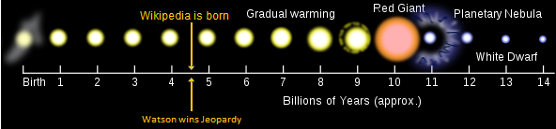
Where We Are, and A Brief History of Entity Work
Game changer: Wikipedia + hardware advancements
  small number of entity classes → large entity collection
Current state: good when there is a lot of annotated data
  Within domain: NER performance for coarse entity type [PER/LOC/ORG/MISC] is good (low 90-ies F1)
  Performance drops significantly across domains and for low resource languages.
Next game changer: deep domain/contextual analysis
  move from one large entity collection to many thousands of domain specific collections, business collections, and personal collections

Slide 14
Where We Are, and A Brief History of Entity Work
Game changer: Wikipedia + hardware advancements
  small number of entity classes → large entity collection → Watson wins Jeopardy
Current state:
  systems outperform humans on entity disambiguation to encyclopedic collections such as Wikipedia and Freebase
Next game changer: deep domain/contextual analysis
  move from one large entity collection to many thousands of domain specific collections, business collections, and personal collections

Slide 15
XXX these may be all too out-of-date XXXNamed Entity Recognition - MUC
MUC 6, 1995:
ENAMEX – proper names and acronyms for
Person, Location, and Organization entities
TIMEX – absolute temporal expressions
NUMEX – numerals, monetary, and percentages
Other tasks:
Coreference
Template Population
Small training and test sets: 100 + 30 WSJ documents (English only)
Extensive use of hand-coded rules, POS taggers, parsers, semantic lexicons, and large gazetteer lists.
Half of the systems tested obtained F-measure scores over .9
Notes:
Just mention MUC..Start with TAC 2009

Slide 16
Early Work on Statistical NER
David D. Palmer and David S. Day. A Statistical Profile of the Named Entity Task. ACL 1997.
Andrew Borthwick, John Sterling, Eugene Agichtein, and Ralph Grishman. Exploiting Diverse Knowledge Sources via Maximum Entropy in Named Entity Recognition. ACL Workshop on Very Large Corpora 1998.
Michael Collins and Yoram Singer. Unsupervised models for named entity classification. EMNLP 1999.
Silviu Cucerzan and David Yarowsky. Language independent named entity recognition combining morphological and contextual evidence. EMNLP 1999.
Andrei Mikheev, Marc Moens and Claire Grover. Named Entity Recognition without Gazetteers, EACL 1999.
Sabine Buchholz and Antal van den Bosch. Integrating Seed Names and n-grams for a Named Entity List and Classifier, LREC 2000.
…

Slide 17
Named Entity Recognition as Sequence Labeling (I-O-B)
Real B_{ORG}
Madrid I_{ORG}
won O
the O
competition O
in O
2002 O
. O
coreference chain
the Champions League
F-measure
Tag accuracy
2N + 1 tags
Entity performance ≠ Tagging performance

Slide 18
Named Entity Recognition - CoNLL
CoNLL Shared Task 2002 – 2003:
ENAMEX-style language-independent named entity recognition
Person, Location, Organization, and Miscellaneous entities
e.g.: [PER Wolff ] , currently a journalist in [LOC Argentina ] , played with [PER Del Bosque ]
in the final years of the seventies in [ORG Real Madrid ] .
Methods (http://www.cnts.ua.ac.be/conll2002/ner, http://www.cnts.ua.ac.be/conll2003/ner):
  Hidden Markov models (Burger et al., 2002; Klein et al., 2003)
  Maximum entropy (Borthwick, 1999; Malouf, 2002; Chieu and Ng, 2003)
  Bootstrapped hierarchical smoothed tries (Cucerzan and Yarowksy, 1998; 2002)
  Transformation-based learning (Florian, 2002; Black and Vasilakopoulos, 2002)
  Memory-based learning (Tjong Kim Sang, 2002)
  Decision trees (Carreras et al., 2002)
  Decision lists (Wu et al., 2002)
  Robust risk minimization (Zhang and Johnson, 2003)
2002: Spanish
Dutch
2003: English
German

Slide 19
Detecting Entity Boundaries
3 tags
(Michael Collins. Ranking Algorithms for Named-Entity Extraction: Boosting and the Voted Perceptron. ACL 2002.)
Features employed:
The word being tagged, the previous word, and the next word.
The previous tag, and the previous two tags (bigram and trigram features).
Is the word at the start of a sentence?
Does the word occur in a list of words which occur more frequently as lower case rather than upper case words in a large corpus of text?
The type of the first letter of the word, defined as ‘A’ if is a capitalized letter, ‘a’ if it is a lower-case letter, ‘0’ if it is a digit, and the letter itself otherwise.
The word with each character mapped to its type.
The word with each character mapped to its type, but repeated consecutive character types are not repeated in the mapped string.
Method | Precision | Recall | F-measure
MaxEnt | 84.4 | 86.3 | 85.3
Boosting | 87.3 | 87.9 | 87.6
Voted Perceptron | 87.3 | 88.6 | 87.9
Web data

Slide 20
Named Entity Recognition - ACE
ACE 2002 – 2008:
5 tasks: detection of entities, values, temporal expressions, relations, and events

Slide 21
Word Sense Disambiguation
SensEval Competitions
1: 1998; 2: 2001; 3: 2004
SemEval Competitions:
1: 2007; 2: 2010; 3: 2013
Text document
Task:
Label each instance of a word
in text with one of a given set
of dictionary senses.
bar
An Important predecessor of Entity Linking
But what is the sense taxonomy?
Another use of bar codes is in security applications.
I'm continuing with the 16-bar guitar solo from Linda Ronstadt's “That'll Be The Day”.
Imagine that you buy a bar of chocolate […]
Stand upright, holding the bar at shoulder height in front of your chest […]
Most of the action takes place in the cavern-like bar […]
Every time he passed the bar he'd pick up any bottle that was on the bar and drink it.
Bar charts are sometimes drawn vertically in columns.
The Pennsylvania Bar Association rated him “one of the best available”.
There won't be a vigorous private bar to defend the Bill of Rights.
Select the Printer options option from the action bar.
Another use of bar codes is in security applications.
I'm continuing with the 16-bar guitar solo from Linda Ronstadt's “That'll Be The Day”.
Imagine that you buy a bar of chocolate […]
Stand upright, holding the bar at shoulder height in front of your chest […]
Most of the action takes place in the cavern-like bar […]
Every time he passed the bar he'd pick up any bottle that was on the bar and drink it.
Bar charts are sometimes drawn vertically in columns.
The Pennsylvania Bar Association rated him “one of the best available”.
There won't be a vigorous private bar to defend the Bill of Rights.
Select the Printer options option from the action bar.

Slide 22
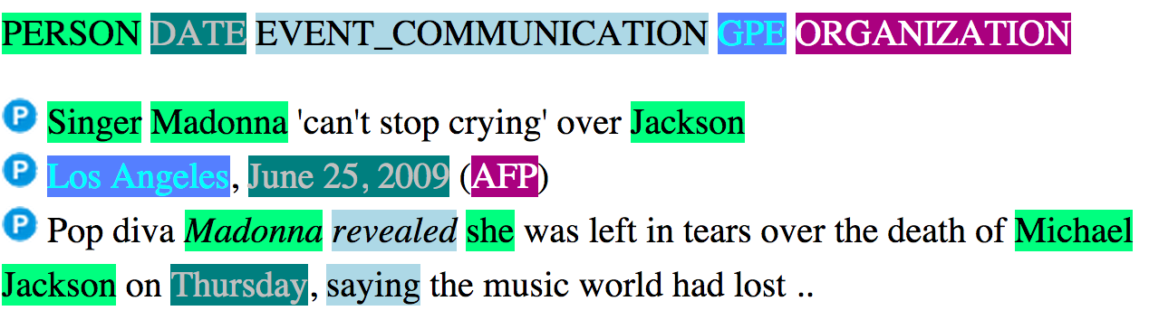
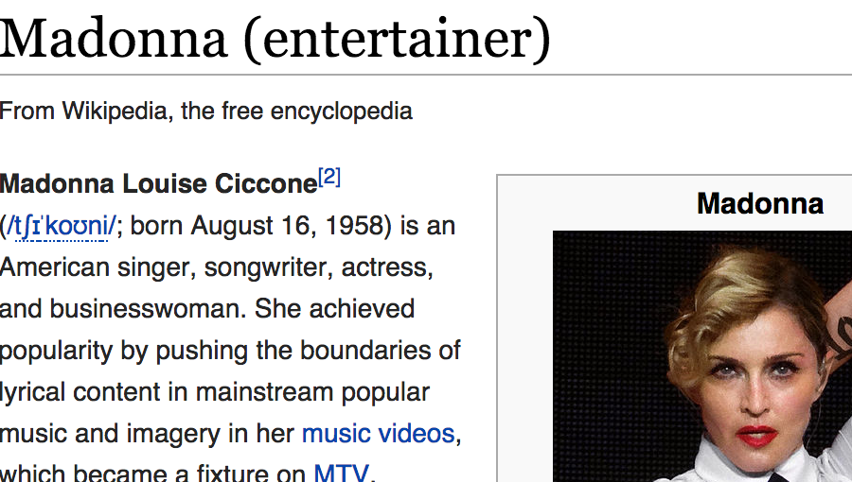
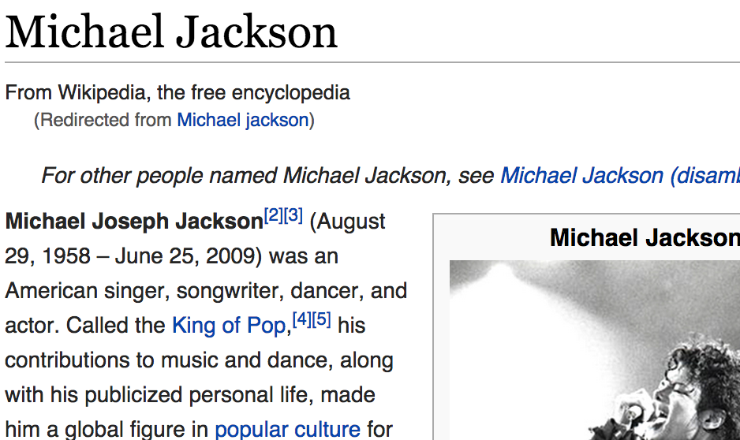
TAC-KBP Cross-lingual Entity Discovery and Linking Track
2009 – Present
  2009 - 2014: Entity Linking
  2014– Present: Entity Discovery and Linking
<DOC id="AFP_ENG_20090626.0737" type="story" >
<HEADLINE>Singer Madonna 'can't stop crying' over Jackson</HEADLINE>
<DATELINE>Los Angeles, June 25, 2009 (AFP)</DATELINE>
<TEXT><P>Pop diva Madonna revealed she was left in tears over the death of
Michael Jackson on Thursday, saying the music world had lost ..</P>
</TEXT>
</DOC>
Notes:
Avi’s Slides: This is the TAC KBP task..showing screenshots of the IBM SIRE EL system

Slide 23
TAC-KBP Cross-lingual Entity Discovery and Linking Track
2009 – Present
  2009 - 2014: Entity Linking
  2014– Present: Entity Discovery and Linking
Link entities in English documents
to an English KB
Evaluation metrics:
Linking accuracy (A),
Known-entity linking accuracy (A_{Wiki}),
NIL accuracy (A_{NIL}),
B-cubed precision and recall with equal element weighting

Slide 24
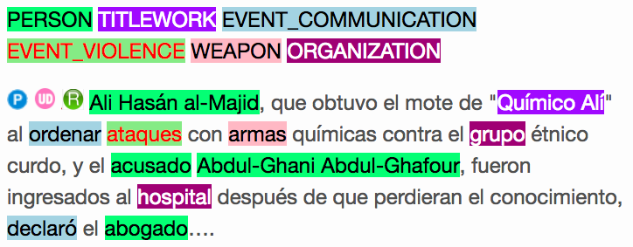
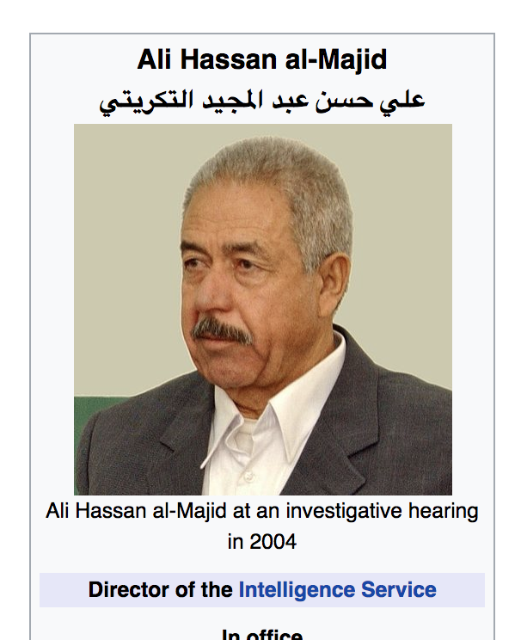
TAC-KBP Cross-lingual Entity Discovery and Linking Track
2009 – Present
  2009 - 2014: Entity Linking
  2014– Present: Entity Discovery and Linking
<DOC id=”XIN_SPA_20090726.0345" type="story" >
<TEXT><P> Ali Hasán al-Majid, que obtuvo el mote de "Químico Alí" al ordenar ataques con armas químicas contra el grupo étnico curdo, y el acusado Abdul-Ghani Abdul-Ghafour, fueron ingresados al hospital después de que perdieran el conocimiento, declaró el abogado…..</P>
</TEXT>
</DOC>
Spanish and Chinese documents
Link mentions to English KB!!
Recently new languages have been added:
Norther Sotho, Nepali, Kikuyu…
Some with very small or no Wikipedia!!!

Slide 25
Outline
Motivation and Tutorial Overview 20 min Silviu
Introduction to Entity Discovery and Linking (EDL) System 20 min Dan
  Challenges: English, and Multilingual
Mono-lingual EDL approaches 30 min Avi, Dan
  High Level Algorithmic Approaches
  Old and new Approaches
Introductions to Cross-lingual EDL 20 min Dan, Avi
  Multilingual embeddings
Coffee Break
Neural Methods for Cross-lingual EDL 40 min Avi, Dan
Multiple Knowledge bases 20 min Silviu
New Tasks, Challenges, and Open questions, QA Session 30 min All
Notes:
Entity DIscovery and linking in English : earlier approaches and move to Entity representation which is nerual methods
. We expect this idea to inspire a completely new philosophy for fact
extraction which will be essential for the creation of a high-quality StructNet.
Incorporate arbitrary global features and soft constraints;
Features are automatically learned selectively
Save some human knowledge engineering efforts
Capture inter-dependency knowledge on the entire structure
Efficient linear-time beam search by joint learning and decoding
No need to model joint/conditional distribution with a large number of variables
Extract all facts jointly in a unified framework
Local predictions can be mutually improved
Avoid error compounding problem

Slide 26



Information overload
Downside:
We need to deal with a lot of information
Upside:
We may be able to acquire knowledge
This knowledge might support language understanding
  (We may need to understand something in order to do it, though)
Notes:
Impose a “network” on this – idea is that information exists both in the content and in the structure.

Slide 27






Wikification: The Reference Problem
Knowledge Acquisition
Blumenthal (D) is a candidate for the U.S. Senate seat now held by Christopher Dodd (D), and he has held a commanding lead in the race since he entered it. But the Times report has the potential to fundamentally reshape the contest in the Nutmeg State.
Blumenthal (D) is a candidate for the U.S. Senate seat now held by Christopher Dodd (D), and he has held a commanding lead in the race since he entered it. But the Times report has the potential to fundamentally reshape the contest in the Nutmeg State.
Ambiguity
Variability
Notes:
Let’s start with what is wikification
Read wiki titles slower

Slide 28
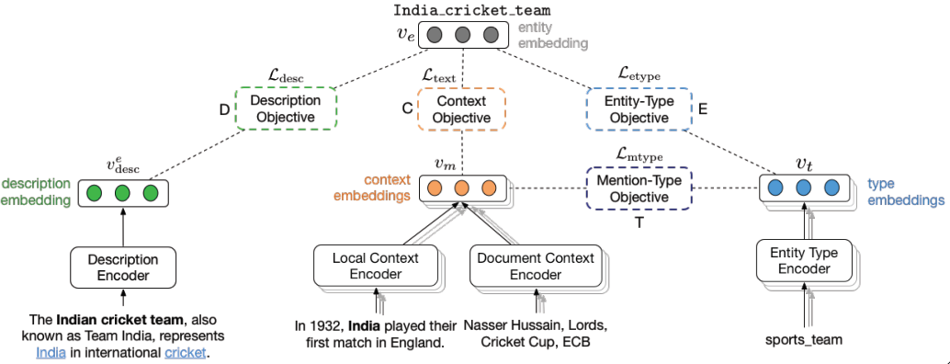
(1) Entiy Linking Challenges
Blumenthal (D) is a candidate for the U.S. Senate seat now held by Christopher Dodd (D), and he has held a commanding lead in the race since he entered it. But the Times report has the potential to fundamentally reshape the contest in the Nutmeg State.
Identify concepts in text
Identify candidate Wikipedia titles for these
Rank the corresponding titles: local context & global mention/title space
    Distance Based Models
  Simple entity representation
  A complex similarity metric
  [Ratinov et al.’11; Chen&Roth’13];….
    Representation Based Models
  Learned entity representation
  Simple similarity metric
  [Tsai et al ‘16; Gupta et al. ’17, Sil et al. 17]
In Both cases: rely on the correctness of the (partial) link structure in Wikipedia with no task specific annotation
Notes:
Quite impressive, bottleneck: adding more sophisticated contextual features does not help much
We do not want to level off here

Slide 29
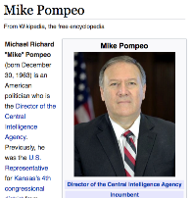
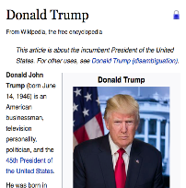
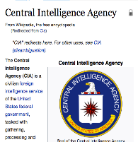
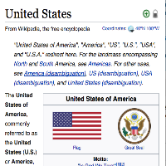
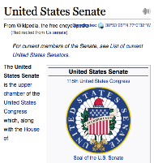
(2) Cross-Lingual EDL
Given a non-English document, extract named entities and disambiguate into the English Wikipedia
    சிஐஏ இயக்குநர் மைக் பாம்பேயோ நியமனத்துக்கு அமெரிக்க செனட் சபை ஒப்புதல். ஆனால், சிஐஏ முகமை மற்றும் அமெரிக்க அதிபர் டிரம்ப் இடையே ஒரு பயனுள்ள அலுவல் ரீதியான உறவினை உருவாக்குவதே மைக் பாம்பேயோவின் உடனடி பணியாக இருக்கும்.
    சிஐஏ இயக்குநர் மைக் பாம்பேயோ நியமனத்துக்கு அமெரிக்க செனட் சபை ஒப்புதல். ஆனால், சிஐஏ முகமை மற்றும் அமெரிக்க அதிபர் டிரம்ப் இடையே ஒரு பயனுள்ள அலுவல் ரீதியான உறவினை உருவாக்குவதே மைக் பாம்பேயோவின் உடனடி பணியாக இருக்கும்.

Slide 30
Challenges: Multilingual [Tsai et al. ‘16, ‘17 ’18; Sil et al. 18; Ji et al. 17]
    சிஐஏ இயக்குநர் மைக் பாம்பேயோ நியமனத்துக்கு அமெரிக்க செனட் சபை ஒப்புதல். ஆனால், சிஐஏ முகமை மற்றும் அமெரிக்க அதிபர் டிரம்ப் இடையே ஒரு பயனுள்ள அலுவல் ரீதியான உறவினை உருவாக்குவதே மைக் பாம்பேயோவின் உடனடி பணியாக இருக்கும்.
    சிஐஏ இயக்குநர் மைக் பாம்பேயோ நியமனத்துக்கு அமெரிக்க செனட் சபை ஒப்புதல். ஆனால், சிஐஏ முகமை மற்றும் அமெரிக்க அதிபர் டிரம்ப் இடையே ஒரு பயனுள்ள அலுவல் ரீதியான உறவினை உருவாக்குவதே மைக் பாம்பேயோவின் உடனடி பணியாக இருக்கும்.
Identifying name mentions in many languages
Identifying candidate English Wikipedia/KB titles
Computing similarity between mention context
and Wikipedia page across languages
Today we can address these challenges in all 293 Wikipedia languages in Wikipedia, without task specific annotation.
One key issue is representational: make use of existing cross-lingual Wikipedia links to learn cross-lingual embeddings
But it’s not only representational
Donald_Trump
Trump,_Colorado
Trumps_(Tarot_cards)
Trumpf

Slide 31
(3) KB Entity Linking
Text
Wikification/Entity Linking into Knowledge Bases
Mentions
BRCA2 and homologous recombination.
Multiple reference KBs & Medical taxonomies
Concept ID
Concept ID
PR:000004804, EG:675
GO:0006310
Protein Ontology
Entrez Gene
id: PR:000004804
name: breast cancer type 2
susceptibility protein
def: A protein that is a translation
product of the human BRCA2
gene or a 1:1 ortholog thereof
synonyms: BRCA2, FACD,…
is_a: PR:000000001
id: EG:675
symbol: BRCA2
description:
protein-coding BRCA2
breast cancer 2, early
onset
synonyms: BRCC2,
BROVCA2, …
Notes:
I’ll describe the task by an example. Given a piece of text, it can be a sentence, a paragraph, or a document. Here it is a title of a journal paper.
There are actually two sub tasks. The first one is mention detection. We want to extract substrings which are concepts. In this example, mentions are the two underlined words.
This task is already very challenging and I’m currently working on it.
In this work, we take the mentions as given and focus on the second step, grounding the mentions to multiple KBs.
Here, BRCA2 is grounded to two concepts in two different ontologies. We can see that the concepts in KBs can overlap and we want to find all concepts the mention refers to.
And here are examples of an entry in the ontology. A concept usually contains an id, name, a short definition, some synonyms, and few relations with other concepts.
This succinct information is quite different from what wikipedia has, which makes this task harder.

Slide 32
KB Entity Linking Challenges
Ambiguity
  A term in text can be used to express many different concepts
  E.g., BRCA2 is used by 177 concepts
Variability
  A concept may be expressed in text using many surface forms
  E.g., EG:675 has synonyms BRCC2, FACD, FAD, FANCD, …
No Annotation
  Wikipedia has nice hyperlink structure which does not exist here
  It is difficult to obtain human annotations
  Minimal descriptive text in the KBs/Ontologies
Incidental supervision: [Tsai & Roth TACL’16; Roth-AAAI’17]
  An algorithmic approach that trains a model by building on [a small percentage of] concepts that are mentioned in multiple KBs.
  An Instance of Constraints Driven Learning [Chang et al. 2013]
Notes:
This task is very challenging, the main challenges are coming from the general WSD problem, the ambiguity and variability.
Ambiguity means a term can be ….
Variability means. …
Another challenge of not using wikipedia is the supervision.
A good wikification system usually trains a ranking model to score concepts using supervised learning. And wikipedia’s hyperlink structure kind of provides free supervision
Which the ontologies we use don’t have. Also, it is reletively difficult to
One of the key contributions in this work is we

Slide 33






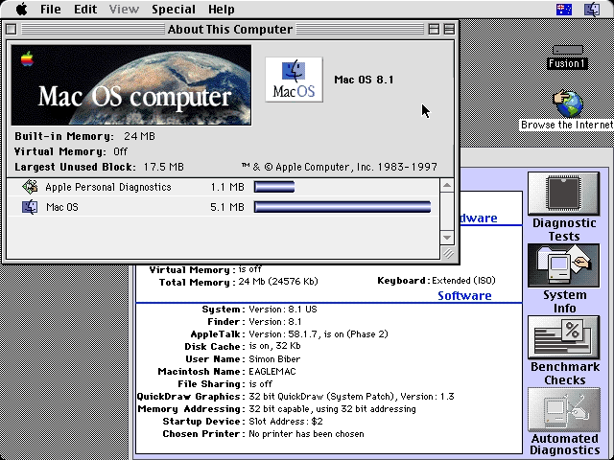
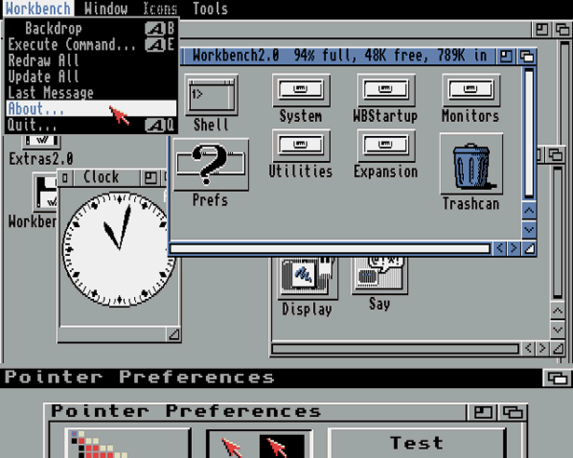
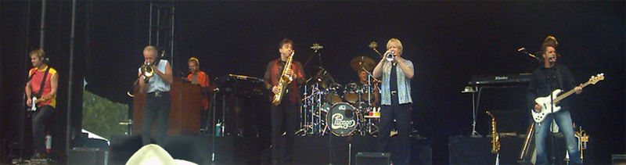
Ambiguity
Cycles of Knowledge: Grounding for/using Knowledge
Organizing knowledge
It’s a version of Chicago – the standard classic Macintosh menu font, with that distinctive thick diagonal in the ”N”.
Chicago was used by default for Mac menus through MacOS 7.6, and OS 8 was released mid-1997..
Chicago VIII was one of the early 70s-era Chicago albums to catch my
ear, along with Chicago II.

Slide 34
Motivation
Dealing with Ambiguity of Natural Language
  Mentions of entities and concepts could have multiple meanings
Dealing with Variability of Natural Language
  A given concept could be expressed in many ways
Entity Linking addresses these two issues in a specific way:
The Reference Problem
  What is meant by this concept? (WSD + Grounding)
  More than just co-reference (within and across documents)
Notes:
. We expect this idea to inspire a completely new philosophy for fact
extraction which will be essential for the creation of a high-quality StructNet.
Incorporate arbitrary global features and soft constraints;
Features are automatically learned selectively
Save some human knowledge engineering efforts
Capture inter-dependency knowledge on the entire structure
Efficient linear-time beam search by joint learning and decoding
No need to model joint/conditional distribution with a large number of variables
Extract all facts jointly in a unified framework
Local predictions can be mutually improved
Avoid error compounding problem

Slide 35
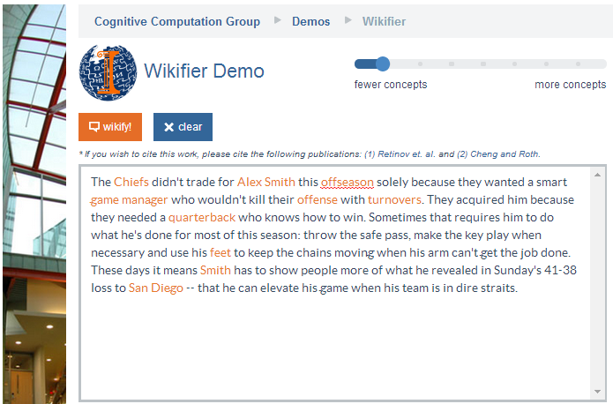
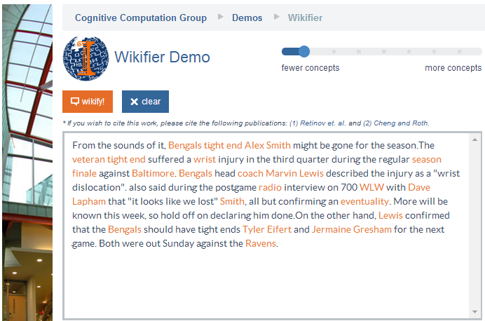
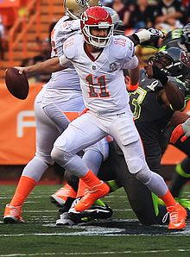
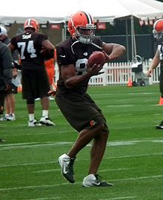
Who is Alex Smith?
Alex Smith
Alex Smith
Smith
Smith
Quarterback of the Kansas City Chief
Tight End of the Cincinnati Bengals
San Diego: The San Diego Chargers (A Football team)
Contextual decision on what is meant by a given entity or concept. WSD with Wikipedia titles as categories.
Ravens: The Baltimore Ravens (A Football team)
Notes:
. We expect this idea to inspire a completely new philosophy for fact
extraction which will be essential for the creation of a high-quality StructNet.
Incorporate arbitrary global features and soft constraints;
Features are automatically learned selectively
Save some human knowledge engineering efforts
Capture inter-dependency knowledge on the entire structure
Efficient linear-time beam search by joint learning and decoding
No need to model joint/conditional distribution with a large number of variables
Extract all facts jointly in a unified framework
Local predictions can be mutually improved
Avoid error compounding problem

Slide 36
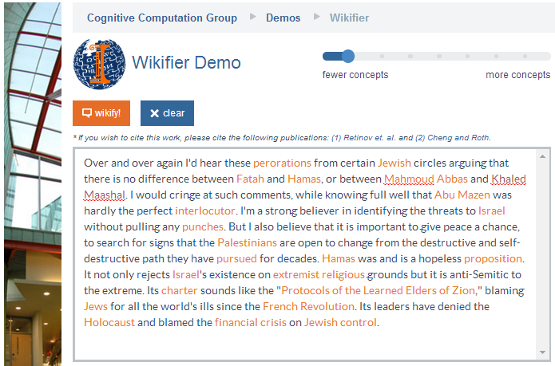
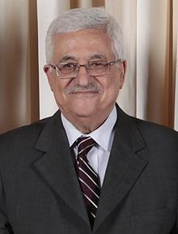
Middle Eastern Politics
Mahmoud Abbas
Abu Mazen
Mahmoud Abbas: http://en.wikipedia.org/wiki/Mahmoud_Abbas
Quarterback of the Kansas City Chief
Tight End of the Cincinnati Bengals
Getting away from surface representations.
Co-reference resolution within and across documents, with grounding
Abu Mazen: http://en.wikipedia.org/wiki/Mahmoud_Abbas
Notes:
. We expect this idea to inspire a completely new philosophy for fact
extraction which will be essential for the creation of a high-quality StructNet.
Incorporate arbitrary global features and soft constraints;
Features are automatically learned selectively
Save some human knowledge engineering efforts
Capture inter-dependency knowledge on the entire structure
Efficient linear-time beam search by joint learning and decoding
No need to model joint/conditional distribution with a large number of variables
Extract all facts jointly in a unified framework
Local predictions can be mutually improved
Avoid error compounding problem

Slide 37
Applications of Entity Linking
Not Enough!
Used as an intermediate task in other NLP tasks:
  Knowledge Acquisition (via grounding)
    Still remains open: how to organize the knowledge in a useful way?
    Fine entity typing [an emerging application]
  Co-reference resolution (Ratinov & Roth, 2012)
    “After the vessel suffered a catastrophic torpedo detonation, Kursk sank in the waters of Barents Sea…”
    Knowing Kursk → Russian submarine K-141 Kursk helps system to co-ref “Kursk” and “vessel”
  Document classification
    Tweets labeled World, US, Science & Technology, Sports, Business, Health, Entertainment (Vitale et. al., 2012)
    Zero-shot/Datalesss classification (ESA-based representations; Song & Roth’ 14)
    Document and concepts are represented via Wikipedia titles
  Visualization: Geo- visualization of News (Gao et. al. CHI’14)
Products
  Coming up towards the end
Notes:
Some recent in vivo tasks are shown here.
Ratinov and Roth used d2w output to aid coreference resolution.
For example, knowing that kursk can be a vessel helps link kursk to vessel.
WP concepts present in a document help to make document similarity calculation more robust.
Also, WP concepts are rich with information including coarse and fine grained properties that can shed light on,
for example, a users intent during query formulation.

Slide 38
Outline
Motivation and Tutorial Overview 20 min Silviu
Introduction to Entity Discovery and Linking (EDL) System 20 min Dan
  Challenges: English, and Multilingual
Mono-lingual EDL approaches 30 min Avi, Dan
  High Level Algorithmic Approaches
  Old and new Approaches
Introductions to Cross-lingual EDL 20 min Dan, Avi
  Multilingual embeddings
Coffee Break
Neural Methods for Cross-lingual EDL 40 min Avi, Dan
Multiple Knowledge bases 20 min Silviu
New Tasks, Challenges, and Open questions, QA Session 30 min All
Notes:
Entity DIscovery and linking in English : earlier approaches and move to Entity representation which is nerual methods
. We expect this idea to inspire a completely new philosophy for fact
extraction which will be essential for the creation of a high-quality StructNet.
Incorporate arbitrary global features and soft constraints;
Features are automatically learned selectively
Save some human knowledge engineering efforts
Capture inter-dependency knowledge on the entire structure
Efficient linear-time beam search by joint learning and decoding
No need to model joint/conditional distribution with a large number of variables
Extract all facts jointly in a unified framework
Local predictions can be mutually improved
Avoid error compounding problem

Slide 39
A bit more about the Task Definition
A formal definition of the task consists of:
  A definition of the mentions (concepts, entities) to highlight
  Determining the target encyclopedic resource (KB)
  Defining what to point to in the KB (title)
Notes:
. We expect this idea to inspire a completely new philosophy for fact
extraction which will be essential for the creation of a high-quality StructNet.
Incorporate arbitrary global features and soft constraints;
Features are automatically learned selectively
Save some human knowledge engineering efforts
Capture inter-dependency knowledge on the entire structure
Efficient linear-time beam search by joint learning and decoding
No need to model joint/conditional distribution with a large number of variables
Extract all facts jointly in a unified framework
Local predictions can be mutually improved
Avoid error compounding problem

Slide 40
1. Mentions
A mention: a phrase used to refer to something in the world
  Named entity (person, organization), object, substance, event, philosophy, mental state, rule …
Task definitions vary across the definition of mentions
  All N-grams (up to a certain size); Dictionary-based selection; Data-driven controlled vocabulary (e.g., all Wikipedia titles); only named entities.
Ideally, one would like to have a mention definition that adapts to the application/user
Notes:
. We expect this idea to inspire a completely new philosophy for fact
extraction which will be essential for the creation of a high-quality StructNet.
Incorporate arbitrary global features and soft constraints;
Features are automatically learned selectively
Save some human knowledge engineering efforts
Capture inter-dependency knowledge on the entire structure
Efficient linear-time beam search by joint learning and decoding
No need to model joint/conditional distribution with a large number of variables
Extract all facts jointly in a unified framework
Local predictions can be mutually improved
Avoid error compounding problem

Slide 41
Examples of Mentions (1)
This specific senate race (coreference)?
Or: the general concept of a political race?
Blumenthal (D) is a candidate for the U.S. Senate seat now held by Christopher Dodd (D), and he has held a commanding lead in the race since he entered it. But the Times report has the potential to fundamentally reshape the contest in the Nutmeg State.
Blumenthal (D) is a candidate for the U.S. Senate seat now held by Christopher Dodd (D), and he has held a commanding lead in the race since he entered it. But the Times report has the potential to fundamentally reshape the contest in the Nutmeg State.
Notes:
Let’s start with what is wikification
Read wiki titles slower

Slide 42
Examples of Mentions (2)
Alex Smith
offseason
turnover
feet
Some task definitions insist on dealing only with mentions that are named entities
How about: Hosni Mubarak’s wife?
Both entities have a Wikipedia page
Notes:
Let’s start with what is wikification
Read wiki titles slower

Slide 43




2. Concept Inventory (KB)
Multiple KBs can be used, in principle, as the target KB.
Wikipedia has the advantage of a broad coverage, regularly maintained KB, with significant amount of text associated with each title.
  All type of pages?
    Content pages
    Disambiguation pages
    List pages
What should happened to mentions that do not have entries in the target KB?
Notes:
. We expect this idea to inspire a completely new philosophy for fact
extraction which will be essential for the creation of a high-quality StructNet.
Incorporate arbitrary global features and soft constraints;
Features are automatically learned selectively
Save some human knowledge engineering efforts
Capture inter-dependency knowledge on the entire structure
Efficient linear-time beam search by joint learning and decoding
No need to model joint/conditional distribution with a large number of variables
Extract all facts jointly in a unified framework
Local predictions can be mutually improved
Avoid error compounding problem

Slide 44


3. What to Link to?
Often, there are multiple sensible links.
Baltimore Ravens: Should the link be any different? Both?
Baltimore: The city? Baltimore Ravens, the Football team? Both?
Atmosphere: The general term? Or the most specific one “Earth Atmosphere?
Notes:
. We expect this idea to inspire a completely new philosophy for fact
extraction which will be essential for the creation of a high-quality StructNet.
Incorporate arbitrary global features and soft constraints;
Features are automatically learned selectively
Save some human knowledge engineering efforts
Capture inter-dependency knowledge on the entire structure
Efficient linear-time beam search by joint learning and decoding
No need to model joint/conditional distribution with a large number of variables
Extract all facts jointly in a unified framework
Local predictions can be mutually improved
Avoid error compounding problem

Slide 45
3. Null Links
There is a Dorothy Byrne Wikipedia page; but it’s not this Dorothy…
Often, there are multiple sensible links.
Dorothy Byrne, a state coordinator for the Florida Green Party,…
How to capture the fact that Dorothy Byrne does not refer to any concept in Wikipedia?
Wikification: Simply map Dorothy Byrne → Null
Entity Linking: If multiple mentions in the given document(s) correspond to the same concept, which is outside KB
  First cluster relevant mentions as representing a single concept
  Map the cluster to Null
Notes:
. We expect this idea to inspire a completely new philosophy for fact
extraction which will be essential for the creation of a high-quality StructNet.
Incorporate arbitrary global features and soft constraints;
Features are automatically learned selectively
Save some human knowledge engineering efforts
Capture inter-dependency knowledge on the entire structure
Efficient linear-time beam search by joint learning and decoding
No need to model joint/conditional distribution with a large number of variables
Extract all facts jointly in a unified framework
Local predictions can be mutually improved
Avoid error compounding problem

Slide 46
Naming Convention
Entity Linking:
  Map Mentions to KB Titles
  If multiple mentions in correspond to the same Title, which is outside KB:
    First cluster relevant mentions as representing a single Title
    Map the cluster to Null
If the set of target mentions only consists of named entities we call the task: Named Entity [Wikification, Linking]
Notes:
. We expect this idea to inspire a completely new philosophy for fact
extraction which will be essential for the creation of a high-quality StructNet.
Incorporate arbitrary global features and soft constraints;
Features are automatically learned selectively
Save some human knowledge engineering efforts
Capture inter-dependency knowledge on the entire structure
Efficient linear-time beam search by joint learning and decoding
No need to model joint/conditional distribution with a large number of variables
Extract all facts jointly in a unified framework
Local predictions can be mutually improved
Avoid error compounding problem

Slide 47
Evaluation
In principle, evaluation on an application is possible, but hasn’t been pursued
Factors in Entity Discovery and Linking Evaluation:
  Mention Selection (*)
    Are the mentions chosen for linking correct (R/P)
  Linking accuracy
    Evaluate quality of links chosen per-mention
      Ranking
      Accuracy (including NIL) (*)
    End-to-End
  NIL clustering (*)
    Entity Linking: evaluate out-of-KB clustering (co-reference)
  Evaluating nominal as co-reference
  Other (including IR-inspired) metrics
    E.g. MRR, MAP, R-Precision, Recall, accuracy
Notes:
A gold standard annotation may contain
Which mentions should be linked as a task in itself
How the system did on mentions that the gold standard said should be linked
How is system output affected when mentions to be linked aren’t given
How well the system handles out of wp concepts, when relevant,
and system performance in an IR setting, treating documents as queries, and concepts as documents

Slide 48
Entity Discovery and Linking: Subtasks
EDL requires addressing several sub-tasks:
  Identifying Target Mentions (Entity Discovery phase)
    Mentions in the input text that should be Wikified
  Identifying Candidate Titles (Fast Search)
    Candidate Wikipedia titles that could correspond to each mention
  Candidate Title Ranking (Entity Linking)
    Rank the candidate titles for a given mention (choose the best link)
  NIL Detection and Clustering
    Identify mentions that do not correspond to a Wikipedia title
    Entity Linking: cluster NIL mentions that represent the same entity.
Notes:
. We expect this idea to inspire a completely new philosophy for fact
extraction which will be essential for the creation of a high-quality StructNet.
Incorporate arbitrary global features and soft constraints;
Features are automatically learned selectively
Save some human knowledge engineering efforts
Capture inter-dependency knowledge on the entire structure
Efficient linear-time beam search by joint learning and decoding
No need to model joint/conditional distribution with a large number of variables
Extract all facts jointly in a unified framework
Local predictions can be mutually improved
Avoid error compounding problem

Slide 49
High-level Algorithmic Approach.
Input: A text document d; Output: a set of pairs (m_{i} ,t_{i})
  m_{i} are mentions in d; t_{j}(m_{i} ) are corresponding Wikipedia titles, or NIL.
(1) Identify mentions m_{i} in d
(2) Local Inference
  For each m_{i} in d:
    Identify a set of relevant titles T(m_{i} )
    Rank titles t_{i} ∈ T(m_{i} )
    [E.g., consider local statistics of edges [(m_{i} ,t_{i}) , (m_{i} ,*), and (*, t_{i} )] occurrences in the Wikipedia graph]
(3) Global Inference
  For each document d:
    Consider all m_{i} ∈ d; and all t_{i} ∈ T(m_{i} )
    Re-rank titles t_{i} ∈ T(m_{i} )
    [E.g., if m, m’ are related by virtue of being in d, their corresponding titles t, t’ may also be related]
Notes:
Don’t focus on “our contribution” only – focus on describing an algorithmic approach (which is impressive and good)

Slide 50
Entity Discovery
Also called Mention detection or Named Entity Recognition
Task :
  Identify the boundaries of mentions (of entities) in a document
  Predict the types of the extracted mentions
    E.g. PER, ORG, LOC
  A lot of work in this area.
    Works well when we have supervised data
    Does not work well across domains – still a challenge
  We’ll talk about it more in the multilingual context

Slide 51
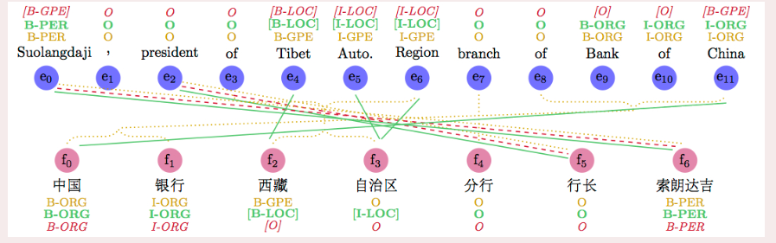
Entity Discovery (Traditional)
Highest recall: Each n-gram is a potential concept mention
  Intractable for larger documents
Surface form based filtering
  Shallow parsing (especially NP chunks), NP’s augmented with surrounding tokens, capitalized words
  Remove: single characters, “stop words”, punctuation, etc.
Classification and statistics based filtering
  English:
    Name tagging (Finkel et al., 2005; Ratinov and Roth, 2009; Li et al., 2012)
    Mention extraction (Florian et al., 2006, Li and Ji, 2014)
  X-lingual:
    Most methods train on the target language and then test on the same
    CoNLL 2003 evaluation consists of German, Dutch NER evals.
    Stanford NER using bilingual parallel text gives ~3F1 over strong CRF baselines (Wang et.al, ACL2013)
Notes:
Named Entity Recognition
We have done extensive research on improving Chinese NER performance using semi-supervised learning methods with bilingual parallel text. Our results yield significant (~3% F1) improvements over strong CRF baselines that are enhanced with distributional similarity features.
Details of the semi-supervised learning with bitext work can be found in the following papers:Mengqiu Wang and Christopher D. Manning. 2013. Cross-lingual Pseudo-Projected Expectation Regularization for Weakly Supervised Learning. Transactions of ACL 2013
Mengqiu Wang, Wanxiang Che and Christopher D. Manning. 2013. Joint Word Alignment and Bilingual Named Entity Recognition Using Dual Decomposition. ACL 2013
Mengqiu Wang, Wanxiang Che and Christopher D. Manning. 2013. Effective Bilingual Constraints for Semi-supervised Learning of Named Entity Recognizers. AAAI 2013 (Outstanding Paper Award Honorable Mention)
Wanxiang Che, Mengqiu Wang and Christopher D. Manning. 2013. Named Entity Recognition with Bilingual Constraints. NAACL 2013

Slide 52
Entity Discovery (Traditional)
Wikipedia Lexicon Construction based on prior link knowledge
  Only n-grams linked in training data (prior anchor text) (Ratinov et al., 2011; Davis et al., 2012; Sil et al., 2012; Han and Sun, 2011; Mihalcea and Csomai, 2007; Cucerzan, 2007; Milne and Witten, 2008; Ferragina and Scaiella, 2010)
    E.g. all n-grams used as anchor text within Wikipedia
  Only terms that exceed link probability threshold (Bunescu, 2006; Cucerzan, 2007; Fernandez et al., 2010; Chang et al., 2010; Chen et al., 2010; Meij et al., 2012; Bysani et al., 2010; Hachey et al., 2013; Huang et al., 2014)
  Dictionary-based chunking
  String matching (n-gram with canonical concept name list)
Mis-spelling correction and normalization (Yu et al., 2013; Charton et al., 2013)

Slide 53
Entity Discovery Systems
Multiple input sources are being used
  Some build on the given text only, some use external resources.
Methods used by some popular systems
  Illinois Wikifier?? (Ratinov et al., 2011; Cheng and Roth, 2013)
    NP chunks and substrings, NER (+nesting), prior anchor text
  TAGME (Ferragina and Scaiella, 2010)
    Prior anchor text
  AIDA (Finkel et al., 2005; Hoffart et al., 2011)
    Name Tagging
  RPI Wikifier?? (Chen and Ji, 2011; Cassidy et al., 2012; Huang et al., 2014)
    Mention Extraction (Li and Ji, 2014)
  IBM Watson Knowledge Studio (Citation?)

Slide 54
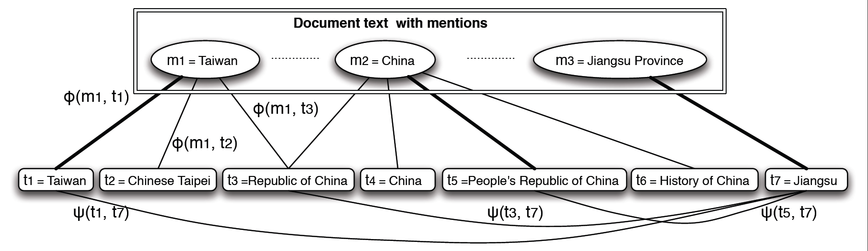
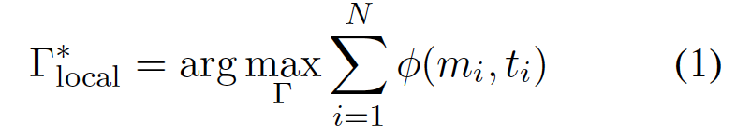
Entity Linking: Local approach
A text Document
Identified mentions
Wikipedia Articles
Local score of matching
the mention to the title
(decomposed by m_{i})
Γ is a solution to the problem
  A set of pairs (m,t)
m: a mention in the document
t: the matched Wikipedia Title
Notes:
Changed—change in related slides.

Slide 55
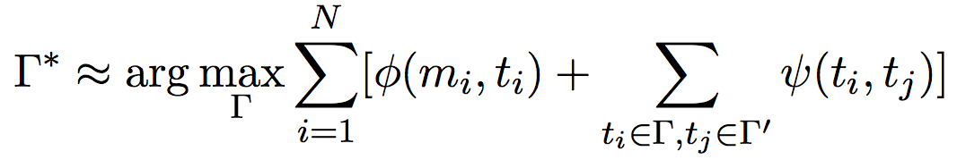
Global Approach: Using Additional Structure
Text Document(s)—News, Blogs,…
Wikipedia Articles
Adding a “global” term to evaluate how good the structure of the solution is.
Use the local solutions Γ’ (each mention considered independently.
Evaluate the structure based on pair-wise coherence scores Ψ(t_{i},t_{j})
Choose those that satisfy document coherence conditions.
Notes:
Add a cartoon of edge cover to justify that the overall problem is hard.

Slide 56
Modern/Recent approaches: Entity Representation
Until 2016-2017, key EDL approaches were “similarity based”
  Exceptions: Cucerzan’12
    Topic based representations of entities
  Entity Representation: tokens from the Wikipedia Page
  Linking decision = Similarity between context and description
  Sim( Wikipedia(mention), Text(mention) )
The move to “entity based”: representing additional information about an entity
  Context in linked data
  Types (possibly fine-grained)
Better sentence-level reasoning
Context at different granularity
Accomplished by acquiring (dense) representations for entities.

Slide 57
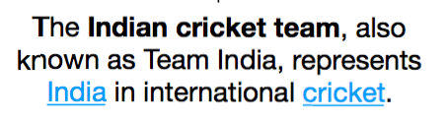


New Approach to Entity Linking [Gupta et al’17]
Learn Entity Representations
  Semantic Space of entities
  Encode information from heterogeneous sources
    Description of entity from KB (Wikipedia)
    Context in which entity is mentioned (Wikipedia Linked Data)
    Fine-Grained Types (Freebase)
  Hence, learn encoders from observed data to new representation space
Today India plays a match in England.
sports_team, organization

Slide 58
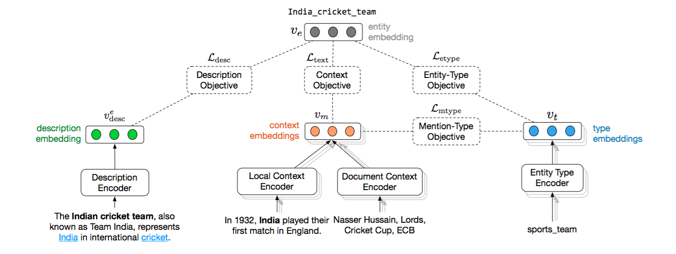
New Approach to Entity Linking [Gupta et al’17]

Slide 59
Entity Linking Results
 |  | CoNLL-Test | ACE-2005 | Wiki
Plato (Wikipedia) |  | 79.7 | - | -
AIDA* |  | 81.8 | - | -
Berkeley-CNN-Sparse* |  | 74.9 | 83.6 | 81.5
Berkeley-CNN-CNN* |  | 81.2 | 84.5 | 75.7
Berkeley-CNN-Full* |  | 85.5 | 89.9 | 82.2
Our Model |  | 82.9 | 86.8 | 89.0
 | ACE-2004
AIDA* | 77.8
Wikifier | 85.1
Vinculum | 88.5
Our Model | 90.7

Slide 60
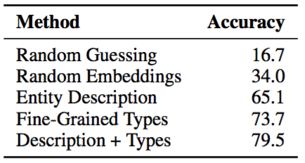
Advantage: Facilitates Cold-Start Entities
Cold-Start Entities
  Multiple KBs have different set of entities
  No Linked Data Available
  Leverage Description and Types
Our Model
  Use Description and/or fine-grained types to represent
  Use the objectives in the model to learn new entity representation
Experimentation Setup
  1000 rare entities (from Wikipedia)
  Total Mentions – 3791 Mentions
  Average 6 candidates per mentions (At least 1 per mention)

Slide 61
Outline
Motivation and Tutorial Overview 20 min Silviu
Introduction to Entity Discovery and Linking (EDL) System 20 min Dan
  Challenges: English, and Multilingual
Mono-lingual EDL approaches 30 min Avi, Dan
  High Level Algorithmic Approaches
  Old and new Approaches
Introductions to Cross-lingual EDL 20 min Dan, Avi
  Multilingual embeddings
Coffee Break
Neural Methods for Cross-lingual EDL 40 min Avi, Dan
Multiple Knowledge bases 20 min Silviu
New Tasks, Challenges, and Open questions, QA Session 30 min All
Notes:
Entity DIscovery and linking in English : earlier approaches and move to Entity representation which is nerual methods
. We expect this idea to inspire a completely new philosophy for fact
extraction which will be essential for the creation of a high-quality StructNet.
Incorporate arbitrary global features and soft constraints;
Features are automatically learned selectively
Save some human knowledge engineering efforts
Capture inter-dependency knowledge on the entire structure
Efficient linear-time beam search by joint learning and decoding
No need to model joint/conditional distribution with a large number of variables
Extract all facts jointly in a unified framework
Local predictions can be mutually improved
Avoid error compounding problem

Slide 62
Flow of MultiLingual
Introduction slide
Old and New
New requires embeddings:
  Embeddings
Multilingual NER
Transliteration
How to get embedding from Wikipedia (NAACL’16): Hard and Easy
Neural
Hard and Easy using Neural

Slide 63
Cross-Lingual Mention Detection and Wikification (EDL)
Given a non-English document, extract named entities and disambiguate into the English Wikipedia
    சிஐஏ இயக்குநர் மைக் பாம்பேயோ நியமனத்துக்கு அமெரிக்க செனட் சபை ஒப்புதல். ஆனால், சிஐஏ முகமை மற்றும் அமெரிக்க அதிபர் டிரம்ப் இடையே ஒரு பயனுள்ள அலுவல் ரீதியான உறவினை உருவாக்குவதே மைக் பாம்பேயோவின் உடனடி பணியாக இருக்கும்.
    சிஐஏ இயக்குநர் மைக் பாம்பேயோ நியமனத்துக்கு அமெரிக்க செனட் சபை ஒப்புதல். ஆனால், சிஐஏ முகமை மற்றும் அமெரிக்க அதிபர் டிரம்ப் இடையே ஒரு பயனுள்ள அலுவல் ரீதியான உறவினை உருவாக்குவதே மைக் பாம்பேயோவின் உடனடி பணியாக இருக்கும்.

Slide 64
Key Challenges
    சிஐஏ இயக்குநர் மைக் பாம்பேயோ நியமனத்துக்கு அமெரிக்க செனட் சபை ஒப்புதல். ஆனால், சிஐஏ முகமை மற்றும் அமெரிக்க அதிபர் டிரம்ப் இடையே ஒரு பயனுள்ள அலுவல் ரீதியான உறவினை உருவாக்குவதே மைக் பாம்பேயோவின் உடனடி பணியாக இருக்கும்.
    சிஐஏ இயக்குநர் மைக் பாம்பேயோ நியமனத்துக்கு அமெரிக்க செனட் சபை ஒப்புதல். ஆனால், சிஐஏ முகமை மற்றும் அமெரிக்க அதிபர் டிரம்ப் இடையே ஒரு பயனுள்ள அலுவல் ரீதியான உறவினை உருவாக்குவதே மைக் பாம்பேயோவின் உடனடி பணியாக இருக்கும்.
Identifying name mentions
Identifying possible English Wikipedia/KB titles
Computing similarity across languages
State-of-the-art methods to address these challenges for all 293 languages in Wikipedia.
  No task specific annotation.
  Demo: http://cogcomp.cs.illinois.edu/page/demo_view/xl_wikifier
Moving beyond Wikipedia Languages
Donald_Trump
Trump,_Colorado
Trumps_(Tarot_cards)
Trumpf
0.5
0.1
0.1
0.3

Slide 65
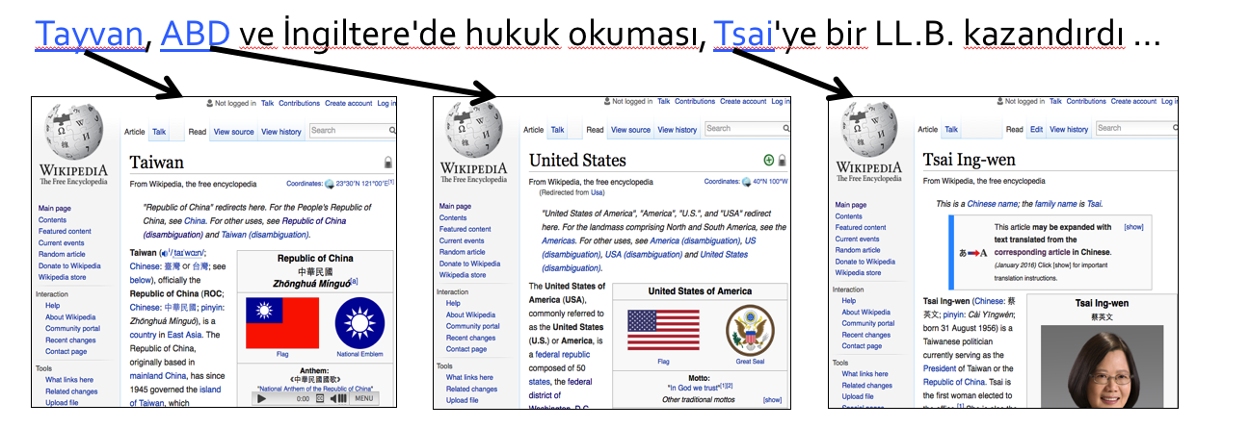
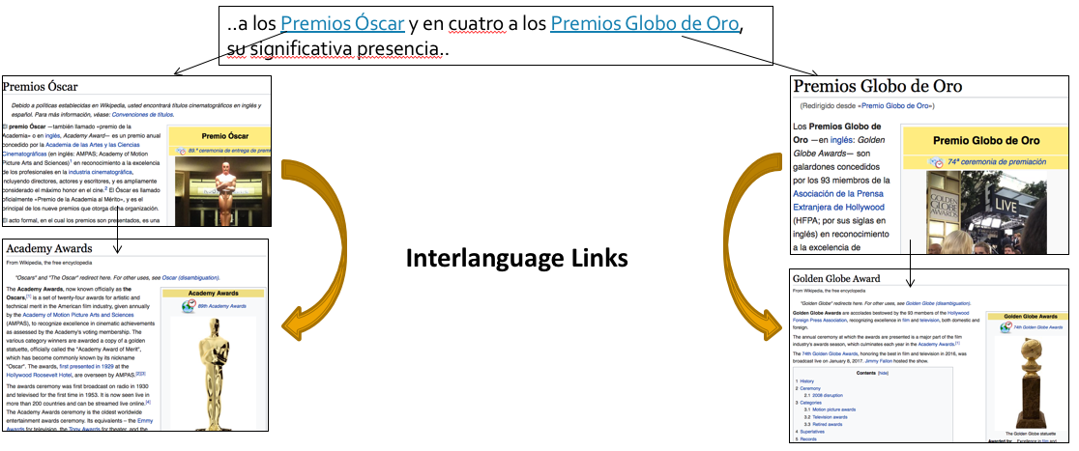
“Traditional” Cross-lingual EDL techniques
Match context from non-English docs with English Wikipedia
Use SOTA MT systems
Use inter-language links
Notes:
Inter language links maybe sparse but is still useful

Slide 66

Traditional Cross-lingual EDL Techniques
LIEL (Sil & Florian, ACL16; Sammons et.al, TAC15, Hong et.al, TAC15)
  Pros
    Train a model on log-linear English model with all language-independent features
    Use the same model for Spanish & Chinese without re-training (Sil 16)
    Translation to English + Add English Wikification (Sammons 15)
    Unsupervised EDL with AMR parsing and overnight EDL system (Hong 15)
  Cons
    Need manual hand-crafted language-independent features
    Rely on inter-language links
    Need a strong MT system
    Need strong tf-idf based features
  Key Challenges come from languages for which Wikipedia is small, and there is little data for NER in the target language.

Slide 67
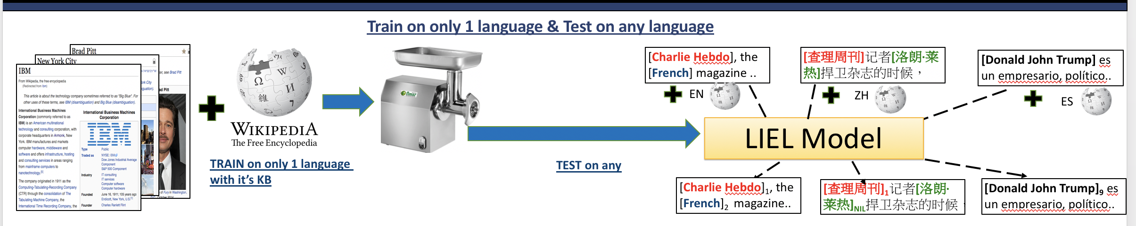
Language Independent Entity Linking (IBM LIEL) (Sil & Florian, ACL 16)
Notes:
Consistent SOTA performer at TAC evaluations

Slide 68
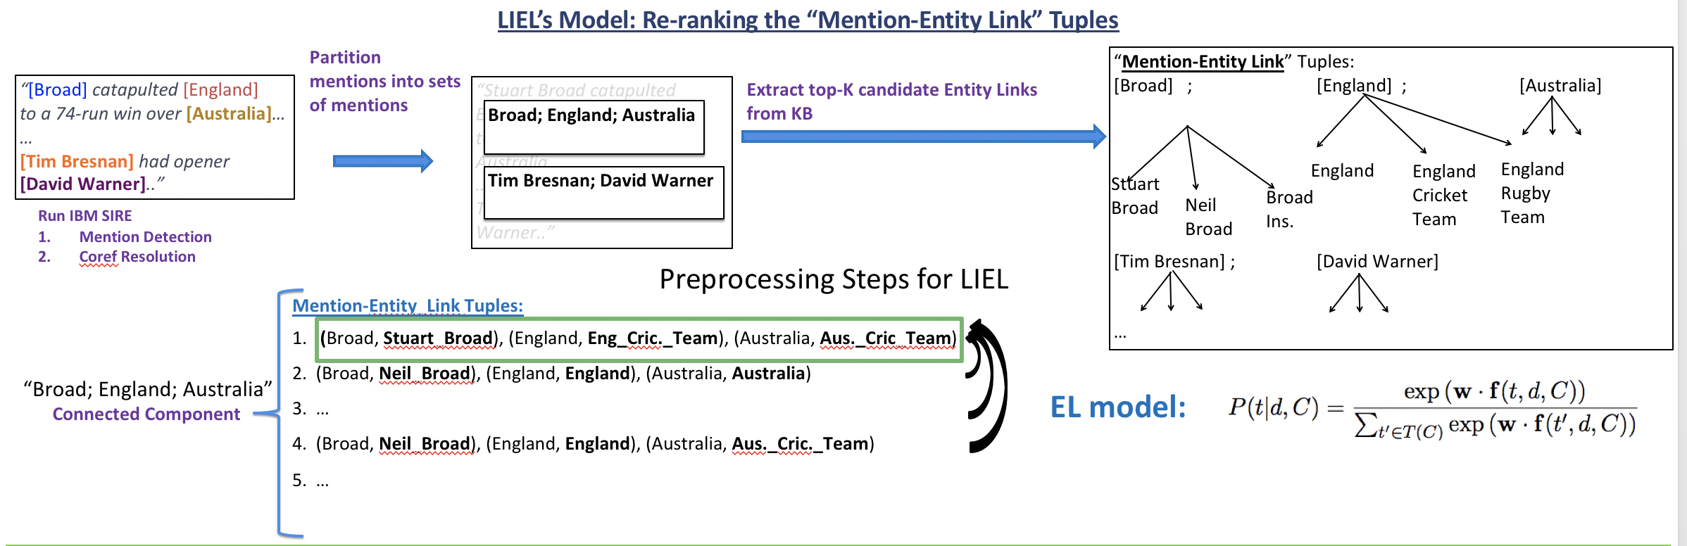
Language Independent Entity Linking (IBM LIEL) (Sil & Florian, ACL 16)
Notes:
Consistent SOTA performer at TAC evaluations

Slide 69
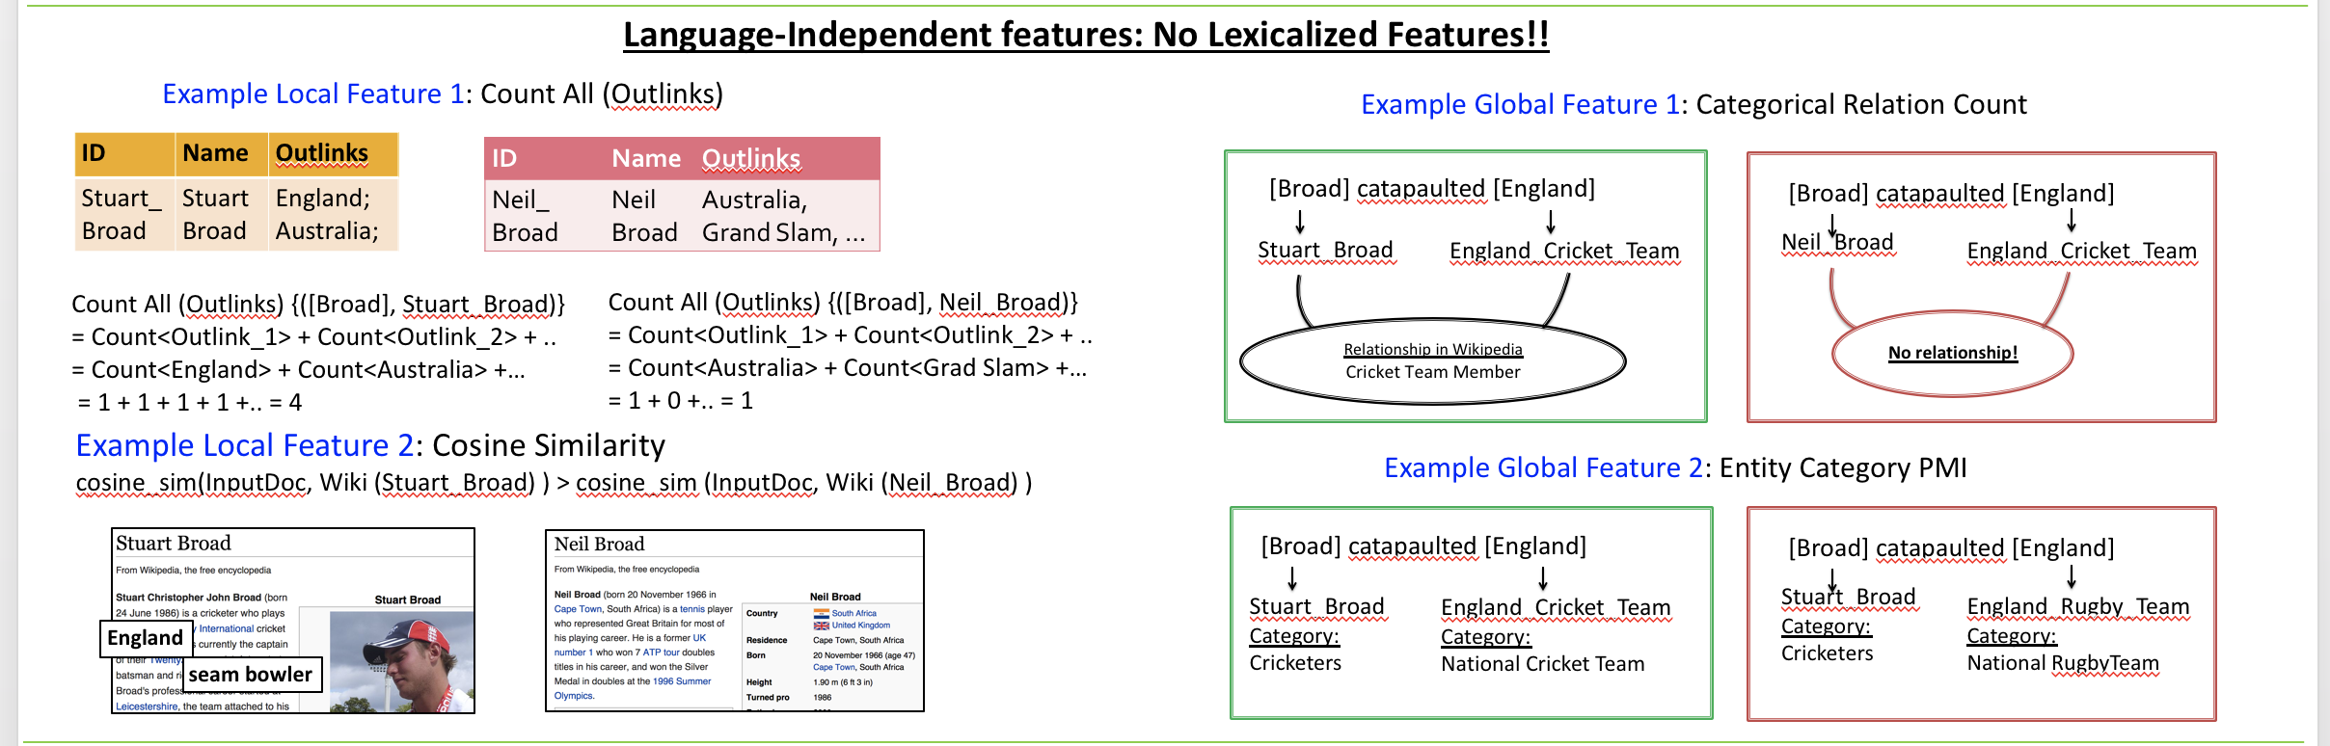
Language Independent Entity Linking (IBM LIEL) (Sil & Florian, ACL 16)
Notes:
Consistent SOTA performer at TAC evaluations

Slide 70
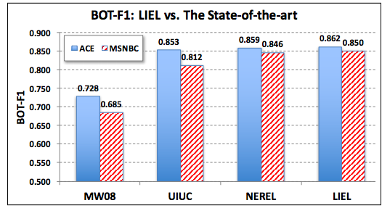
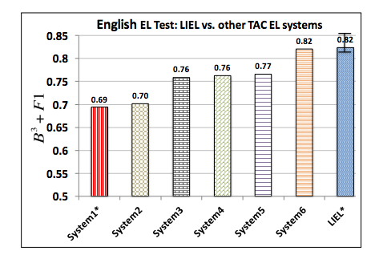
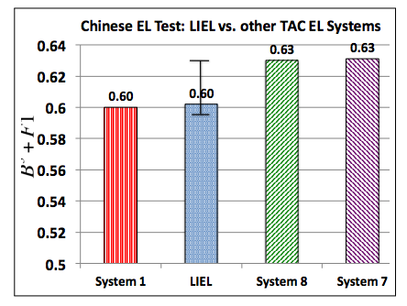
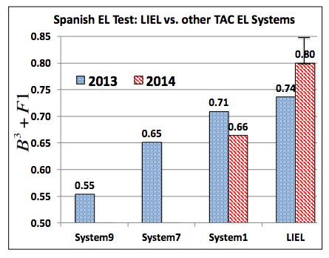
Language Independent Entity Linking (IBM LIEL) (Sil & Florian, ACL 16)
Notes:
Consistent SOTA performer at TAC evaluations

Slide 71
Traditional Cross-lingual EDL Techniques
LIEL (Sil & Florian, ACL16; Sammons et.al, TAC15, Hong et.al, TAC15)
  Pros
    Train a model on log-linear English model with all language-independent features
    Use the same model for Spanish & Chinese without re-training (Sil 16)
    Fast! And doesn’t need a whole lot of training data (Sil 16)
    Translation to English + Add English Wikification (Sammons 15)
    Unsupervised EDL with AMR parsing and overnight EDL system (Hong 15)
  Cons
    Need manual hand-crafted language-independent features
    Rely on inter-language links
    Need a strong MT system
    Need strong tf-idf based features
  Key Challenges come from languages for which Wikipedia is small, and there is little data for NER in the target language.
Notes:
Using LIEL on research projects and is very fast.

Slide 72
Similarity Metrics In Entity Linking
Cosine Similarity
  Word level token overlap
  Similarity of the topic of the document
Pros
  Simple and effective
Cons:
  Need the same tokens or lemmas
  The token “USA” will match with the token “USA” but not “United Stated of America”.
  Hence we need word embeddings
  Topic modeling doesn’t always provide useful topics

Slide 73
Multi-lingual Embeddings
(2012) Klementiev et al. CoLING
(2013) Zou et al. EMNLP, Mikolov et al. Arxiv
(2014) Hermann et al. ACL, Faruqui et al. EACL, Kocisky et al. ACL, Chandar et al. NIPS
(2015) Camacho­Collados et al. ACL, Lu et al. NAACL, Luong et al. NAACL, Guows et al. ICML, Ishiwatari et al CoNLL, Shi et al, Guo et al, Gardner et al. EMNLP, Coulmance et al. EMNLP, Vulic et al. ACL
2016 Tsai and Roth, NAACL (First in the context of EDL)
(2016) Already a few papers in NAACL, ACL.

Slide 74
Cross-lingual Representations = Continuous Approx. of Dictionaries
[ACL’16(Upadhyay & Roth) @UIUC; (Faruqui & Dyer) @ CMU]
Vectors in English
monde
law
world
English | French
children | enfants
law | loi
money | argent
world | ??
?? | paix
?? | marche
loi
market
marche
life
vie
enfants
children
war
guerre
country
pays
Vectors in French
argent
money
peace
energy
paix
energie
Cross-lingual representations act as a “continuous” approx. of the dictionary
Notes:
… ca be viewed as …
Consider this translation dict from …
In practice, this dict will have some missing entries.
But if we encode this dictionary in a cont repr space such that vectors of a word in English and its translation in French are close.
This way we can also approximate what the missing entries should have been, and generalize better.
Cross-lingual embeddings encode words in two languages L1 and L2 such that the emb. capture distributional information across lthe anguages.
For eg. here the embeddings encode translational information, resulting in a word in eng and its translation in french being aligned in space.
Hope is the embedding allow transfer of some linguistic information (either syntactic or semantic or both) in cross-lingual NLP tasks.

Slide 75
General Schema
Vectors in L1
Initial embedding (Optional) W
Cross-lingual
Supervision
L1 and L2
Cross-lingual Word Vector Model
Initial embedding (Optional) V
Vectors in L2
Notes:
Slides from Shyam Upa..

Slide 76
Forms of Cross-lingual Supervision
[ACL’16 (Upadhyay & Roth)@UIUC; (Faruqui & Dyer) @ CMU]
Decreasing Cost
(You, t’)
(Love, aime)
(I, je)
Bonjour! Je t’ aime
Je
t’
aime
Je t’ aime
Hello! How are you? I love you
I
love
You
I love you
word + sentence
sentence
word
document
BiSkip
Luong et al. 15
BiCVM
Hermann et al. 14
BiCCA
Faruqui et al. 14
BiVCD
Vulic et al. 15
Notes:
(GO SLOW) The cross lingual supervision used can be categorized into 4 categories.
We can use supervision in the form of
Alignments at word and sentence level
Alignments at sentence level alone
high quality word alignments in the form of a Bilingual dictionary
Alignment at document level in the form of Comparable corpora.
Note that from left to right the cost of obtaining the supervision decreases with word + sentence being ….
Also, note that two of the supervisions involve some form of word-level cross-lingual information.
We will compare representative models for each form of cross-lingual supervision using public implementation from their respective papers.

Slide 77
General Algorithm [Upadhyay et al. ACL’16]
Vectors for L2
Mono. Obj. of L1
Mono. Obj. of L2
Cross-lingual Obj.
Vectors for L1
Notes:
All cross-lingual embedd models can be viewed as instances of the above general algorithm.
The algo optimizes an objective containing monolingual terms A and B for each language,
and a cross lingual interaction term C, coupling the embeddings across langauges.
The output is the cross lingually trained embeddings.
We can show how to reduce the 4 models described earlier using different choices of A.B and C
For eg. for the BiSkip models, A and B are monoling skip-gram objective in each language and C is sum of two cross lingual skipgram terms D12 and D21, one from each direction.
We omit the details of choice of ABC for other models due to time constraints.

Slide 78
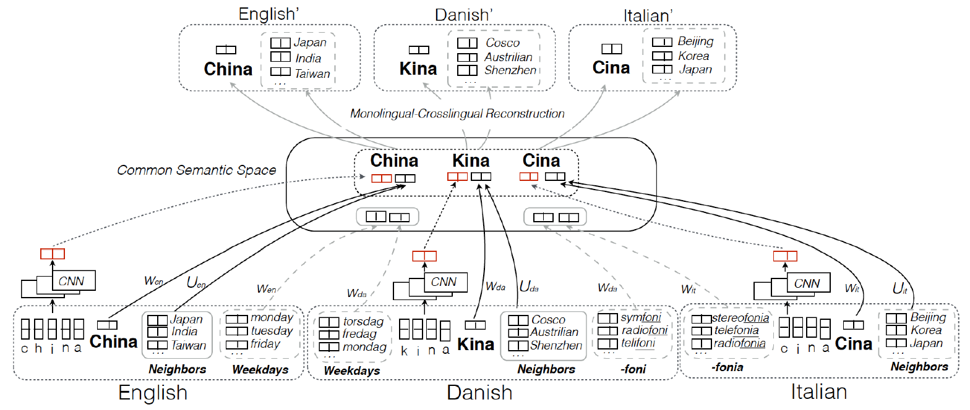
Multi-lingual Common Space Construction (Lin et al., ACL2018; EMNLP 2018)
Cluster distribution tends to be consistent across languages
Notes:
Multilingual common space distributions of words tend to be consistent across languages. What if no bilingual dictionaries.
They extend the hypothesis to distributions of clusters tend to be consistent across languages. They build three types of clusters. Character embedding, linguistic property, neighbors
The goal is to learn a common semantic space where words from multiple languages are mapped into a language-agnostic semantic continuous space, so that resources and knowledge can be shared across languages
Words can be clustered through explicit (e.g., affixes) or implicit clues (e.g., sharing neighbors). Besides word alignment, Such clusters should also be consistent and aligned across multiple languages

Slide 79
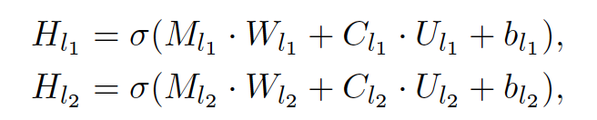
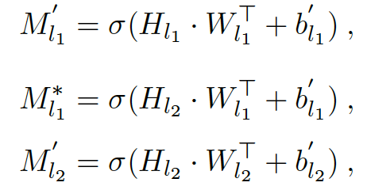
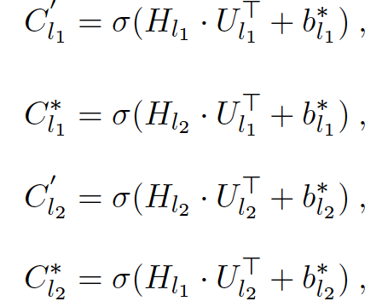

Neighboring Consistent CorrNet (Lin et al., ACL2018; EMNLP 2018)
Monolingual Projection for Words and Contexts:
Monolingual and Cross-lingual Reconstruction:
Notes:
They build their model on the basis of a Correlational Neural Network. It projects each monolingual semantic space (e.g., M_l) to a common semantic space (e.g., H_l) with a projection function (e.g., W_l), ensuring the alignment of bilingual words in the common semantic space, and reconstruct the original monolingual word embeddings from the common semantic space using the same function.
They extend CorrNet to neighbor-consistent by incorporating monolingual neighbor clusters when projecting each monolingual word into the common semantic space. For each word, its neighbor cluster can be seen as the semantic meaning representation of it in the monolingual semantic space.
For the same concept, it may have various semantic bias in multiple languages. Thus, this neighbor-consistent corrnet can ensure that the crosslingual mapping from and to the common semantic space is locally smooth.
In these formulas, M_l1 denotes the monolingual word embeddings for language l1, M_l2 denotes the monolingual word embeddings for language l2, C_l1 denotes neighboring word embeddings for l1. We use two sets of projection functions W_l, U_l to incorporate monolingual neighbor word information and project them into the common semantic space H. Then, we reconstruct each monolingual word embedding and monolingual neighbor cluster embedding using the same projection functions.

Slide 80
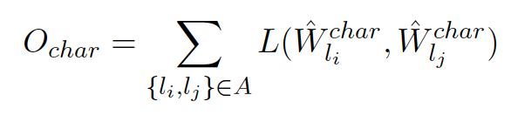
Character-Level Word Alignment (Lin et al., ACL2018; EMNLP 2018)
Motivation
  Bilingual word alignment is not always enough, especially for low resource languages; The words that refer to the same concept usually share similar sets of characters;
Char-CNN
  Character Lookup Embeddings
    For each character C, we average the embeddings of all words which contain this character.
  Character-Level CNN (Kim et al., 2016)
  Cross-lingual Mapping
Notes:
Bilingual word alignment is not always enough. They found that many related languages share very similar character set, and many words that refer to the same concept share similar compositional characters or patterns.
So they introduce character-level alignment.
For each language, for each character, they average the embeddings of all words which contain this character to initialize the character’s vector representation. Then they use language independent CNN to compose word embeddings from characters and align these word representations in the common semantic space. (Means use a language-independent CNN to learn word-level embeddings from character-level embeddings)
They concatenate these character based word representations with the projected word representations in the common semantic space as the final word representations.

Slide 81
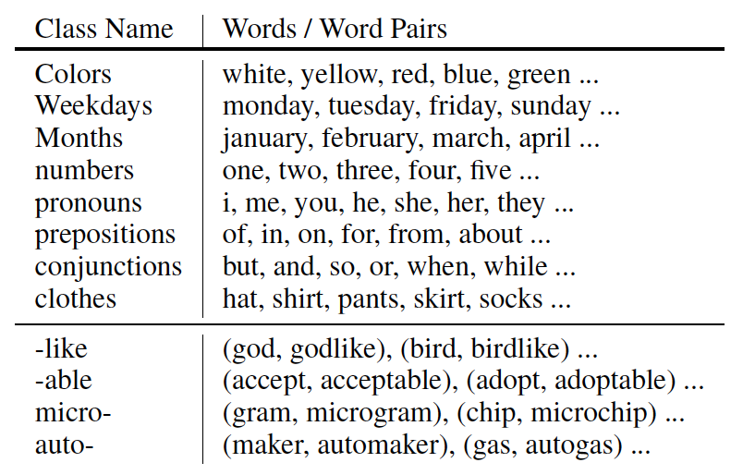
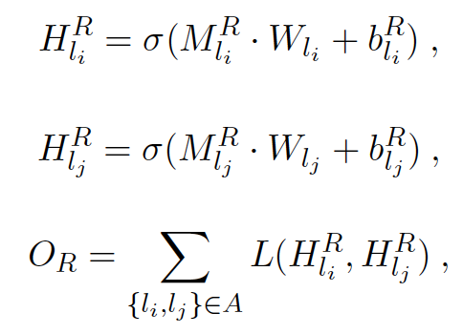
Linguistic Property Alignment (Lin et al., ACL2018; EMNLP 2018)
Knowledge Bases:
  CLDR (Unicode Common Locale Data Repository)
  Wiktionary
  Panlex
Word Clusters:
  closed word classes
  affix
Notes:
Besides, many languages also share very similar linguistic properties, such as apposition, conjunction, and plural suffix. They summarized such properties from available knowledge bases, such as CLDR, wiktionary, Panlex.
For each property, they either use a cluster of words or a cluster of word pairs to denote it.
The representation of each cluster is obtained by the average of the its word vectors. We project such cluster representations into the common semantic space and align them.

Slide 82
Cross-lingual Joint Entity and Word Embedding Learning
Code-switch cross-lingual entity/word data generation
Use English entities as anchor points to learn a mapping (rotation matrix) W which aligns distributions in IL and English
Notes:
Traditional methods of representing entity mentions consider each name mention as a common phrase, and use the combination of word embeddings for first name token and last name token. There are two major problems: (1) many names are out-of-vocabulary and they don’t appear in training data to learn word embeddings; (2) phrase embedding can’t disambiguate entities as well.
They propose a novel cross-lingual joint entity and word embedding method that not only can capture each entity mention as a single unit and perform disambiguation, but also allow all languages to share one common space. For each sentence in a foreign language (IL) Wikipedia, they replace each IL mention with the title of the English entity it’s linked to, and then use this code-switch data to learn joint entity and word embeddings for IL; then for each English Wikipedia sentence, they replace each mention with the title of the English entity it’s linked to to learn the semantic space for English. In other words, the shared linked English entities become the anchor to align two spaces.
They gradually rotate the IL space so it can be aligned with the English space by learning a mapping function (rotation matrix).
There are two cool results: (1) for linkable mentions, they can perform unsupervised cross-lingual entity linking by linking each IL mention to its closest English entity; (2) they can use it to perform unsupervised NIL clustering. E.g. 小米 is an unlinkable mention but from the aligned space we can clearly see it’s closet to English entities like Apple_Inc and words such as phone, macintosh and we an infer it’s likely to be a tech company.
Code-switch, english anchor link, learn rotation matrix to align two spaces. So now we get xiaomi is aligned to apple_inc, so we at least know it’s tech company

Slide 83
1. Identifying Named Entity Mentions
    சிஐஏ இயக்குநர் மைக் பாம்பேயோ நியமனத்துக்கு அமெரிக்க செனட் சபை ஒப்புதல். ஆனால், சிஐஏ முகமை மற்றும் அமெரிக்க அதிபர் டிரம்ப் இடையே ஒரு பயனுள்ள அலுவல் ரீதியான உறவினை உருவாக்குவதே மைக் பாம்பேயோவின் உடனடி பணியாக இருக்கும்.
    சிஐஏ இயக்குநர் மைக் பாம்பேயோ நியமனத்துக்கு அமெரிக்க செனட் சபை ஒப்புதல். ஆனால், சிஐஏ முகமை மற்றும் அமெரிக்க அதிபர் டிரம்ப் இடையே ஒரு பயனுள்ள அலுவல் ரீதியான உறவினை உருவாக்குவதே மைக் பாம்பேயோவின் உடனடி பணியாக இருக்கும்.

Slide 84
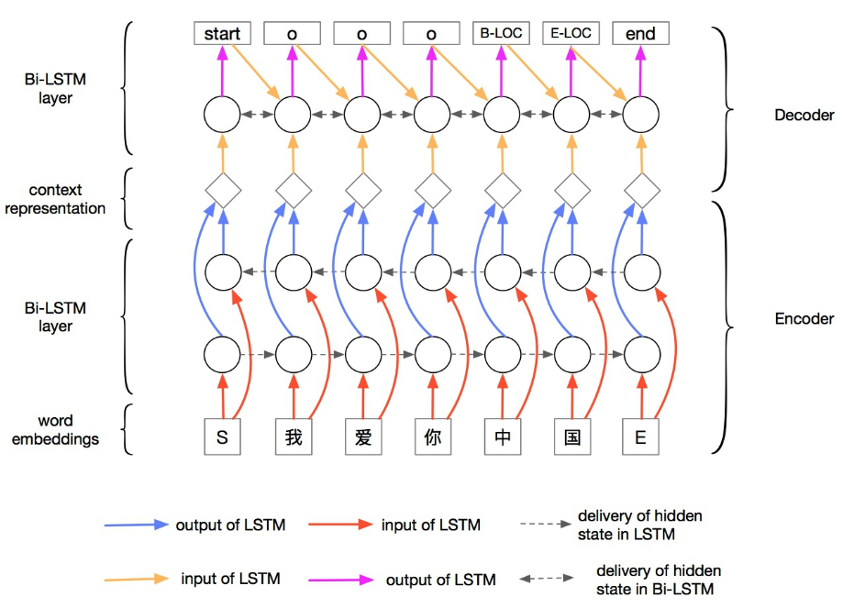
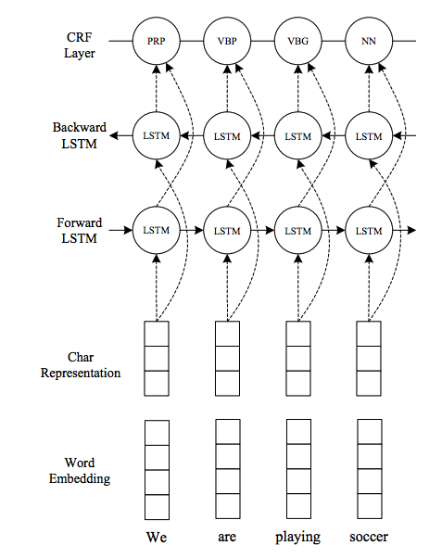


Neural Entity Discovery
Bi-LSTM CRF is the dominant model when
there is a lot of training data.
Adaptation, and performance when there is little training data are questionable.
“Traditional” models (e.g., Illinois NER; LREC’18) outperform them in these cases.
BLSTM-CRF:
Notes:
Started with RNNs..then everyone in the planet used BiLSTMs

Slide 85
Mention Detection
Standard IOB sequence classifier, trained on the task
2 main classifiers: CRF and Neural Network-based

Slide 86

Mention Detection (NN) (Sil et.al, 17)
Standard IOB sequence classifier, trained on the task
Model probability:
Additional features: Gazetteers, Character-level LSTMs
Recurrence: previous 2 labels are embedded and added as input

Slide 87
System Combination for Mention Detection at TAC-KBP (Sil et.al, 17)
Perform NN + CRF systems
Both systems have high precision
We combine them as follows
  Start with the “best” system
  For each consequent system
    Add any mentions that do not overlap with the current output
 | CRF - dev | NN - dev | NN+CRF - tst
English | 0.803 | 0.843 | 0.806
Spanish | 0.785 | 0.809 | 0.785
Chinese | 0.811 | 0.843 | 0.699
Notes:
Test CRF numbers are worse. Generalized worse than the NN models which seems robust across the Languages and datasets.
Lample same for CMN and ENG but low on SPA.

Slide 88
Pilot Task – minimally supervised transfer at TAC-KBP (Sil et.al, 17)
Train cross-lingual embeddings in En and foreign language
Train a En mention detection model
Decode new languages using the En model and mapped embeddings
Notes:
CMN, SPA: 10k word pairs and translation prob from a phrase table
Trained a linear map weighing the samples using the weights from the phrase tables
Now using the translation matrix/ mapping you can map any unseen words from the foreign language into the english space

Slide 89
Mention Detection for Pilot Task at TAC-KBP (Sil et.al, 17)
Weak classifiers:
  Silver-data trained models
  Cross-lingual transfer of models with: 1. TAC data and 2. In-house mention detection data
Train a NN classifier to combine all the weak classifier outputs
Use Spanish as a test case, apply to all other languages
 | Silver-trained | Best transfer | Combination | Supervised
Spanish | 0.335 | 0.609 | 0.704 | 0.809
Notes:
Followed Ni etal17, we’ve models with KLUE annotation using which we already had projection models for the languges
Also we used the KLUE labels
NN classifer combiner is a FF NN.
Best transfer : models with best precision/recall tradeoffs
In total we’d 5 models, 1 silver, 4 transfer

Slide 90

Results:

Slide 91
Named Entities Challenges
We already know that, when we have a lot of annotated data, we can learn excellent NER models.
What if we don’t have a lot of Data/Resources?
All the key approaches to deal with it focus on developing ways to get better annotations in the target language, via projection
  Once you have it, train your standard NER model.
Or, train your standard NER model so that it also works on the target language
  Via cross-lingual features.

Slide 92
Multilingual NER via Wikification
NER for many languages
  Person, Organization, Location, …, Miscellaneous
Challenge: no training data in most languages
Approach: Directly transfer a model trained on another language
  Language-independent features
Turkish
Tayvan, ABD ve İngiltere'de hukuk okuması, Tsai'ye bir LL.B. kazandırdı
Tayvan, ABD ve İngiltere'de hukuk okuması, Tsai'ye bir LL.B. kazandırdı
English training data
U.N. official Ekeus heads for Baghdad
NER Model
Bengali
এটি মূলত তুরস্কে কথিত হয়, তবে সাইপ্রাস, গ্রিস, ও পূর্ব ইউরোপের বহু দেশে তুর্কীভাষী সম্প্রদায় আছে
এটি মূলত তুরস্কে কথিত হয়, তবে সাইপ্রাস, গ্রিস, ও পূর্ব ইউরোপের বহু দেশে তুর্কীভাষী সম্প্রদায় আছে
German training data
Verstehen Albrecht Lehmann läßt Flüchtlinge und
Model Transfer via Cross-Lingual
Wikifier
Yoruba
Indonésíà jẹ́ orílẹ̀-èdè olómìnira, pẹ̀lú aṣòfin àti ààrẹ adìbòyàn. Olúìlú rẹ̀ ni Jakarta.
Indonésíà jẹ́ orílẹ̀-èdè olómìnira, pẹ̀lú aṣòfin àti ààrẹ adìbòyàn. Olúìlú rẹ̀ ni Jakarta.

Slide 93
Enhancing Transfer: Key Idea
Instead of the traditional pipeline: NER Wikification
Cross-lingual grounding component
  Input: foreign language string
  Output: ranked English Wikipedia titles
Cross-Lingual Grounding
Multilingual NER
English Candidate Generation
English Candidate Ranking

Slide 94
NER with no Target Language Training Data
Cross-lingual Wikification generates good language-independent features for NER by grounding n-grams
Words in any language are grounded to the English Wikipedia
  Features extracted based on the titles can be used across languages
Instead of the traditional pipeline: NER → Wikification
  Wikified n-grams provide features for the NER model
Person
Location
… nachvollziehenden Verstehen Albrecht Lehmann läßt Flüchtlinge und Vertriebene in Westdeutschland
Understanding
Albert,_Duke_of_Prussia
Jens_Lehmann
Refugee
Western_Germany
media_common
quotation_subject
person
noble_person
person
athlete
field_of_study
literature_subject
location
country

Slide 95
Cross-Lingual NER Model
We use Illinois NER [Ratinov and Roth, 2009] as the base model
Features
  Wikifier features facilitate direct transfer!
Feature Group | Description
Base features | Word forms and affixes
 | Word type: contain capital? digit?
 | Previous tag pattern
 | Tag context
 | Previous tags
Gazetteers | Wikipedia titles in multiple languages
Wikifier | Freebase types and Wikipedia categories

Slide 96
Results [Tsai et. al. CoNLL’16]
Works on all Wikipedia languages; evaluated on 9 languages for which we can train monolingual models, and evaluate.
 | English | Dutch | German | Spanish | Turkish | Tagalog | Yoruba | Bengali | Tamil | Avg
Wikipedia Size | 5.1M | 1.9M | 1.9M | 1.3M | 269K | 64K | 31K | 42K | 85K
Monolingual Experiments (train and test on the same language)
Direct Transfer Experiments (train on English)
Non-latin script
Täckström’12 |  | 58.4 | 40.4 | 59.3 | - | - | - | - | - | -
Zhang’16 |  | - | - | - | 43.6 | 51.3 | 36.0 | 34.8 | 26.0 | -

Slide 97
Transfer via Cheap Translation [Mayhew, Tsai, Roth EMNLP’17]
But it is good enough for NER!
Start with English Gold NER data
Translate word-by-word into Turkish
Result is “Turkish-flavored English”
  Further Improvement – Translate from a Similar Language
Train with any standard, state-of-the-art NER (here: Illinois-NER)
Translation is bad:
  Ignorance of morphology
  Wrong word order
  Missing vocabulary

Slide 98

Wikifier Features
Further improvement to the annotation transfer can be achieved via additional cross-lingual features [Tsai et. al. CoNLL’16]
Given data in language X, ground n-grams to Wikipedia using Cross-Lingual Wikifier
  Ground to English Wikipedia
  Use Wikipedia categories and Freebase types as features
Shown to produce Robust Cross-lingual features
  Orthogonal to the annotation transfer approach, easy to combine.
Even though the wikifier makes mistakes, it gets pretty good “types”

Slide 99

Cheap Translation Transfer: Results [EMNLP’17]
Google Translate is the ceiling here, and is surprisingly low.
  Outperform it once we add Wikification features.
Outperform state of the art by 5.2 points F1
Enhancing by transfer from similar languages adds 1.6 F1.

Slide 100
2. Identifying English Title Candidates
    சிஐஏ இயக்குநர் மைக் பாம்பேயோ நியமனத்துக்கு அமெரிக்க செனட் சபை ஒப்புதல். ஆனால், சிஐஏ முகமை மற்றும் அமெரிக்க அதிபர் டிரம்ப் இடையே ஒரு பயனுள்ள அலுவல் ரீதியான உறவினை உருவாக்குவதே மைக் பாம்பேயோவின் உடனடி பணியாக இருக்கும்.
Central_Intelligence_Agency
Cairo_International_Airport
C.I.A_(group)
California_Institute_of_Art
Donald_Trump
Trump,_Colorado
Trumps_(Tarot_cards)
Trumpf

Slide 101
Identifying English Title Candidates
Given a non-English name, retrieve a set of English title candidates
Two intuitive methods:
  Querying English titles by the foreign name directly.
    “Obama” is expressed identically in Spanish
  Querying foreign titles in the foreign Wikipedia and follow the inter-language links in Wikipedia
  Problem: Coverage is |Wikipedia (foreign) ∩ Wikipedia (English))|
Spanish Mention
Spanish Title
English Title
ruso
Rusia
Russia
Relaciones Exteriores de Ucrania
No Spanish Title
 | Spanish | Turkish | Bengali
#Aligned titles / #English titles | 16.14% | 3.74% | 0.75%
Proposed Method | 64.62% | 63.47% | 65.18%

Slide 102
Identifying English Title for Foreign Mentions: Key Idea
Translate the foreign names into English, and query the English title index
Learning name translation from Wikipedia title pairs
  Inter-language links
  Transliteration is needed
  Phrase pairs instead of word pairs
    Word Alignment is needed
  We propose a probabilistic model to learn word alignment and transliteration jointly
universidad de keiō keio university
carranza karrantza
fuerza aérea eslovaca slovak air force

Slide 103

Name Translation Model
Given a foreign-English title pair (F, E)
    A: word alignment
    a_{A}: sub-word alignment
    m: # of words in F
Example: (F, E) = (universidad de keiō, keio university)
univer-sidad de ke-iō
  P( )
  ke-io univer-sity
  = P ( ) P(ke | ke) P(iō | io) P(univer | univer) P(sidad | sity)

Slide 104
Experiments
6 other approaches
  4 traditional transliteration model [Jiampojamarn et al., 2008, Bisani and Ney, 2008, Pasternack and Roth, 2009, Liu et al., 2016]
    Word alignment as preprocessing
    LM reordering
  2 character-based NMT models [Chung et al., 2016, Lee et al., 2016]
9 languages
  Spanish, German, Turkish, Tagalog, Bengali, French, Italian, Hebrew, Arabic
All models are trained on the same training data

Slide 105
Candidate Generation Performance
Percentage of mentions that have gold title in the candidate set
Average of 9 languages
NMT-char NMT-bpe JANUS DirecTL+ Sequitur P&R Ours
 | Current upper bound | Proposed method
Spanish | 40.44% | 64.62%
Bengali | 20.82% | 65.18%
Tagalog | 16.23% | 73.23%

Slide 106
Challenge: Low-Resource Transliteration for Cross-lingual Entity Linking
Can we learn a good transliteration model from a low resource language to English with little training data?
Can we identify what kind of examples should we seek from native annotator?
How to correctly use the transliteration model for improving cross-lingual entity linking and vice versa?

Slide 107
3. Computing Cross-Lingual Similarity [Tsai and Roth, NAACL’16]
Key Challenge
  Similarity of non-English words and English Wikipedia titles
  Relevance score of (foreign mention, English title candidate)
Our Solution
  Jointly embed words and titles of two languages in the same continuous vector space (based on CCA; e.g., Faruqui and Dyer ‘14, Upadhyay et. al. ‘16)
  Instead of a dictionary, use the title mapping obtained from inter-language links
  Used to augment the ranking model (only requires a Wikipedia dump)
    சிஐஏ இயக்குநர் மைக் பாம்பேயோ நியமனத்துக்கு அமெரிக்க செனட் சபை ஒப்புதல். ஆனால், சிஐஏ முகமை மற்றும் அமெரிக்க அதிபர் டிரம்ப் இடையே ஒரு பயனுள்ள அலுவல் ரீதியான உறவினை உருவாக்குவதே மைக் பாம்பேயோவின் உடனடி பணியாக இருக்கும்.
Cairo_International_Airport
Central_Intelligence_Agency
C.I.A_(group)
California_Institute_of_Art
Donald_Trump
Trump,_Colorado
Trumps_(Tarot_cards)
Trumpf

Slide 108

Cross-Lingual Wikification Using Multilingual Embeddings
Given mentions in a non-English document, find the corresponding titles in the English Wikipedia
cuarto y actual presidente de los Estados Unidos de América
Amerika Birleşik Devletleri'nin devlet başkanıdır.
ஐக்கிய அமெரிக்காவின் தற்போதைய குடியரசுத் தலைவர்
นประธานาธิบดีคนที่ 44 คนปัจจุบันของสหรัฐอเมริกา
也是第44任美國總統
dake yankin Hawai a ƙasar Amurika
Key Challenge
  Matching words in a foreign language to
  English Wikipedia titles
Jointly embedding words and titles
in different languages

Slide 109
Multilingual Word and Title Embeddings
Learn joint mono-lingual word and title embeddings [Wang et. al. 14]
  "It is led by and mainly composed of Sunni Arabs from Iraq..."
  "It is led by and mainly composed of en.wikipedia.org/wiki/Sunni_Islam Arabs from en.wikipedia.org/wiki/Iraq..."
  Skip-gram with negative sampling [Mikolov et al., 2013]
Done for English and target Language L.
Since titles appear as a token in the transformed text, we will obtain an embedding for each word and title from the model.

Slide 110
Multilingual Word and Title Embeddings (Cont.)
Aligning embeddings of two languages using the CCA-based model [Hotelling, 1936]
Rather than using a dictionary which maps the words between two languages, we use the title mappings in Wikipedia.
P_{en}, P_{tr} = CCA( , )
M_{en} = E_{en} P_{en} , M_{tr} = E_{tr} P_{tr}
  E: Monolingual embeddings
  M: Multilingual embeddings
United_States
Texas
Turkey
Istanbul
…
Amerika_Birleşik_Devletleri
Teksas
Türkiye
İstanbul
…

Slide 111
Evaluating Multlingual Wikipedia Dataset
Language | #Training | #Test
German | 23,124 | 9,798
Spanish | 30,471 | 12,153
French | 37,860 | 14,358
Italian | 34,185 | 12,775
Chinese | 44,246 | 11,394
Hebrew | 20,223 | 16,146
Thai | 16,819 | 11,381
Arabic | 22,711 | 10,646
Turkish | 12,942 | 13,798
Tamil | 21,373 | 11,346
Tagalog | 4,835 | 1,074
Urdu | 1,413 | 1,389
Spanish German French Italian Chinese
Hebrew Thai Arabic Turkish Tamil Tagalog Urdu

Slide 112
Evaluation [Tsai & Roth’16]
Create a dataset from 12 languages of Wikipedia articles
Languages | # Training | # Test (# Hard)
German | 23,124 | 9,798 (3,266)
Spanish | 30,471 | 12,153 (4,051)
French | 37,860 | 14,358 (4,786)
Italian | 34,185 | 12,775 (4,254)
Chinese | 44,246 | 11,394 (3,798)
Hebrew | 20,223 | 16,146 (5,382)
Thai | 16,819 | 11,381 (3,792)
Arabic | 22,711 | 10,646 (3,549)
Turkish | 12,942 | 13,798 (4,598)
Tamil | 21,373 | 11,346 (3,776)
Tagalog | 4,835 | 1,074 (358)
Urdu | 1,413 | 1,389 (463)
Hard mentions:
can’t be solved by the
most common title given the mention

Slide 113
Wikipedia Dataset [Tsai&Roth’16]
For many mentions in Wikipedia, the baseline of simply choosing the title that maximizes Pr(title|mention) is very good
Language | Method | Hard | Easy | Total
Spanish | EsWikifier | 40.11 | 99.28 | 79.56
 | MonoEmb | 38.46 | 96.12 | 76.90
 | WordAlign | 48.75 | 95.78 | 80.10
 | WikiME | 54.46 | 94.83 | 81.37
Chinese | MonoEmb | 43.73 | 97.85 | 79.81
 | WikiME | 57.61 | 98.03 | 84.55
Turkish | MonoEmb | 40.47 | 98.15 | 78.93
 | WikiME | 60.18 | 97.55 | 85.10
Tamil | MonoEmb | 34.51 | 98.65 | 77.30
 | WikiME | 54.13 | 99.13 | 84.15
Tagalog | MonoEmb | 35.47 | 99.44 | 78.12
 | WikiME | 56.70 | 98.46 | 84.54

Slide 114
Extensions: Character-Level Word Alignment
Motivation
  Bilingual word alignment is not always enough, especially for low resource languages; The words that refer to the same concept usually share similar sets of characters;
Char-CNN
  Character Lookup Embeddings
    For each character C, we average the embeddings of all words which contain this character.
  Character-Level CNN (Kim et al., 2016)
  Cross-lingual Mapping
Notes:
Bilingual word alignment is not always enough.
We found that many related languages share very similar character set, and many words that refer to the same concept share similar compositional characters or patterns. So we introduce character-level alignment. For each language, for each character, we average the embeddings of all words which contain this character to initialize the character’s vector representation. Then we use language independent CNN to compose word embeddings from characters and align these word representations in the common semantic space. We concatenate these character based word representations with the projected word representations in the common semantic space as the final word representations.

Slide 115
Linguistic Property Alignment
Knowledge Bases:
  CLDR (Unicode Common Locale Data Repository)
  Wiktionary
  Panlex
Word Clusters:
  closed word classes
  affix
Notes:
Besides, many languages also share very similar linguistic properties, such as apposition, conjunction, and plural suffix. We summarized such properties from available knowledge bases, such as CLDR, wiktionary, Panlex. For each property, we either use a cluster of words or a cluster of word pairs to denote it.
The representation of each cluster is obtained by the average of the its word vectors. We project such cluster representations into the common semantic space and align them.

Slide 116

Intrinsic Evaluation
QVEC: correlation between vectors compared to human created ground truth
QVEC-CCA: correlation between matrices
3 languages: English, Danish, Italian
12 languages: Bulgarian, Czech, Danish, German, Greek, English, Spanish, Finnish, French, Hungarian, Italian, Swedish
Notes:
By introducing the neighboring words, the monolingual QVEC and QVEC-CCA can be improved;
By introducing the character-level compositional representations and linguistic property based clusters, the multilingual representation quality is improved.

Slide 117

Impact of Bilingual Dictionary Size
Previous methods MultiCCA and CorrNet approaches are very sensitive to the size of bilingual lexicons
Our approach maintains high performance, even when the size of bilingual lexicons is reduced to 2,000
Notes:
We further show the impact of the size of bilingual word dictionaries on the construction of the common semantic space.
We use three languages as a case study, and gradually reduce the size of the lexicons for each pair of languages from 40,000 to 10,000 and 2,000. We can see that both MultiCCA and CorrNet approaches are very sensitive to the size of bilingual lexicons.
Our approach on the other hand could maintain high performance even when the bilingual lexicons were reduced to 2,000.

Slide 118
Cross-lingual Joint Entity and Word Embedding Learning
Code-switch cross-lingual entity/word data generation
Use English entities as anchor points to learn a mapping (rotation matrix) W which aligns distributions in IL and English
Notes:
Code-switch, english anchor link, learn rotation matrix to align two spaces. So now we get xiaomi is aligned to apple_inc, so we at least know it’s tech company

Slide 119
Outline
Motivation and Tutorial Overview 20 min Silviu
Introduction to Entity Discovery and Linking (EDL) System 20 min Dan
  Challenges: English, and Multilingual
Mono-lingual EDL approaches 30 min Avi, Dan
  High Level Algorithmic Approaches
  Old and new Approaches
Introductions to Cross-lingual EDL 20 min Dan, Avi
  Multilingual embeddings
Coffee Break
Neural Methods for Cross-lingual EDL 40 min Avi, Dan
Multiple Knowledge bases 20 min Silviu
New Tasks, Challenges, and Open questions, QA Session 30 min All
Notes:
Entity DIscovery and linking in English : earlier approaches and move to Entity representation which is nerual methods
. We expect this idea to inspire a completely new philosophy for fact
extraction which will be essential for the creation of a high-quality StructNet.
Incorporate arbitrary global features and soft constraints;
Features are automatically learned selectively
Save some human knowledge engineering efforts
Capture inter-dependency knowledge on the entire structure
Efficient linear-time beam search by joint learning and decoding
No need to model joint/conditional distribution with a large number of variables
Extract all facts jointly in a unified framework
Local predictions can be mutually improved
Avoid error compounding problem

Slide 120
Reminder: Key Challenges in Cross-Lingual EDL
    சிஐஏ இயக்குநர் மைக் பாம்பேயோ நியமனத்துக்கு அமெரிக்க செனட் சபை ஒப்புதல். ஆனால், சிஐஏ முகமை மற்றும் அமெரிக்க அதிபர் டிரம்ப் இடையே ஒரு பயனுள்ள அலுவல் ரீதியான உறவினை உருவாக்குவதே மைக் பாம்பேயோவின் உடனடி பணியாக இருக்கும்.
    சிஐஏ இயக்குநர் மைக் பாம்பேயோ நியமனத்துக்கு அமெரிக்க செனட் சபை ஒப்புதல். ஆனால், சிஐஏ முகமை மற்றும் அமெரிக்க அதிபர் டிரம்ப் இடையே ஒரு பயனுள்ள அலுவல் ரீதியான உறவினை உருவாக்குவதே மைக் பாம்பேயோவின் உடனடி பணியாக இருக்கும்.
Identifying name mentions
Identifying possible English Wikipedia/KB titles
Computing similarity across languages
State-of-the-art methods to address these challenges for all 293 languages in Wikipedia.
  No task specific annotation.
  Demo: http://cogcomp.cs.illinois.edu/page/demo_view/xl_wikifier
Moving beyond Wikipedia Languages
The Neural Methods introduced next focus on a good entity representation that facilitates similarity across languages. Mentions are assumed given.
Donald_Trump
Trump,_Colorado
Trumps_(Tarot_cards)
Trumpf
0.5
0.1
0.1
0.3

Slide 121



Cross-Lingual Entity Linking
Tayvan, ABD ve İngiltere'de hukuk okuması, Tsai'ye bir LL.B. kazandırdı …
Example by Tsai & Roth’16
  Challenges:
    Link to the English Wikipedia
    Comparing non-English words to English Wikipedia titles
Notes:
Given mentions in a non-English document, find the corresponding titles in the English Wikipedia
This is a Turkish document

Slide 122



Zero-shot Cross-lingual Entity Linking (Sil et.al. AAAI18)
Correct
Link
(C=1)
Incorrect
Link
(C=0)
$$Softmax(W_{0}h+ b_{0})$$
$$h=σ(W_{h}S+b_{h})$$
…
RBF
Layer
MPCM
Layer
…
…
Cosine features
LIEL features
LDC Vectors
Query Ctx
Wiki Ctx

Slide 123


Problem Formulation (English EL)
Given: Query mention $m$and a document $D ∈en$and Wikipedia KB_{en}
Step 1 (Fast Search): Extract the most likely list of links $l_{j_{1}}$,.., $l_{j_{m}}$ for $m$ in $D$
Step 2 (Ranking): Estimate:
where “$C$” is the consistency measure for matching contexts between:
  the pair ($m,D$) and a Wikipedia link $lj$

Slide 124

Problem Formulation (cross-lingual EL)
Given: Query mention $m$and a document $D ∈tr$and Wikipedia KB_{en}
Step 1 (Fast Search): Extract the most likely list of links $l_{j_{1}}$,.., $l_{j_{m}}$ for $m$ in $D$
Step 2 (Ranking): Estimate:
where “$C$” is the consistency measure for matching contexts between:
  the pair ($m,D$) and a Wikipedia link $lj$

Slide 125
Cross-Lingual Entity Linking
Tayvan, ABD ve İngiltere'de hukuk okuması, Tsai'ye bir LL.B. kazandırdı …
Example by Tsai & Roth’16
  Challenges:
    Link to the English Wikipedia
    Comparing non-English words to English Wikipedia titles
Notes:
Given mentions in a non-English document, find the corresponding titles in the English Wikipedia
This is a Turkish document

Slide 126




Fast Search (Cross-Lingual)
..a los Premios Óscar y en cuatro a los Premios Globo de Oro, su significativa presencia..
Interlanguage Links
Premios Oscar: en/Academy_Awards (probability: 1.0)
Premios Globo de Oro: en/Golden_Globe_Awards (probability: 1.0)

Slide 127
Neural Model Architecture
Correct
Link
(C=1)
Incorrect
Link
(C=0)
$$Softmax(W_{0}h+ b_{0})$$
$$h=σ(W_{h}S+b_{h})$$
…
MPBL
Layer
MPCM
Layer
…
…
Cosine features
LIEL features
LDC Vectors
Query Ctx
Wiki Ctx

Slide 128

Neural Model Architecture
Feature Abstraction Layer

Slide 129
Modeling Context from the query Document
Get all sentences from the entity coref chain
Concatenate them together
  Get a variable length representation
“ [Broad] catapulted [England] to a 74-run win over [Australia]…
[Broad] sent captain [Michael Clarke]'s off stump cart-wheeling before [Steve Smith]..
[Broad] and [Bresnan] found their stride in the evening session..”

Slide 130
Modeling Context from the query Document
tanh
Mean Pool
Convolution
Layer
Context from the Source Document

Slide 131


Modeling Context from target Wikipedia page
Get all possible links of the mention from the KB
“ [Broad] catapulted [England] to a 74-run win over [Australia]…

Slide 132

Modeling Context from target Wikipedia page
Extract the first paragraph of the current link/page
Run CNNs on them

Slide 133


Wikipedia Link Embeddings
Objective: Model the whole Wikipedia page for an entity
We compute the embeddings $ep$ of the page $p$:
Notes:
CNNs are expensive to compute over all the sentences in the WP page of famous entities

Slide 134
Fine Grained Context Modeling
Final Context Vector
Slices of NTN
Overall Left Context
Overall Right
Context
…
Mean-pooling
Mean-pooling
…
h₁
h₂
h_{m}
h₇
h₈
h_{m}
h_{m}
h₂₁
h₂₂
h_{m}
h₄₁
h₄₂
LSTM
LSTM
LSTM
LSTM
LSTM
LSTM
LSTM
LSTM
LSTM
LSTM
LSTM
LSTM
…
…
w₁
w₂
m
w₇
w₈
m
m
w₂₁
w₂₂
m
w₄₁
w₄₂
Left Context 1
Left Context n
Right Context 1
Right Context 1

Slide 135
Feature Abstraction Layer
Similarity Features by comparing Context Representations
  “Sentence context - Wiki Link” Similarity
  “Sentence context - Wiki First Paragraph” Similarity
  “Fine-grained context - Wiki Link” Similarity
  Within-language Features (LIEL, Sil & Florian, ACL16)
Semantic Similarities and Dis-similarities
  Lexical Decomposition and Composition (LDC) (Wang et.al.,16a)
  Multi-perspective Context Matching (MPCM) (Wang et.al.,16b)

Slide 136
Measure the Cosine Similarity
sim
tanh
tanh
Mean Pool
Mean Pool
Convolution
Layer
Convolution
Layer
Context from the query Document
Context from the target Wiki Page

Slide 137
Similarities over multiple granularities of context
Cosine Similarity based features:
These values are mapped to a 100-D vector using an RBF node
  Smooth binning process
  More parameters than a single cosine value
sim
sim
Conv(sent)
Conv(WFPara)
Conv(sent)
Wiki Page Emb

Slide 138
Neural Model Architecture
Features from LIEL (ACL 2016) paper

Slide 139


Neural Model Architecture
Cosine similarity based features
We run CNNs on the context of the entity
to create representations of the source and
target document

Slide 140
Neural Model Architecture
Multi-perspective Binning Layer ☺
Project features to higher dimensional space
The layer chooses the bins instead of a human
Details in our paper

Slide 141
Neural Model Architecture
Multi-perspective Similarities (SQuAD QA papers!)
Semantic Similarity and Dis-similarities (LDC)
Multi-perspective Cosine
Notes:
Use models from QA for Entity Linking. EL is also a QA task

Slide 142
Zero-shot Cross-lingual EL
A Generic EL Model
Notes:
Start with an English EL system but take it further

Slide 143



Zero-shot Cross-lingual EL
A Generic EL Model
English
Corpus
English WP
Apply the model to
Any Language for EL
Multi-lingual Word
Embeddings
Inter-language
Wiki links
Multi-lingual Word
Embeddings
English WP
Spanish
Corpus

Slide 144
Experiments (Sil et.al. AAAI 2018)
Datasets:
  English:
    CoNLL 2003
    TAC 2010
  Cross-lingual (Spanish & Chinese):
    TAC 2015

Slide 145



English Experiments
Yamada et.al: KB Graph model to jointly
Learn word and entities in the same space
Globerson et.al.: Google EL system where they
Use multi-focal attention for a global EL system
Both techniques need effective cross-lingual embeddings
Better context representations
Notes:
Discuss the other systems

Slide 146


Cross-lingual Experiments

Slide 147

TAC 2017 Results
Second in Mention Detection
Top score in End-end metric
Third in Spanish Mention and EL

Slide 148

Top score in English
Accuracy
Rank of systems ->

Slide 149
2017 Pilot Task Results
Very little drop in
Performance even when our
model works in a pipeline
Models:
  Mention: System combo
  Coref & EL: Purely NN
Second position overall end-to-end metric
Transfer of knowledge from English helps

Slide 150
Extensions (1)

Slide 151

Obtain Silver-Standard Training Data
Derive “silver-standard” training data automatically from Wikipedia markups and apply self-training
But DNN is very sensitive to noise...
151
Notes:
Universal Tokenizer XXX Punkt; classify based on amr features

Slide 152

Exploit Non-traditional Universal Linguistic Resources
Grammar books from Lori Levin’s bookshelf and CIA Names from DARPA PM’s bookshelf
Unicode Common Locale Data Repository, Wikitionary, Panlex, Multilingual WordNet, GeoNames, JRC Names, phrase pairs mined
from Wikipedia
Phrase Books from Language Survival Kits and
Elicitation Corpus
152
Notes:
XXXX put in a book shelf picture from lori levin, and a cia name book from darpa, put in turkish name example…
Basic Knowledge from Wikipedia Description and

Slide 153

    Linguistic Structure from WALS database and Syntactic Structures of the World's Languages
Universal Morphology Analyzer based on Wikipedia Markups
  Kıta Fransası, güneyde [[Akdeniz]]den kuzeyde [[Manş Denizi]]ve [[Kuzey Denizi]]ne, doğuda [[Ren Nehri]]nden batıda [[Atlas Okyanusu]]na kadar yayılan topraklarda yer alır. (Continental France is located in the south [[Mediterranean Sea]] in the north [[English Sea]] and [[North Sea]] in the east [[Rhine River]] to the west [[Atlantic Ocean]].)
153
Notes:
conjunctions, pronoun, quantifier, numeral, time expression, question particle, demonstrative, degree word, plural prefix/suffix, subordinator, reduplication, possessive, situational and epistemic markers

Slide 154

Feed Non-traditional Linguistic Resources into DNN
154

Slide 155

Multi-lingual Multi-Task Learning
Notes:
Character-level CNN to compose word embedding; word embedding bi-lstm, sharing whole sentence context, learn weights for features; share parameters
Technical approach
In low-resource settings, a transfer model can only bring limited improvement. We propose a multi-lingual multi-task architecture that combines different transfer models within a unified architecture to transfer various types of knowledge at the same time.
Two layers of parameter sharing:
First layer. We construct the basis of the architecture by sharing the bidirectional LSTM, character-level CNN and character embeddings to provide universal word representation and feature extraction capability.
Second layer. We adopt different parameter sharing strategies for different transfer schemes.

Slide 156
Extensions (2): Neural Architectures
The key use of the neural architectures is to induce better entity representations
What data should we use for that?
  Joint Training on Multiple Languages
    Facilitates linking from low resource languages, with little “training” data.
    Facilitates “almost” zero-shot EDL, even on the hard cases

Slide 157



Cross-lingual Entity Linking (XEL)
Given a non-English document, extract named entities and disambiguate into the English Wikipedia (KB)
… its lead singer Nunn left Berlin to audition for Star Wars …
... sein Leadsänger Nunn verließ Berlin, um für Star Wars vorzuspielen ...
... 其主唱 纳恩 离开 柏林 去参加 星球大战 的试镜 ...
... 其主唱 纳恩 离开 柏林 去参加 星球大战 的试镜 ...
Notes:
Given a doc in a foreign language, for instance chinese, we want to identify certain spans of text and ground them to english wikipedia.
We should be able to do this regardless of the langage. Be it Germna or English. All theese sentences are translations of each other.
Note that this requires contextual understanding to identify that Berlin refers to the band and not the city.

Slide 158
Cross-lingual Entity Linking (XEL)
Challenges:
Identifying name mentions
Identifying possible KB candidates
Computing similarity across languages
  Depends on Entity Representation + Cross-Lingual Approach
… its lead singer Nunn left Berlin to audition for Star Wars …
... sein Leadsänger Nunn verließ Berlin, um für Star Wars vorzuspielen ...
... 其主唱 纳恩 离开 柏林 去参加 星球大战 的试镜 ...
... 其主唱 纳恩 离开 柏林 去参加 星球大战 的试镜 ...
We presented earlier models that address these challenges for all 293 languages in Wikipedia [Tsai et. a. NAACL’16; Ji et al.’17]
+
Ideas about multi-lingual representations
Upadhyay et al. (in submission)
We presented new ways to represent entities [e.g., Gupta et al. EMNLP’17; Sil at al. AAAI’18]
Notes:
Given a doc in a foreign language, for instance chinese, we want to identify certain spans of text and ground them to english wikipedia.
We should be able to do this regardless of the langage. Be it Germna or English. All theese sentences are translations of each other.
Note that this requires contextual understanding to identify that Berlin refers to the band and not the city.

Slide 159
Entity Representation
Until 2016-2017, key EDL approaches were “similarity based”
  Entity Representation: tokens from the Wikipedia Page
  Linking decision = Similarity between context and description
  Sim( Wikipedia(mention), Text(mention) )
The move to “entity based”: it’s possible to represent additional information about an entity
  Context in linked data
  Types (possibly fine-grained)
Better sentence-level reasoning
Context at different granularity
Accomplished by acquiring (dense) representations for entities.

Slide 160
New Approach to Entity Linking [Gupta et al’17]
Learn Entity Representations
  Semantic Space of entities
  Encode information from heterogeneous sources
    Description of entity from KB (Wikipedia)
    Context in which entity is mentioned (Wikipedia Linked Data)
    Fine-Grained Types (Freebase)
  Hence, learn encoders from observed data to new representation space
Today India plays a match in England.
sports_team, organization

Slide 161

Current Approaches for XEL
Separate models for each language (Monolingual Supervision).
Use target language Wikipedia to derive supervision.
  Suffers when target language Wikipedia is small.
  Quality and length of Wikipedia articles varies
  with language (Lewoniewski et al., 2017).
Lang. | Size Relative to Eng. Wikipedia (%)
German | 43.7%
Spanish | 26.7%
French | 31.3%
Italian | 22.2%
Chinese | 11.4%
Arabic | 6.0%
Turkish | 3.5%
Tamil | 0.9%
Notes:
Current app do not share any xling information, and train separate models for each langauge.
Example page of Helmholtz in Hindi shows that size and content quality varies vastly across different wikipedias.

Slide 162

Why Do we Want Cross-Lingual Training?
The Entity “Liverpool” has 9 contexts in Tamil; 5300 in English
If we could learn a representation for it from multiple languages…

Slide 163
Using Multilingual Supervision for XEL
Unified XEL Model
Linked Documents
Entity Level Metadata
Shared Feature Space
Advantage
  Multilingual representation space allows parameter sharing between languages.
  Allows to use supervision available in high resource languages to help for languages with little (or no) available supervision.
Multilingual context representation space
English
German
Tamil
Urdu…
Notes:
I propose to train a single unified XEL model.
ADD SMALL FIGURE

Slide 164
New Approach to Entity Linking [Gupta et al’17]

Slide 165
Schema of the Multilingual XEL Model
(entity vector)
(type vector)
(context vector)
Mention Context Encoder
{… Artists such as Irene Cara , [Berlin] and the late Laura Branigan saw a surge …}
{…Take My Breath Away der Band [Berlin] , komponiert von Giorgio Moroder und …}
{…, Irene_Cara, Laura_Branigan,
…}
{…, Giorgio_Moroder,
Take_My_Breath_Away, …}
Local Context
Document Context

Slide 166
Results on TAC 2015
Notes:
JOINT → JOINT w/ English

Slide 167
Results on Tsai and Roth 2016 (Hard Mentions)

Slide 168
Results on Tsai and Roth 2016 (Hard Mentions) Continued
The improvements of Joint training over multiple language is larger on smaller languages, and on the hard instances. .

Slide 169
Zero-shot Results [in submission]
No training mention contexts are available for the target language.
Zero-Shot was thought to work when people only looked at large languages; due to good priors.
It’s not working well on the hard cases. But, even a little supervision in the target language gives a big boost.

Slide 170

Working with Low Supervision in Target Language
While Joint is always better, this is a lot more significant in the low data regime (<0.5M mentions)
Even a small amount of training mentions from the target language helps a lot.

Slide 171

Overall Name Tagging Results
(Pan et al., ACL2017)
171
Notes:
Put in a big table
Good results from silver-standard Wikipedia markup annotations

Slide 172

Overall Cross-lingual Entity Linking Results
172
Notes:
To fix typo

Slide 173

Impact of Non-Traditional Linguistic Resources: More Robust to Noise
  (Zhang et al., 2017)
173
Notes:
We can see that non-traditional linguistic resources can make name tagger much more robust to noise. A model trained from 40% noise in training data can achieve similar performance as the model trained from clean data.
Noise Level definition:
By projecting English annotation across parallel sentences to IL side, they obtain an automatically generated noisy training data set $Train_{noise}$.
They denote $Train_{clean}$ as the ground truth which is manually created by human annotators on set $S$.
They mix $Train_{noise}$ and $Train_{clean}$ in different proportions to obtain a training set $Train_{mix}$ on various noise levels.
They define \textbf{\emph{noise level}} as $1 - fscore (Train_{mix})$ where the f-score of $Train_{mix}$ is computed against $Train_{clean}$. For example, when $Train_{mix}$ is full of manually created clean data, the noise level is 0;

Slide 174
Dealing with low resource languages
All our methods rely on multi-lingual embeddings
For “small” languages, the quality of these is low.
It’s possible to improve by: [Lin et al. ACL’18; in submission]
  clustering together “similar” low resource languages.
    This was shown in the context of entity tagging
  Training embeddings for words and entities in the same space

Slide 175

Impact of Cluster-Consistent Multi-lingual Embedding
Data
  2 sets of languages: (Amharic and Tigrinya), (English, Uighur, Turkish)
Linguistic properties extracted from CLDR, Wiktionary, PanLex
Notes:
We evaluate the quality of multilingual embeddings on a low resource language name tagging by using the mebeddings as input features. We experiment with two sets of languages: Amharic and Tigrinya, English, Uighur and Turkish. We use LSTM-CRF architecture for name tagging.

Slide 176

Impact of Cluster-Consistent Multi-lingual Embedding
Cross-lingual direct transfer: trained on a related language and tested on a target language
Notes:
They demonstrate the effectiveness of our multilingual embeddings on direct knowledge transfer.
In this setting, they train a name tagger on one or two languages and test it on a new language without any annotated data.
They can see, For each testing language, their approach achieves better performance than MultiCCA and CorrNet.
The closer that the languages are, such as Amharic and Tigrinya, and Turkish and Uighur, the better performance could be achieved, even when they may have distinct language scripts, e.g., turkish and uighur.

Slide 177

Impact of Cluster-Consistent Multi-lingual Embedding
Mutual enhancement: training set expanded by annotated instances in related languages
Notes:
They finally show the improvement by adding more cross-lingual annotated data and using multilingual.
From this table, we can see that, the multilingual embeddings learned by their approach consistently outperforms MultiCCA.
More specifically, when there are not enough annotated examples, the performance could be improved by incorporating annotated examples from other languages. This is evident for Amharic, Tigrinya and Uighur.

Slide 178
Impact of Cross-lingual Joint Entity and Word Embedding
Data: KBP2015 Entity Linking with perfect mentions
Metric: NERLC (mention boundary + type + KBID)
Source Language | Method | Precision | Recall | F-score
English | State-of-the-art (Pan et al., 2015) | 66.1% | 68.1% | 67.1%
 | + Cross-lingual Joint Entity and Word Embedding | 69.3% | 70.8% | 70%
Chinese | State-of-the-art (Pan et al., 2015) | 78.1% | 78.1% | 78.1%
 | + Cross-lingual Joint Entity and Word Embedding | 80.5% | 81.9% | 81.2%
Notes:
By adding cross-lingual joint word and entity embeddings, they significantly improved state-of-the-art cross-lingual entity linking for both english and chinese.

Slide 179

English POS Tagging + English Name Tagging +Spanish POS Tagging + Spanish Name Tagging → Spanish Name Tagging
Impact of Cross-lingual Cross-task Transfer Learning
Notes:
Character-level CNN to compose word embedding; word embedding bi-lstm, sharing whole sentence context, learn weights for features; share parameters
Technical approach
In low-resource settings, a transfer model can only bring limited improvement. We propose a multi-lingual multi-task architecture that combines different transfer models within a unified architecture to transfer various types of knowledge at the same time.
Two layers of parameter sharing:
First layer. We construct the basis of the architecture by sharing the bidirectional LSTM, character-level CNN and character embeddings to provide universal word representation and feature extraction capability.
Second layer. We adopt different parameter sharing strategies for different transfer schemes.

Slide 180

English POS Tagging + English Name Tagging +Dutch POS Tagging + Dutch Name Tagging → Dutch Name Tagging
Impact of Cross-lingual Cross-task Transfer Learning

Slide 181

Russian POS tagging + Russian Name Tagging + Chechen Name Tagging → Chechen Name Tagging
Impact of Cross-lingual Cross-task Transfer Learning
Notes:
Character-level CNN to compose word embedding; word embedding bi-lstm, sharing whole sentence context, learn weights for features; share parameters
Technical approach
In low-resource settings, a transfer model can only bring limited improvement. We propose a multi-lingual multi-task architecture that combines different transfer models within a unified architecture to transfer various types of knowledge at the same time.
Two layers of parameter sharing:
First layer. We construct the basis of the architecture by sharing the bidirectional LSTM, character-level CNN and character embeddings to provide universal word representation and feature extraction capability.
Second layer. We adopt different parameter sharing strategies for different transfer schemes.

Slide 182

Impact of Cross-lingual Cross-task Transfer Learning
With only 1% auxiliary task data, our model already obtains 3.9% to 10.5% absolute gains in F-score.

Slide 183

Impact of Cross-lingual Cross-task Transfer Learning
Notes:
First three, character level sharing
#4 remove lower cased ones
#5 compesinos (farm worker)
In Table 4, we compare Name Tagging results
from the baseline model and our model, both
trained with 100 main task sentences.
The first three examples show that shared
character-level networks can transfer different levels
of morphological and semantic information.
In example #1, the baseline model fails to iden-
Task Model F-score
Dutch Name Tagging Gillick et al. (2016) 82.84
Lample et al. (2016) 81.74
Yang et al. (2017) 85.19
Baseline 85.20
Cross-task 85.97
Cross-lingual 85.51
Our Model 86.75
Spanish Name Tagging Gillick et al. (2016) 82.95
Lample et al. (2016) 85.75
Yang et al. (2017) 85.77
Baseline 84.50
Cross-task 85.22
Cross-lingual 85.73
Our Model 85.67
Table 3: Comparison with state-of-the-art models.
tify “Palestijnen”, an unseen word in the Dutch
data, while our model can recognize it because
the shared CharCNN represents it in a way similar
to its corresponding English word “Palestinians”,
which occurs 20 times. In addition to mentions,
the shared CharCNN can also improve representations
of context words, such as “staat” (state) in
the example. For some words dissimilar to corresponding
English words, the CharCNN may enhance
their word representations by transferring
morpheme-level knowledge. For example, in sentence
#2, our model is able to identify “Rusland”
(Russia) as the suffix -land is usually associated
with location names in the English data; e.g., Finland.
Furthermore, the CharCNN is capable of
capturing some word-level patterns, such as capitalized
hyphenated compound and acronym as example
#3 shows. In this sentence, neither “PMScentra”
nor “MST” can be found in auxiliary task
data, while we observe a number of similar expressions,
such as American-style and LDP.
The transferred knowledge also helps reduce
overfitting. For example, in sentence #4, the
baseline model mistakenly tags “secci´on” (section)
and “conseller´ıa” (department) as organizations
because their capitalized forms usually appear
in Spanish organization names. With knowledge
learned in auxiliary tasks that a lowercased
word is rarely tagged as a proper noun, our model
is able to avoid overfitting and correct these errors.
Sentence #5 shows an opposite situation, where
the capitalized word “campesinos” (farm worker)
never appears in Spanish names.
In Table 5, we show differences between crosslingual
transfer and cross-task transfer. Although
the cross-task transfer model recognizes “Ingeborg
Marx” missed by the baseline model, it mis

Slide 184

Cross-lingual Vs. Cross-task
Both transfer models can identify “Ingeborg Marx”.
In the cross-lingual transfer setting, the CRFs layer is shared between Dutch and English models. Invalid transitions, such as B-PER → S-PER, will be punished by the CRFs layer fully trained on high-resource English data.

Slide 185
Extended to Thousands of Entities
7,297 hierarchical entity types defined in YAGO, derived from WordNet synsets
  Top level: thing
  Second level: person, organization, building, artifact, abstraction, physical entity, geographical entity
  Each type has at least 10 Wikipedia entries
KBP2018 EDL task: 7,297 hierarchical entity types defined in YAGO and WordNet, each type has at least 10 Wikipedia entries

Slide 186
Entity Extraction Results & Examples
Mention extraction F-score 70% for Chinese and 75% for English
Hormone
  Briain-derived neuotrophic factor (“BDNF”), another important gene in neural plasticity, has also been shown to have reduced methylation and increased transcription in animals that have undergone learning.
Infectious Disease
  Notable exceptions include the Large Pine Weevil (“Hylobius abietis”), which can kill young conifers.
Dumpling
  Shengjian mantou is a type of small , pan - fried " baozi " ( steamed buns ) which is a specialty of Shanghai .
Fairy
  The background story of the game starts somewhere in the desert where Anwar , a pure hearted young man finds a rusty oil lamp from what he releases a very powerful and evil djinn the Nadir .

Slide 187
English Results & Examples (Cont’)
Lawsuit
  The landmark Brown v. Board of Education decision paved they way for PARC v. Commonwealth of Pennsylvania and Mills vs. Board of Education of District of Columbia, which challenged the segregation of students with special needs.
Mental Disorder
  Many of these veterans suffer from post traumatic stress disorder, an anxiety disorder that often occurs after extreme emotional trauma involving threat or injury.
Military Academy
  The year after, the prince went back to France,[2] where he eventually entered the prestigious academy of École spéciale militaire de Saint-Cyr-Coëtquidan.
Military Uniform
  The following below depicted gallery of mounting loops are practically in use in conjunction with the 5- or 3 color flectarn fighting suit.

Slide 188
English Results & Examples (Cont’)
Fundraiser
  The U.S. Fund administers the long-running Trick-or-Treat for UNICEF compaign which began as a local fundraising event in Pennsylvania in 1950 and has since raised more than US $170 million to support UNICEF’s work.
Investigator
  Samuel Hume was born in San Francisco, California in 1885, the son of James B. Hume, a famous Wells Fargo detective.
Lobbyist
  Represented by Lanny Davis, the CES lobbied for changes to the “gainful employment rule”.
Medical Scientist
  Pillemer was born on October 15, 1954, to Jean Burrell Pillemer and Louis Pillemer, and early pioneer in the filed of immunology at Case Western Reserve University.

Slide 189
English Results & Examples (Cont’)
Molecular Biologist
  Meanwhile an overlapping class of transposable element was described under the name " polintons", derived from the key proteins polymerase and integrase, by Vladimir Kapitonov and Jerzy Jurka.
Natural Language
  The Vai language , also called Vy or Gallinas , is a Mande language spoken by the Vai people , roughly 104,000 in Liberia , and by smaller populations , some 15,500 , in Sierra Leone
Naval Commander
  His ship drifting dangerously inshore , at 14:30 Captain Thomas Frederick gave control to a sailor on board who claimed to have navigated the region and knew a safe anchorage .
Naval Gun
  She carried one15 cm SK L/45 gun, four 10.5 cm SK L/45 guns, four SK L/45 gun, four 8.8 cm SK L/35 guns, five 8.8 cm SK L/30 guns, and one 8.8 cm SK L/30 gun in a U- boat mounting.

Slide 190
English Results & Examples (Cont’)
Poisoner
  It began to be used for murderers who used poisons after the Bishop of Rochester 's cook , Richard Rice , gave a number of people poisoned porridge , resulting in two deaths in February 1532 .
President
  Founder 's Day is national public holiday observed in Ghana to mark the birthday of Ghana 's first president , Dr. Kwame Nkrumah the key founding father of Ghana .
Queen
  He later became the King of Spain and married twice to Marie Louise of Savoy and then Elisabeth Farnese .
Religion
  The Mu'tazila tradition of tafsir has received little attention in modern scholarship , owing to several reasons .
Salad
  Texas caviar is a salad of black - eyed peas lightly pickled in a vinaigrette - style dressing , often eaten as a dip accompaniment to tortilla chips .

Slide 191
English Results & Examples (Cont’)
Seafood
  Lauriea siagiani, is a species of squat lobster in the family Galatheidae, genus " Lauriea" .
Sign Language
  Following this , he has been at many festivals , including Ferstival Clin d’Œil throughout Europe as an actor , performer in various sign languages like DGS , BSL , LIS and LSF .
Appetizer
  This invention of a faux Polynesian experience is heavily influenced by Don the Beachcomber , who is credited for the creation of the "pūpū" platter and the drink named the " Zombie " for his Hollywood restaurant .
Bomber
  The carburetor intake was much larger , a long duct like that on the Nakajima B6N Tenzan was added , and a large spinner — like that on the Yokosuka D4Y Suisei with the Kinsei 62—was mounted .

Slide 192
Chinese Results & Examples (Cont’)
Vector
  一般 的 ， 令 D 是 作用 于 黎曼流 形 M 上 的 向量丛 V 的 一阶 微分 算子 。
  (In general, let D be the first-order differential operator of the vector bundle V acting on the Riemannian manifold M.)
  柯西 - 施瓦茨 不等式 叙述 ， 对于 一个 内积空间 所有 向量 " x " 和 " y "
  (Cauchy - Schwarz inequality description, for an inner product space of all vectors "x" and "y”)
Footbridge
  而 较 高 的 一座 哥特式 塔楼 于 1357 年 与 查理大桥 一起 由 彼得 帕尔 莱勒 兴建 ， 直到 1464 年 才 完成 。
  (The taller Gothic tower was built in 1357 by Peter Parleler with the Charles Bridge until 1464.)
  而 中国 最着 名 的 铁索 吊桥 是 四川省 甘孜 的 泸定桥 。
  (The most famous iron suspension bridge in China is Luding Bridge in Garze, Sichuan Province.)

Slide 193
Chinese Results & Examples (Cont’)
AutomotiveTechnology
  同时， 奥迪 也 在 这 一代 A4 中 引入 了 当时 全新 开发 的 Tiptronic 手自一体变速箱
  (At the same time, Audi also introduced a newly developed Tiptronic tiptronic transmission to this generation of A4 )
  电子稳定程序 ， 亦 称 车身动态稳定系统 （ 常 缩写 为 ESP® ） ， 又称 电子稳定控制系统 （ 缩写 ： ESC ） ， 是 对 旨在 提升 车辆 的 操控 表现 的 同时 、 有效 地 防止 汽车 达到 其 动态 极限 时 失控 的 系统 或 程序 的 通称。
  (Electronic stability program, also known as dynamic body stability system (often abbreviated as ESP®), also known as electronic stability control system (abbreviation: ESC), is designed to improve vehicle handling performance, while effectively preventing the car to reach The generic term for a system or program out of control at its dynamic limits.)
DataInputDevice
  多数 键盘布局 及 输入法 皆 可 用于 输入 拉丁文 字 或 汉字 。
  (Most keyboard layouts and input methods are available for entering Latin text or Chinese characters.)

Slide 194
Outline
Motivation and Tutorial Overview 20 min Silviu
Introduction to Entity Discovery and Linking (EDL) System 20 min Dan
  Challenges: English, and Multilingual
Mono-lingual EDL approaches 30 min Avi, Dan
  High Level Algorithmic Approaches
  Old and new Approaches
Introductions to Cross-lingual EDL 20 min Dan, Avi
  Multilingual embeddings
Coffee Break
Neural Methods for Cross-lingual EDL 40 min Avi, Dan
Multiple Knowledge bases 20 min Silviu
New Tasks, Challenges, and Open questions, QA Session 30 min All
Notes:
Entity DIscovery and linking in English : earlier approaches and move to Entity representation which is nerual methods
. We expect this idea to inspire a completely new philosophy for fact
extraction which will be essential for the creation of a high-quality StructNet.
Incorporate arbitrary global features and soft constraints;
Features are automatically learned selectively
Save some human knowledge engineering efforts
Capture inter-dependency knowledge on the entire structure
Efficient linear-time beam search by joint learning and decoding
No need to model joint/conditional distribution with a large number of variables
Extract all facts jointly in a unified framework
Local predictions can be mutually improved
Avoid error compounding problem

Slide 195
Outline
Motivation and Tutorial Overview 20 min Silviu
Introduction to Entity Discovery and Linking (EDL) System 20 min Dan
  Challenges: English, and Multilingual
Mono-lingual EDL approaches 30 min Avi, Dan
  High Level Algorithmic Approaches
  Old and new Approaches
Introductions to Cross-lingual EDL 20 min Dan, Avi
  Multilingual embeddings
Coffee Break
Neural Methods for Cross-lingual EDL 40 min Avi, Dan
Multiple Knowledge bases 20 min Silviu
New Tasks, Challenges, and Open questions, QA Session 30 min All
Notes:
Entity DIscovery and linking in English : earlier approaches and move to Entity representation which is nerual methods
. We expect this idea to inspire a completely new philosophy for fact
extraction which will be essential for the creation of a high-quality StructNet.
Incorporate arbitrary global features and soft constraints;
Features are automatically learned selectively
Save some human knowledge engineering efforts
Capture inter-dependency knowledge on the entire structure
Efficient linear-time beam search by joint learning and decoding
No need to model joint/conditional distribution with a large number of variables
Extract all facts jointly in a unified framework
Local predictions can be mutually improved
Avoid error compounding problem

Slide 196
How Deep Should One Single Knowledge Repository Go
Death Eater
MOM
Horcrux
Although he initially laid low, Voldemort was soon forced into the open, and began his bloody conquest of the wizarding world anew. After two years of constant warfare, Voldemort finally gained control of the MOM, and ruled relatively unopposed, save for a few pockets of resistance. Despite his hold over the country, Voldemort was still unsatisfied, as he had yet to remove the danger the prophecy presented to him. After learning of Potter's location, Voldemort set out to destroy the boy once and for all launching his entire amassed force against Hogwarts. Upon arriving at the school, Voldemort was met by a full scale rebellion of Hogwarts staff and students, along with the members of the Order of the Phoenix and the residents of Hogsmeade. As the battle progressed the Death Eaters were driven into the Great Hall, where Voldemort engaged Harry Potter in a duel, and, because all of his Horcruxes were destroyed, Tom Marvolo Riddle was finally killed once and for all. […]

Slide 197
How Deep Should One Single Knowledge Repository Go
Can
e.g.:
Earth, year 2016:
Harry Potter world:
London
London
British Parliament
British Ministry of Magic
Baker Street
Baker Street

Slide 198


How Deep Should One Single Knowledge Repository Go
Can
Legal Issues
  IP: how do we merge a company’s knowledge into a universal KB and insure no other company takes advantage of it?
  Privacy: are we willing to make it easy for everybody to retrieve our personal data (even if some is already public)?
Expertise
https://en.wikipedia.org/wiki/Airbus_A380
https://en.wikipedia.org/wiki/Boeing_747

Slide 199




Entity Linking with Multiple Knowledge Bases
NEMO+
General-purpose
Entity Service
Specialized
Entity Services
Personalized System
no explicit merging
General-knowledge (Wikipedia)
Knowledge Base
Custom Contexts and Entities
Finance
Harry Potter
LoTR
Lego
…
Specialized Knowledge Bases
Personal Entity Collections
Two-step approach to analyze an input document:
(1) detect appropriate specialized KB
(2) extract and resolve the entity mentions in the document to the merged-on-the-fly specialized KB with the general-knowledge KB
Content providers
(Microsoft) Silviu Cucerzan. Entity platform and entity store.
US Patent App 20150269612 A1, March 18, 2014

Slide 200

Domain/KB Detection
Ning Gao and Silviu Cucerzan. Entity Linking to One Thousand Knowledge Bases. ECIR 2017
Given a large set of entity repositories, identify the one that is the most appropriate for a given document
to perform entity linking.
Although he initially laid low, Voldemort was soon forced into the open, and began his bloody conquest of the wizarding world anew. After two years of constant warfare, Voldemort finally gained control of the MOM, and ruled relatively unopposed, save for a few pockets of resistance. Despite his hold over the country, Voldemort was still unsatisfied, as he had yet to remove the danger the prophecy presented to him. After learning of Potter's location, Voldemort set out to destroy the boy once and for all launching his entire amassed force against Hogwarts. Upon arriving at the school, Voldemort was met by a full scale rebellion of Hogwarts staff and students, along with the members of the Order of the Phoenix and the residents of Hogsmeade. As the battle progressed the Death Eaters were driven into the Great Hall, where Voldemort engaged Harry Potter in a duel, and, because all of his Horcruxes were destroyed, Tom Marvolo Riddle was finally killed once and for all.

Slide 201

One Wikipedia, 325,000 Wikias
Rank | WAM Score | Wikia URL
1 | 99.84 | elderscrolls.wikia.com
2 | 99.76 | disney.wikia.com
3 | 99.75 | runescape.wikia.com
4 | 99.73 | cardfight.wikia.com
5 | 99.71 | starwars.wikia.com
6 | 99.71 | marvel.wikia.com
7 | 99.67 | warframe.wikia.com
8 | 99.65 | avatar.wikia.com
9 | 99.64 | leagueoflegends.wikia.com
10 | 99.63 | yugioh.wikia.com
 |  | animals.wikia.com
 |  | howtotrainyourdragon.wikia.com

Slide 202
Statistics (summer 2014)
Wikipedia
Entity Pages: 4.5 million
Page Length: 4284 chars
Links to Wikipedia Per Page: 32
Links to Wikias Per Page 0
Wikia (1,163 Collections)
Entity Pages: 3 million
Page Length: 2573 chars
New Entity Names: 2.5 million
Links to the Same Wikia Per Page: 8
Links to Wikipedia Per Page: 0.14
Links to Other Wikias Per Page: 0.03

Slide 203
System Architecture
Document
All Wikia
Collections
Stage 0
Wikipedia
Entity Detection
Surface Forms (mentions)
Stage 1
Stage 2
Collection Detection
TF*IDF
Query Log
Manual Links
Auto Links
Content Similarity
Wikia Quality
NIL
Wikipedia trigger
Wikia
Collection k
Collection 1
or
Collection 2
NIL
.
.
.
Collection N
Entity Disambiguation
Entities in Wikipedia and Wikia Collection k
Notes:
Stage 1: extract candidate entity mentions
Stage 2: detect best Wikia collection (out of 1,163)
Stage 3: perform entity extraction and disambiguation in
the merged entity space of the detected Wikia
and Wikipedia

Slide 204

Collection Detection: Feature Group Evaluation (1)
Single Feature Group

Slide 205

Collection Detection: Feature Group Evaluation (2)
Feature Group Ablation

Slide 206

Collection Detection: Feature Group Evaluation (3)
Feature Group Addition (Greedily)
TF*IDF
Auto Links
Wikia Quality
Wikia
Triggers

Slide 207
Results: Wikia Detection for Wikia Pages
Number of pages | 1,568,325
Average Number of Candidate Collections | 206
Recall | 0.95
Precision | 0.84
Accuracy | 0.79
MRR | 0.85

Slide 208

Error Analysis
316 Pairs with more than 100 confusions
  (covering 42.3% of the errors)
89.6% mistakes due to comparable Wikia collections
Wikia Pairs | Number of Pages
swfanon, starwars | 5302
stexpanded, memory-beta | 2427
pokemonfanon, pokemon | 2387
classiccars, automobile | 1737
doctor-who-collectors, tardis | 1728
lost, lostpedia | 1611
ewrestling, prowrestling | 1544
narutofanon, naruto | 1509
nintendo, gaming | 1370
starwars, swfanon | 1264

Slide 209

Troublesome Wikias
uncyclopedia
althistory
conworld
liberapedia
wackypedia

Slide 210
Linking to Both Wikia and Wikipedia
Employ disjoint identifiers for the features in Wikia and Wikipedia
  e.g. topic Ids: - positive integers for Wikipedia
  - negative integers for Wikia
For each surface form that is common to Wikipedia and the detected Wikia: perform the composition of Wikipedia surface form and Wikia surface form records
Surface forms that belong to only one of the collections contribute only the information from that collection

Slide 211
Wikia Pages Linking Evaluation
Linking to Wikia & Wikipedia
Error analysis:
  73,160 missed links, of which
    15.4% years
    5.8% occupations
    12.9% lower case common nouns
    3.7% other lower-case words (e.g., “here” is linked 1,650 times)
  ~1% of linking errors contain the string “Wikipedia”
Total inner-Wikia links | 8,305,241
Total Wikipedia links | 271,744
NER recall | 0.77
NER accuracy | 0.67
EL Wikia accuracy | 0.93
EL Wikipedia accuracy | 0.74

Slide 212
Wikia Detection for News Articles
Training Set
  NIL: 1,000 local news from komonews.com
  3,000 randomly selected Wikia pages
  246 entertainment news articles from komonews.com for which there is a Wikia name in the title: “Batman star Christian Bale visits shooting victims”
  300 randomly selected Wikipedia pages with manual annotation
Test Set
  260 news articles selected from 15 news websites (e.g. CNN, Foxnews)
  News articles are selected from the 2013 Bing query log so that in the same session:
    The user opened a Wikipedia page and a Wikia page
    The user read either the Wikipedia page or Wikia page for more than 30 seconds

Slide 213
News Articles Evaluation
Collection Detection Accuracy:
  Non-NIL (65%): 0.90 (correct), 0.95 (correct + interesting)
  NIL (35%): 0.77
Entity Linking:
  9% more recognized surface forms
  Reduced NIL from 28% to 16%

Slide 214
Outline
Motivation and Tutorial Overview 20 min Silviu
Introduction to Entity Discovery and Linking (EDL) System 20 min Dan
  Challenges: English, and Multilingual
Mono-lingual EDL approaches 30 min Avi, Dan
  High Level Algorithmic Approaches
  Old and new Approaches
Introductions to Cross-lingual EDL 20 min Dan, Avi
  Multilingual embeddings
Coffee Break
Neural Methods for Cross-lingual EDL 40 min Avi, Dan
Multiple Knowledge bases 20 min Silviu
New Tasks, Challenges, and Open questions, QA Session 30 min All
Notes:
Entity DIscovery and linking in English : earlier approaches and move to Entity representation which is nerual methods
. We expect this idea to inspire a completely new philosophy for fact
extraction which will be essential for the creation of a high-quality StructNet.
Incorporate arbitrary global features and soft constraints;
Features are automatically learned selectively
Save some human knowledge engineering efforts
Capture inter-dependency knowledge on the entire structure
Efficient linear-time beam search by joint learning and decoding
No need to model joint/conditional distribution with a large number of variables
Extract all facts jointly in a unified framework
Local predictions can be mutually improved
Avoid error compounding problem

Slide 215

Application (and Motivation): Context-aware Search
NASA
Space station
Solar panels
Discovery
Space shuttle
Space lab
John Curry
Atmospheric reentry
Power system
Peter King
CBS News
Associated Press
53.9% relevant
33.0% irrelevant
5.8% cannot say
  7.3% navigational for news
S. Cucerzan and E. Brill. Context-based Search and Document Retrieval. US Patent 7,974,964. 1/17/2007
M. Rahurkar and S. Cucerzan. Predicting when Browsing Context Is Relevant to Search. SIGIR 2008

Slide 216
Application: Ad Matching, Query Suggestion
Bing: 2008
Normalization of keyphrases and queries:
e.g. big lots sales → big lots, sale
on sale at big lots → big lots, sale
big sale of lots → big, lot, sale
Broad matching / Search query suggestion:
  replace entities in a query with related entities
e.g. kia sorento mpg → hyundai santa fe mpg

Slide 217


Application: News Indexing and Video Annotation
MSNBC: 2008 - 2010

Slide 218



Applications: Social-media-driven News, Trending Topics
Bing: 2011
Real-time analysis
of social media
MSN: 2012
Emre Kiciman, Chun-Kai Wang, Silviu Cucerzan
http://apps.facebook.com/msrcollage/

Slide 219

Application: Web-based Factoid Question Answering
Christopher Columbus
Bing: 2014

Slide 220



Application: Fact Extraction from the Web
NEMO
Satori Id
fe22ca15-6baf-0479-a40b-aab2298398e4
http://www.celebheights.com/s/Bill-Murray-32.html
NEMO
Satori Id
de332f72-a4ac-6846-babd-d0f42db4371c
http://www.celebheights.com/s/Billy-Murray-4501.html

Slide 221

Smart Lookup
Word: 2014

Slide 222

Entities and Attributes in Spreadsheets
Excel: 2018

Slide 223
Conclusion: New Challenges and Directions

Slide 224
This Tutorial
Grounding is an essential step in understanding a document
  What needs to be grounded?
  What to ground to?
  …..
  How?

Slide 225
First phase: Wikification
Key Challenges:
Identifying name mentions
Identifying candidate Wikipedia/KB titles for each
Computing similarity between mention neighborhood in target document and Wikipedia Title
Blumenthal (D) is a candidate for the U.S. Senate seat now held by Christopher Dodd (D), and he has held a commanding lead in the race since he entered it. But the Times report has the potential to fundamentally reshape the contest in the Nutmeg State.
Blumenthal (D) is a candidate for the U.S. Senate seat now held by Christopher Dodd (D), and he has held a commanding lead in the race since he entered it. But the Times report has the potential to fundamentally reshape the contest in the Nutmeg State.
Ambiguity
Variability
Notes:
Let’s start with what is wikification
Read wiki titles slower

Slide 226
What Has Happened?
We used to call it Wikification
  Now we call it Entity Linking
A lot of the key ideas came at the beginning [Ratinov et. al. 2011]
1. The realization that the baseline is quite good
  Title* = Argmax_{titles} P(title|mention)
2. The realization that doing some global inference helps
  Mentions that are close in a given document are more likely to be mapped to similar titles
  Incorporating some relational inference

Slide 227


Coherence via inference
Mubarak,
the wife of deposed Egyptian President Hosni Mubarak,…

Slide 228
Relational Inference
Mubarak, the wife of deposed Egyptian President Hosni Mubarak, …
Egyptian President
Hosni Mubarak
, the of deposed , …
Mubarak
wife
What are we missing with Bag of Words (BOW) models?
  Who is Mubarak?
Textual relations provide another dimension of text understanding
Can be used to constrain interactions between concepts
  (Mubarak, wife, Hosni Mubarak)
Has impact in several steps in the Wikification process:
  From candidate selection to ranking and global decision
Notes:
Main contribution here
We will show that by identifying

Slide 229






Inference Formulation
  Goal: Promote concepts that are coherent with textual relations
Formulate as an Integer Linear Program (ILP):
If no relation exists, collapses to the non-structured decision
weight of variable $e_{i}^{k}$
Boolean variable: $k$th candidate corresponds to $i$th mention (or not)
weight of a relation ${r_{ij}^{}}^{(k,l)}$
Boolean variable: a relation exists between $e_{i}^{k}$ and $e_{j}^{l}$ (or not)
Notes:
Formalize intuition, weights induced from data, small constraints
Objective function collapse to the original output when there is no relation, so our model is negatives-proof
True-negatives and false-negatives will not negatively impact performance of baseline

Slide 230
Second Phase: Cross-Lingual EDL
Given a non-English document, extract named entities and disambiguate into the English Wikipedia
    சிஐஏ இயக்குநர் மைக் பாம்பேயோ நியமனத்துக்கு அமெரிக்க செனட் சபை ஒப்புதல். ஆனால், சிஐஏ முகமை மற்றும் அமெரிக்க அதிபர் டிரம்ப் இடையே ஒரு பயனுள்ள அலுவல் ரீதியான உறவினை உருவாக்குவதே மைக் பாம்பேயோவின் உடனடி பணியாக இருக்கும்.
    சிஐஏ இயக்குநர் மைக் பாம்பேயோ நியமனத்துக்கு அமெரிக்க செனட் சபை ஒப்புதல். ஆனால், சிஐஏ முகமை மற்றும் அமெரிக்க அதிபர் டிரம்ப் இடையே ஒரு பயனுள்ள அலுவல் ரீதியான உறவினை உருவாக்குவதே மைக் பாம்பேயோவின் உடனடி பணியாக இருக்கும்.

Slide 231

The Future of EDL: A broader notion of Coherence
A long tail of relational information impacts accurate EDL
  Beyond (Mubarak, wife, Mubarak)
  Geographic Constraints
  Temporal Constraints
Multimodal Coherence
  Identifying People, Locations, Objects
  Concrete Objects?
  Trump’s controversial visit to the Western Wall
    Time of article would also help
Requires Reasoning

Slide 232
The Future of EDL: Mentions
The name of the person?
The concept of a Bomber?
The city?
The Event?
Ground Everything
  Other units of text; into multiple resources
  Once we expand the notion of a mention, a few problems arise
  Manchester Bomber Believed Muslims Were Mistreated, Sought Revenge
  The US has now managed to upset two of its closest allies by allowing the disclosure of sensitive information -
  But not everything needs to be grounded every time
    Notion of importance
    Ideally, adaptive to the user
    Interaction?
The concept
The allies?
  Harder

Slide 233
The Future of EDL: Mentions
Ground Everything
  Other units of text; into multiple resources
  Even Events
    Requires good definitions; requires reasoning
Ground Email & Other Social Media
  Into KB, Encyclopedic Resources; other E-mails and Posts
    Creative names: “Hellary” (probably meaningful beyond grounding)
  Better integration between cross-document coref and grounding
    Reference to earlier posts is important
Grounding as a Cultural Expert
  Read fiction and learn about the world
    EDL as a source of supervision
  Ground into historical references
    It was the age of wisdom, it was the age of foolishness…
Temporal grounding
  Multiple interpretations
Notes:
Dickens: It was the best of times, it was the worst of times

Slide 234
The Future of EDL: Languages
Thank you
Ground from many languages
  Also into other languages?
  Important in some domains (e.g. Health)
Size
  Grounding into many languages (today) means carrying 10G of cross lingual embeddings
  Installing on you own machines becomes difficult/infeasible

Slide 235
Backup Slides

Slide 236
References
References in:
  https://sites.google.com/view/xlingedl/home
  http://nlp.cs.rpi.edu/kbp/2018/elreading.html

Slide 237
Extra Neural EDL Slides by Avi..

Slide 238
Zero-shot Cross-lingual Entity Linking (Sil et.al. AAAI18)
Correct
Link
(C=1)
Incorrect
Link
(C=0)
$$Softmax(W_{0}h+ b_{0})$$
$$h=σ(W_{h}S+b_{h})$$
…
RBF
Layer
MPCM
Layer
…
…
Cosine features
LIEL features
LDC Vectors
Query Ctx
Wiki Ctx

Slide 239
Modeling Context from target Wikipedia page
Extract the first paragraph of the current link/page
Run CNNs on them

Slide 240
Fine Grained Context Modeling
Final Context Vector
Slices of NTN
Overall Left Context
Overall Right
Context
…
Mean-pooling
Mean-pooling
…
h₁
h₂
h_{m}
h₇
h₈
h_{m}
h_{m}
h₂₁
h₂₂
h_{m}
h₄₁
h₄₂
LSTM
LSTM
LSTM
LSTM
LSTM
LSTM
LSTM
LSTM
LSTM
LSTM
LSTM
LSTM
…
…
w₁
w₂
m
w₇
w₈
m
m
w₂₁
w₂₂
m
w₄₁
w₄₂
Left Context 1
Left Context n
Right Context 1
Right Context 1

Slide 241
Feature Abstraction Layer
Similarity Features by comparing Context Representations
  “Sentence context - Wiki Link” Similarity
  “Sentence context - Wiki First Paragraph” Similarity
  “Fine-grained context - Wiki Link” Similarity
  Within-language Features (LIEL, Sil & Florian, ACL16)
Semantic Similarities and Dis-similarities
  Lexical Decomposition and Composition (LDC) (Wang et.al.,16a)
  Multi-perspective Context Matching (MPCM) (Wang et.al.,16b)

Slide 242
Measure the Cosine Similarity
sim
tanh
tanh
Mean Pool
Mean Pool
Convolution
Layer
Convolution
Layer
Context from the query Document
Context from the target Wiki Page

Slide 243
Similarities over multiple granularities of context
Cosine Similarity based features:
These values are mapped to a 100-D vector using an RBF node
  Smooth binning process
  More parameters than a single cosine value
sim
sim
Conv(sent)
Conv(WFPara)
Conv(sent)
Wiki Page Emb

Slide 244


Demo: Cross-lingual EDL for 282 Languages

Slide 245

Demo: Cross-lingual EDL for 282 Languages
Re-trainable Systems: http://blender02.cs.rpi.edu:3300/elisa_ie/api
Data and Resources: http://nlp.cs.rpi.edu/wikiann/
Demos: http://blender02.cs.rpi.edu:3300/elisa_ie http://blender02.cs.rpi.edu:3300/elisa_ie/heatmap

