Slide 1
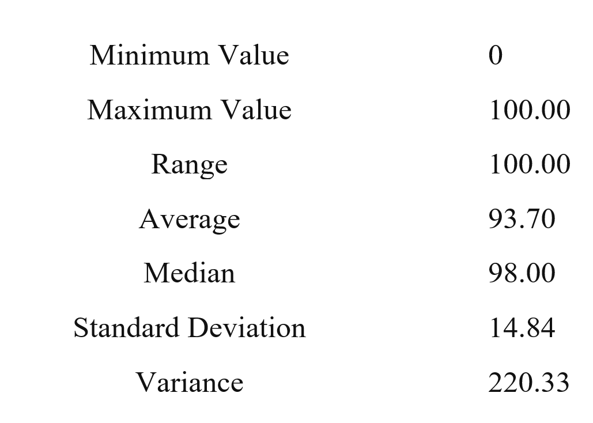
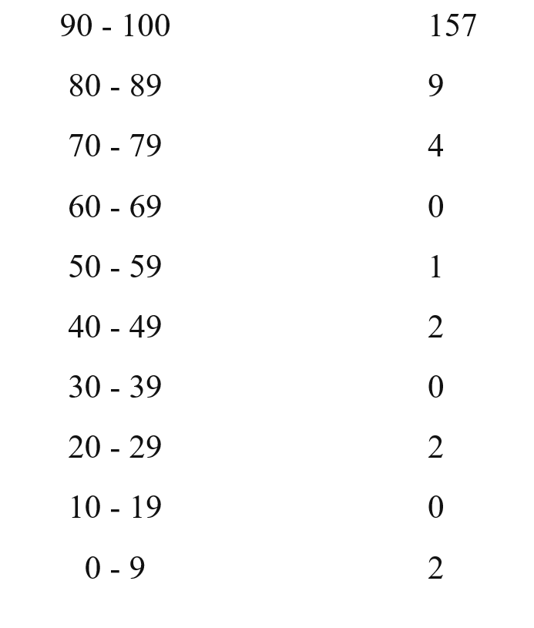
HW 2

Slide 2
Where are we?
Algorithms
DTs
Perceptron + Winnow
Gradient Descent
NN
Theory
Mistake Bound
PAC Learning
We have a formal notion of “learnability”
We understand Generalization
How will your algorithm do on the next example?
How it depends on the hypothesis class (VC dim)
and other complexity parameters
Algorithmic Implications of the theory?

Slide 3
Boosting
Boosting is (today) a general learning paradigm for putting together a Strong Learner, given a collection (possibly infinite) of Weak Learners.
The original Boosting Algorithm was proposed as an answer to a theoretical question in PAC learning. [The Strength of Weak Learnability; Schapire, 89]
Consequently, Boosting has interesting theoretical implications, e.g., on the relations between PAC learnability and compression.
If a concept class is efficiently PAC learnable then it is efficiently PAC learnable by an algorithm whose required memory is bounded by a polynomial in n, size c and log(1/ε).
There is no concept class for which efficient PAC learnability requires that the entire sample be contained in memory at one time – there is always another algorithm that “forgets” most of the sample.

Slide 4
Boosting Notes
However, the key contribution of Boosting has been practical, as a way to compose a good learner from many weak learners.
It is a member of a family of Ensemble Algorithms, but has stronger guarantees than others.
A Boosting demo is available at http://cseweb.ucsd.edu/~yfreund/adaboost/
Example
Theory of Boosting
Simple & insightful

Slide 5
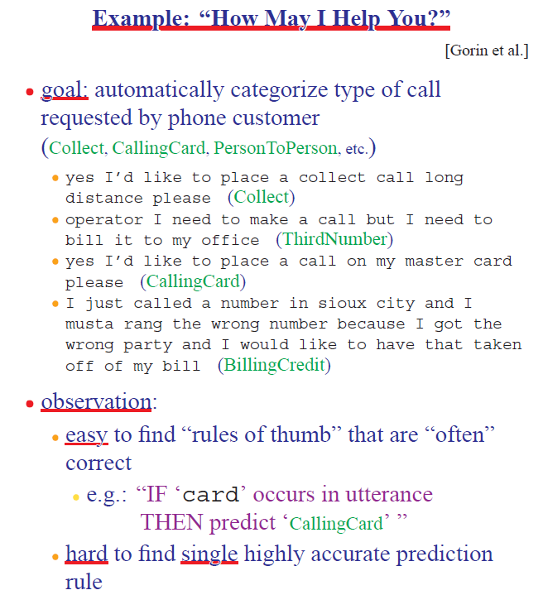
Boosting Motivation

Slide 6
The Boosting Approach
Algorithm
Select a small subset of examples
Derive a rough rule of thumb
Examine 2nd set of examples
Derive 2nd rule of thumb
Repeat T times
Combine the learned rules into a single hypothesis
Questions:
How to choose subsets of examples to examine on each round?
How to combine all the rules of thumb into single prediction rule?
Boosting
General method of converting rough rules of thumb into highly accurate prediction rule

Slide 7
Theoretical Motivation
“Strong” PAC algorithm:
for any distribution
8 ², ± > 0
Given polynomially many random examples
Finds hypothesis with error · ² with probability ¸ (1-±)
“Weak” PAC algorithm
Same, but only for some ² · ½ - °
[Kearns & Valiant ’88]:
Does weak learnability imply strong learnability?
Anecdote: the importance of the distribution free assumption
It does not hold if PAC is restricted to only the uniform distribution, say

Slide 8
History
[Schapire ’89]:
First provable boosting algorithm
Call weak learner three times on three modified distributions
Get slight boost in accuracy
apply recursively
[Freund ’90]:
“Optimal” algorithm that “boosts by majority”
[Drucker, Schapire & Simard ’92]:
First experiments using boosting
Limited by practical drawbacks
[Freund & Schapire ’95]:
Introduced “AdaBoost” algorithm
Strong practical advantages over previous boosting algorithms
AdaBoost was followed by a huge number of papers and practical applications
Some lessons for Ph.D. students

Slide 9
A Formal View of Boosting
Given training set (x₁, y₁), … (x_{m}, y_{m})
y_{i} 2 {-1, +1} is the correct label of instance x_{i} 2 X
For t = 1, …, T
Construct a distribution D_{t} on {1,…m}
Find weak hypothesis (“rule of thumb”)
h_{t} : X ! {-1, +1}
with small error ²_{t} on D_{t}:
²_{t} = Pr_{D} [h_{t} (x_{i}) := y_{i}]
Output: final hypothesis H_{final}

Slide 10
Adaboost
Think about unwrapping it all the way to 1/m
Constructing D_{t} on {1,…m}:
D₁(i) = 1/m
Given D_{t} and h_{t} :
D_{t+1} = D_{t}(i)/z_{t} £ e^{-®t} if y_{i} = h_{t}(x_{i})
D_{t}(i)/z_{t} £ e^{+®t} if y_{i} := h_{t} (x_{i})
= D_{t}(i)/z_{t} £ exp(-®_{t} y_{i} h_{t} (x_{i}))
where z_{t} = normalization constant
and
®_{t} = ½ ln{ (1 - ²_{t})/²_{t} }
Final hypothesis: H_{final} (x) = sign (∑_{t} ®_{t} h_{t}(x) )
< 1; smaller weight
> 1; larger weight
Notes about ®_{t}:
Positive due to the weak learning assumption
Examples that we predicted correctly are demoted, others promoted
Sensible weighting scheme: better hypothesis (smaller error) → larger weight
e^{+®t} = sqrt{(1 - ²_{t})/²_{t} }>1

Slide 11
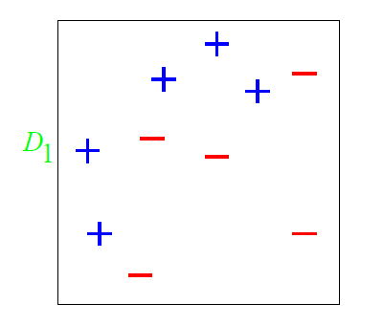
A Toy Example

Slide 12
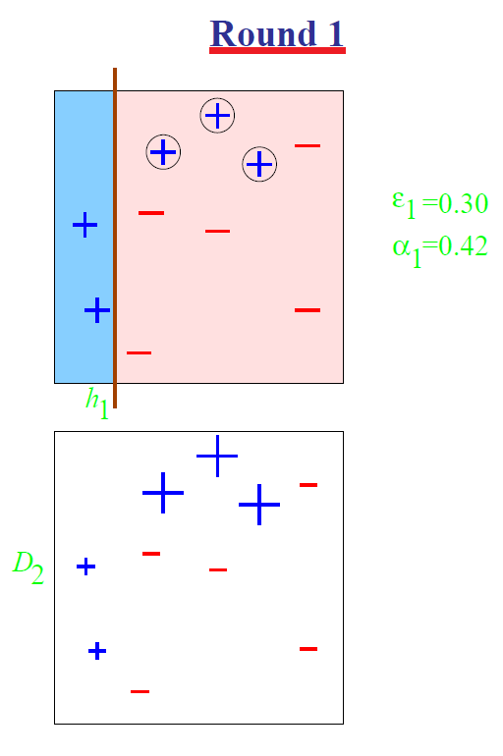
A Toy Example

Slide 13
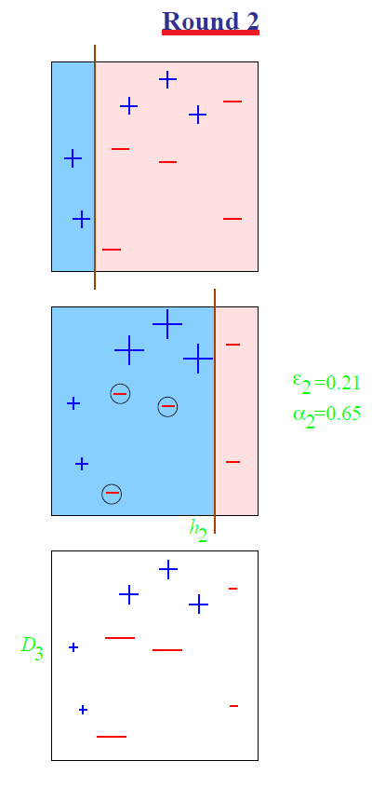
A Toy Example

Slide 14
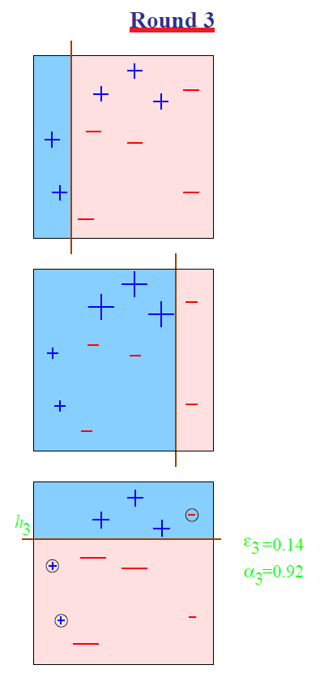
A Toy Example

Slide 15
A Toy Example
A cool and important note about the final hypothesis: it is possible that the combined hypothesis makes no mistakes on the training data, but boosting can still learn, by adding more weak hypotheses.

Slide 16
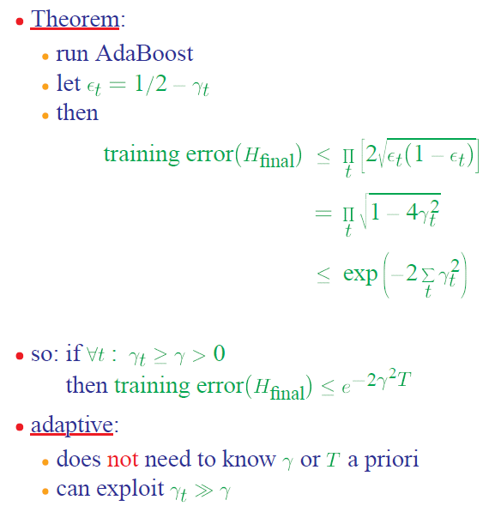
Analyzing Adaboost
1. Why is the theorem stated in terms of minimizing training error? Is that what we want?
2. What does the bound mean?
Need to prove only the first inequality, the rest is algebra.
²_{t} (1- ²_{t}) = (1/2-°_{t})(1/2+°_{t})) = 1/4 - °_{t}²
1-(2°_{t})² · exp(-(2°_{t})²)

Slide 17
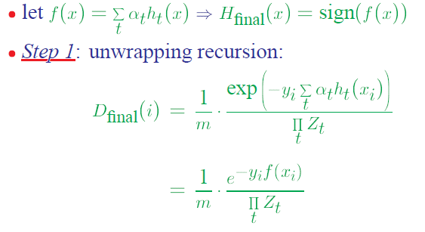
AdaBoost Proof (1)
Need to prove only the first inequality, the rest is algebra.
The final “weight” of the i-th example

Slide 18
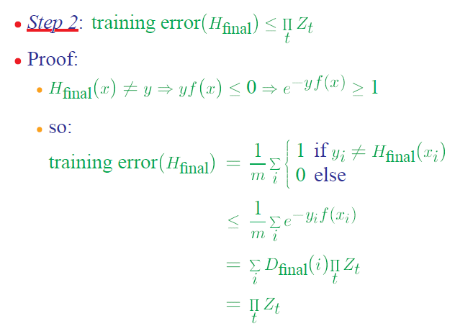
AdaBoost Proof (2)
The definition of training error
Always holds for mistakes (see above)
Using Step 1
D is a distribution over the m examples

Slide 19
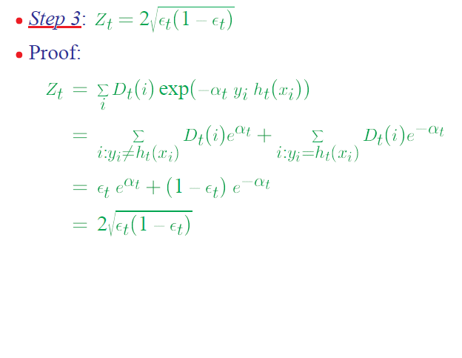
AdaBoost Proof(3)
Why does it work?
The Weak Learning Hypothesis
A strong assumption due to the “for all distributions”.
But – works well in practice
By definition of Z_{t}; it’s a normalization term
Splitting the sum to “mistakes” and no-mistakes”
The definition of ²_{t}
The definition of ®_{t}
e^{+®t} = sqrt{(1 - ²_{t})/²_{t} }>1
Steps 2 and 3 together prove the Theorem.
→ The error of the final hypothesis can be as low as you want.

Slide 20
Boosting The Confidence
Unlike Boosting the accuracy (ε), Boosting the confidence (δ) is easy.
Let’s fix the accuracy parameter to ε.
Suppose that we have a learning algorithm L such that for any target concept c 2 C and any distribution D, L outputs h s.t. error(h) < ε with confidence at least 1- δ_{0,} where δ₀ = 1/q(n,size(c)), for some polynomial q.
Then, if we are willing to tolerate a slightly higher hypothesis error, ε + γ (γ > 0, arbitrarily small) then we can achieve arbitrary high confidence 1-δ.

Slide 21
Boosting The Confidence(2)
Idea: Given the algorithm L, we construct a new algorithm L’ that simulates algorithm L k times (k will be determined later) on independent samples from the same distribution
Let h₁, …h_{k} be the hypotheses produced. Then, since the simulations are independent, the probability that all of h₁,. h_{k} have error >ε is as most (1-δ₀)^{k}. Otherwise, at least one h_{j} is good.
Solving (1-δ₀)^{k} < δ/2 yields that value of k we need,
k > (1/δ₀) ln(2/δ)
There is still a need to show how L’ works. It would work by using the h_{i} that makes the fewest mistakes on the sample S; we need to compute how large S should be to guarantee that it does not make too many mistakes. [Kearns and Vazirani’s book]

Slide 22
Summary of Ensemble Methods
Boosting
Bagging
Random Forests

Slide 23
Boosting
Initialization:
Weigh all training samples equally
Iteration Step:
Train model on (weighted) train set
Compute error of model on train set
Increase weights on training cases model gets wrong!!!
Typically requires 100’s to 1000’s of iterations
Return final model:
Carefully weighted prediction of each model

Slide 24
Boosting: Different Perspectives
Boosting is a maximum-margin method
(Schapire et al. 1998, Rosset et al. 2004)
Trades lower margin on easy cases for higher margin on harder cases
Boosting is an additive logistic regression model (Friedman, Hastie and Tibshirani 2000)
Tries to fit the logit of the true conditional probabilities
Boosting is an equalizer
(Breiman 1998) (Friedman, Hastie, Tibshirani 2000)
Weighted proportion of times example is misclassified by base learners tends to be the same for all training cases
Boosting is a linear classifier, but does not give well calibrated probability estimate.

Slide 25
Bagging
Bagging predictors is a method for generating multiple versions of a predictor and using these to get an aggregated predictor.
The aggregation averages over the versions when predicting a numerical outcome and does a plurality vote when predicting a class.
The multiple versions are formed by making bootstrap replicates of the learning set and using these as new learning sets.
That is, use samples of the data, with repetition
Tests on real and simulated data sets using classification and regression trees and subset selection in linear regression show that bagging can give substantial gains in accuracy.
The vital element is the instability of the prediction method. If perturbing the learning set can cause significant changes in the predictor constructed then bagging can improve accuracy.

Slide 26
Example: Bagged Decision Trees
Draw 100 bootstrap samples of data
Train trees on each sample → 100 trees
Average prediction of trees on out-of-bag samples
…
Average prediction
(0.23 + 0.19 + 0.34 + 0.22 + 0.26 + … + 0.31) / # Trees = 0.24

Slide 27
Random Forests (Bagged Trees++)
Draw 1000+ bootstrap samples of data
Draw sample of available attributes at each split
Train trees on each sample/attribute set → 1000+ trees
Average prediction of trees on out-of-bag samples
…
Average prediction
(0.23 + 0.19 + 0.34 + 0.22 + 0.26 + … + 0.31) / # Trees = 0.24

