Slide 1
Administration
Questions
Registration
Hw3 is out
Due on Thursday 10/6
Lecture Captioning (Extra-Credit)
Look at Piazza for details
Scribing lectures
With pay; come talk to me/send email.

Slide 2
Projects
Projects proposals are due on Friday 10/14/16
Within a week we will give you an approval to continue with your project along with comments and/or a request to modify/augment/do a different project. There will also be a mechanism for peer comments.
We encourage team projects – a team can be up to 3 people.
Please start thinking and working on the project now.
Your proposal is limited to 1-2 pages, but needs to include references and, ideally, some of the ideas you have developed in the direction of the project (maybe even some preliminary results).
Any project that has a significant Machine Learning component is good.
You can do experimental work, theoretical work, a combination of both or a critical survey of results in some specialized topic.
The work has to include some reading. Even if you do not do a survey, you must read (at least) two related papers or book chapters and relate your work to it.
Originality is not mandatory but is encouraged.
Try to make it interesting!

Slide 3
Examples
KDD Cup 2013:
"Author-Paper Identification": given an author and a small set of papers, we are asked to identify which papers are really written by the author.
https://www.kaggle.com/c/kdd-cup-2013-author-paper-identification-challenge
“Author Profiling”: given a set of document, profile the author: identification, gender, native language, ….
Caption Control: Is it gibberish? Spam? High quality text?
Adapt an NLP program to a new domain
Work on making learned hypothesis (e.g., linear threshold functions, NN) more comprehensible
Explain the prediction
Develop a (multi-modal) People Identifier
Compare Regularization methods: e.g., Winnow vs. L1 Regularization
Large scale clustering of documents + name the cluster
Deep Networks: convert a state of the art NLP program to a deep network, efficient, architecture.
Try to prove something

Slide 4
Neural Networks
Robust approach to approximating real-valued, discrete-valued and vector valued target functions.
Among the most effective general purpose supervised learning method currently known.
Effective especially for complex and hard to interpret input data such as real-world sensory data, where a lot of supervision is available.
The Backpropagation algorithm for neural networks has been shown successful in many practical problems
handwritten character recognition, speech recognition, object recognition, some NLP problems

Slide 5
Neural Networks
Neural Networks are functions: $NN:X→Y$
where $X={\left[0,1\right]}^{n}$, or ${\{0,1\}}^{n}$ and $Y=\left[0,1\right]$, $\{0,1\}$
NN can be used as an approximation of a target classifier
In their general form, even with a single hidden layer, NN can approximate any function
Algorithms exist that can learn a NN representation from labeled training data (e.g., Backpropagation).

Slide 6
Multi-Layer Neural Networks
Multi-layer network were designed to overcome the computational (expressivity) limitation of a single threshold element.
The idea is to stack several
layers of threshold elements,
each layer using the output of
the previous layer as input.
activation
Output
Hidden
Input

Slide 7
Motivation for Neural Networks
Inspired by biological systems
But don’t take this (as well as any other words in the new on “emergence” of intelligent behavior) seriously;
We are currently on rising part of a wave of interest in NN architectures, after a long downtime from the mid-90-ies.
Better computer architecture (GPUs, parallelism)
A lot more data than before; in many domains, supervision is available.
Current surge of interest has seen very minimal algorithmic changes

Slide 8
Motivation for Neural Networks
Minimal to no algorithmic changes
One potentially interesting perspective:
Before we looked at NN only as function approximators.
Now, we look at the intermediate representations generated while learning as meaningful
Ideas are being developed on the value of these intermediate representations for transfer learning etc.
We will present in the next two lectures a few of the basic architectures and learning algorithms, and provide some examples for applications

Slide 9
Neural Speed Constraints
Neuron “switching time” is O(milliseconds), compared to nanosecond for transistors.
However, biological systems can perform significant cognitive tasks (vision, language understanding) in fractions of a second.
Even for limited abilities, current AI systems require orders of magnitude more steps.
Human brain has approximately 10^10 neurons, each connected to 10^4; must explore massive parallelism (but there’s more…)

Slide 10
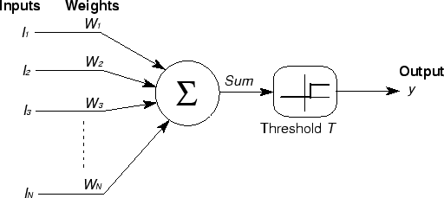
Basic Unit in Multi-Layer Neural Network
Linear Unit: $o_{j}=\vec{w}.\vec{x}$ multiple layers of linear functions produce linear functions. We want to represent nonlinear functions.
Threshold units: $o_{j}=sgn(\vec{w}.\vec{x}−T)$ are not differentiable, hence unsuitable for gradient descent
activation
Output
Hidden
Input

Slide 11
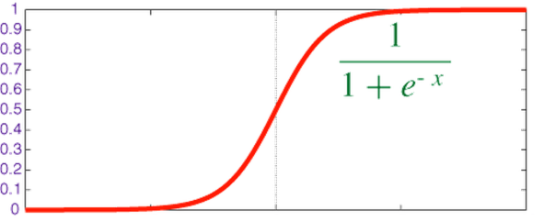
Model Neuron (Logistic)
Neuron is modeled by a unit $j$ connected by weighted links $w_{ij}$ to other units $i$.
Use a non-linear, differentiable output function such as the sigmoid or logistic function
Net input to a unit is defined as:
Output of a unit is defined as:
The parameters so far?
The set of connective weights: $w_{ij}$ The threshold value: $T_{j}$
$$x_{1}$$
$$x_{2}$$
$$x_{3}$$
$$x_{4}$$
$$x_{5}$$
$$x_{6}$$
$$w_{17}$$
$$x_{7}$$
$$o_{j}$$
$$w_{67}$$
Neuron Definition
$${net}_{j}=∑w_{ij}.x_{i}$$
$$o_{j}=\frac{1}{1+exp\left(−({net}_{j}−T_{j})\right)}$$

Slide 12
History: Neural Computation
McCollough and Pitts (1943) showed how linear threshold units can be used to compute logical functions
Can build basic logic gates
AND:
OR:
NOT: use negative weight
Can build arbitrary logic circuits, finite-state machines and computers given these basis gates.
Can specify any Boolean function using two layer network (w/ negation)
DNF and CNF are universal representations
$${net}_{j}=∑w_{ij}.x_{i}$$
$$o_{j}=\frac{1}{1+exp\left(−({net}_{j}−T_{j})\right)}$$
$$w_{ij}=T_{j}/n$$
$$w_{ij}=T_{j}$$

Slide 13
History: Learning Rules
Hebb (1949) suggested that if two units are both active (firing) then the weights between them should increase: $w_{ij}=w_{ij}+Ro_{i}o_{j}$
$R$ and is a constant called the learning rate
Supported by physiological evidence
Rosenblatt (1959) suggested that when a target output value is provided for a single neuron with fixed input, it can incrementally change weights and learn to produce the output using the Perceptron learning rule.
assumes binary output units; single linear threshold unit
Led to the Perceptron Algorithm
See: http://people.idsia.ch/~juergen/who-invented-backpropagation.html
Examples of update rules

Slide 14
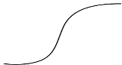
Perceptron Learning Rule
Given:
the target output for the output unit is $t_{j}$
the input the neuron sees is $x_{i}$
the output it produces is $o_{j}$
Update weights according to $w_{ij}←w_{ij}+R\left(t_{j}−o_{j}\right)x_{i}$
If output is correct, don’t change the weights
If output is wrong, change weights for all inputs which are 1
If output is low (0, needs to be 1) increment weights
If output is high (1, needs to be 0) decrement weights
$$x_{1}$$
$$x_{2}$$
$$x_{3}$$
$$x_{4}$$
$$x_{5}$$
$$x_{6}$$
$$w_{17}$$
$$x_{7}$$
$$o_{j}$$
$$T_{j}$$
$$w_{67}$$

Slide 15
Widrow-Hoff Rule
This incremental update rule provides an approximation to the goal:
Find the best linear approximation of the data
$$Err\left({\vec{w}}^{\left(j\right)}\right)=\frac{1}{2}\sum_{d∈D}{{\left(t_{d}−o_{d}\right)}^{2}}$$
where:
$$o_{d}=\sum_{i}{w_{ij}.x_{i}=}{\vec{w}}^{\left(j\right)}.{\vec{x}}^{}$$
output of linear unit on example d
$t_{d}$ = Target output for example d

Slide 16
Gradient Descent
We use gradient descent determine the weight vector that minimizes $Err\left({\vec{w}}^{\left(j\right)}\right)$;
Fixing the set $D$ of examples, $E$ is a function of ${\vec{w}}^{\left(j\right)}$
At each step, the weight vector is modified in the direction that produces the steepest descent along the error surface.
$Err(w)$
$$w$$
$w_{3}$ $w_{2}$ $w_{1}$ $w_{0}$

Slide 17
Summary: Single Layer Network
Variety of update rules
Multiplicative
Additive
Batch and incremental algorithms
Various convergence and efficiency conditions
There are other ways to learn linear functions
Linear Programming (general purpose)
Probabilistic Classifiers ( some assumption)
Key algorithms are driven by gradient descent

Slide 18
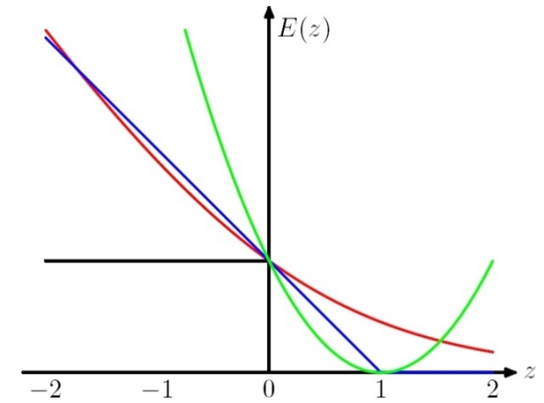
Stochastic Gradient Algorithms
w_{t+1} = w_{t} – r_{t} g_{w} Q(z_{t}, w_{t}) = w_{t} – r_{t} g_{t}
LMS: Q((x, y), w) =1/2 (y – w ¢ x)²
leads to the update rule (Also called Widrow’s Adaline):
w_{t+1} = w_{t} + r (y_{t} – w_{t} ¢ x_{t}) x_{t}
Here, even though we make binary predictions based on sign (w ¢ x) we do not take the sign of the dot-product into account in the loss.
Another common loss function is:
Hinge loss:
Q((x, y), w) = max(0, 1 - y w ¢ x)
This leads to the perceptron update rule:
If y_{i} w_{i} ¢ x_{i} > 1 (No mistake, by a margin): No update
Otherwise (Mistake, relative to margin): w_{t+1} = w_{t} + r y_{t} x_{t}
w ¢ x

Slide 19
Summary: Single Layer Network
Variety of update rules
Multiplicative
Additive
Batch and incremental algorithms
Various convergence and efficiency conditions
There are other ways to learn linear functions
Linear Programming (general purpose)
Probabilistic Classifiers ( some assumption)
Key algorithms are driven by gradient descent
However, the representational restriction is limiting in many applications

Slide 20
Learning with a Multi-Layer Perceptron
It’s easy to learn the top layer – it’s just a linear unit.
Given feedback (truth) at the top layer, and the activation at the layer below it, you can use the Perceptron update rule (more generally, gradient descent) to updated these weights.
The problem is what to do with
the other set of weights – we do
not get feedback in the
intermediate layer(s).
activation
Output
w²_{ij}
Hidden
w¹_{ij}
Input

Slide 21
Learning with a Multi-Layer Perceptron
The problem is what to do with
the other set of weights – we do
not get feedback in the
intermediate layer(s).
Solution: If all the activation
functions are differentiable, then
the output of the network is also
a differentiable function of the input and weights in the network.
Define an error function (e.g., sum of squares) that is a differentiable function of the output, i.e. this error function is also a differentiable function of the weights.
We can then evaluate the derivatives of the error with respect to the weights, and use these derivatives to find weight values that minimize this error function, using gradient descent (or other optimization methods).
This results in an algorithm called back-propagation.
activation
Output
w²_{ij}
Hidden
w¹_{ij}
Input

Slide 22
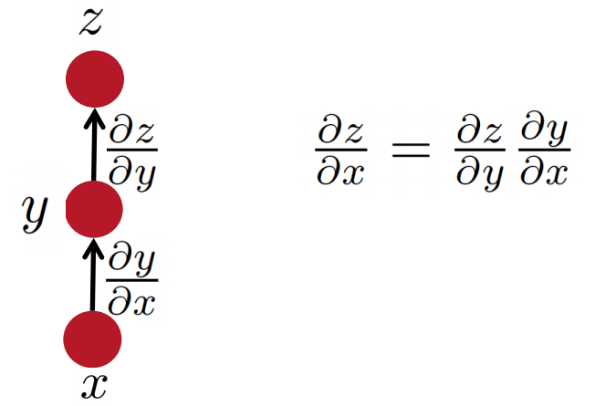
Some facts from real analysis
Simple chain rule
If $z$ is a function of $y$, and $y$ is a function of $x$
Then $z$ is a function of $x$, as well.
Question: how to find $\frac{∂z}{∂x}$
Reminder
We will use these facts to derive the details of the Backpropagation algorithm.
z will be the error (loss) function.
- We need to know how to differentiate z
Intermediate nodes use a logistics function (or another differentiable step function).
- We need to know how to differentiate it.
Slide Credit: Richard Socher

Slide 23
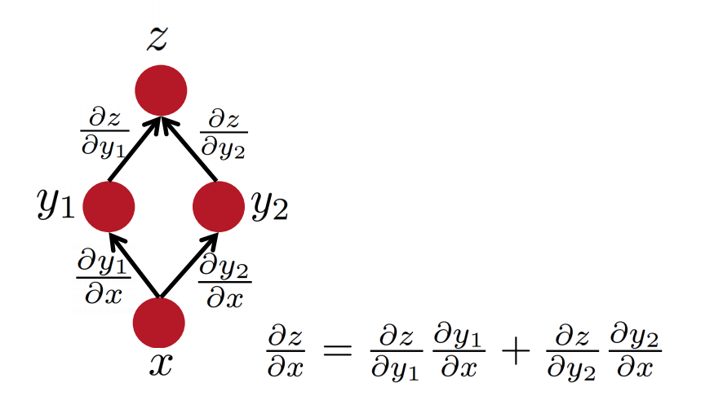
Some facts from real analysis
Multiple path chain rule
Reminder
Slide Credit: Richard Socher

Slide 24
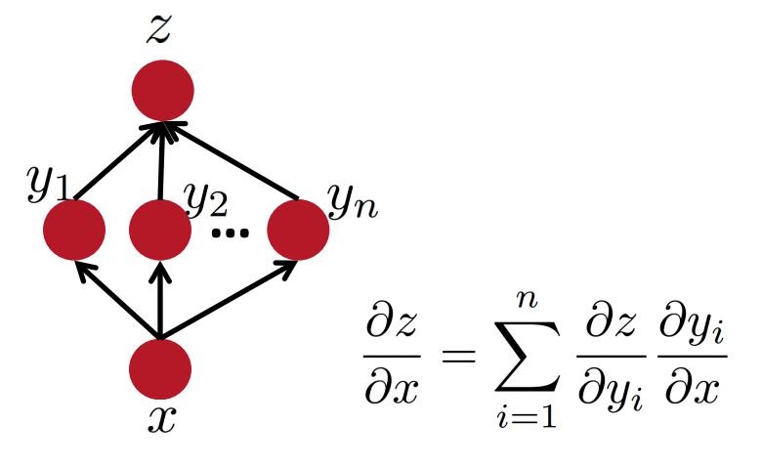
Some facts from real analysis
Multiple path chain rule: general
Reminder
Slide Credit: Richard Socher

Slide 25
Backpropagation Learning Rule
Since there could be multiple output units, we define the error as the sum over all the network output units.
$Err\left(\vec{w}\right)=\frac{1}{2}\sum_{d∈D}{\sum_{k∈K}{}{\left(t_{kd}−o_{kd}\right)}^{2}}$
where $D$ is the set of training examples,
$K$ is the set of output units
This is used to derive the (global) learning rule which performs gradient descent in the weight space in an attempt to minimize the error function.
$$Δw_{ij}=−R\frac{∂E}{∂w_{ij}}$$
$o_{1}$…$o_{k}$
$$(1, 0, 1, 0, 0)$$
Function 1

Slide 26
Reminder: Model Neuron (Logistic)
Neuron is modeled by a unit $j$ connected by weighted links $w_{ij}$ to other units $i$.
Use a non-linear, differentiable output function such as the sigmoid or logistic function
Net input to a unit is defined as:
Output of a unit is defined as:
$$x_{1}$$
$$x_{2}$$
$$x_{3}$$
$$x_{4}$$
$$x_{5}$$
$$x_{6}$$
$$w_{17}$$
$$x_{7}$$
$$o_{j}$$
$$w_{67}$$
Neuron Definition
Function 2
$${net}_{j}=∑w_{ij}.x_{i}$$
Function 3
$$o_{j}=\frac{1}{1+exp\left(−({net}_{j}−T_{j})\right)}$$

Slide 27
Derivatives
Function 1 (error):
$y= \frac{1}{2}\sum_{k∈K}{{\left(c_{k}−x_{k}\right)}^{2}}$
$\frac{∂y}{∂x_{i}}=−\left(ti −xi\right)$
Function 2 (linear gate):
$y=∑w_{i}.x_{i}$
$\frac{∂y}{∂w_{i}}=xi$
Function 3 (differentiable step function):
$y=\frac{1}{1+\exp{\{−(x−T)\}}}$
$\frac{∂y}{∂x}=\frac{\exp{\{−(x−T)\}}}{(1+\exp{\{−(x−T)\})2}}$= $y(1−y)$
Propagation error to earlier layer
$o_{1}$…$o_{k}$
$j$
$i$
$$w_{ij}$$

Slide 28
Derivation of Learning Rule
The weights are updated incrementally; the error is computed for each example and the weight update is then derived.
$Err_{d}\left(\vec{w}\right)=\frac{1}{2}\sum_{k∈K}{{\left(t_{k}−o_{k}\right)}^{2}}$
$w_{ij}$ influences the output only through ${net}_{j}$
$${net}_{j}=∑w_{ij}.x_{ij}$$
Therefore:
$$\frac{∂E_{d}}{∂w_{ij}}=\frac{∂E_{d}}{∂{net}_{j}}\frac{∂{net}_{j}}{∂w_{ij}}$$
Propagation error to earlier layer
$o_{1}$…$o_{k}$
$j$
$i$
$$w_{ij}$$

Slide 29
Derivation of Learning Rule (2)
Weight updates of output units:
$w_{ij}$ influences the output only through ${net}_{j}$
Therefore:
$$\frac{∂E_{d}}{∂w_{ij}}=\frac{∂E_{d}}{∂{net}_{j}} \frac{∂{net}_{j}}{∂w_{ij}}$$
$j$
$i$
$$w_{ij}$$
$$=\frac{∂E_{d}}{∂o_{j}} \frac{∂o_{j}}{∂{net}_{j}} \frac{∂{net}_{j}}{∂w_{ij}}$$
$$=−\left(t_{j}−o_{j}\right) o_{j}\left(1−o_{j}\right) x_{ij}$$
$$Err_{d}\left(\vec{w}\right)=\frac{1}{2}\sum_{k∈K}{{\left(t_{k}−o_{k}\right)}^{2}}$$
$$\frac{∂o_{j}}{∂{net}_{j}}=o_{j}(1−o_{j})$$
$$o_{j}=\frac{1}{1+\exp{\{−({net}_{j}−T_{j})\}}}$$
$${net}_{j}=∑w_{ij}.x_{ij}$$

Slide 30
Derivation of Learning Rule (3)
Weights of output units:
$w_{ij}$ is changed by:
where
$$δ_{j}=\left(t_{j}−o_{j}\right)o_{j}\left(1−o_{j}\right)$$
$$o_{j}$$
$j$
$i$
$$w_{ij}$$
$$Δw_{ij}=R\left(t_{j}−o_{j}\right)o_{j}\left(1−o_{j}\right)x_{ij}=Rδ_{j}x_{ij}$$
$$x_{ij}$$

Slide 31
Derivation of Learning Rule (4)
Weights of hidden units:
$w_{ij}$ Influences the output only through all the units whose direct input include $j$
$$o_{k}$$
$k$
$j$
$i$
$${net}_{j}=∑w_{ij}.x_{ij}$$
$$\frac{∂E_{d}}{∂w_{ij}}=\frac{∂E_{d}}{∂{net}_{j}} \frac{∂{net}_{j}}{∂w_{ij}}=$$
$$w_{ij}$$
$$=\sum_{k∈downstream(j) }{\frac{∂E_{d}}{∂{net}_{k}} \frac{∂{net}_{k}}{∂{net}_{j}}x_{ij}}$$
$$=\sum_{k∈downstream(j) }{−δ_{k} \frac{∂{net}_{k}}{∂{net}_{j}}x_{ij}}$$

Slide 32
Derivation of Learning Rule (5)
Weights of hidden units:
$w_{ij}$influences the output only through all the units whose direct input include $j$
$$o_{k}$$
$k$
$j$
$i$
$$w_{ij}$$
$$\frac{∂E_{d}}{∂w_{ij}}=\sum_{k∈downstream(j) }{−δ_{k} \frac{∂{net}_{k}}{∂{net}_{j}}x_{ij}}=$$
$$=\sum_{k∈downstream(j) }{−δ_{k} \frac{∂{net}_{k}}{∂o_{j}}\frac{∂o_{j}}{∂{net}_{j}}x_{ij}}$$
$$=\sum_{k∈downstream(j) }{−δ_{k} w_{jk}{ o}_{j}(1−o_{j}) x_{ij}}$$

Slide 33
Derivation of Learning Rule (6)
Weights of hidden units:
$w_{ij}$ is changed by:
Where
$$δ_{j}=o_{j}\left(1−o_{j}\right).\left(\sum_{k∈downstream\left(j\right)}{−δ_{k} w_{jk} }\right)$$
First determine the error for the output units.
Then, backpropagate this error layer by layer through the network, changing weights appropriately in each layer.
$${Δw_{ij}= R o}_{j}\left(1−o_{j}\right).\left(\sum_{k∈downstream\left(j\right)}{−δ_{k} w_{jk} }\right)x_{ij}=Rδ_{j}x_{ij}$$
$$o_{k}$$
$k$
$j$
$i$
Delta Rule
$$w_{ij}$$

Slide 34
The Backpropagation Algorithm
Create a fully connected three layer network. Initialize weights.
Until all examples produce the correct output within $ε$ (or other criteria)
For each example in the training set do:
Compute the network output for this example
Compute the error between the output and target value
$$δ_{k}=\left(t_{k}−o_{k}\right)o_{k}\left(1−o_{k}\right)$$
For each output unit k, compute error term
$${δ_{j}= o}_{j}\left(1−o_{j}\right).\sum_{k∈downstream\left(j\right)}{−δ_{k} w_{jk} }$$
For each hidden unit, compute error term:
$$Δw_{ij}=Rδ_{j}x_{ij}$$
Update network weights
End epoch

Slide 35
More Hidden Layers
The same algorithm holds for more hidden layers.
input $h_{1}$ $h_{2}$ $h_{3}$ output

Slide 36
Comments on Training
No guarantee of convergence; may oscillate or reach a local minima.
In practice, many large networks can be trained on large amounts of data for realistic problems.
Many epochs (tens of thousands) may be needed for adequate training. Large data sets may require many hours of CPU
Termination criteria: Number of epochs; Threshold on training set error; No decrease in error; Increased error on a validation set.
To avoid local minima: several trials with different random initial weights with majority or voting techniques

Slide 37
Over-training Prevention
Running too many epochs may over-train the network and result in over-fitting. (improved result on training, decrease in performance on test set)
Keep an hold-out validation set and test accuracy after every epoch
Maintain weights for best performing network on the validation set and return it when performance decreases significantly beyond that.
To avoid losing training data to validation:
Use 10-fold cross-validation to determine the average number of epochs that optimizes validation performance
Train on the full data set using this many epochs to produce the final results

Slide 38
Over-fitting prevention
Too few hidden units prevent the system from adequately fitting the data and learning the concept.
Using too many hidden units leads to over-fitting.
Similar cross-validation method can be used to determine an appropriate number of hidden units. (general)
Another approach to prevent over-fitting is weight-decay: all weights are multiplied by some fraction in (0,1) after every epoch.
Encourages smaller weights and less complex hypothesis
Equivalently: change Error function to include a term for the sum of the squares of the weights in the network. (general)

Slide 39
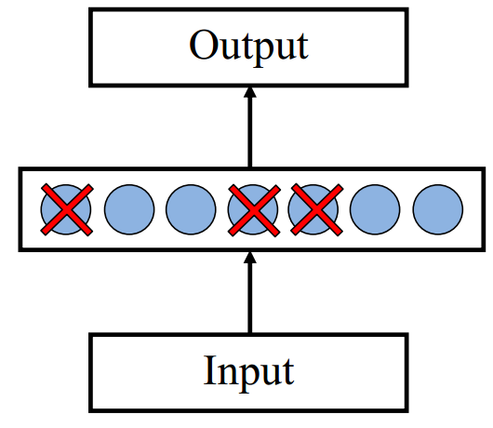
Dropout training
Proposed by (Hinton et al, 2012)
Each time decide whether to delete one hidden unit with some probability p

Slide 40
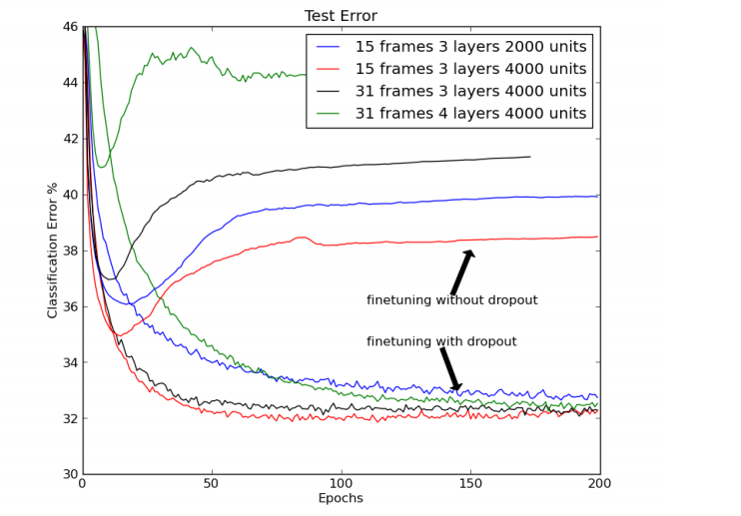
Dropout training
Dropout of 50% of the hidden units and 20% of the input units (Hinton et al, 2012)

Slide 41
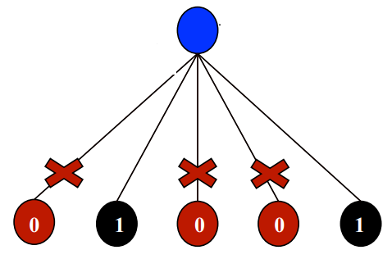
Dropout training
Model averaging effect
Among models, with shared parameters
H: number of units in the network
Only a few get trained
Much stronger than the known regularizer
What about the input space?
Do the same thing!

Slide 42
Input-Output Coding
One way to do it, if you start with a collection of sparsely representation examples, is to use dimensionality reduction methods:
Your m examples are represented as a m x 10⁶ matrix
Multiple it by a random matrix of size 10⁶ x 300, say.
Random matrix: Normal(0,1)
New representation: m x 300 dense rows
Appropriate coding of inputs and outputs can make learning problem easier and improve generalization.
Encode each binary feature as a separate input unit;
For multi-valued features include one binary unit per value rather than trying to encode input information in fewer units.
Very common today to use distributed representation of the input – real valued, dense representation.
For disjoint categorization problem, best to have one output unit for each category rather than encoding N categories into log N bits.

Slide 43
Representational Power
The Backpropagation version presented is for networks with a single hidden layer,
But:
Any Boolean function can be represented by a two layer network (simulate a two layer AND-OR network)
Any bounded continuous function can be approximated with arbitrary small error by a two layer network.
Sigmoid functions provide a set of basis function from which arbitrary function can be composed.
Any function can be approximated to arbitrary accuracy by a three layer network.

Slide 44
Hidden Layer Representation
Weight tuning procedure sets weights that define whatever hidden units representation is most effective at minimizing the error.
Sometimes Backpropagation will define new hidden layer features that are not explicit in the input representation, but which capture properties of the input instances that are most relevant to learning the target function.
Trained hidden units can be seen as newly constructed features that re-represent the examples so that they are linearly separable

Slide 45
Gradient Checks are useful!
Allow you to know that there are no bugs in your neural network implementation!
Implement your gradient
Implement a finite difference computation by looping through the parameters of your network, adding and subtracting a small epsilon (∼10^-4) and estimate derivatives
$f^{′}\left(θ\right)≈\frac{f\left(θ^{+}\right)−f(θ^{−})}{2ε}$ $θ^{±}=θ^{}±ε$
Compare the two and make sure they are almost the same

Slide 46
Auto-associative Network
An auto-associative network trained with 8 inputs, 3 hidden units and 8 output nodes, where the output must reproduce the input.
When trained with vectors with only one bit on
INPUT HIDDEN
1 0 0 0 0 0 0 0 .89 .40 0.8
0 1 0 0 0 0 0 0 .97 .99 .71
….
0 0 0 0 0 0 0 1 .01 .11 .88
Learned the standard 3-bit encoding for the 8 bit vectors.
Illustrates also data compression aspects of learning
1 0 0 0 1 0 0 0
1 0 0 0 1 0 0 0

Slide 47
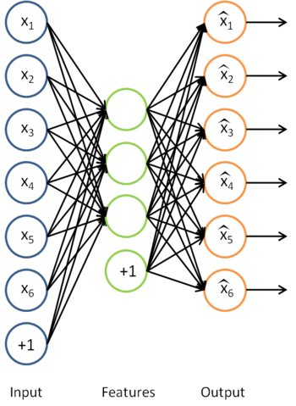
Sparse Auto-encoder
Encoding:
Decoding:
Goal: perfect reconstruction of
input vector $x$, by the output ${\hat{x}=h}_{θ}(x)$
Where $θ=\{W, W′\}$
Minimize an error function $l(h_{θ}\left(x\right), x)$
For example:
And regularize it
After optimization drop the
reconstruction layer and add a new layer
$$y=f(Wx+b)$$
$$\hat{x}=g(W′y+b′)$$
$$l\left(h_{θ}\left(x\right), x\right)={\left\|h_{θ}\left(x\right)−x\right\|}^{2}$$
$$\min_{θ}{\sum_{x}{l \left(h_{θ}\left(x\right), x\right)}+\sum_{i}{|w_{i}|}}$$

Slide 48
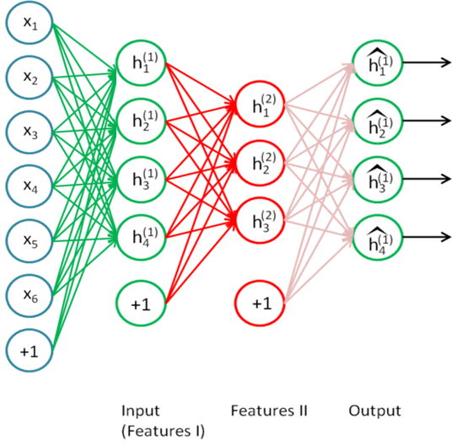
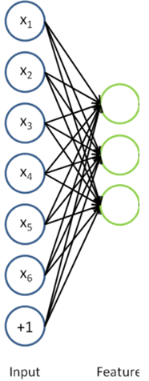
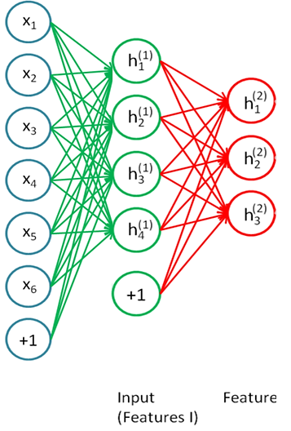
Stacking Auto-encoder
Add a new layer, and a reconstruction layer for it.
And try to tune its parameters such that
And continue this for each layer

Slide 49
Beyond supervised learning
So far what we had was purely supervised.
Initialize parameters randomly
Train in supervised mode typically, using backprop
Used in most practical systems (e.g. speech and image recognition)
Unsupervised, layer-wise + supervised classifier on top
Train each layer unsupervised, one after the other
Train a supervised classifier on top, keeping the other layers fixed
Good when very few labeled samples are available
Unsupervised, layer-wise + global supervised fine-tuning
Train each layer unsupervised, one after the other
Add a classifier layer, and retrain the whole thing supervised
Good when label set is poor (e.g. pedestrian detection)
We won’t talk about unsupervised pre-training here. But it’s good to have this in mind, since it is an active topic of research.

