Slide 1
Administration
Questions
HW1 grades should be up!
HW3 is due midnight.
Hw4 will be released next Tuesday.
Please start working on it as soon as possible
Come to sections with questions
Deadline for project proposals is close
Make sure to find a partner and explore the ideas.

Slide 2
Recap: Multi-Layer Perceptrons
Multi-layer network
A global approximator
Different rules for training it
The Back-propagation
Forward step
Back propagation of errors
Congrats! Now you know the hardest concept about neural networks!
Today:
Convolutional Neural Networks
Recurrent Neural Networks
activation
Output
Hidden
Input

Slide 3
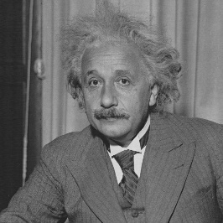
Receptive Fields
The receptive field of an individual sensory neuron is the particular region of the sensory space (e.g., the body surface, or the retina) in which a stimulus will trigger the firing of that neuron.
In the auditory system, receptive fields can correspond to volumes in auditory space
Designing “proper” receptive fields for the input Neurons is a significant challenge.
Consider a task with image inputs
Receptive fields should give expressive features from the raw input to the system
How would you design the receptive fields for this problem?

Slide 4
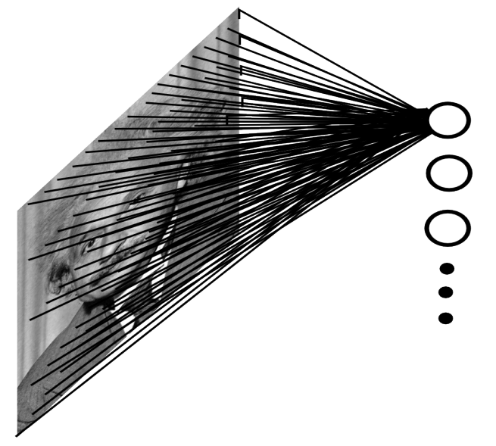
A fully connected layer:
Example:
100x100 images
1000 units in the input
Problems:
10^7 edges!
Spatial correlations lost!
Variables sized inputs.
Slide Credit: Marc'Aurelio Ranzato

Slide 5
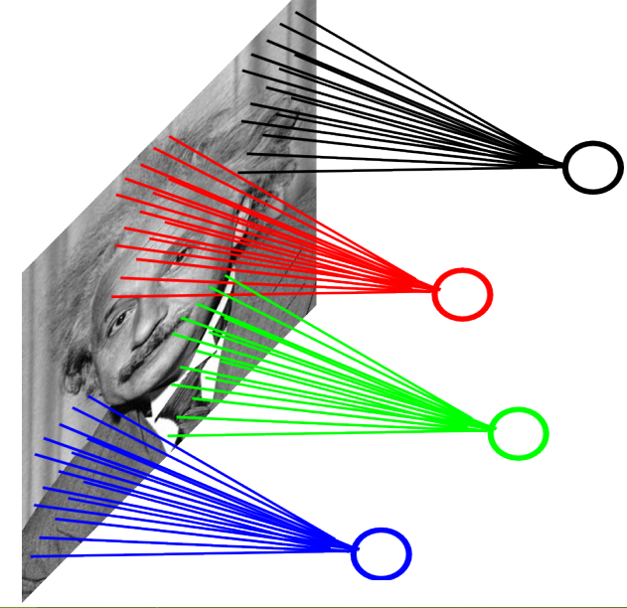
Consider a task with image inputs:
A locally connected layer:
Example:
100x100 images
1000 units in the input
Filter size: 10x10
Local correlations preserved!
Problems:
10^5 edges
This parameterization is good
when input image is
registered (e.g., face recognition).
Variable sized inputs, again.
Slide Credit: Marc'Aurelio Ranzato

Slide 6
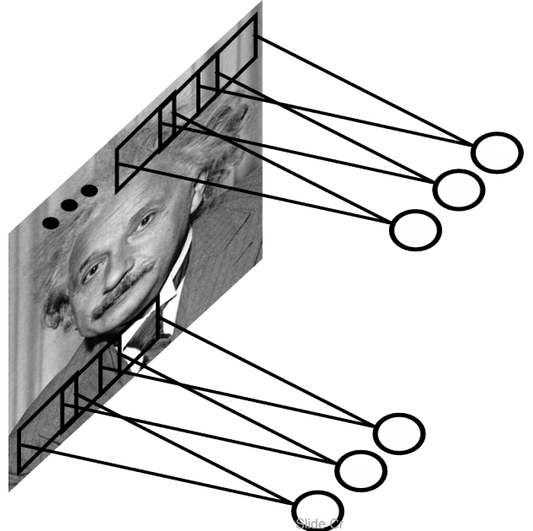
Convolutional Layer
A solution:
Filters to capture different patterns in the input space.
Share parameters across different locations (assuming input is stationary)
Convolutions with learned filters
Filters will be learned during training.
The issue of variable-sized inputs will be
resolved with a pooling layer.
So what is a convolution?
Slide Credit: Marc'Aurelio Ranzato

Slide 7
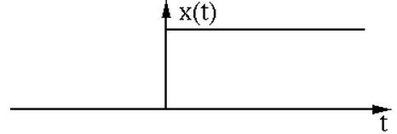
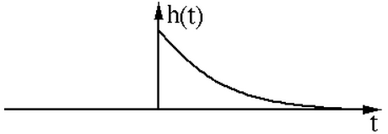
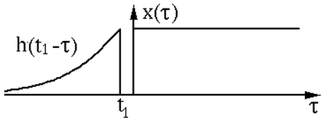
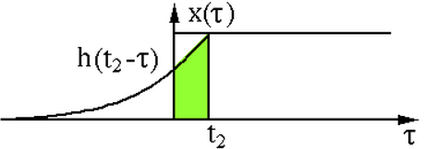
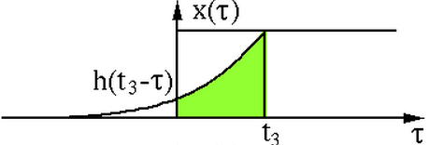
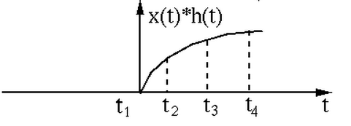
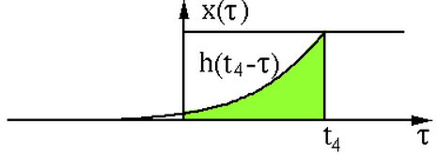
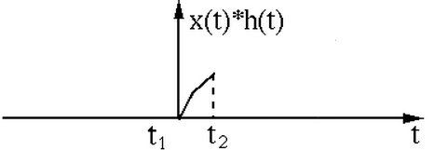
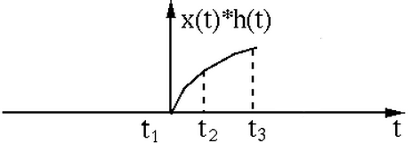
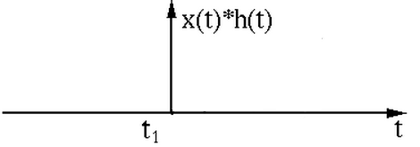
Convolution Operator
“Convolution” is very similar to “cross-correlation”, except that in convolution one of the functions is flipped.
Convolution operator: $∗$
takes two functions and gives another function
One dimension:
$$\left(x∗h\right)\left(t\right)=\int{x\left(τ\right)h\left(t−τ\right)dτ}$$
$\left(x∗h\right)[n]=\sum_{m}{x\left[m\right]h[n−m]}$
Example convolution:

Slide 8
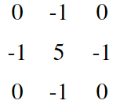
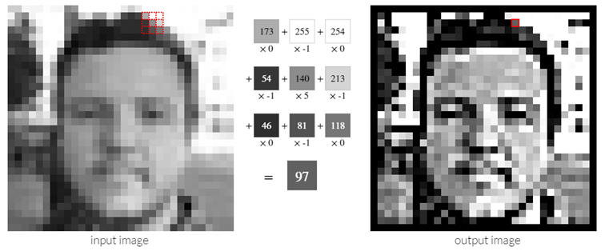
Convolution Operator (2)
Convolution in two dimension:
The same idea: flip one matrix and slide it on the other matrix
Example: Sharpen kernel:
Try other kernels: http://setosa.io/ev/image-kernels/

Slide 9
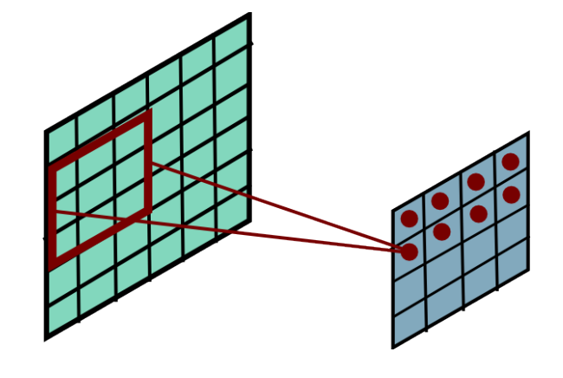
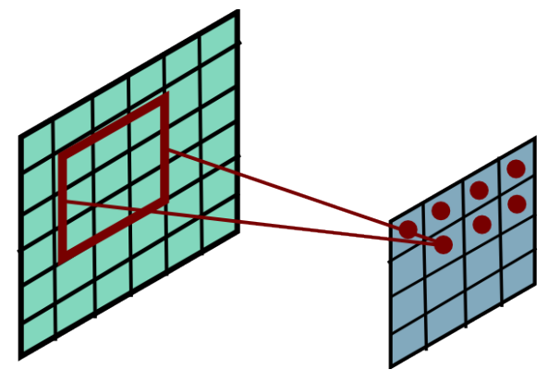
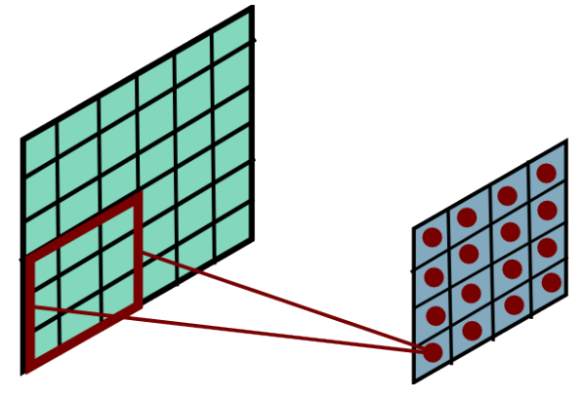
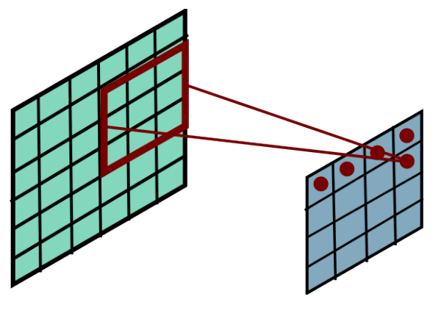
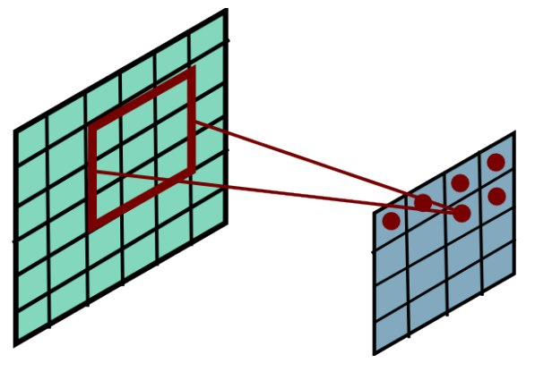
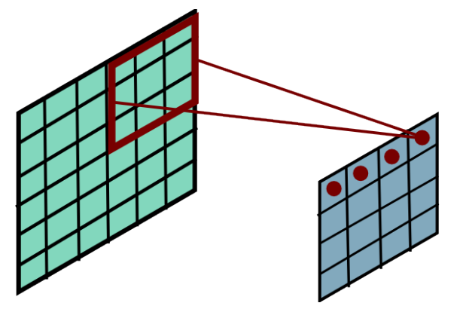
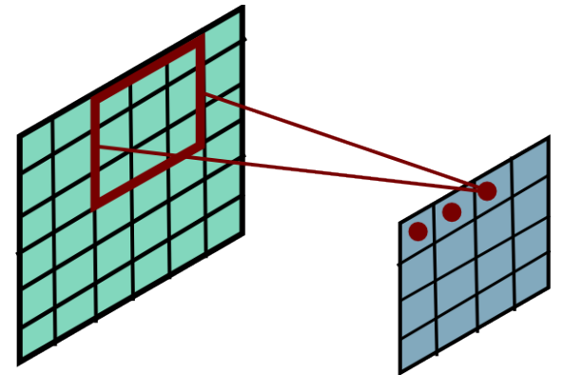
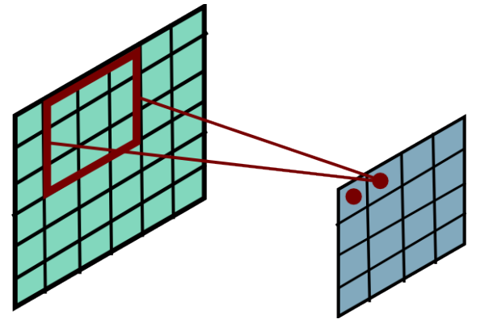
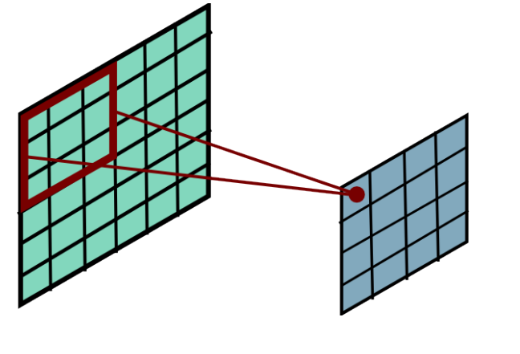
Convolution Operator (3)
Convolution in two dimension:
The same idea: flip one matrix and slide it on the other matrix
Slide Credit: Marc'Aurelio Ranzato

Slide 10
Complexity of Convolution
Complexity of convolution operator is $nlog\left(n\right)$, for $n$ inputs.
Uses Fast-Fourier-Transform (FFT)
For two-dimension, each convolution takes $MNlog\left(MN\right)$ time, where the size of input is $MN$.
Slide Credit: Marc'Aurelio Ranzato

Slide 11
Convolutional Layer
The convolution of the input (vector/matrix) with weights (vector/matrix) results in a response vector/matrix.
We can have multiple filters in each convolutional layer, each producing an output.
If it is an intermediate layer, it can have multiple inputs!
Convolutional Layer
Filter
Filter
Filter
One can add nonlinearity at the output of convolutional layer
Filter

Slide 12
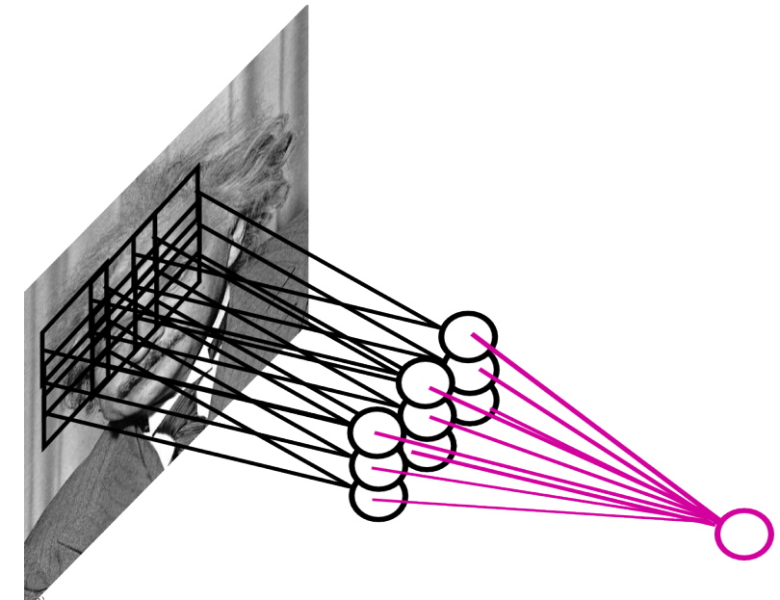
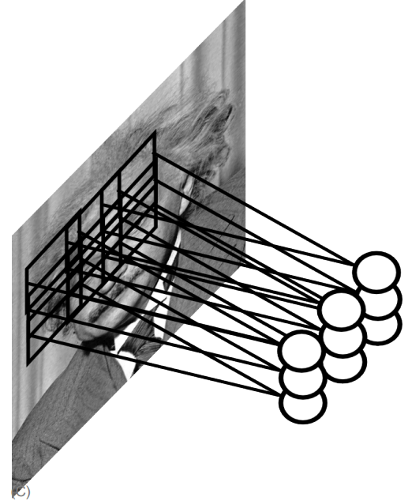
Pooling Layer
How to handle variable sized inputs?
A layer which reduces inputs of different size, to a fixed size.
Pooling
Slide Credit: Marc'Aurelio Ranzato

Slide 13
Pooling Layer
How to handle variable sized inputs?
A layer which reduces inputs of different size, to a fixed size.
Pooling
Different variations
Max pooling
$h_{i}\left[n\right]=\max_{i∈N(n)} \tilde{h} [i]$
Average pooling
$h_{i}\left[n\right]=\frac{1}{n}\underset{i∈N(n)}{∑} \tilde{h} [i]$
L2-pooling
$h_{i}\left[n\right]=\frac{1}{n}\sqrt{\underset{i∈N(n)}{∑} {\tilde{h}}^{2} [i]}$
etc

Slide 14
Convolutional Nets
One stage structure:
Whole system:
Convol.
Pooling
Stage 1
Stage 2
Stage 3
Fully Connected Layer
Input Image
Class Label
An example system (LeNet):
Slide Credit: Druv Bhatra

Slide 15
Training a ConvNet
The same procedure from Back-propagation applies here.
Remember in backprop we started from the error terms in the last stage, and passed them back to the previous layers, one by one.
Back-prop for the pooling layer:
Consider, for example, the case of “max” pooling.
This layer only routes the gradient to the input that has the highest value in the forward pass.
Hence, during the forward pass of a pooling layer it is common to keep track of the index of the max activation (sometimes also called the switches) so that gradient routing is efficient during backpropagation.
Therefore we have: $δ=\frac{∂E_{d}}{∂y_{i}}$
$$x_{i}$$
$$y_{i}$$
$$δ_{last−layer}=\frac{∂E_{d}}{∂y_{last−layer}}$$
Convol.
Pooling
$$δ_{first−layer}=\frac{∂E_{d}}{∂y_{first−layer}}$$
$$E_{d}$$
Input Image
Stage 1
Stage 2
Stage 3
Fully Connected Layer
Class Label

Slide 16
Training a ConvNet
Back-prop for the convolutional layer:
We derive the update rules for a 1D convolution, but the idea is the same for bigger dimensions.
$$\tilde{y}=w∗x ⟺ {\tilde{y}}_{i}=\sum_{a=0}^{m−1}{w_{a}}x_{i−a}=\sum_{a=0}^{m−1}{w_{i−a}}x_{a} ∀i$$
The convolution
$$y=f\left(\tilde{y}\right) ⟺ {y_{i}=f(\tilde{y}}_{i}) ∀i$$
A differentiable nonlinearity
$$\frac{∂E_{d}}{∂w_{a}}=$$
$$\sum_{i=0}^{m−1}{\frac{∂E_{d}}{∂{\tilde{y}}_{i}}\frac{∂{\tilde{y}}_{i}}{∂w_{a}}}$$
$$=\sum_{i=0}^{m−1}{\frac{∂E_{d}}{∂{\tilde{y}}_{i}}x_{i−a}}$$
$$\frac{∂E_{d}}{∂{\tilde{y}}_{i}}=$$
$$\frac{∂E_{d}}{∂y_{i}}\frac{∂y_{i}}{∂{\tilde{y}}_{i}}$$
$$=\frac{∂E_{d}}{∂y_{i}}f′(\tilde{y})$$
Now we have everything in this layer to update the filter
Now we can repeat this for each stage of ConvNet.
$$δ= \frac{∂E_{d}}{∂x_{a}}=$$
$$\sum_{i=0}^{m−1}{\frac{∂E_{d}}{∂{\tilde{y}}_{i}}\frac{∂{\tilde{y}}_{i}}{∂x_{a}}}$$
$$=\sum_{i=0}^{m−1}{\frac{∂E_{d}}{∂{\tilde{y}}_{i}}w_{i−a}}$$
We need to pass the gradient to the previous layer
$$x_{i}$$
$$y_{i}$$
$$δ_{last−layer}=\frac{∂E_{d}}{∂y_{last−layer}}$$
Convol.
Pooling
$$δ_{first−layer}=\frac{∂E_{d}}{∂y_{first−layer}}$$
$$E_{d}$$
Input Image
Stage 1
Stage 2
Stage 3
Fully Connected Layer
Class Label

Slide 17
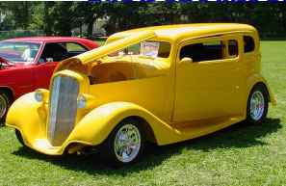
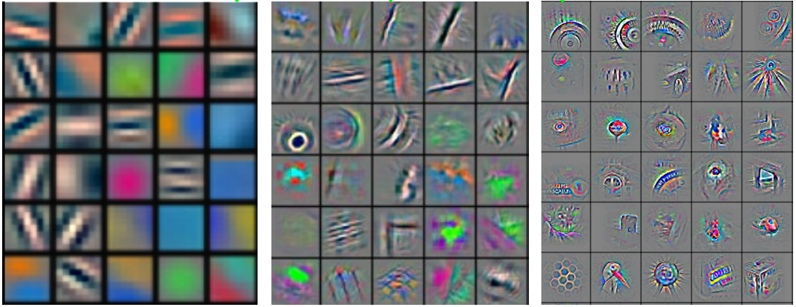
Convolutional Nets
Stage 1
Stage 2
Stage 3
Fully Connected Layer
Input Image
Class Label
An example system :
Feature visualization of convolutional net trained on ImageNet from [Zeiler & Fergus 2013]

Slide 18
ConvNet roots
Fukushima, 1980s designed network with same basic structure but did not train by backpropagation.
The first successful applications of Convolutional Networks by Yann LeCun in 1990's (LeNet)
Was used to read zip codes, digits, etc.
Many variants nowadays, but the core idea is the same
Example: a system developed in Google (GoogLeNet)
Compute different filters
Compose one big vector from all of them
Layer this iteratively
Demo!
See more: http://arxiv.org/pdf/1409.4842v1.pdf

Slide 19
Depth matters
Slide from [Kaiming He 2015]

Slide 20
Practical Tips
Before large scale experiments, test on a small subset of the data and check the error should go to zero.
Overfitting on small training
Visualize features (feature maps need to be uncorrelated) and have high variance
Bad training: many hidden units ignore the input and/or exhibit strong correlations.
Figure Credit: Marc'Aurelio Ranzato

Slide 21
Debugging
Training diverges:
Learning rate may be too large → decrease learning rate
BackProp is buggy → numerical gradient checking
Loss is minimized but accuracy is low
Check loss function: Is it appropriate for the task you want to solve? Does it have degenerate solutions?
NN is underperforming / under-fitting
Compute number of parameters → if too small, make network larger
NN is too slow
Compute number of parameters → Use distributed framework, use GPU, make network smaller
Many of these points apply to many machine learning models, no just neural networks.

Slide 22
CNN for vector inputs
Let’s study another variant of CNN for language
Example: sentence classification (say spam or not spam)
First step: represent each word with a vector in $ℝ^{d}$
This is not a spam
Concatenate the vectors
Now we can assume that the input to the system is a vector $ℝ^{dl}$
Where the input sentence has length $l$ ($l=5$ in our example )
Each word vector’s length $d$ ($d=7$ in our example )
O O O O O O O
O O O O O O O
O O O O O O O
O O O O O O O
O O O O O O O
O O O O O O O O O O O O O O O O O O O O O O O O O O O O O O O O O O O

Slide 23
Convolutional Layer on vectors
Think about a single convolutional layer
A bunch of vector filters
Each defined in $ℝ^{dh}$
Where $h$ is the number of the words the filter covers
Size of the word vector $d$
Find its (modified) convolution with the input vector
Result of the convolution with the filter
Convolution with a filter that spans 2 words, is operating on all of the bi-grams (vectors of two consecutive word, concatenated): “this is”, “is not”, “not a”, “a spam”.
Regardless of whether it is grammatical (not appealing linguistically)
O O O O O O O O O O O O O O
A convolutional layer
O O O O O O O O O O O O O O
O O O O O O O O O O O O O O
O O O O O O O O O O O O O O
O O O O O O O O O O O O O O
O O O O O O O O O O O O O O O O O O O O O O O O O O O O O O O O O O O
O O O O O O O O O O O O O O O O O O O O O O O O O O O O O O O O O O O
O O O O O O O O O O O O O O O O O O O O O O O O O O O O O O O O O O O
O O O O O O O O O O O O O O O O O O O O O O O O O O O O O O O O O O O
O O O O O O O O O O O O O O O O O O O O O O O O O O O O O O O O O O O
$$c_{1}=f(w.x_{1:h})$$
$$c_{2}=f(w.x_{h+1:2h})$$
$$c_{3}=f(w.x_{2h+1:3h})$$
$$c_{4}=f(w.x_{3h+1:4h})$$
$$c=[c_{1}, …., c_{n−h+1}]$$
O O O O

Slide 24
Convolutional Layer on vectors
This is not a spam
Get word vectors for each words
O O O O O O O
O O O O O O O
O O O O O O O
O O O O O O O
O O O O O O O
Concatenate vectors
O O O O O O O O O O O O O O O O O O O O O O O O O O O O O O O O O O O
*
Perform convolution with each filter
O O O O O O O
O O O O O O O O O O O O O O
Filter bank
O O O O O O O O O O O O O O
O O O O O O O O O O O O O O O O O O O O O
O O O O O O O O O O O O O O O O O O O O O
How are we going to handle the variable sized response vectors?
Pooling!
O O O O O
O O O O
Set of response vectors
#of filters
O O O O
O O O
O O O
#words - #length of filter + 1

Slide 25
Convolutional Layer on vectors
This is not a spam
Get word vectors for each words
Now we can pass the fixed-sized vector to a logistic unit (softmax), or give it to multi-layer network (last session)
O O O O O O O
O O O O O O O
O O O O O O O
O O O O O O O
O O O O O O O
Concatenate vectors
O O O O O O O O O O O O O O O O O O O O O O O O O O O O O O O O O O O
*
Perform convolution with each filter
O O O O O O O
O O O O O O O O O O O O O O
Filter bank
O O O O O O O O O O O O O O
O O O O O O O O O O O O O O O O O O O O O
O O O O O O O O O O O O O O O O O O O O O
Some choices for pooling:
k-max, mean, etc
Pooling on filter responses
O O O O O
O O O
O O O O
O O O
#of filters
O O O O
O O O
O O O
O O O
O O O
O O O
#words - #length of filter + 1

Slide 26
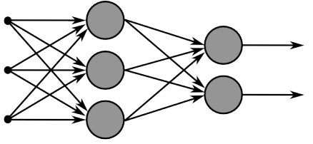
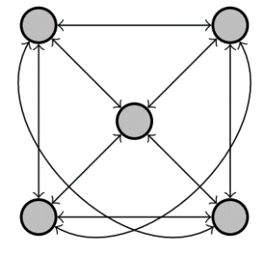
Recurrent Neural Networks
Multi-layer feed-forward NN: DAG
Just computes a fixed sequence of
non-linear learned transformations to convert an input patter into an output pattern
Recurrent Neural Network: Digraph
Has cycles.
Cycle can act as a memory;
The hidden state of a recurrent net can carry along information about a “potentially” unbounded number of previous inputs.
They can model sequential data in a much more natural way.

Slide 27
Equivalence between RNN and Feed-forward NN
Assume that there is a time delay of 1 in using each connection.
The recurrent net is just a layered net that keeps reusing the same weights.
time=3
W1 W2 W3 W4
w1 w4
time=2
W1 W2 W3 W4
w2 w3
time=1
W1 W2 W3 W4
time=0
Slide Credit: Geoff Hinton

Slide 28
Recurrent Neural Networks
Training a general RNN’s can be hard
Here we will focus on a special family of RNN’s
Prediction on chain-like input:
Example: POS tagging words of a sentence
Issues :
Structure in the output: There is connections between labels
Interdependence between elements of the inputs: The final decision is based on an intricate interdependence of the words on each other.
Variable size inputs: e.g. sentences differ in size
How would you go about solving this task?
$X=$ This is a sample sentence .
Y$=$ DT VBZ DT NN NN .

Slide 29
Recurrent Neural Networks
A chain RNN:
Has a chain-like structure
Each input is replaced with its vector representation $x_{t}$
Hidden (memory) unit $h_{t}$ contain information about previous inputs and previous hidden units $h_{t−1},h_{t−2},$ etc
Computed from the past memory and current word. It summarizes the sentence up to that time.
$x_{t−1}$ $x_{t}$ $x_{t+1}$
O O O O O
O O O O O
O O O O O
Input layer
O O O O O
O O O O O
O O O O O
Memory layer
$h_{t−1}$ $h_{t}$ $h_{t+1}$

Slide 30
Recurrent Neural Networks
A popular way of formalizing it:
$$h_{t}=f(W_{h}h_{t−1}+W_{i}x_{t})$$
Where $f$ is a nonlinear, differentiable (why?) function.
Outputs?
Many options; depending on problem and computational resource
$x_{t−1}$ $x_{t}$ $x_{t+1}$
O O O O O
O O O O O
O O O O O
O O O O O
O O O O O
O O O O O
$h_{t−1}$ $h_{t}$ $h_{t+1}$

Slide 31
Recurrent Neural Networks
Prediction for $x_{t}$, with $h_{t}$
Prediction for $x_{t}$, with $h_{t},{…, h}_{t−τ}$
Prediction for the whole chain
Some inherent issues with RNNs:
Recurrent neural nets cannot capture phrases without prefix context
They often capture too much of last words in final vector
$$y_{t}=softmax\left(W_{o}h_{t} \right)$$
$$y_{t}=softmax\left(\sum_{i=0}^{τ}{α^{i}{W_{o}^{}}^{−i}h_{t−i}}\right)$$
$$y_{T}=softmax\left(W_{o}h_{T} \right)$$
$x_{t−1}$ $x_{t}$ $x_{t+1}$
O O O O O
O O O O O
O O O O O
O O O O O
O O O O O
O O O O O
$h_{t−1}$ $h_{t}$ $h_{t+1}$
$y_{t−1}$ $y_{t}$ $y_{t+1}$

Slide 32
Bi-directional RNN
One of the issues with RNN:
Hidden variables capture only one side context
A bi-directional structure
$x_{t−1}$ $x_{t}$ $x_{t+1}$
O O O O O
O O O O O
O O O O O
$$h_{t}=f(W_{h}h_{t−1}+W_{i}x_{t})$$
$h_{t−1}$ $h_{t}$ $h_{t+1}$
$${\tilde{h}}_{t}=f({\tilde{W}}_{h}{\tilde{h}}_{t+1}+{\tilde{W}}_{i}x_{t})$$
$$y_{t}=softmax\left(W_{o}h_{t}+{\tilde{W}}_{o}{\tilde{h}}_{t}\right)$$
O O O O O
O O O O O
O O O O O
O O O O O
O O O O O
O O O O O
${\tilde{h}}_{t−1}$ ${\tilde{h}}_{t}$ ${\tilde{h}}_{t+1}$
$y_{t−1}$ $y_{t}$ $y_{t+1}$

Slide 33
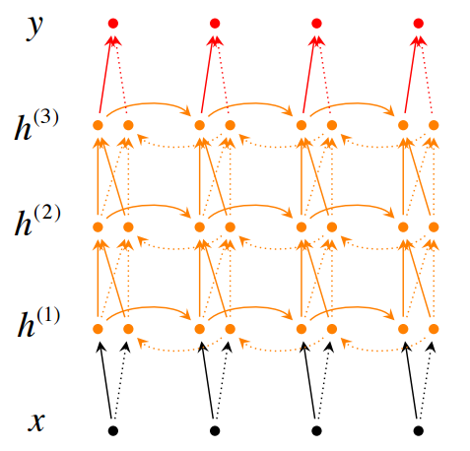
Stack of bi-directional networks
Use the same idea and make your model further complicated:

Slide 34
Training RNNs
How to train such model?
Generalize the same ideas from back-propagation
Total output error: $E\left(\vec{y}, \vec{t}\right)=\sum_{t=1}^{T}{E_{t}\left(y_{t}{, t}_{t}\right)}$
Parameters?
$W_{o}$, $W_{i}$, $W_{h}$ +
vectors for input
$$\frac{∂E}{∂W}=\sum_{t=1}^{T}{\frac{∂E_{t}}{∂W}}$$
Reminder:
$$y_{t}=softmax\left(W_{o}h_{t} \right)$$
$$h_{t}=f(W_{h}h_{t−1}+W_{i}x_{t})$$
$$\frac{∂E_{t}}{∂W}=\sum_{t=1}^{T}{\frac{∂E_{t}}{∂y_{t}}\frac{∂y_{t}}{∂h_{t}}\frac{∂h_{t}}{∂h_{t−k}}\frac{∂h_{t−k}}{∂W}}$$
Backpropagation for RNN
This sometimes is called “Backpropagation Through Time”, since the gradients are propagated back through time.
$x_{t−1}$ $x_{t}$ $x_{t+1}$
O O O O O
O O O O O
O O O O O
O O O O O
O O O O O
O O O O O
$h_{t−1}$ $h_{t}$ $h_{t+1}$
$y_{t−1}$ $y_{t}$ $y_{t+1}$

Slide 35
Recurrent Neural Network
$$\frac{∂E}{∂W}=\sum_{t=1}^{T}{\frac{∂E_{t}}{∂y_{t}}\frac{∂y_{t}}{∂h_{t}}\frac{∂h_{t}}{∂h_{t−k}}\frac{∂h_{t−k}}{∂W}}$$
Reminder:
$$y_{t}=softmax\left(W_{o}h_{t} \right)$$
$$h_{t}=f(W_{h}h_{t−1}+W_{i}x_{t})$$
$$\frac{∂h_{t}}{∂h_{t−1}}=W_{h}diag\left[f^{′}(W_{h}h_{t−1}+W_{i}x_{t})\right]$$
$$diag\left[a_{1}, …, a_{n}\right]=\left[\begin{matrix}a_{1} & 0 & 0 \\ 0 & ⋱ & 0 \\ 0 & 0 & a_{n}\end{matrix}\right]$$
$$\frac{∂h_{t}}{∂h_{t−k}}=\prod_{j=t−k+1}^{t}{\frac{∂h_{j}}{∂h_{j−1}}}=\prod_{j=t−k+1}^{t}{W_{h}diag\left[f^{′}(W_{h}h_{t−1}+W_{i}x_{t})\right]}$$
Backpropagation for RNN
$x_{t−1}$ $x_{t}$ $x_{t+1}$
O O O O O
O O O O O
O O O O O
O O O O O
O O O O O
O O O O O
$h_{t−1}$ $h_{t}$ $h_{t+1}$
$y_{t−1}$ $y_{t}$ $y_{t+1}$

Slide 36
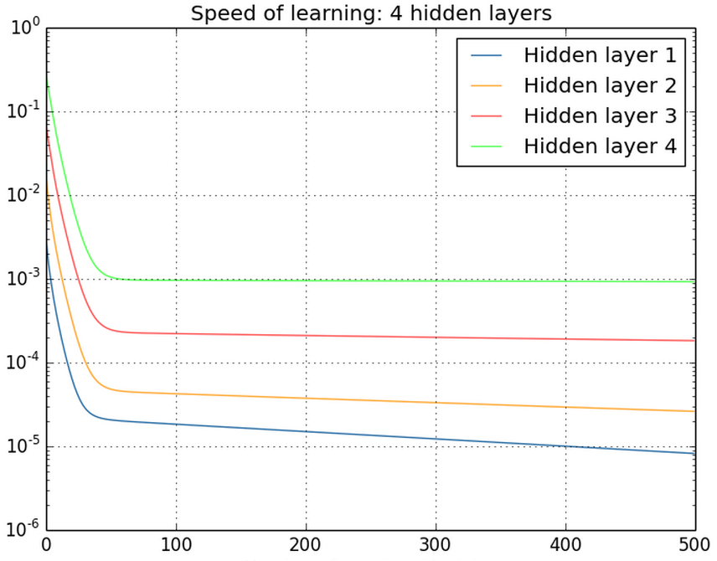
Vanishing/exploding gradients
$$\frac{∂h_{t}}{∂h_{t−k}}=\prod_{j=t−k+1}^{t}{W_{h}diag\left[f^{′}(W_{h}h_{t−1}+W_{i}x_{t})\right]}$$
Vanishing gradients are quite prevalent and a serious issue.
A real example
Training a feed-forward network
y-axis: sum of the gradient norms
Earlier layers have exponentially
smaller sum of gradient norms
This will make training earlier
layers much slower.
$$\frac{∂h_{t}}{∂h_{k}}≤\prod_{j=t−k+1}^{t}{\left\|W_{h}\right\|\left\|diag\left[f^{′}(W_{h}h_{t−1}+W_{i}x_{t})\right]\right\|≤\prod_{j=t−k+1}^{t}{αβ=}{\left(αβ\right)}^{k}}$$
Gradient can become very small or very large quickly, and the locality assumption of gradient descent breaks down (Vanishing gradient) [Bengio et al 1994]

Slide 37
Vanishing/exploding gradients
In an RNN trained on long sequences (e.g. 100 time steps) the gradients can easily explode or vanish.
So RNNs have difficulty dealing with long-range dependencies.
Many methods proposed for reduce the effect of vanishing gradients; although it is still a problem
Introduce shorter path between long connections
Abandon stochastic gradient descent in favor of a much more sophisticated Hessian-Free (HF) optimization
Add fancier modules that are robust to handling long memory; e.g. Long Short Term Memory (LSTM)
One trick to handle the exploding-gradients:
Clip gradients with bigger sizes:
Defnne $g=\frac{∂E}{∂W}$
If $\left\|g\right\|≥threshold$ then
$g←\frac{threshold}{\left\|g\right\|}g$

