Slide 1
Bayesian Classifier
f:X→V, finite set of values
Instances x∈X can be described as a collection of features
x = (x₁, x₂, … x_{n}) x_{i} 2 {0,1}
Given an example, assign it the most probable value in V
Bayes Rule:
Notational convention: P(y) means P(Y=y)

Slide 2
Bayesian Classifier
V_{MAP} = argmax_{v} P(x₁, x₂, …, x_{n} | v )P(v)
Given training data we can estimate the two terms.
Estimating P(v) is easy. E.g., under the binomial distribution assumption, count the number of times v appears in the training data.
However, it is not feasible to estimate P(x₁, x₂, …, x_{n} | v )
In this case we have to estimate, for each target value, the probability of each instance (most of which will not occur).
In order to use a Bayesian classifiers in practice, we need to make assumptions that will allow us to estimate these quantities.

Slide 3

Naive Bayes
V_{MAP} = argmax_{v} P(x₁, x₂, …, x_{n} | v )P(v)
Assumption: feature values are independent given the target value

Slide 4
Naive Bayes (2)
V_{MAP} = argmax_{v} P(x₁, x₂, …, x_{n} | v )P(v)
Assumption: feature values are independent given the target value
P(x₁ = b₁, x₂ = b₂,…,x_{n} = b_{n} | v = v_{j} ) = ¦₁^{n} P(x_{n} = b_{n} | v = v_{j} )
Generative model:
First choose a value v_{j} ∈V according to P(v)
For each v_{j} : choose x₁ x₂, …, x_{n} according to P(x_{k} |v_{j} )

Slide 5
Naive Bayes (3)
V_{MAP} = argmax_{v} P(x₁, x₂, …, x_{n} | v )P(v)
Assumption: feature values are independent given the target value
P(x₁ = b₁, x₂ = b₂,…,x_{n} = b_{n} | v = v_{j} ) = ¦₁^{n} P(x_{i} = b_{i} | v = v_{j} )
Learning method: Estimate n|V| + |V| parameters and use them to make a prediction. (How to estimate?)
Notice that this is learning without search. Given a collection of training examples, you just compute the best hypothesis (given the assumptions).
This is learning without trying to achieve consistency or even approximate consistency.
Why does it work?

Slide 6
Conditional Independence
Notice that the features values are conditionally independent
given the target value, and are not required to be independent.
Example: The Boolean features are x and y.
We define the label to be l = f(x,y)=x∧y
over the product distribution: p(x=0)=p(x=1)=1/2 and p(y=0)=p(y=1)=1/2
The distribution is defined so that x and y are independent: p(x,y) = p(x)p(y)
That is:
But, given that l =0:
p(x=1| l =0) = p(y=1| l =0) = 1/3
while: p(x=1,y=1 | l =0) = 0
so x and y are not conditionally independent.
 | X=0 | X=1
Y=0 | ¼ (l = 0) | ¼ (l = 0)
Y=1 | ¼ (l = 0) | ¼ (l = 1)

Slide 7
Conditional Independence
The other direction also does not hold.
x and y can be conditionally independent but not independent.
Example: We define a distribution s.t.:
l =0: p(x=1| l =0) =1, p(y=1| l =0) = 0
l =1: p(x=1| l =1) =0, p(y=1| l =1) = 1
and assume, that: p(l =0) = p(l =1)=1/2
Given the value of l, x and y are independent (check)
What about unconditional independence ?
p(x=1) = p(x=1| l =0)p(l =0)+p(x=1| l =1)p(l =1) = 0.5+0=0.5
p(y=1) = p(y=1| l =0)p(l =0)+p(y=1| l =1)p(l =1) = 0+0.5=0.5
But,
p(x=1, y=1)=p(x=1,y=1| l =0)p(l =0)+p(x=1,y=1| l =1)p(l =1) = 0
so x and y are not independent.
 | X=0 | X=1
Y=0 | 0 (l= 0) | ½ (l= 0)
Y=1 | ½ (l= 1) | 0 (l= 1)

Slide 8
Naïve Bayes Example
Day Outlook Temperature Humidity Wind PlayTennis
1 Sunny Hot High Weak No
2 Sunny Hot High Strong No
3 Overcast Hot High Weak Yes
4 Rain Mild High Weak Yes
5 Rain Cool Normal Weak Yes
6 Rain Cool Normal Strong No
7 Overcast Cool Normal Strong Yes
8 Sunny Mild High Weak No
9 Sunny Cool Normal Weak Yes
10 Rain Mild Normal Weak Yes
11 Sunny Mild Normal Strong Yes
12 Overcast Mild High Strong Yes
13 Overcast Hot Normal Weak Yes
14 Rain Mild High Strong No

Slide 9
Estimating Probabilities
How do we estimate ?

Slide 10
Example
Compute P(PlayTennis= yes); P(PlayTennis= no)
Compute P(outlook= s/oc/r | PlayTennis= yes/no) (6 numbers)
Compute P(Temp= h/mild/cool | PlayTennis= yes/no) (6 numbers)
Compute P(humidity= hi/nor | PlayTennis= yes/no) (4 numbers)
Compute P(wind= w/st | PlayTennis= yes/no) (4 numbers)

Slide 11
Example
Compute P(PlayTennis= yes); P(PlayTennis= no)
Compute P(outlook= s/oc/r | PlayTennis= yes/no) (6 numbers)
Compute P(Temp= h/mild/cool | PlayTennis= yes/no) (6 numbers)
Compute P(humidity= hi/nor | PlayTennis= yes/no) (4 numbers)
Compute P(wind= w/st | PlayTennis= yes/no) (4 numbers)
Given a new instance:
(Outlook=sunny; Temperature=cool; Humidity=high; Wind=strong)
Predict: PlayTennis= ?

Slide 12
Example
Given: (Outlook=sunny; Temperature=cool; Humidity=high; Wind=strong)
P(PlayTennis= yes)=9/14=0.64 P(PlayTennis= no)=5/14=0.36
P(outlook = sunny | yes)= 2/9 P(outlook = sunny | no)= 3/5
P(temp = cool | yes) = 3/9 P(temp = cool | no) = 1/5
P(humidity = hi |yes) = 3/9 P(humidity = hi | no) = 4/5
P(wind = strong | yes) = 3/9 P(wind = strong | no)= 3/5
P(yes, …..) ~ 0.0053 P(no, …..) ~ 0.0206

Slide 13
Example
Given: (Outlook=sunny; Temperature=cool; Humidity=high; Wind=strong)
P(PlayTennis= yes)=9/14=0.64 P(PlayTennis= no)=5/14=0.36
P(outlook = sunny | yes)= 2/9 P(outlook = sunny | no)= 3/5
P(temp = cool | yes) = 3/9 P(temp = cool | no) = 1/5
P(humidity = hi |yes) = 3/9 P(humidity = hi | no) = 4/5
P(wind = strong | yes) = 3/9 P(wind = strong | no)= 3/5
P(yes, …..) ~ 0.0053 P(no, …..) ~ 0.0206
P(no|instance) = 0.0206/(0.0053+0.0206)=0.795
What if we were asked about Outlook=OC ?

Slide 14
Estimating Probabilities
How do we estimate ?
As we suggested before, we made a Binomial assumption; then:
Sparsity of data is a problem
-- if is small, the estimate is not accurate
-- if is 0, it will dominate the estimate: we will never predict
if a word that never appeared in training (with )
appears in the test data

Slide 15
Robust Estimation of Probabilities
This process is called smoothing.
There are many ways to do it, some better justified than others;
An empirical issue.
Here:
n_{k} is # of occurrences of the word in the presence of v
n is # of occurrences of the label v
p is a prior estimate of v (e.g., uniform)
m is equivalent sample size (# of labels)
  Is this a reasonable definition?

Slide 16
Robust Estimation of Probabilities
Smoothing:
Common values:
Laplace Rule: for the Boolean case, p=1/2 , m=2
Learn to classify text: p = 1/(|values|) (uniform)
m= |values|

Slide 17
Robust Estimation
Assume a Binomial r.v.:
  p(k|n,µ) = C_{n}^{k} µ^{k} (1- µ)^{n-k}
We saw that the maximum likelihood estimate is µ_{ML} = k/n
In order to compute the MAP estimate, we need to assume a prior.
It’s easier to assume a prior of the form:
  p(µ) = µ^{a-1} (1- µ)^{b-1} (a and b are called the hyper parameters)
  The prior in this case is the beta distribution, and it is called a conjugate prior, since it has the same form as the posterior. Indeed, it’s easy to compute the posterior:
  p(µ|D) ~= p(D|µ)p(µ) = µ^{a+k-1} (1- µ)^{b+n-k-1}
Therefore, as we have shown before (differentiate the log posterior)
µ_{map} = k+a-1/(n+a+b-2)
The posterior mean:
E(µ|D) = s₀¹ µp(µ|D)dµ = a+k/(a+b+n)
Under the uniform prior, the posterior mean of observing (k,n) is: k+1/n+2

Slide 18
Naïve Bayes: Two Classes
Notice that the naïve Bayes method gives a method for predicting
rather than an explicit classifier.
In the case of two classes, v∈{0,1} we predict that v=1 iff:

Slide 19
Naïve Bayes: Two Classes
Notice that the naïve Bayes method gives a method for predicting
rather than an explicit classifier.
In the case of two classes, v∈{0,1} we predict that v=1 iff:

Slide 20
Naïve Bayes: Two Classes
In the case of two classes, v∈{0,1} we predict that v=1 iff:

Slide 21
Naïve Bayes: Two Classes
In the case of two classes, v∈{0,1} we predict that v=1 iff:

Slide 22
Naïve Bayes: Two Classes
In the case of two classes, v∈{0,1} we predict that v=1 iff:
We get that naive Bayes is a linear separator with

Slide 23
Naïve Bayes: Two Classes
In the case of two classes we have that:
but since
We get:
Which is simply the logistic function.
The linearity of NB provides a better explanation for why it works.
We have:
A = 1-B; Log(B/A) = -C. Then:
Exp(-C) = B/A =
= (1-A)/A = 1/A – 1
= 1 + Exp(-C) = 1/A
A = 1/(1+Exp(-C))

Slide 24
A few more NB examples

Slide 25
Example: Learning to Classify Text
Instance space X: Text documents
Instances are labeled according to f(x)=like/dislike
Goal: Learn this function such that, given a new document
you can use it to decide if you like it or not
How to represent the document ?
How to estimate the probabilities ?
How to classify?

Slide 26
Document Representation
Instance space X: Text documents
Instances are labeled according to y = f(x) = like/dislike
How to represent the document ?
A document will be represented as a list of its words
The representation question can be viewed as the generation question
We have a dictionary of n words (therefore 2n parameters)
We have documents of size N: can account for word position & count
Having a parameter for each word & position may be too much:
  # of parameters: 2 x N x n (2 x 100 x 50,000 ~ 10⁷)
Simplifying Assumption:
  The probability of observing a word in a document is independent of its location
  This still allows us to think about two ways of generating the document

Slide 27
Classification via Bayes Rule (B)
We want to compute
argmax_{y} P(y|D) = argmax_{y} P(D|y) P(y)/P(D) =
= argmax_{y} P(D|y)P(y)
Our assumptions will go into estimating P(D|y):
Multivariate Bernoulli
  To generate a document, first decide if it’s good (y=1) or bad (y=0).
  Given that, consider your dictionary of words and choose w into your document with probability p(w |y), irrespective of anything else.
  If the size of the dictionary is |V|=n, we can then write
P(d|y) = ¦₁^{n} P(w_{i}=1|y)^{b}i P(w_{i}=0|y)^{1-b}i
Where:
p(w=1/0|y): the probability that w appears/does-not in a y-labeled document.
b_{i} ∈{0,1} indicates whether word w_{i} occurs in document d
2n+2 parameters:
Estimating P(w_{i} =1|y) and P(y) is done in the ML way as before (counting).
Parameters:
Priors: P(y=0/1)
8 w_{i} 2 Dictionary
p(w_{i} =0/1 |y=0/1)

Slide 28
A Multinomial Model
We want to compute
argmax_{y} P(y|D) = argmax_{y} P(D|y) P(y)/P(D) =
= argmax_{y} P(D|y)P(y)
Our assumptions will go into estimating P(D|y):
2. Multinomial
  To generate a document, first decide if it’s good (y=1) or bad (y=0).
  Given that, place N words into d, such that w_{i} is placed with probability P(w_{i}|y), and ∑_{i}^{N} P(w_{i}|y) =1.
  The Probability of a document is:
  P(d|y) N!/n₁!...n_{k}! P(w₁|y)^{n1}…p(w_{k}|y)^{nk}
Where n_{i} is the # of times w_{i} appears in the document.
Same # of parameters: 2n+2, where n = |Dictionary|, but the estimation is done a bit differently. (HW).
Parameters:
Priors: P(y=0/1)
8 w_{i} 2 Dictionary
p(w_{i} =0/1 |y=0/1)
N dictionary items are
chosen into D

Slide 29
Model Representation
The generative model in these two cases is different
µ
¯
µ
¯
label
label
Documents d
Appear
Documents d
Appear (d)
Words w
Position p
Bernoulli: A binary variable corresponds to a document d and a dictionary word w, and it takes the value 1 if w appears in d. Document topic/label is governed by a prior µ, its topic (label), and the variable in the intersection of the plates is governed by µ and the Bernoulli parameter ¯ for the dictionary word w
Multinomial: Words do not correspond to dictionary words but to positions (occurrences) in the document d. The internal variable is then W(D,P). These variables are generated from the same multinomial distribution ¯, and depend on the topic/label.

Slide 30
General NB Scenario
We assume a mixture probability model, parameterized by µ.
Different components {c₁,c₂,… c_{k}} of the model are parameterize by disjoint subsets of µ.
The generative story: A document d is created by
(1) selecting a component according to the priors, P(c_{j} |µ), then
(2) having the mixture component generate a document according to its own parameters, with distribution P(d|c_{j}, µ)
So we have:
P(d|µ) = ∑₁^{k} P(c_{j}|µ) P(d|c_{j},µ)
In the case of document classification, we assume a one to one correspondence between components and labels.

Slide 31
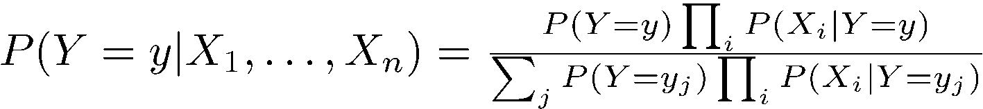
Naïve Bayes: Continuous Features
X_{i} can be continuous
We can still use
And

Slide 32
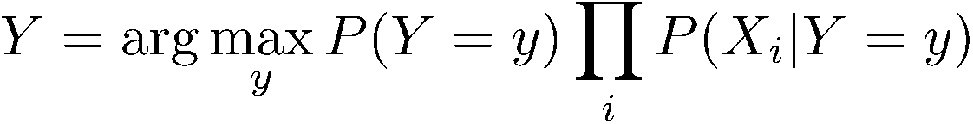
Naïve Bayes: Continuous Features
X_{i} can be continuous
We can still use
And
Naïve Bayes classifier:

Slide 33
Naïve Bayes: Continuous Features
X_{i} can be continuous
We can still use
And
Naïve Bayes classifier:
Assumption: P(X_{i}|Y) has a Gaussian distribution

Slide 34
The Gaussian Probability Distribution
Gaussian probability distribution also called normal distribution.
It is a continuous distribution with pdf:
μ = mean of distribution
σ² = variance of distribution
x is a continuous variable (-∞ ≤ x ≤ ∞)
Probability of x being in the range [a, b] cannot be evaluated analytically (has to be looked up in a table)
x

Slide 35
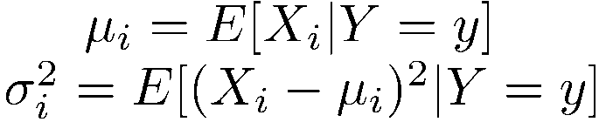
Naïve Bayes: Continuous Features
P(X_{i}|Y) is Gaussian
Training: estimate mean and standard deviation
Note that the following slides abuse notation significantly. Since P(x) =0 for continues distributions, we think of
P (X=x| Y=y), not as a classic probability distribution, but just as a function f(x) = N(x, ¹, ¾²).
f(x) behaves as a probability distribution in the sense that 8 x, f(x) ¸ 0 and the values add up to 1. Also, note that f(x) satisfies Bayes Rule, that is, it is true that:
f_{Y}(y|X = x) = f_{X} (x|Y = y) f_{Y} (y)/f_{X}(x)

Slide 36
Naïve Bayes: Continuous Features
P(X_{i}|Y) is Gaussian
Training: estimate mean and standard deviation
X₁ X₂ X₃ Y
2 3 1 1
-1.2 2 .4 1
2 0.3 0 0
2.2 1.1 0 1

Slide 37
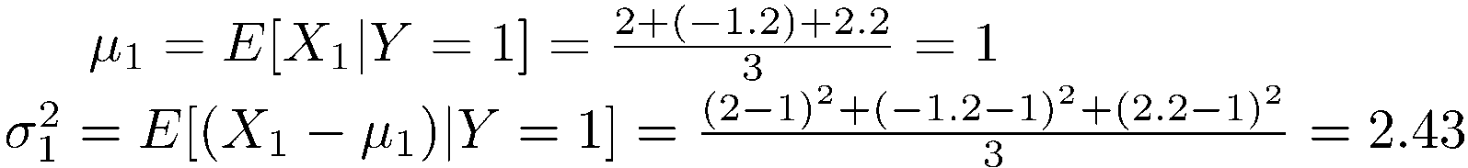
Naïve Bayes: Continuous Features
P(X_{i}|Y) is Gaussian
Training: estimate mean and standard deviation
X₁ X₂ X₃ Y
2 3 1 1
-1.2 2 .4 1
2 0.3 0 0
2.2 1.1 0 1

Slide 38
Recall: Naïve Bayes, Two Classes
In the case of two classes we have that:
but since
We get:
Which is simply the logistic function (also used in the neural network
representation)
The same formula can be written for continuous features

Slide 39
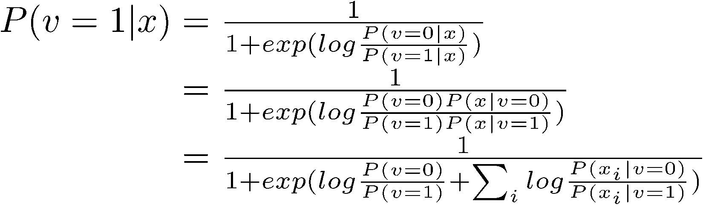
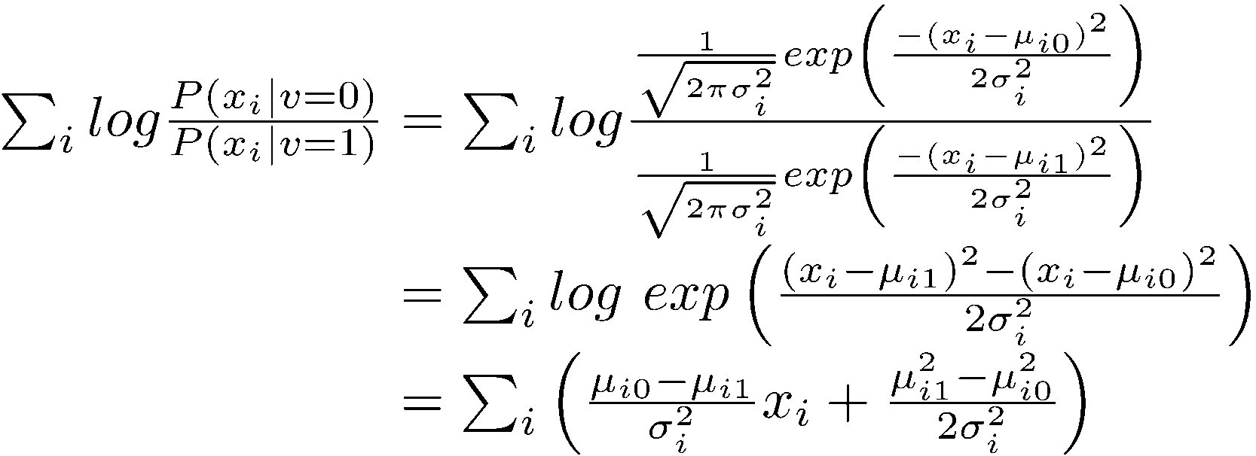
Logistic Function: Continuous Features
Logistic function for Gaussian features
Note that we are using ratio of probabilities, since x is a continuous variable.

Slide 40
Hidden Markov Model (HMM)
A probabilistic generative model: models the generation of an observed sequence.
At each time step, there are two variables: Current state (hidden), Observation
Elements
  Initial state probability P(s₁) (|S| parameters)
  Transition probability P(s_{t}|s_{t-1}) (|S|^2 parameters)
  Observation probability P(o_{t}|s_{t}) (|S|x |O| parameters)
As before, the graphical model is an encoding of the independence assumptions:
  P(s_{t}|s_{t-1}, s_{t-2},…s₁) =P(s_{t}|s_{t-1})
  P(o_{t}| s_{T},…,s_{t},…s₁, o_{T},…,o_{t},…o₁ )=P(o_{t}|s_{t})
Examples: POS tagging, Sequential Segmentation
s₁
s₂
s₃
s₄
s₅
s₆
o₁
o₂
o₃
o₄
o₅
o₆

Slide 41
HMM for Shallow Parsing
States:
  {B, I, O}
Observations:
  Actual words and/or part-of-speech tags
s₁=B
s₂=I
s₃=O
s₄=B
s₅=I
s₆=O
o₁
Mr.
o₂
Brown
o₃
blamed
o₄
Mr.
o₅
Bob
o₆
for

Slide 42
HMM for Shallow Parsing
Given a sentences, we can ask what the most likely state sequence is
s₁=B
s₂=I
s₃=O
s₄=B
s₅=I
s₆=O
o₁
Mr.
o₂
Brown
o₃
blamed
o₄
Mr.
o₅
Bob
o₆
for
Transition probabilty:
P(s_{t}=B|s_{t-1}=B),P(s_{t}=I|s_{t-1}=B),P(s_{t}=O|s_{t-1}=B),
P(s_{t}=B|s_{t-1}=I),P(s_{t}=I|s_{t-1}=I),P(s_{t}=O|s_{t-1}=I),
…
Initial state probability:
P(s₁=B),P(s₁=I),P(s₁=O)
Observation Probability:
P(o_{t}=‘Mr.’|s_{t}=B),P(o_{t}=‘Brown’|s_{t}=B),…,
P(o_{t}=‘Mr.’|s_{t}=I),P(o_{t}=‘Brown’|s_{t}=I),…,
…

Slide 43
Three Computational Problems
B
0.2
I
0.5
I
0.5
0.5
0.5
I
B
0.25
0.25
0.25
0.25
0.4
a
c
d
a
d
Decoding – finding the most likely path
  Have: model, parameters, observations (data)
  Want: most likely states sequence
Evaluation – computing observation likelihood
  Have: model, parameters, observations (data)
  Want: the likelihood to generate the observed data
In both cases – a simple minded solution depends on |S|^{T} steps
Training – estimating parameters
  Supervised: Have: model, annotated data(data + states sequence)
  Unsupervised: Have: model, data
  Want: parameters

Slide 44
Finding most likely state sequence in HMM (1)
P
(
)
s
;
s
;
:
:
:
;
s
;
o
;
o
;
:
:
:
;
o
k
k
1
1
1
1
¡
k
k
¡
=
(
)
P
o
j
o
;
o
;
:
:
:
;
o
;
s
;
s
;
:
:
:
;
s
k
k
¡
1
k
¡
2
1
k
k
¡
1
1
¢
(
)
P
o
;
o
;
:
:
:
;
o
;
s
;
s
;
:
:
:
;
s
k
¡
1
2
1
1
1
k
¡
k
k
¡
=
(
)
(
)
P
o
j
¢
s
P
o
;
o
;
:
:
:
;
o
;
s
;
s
;
:
:
:
;
s
k
k
k
¡
1
k
¡
2
1
k
k
¡
1
1
=
(
)
(
)
P
o
j
¢
j
s
P
s
s
;
s
;
:
:
:
;
s
;
o
;
o
;
:
:
:
;
o
k
k
k
k
¡
1
2
1
1
2
1
k
¡
k
¡
k
¡
¢
(
)
P
s
;
s
;
:
:
:
;
s
;
o
;
o
;
:
:
:
;
o
k
¡
1
k
¡
2
1
k
¡
1
k
¡
2
1
=
(
)
(
)
P
o
j
¢
j
k
s
P
s
s
1
k
k
k
¡
¢
(
)
P
s
;
s
;
:
:
:
;
s
;
o
;
o
;
:
:
:
;
o
k
¡
1
k
¡
2
1
k
¡
1
k
¡
2
1
k
¡
1
Y
=
(
)
[
(
)
(
)]
(
)
P
o
j
¢
j
¢
j
¢
s
P
s
s
P
o
s
P
s
+1
1
k
k
t
t
t
t
=1
t

Slide 45
Finding most likely state sequence in HMM (2)
a
rg
max
(
j
)
P
s
;
s
;
:
:
:
;
s
o
;
o
;
:
:
:
;
o
k
k
1
1
1
1
s
;s
;:::
;s
¡
k
k
¡
k
k
1
1
¡
P
(
)
s
;
s
;
:
:
:
;
s
;
o
;
o
;
:
:
:
;
o
=
a
k
k
¡
1
1
k
k
¡
1
1
rg
max
s
;s
;:::
;s
P
(
)
1
1
o
;
o
;
:
:
:
;
o
k
k
¡
k
k
¡
1
1
=
a
rg
max
(
)
P
s
;
s
;
:
:
:
;
s
;
o
;
o
;
:
:
:
;
o
k
k
¡
1
1
k
k
¡
1
1
s
;s
;:::
;s
k
k
1
1
¡
k
¡
1
Y
=
a
rg
max
(
)
[
(
)
(
)]
(
)
P
o
j
¢
j
¢
j
¢
s
P
s
s
P
o
s
P
s
1
t
t
t
k
k
+1
s
;s
;:::
;s
t
k
k
1
1
¡
t
=1

Slide 46
Finding most likely state sequence in HMM (3)
A function of s_{k}
k
¡
1
Y
max
P
(
o
k
j
s
k
)
¢
[
P
(
s
t
+1
j
s
t
)
¢
P
(
o
t
j
s
t
)]
¢
P
(
s
1
)
s
k
;s
k
¡
1
;:::
;s
1
=1
t
k
¡
1
Y
=
max
(
)
max
j
¢
[
(
j
)
(
)]
(
)
P
o
s
P
s
s
¢
P
o
j
¢
+1
s
P
s
1
s
k
k
s
;:::
;s
t
t
t
t
k
k
1
1
¡
t
=1
=
max
(
)
max
j
¢
[
(
j
)
(
)]
P
o
s
P
s
s
¢
P
o
j
1
s
k
k
k
k
¡
k
¡
1
1
s
s
k
¡
k
k
1
¡
k
¡
2
Y
max
¢
[
(
j
)
(
)]
(
)
P
s
s
¢
j
¢
+1
P
o
s
P
s
s
;:::
;s
t
t
t
t
1
k
2
1
¡
t
=1
=
max
(
)
max
j
¢
[
(
j
)
(
)]
P
o
s
P
s
s
¢
P
o
j
1
s
k
k
k
k
¡
k
¡
1
1
s
s
1
k
¡
k
k
¡
max
¢
[
(
j
)
(
)]
P
s
s
¢
j
¢
1
2
P
o
s
:
:
:
s
k
¡
k
¡
k
¡
2
k
¡
2
k
2
¡
max
¢
[
(
)
(
)]
(
)
P
s
j
¢
j
¢
s
P
o
s
P
s
s
2
1
1
1
1
1

Slide 47
Finding most likely state sequence in HMM (4)
max
Viterbi’s Algorithm
  Dynamic Programming
(
)
max
j
¢
[
(
)
(
)]
P
o
s
P
s
j
¢
j
s
1
P
o
s
k
k
k
k
1
1
s
s
1
¡
k
¡
k
¡
k
k
¡
max
¢
[
(
j
)
(
)]
P
s
s
¢
P
o
j
¢
1
2
s
:
:
:
k
¡
k
¡
k
2
2
¡
k
s
¡
k
¡
2
max
¢
[
(
)
(
)]
P
s
j
¢
j
¢
s
P
o
s
s
3
2
2
2
2
max
¢
[
(
)
(
)]
(
)
P
s
j
¢
j
¢
s
P
o
s
P
s
s
2
1
1
1
1
1

Slide 48
Learning the Model
Estimate
  Initial state probability P (s₁)
  Transition probability P(s_{t}|s_{t-1})
  Observation probability P(o_{t}|s_{t})
Unsupervised Learning (states are not observed)
  EM Algorithm
Supervised Learning (states are observed; more common)
  ML Estimate of above terms directly from data
Notice that this is completely analogues to the case of naive Bayes, and essentially all other models.

