Slide 1
On-Line Learning
Not the most general setting for on-line learning.
Not the most general metric
(Regret: cumulative loss; Competitive analysis)
Model:
  Instance space: X (dimensionality – n)
  Target: f: X →{0,1}, f ∈ C, concept class (parameterized by n)
Protocol:
  learner is given x ∈ X
  learner predicts h(x), and is then given f(x) (feedback)
Performance: learner makes a mistake when h(x) ≠ f(x)
  number of mistakes algorithm A makes on sequence S of examples, for the target function f.
A is a mistake bound algorithm for the concept class C, if MA(c) is a polynomial in n, the complexity parameter of the target concept.
On Line Model

Slide 2
Representation
Assume that you want to learn conjunctions. Should your hypothesis space be the class of conjunctions?
  Theorem: Given a sample on n attributes that is consistent with a conjunctive concept, it is NP-hard to find a pure conjunctive hypothesis that is both consistent with the sample and has the minimum number of attributes.
  [David Haussler, AIJ’88: “Quantifying Inductive Bias: AI Learning Algorithms and Valiant's Learning Framework”]
Same holds for Disjunctions.
Intuition: Reduction to minimum set cover problem.
  Given a collection of sets that cover X, define a set of examples so that learning the best (dis/conj)junction implies a minimal cover.
Consequently, we cannot learn the concept efficiently as a (dis/con)junction.
But, we will see that we can do that, if we are willing to learn the concept as a Linear Threshold function.
In a more expressive class, the search for a good hypothesis sometimes becomes combinatorially easier.
Importance of Representation

Slide 3
Linear Functions
{
1 if w1 x1 + w2 x2 +. . . wn xn >= θ
0 Otherwise
f (x) =
Disjunctions
At least m of n:
Exclusive-OR:
Non-trivial DNF
y = x1 ∨ x3 ∨ x5
y = ( 1• x1 + 1• x3 + 1• x5 >= 1)
y = at least 2 of {x1 , x3 , x5}
y = ( 1• x1 + 1• x3 + 1• x5 >=2)
Linear Functions
y = (x1 Λ x2 v ) (x1 Λ x2)
y = (x1 Λ x2) v (x3 Λ x4)

Slide 4
Perceptron learning rule
We learn f:X→{-1,+1} represented as f =sgn{w•x)
Where X= {0,1}^{n} or X= R^{n} and w∈ R^{n}
Given Labeled examples: {(x₁, y₁), (x₂, y₂),…(x_{m}, y_{m})}
  Initialize w=0∈
2. Cycle through all examples
  a. Predict the label of instance x to be y’ = sgn{w•x)
  b. If y’≠y, update the weight vector:
w = w + r y x (r - a constant, learning rate)
Otherwise, if y’=y, leave weights unchanged.
Perceptron

Slide 5
Perceptron Convergence
Perceptron Convergence Theorem:
If there exist a set of weights that are consistent with the data (i.e., the data is linearly separable), the perceptron learning algorithm will converge
  How long would it take to converge ?
Perceptron Cycling Theorem:
If the training data is not linearly separable the perceptron learning algorithm will eventually repeat the same set of weights and therefore enter an infinite loop.
  How to provide robustness, more expressivity ?
Perceptron

Slide 6
Perceptron: Mistake Bound Theorem
Maintains a weight vector w∈R^{N}, w₀=(0,…,0).
Upon receiving an example x ∈ R^{N}
Predicts according to the linear threshold function w•x ≥ 0.
Theorem [Novikoff,1963] Let (x₁; y₁),…,: (x_{t}; y_{t}), be a sequence of labeled examples with x_{i} ∈<^{N}, ||x_{i}||≤R and y_{i} ∈{-1,1} for all i. Let u∈ <^{N}, γ > 0 be such that, ||u|| = 1 and y_{i} u • x_{i} ≥ γ for all i.
Then Perceptron makes at most R² / γ ² mistakes on this example sequence.
(see additional notes)
Analysis
Complexity Parameter

Slide 7
Robustness to Noise
In the case of non-separable data , the extent to which a data point fails to have margin ° via the hyperplane w can be quantified by a slack variable
»_{i}= max(0, ° − y_{i} w¢ x_{i}).
Observe that when »_{i} = 0, the example x_{i} has margin at least °. Otherwise, it grows linearly with − y_{i} w¢ x_{i}
Denote: D₂ = [∑ {»_{i}²}]^{1/2}
Theorem: The perceptron is
guaranteed to make no more than
((R+D₂)/°)² mistakes on any sequence
of examples satisfying ||x_{i}||²<R
Perceptron is expected to
have some robustness to noise.
Non separable
case
-
-
-
-
-
-
-
-
-
-
-
-
-
-
-
Notes:
Need to understand \xi :

Slide 8
Winnow Algorithm
The Winnow Algorithm learns Linear Threshold Functions.
For the class of disjunctions:
  instead of demotion we can use elimination.
Winnow

Slide 9
Winnow – Mistake Bound
Claim: Winnow makes O(k log n) mistakes on k-disjunctions
u - # of mistakes on positive examples (promotions)
v - # of mistakes on negative examples (demotions)
u < k log(2n)
A weight that corresponds to a good variable is only promoted.
When these weights get to n there will be no more mistakes on positives.
Analysis

Slide 10
I Regularization Via Averaged Perceptron
An Averaged Perceptron Algorithm is motivated by the following considerations:
  Every Mistake-Bound Algorithm can be converted efficiently to a PAC algorithm – to yield global guarantees on performance.
  In the mistake bound model:
    We don’t know when we will make the mistakes.
  In the PAC model:
    Dependence is on number of examples seen and not number of mistakes.
    Which hypothesis will you choose…??
    Being consistent with more examples is better
To convert a given Mistake Bound algorithm (into a global guarantee algorithm):
  Wait for a long stretch w/o mistakes (there must be one)
  Use the hypothesis at the end of this stretch.
  Its PAC behavior is relative to the length of the stretch.
Averaged Perceptron returns a weighted average of a number of earlier hypotheses; the weights are a function of the length of no-mistakes stretch.
Averaged Perceptron
Notes:
Assume that you are hoping to see a stretch of 1000 examples, with no mistakes; if you see that, you know that the algorithm is good enough. (to be justified when we talk about PAC).
And assume that your mistake bound algorithm has a bound of 500.
The worst scenario is that you go 999 examples, almost happy, but then you see a mistake; so you start again; see 999 examples, and another mistake; and so on. But this can happen at most 500 times. After that, you will get as long a stretch as you want.

Slide 11
I Regularization Via Averaged Perceptron (or Winnow)
Training:
[m: #(examples); k: #(mistakes) = #(hypotheses); c_{i}: consistency count for v_{i} ]
Input: a labeled training set {(x₁, y₁),…(x_{m}, y_{m})}
Number of epochs T
Output: a list of weighted perceptrons {(v₁, c₁),…,(v_{k}, c_{k})}
Initialize: k=0; v₁ = 0, c₁ = 0
Repeat T times:
  For i =1,…m:
  Compute prediction y’ = sign(v_{k} ¢ x_{i} )
  If y’ = y, then c_{k} = c_{k} + 1
  else: v_{k+1} = v_{k} + y_{i} x ; c_{k+1} = 1; k = k+1
Prediction:
Given: a list of weighted perceptrons {(v₁, c₁),…(v_{k}, c_{k})} ; a new example x
Predict the label(x) as follows:
y(x)= sign [ ∑_{1, k} c_{i} sign(v_{i} ¢ x) ]
Averaged Perceptron

Slide 12
II Perceptron with Margin
Thick Separator (aka as Perceptron with Margin) (Applies both for Perceptron and Winnow)
Promote if:
  w x - θ < γ
Demote if:
  w x - θ > γ
w ¢ x = θ
-
-
-
-
-
-
-
-
-
-
-
-
-
-
w ¢ x = 0
-
Note: γ is a functional margin. Its effect could disappear as w grows.
Nevertheless, this has been shown to be a very effective algorithmic addition.
(Grove & Roth 98,01; Karov et. al 97)

Slide 13
Winnow - Extensions
This algorithm learns monotone functions
For the general case:
  Duplicate variables (down side?)
  For the negation of variable x, introduce a new variable y.
  Learn monotone functions over 2n variables
Balanced version:
  Keep two weights for each variable; effective weight is the difference
  We’ll come back to this idea when talking about multiclass.
Extensions

Slide 14
Winnow – A Robust Variation
Modeling:
  Adversary’s turn: may change the target concept by adding or removing some variable from the target disjunction.
    Cost of each addition move is 1.
  Learner’s turn: makes prediction on the examples given, and is then told the correct answer (according to current target function)
  Winnow-R: Same as Winnow, only doesn’t let weights go below 1/2
  Claim: Winnow-R makes O(c log n) mistakes, (c - cost of adversary) (generalization of previous claim)
Extensions

Slide 15

General Stochastic Gradient Algorithms
Given examples {z=(x,y)}_{1, m} from a distribution over XxY, we are trying to learn a linear function, parameterized by a weight vector w, so that we minimize the expected risk function
J(w) = E_{z} Q(z,w) ~=~ 1/m ∑_{1, m} Q(z_{i}, w_{i})
In Stochastic Gradient Descent Algorithms we approximate this minimization by incrementally updating the weight vector w as follows:
w_{t+1} = w_{t} – r_{t} g_{w} Q(z_{t}, w_{t}) = w_{t} – r_{t} g_{t}
  Where g_t = g_{w} Q(z_{t}, w_{t}) is the gradient with respect to w at time t.
The difference between algorithms now amounts to choosing a different loss function Q(z, w)

Slide 16
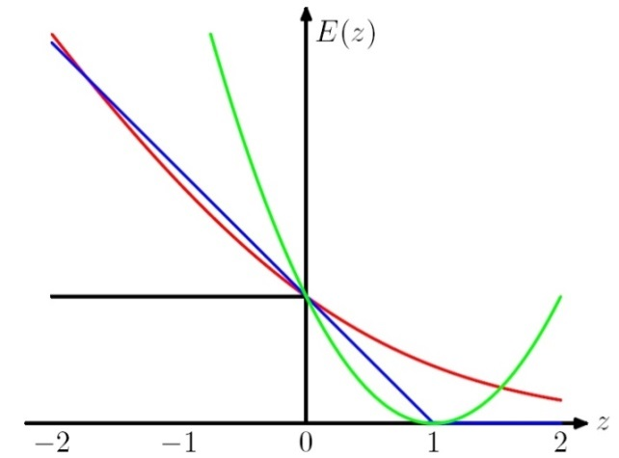
Stochastic Gradient Algorithms
w_{t+1} = w_{t} – r_{t} g_{w} Q(z_{t}, w_{t}) = w_{t} – r_{t} g_{t}
  LMS: Q((x, y), w) =1/2 (y – w ¢ x)²
  leads to the update rule (Also called Widrow’s Adaline):
  w_{t+1} = w_{t} + r (y_{t} – w_{t} ¢ x_{t}) x_{t}
  Here, even though we make binary predictions based on sign (w ¢ x) we do not take the sign of the dot-product into account in the loss.
  Another common loss function is:
  Hinge loss:
  Q((x, y), w) = max(0, 1 - y w ¢ x)
  This leads to the perceptron update rule:
  If y_{i} w_{i} ¢ x_{i} > 1 (No mistake, by a margin): No update
  Otherwise (Mistake, relative to margin): w_{t+1} = w_{t} + r y_{t} x_{t}
w ¢ x

Slide 17
New Stochastic Gradient Algorithms
w_{t+1} = w_{t} – r_{t} g_{w} Q(z_{t}, w_{t}) = w_{t} – r_{t} g_{t}
(notice that this is a vector, each coordinate (feature) has its own wt,j and gt,j)
  So far, we used fixed learning rates r = r_{t}, but this can change.
  AdaGrad alters the update to adapt based on historical information, so that frequently occurring features in the gradients get small learning rates and infrequent features get higher ones.
  The idea is to “learn slowly” from frequent features but “pay attention” to rare but informative features.
  Define a “per feature” learning rate for the feature j, as:
  r_{t,j} = r/(G_{t,j})^{1/2}
  where G_{t,j} = ∑_{k=1, t} g²_{k,j} the sum of squares of gradients at feature j until time t.
  Overall, the update rule for Adagrad is:
  w_{t+1,j} = w_{t,j} - g_{t,j} r/(G_{t,j})^{1/2}
  This algorithm is supposed to update weights faster than Perceptron or LMS when needed.

Slide 18
Regularization
The more general formalism adds a regularization term to the risk function, and attempts to minimize:
J(w) = ∑_{1, m} Q(z_{i}, w_{i}) + ¸ R_{i} (w_{i})
Where R is used to enforce “simplicity” of the learned functions.
LMS case: Q((x, y), w) =(y – w ¢ x)²
  R(w) = ||w||²₂ gives the optimization problem called Ridge Regression.
  R(w) = ||w||₁ gives a problem called the LASSO problem
Hinge Loss case: Q((x, y), w) = max(0, 1 - y w ¢ x)
  R(w) = ||w||²₂ gives the problem called Support Vector Machines
Logistics Loss case: Q((x,y),w) = log (1+exp{-y w ¢ x})
  R(w) = ||w||²₂ gives the problem called Logistics Regression
These are convex optimization problems and, in principle, the same gradient descent mechanism can be used in all cases.
We will see later why it makes sense to use the “size” of w as a way to control “simplicity”.

Slide 19
Generalization
Dominated by the sparseness of the function space
  Most features are irrelevant
# of examples required by multiplicative algorithms depends mostly on # of relevant features
  (Generalization bounds depend on the target ||u|| )
# of examples required by additive algoirithms depends heavily on sparseness of features space:
  Advantage to additive. Generalization depend on input ||x||
    (Kivinen/Warmuth 95).
Generalization

Slide 20
Which Algorithm to Choose?
Generalization
  Multiplicative algorithms:
    Bounds depend on ||u||, the separating hyperplane; i: example #)
    M_{w} =2ln n ||u||₁² max_{i}||x^{(i)}||₁² /min_{i}(u ¢ x^{(i)})²
    Do not care much about data; advantage with sparse target u
  Additive algorithms:
    Bounds depend on ||x|| (Kivinen / Warmuth, ‘95)
    M_{p} = ||u||₂² max_{i}||x^{(i)}||₂²/min_{i}(u ¢ x^{(i)})²
    Advantage with few active features per example
The l₁ norm: ||x||₁ = ∑_{i}|x_{i}| The l₂ norm: ||x||₂ =(∑₁^{n}|x_{i}|²)^{1/2}
The l_{p} norm: ||x||_{p} = (∑₁^{n}|x_{i}|^{P} )^{1/p} The l₁ norm: ||x||₁ = max_{i}|x_{i}|

Slide 21
Making data linearly separable
f(x) = 1 iff x₁² + x₂² ≤ 1

Slide 22
Making data linearly separable
In order to deal with this, we introduce two new concepts:
  Dual Representation
  Kernel (& the kernel trick)
Transform data: x = (x₁, x₂ ) => x’ = (x₁², x₂² )
f(x’) = 1 iff x’₁ + x’₂ ≤ 1

Slide 23
Dual Representation
Let w be an initial weight vector for perceptron. Let (x¹,+), (x²,+), (x³,-), (x⁴,-) be examples and assume mistakes are made on x¹, x² and x⁴.
What is the resulting weight vector?
        w = w + x¹ + x² - x⁴
In general, the weight vector w can be written
as a linear combination of examples:
w = ∑_{1,m} r ®_{i} y_{i} x_{i}
Where ®_{i} is the number of mistakes made on x_{i}.
Note: We care about the dot product: f(x) = w ¢ x =
= (∑_{1,m} r®_{i} y_{i} x_{i}) ¢ x
= ∑_{1,m} r®_{i} y_{i} (x_{i} ¢ x)

Slide 24
Kernel Based Methods
A method to run Perceptron on a very large feature set, without incurring the cost of keeping a very large weight vector.
Computing the dot product can be done in the original feature space.
Notice: this pertains only to efficiency: The classifier is identical to the one you get by blowing up the feature space.
Generalization is still relative to the real dimensionality (or, related properties).
Kernels were popularized by SVMs, but many other algorithms can make use of them (== run in the dual).
  Linear Kernels: no kernels; stay in the original space. A lot of applications actually use linear kernels.
General

Slide 25
Implementation
Simply run Perceptron in an on-line mode, but keep track of the set M.
Keeping the set M allows us to keep track of S(z).
Rather than remembering the weight vector w, remember the set M (P and D) – all those examples on which we made mistakes.
Dual Representation

Slide 26
Kernels – General Conditions
Kernel Trick: You want to work with degree 2 polynomial features, Á(x). Then, your dot product will be in a space of dimensionality n(n+1)/2. The kernel trick allows you to save and compute dot products in an n dimensional space.
Can we use any K(.,.)?
  A function K(x,z) is a valid kernel if it corresponds to an inner product in some (perhaps infinite dimensional) feature space.
Take the quadratic kernel: k(x,z) = (x^{T}z)²
Example: Direct construction (2 dimensional, for simplicity):
K(x,z) = (x₁ z₁ + x₂ z₂)² = x₁² z₁² +2x₁ z₁ x₂ z₂ + x₂² z₂²
= (x₁², sqrt{2} x₁x₂, x₂²) (z₁², sqrt{2} z₁z₂, z₂²)
= ©(x)^{T} ©(z) → A dot product in an expanded space.
It is not necessary to explicitly show the feature function Á.
General condition: construct the Gram matrix {k(x_{i} ,z_{j})}; check that it’s positive semi definite.
Kernel: Example

Slide 27
The Kernel Matrix
The Gram matrix of a set of n vectors S = {x₁…x_{n}} is the n×n matrix G with G_{ij} = x_{i}x_{j}
  The kernel matrix is the Gram matrix of {φ(x₁), …,φ(x_{n})}
  (size depends on the # of examples, not dimensionality)
Direct option:
  If you have the φ(x_{i}), you have the Gram matrix (and it’s easy to see that it will be positive semi-definite)
Indirect:
  If you have the Kernel, write down the Kernel matrix K_{ij}, and show that it is a legitimate kernel, without an explicit construction of φ(x_{i})

Slide 28
Properties of the kernel matrix K
K is symmetric:
K_{ij} = k(x_{i}, x_{j}) = φ(x_{i})φ(x_{j}) = k(x_{j}, x_{i}) = K_{ji}
K is positive semi-definite (∀ vectors v: v^{T}Kv ≥0):
Proof:

Slide 29
Constructing New Kernels
You can construct new kernels k’(x, x’) from existing ones:
  Multiplying k(x, x’) by a constant c:
  k’(x, x’) = ck(x, x’)
  Multiplying k(x, x’) by a function f applied to x and x’:
  k’(x, x’) = f(x)k(x, x’)f(x’)
  Applying a polynomial (with non-negative coefficients) to k(x, x’):
  k’(x, x’) = P( k(x, x’) ) with P(z) = ∑_{i} a_{i}z^{i} and a_{i}≥0
  Exponentiating k(x, x’):
  k’(x, x’) = exp(k(x, x’))

Slide 30
Summary – Kernel Based Methods
A method to run Perceptron on a very large feature set, without incurring the cost of keeping a very large weight vector.
Computing the weight vector can be done in the original feature space.
Notice: this pertains only to efficiency: the classifier is identical to the one you get by blowing up the feature space.
Generalization is still relative to the real dimensionality (or, related properties).
Kernels were popularized by SVMs but apply to a range of models, Perceptron, Gaussian Models, PCAs, etc.

Slide 31
Efficiency-Generalization Tradeoff
There is a tradeoff between the computational efficiency with which these kernels can be computed and the generalization ability of the classifier.
For example, using such kernels the Perceptron algorithm can make an exponential number of mistakes even when learning simple functions. [Khardon,Roth,Servedio,NIPS’01; Ben David et al.]
In addition, computing with kernels depends strongly on the number of examples. It turns out that sometimes working in the blown up space is more efficient than using kernels. [Cumby,Roth,ICML’03]

Slide 32
Explicit & Implicit Kernels: Complexity
Is it always worthwhile to define kernels and work in the dual space?
Computationally: [Cumby,Roth 2003]
  Dual space – t₁ m² vs, Primal Space – t₂ m
  Where m is # of examples, t₁, t₂ are the sizes of the (Dual, Primal) feature spaces, respectively.
  Typically, t₁ << t₂, so it boils down to the number of examples one needs to consider relative to the growth in dimensionality.
Rule of thumb: a lot of examples → use Primal space
Most applications today: People use explicit kernels. That is, they blow up the feature space explicitly.

Slide 33
Kernels: Generalization
Do we want to use the most expressive kernels we can?
  (e.g., when you want to add quadratic terms, do you really want to add all of them?)
No; this is equivalent to working in a larger feature space, and will lead to overfitting.
Here is a simple argument that shows that simply adding irrelevant features does not help.

Slide 34
Kernels: Generalization(2)
Given: A linearly separable set of points S={x₁,…x_{n}} 2 R^{n} with separator w 2 R^{n}
Embed S into a higher dimensional space n’>n , by adding zero-mean random noise e to the additional dimensions.
Then w’ ¢ x= (w,0) ¢ (x,e) = w ¢ x
So w’ 2 R^{n}’ still separates S.
We will now look at °/||x|| which we have shown to be inversely proportional to generalization (and mistake bound) ?
γ (S, w’)/||x’|| = min_{S} w’^{T} x’ / ||w’|| ||x’|| =
min_{S} w^{T} x /||w|| ||x’|| < γ (S, w’)/||x||
Since ||x’|| = ||(x,e)|| > ||x||
The new ratio is larger, which implies generalization suffers.
Intuition: adding a lot of noisy/irrelevant features cannot help

Slide 35
Multi-Layer Neural Network
Multi-layer network were designed to overcome the computational (expressivity) limitation of a single threshold element.
The idea is to stack several
layers of threshold elements,
each layer using the output of
the previous layer as input.
Multi-layer networks can represent arbitrary functions, but building effective learning methods for such network was [thought to be] difficult.
activation
Output
Hidden
Input

Slide 36
Basic Units
Linear Unit: Multiple layers of linear functions o_{j} = w ¢ x produce linear functions. We want to represent nonlinear functions.
Threshold units: o_{j} = sgn(w ¢ x)
are not differentiable, hence
unsuitable for gradient descent.
The key idea (Rumelhart, Hinton, Williiam, 1986) was to notice that the discontinuity of the threshold element can be represents by a smooth non-linear approximation: o_{j} = [1+ exp{-w ¢ x}]⁻¹
activation
Output
w²_{ij}
Hidden
w¹_{ij}
Input

Slide 37
Learning with a Multi-Layer Perceptron
It’s easy to learn the top layer – it’s just a linear unit.
Given feedback (truth) at the top layer, and the activation at the layer below it, you can use the Perceptron update rule (more generally, gradient descent) to updated these weights.
The problem is what to do with
the other set of weights – we do
not get feedback in the
intermediate layer(s).
activation
Output
w²_{ij}
Hidden
w¹_{ij}
Input

Slide 38
Learning with a Multi-Layer Perceptron
The problem is what to do with
the other set of weights – we do
not get feedback in the
intermediate layer(s).
Solution: If all the activation
functions are differentiable, then
the output of the network is also
a differentiable function of the input and weights in the network.
Define an error function (e.g., sum of squares) that is a differentiable function of the output, that this error function is also a differentiable function of the weights.
We can then evaluate the derivatives of the error with respect to the weights, and use these derivatives to find weight values that minimize this error function. This can be done, for example, using gradient descent (or other optimization methods).
This results in an algorithm called back-propagation.
activation
Output
w²_{ij}
Hidden
w¹_{ij}
Input

Slide 39
Computational Learning Theory
What general laws constrain inductive learning ?
  What learning problems can be solved ?
  When can we trust the output of a learning algorithm ?
We seek theory to relate
  Probability of successful Learning
  Number of training examples
  Complexity of hypothesis space
  Accuracy to which target concept is approximated
  Manner in which training examples are presented

Slide 40
Quantifying Performance
Recall what we did earlier:
We want to be able to say something rigorous about the performance of our learning algorithm.
We will concentrate on discussing the number of examples one needs to see before we can say that our learned hypothesis is good.

Slide 41
PAC Learning – Intuition
We have seen many examples (drawn according to D )
Since in all the positive examples x₁ was active, it is very likely that it will be
active in future positive examples
If not, in any case, x₁ is active only in a small percentage of the
examples so our error will be small
-
f
+
h
+
-
-
f and h disagree

Slide 42
Formulating Prediction Theory
Instance Space X, Input to the Classifier; Output Space Y = {-1, +1}
Making predictions with: h: X → Y
D: An unknown distribution over X £ Y
S: A set of examples drawn independently from D; m = |S|, size of sample.
Now we can define:
True Error: Error_{D} = Pr_{(x,y) 2 D} [h(x) : = y]
Empirical Error: Error_{S} = Pr_{(x,y) 2 S} [h(x) : = y] = ∑_{1,m} [h(x_{i}) := y_{i}]
  (Empirical Error (Observed Error, or Test/Train error, depending on S))
This will allow us to ask: (1) Can we describe/bound Error_{D} given Error_{S} ?
Function Space: C – A set of possible target concepts; target is: f: X → Y
Hypothesis Space: H – A set of possible hypotheses
This will allow us to ask: (2) Is C learnable?
  Is it possible to learn a given function in C using functions in H, given the supervised protocol?

Slide 43
Probably Approximately Correct
Cannot expect a learner to learn a concept exactly.
Cannot always expect to learn a close approximation to the target concept
Therefore, the only realistic expectation of a good learner is that with high probability it will learn a close approximation to the target concept.
In Probably Approximately Correct (PAC) learning, one requires that given small parameters ε and δ, with probability at least (1- δ) a learner produces a hypothesis with error at most ε
The reason we can hope for that is the Consistent Distribution assumption.
Learning

Slide 44
PAC Learnability
Consider a concept class C defined over an instance space X (containing instances of length n), and a learner L using a hypothesis space H.
C is PAC learnable by L using H if
  for all f ∈ C,
  for all distributions D over X, and fixed 0< ε, δ < 1,
L, given a collection of m examples sampled independently according to D produces
  with probability at least (1- δ) a hypothesis h ∈ H with error at most ε, (ErrorD = PrD[f(x) : = h(x)])
where m is polynomial in 1/ ε, 1/ δ, n and size(H)
C is efficiently learnable if L can produce the hypothesis in time polynomial in 1/ ε, 1/ δ, n and size(H)
Definition

Slide 45
PAC Learnability
We impose two limitations:
Polynomial sample complexity (information theoretic constraint)
  Is there enough information in the sample to distinguish a hypothesis h that approximate f ?
Polynomial time complexity (computational complexity)
  Is there an efficient algorithm that can process the sample and produce a good hypothesis h ?
To be PAC learnable, there must be a hypothesis h ∈ H with arbitrary small error for every f ∈ C. We generally assume H ⊇ C. (Properly PAC learnable if H=C)
Worst Case definition: the algorithm must meet its accuracy
  for every distribution (The distribution free assumption)
  for every target function f in the class C
Comments

Slide 46
Occam’s Razor (1)
Claim: The probability that there exists a hypothesis h ∈ H that
(1) is consistent with m examples and
(2) satisfies error(h) > ε ( Error_{D}(h) = Pr_{x 2 D} [f(x) :=h(x)] )
is less than |H|(1- ε )^{m} .
Proof: Let h be such a bad hypothesis.
- The probability that h is consistent with one example of f is
- Since the m examples are drawn independently of each other,
The probability that h is consistent with m example of f is less than
- The probability that some hypothesis in H is consistent with m examples
is less than
Note that we don’t need a true f for this argument; it can be done with h, relative to a distribution over X £ Y.

Slide 47
Occam’s Razor (1)
We want this probability to be smaller than δ, that is:
|H|(1- ε) < δ
ln(|H|) + m ln(1- ε) < ln(δ)
(with e^{-x} = 1-x+x²/2+…; e^{-x} > 1-x; ln (1- ε) < - ε; gives a safer δ)
(gross over estimate)
It is called Occam’s razor, because it indicates a preference towards small
hypothesis spaces
What kind of hypothesis spaces do we want ? Large ? Small ?
To guarantee consistency we need H ⊇ C. But do we want the smallest H possible ?
m
What do we know now about the Consistent Learner scheme?
We showed that a m-consistent hypothesis generalizes well (err< ²) (Appropriate m is a function of |H|, ², ±)

Slide 48
Consistent Learners
Immediately from the definition, we get the following general scheme for PAC learning:
Given a sample D of m examples
  Find some h ∈ H that is consistent with all m examples
    We showed that if m is large enough, a consistent hypothesis must be close enough to f
    Check that m is not too large (polynomial in the relevant parameters) : we showed that the “closeness” guarantee requires that
    m > 1/² (ln |H| + ln 1/±)
  Show that the consistent hypothesis h ∈ H can be computed efficiently
In the case of conjunctions
  We used the Elimination algorithm to find a hypothesis h that is consistent with the training set (easy to compute)
  We showed directly that if we have sufficiently many examples (polynomial in the parameters), than h is close to the target function.
We did not need to show it directly. See above.

Slide 49
Computational Complexity
Determining whether there is a 2-term DNF consistent with a set of training data is NP-Hard
Therefore the class of k-term-DNF is not efficiently (properly) PAC learnable due to computational complexity
We have seen an algorithm for learning k-CNF.
And, k-CNF is a superset of k-term-DNF
  (That is, every k-term-DNF can be written as a k-CNF)
Therefore, C=k-term-DNF can be learned as using H=k-CNF as the hypothesis Space
Importance of representation:
  Concepts that cannot be learned using one representation can be learned using another (more expressive) representation.
C
H
This result is analogous to an earlier observation that it’s better to learn linear separators than conjunctions.

Slide 50
Negative Results – Examples
Two types of nonlearnability results:
Complexity Theoretic
  Showing that various concepts classes cannot be learned, based on well-accepted assumptions from computational complexity theory.
  E.g. : C cannot be learned unless P=NP
Information Theoretic
  The concept class is sufficiently rich that a polynomial number of examples may not be sufficient to distinguish a particular target concept.
  Both type involve “representation dependent” arguments.
  The proof shows that a given class cannot be learned by algorithms using hypotheses from the same class. (So?)
Usually proofs are for EXACT learning, but apply for the distribution free case.

Slide 51
Agnostic Learning
Assume we are trying to learn a concept f using hypotheses in H, but f ∉ H
In this case, our goal should be to find a hypothesis h ∈ H, with a small training error:
We want a guarantee that a hypothesis with a small training error will have a good accuracy on unseen examples
Hoeffding bounds characterize the deviation between the true probability of some event and its observed frequency over m independent trials.
  (p is the underlying probability of the binary variable (e.g., toss is Head) being 1)

Slide 52
Agnostic Learning
Therefore, the probability that an element in H will have training error which is off by more than ε can be bounded as follows:
Doing the same union bound game as before, with δ=|H|e^{-2mε2}
We get a generalization bound – a bound on how much will the true error E_{D} deviate from the observed (training) error E_{TR}.
For any distribution D generating training and test instances, with probability at least 1-δ over the choice of the training set of size m, (drawn IID), for all h∈H

Slide 53
Agnostic Learning
An agnostic learner which makes no commitment to whether f is in H and returns the hypothesis with least training error over at least the following number of examples m can guarantee with probability at least (1-δ) that its training error is not off by more than ε from the true error.
Learnability depends on the log of the size of the hypothesis space

Slide 54
Infinite Hypothesis Space
The previous analysis was restricted to finite hypothesis spaces
Some infinite hypothesis spaces are more expressive than others
  E.g., Rectangles, vs. 17- sides convex polygons vs. general convex polygons
  Linear threshold function vs. a conjunction of LTUs
Need a measure of the expressiveness of an infinite hypothesis space other than its size
The Vapnik-Chervonenkis dimension (VC dimension) provides such a measure.
Analogous to |H|, there are bounds for sample complexity using VC(H)

Slide 55
Shattering
We say that a set S of examples is shattered by a set of functions H if
for every partition of the examples in S into positive and negative examples
there is a function in H that gives exactly these labels to the examples
(Intuition: A rich set of functions shatters large sets of points)
Left bounded intervals on the real axis: [0,a), for some real number a>0
Sets of two points cannot be shattered
(we mean: given two points, you can label them in such a way that
no concept in this class will be consistent with their labeling)
+
+
+
+
+
-
-
+
+
+
+
+
-
0
a
0
-
a
+

Slide 56
VC Dimension
We say that a set S of examples is shattered by a set of functions H if
for every partition of the examples in S into positive and negative examples
there is a function in H that gives exactly these labels to the examples
The VC dimension of hypothesis space H over instance space X
is the size of the largest finite subset of X that is shattered by H.
If there exists a subset of size d that can be shattered, then VC(H) >=d
If no subset of size d can be shattered, then VC(H) < d
VC(Half intervals) = 1 (no subset of size 2 can be shattered)
VC( Intervals) = 2 (no subset of size 3 can be shattered)
VC(Half-spaces in the plane) = 3 (no subset of size 4 can be shattered)
Even if only one subset of this size does it!
Some are shattered, but some are not

Slide 57
Sample Complexity & VC Dimension
Using VC(H) as a measure of expressiveness we have an Occam algorithm
for infinite hypothesis spaces.
Given a sample D of m examples
Find some h ∈ H that is consistent with all m examples
If
Then with probability at least (1-δ), h has error less than ε.
(that is, if m is polynomial we have a PAC learning algorithm;
to be efficient, we need to produce the hypothesis h efficiently.
Notice that to shatter m examples it must be that: |H|>2^{m}, so log(|H|)¸VC(H)
What if H is finite?

Slide 58
Learning Rectangles
Consider axis parallel rectangles in the real plan
Can we PAC learn it ?
(1) What is the VC dimension ?
But, no five instances can be shattered
There can be at most 4 distinct
extreme points (smallest or largest
along some dimension) and these
cannot be included (labeled +)
without including the 5th point.
Therefore VC(H) = 4
As far as sample complexity, this guarantees PAC learnabilty.

Slide 59
Sample Complexity Lower Bound
There is also a general lower bound on the minimum number of examples
necessary for PAC leaning in the general case.
Consider any concept class C such that VC(C)>2,
any learner L and small enough ε, δ.
Then, there exists a distribution D and a target function in C such that
if L observes less than
examples, then with probability at least δ,
L outputs a hypothesis having error(h) > ε .
Ignoring constant factors, the lower bound is the same as the upper bound,
except for the extra log(1/ε) factor in the upper bound.

Slide 60
Boosting
Boosting is (today) a general learning paradigm for putting together a Strong Learner, given a collection (possibly infinite) of Weak Learners.
The original Boosting Algorithm was proposed as an answer to a theoretical question in PAC learning. [The Strength of Weak Learnability; Schapire, 89]
Consequently, Boosting has interesting theoretical implications, e.g., on the relations between PAC learnability and compression.
  If a concept class is efficiently PAC learnable then it is efficiently PAC learnable by an algorithm whose required memory is bounded by a polynomial in n, size c and log(1/ε).
  There is no concept class for which efficient PAC learnability requires that the entire sample be contained in memory at one time – there is always another algorithm that “forgets” most of the sample.

Slide 61
The Boosting Approach
Algorithm
  Select a small subset of examples
  Derive a rough rule of thumb
  Examine 2nd set of examples
  Derive 2nd rule of thumb
  Repeat T times
  Combine the learned rules into a single hypothesis
Questions:
  How to choose subsets of examples to examine on each round?
  How to combine all the rules of thumb into single prediction rule?
Boosting
  General method of converting rough rules of thumb into highly accurate prediction rule

Slide 62
A Formal View of Boosting
Given training set (x₁, y₁), … (x_{m}, y_{m})
y_{i} 2 {-1, +1} is the correct label of instance x_{i} 2 X
For t = 1, …, T
  Construct a distribution D_{t} on {1,…m}
  Find weak hypothesis (“rule of thumb”)
  h_{t} : X ! {-1, +1}
  with small error ²_{t} on D_{t}:
  ²_{t} = Pr_{D} [h_{t} (x_{i}) := y_{i}]
Output: final hypothesis H_{final}

Slide 63

Adaboost
Think about unwrapping it all the way to 1/m
  Constructing D_{t} on {1,…m}:
  D₁(i) = 1/m
  Given D_{t} and h_{t} :
  D_{t+1} = D_{t}(i)/z_{t} £ e^{-®t} if y_{i} = h_{t}(x_{i})
  D_{t}(i)/z_{t} £ e^{+®t} if y_{i} := h_{t} (x_{i})
  = D_{t}(i)/z_{t} £ exp(-®_{t} y_{i} h_{t} (x_{i}))
  where z_{t} = normalization constant
  and
  ®_{t} = ½ ln{ (1 - ε²_{t})/ε²_{t} }
Final hypothesis: H_{final} (x) = sign (∑_{t} ®_{t} h_{t}(x) )
< 1; smaller weight
> 1; larger weight
  Notes about ®_{t}:
Positive due to the weak learning assumption
Examples that we predicted correctly are demoted, others promoted
Sensible weighting scheme: better hypothesis (smaller error) → larger weight
  e^{+®t} = sqrt{(1 - ²_{t})/²_{t} }>1

Slide 64
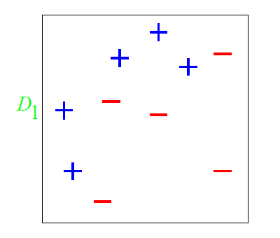
A Toy Example

Slide 65
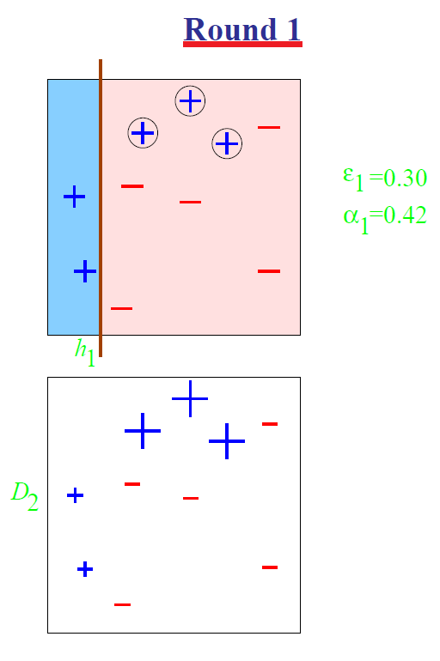
A Toy Example

Slide 66
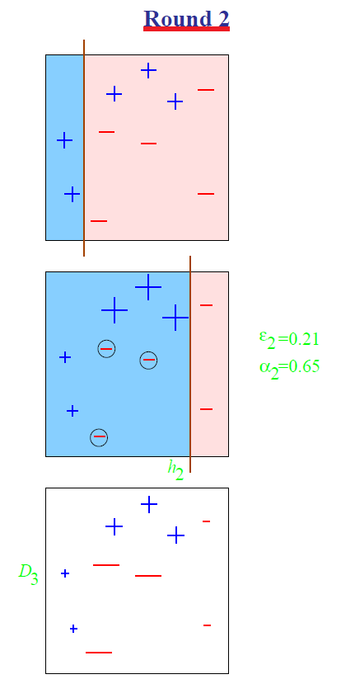
A Toy Example

Slide 67
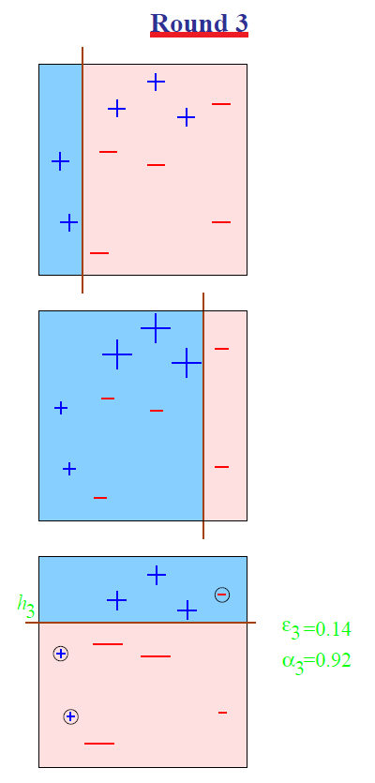
A Toy Example

Slide 68
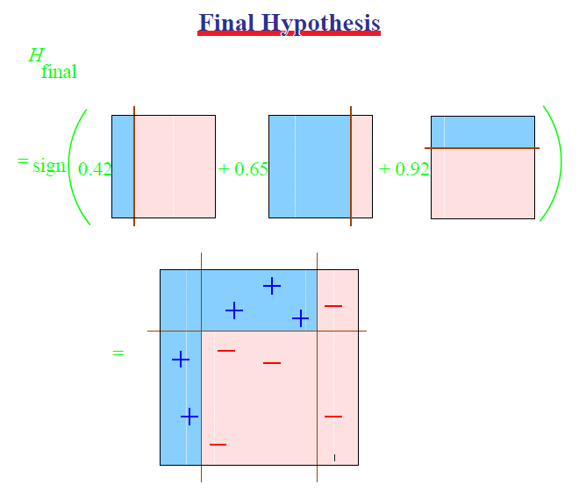
A Toy Example
A cool and important note about the final hypothesis: it is possible that the combined hypothesis makes no mistakes on the training data, but boosting can still learn, by adding more weak hypotheses.

Slide 69
Summary of Ensemble Methods
Boosting
Bagging
Random Forests

Slide 70
Boosting
Initialization:
  Weigh all training samples equally
Iteration Step:
  Train model on (weighted) train set
  Compute error of model on train set
  Increase weights on training cases model gets wrong!!!
Typically requires 100’s to 1000’s of iterations
Return final model:
  Carefully weighted prediction of each model

Slide 71
Bagging
Bagging predictors is a method for generating multiple versions of a predictor and using these to get an aggregated predictor.
The aggregation averages over the versions when predicting a numerical outcome and does a plurality vote when predicting a class.
The multiple versions are formed by making bootstrap replicates of the learning set and using these as new learning sets.
  That is, use samples of the data, with repetition
Tests on real and simulated data sets using classification and regression trees and subset selection in linear regression show that bagging can give substantial gains in accuracy.
The vital element is the instability of the prediction method. If perturbing the learning set can cause significant changes in the predictor constructed then bagging can improve accuracy.

Slide 72
Example: Bagged Decision Trees
Draw 100 bootstrap samples of data
Train trees on each sample → 100 trees
Average prediction of trees on out-of-bag samples
…
Average prediction
(0.23 + 0.19 + 0.34 + 0.22 + 0.26 + … + 0.31) / # Trees = 0.24

Slide 73
Random Forests (Bagged Trees++)
Draw 1000+ bootstrap samples of data
Draw sample of available attributes at each split
Train trees on each sample/attribute set → 1000+ trees
Average prediction of trees on out-of-bag samples
…
Average prediction
(0.23 + 0.19 + 0.34 + 0.22 + 0.26 + … + 0.31) / # Trees = 0.24

Slide 74
Classification
So far we focused on Binary Classification
For linear models:
  Perceptron, Winnow, SVM, GD, SGD
The prediction is simple:
  Given an example x,
  Prediction = sgn(w^{T}x)
  Where w is the learned model
The output is a single bit

Slide 75
Multi-Categorical Output Tasks
Multi-class Classification (y ∈ {1,...,K})
  character recognition (‘6’)
  document classification (‘homepage’)
Multi-label Classification (y ⊆ {1,...,K})
  document classification (‘(homepage,facultypage)’)
Category Ranking (y ∈ πK)
  user preference (‘(love > like > hate)’)
  document classification (‘hompage > facultypage > sports’)
Hierarchical Classification (y ⊆ {1,..,K})
  cohere with class hierarchy
  place document into index where ‘soccer’ is-a ‘sport’
Notes:
Most simple, and in some sense most general is the mult-class classification problem
describe each one...
Say: ALL OF THESE TASKS have a fairly limited output space...
IN THAT: NUMBER OF CLASSES IS PRETTY SMALL...
THIS ISN”T ALWAYS THE CASE

Slide 76
Setting
Learning:
  Given a data set D = {(x_{i} , y_{i})}₁^{m}
  Where x_{i} 2 R^{n}, y_{i} 2 {1,2,…,k}.
Prediction (inference):
  Given an example x, and a learned function (model),
  Output a single class labels y.

Slide 77
Binary to Multiclass
Most schemes for multiclass classification work by reducing the problem to that of binary classification.
The are multiple ways to decompose the multiclass prediction into multiple binary decisions
  One-vs-all
  All-vs-all
  Error correcting codes
We will then talk about a more general scheme:
  Constraint Classification
It can be used to model other non-binary classification and leads to Structured Prediction.

Slide 78
One-Vs-All
Assumption: Each class can be separated from all the rest using a binary classifier in the hypothesis space.
Learning: Decomposed to learning k independent binary classifiers, one for each class label.
Learning:
  Let D be the set of training examples.
  8 label l, construct a binary classification problem as follows:
    Positive examples: Elements of D with label l
    Negative examples: All other elements of D
  This is a binary learning problem that we can solve, producing k binary classifiers w₁, w₂, …w_{k}
Decision: Winner Takes All (WTA):
  f(x) = argmax_{i} w_{i} ^{T}x

Slide 79
Solving MultiClass with 1vs All learning
MultiClass classifier
  Function f : R^{n} → {1,2,3,...,k}
Decompose into binary problems
Not always possible to learn
No theoretical justification
  Need to make sure the range of all classifiers is the same
(unless the problem is easy)
Notes:
Most work in ML is for the BINARY problem
Well understood (Theory)
Many algorithms work well (Practice)
Therefore
Tempting and DESIREABLE to use binary algs to solve multiclass
The most common approach : **OvA**
Learn a set of classifiers: one for each class versus the rest
Notice however, that while it may be possilbe to find such a classifier
-NOT ALWAYS THE CASE.
In the last partition here, it is impossible to separate the red points
from the rest using a linear function.
Therefore this classifier will FAIL
**No theoretical justification unless the problem is easy**

Slide 80
Learning via One-Versus-All (OvA) Assumption
Find v_{r},v_{b},v_{g},v_{y} ∈ R^{n} such that
  v_{r}.x > 0 iff y = red ⊗
  v_{b}.x > 0 iff y = blue √
  v_{g}.x > 0 iff y = green √
  v_{y}.x > 0 iff y = yellow √
Classification: f(x) = argmax_{i} v_{i} x
H = R^{nk}
Real Problem
Notes:
OvA (one versus all)
learn k independent classifiers
each separate one class from rest
blue, yellow, green – works fine
red – impossible
It’s possible that f(x) WILL classify correctly
Can be shown that it may not
Look at decision surface.
Colored regions, THERE IS NO DISPUTE FROM CLASSIFIERS
Black – all will be less than zero
the rest depend on the magnitude of weight vectors
... and how they are found
IF RED HAS HIGH MAG → will dominate classification
OVA uses rich enough rep
Learning technique is inadequate
binary classifiers it uses don’t have enough information

Slide 81
All-Vs-All
Assumption: There is a separation between every pair of classes using a binary classifier in the hypothesis space.
Learning: Decomposed to learning [k choose 2] ~ k² independent binary classifiers, one corresponding to each pair of class labels. For the pair (i, j):
  Positive example: all exampels with label i
  Negative examples: all examples with label j
Decision: More involved, since output of binary classifier may not cohere. Each label gets k-1 votes.
Decision Options:
  Majority: classify example x to take label i if i wins on x more often than j (j=1,…k)
  A tournament: start with n/2 pairs; continue with winners .

Slide 82
Learning via All-Verses-All (AvA) Assumption
It is possible to separate all k classes with the O(k²) classifiers
Find v_{rb},v_{rg},v_{ry},v_{bg},v_{by},v_{gy} ∈ R^{d} such that
  v_{rb}.x > 0 if y = red
  < 0 if y = blue
  v_{rg}.x > 0 if y = red
  < 0 if y = green
  ... (for all pairs)
H = R^{kkn}
How to classify?
Individual
Classifiers
Decision
Regions
Notes:
[ GENERAL NOTE: Focus on diagram, say it’s more powerful than WTA]
AvA (All versus all)
expand representation space
learn (k choose 2) classifiers
separate each pair of classes
for example Vred,green separates all red points from greed points
Decision Surface
Can cover any example set the WTA can generate
BUT
1. TOO COMPLEX
2. AMBIGUOUS – Black regions are unknown
tournament or majority vote necessary

Slide 83
Classifying with AvA
Tournament
Majority Vote
1 red, 2 yellow, 2 green
➔ ?
All are post-learning and might cause weird stuff

Slide 84
One-vs-All vs. All vs. All
Assume m examples, k class labels.
  For simplicity, say, m/k in each.
One vs. All:
  classifier f_{i}: m/k (+) and (k-1)m/k (-)
  Decision:
  Evaluate k linear classifiers and do Winner Takes All (WTA):
  f(x) = argmax_{i} f_{i}(x) = argmax_{i} w_{i}^{T}x
All vs. All:
  Classifier f_{ij}: m/k (+) and m/k (-)
  More expressivity, but less examples to learn from.
  Decision:
  Evaluate k² linear classifiers; decision sometimes unstable.
What type of learning methods would prefer All vs. All (efficiency-wise)?
(Think about Dual/Primal)

Slide 85
Problems with Decompositions
Learning optimizes over local metrics
  Does not guarantee good global performance
  We don’t care about the performance of the local classifiers
Poor decomposition ⇒ poor performance
  Difficult local problems
  Irrelevant local problems
Especially true for Error Correcting Output Codes
  Another (class of) decomposition
  Difficulty: how to make sure that the resulting problems are separable.
Efficiency: e.g., All vs. All vs. One vs. All
Former has advantage when working with the dual space.
Not clear how to generalize multi-class to problems with a very large # of output.
Notes:
However, a PROBLEM W/ DECOMPOSITION TECHNIQUES
Induced Binary problems are optimized INDEPENDENTLY
NO GLOBAL METRIC IS USED.
FOR EXAMPLE, in MC,
we don’t care about 1 vs rest performance
only about the FINAL MC Classification
TRANSISTION:
We can look at a simple example:

Slide 86
Recall: Winnow’s Extensions
Positive
w⁺
Negative
w⁻
Winnow learns monotone Boolean functions
We extended to general Boolean functions via
“Balanced Winnow”
  2 weights per variable;
  Decision: using the “effective weight”,
  the difference between w⁺ and w⁻
  This is equivalent to the Winner take all decision
  Learning: In principle, it is possible to use the 1-vs-all rule and update each set of n weights separately, but we suggested the “balanced” Update rule that takes into account how both sets of n weights predict on example x
Can this be generalized to the case of k labels, k >2?
We need a “global” learning approach

Slide 87
Extending Balanced
In a 1-vs-all training you have a target node that represents positive examples and target node that represents negative examples.
Typically, we train each node separately (mine/not-mine example).
Rather, given an example we could say: this is more a + example than a – example.
We compared the activation of the different target nodes (classifiers) on a given example. (This example is more class + than class -)
Can this be generalized to the case of k labels, k >2?
Notes:
Brief introduction to St. Out. problems
HIGHLIGHT THE DIFFERENCE BETWEEN LOCAL AND GLOBAL LEARNING!!!
Start w/ probably the simplest St. Out. problem: MULTICLASS!!!
where instead of viewing the label as a single integer, we can view it as a bit vector
ALONG WITH THE RESTIRCTION saying “EXACLTY ONE....”
Then, as we saw in the previous section, we can learn a collection of functions in two ways.
OvA attempts to have each function predict a single bit w/o looking at the rest! We call this LOCAL learning.
CC also learns the collection, but in a way the RESPECTS THE GLOB REST. LEARNS GLOBALLY all functions toghehter.
(LOOK AT SLIDE)!
Sequence tasks:
***** EX POS TAGGING,
TWO WAYS TO VIEW LABEL ::: Collection of word/pos pairs
::: Single label (WHOLE SENT TAG).
LEARN IN TWO WAYS ::: Fucnt to predict each POS tag sep.
::: Funct to predict whole tag seq at once.
Struct output:
arbitrary global constraints
**** LOCAL FUNCTIONS DON’T HAVE ACCESS TO THE GLOBAL CONSTRAINTS
--> NO CHANCE!!

Slide 88
Recall: Margin for binary classifiers
The margin of a hyperplane for a dataset is the distance between the hyperplane and the data point nearest to it.
-
-
+
+
+
-
+
+
-
-
-
-
+
+
+
-
-
-
-
-
-
-
-
-
-
Margin with respect to this hyperplane
-

Slide 89
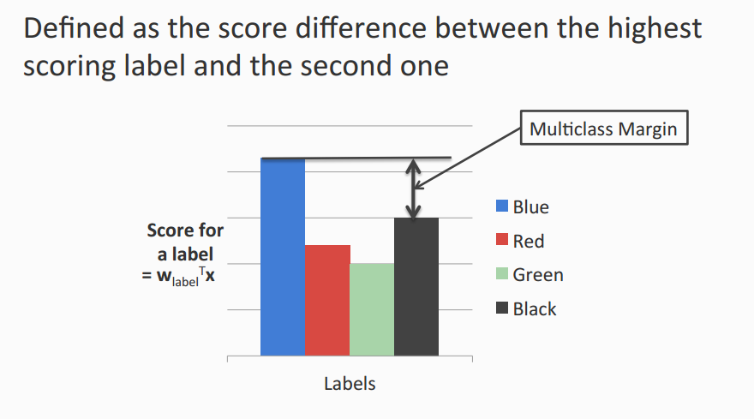
Multiclass Margin

Slide 90
Multiclass SVM (Intuition)
Recall: Binary SVM
  Maximize margin
  Equivalently,
    Minimize norm of weights such that the closest points to the hyperplane have a score §1
Multiclass SVM
  Each label has a different weight vector (like one-vs-all)
  Maximize multiclass margin
  Equivalently,
    Minimize total norm of the weights such that the true label is scored at least 1 more than the second best one

Slide 91
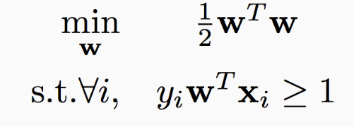
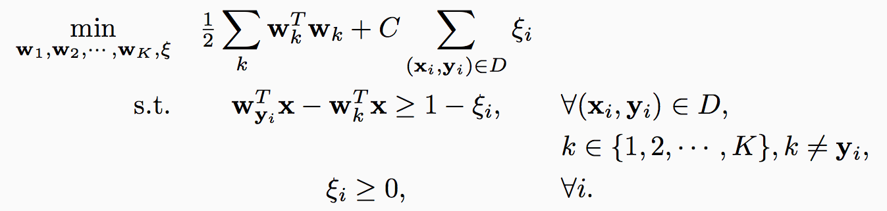
Multiclass SVM in the separable case
Recall hard binary SVM
Size of the weights. Effectively, regularizer
The score for the true label is higher than the score for any other label by 1

Slide 92
Multiclass SVM: General case
Total slack. Effectively, don’t allow too many examples to violate the margin constraint
Size of the weights. Effectively, regularizer
The score for the true label is higher than the score for any other label by
1 - »_{i}
Slack variables. Not all examples need to satisfy the margin constraint.
Slack variables can only be positive

Slide 93
Multiclass SVM: Summary
Training:
  Optimize the “global” SVM objective
Prediction:
  Winner takes all
    argmax_{i} w_{i}^{T}x
With K labels and inputs in <^{n}, we have nK weights in all
  Same as one-vs-all
Why does it work?
  Why is this the “right” definition of multiclass margin?
A theoretical justification, along with extensions to other algorithms beyond SVM is given by “Constraint Classification”
  Applies also to multi-label problems, ranking problems, etc.
  [Dav Zimak; with D. Roth and S. Har-Peled]

Slide 94
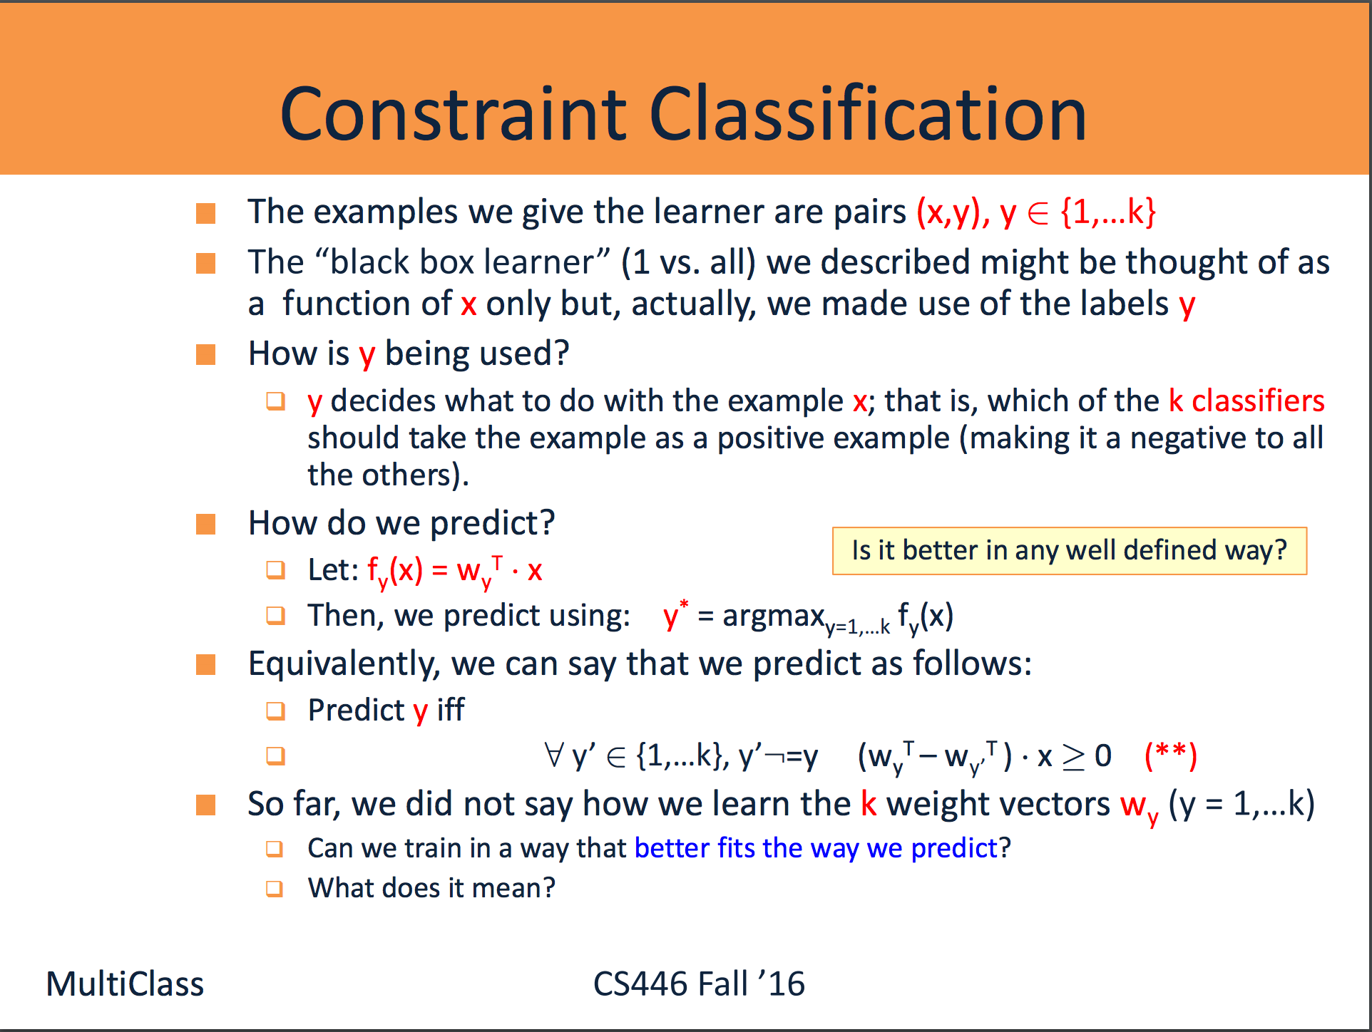

Slide 95
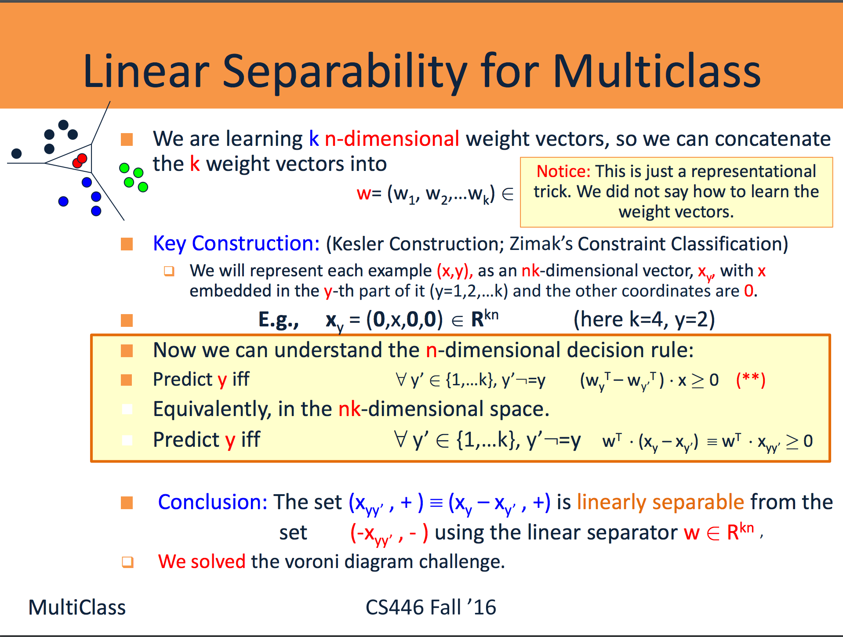

Slide 96
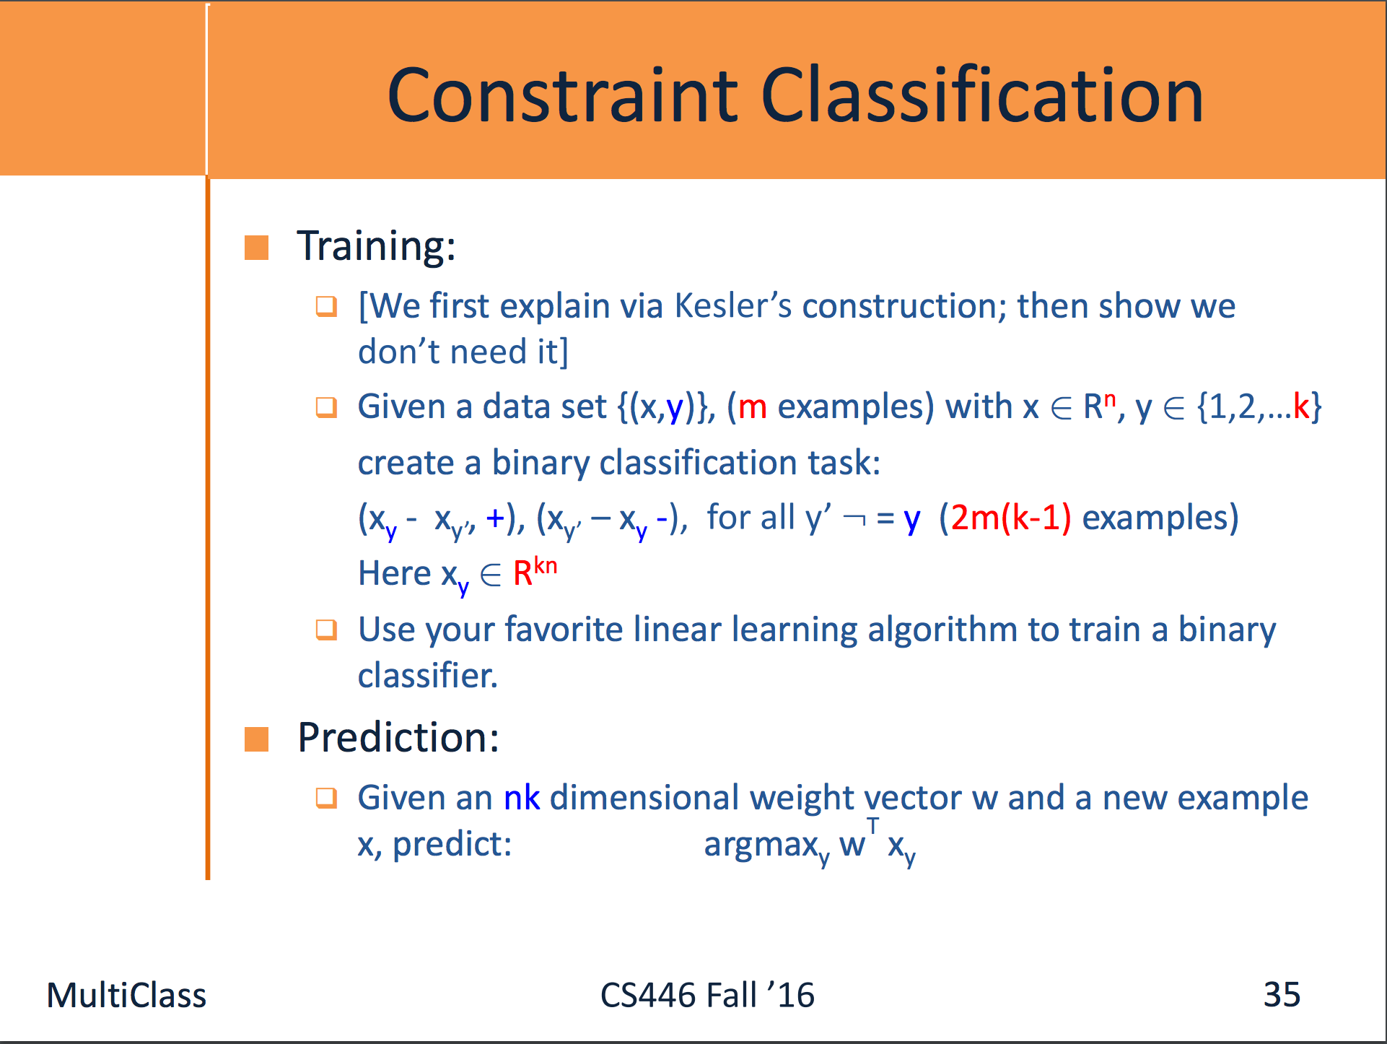

Slide 97
Details: Kesler Construction &
Multi-Class Separability
If (x,i) was a given n-dimensional example (that is, x has is labeled i, then
x_{ij}, 8 j=1,…k, j:= i, are positive examples in the nk-dimensional space. –x_{ij} are negative examples.
Transform Examples
2>4
2>1
2>1
2>3
2>4
2>3
i>j f_{i}(x) - f_{j}(x) > 0
w_{i} ⋅ x - w_{j} ⋅ x > 0
W ⋅ X_{i} - W ⋅ X_{j} > 0
W ⋅ (X_{i} - X_{j}) > 0
W ⋅ X_{ij} > 0
X_{i} = (0,x,0,0) ∈ R^{kd}
X_{j} = (0,0,0,x) ∈ R^{kd}
X_{ij} = X_{i} - X_{j} = (0,x,0,-x)
W = (w₁,w₂,w₃,w₄) ∈ R^{kd}
Notes:
(LOOK AT SLIDE)!
Each example is labeled with a set of constraints.
Then, to maintain these preferences, we must maintain
fi > fj
Linar case, we have
wi.x - wj.x > 0
By rewriting all in one vector
(W = (w1,...))
defining Xi = x in the ith component of Zero vector
we can define NEW EXAMPLES
X IJ
Now, the only thing to learn is W!!!!
[CLICK]
Graphically, this produces a bunch of examples
XIJ -- here we dipict also -XIJ as negative examples so that it is clear we are looking for a BINARY SEPARATION!

Slide 98
Learning via Kesler’s Construction
Given (x₁, y₁), ..., (x_{N}, y_{N}) ∈ R^{n} x {1,...,k}
Create
  P⁺ = ∪ P⁺(x_{i},y_{i})
  P– = ∪ P–(x_{i},y_{i})
Find w = (w₁, ..., w_{k}) ∈ R^{kn}, such that
  w.x separates P⁺ from P–
One can use any algorithm in this space: Perceptron, Winnow, SVM, etc.
To understand how to update the weight vector in the n-dimensional space, we note that
w^{T} ¢ x_{yy’} ¸ 0 (in the nk-dimensional space)
is equivalent to:
(w_{y}^{T} – w_{y’}^{T} ) ¢ x ¸ 0 (in the n-dimensional space)
Notes:
The goal of learning
-SEPARATE positive from negative (P+ from P-)
Notice the output:
- interpret the components of BOLD(v)
as class weight vectors
- a winner take all case
Interpretation of examples in kd
each point specifies that i is preferred over j for example x
linear case, these constraints ensure wta
Any WTA function can be learned
- by perceptron convergence theorem

Slide 99
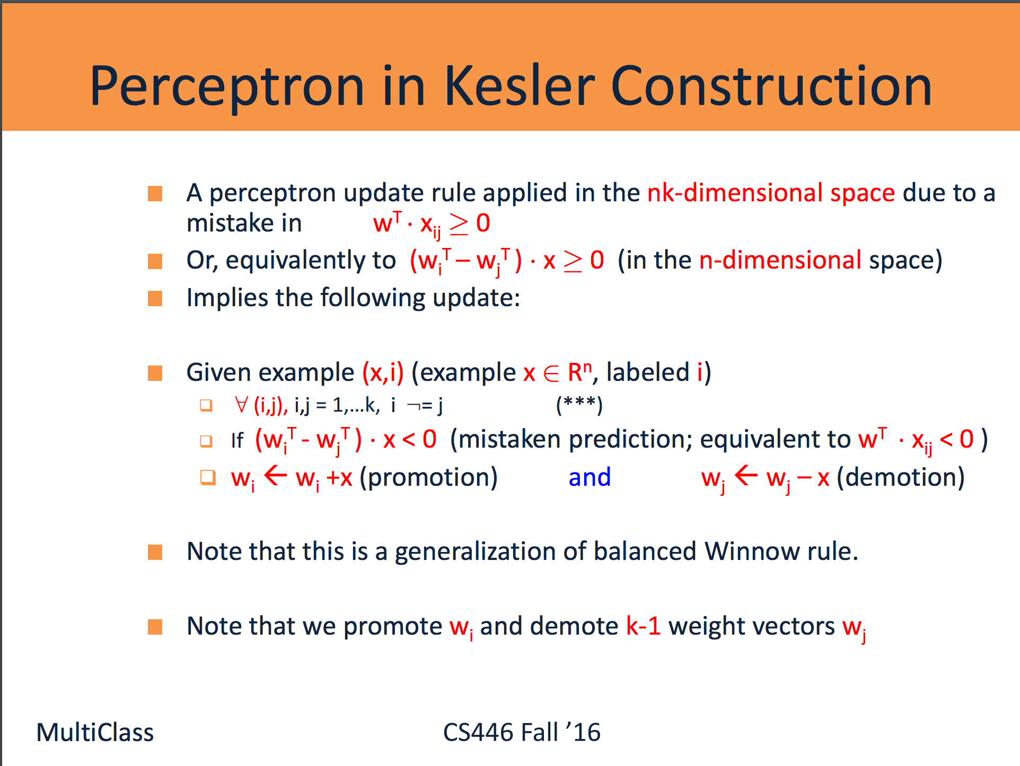

Slide 100
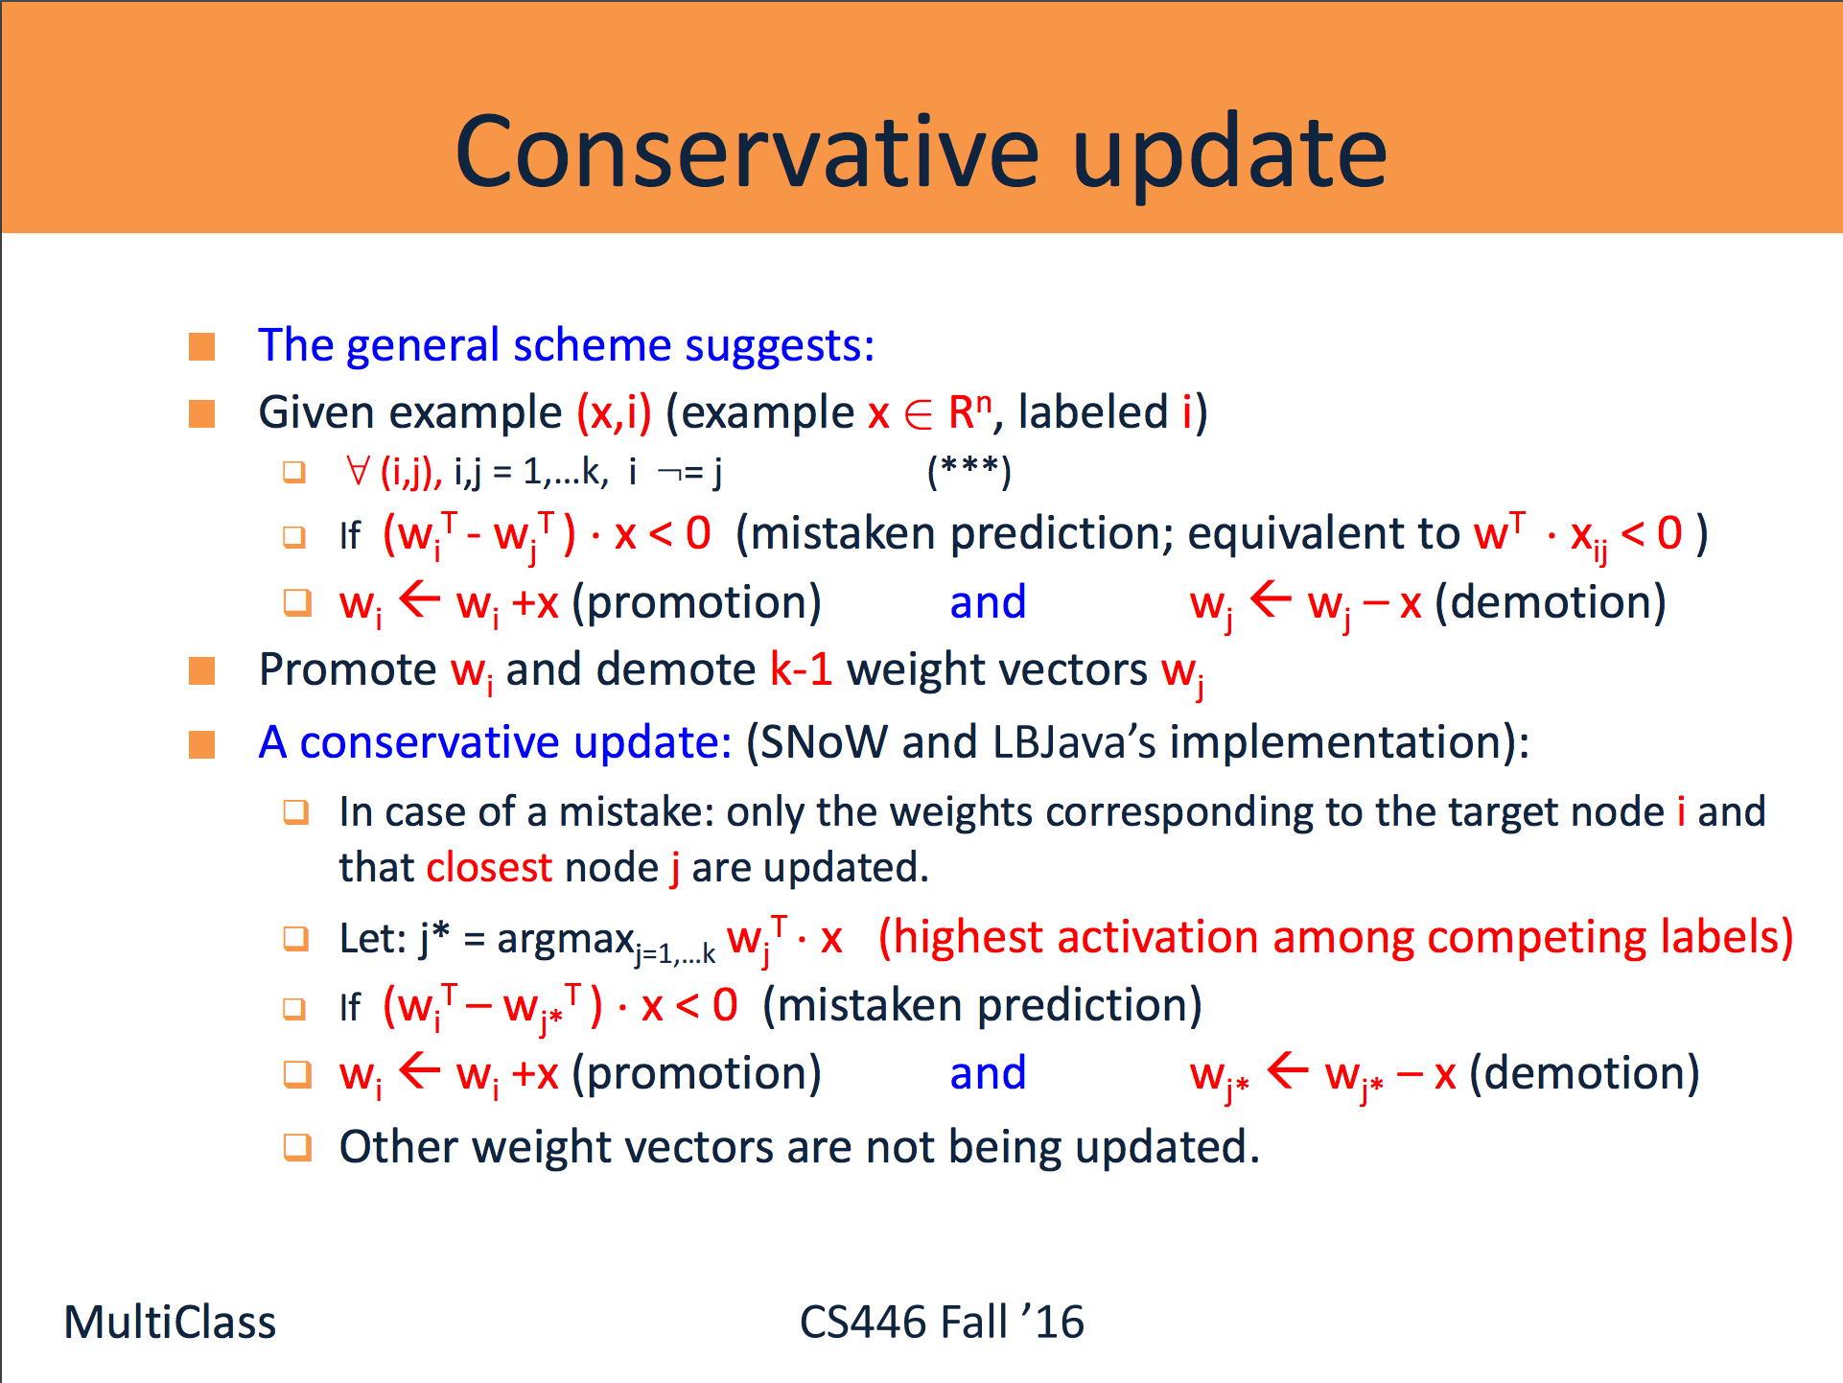

Slide 101
Data Dependent VC dimension
So far we discussed VC dimension in the context of a fixed class of functions.
We can also parameterize the class of functions in interesting ways.
Recall the VC based generalization bound:
Err(h) · err_{TR}(h) + Poly{VC(H), 1/m, log(1/±)}

Slide 102
Linear Classification
Although both classifiers separate the data, the distance with which the separation is achieved is different:
h₁
h₂

Slide 103
Concept of Margin
The margin °_{i} of a point x_{i} 2 R^{n} with respect to a linear classifier h(x) = sign(w ¢ x +b) is defined as the distance of x_{i} from the hyperplane w ¢ x + b = 0:
°_{i} = |(w ¢ x_{i} +b)/||w|| |
The margin of a set of points {x₁,…x_{m}} with respect to a hyperplane w, is defined as the margin of the point closest to the hyperplane:
° = min_{i}°_{i} = min_{i}|(w ¢ x_{i} +b)/||w|| |

Slide 104
VC and Linear Classification
If H° is the space of all linear classifiers in <^{n} that separate the training data with margin at least °, then:
VC(H°) · min(R²/°², n) +1,
Where R is the radius of the smallest sphere (in <^{n}) that contains the data.
Thus, for such classifiers, we have a bound of the form:
Err(h) · err_{TR}(h) + { (O(R²/°² ) + log(4/±))/m }^{1/2}

Slide 105
Data Dependent VC dimension
Namely, when we consider the class H° of linear hypotheses that separate a given data set with a margin °,
We see that
  Large Margin ° → Small VC dimension of H°
Consequently, our goal could be to find a separating hyperplane w that maximizes the margin of the set S of examples.
A second observation that drives an algorithmic approach is that:
Small ||w|| → Large Margin
This leads to an algorithm: from among all those w’s that agree with the data, find the one with the minimal size ||w||

Slide 106
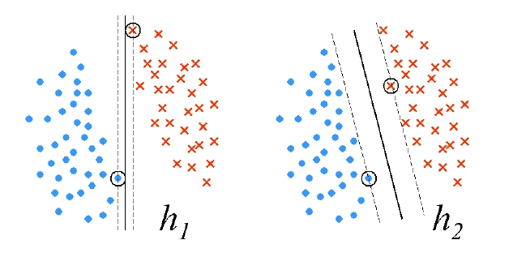
Maximal Margin
(PS0, PS1): The distance between a point x and the hyperplane defined by (w; b) is: |w^{T} x + b|/||w||
  This discussion motivates the notion of a maximal margin.
  The maximal margin of a data set S is define as:
  °(S) = max_{||w||=1} min_{(x,y) 2 S} |y w^{T} x|
For a given w: Find the closest point.
2. Then, find the one the gives the maximal margin value across all w’s (of size 1).
Note: the selection of the point is in the min and therefore the max does not change if we scale w, so it’s okay to only deal with normalized w’s.
How does it help us to derive these h’s?
argmax_{||w||=1} min_{(x,y) 2 S} |y w^{T} x|

Slide 107
Hard SVM Optimization
We have shown that the sought after weight vector w is the solution of the following optimization problem:
  SVM Optimization: (***)
  Minimize: ½ ||w||²
  Subject to: 8 (x,y) 2 S: y w^{T} x ¸ 1
This is an optimization problem in (n+1) variables, with |S|=m inequality constraints.

Slide 108
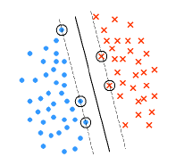
Support Vector Machines
The name “Support Vector Machine” stems from the fact that w* is supported by (i.e. is the linear span of) the examples that are exactly at a distance 1/||w*|| from the separating hyperplane. These vectors are therefore called support vectors.
Theorem: Let w* be the minimizer of
the SVM optimization problem (***)
for S = {(x_{i}, y_{i})}. Let I= {i: w^{*T}x = 1}.
Then there exists coefficients ®_{i} >0 such that:
w* = ∑_{i 2 I} ®_{i} y_{i} x_{i}
This representation should ring a bell…

Slide 109
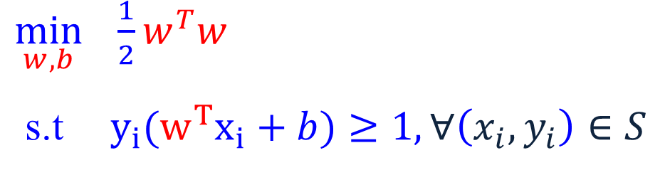
Maximal Margin
The margin of a linear separator
w^{T} x+b = 0
is 2 / ||w||
max 2 / ||w|| = min ||w||
= min ½ w^{T}w
  $\min_{w,b} \frac{1}{2}w^{T}w$
  s.t $y_{i}{(w}^{T}x_{i}+b)≥1, ∀\left(x_{i},y_{i}\right)∈S$

Slide 110
Duality
This, and other properties of Support Vector Machines are shown by moving to the dual problem.
Theorem: Let w* be the minimizer of
the SVM optimization problem (***)
for S = {(x_{i}, y_{i})}.
Let I= {i: y_{i} (w^{*T}x_{i} +b)= 1}.
Then there exists coefficients ®_{i} >0
such that:
w* = ∑_{i 2 I} ®_{i} y_{i} x_{i}

Slide 111
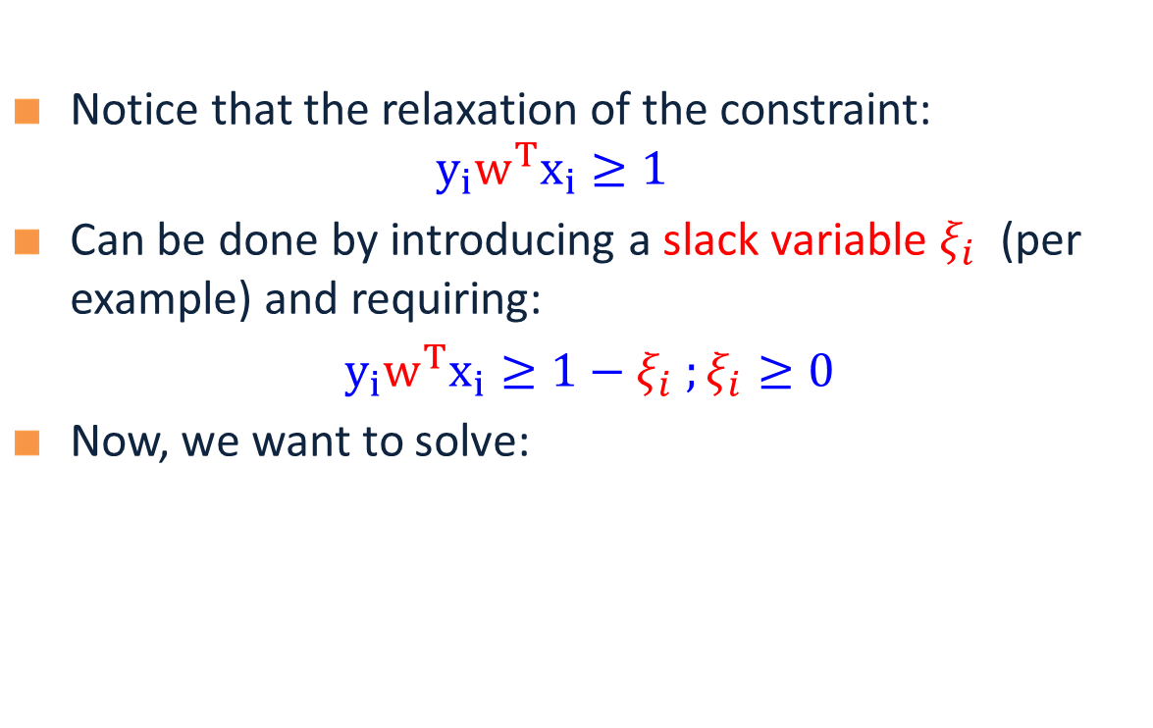
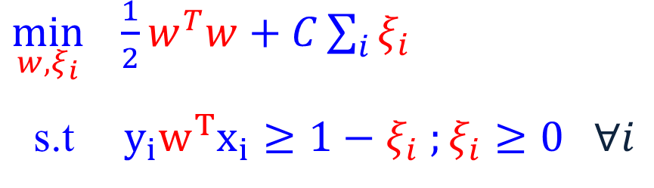
Soft SVM
Notice that the relaxation of the constraint: $y_{i}w^{T}x_{i}≥1$
Can be done by introducing a slack variable $ξ_{i}$ (per example) and requiring:
$y_{i}w^{T}x_{i}≥1−ξ_{i} ;ξ_{i}≥0$
Now, we want to solve:
  $\min_{w, ξ_{i}} \frac{1}{2}w^{T}w+C\sum_{i}{ξ_{i}}$
  s.t $y_{i}w^{T}x_{i}≥1−ξ_{i} ;ξ_{i}≥0 ∀i$
Notes:
What is the value of slack variable when the data point is classified correctly?

Slide 112
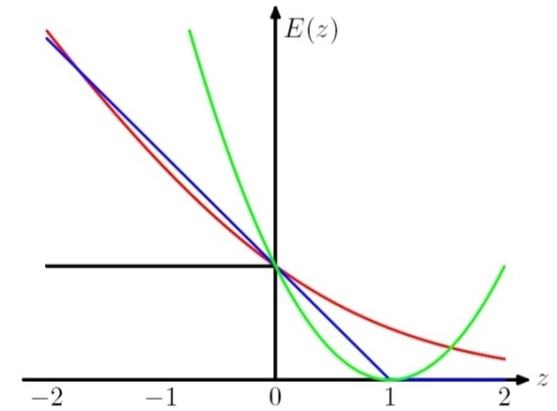

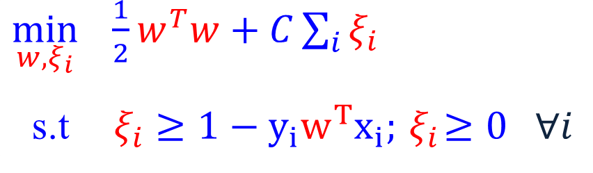

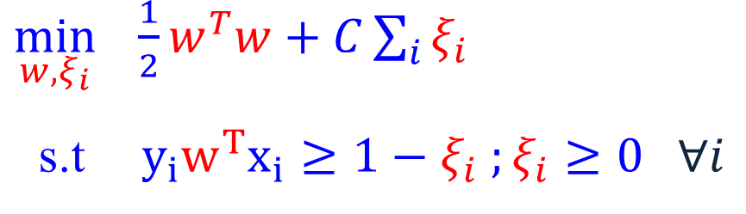
Soft SVM (2)
Now, we want to solve:
Which can be written as:
$$\min_{w} \frac{1}{2}w^{T}w+C\sum_{i}{\max{(0, 1−y_{i}w^{T}x_{i})}}.$$
What is the interpretation of this?
  $\min_{w, ξ_{i}} \frac{1}{2}w^{T}w+C\sum_{i}{ξ_{i}}$
  s.t $y_{i}w^{T}x_{i}≥1−ξ_{i} ;ξ_{i}≥0 ∀i$
  $\min_{w, ξ_{i}} \frac{1}{2}w^{T}w+C\sum_{i}{ξ_{i}}$
  s.t$ξ_{i}≥1−y_{i}w^{T}x_{i};{ ξ}_{i}≥0 ∀i$
In optimum, $ξ_{i}=\max{(0, 1−y_{i}w^{T}x_{i})}$

Slide 113
SVM Objective Function
The problem we solved is:
Min ½ ||w||² + c ∑ »_{i}
Where »_{i} > 0 is called a slack variable, and is defined by:
  » _{i} = max(0, 1 – y_{i} w^{t}x_{i})
  Equivalently, we can say that: y_{i} w^{t}x_{i} ¸ 1 - »; » ¸ 0
And this can be written as:
Min ½ ||w||² + c ∑ »_{i}
General Form of a learning algorithm:
  Minimize empirical loss, and Regularize (to avoid over fitting)
  Theoretically motivated improvement over the original algorithm we’ve see at the beginning of the semester.
Regularization term
Empirical loss
Can be replaced by other regularization functions
Can be replaced by other loss functions

Slide 114
Balance between regularization and empirical loss

Slide 115
Balance between regularization and empirical loss
(DEMO)

Slide 116
Underfitting and Overfitting
Underfitting
Overfitting
Expected
Error
Variance
Bias
Model complexity
Simple models:
High bias and low variance
Complex models:
High variance and low bias
Smaller C
Larger C

Slide 117
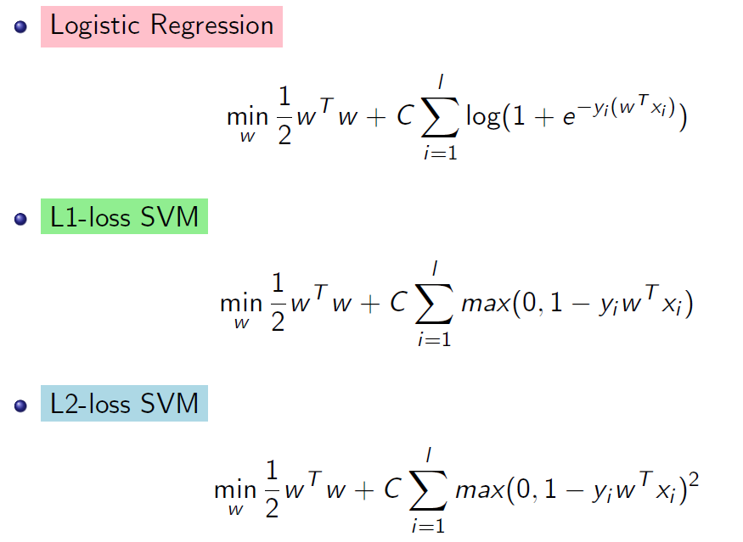
What Do We Optimize?

Slide 118
Optimization: How to Solve
1. Earlier methods used Quadratic Programming. Very slow.
2. The soft SVM problem is an unconstrained optimization problems. It is possible to use the gradient descent algorithm! Still, it is quite slow.
Many options within this category:
  Iterative scaling; non-linear conjugate gradient; quasi-Newton methods; truncated Newton methods; trust-region newton method.
  All methods are iterative methods, that generate a sequence w_{k} that converges to the optimal solution of the optimization problem above.
  Currently: Limited memory BFGS is very popular
3. 3rd generation algorithms are based on Stochastic Gradient Decent
  The runtime does not depend on n=#(examples); advantage when n is very large.
  Stopping criteria is a problem: method tends to be too aggressive at the beginning and reaches a moderate accuracy quite fast, but it’s convergence becomes slow if we are interested in more accurate solutions.
4. Dual Coordinated Descent (& Stochastic Version)

Slide 119

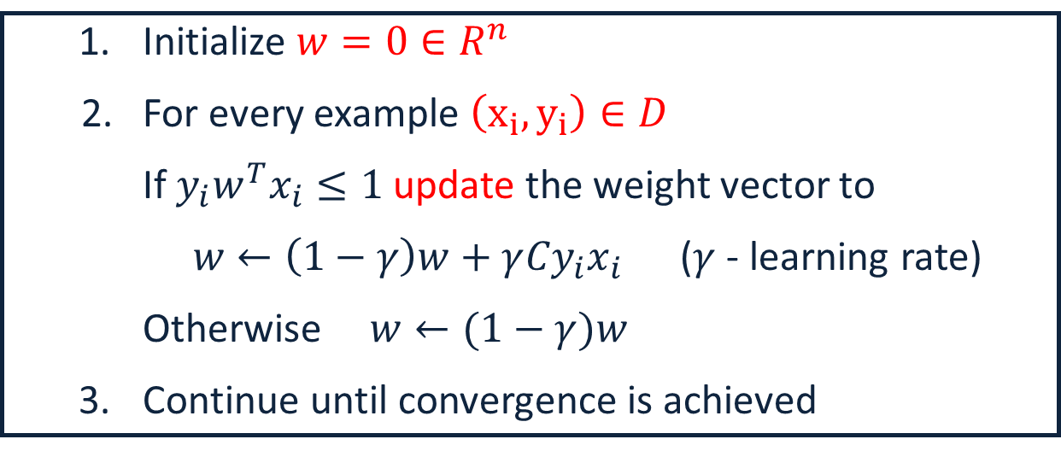
SGD for SVM
Goal: $\min_{w} f\left(w\right)≡ \frac{1}{2}w^{T}w+\frac{C}{m}\sum_{i}{\max\left(0, 1−y_{i}w^{T}x_{i}\right)}.$ m: data size
Compute sub-gradient of $f\left(w\right):$
$∇f\left(w\right)=w−Cy_{i}x_{i}$ if ${1−y_{i}w}^{T}x_{i}≥0$ ; otherwise $∇f\left(w\right)=w$
m is here for mathematical correctness, it doesn’t matter in the view of modeling.
  Initialize $w=0∈R^{n}$
2. For every example $\left(x_{i},y_{i}\right)∈D$
If $y_{i}w^{T}x_{i}≤1$ update the weight vector to
$w←\left(1−γ\right)w+γ{Cy}_{i}x_{i}$ ($γ$ - learning rate)
Otherwise $w←(1−γ)w$
  Continue until convergence is achieved
Convergence can be proved for a slightly complicated version of SGD (e.g, Pegasos)
This algorithm should ring a bell…

Slide 120
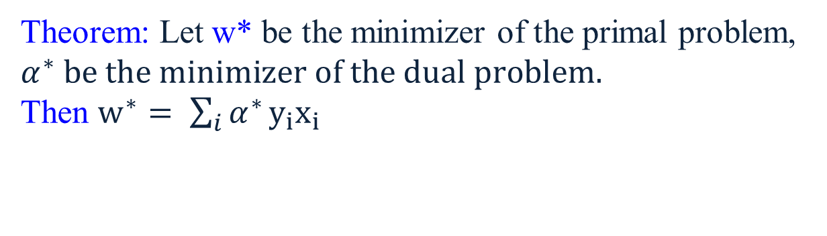
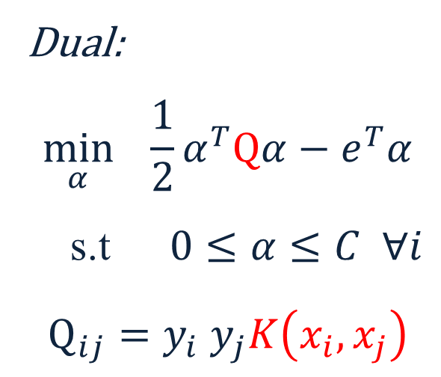
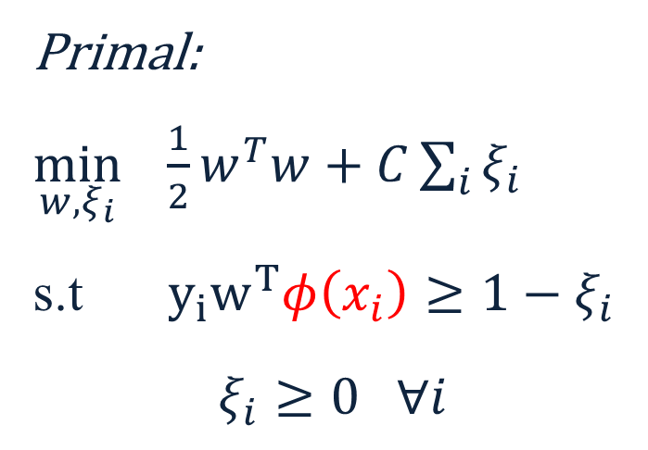

Nonlinear SVM
We can map data to a high dimensional space: $x→φ\left(x\right)$ (DEMO)
Then use Kernel trick: $K\left(x_{i},x_{j}\right)=φ{\left(x_{i}\right)}_{}^{T}φ\left(x_{j}\right)$ (DEMO2)
  Primal:
  $\min_{w, ξ_{i}} \frac{1}{2}w^{T}w+C\sum_{i}{ξ_{i}}$
  s.t $y_{i}w^{T}φ\left(x_{i}\right)≥1−ξ_{i}$
  $$ξ_{i}≥0 ∀i$$
  Dual:
  $$\min_{α} \frac{1}{2}α^{T}Qα−e^{T}α$$
  s.t $0≤α≤C ∀i$
  $$Q_{ij}=y_{i} y_{j}K\left(x_{i}, x_{j}\right)$$
Theorem: Let w* be the minimizer of the primal problem, $α^{∗} be the minimizer of the dual problem.$
Then $w^{∗}= \sum_{i}{α^{∗}}y_{i}x_{i}$

Slide 121
1: Direct Learning
Model the problem of text correction as a problem of learning from examples.
Goal: learn directly how to make predictions.
PARADIGM
Look at many (positive/negative) examples.
Discover some regularities in the data.
Use these to construct a prediction policy.
A policy (a function, a predictor) needs to be specific.
[it/in] rule: if the occurs after the target ⇒in
Assumptions comes in the form of a hypothesis class.
Bottom line: approximating h : X → Y, is estimating P(Y|X).

Slide 122
Direct Learning (2)
Consider a distribution D over space X×Y
X - the instance space; Y - set of labels. (e.g. +/-1)
Given a sample {(x,y)}₁^{m},, and a loss function L(x,y)
Find h∈H that minimizes
Σ_{i=1,m}D(x_{i},y_{i})L(h(x_{i}),y_{i}) + Reg
L can be: L(h(x),y)=1, h(x)≠y, o/w L(h(x),y) = 0 (0-1 loss)
L(h(x),y)=(h(x)-y)² , (L₂ )
L(h(x),y)= max{0,1-y h(x)} (hinge loss)
L(h(x),y)= exp{- y h(x)} (exponential loss)
Guarantees: If we find an algorithm that minimizes loss on the observed data. Then, learning theory guarantees good future behavior (as a function of H).

Slide 123
2: Generative Model
The model is called “generative” since it assumes how data X is generated given y
Model the problem of text correction as that of generating correct sentences.
Goal: learn a model of the language; use it to predict.
PARADIGM
Learn a probability distribution over all sentences
  In practice: make assumptions on the distribution’s type
Use it to estimate which sentence is more likely.
  Pr(I saw the girl it the park) <> Pr(I saw the girl in the park)
  In practice: a decision policy depends on the assumptions
Guarantees: We need to assume the “right” probability distribution
Bottom line: the generating paradigm approximates
P(X,Y) = P(X|Y) P(Y).

Slide 124
Probabilistic Learning
There are actually two different notions.
Learning probabilistic concepts
  The learned concept is a function c:X→[0,1]
  c(x) may be interpreted as the probability that the label 1 is assigned to x
  The learning theory that we have studied before is applicable (with some extensions).
Bayesian Learning: Use of a probabilistic criterion in selecting a hypothesis
  The hypothesis can be deterministic, a Boolean function.
It’s not the hypothesis – it’s the process.

Slide 125
Basics of Bayesian Learning
Goal: find the best hypothesis from some space H of hypotheses, given the observed data D.
Define best to be: most probable hypothesis in H
In order to do that, we need to assume a probability distribution over the class H.
In addition, we need to know something about the relation between the data observed and the hypotheses (E.g., a coin problem.)
  As we will see, we will be Bayesian about other things, e.g., the parameters of the model

Slide 126
Basics of Bayesian Learning
P(h) - the prior probability of a hypothesis h
Reflects background knowledge; before data is observed. If no information - uniform distribution.
P(D) - The probability that this sample of the Data is observed. (No knowledge of the hypothesis)
P(D|h): The probability of observing the sample D, given that hypothesis h is the target
P(h|D): The posterior probability of h. The probability that h is the target, given that D has been observed.

Slide 127
Bayes Theorem
P(h|D) increases with P(h) and with P(D|h)
P(h|D) decreases with P(D)

Slide 128
Learning Scenario
P(h|D) = P(D|h) P(h)/P(D)
The learner considers a set of candidate hypotheses H (models), and attempts to find the most probable one h ∈H, given the observed data.
Such maximally probable hypothesis is called maximum a posteriori hypothesis (MAP); Bayes theorem is used to compute it:
h_{MAP} = argmax_{h 2 H} P(h|D) = argmax_{h 2 H} P(D|h) P(h)/P(D)
= argmax_{h 2 H} P(D|h) P(h)

Slide 129
Learning Scenario (2)
h_{MAP} = argmax_{h 2 H} P(h|D) = argmax_{h 2 H} P(D|h) P(h)
We may assume that a priori, hypotheses are equally probable: P(h_{i}) = P(h_{j}) 8 h_{i}, h_{j} 2 H
We get the Maximum Likelihood hypothesis:
h_{ML} = argmax_{h 2 H} P(D|h)
Here we just look for the hypothesis that best explains the data

Slide 130
Bayes Optimal Classifier
How should we use the general formalism?
What should H be?
H can be a collection of functions. Given the training data, choose an optimal function. Then, given new data, evaluate the selected function on it.
H can be a collection of possible predictions. Given the data, try to directly choose the optimal prediction.
Could be different!

Slide 131
Bayes Optimal Classifier
The first formalism suggests to learn a good hypothesis and use it.
(Language modeling, grammar learning, etc. are here)
The second one suggests to directly choose a decision.[it/in]:
This is the issue of “thresholding” vs. entertaining all options until the last minute. (Computational Issues)

Slide 132
Justification: Bayesian Approach
The Bayes optimal function is
f_{B}(x) = argmax_{y}D(x; y)
That is, given input x, return the most likely label
It can be shown that f_{B} has the lowest possible value for Err(f)
Caveat: we can never construct this function: it is a function of D, which is unknown.
But, it is a useful theoretical construct, and drives attempts to make assumptions on D

Slide 133
Maximum-Likelihood Estimates
We attempt to model the underlying distribution
D(x, y) or D(y | x)
To do that, we assume a model
P(x, y | θ) or P(y | x , θ ),
where θ is the set of parameters of the model
Example: Probabilistic Language Model (Markov Model):
  We assume a model of language generation. Therefore, P(x, y | θ) was written as a function of symbol & state probabilities (the parameters).
We typically look at the log-likelihood
Given training samples (x_{i}; y_{i}), maximize the log-likelihood
L(θ) = Σ_{i} log P (x_{i}; y_{i} | θ) or L(θ) = Σ_{i} log P (y_{i} | x_{i} , θ))

Slide 134
Justification: Bayesian Approach
Assumption: Our selection of the model is good; there is some parameter setting θ* such that the true distribution is really represented by our model
D(x, y) = P(x, y | θ*)
Define the maximum-likelihood estimates:
θ_{ML} = argmax_{θ}L(θ)
As the training sample size goes to ∞, then
P(x, y | θ_{ML} ) converges to D(x, y)
Given the assumption above, and the availability of enough data
argmax_{y} P(x, y | θ_{ML} )
converges to the Bayes-optimal function
f_{B}(x) = argmax_{y}D(x; y)

Slide 135
Bayesian Classifier
f:X→V, finite set of values
Instances x∈X can be described as a collection of features
x = (x₁, x₂, … x_{n}) x_{i} 2 {0,1}
Given an example, assign it the most probable value in V
Bayes Rule:
Notational convention: P(y) means P(Y=y)

Slide 136
Bayesian Classifier
V_{MAP} = argmax_{v} P(x₁, x₂, …, x_{n} | v )P(v)
Given training data we can estimate the two terms.
Estimating P(v) is easy. E.g., under the binomial distribution assumption, count the number of times v appears in the training data.
However, it is not feasible to estimate P(x₁, x₂, …, x_{n} | v )
In this case we have to estimate, for each target value, the probability of each instance (most of which will not occur).
In order to use a Bayesian classifiers in practice, we need to make assumptions that will allow us to estimate these quantities.

Slide 137
Naive Bayes
V_{MAP} = argmax_{v} P(x₁, x₂, …, x_{n} | v )P(v)
Assumption: feature values are independent given the target value

Slide 138
Naive Bayes (2)
V_{MAP} = argmax_{v} P(x₁, x₂, …, x_{n} | v )P(v)
Assumption: feature values are independent given the target value
P(x₁ = b₁, x₂ = b₂,…,x_{n} = b_{n} | v = v_{j} ) = ¦₁^{n} P(x_{n} = b_{n} | v = v_{j} )
Generative model:
First choose a value v_{j} ∈V according to P(v)
For each v_{j} : choose x₁ x₂, …, x_{n} according to P(x_{k} |v_{j} )

Slide 139
Naive Bayes (3)
V_{MAP} = argmax_{v} P(x₁, x₂, …, x_{n} | v )P(v)
Assumption: feature values are independent given the target value
P(x₁ = b₁, x₂ = b₂,…,x_{n} = b_{n} | v = v_{j} ) = ¦₁^{n} P(x_{i} = b_{i} | v = v_{j} )
Learning method: Estimate n|V| + |V| parameters and use them to make a prediction. (How to estimate?)
Notice that this is learning without search. Given a collection of training examples, you just compute the best hypothesis (given the assumptions).
This is learning without trying to achieve consistency or even approximate consistency.

Slide 140
Lecture 10: EM
EM is a class of algorithms that is used to estimate a probability distribution in the presence of missing attributes.
Using it requires an assumption on the underlying probability distribution.
The algorithm can be very sensitive to this assumption and to the starting point (that is, the initial guess of parameters).
In general, known to converge to a local maximum of the maximum likelihood function.

Slide 141
Three Coin Example
We observe a series of coin tosses generated in the following way:
A person has three coins.
  Coin 0: probability of Head is α
  Coin 1: probability of Head p
  Coin 2: probability of Head q
Consider the following coin-tossing scenarios:

Slide 142
Estimation Problems
Scenario I: Toss one of the coins four times.
Observing HHTH
Question: Which coin is more likely to produce this sequence ?
Scenario II: Toss coin 0. If Head – toss coin 1; o/w – toss coin 2
Observing the sequence HHHHT, THTHT, HHHHT, HHTTH
produced by Coin 0 , Coin1 and Coin2
Question: Estimate most likely values for p, q (the probability of H in each coin) and the probability to use each of the coins (α)
Scenario III: Toss coin 0. If Head – toss coin 1; o/w – toss coin 2
Observing the sequence HHHT, HTHT, HHHT, HTTH
produced by Coin 1 and/or Coin 2
Question: Estimate most likely values for p, q and α
Coin 0
There is no known analytical solution to this problem (general setting). That is, it is not known how to compute the values of the parameters so as to maximize the likelihood of the data.
1st toss
2nd toss
nth toss

Slide 143
Key Intuition (1)
If we knew which of the data points (HHHT), (HTHT), (HTTH) came from Coin1 and which from Coin2, there was no problem.
Recall that the “simple” estimation is the ML estimation:
Assume that you toss a (p,1-p) coin m times and get k Heads m-k Tails.
log[P(D|p)] = log [ p^{k} (1-p)^{m-k} ]= k log p + (m-k) log (1-p)
To maximize, set the derivative w.r.t. p equal to 0:
d log P(D|p)/dp = k/p – (m-k)/(1-p) = 0
Solving this for p, gives: p=k/m

Slide 144
Key Intuition (2)
If we knew which of the data points (HHHT), (HTHT), (HTTH) came from Coin1 and which from Coin2, there was no problem.
Instead, use an iterative approach for estimating the parameters:
  Guess the probability that a given data point came from Coin 1 or 2; Generate fictional labels, weighted according to this probability.
  Now, compute the most likely value of the parameters. [recall NB example]
  Compute the likelihood of the data given this model.
  Re-estimate the initial parameter setting: set them to maximize the likelihood of the data.
(Labels ←→ Model Parameters)←→ Likelihood of the data
This process can be iterated and can be shown to converge to a local maximum of the likelihood function

Slide 145
EM Algorithm (Coins) -I
We will assume (for a minute) that we know the parameters and use it to estimate which Coin it is (Problem 1)
Then, we will use this “label” estimation of the observed tosses, to estimate the most likely parameters
  and so on...
Notation: n data points; in each one: m tosses, h_{i} heads.
What is the probability that the ith data point came from Coin1 ?
STEP 1 (Expectation Step): (Here h=h_{i} )

Slide 146
EM Algorithm (Coins) - II
  LL= ∑_{i=1,n} log ∑_{y=0,1} P(D^{i}, y | p,q, α) =
  = ∑_{i=1,n} log ∑_{y=0,1} P(D^{i}|p,q, α )P(y|D^{i},p,q,α) =
  = ∑_{i=1,n} log E_y P(D^{i} |p,q, α) ¸
  ¸ ∑_{i=1,n} E_y log P(D^{i} |p,q, α)
  Where the inequality is due to Jensen’s Inequality.
  We maximize a lower bound on the Likelihood.
Now, we would like to compute the likelihood of the data, and find the parameters that maximize it.
We will maximize the log likelihood of the data (n data points)
  LL = ∑_{1,n} logP(D^{i} |p,q,α)
But, one of the variables – the coin’s name - is hidden. We can marginalize:
  LL= ∑_{i=1,n} log ∑_{y=0,1} P(D^{i}, y | p,q, α)
However, the sum is inside the log, making ML solution difficult.
Since the latent variable y is not observed, we cannot use the complete-data log likelihood. Instead, we use the expectation of the complete-data log likelihood under the posterior distribution of the latent variable to approximate log p(D^{i}| p’,q’,®’)
We think of the likelihood logP(D^{i}|p’,q’,α’) as a random variable that depends on the value y of the coin in the i^{th} toss. Therefore, instead of maximizing the LL we will maximize the expectation of this random variable (over the coin’s name). [Justified using Jensen’s Inequality; later & above]
Notes:
We abuse the notation:
Really, we should say whether D^i is only the x part of the data or also the y part; we start by treating D^i = (x^i, y^i), but when we continue we only have D^i = (x^i).

Slide 147
EM Algorithm (Coins) - III
We maximize the expectation of this random variable (over the coin name).
E[LL] = E[∑_{i=1,n} log P(D^{i}| p,q, α)] = ∑_{i=1,n}E[log P(D^{i}| p,q, α)] =
= ∑_{i=1,n} P₁^{i} log P(D^{i}, 1 | p,q, α)] + (1-P₁^{i}) log P(D^{i}, 0 | p,q, α)]
This is due to the linearity of the expectation and the random variable definition:
log P(D^{i}, y | p,q, α) = log P(D^{i}, 1 | p,q, α) with Probability P₁^{i}
log P(D^{i}, 0 | p,q, α) with Probability (1-P₁^{i})

Slide 148
EM Algorithm (Coins) - IV
Explicitly, we get:

Slide 149
EM Algorithm (Coins) - V
When computing the derivatives, notice P₁^{i} here is a constant; it was computed using the current parameters in the E step
Finally, to find the most likely parameters, we maximize the derivatives with respect to :
STEP 2: Maximization Step
(Sanity check: Think of the weighted fictional points)

Slide 150
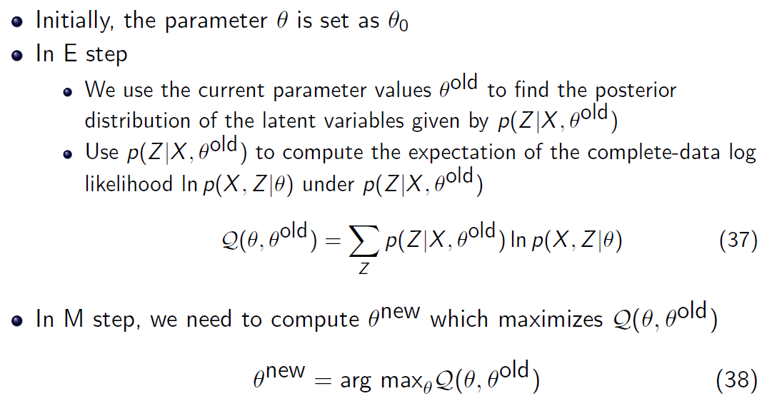
The General EM Procedure
E
M

Slide 151
Summary: EM
EM is a general procedure for learning in the presence of unobserved variables.
We have shown how to use it in order to estimate the most likely density function for a mixture of probability distributions.
EM is an iterative algorithm that can be shown to converge to a local maximum of the likelihood function. Thus, might requires many restarts.
It depends on assuming a family of probability distributions.
It has been shown to be quite useful in practice, when the assumptions made on the probability distribution are correct, but can fail otherwise.
Notes:
See lecture slides for additional example: k-means

Slide 152
Lecture 11: Representing Probability Distribution
Goal: To represent all joint probability distributions over a set of random variables X₁, X₂,…., X_{n}
There are many ways to represent distributions.
A table, listing the probability of each instance in {0,1}^{n}
  We will need 2^{n}-1 numbers
What can we do? Make Independence Assumptions
Multi-linear polynomials
  Polynomials over variables (Samdani & Roth’09, Poon & Domingos’11)
Bayesian Networks
  Directed acyclic graphs
Markov Networks
  Undirected graphs

Slide 153
Unsupervised Learning
In general, the problem is very hard. But, under some assumptions on the distribution we have shown that we can do it. (exercise: show it’s the most likely distribution)
Assumptions: (conditional independence given y)
  P(x_{i} | x_{j},y) = P(x_{i}|y) i,j
Can these assumptions be relaxed ?
Can we learn more general probability distributions ?
  (These are essential in many applications: language, vision.)
We can compute the probability of any event or conditional event over the n+1 variables.

Slide 154
Graphical Models of Probability Distributions
Bayesian Networks represent the joint probability distribution over a set of variables.
Independence Assumption: x, x is independent of its non-descendants given its parents
With these conventions, the joint probability distribution is given by:
z is a parent of x
This is a theorem. To prove it, order the nodes from leaves up, and use the product rule.
The terms are called CPTs (Conditional Probability tables) and they completely define the probability distribution.
Y
x is a descendant of y
Z₁
Z₂
Z
Z₃
X₁₀
X
X₂

Slide 155
Bayesian Network
Semantics of the DAG
  Nodes are random variables
  Edges represent causal influences
  Each node is associated with a conditional probability distribution
Two equivalent viewpoints
  A data structure that represents the joint distribution compactly
  A representation for a set of conditional independence assumptions about a distribution

Slide 156
Bayesian Network: Example
The burglar alarm in your house rings when there is a burglary or an earthquake. An earthquake will be reported on the radio. If an alarm rings and your neighbors hear it, they will call you.
What are the random variables?

Slide 157
Bayesian Network: Example
If there’s an earthquake, you’ll probably hear about it on the radio.
Earthquake
Burglary
An alarm can ring because of a burglary or an earthquake.
Radio
Alarm
How many parameters do we have?
How many would we have if we had to store the entire joint?
Mary Calls
John Calls
If your neighbors hear an alarm, they will call you.
Notes:
2^6 = 64 parameters if no edges

Slide 158
Bayesian Network: Example
P(E)
Earthquake
P(B)
Burglary
P(R | E)
P(A | E, B)
Radio
Alarm
With these probabilities,
(and assumptions, encoded in the graph) we can compute the probability of any event over these variables.
P(M | A)
P(J | A)
Mary Calls
John Calls
Notes:
Note that Naïve Bayes is a very simple bayes net.

Slide 159
Computational Problems
Learning the structure of the Bayes net
  (What would be the guiding principle?)
Learning the parameters
  Supervised? Unsupervised?
Inference:
  Computing the probability of an event: [#P Complete, Roth’93, ’96]
    Given structure and parameters
    Given an observation E, what is the probability of Y? P(Y=y | E=e)
    (E, Y are sets of instantiated variables)
  Most likely explanation (Maximum A Posteriori assignment, MAP, MPE) [NP-Hard; Shimony’94]
    Given structure and parameters
    Given an observation E, what is the most likely assignment to Y?
    Argmax_{y} P(Y=y | E=e)
    (E, Y are sets of instantiated variables)
Notes:
#P complete: harder than NP complete, e.g. counting the number of satisfying assignments to 3SAT
Choosing a different distribution (e.g. multivariate polynomia) makes some of these programs easier.

Slide 160
Tree Dependent Distributions
Directed Acyclic graph
  Each node has at most one parent
Independence Assumption:
  x is independent of its non-descendants given its parents
(x is independent of other nodes give z; v is independent of w given u;)
Need to know two numbers for each link: p(x|z), and a prior for the root p(y)
Y
P(y)
P(s|y)
W
U
Z
S
V
X
P(x|z)
T

Slide 161
Tree Dependent Distributions
This is a generalization of naïve Bayes.
Inference Problem:
  Given the Tree with all the associated probabilities, evaluate the probability of an event p(x) ?
Y
P(y)
P(s|y)
W
U
Z
S
V
X
P(x|z)
T
P(x=1) =
= P(x=1|z=1)P(z=1) + P(x=1|z=0)P(z=0)
Recursively, go up the tree:
P(z=1) = P(z=1|y=1)P(y=1) + P(z=1|y=0)P(y=0)
P(z=0) = P(z=0|y=1)P(y=1) + P(z=0|y=0)P(y=0)
Linear Time Algorithm
Now we have everything in terms of the CPTs (conditional probability tables)

Slide 162
Tree Dependent Distributions
This is a generalization of naïve Bayes.
Inference Problem:
  Given the Tree with all the associated probabilities, evaluate the probability of an event p(x,y) ?
Y
P(y)
P(s|y)
W
U
Z
S
V
X
P(x|z)
T
P(x=1,y=0) =
= P(x=1|y=0)P(y=0)
Recursively, go up the tree along the path from x to y:
P(x=1|y=0) = ∑_{z=0,1} P(x=1|y=0, z)P(z|y=0) =
= ∑_{z=0,1} P(x=1|z)P(z|y=0)
Now we have everything in terms of the CPTs (conditional probability tables)

Slide 163
Tree Dependent Distributions
This is a generalization of naïve Bayes.
Inference Problem:
  Given the Tree with all the associated probabilities, evaluate the probability of an event p(x,u) ?
  (No direct path from x to u)
Y
P(y)
P(s|y)
W
U
Z
S
V
X
P(x|z)
T
P(x=1,u=0) = P(x=1|u=0)P(u=0)
Let y be a parent of x and u (we always have one)
P(x=1|u=0) = ∑_{y=0,1} P(x=1|u=0, y)P(y|u=0) =
= ∑_{y=0,1} P(x=1|y)P(y|u=0) =
Now we have reduced it to cases we have seen

Slide 164
Graphical Models of Probability Distributions
For general Bayesian Networks
  The learning problem is hard
  The inference problem (given the network, evaluate the probability of a given event) is hard (#P Complete)
Y
P(y)
Z₁
Z₂
Z
Z₃
P(z₃ | y)
X₁₀
X
X₂
P(x | z₁, z₂ ,z, z₃)

Slide 165
Tree Dependent Distributions
Learning Problem:
Given data (n tuples) assumed to be sampled from a tree-dependent distribution
  What does that mean?
  Generative model
Find the tree representation of the distribution.
  What does that mean?
Y
P(y)
P(s|y)
W
U
Z
S
V
X
P(x|z)
T
Among all trees, find the most likely one, given the data:
P(T|D) = P(D|T) P(T)/P(D)

Slide 166
Tree Dependent Distributions
Learning Problem:
Given data (n tuples) assumed to be sampled from a tree-dependent distribution
Find the tree representation of the distribution.
Y
P(y)
P(s|y)
W
U
Z
S
V
X
P(x|z)
T
Assuming uniform prior on trees, the Maximum Likelihood approach is to maximize P(D|T),
T_{ML} = argmax_{T} P(D|T) = argmax_{T} ¦ _{{x}} P_{T} (x₁, x₂, … x_{n})
Now we can see why we had to solve the inference problem first; it is required for learning.

Slide 167
Tree Dependent Distributions
Learning Problem:
Given data (n tuples) assumed to be sampled from a tree-dependent distribution
Find the tree representation of the distribution.
Y
P(y)
P(s|y)
W
U
Z
S
V
X
P(x|z)
T
Assuming uniform prior on trees, the Maximum Likelihood approach is to maximize P(D|T),
T_{ML} = argmax_{T} P(D|T) = argmax_{T} P_{T} (x₁, x₂, … x_{n}) =
= argmax_{T} P_{T} (x_{i}|Parents(x_{i}))
Try this for naïve Bayes

Slide 168
Example: Learning Distributions
Probability Distribution 1:
0000 0.1 0001 0.1 0010 0.1 0011 0.1
0100 0.1 0101 0.1 0110 0.1 0111 0.1
1000 0 1001 0 1010 0 1011 0
1100 0.05 1101 0.05 1110 0.05 1111 0.05
Probability Distribution 2:
Probability Distribution 3
Are these representations of the same distribution?
Given a sample, which of these generated it?
X₄
P(x₄)
P(x₃|x₄)
P(x₂|x₄)
P(x₁|x₄)
X₁
X₂
X₃
P(x₄)
X₄
P(x₂|x₄)
X₂
P(x₁|x₄)
X₁
P(x₃|x₂)
X₃

Slide 169
Example: Learning Distributions
Probability Distribution 1:
0000 0.1 0001 0.1 0010 0.1 0011 0.1
0100 0.1 0101 0.1 0110 0.1 0111 0.1
1000 0 1001 0 1010 0 1011 0
1100 0.05 1101 0.05 1110 0.05 1111 0.05
Probability Distribution 2:
Probability Distribution 3
We are given 3 data points: 1011; 1001; 0100
Which one is the target distribution?
X₄
P(x₄)
P(x₃|x₄)
P(x₂|x₄)
P(x₁|x₄)
X₁
X₂
X₃
P(x₄)
X₄
P(x₂|x₄)
X₂
P(x₁|x₄)
X₁
P(x₃|x₂)
X₃

Slide 170
Example: Learning Distributions
Probability Distribution 1:
0000 0.1 0001 0.1 0010 0.1 0011 0.1
0100 0.1 0101 0.1 0110 0.1 0111 0.1
1000 0 1001 0 1010 0 1011 0
1100 0.05 1101 0.05 1110 0.05 1111 0.05
What is the likelihood that this table generated the data?
P(T|D) = P(D|T) P(T)/P(D)
Likelihood(T) ~= P(D|T) ~= P(1011|T) P(1001|T)P(0100|T)
  P(1011|T)= 0
  P(1001|T)= 0.1
  P(0100|T)= 0.1
P(Data|Table)=0
We are given 3 data points: 1011; 1001; 0100
Which one is the target distribution?

Slide 171
Example: Learning Distributions
Probability Distribution 2:
What is the likelihood that the data was
sampled from Distribution 2?
Need to define it:
  P(x₄=1)=1/2
  p(x₁=1|x₄=0)=1/2 p(x₁=1|x₄=1)=1/2
  p(x₂=1|x₄=0)=1/3 p(x₂=1|x₄=1)=1/3
  p(x₃=1|x₄=0)=1/6 p(x₃=1|x₄=1)=5/6
Likelihood(T) ~= P(D|T) ~= P(1011|T) P(1001|T)P(0100|T)
  P(1011|T)= p(x₄=1)p(x₁=1|x₄=1)p(x₂=0|x₄=1)p(x₃=1|x₄=1)=1/2 1/2 2/3 5/6= 10/72
  P(1001|T)= = 1/2 1/2 2/3 5/6=10/72
  P(0100|T)= =1/2 1/2 2/3 5/6=10/72
  P(Data|Tree)=125/4*3⁶
X₄
P(x₄)
P(x₃|x₄)
P(x₂|x₄)
P(x₁|x₄)
X₁
X₂
X₃

Slide 172
Example: Learning Distributions
Probability Distribution 3:
What is the likelihood that the data was
sampled from Distribution 2?
Need to define it:
  P(x₄=1)=2/3
  p(x₁=1|x₄=0)=1/3 p(x₁=1|x₄=1)=1
  p(x₂=1|x₄=0)=1 p(x₂=1|x₄=1)=1/2
  p(x₃=1|x₂=0)=2/3 p(x₃=1|x₂=1)=1/6
Likelihood(T) ~= P(D|T) ~= P(1011|T) P(1001|T)P(0100|T)
  P(1011|T)= p(x₄=1)p(x₁=1|x₄=1)p(x₂=0|x₄=1)p(x₃=1|x₂=1)=2/3 1 1/2 2/3= 2/9
  P(1001|T)= = 2/3 1 1/2 1/3=1/9
  P(0100|T)= =1/3 2/3 1 5/6=10/54
  P(Data|Tree)=10/3⁷
P(x₄)
X₄
P(x₂|x₄)
X₂
P(x₁|x₄)
X₁
P(x₃|x₂)
X₃
Distribution 2 is the most likely distribution to have produced the data.

Slide 173
Example: Summary
We are now in the same situation we were when we decided which of two coins, fair (0.5,0.5) or biased (0.7,0.3) generated the data.
But, this isn’t the most interesting case.
In general, we will not have a small number of possible distributions to choose from, but rather a parameterized family of distributions. (analogous to a coin with p [0,1] )
We need a systematic way to search this family of distributions.

Slide 174
Learning Tree Dependent Distributions
Learning Problem:
  1. Given data (n tuples) assumed to be sampled from a tree-dependent distribution
  find the most probable tree representation of the distribution.
  2. Given data (n tuples)
  find the tree representation that best approximates the distribution (without assuming that the data is sampled from a tree-dependent distribution.)
Y
P(y)
P(s|y)
W
U
Z
S
V
X
P(x|z)
T
Space of all Distributions
Space of all Tree Distributions
Target Distribution
Find the Tree closest to the target
Target Distribution

Slide 175
Learning Tree Dependent Distributions
Learning Problem:
  1. Given data (n tuples) assumed to be sampled from a tree-dependent distribution
  find the most probable tree representation of the distribution.
  2. Given data (n tuples)
  find the tree representation that best approximates the distribution (without assuming that the data is sampled from a tree-dependent distribution.)
Y
P(y)
P(s|y)
W
U
Z
S
V
X
P(x|z)
T
The simple minded algorithm for learning a tree dependent distribution requires
(1) for each tree, compute its likelihood
L(T) = P(D|T) =
= P_{T} (x₁, x₂, … x_{n}) =
= P_{T} (x_{i}|Parents(x_{i}))
(2) Find the maximal one

Slide 176
1. Distance Measure
To measure how well a probability distribution P is approximated by probability distribution T we use here the Kullback-Leibler cross entropy measure (KL-divergence):
Non negative.
D(P,T)=0 iff P and T are identical
Non symmetric. Measures how much P differs from T.

Slide 177
2. Ranking Dependencies
Intuitively, the important edges to keep in the tree are edges (x---y) for x, y which depend on each other.
Given that the distance between the distribution is measured using the KL divergence, the corresponding measure of dependence is the mutual information between x and y, (measuring the information x gives about y)
which we can estimate with respect to the empirical distribution (that is, the given data).

Slide 178
Learning Tree Dependent Distributions
The algorithm is given m independent measurements from P.
For each variable x, estimate P(x) (Binary variables – n numbers)
For each pair of variables x, y, estimate P(x,y) (O(n²) numbers)
For each pair of variables compute the mutual information
Build a complete undirected graph with all the variables as vertices.
Let I(x,y) be the weights of the edge (x,y)
Build a maximum weighted spanning tree

Slide 179
Learning Tree Dependent Distributions
The algorithm is given m independent measurements from P.
For each variable x, estimate P(x) (Binary variables – n numbers)
For each pair of variables x, y, estimate P(x,y) (O(n²) numbers)
For each pair of variables compute the mutual information
Build a complete undirected graph with all the variables as vertices.
Let I(x,y) be the weights of the edge (x,y)
Build a maximum weighted spanning tree
Transform the resulting undirected tree to a directed tree.
  Choose a root variable and set the direction of all the edges away from it.
Place the corresponding conditional probabilities on the edges.
(2)
(3)
(1)

