Slide 1
Administration
Midterm exam on Tuesday 10/25
  Closed books; in class; ~4 questions
  All the material covered before the midterm
  Go over practice midterms
Questions?

Slide 2
Midterm Review
Today:
Quick run-through of the material we’ve covered so far
The selection of slides in today’s lecture doesn’t mean that you don’t need to look at the rest when prepping for the exam!
Slides are from previous lectures
  I’ll not go in to the details
  Slides chosen might be not completely coherent
  The goal is to remind you what we did and solicit questions

Slide 3
Midterm
  Closed book exam
  All lectures until today
  Intro. to ML / Decision Trees / Online learning / COLT /NN/ Boosting/SVM
    Lectures / Problem sets
  Cheating?
    No.

Slide 4
Sample Questions
Question types:
4~5 question sets including a set of short questions
Previous midterm exams / solutions:
http://l2r.cs.illinois.edu/~danr/Teaching/CS446-16/handout.html

Slide 5
Sample of short Question

Slide 6
Sample Question set

Slide 7
Sample Question set

Slide 8
Sample Question set

Slide 9

Course Overview
Introduction: Basic problems and questions
A detailed example: Linear threshold units
Two Basic Paradigms:
  PAC (Risk Minimization)
  Bayesian theory
Learning Protocols:
  Supervised; Unsupervised; Semi-supervised
Algorithms
  Decision Trees (C4.5)
  [Rules and ILP (Ripper, Foil)]
  Linear Threshold Units (Winnow; Perceptron; Boosting; SVMs; Kernels)
    Gradient Descent
  Neural Networks (Backpropagation)
  Probabilistic Representations (naïve Bayes; Bayesian trees; Densities)
  Unsupervised /Semi supervised: EM
Clustering; Dimensionality Reduction

Slide 10
Key Issues in Machine Learning
Modeling
  How to formulate application problems as machine learning problems ? How to represent the data?
  Learning Protocols (where is the data & labels coming from?)
Representation
  What are good hypothesis spaces ?
  Any rigorous way to find these? Any general approach?
Algorithms
  What are good algorithms?
  How do we define success?
  Generalization Vs. over fitting
  The computational problem
Notes:
Badges game
Don’t give me the answer
Start thinking about how to write a program that will figure out whether my name has + or – next to it.

Slide 11
Using supervised learning
What is our instance space?
  Gloss: What kind of features are we using?
What is our label space?
  Gloss: What kind of learning task are we dealing with?
What is our hypothesis space?
  Gloss: What kind of model are we learning?
What learning algorithm do we use?
  Gloss: How do we learn the model from the labeled data?
(What is our loss function/evaluation metric?)
  Gloss: How do we measure success?

Slide 12
Terminology
Target function (concept): The true function f :X →{…Labels…}
Concept: Boolean function. Example for which f (x)= 1 are positive examples; those for which f (x)= 0 are negative examples (instances)
Hypothesis: A proposed function h, believed to be similar to f. The output of our learning algorithm.
Hypothesis space: The space of all hypotheses that can, in principle, be output by the learning algorithm.
Classifier: A discrete valued function produced by the learning algorithm. The possible value of f: {1,2,…K} are the classes or class labels. (In most algorithms the classifier will actually return a real valued function that we’ll have to interpret).
Training examples: A set of examples of the form {(x, f (x))}
Notes:
Badges game
Don’t give me the answer
Start thinking about how to write a program that will figure out whether my name has + or – next to it.

Slide 13
Protocol: Supervised learning
Input
x∈ X
An item x
drawn from an instance space X
Target function
y = f(x)
Output
y∈ Y
An item y
drawn from a label space Y
Learned Model
y = g(x)

Slide 14
The i.i.d. assumption
Training and test items are independently and identically distributed (i.i.d.):
  There is a distribution P(X, Y) from which the data D = {(x, y)} is generated.
    Sometimes it’s useful to rewrite P(X, Y) as P(X)P(Y|X)
    Usually P(X, Y) is unknown to us (we just know it exists)
  Training and test data are samples drawn from the same P(X, Y): they are identically distributed
  Each (x, y) is drawn independently from P(X, Y)

Slide 15
Supervised learning: Training
  Labeled Training Data
  D ^{train}
  (x₁, y₁)
  (x₂, y₂)
  …
  (x_{N}, y_{N})
Learned model
g(x)
Learning Algorithm
Give the learner examples in D ^{train}
The learner returns a model g(x)

Slide 16
Supervised learning: Testing
Apply the model to the raw test data
  Raw Test Data
  X ^{test}
  x’₁
  x’₂
  ….
  x’_{M}
  Predicted
  Labels
  g(X ^{test})
  g(x’₁)
  g(x’₂)
  ….
  g(x’_{M})
  Test
  Labels
  Y ^{test}
  y’₁
  y’₂
  ...
  y’_{M}
Learned model
g(x)

Slide 17
Supervised learning: Testing
Evaluate the model by comparing the predicted labels against the test labels
  Raw Test Data
  X ^{test}
  x’₁
  x’₂
  ….
  x’_{M}
  Predicted
  Labels
  g(X ^{test})
  g(x’₁)
  g(x’₂)
  ….
  g(x’_{M})
  Test
  Labels
  Y ^{test}
  y’₁
  y’₂
  ...
  y’_{M}
Learned model
g(x)

Slide 18
Experimental Machine Learning
Machine Learning is an Experimental Field and we will spend some time (in Problem sets) learning how to run experiments and evaluate results
  First hint: be organized; write scripts
Basics:
  Split your data into two (or three) sets:
    Training data (often 70-90%)
    Test data (often 10-20%)
    Development data (10-20%)
You need to report performance on test data, but you are not allowed to look at it.
  You are allowed to look at the development data (and use it to tweak parameters)

Slide 19
N-fold cross validation
Instead of a single test-training split:
Split data into N equal-sized parts
Train and test N different classifiers
Report average accuracy and standard deviation of the accuracy
train
test

Slide 20
Decision Trees
A hierarchical data structure that represents data by implementing a divide and conquer strategy
Can be used as a non-parametric classification and regression method
Given a collection of examples, learn a decision tree that represents it.
Use this representation to classify new examples
B
A
C

Slide 21
The Representation
Decision Trees are classifiers for instances represented as feature vectors (color= ; shape= ; label= )
Nodes are tests for feature values
There is one branch for each value of the feature
Leaves specify the category (labels)
Can categorize instances into multiple disjoint categories
B
A
C
(color= RED ;shape=triangle)
Decision Trees
Evaluation of a
Decision Tree
Color
Learning a
Decision Tree
Blue
red
Green
Shape
B
Shape
triangle
circle
circle
square
square
B
C
B
A
A

Slide 22
Information Gain
High Entropy – High level of Uncertainty
Low Entropy – No Uncertainty.
Outlook
Sunny
Overcast
Rain
The information gain of an attribute a is the expected reduction in entropy caused by partitioning on this attribute
where S_{v} is the subset of S for which attribute a has value v, and the entropy of partitioning the data is calculated by weighing the entropy of each partition by its size relative to the original set
  Partitions of low entropy (imbalanced splits) lead to high gain
Go back to check which of the A, B splits is better
Notes:
The A, B case:
If we choose A: the reduction is: 100/203 Ent(100,0) + 103/203 Ent(100,3) ~~ 0
If we choose B: the reduction is: 53/203 Ent(53,0) + 150/203 Ent(100,50) >> 0

Slide 23
On-Line Learning
Not the most general setting for on-line learning.
Note: online learning protocol v.s. online learning algorithm
Model:protocol
  Instance space: X (dimensionality – n)
  Target: f: X →{0,1}, f ∈ C, concept class (parameterized by n)
Protocol:
  learner is given x ∈ X
  learner predicts h(x), and is then given f(x) (feedback)
Performance: learner makes a mistake when h(x) ≠ f(x)
  number of mistakes algorithm A makes on sequence S of examples, for the target function f.
On Line Model

Slide 24
Quantifying Performance
We want to be able to say something rigorous about the performance of our learning algorithm.
Evaluating a learning algorithm:
  Experiments
  COLT
    E.g, PAC theory, VC theory, Mistake bound

Slide 25
Mistake Driven Learning Algorithm
learn a linear function over the feature space
  Perceptron (+ many variations)
  Winnow
  General Gradient Descent view
Issues:
  Importance of Representation
  Complexity of Learning
  Idea of Kernel Based Methods
  More about features

Slide 26
The Halving Algorithm
Let C be a concept class. Learn f ² C
Halving:
In the ith stage of the algorithm:
  all concepts in C consistent with all i-1 previously seen examples
Given an example consider the value for all and predict by majority.
Predict 1 if
Clearly and if a mistake is made in the ith example, then
The Halving algorithm makes at most log(|C|) mistakes

Slide 27
Perceptron learning rule
On-line, mistake driven algorithm.
Rosenblatt (1959) suggested that when a target output value is provided for a single neuron with fixed input, it can incrementally change weights and learn to produce the output using the Perceptron learning rule
(Perceptron == Linear Threshold Unit)
Perceptron
1
2
7
T
3
4
5
6

Slide 28
Perceptron learning rule
We learn f:X→{-1,+1} represented as f =sgn{w•x)
Where X= {0,1}^{n} or X= R^{n} and w∈ R^{n}
Given Labeled examples: {(x₁, y₁), (x₂, y₂),…(x_{m}, y_{m})}
  Initialize w=0∈
2. Cycle through all examples
  a. Predict the label of instance x to be y’ = sgn{w•x)
  b. If y’≠y, update the weight vector:
w = w + r y x (r - a constant, learning rate)
Otherwise, if y’=y, leave weights unchanged.
Perceptron

Slide 29
Perceptron Convergence
Perceptron Convergence Theorem:
If there exist a set of weights that are consistent with the data (i.e., the data is linearly separable), the perceptron learning algorithm will converge
  How long would it take to converge ?
Perceptron Cycling Theorem:
If the training data is not linearly separable the perceptron learning algorithm will eventually repeat the same set of weights and therefore enter an infinite loop.
  How to provide robustness, more expressivity ?
Perceptron

Slide 30
Perceptron: Mistake Bound Theorem
Maintains a weight vector w∈R^{N}, w₀=(0,…,0).
Upon receiving an example x ∈ R^{N}
Predicts according to the linear threshold function w•x ≥ 0.
Theorem [Novikoff,1963] Let (x₁; y₁),…,: (x_{t}; y_{t}), be a sequence of labeled examples with x_{i} ∈<^{N}, ||x_{i}||≤R and y_{i} ∈{-1,1} for all i. Let u∈ <^{N}, γ > 0 be such that, ||u|| = 1 and y_{i} u • x_{i} ≥ γ for all i.
Then Perceptron makes at most R² / γ ² mistakes on this example sequence.
(see additional notes)
Analysis
Complexity Parameter

Slide 31
Winnow Algorithm
The Winnow Algorithm learns Linear Threshold Functions.
For the class of disjunctions:
  instead of demotion we can use elimination.
Winnow

Slide 32
Winnow – Mistake Bound
Claim: Winnow makes O(k log n) mistakes on k-disjunctions
u - # of mistakes on positive examples (promotions)
v - # of mistakes on negative examples (demotions)
# of mistakes: u + v < 3u + 2 = O(k log n)
Winnow

Slide 33
Transforming Feature Spaces
Whether
Weather
New discriminator in functionally simpler

Slide 34
General Stochastic Gradient Algorithms
Given examples {z=(x,y)}_{1, m} from a distribution over XxY, we are trying to learn a linear function, parameterized by a weight vector w, so that expected risk function
J(w) = E_{z} Q(z,w) ~=~ 1/m ∑_{1, m} Q(z_{i}, w_{i})
In Stochastic Gradient Descent Algorithms we approximate this minimization by incrementally updating the weight vector w as follows:
w_{t+1} = w_{t} – r_{t} g_{w} Q(z_{t}, w_{t}) = w_{t} – r_{t} g_{t}
  Where g_t = g_{w} Q(z_{t}, w_{t}) is the gradient with respect to w at time t.
The difference between algorithms now amounts to choosing a different loss function Q(z, w)

Slide 35
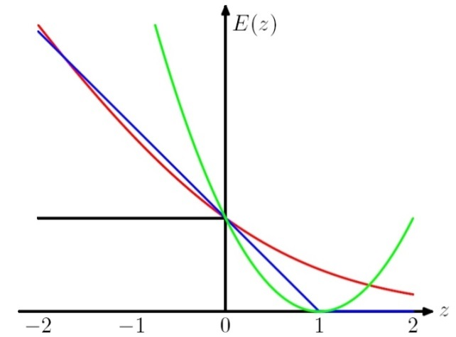
Stochastic Gradient Algorithms
w_{t+1} = w_{t} – r_{t} g_{w} Q(z_{t}, w_{t}) = w_{t} – r_{t} g_{t}
  LMS: Q((x, y), w) =1/2 (y – w ¢ x)²
  leads to the update rule (Also called Widrow’s Adaline):
  w_{t+1} = w_{t} + r (y_{t} – w_{t} ¢ x_{t}) x_{t}
  Here, even though we make binary predictions based on sign (w ¢ x) we do not take the sign of the dot-product into account in the loss.
  Another common loss function is:
  Hinge loss:
  Q((x, y), w) = max(0, 1 - y w ¢ x)
  This leads to the perceptron update rule:
  If y_{i} w_{i} ¢ x_{i} > 1 (No mistake, by a margin): No update
  Otherwise (Mistake, relative to margin): w_{t+1} = w_{t} + r y_{t} x_{t}

Slide 36
New Stochastic Gradient Algorithms
w_{t+1} = w_{t} – r_{t} g_{w} Q(z_{t}, w_{t}) = w_{t} – r_{t} g_{t}
(notice that this is a vector, each coordinate (feature) has its own wt,j and gt,j)
  So far, we used fixed learning rates r = r_{t}, but this can change.
  AdaGrad alters the update to adapt based on historical information, so that frequently occurring features in the gradients get small learning rates and infrequent features get higher ones.
  The idea is to “learn slowly” from frequent features but “pay attention” to rare but informative features.
  Define a “per feature” learning rate for the feature j, as:
  r_{t,j} = r/(G_{t,j})^{1/2}
  where G_{t,j} = ∑_{k=1, t} g²_{k,j} the sum of squares of gradients at feature j until time t.
  Overall, the update rule for Adagrad is:
  w_{t+1,j} = w_{t,j} - g_{t,j} r/(G_{t,j})^{1/2}
  This algorithm is supposed to update weights faster than Perceptron or LMS when needed.

Slide 37
Regularization
The more general formalism adds a regularization term to the risk function, and attempts to minimize:
J(w) = ∑_{1, m} Q(z_{i}, w_{i}) + ¸ R_{i} (w_{i})
Where R is used to enforce “simplicity” of the learned functions.
LMS case: Q((x, y), w) =(y – w ¢ x)²
  R(w) = ||w||²₂ gives the optimization problem called Ridge Regression.
  R(w) = ||w||₁ gives the problem call the LASSO problem
Hinge Loss case: Q((x, y), w) = max(0, 1 - y w ¢ x)
  R(w) = ||w||²₂ gives the problem called Support Vector Machines
Logistics Loss case: Q((x,y),w) = log (1+exp{-y w ¢ x})
  R(w) = ||w||²₂ gives the problem called Logistics Regression
These are convex optimization problems and, in principle, the same gradient descent mechanism can be used in all cases.
We will see later why it makes sense to use the “size” of w as a way to control “simplicity”.

Slide 38
Multi-Layer Neural Networks
Multi-layer network were designed to overcome the computational (expressivity) limitation of a single threshold element.
The idea is to stack several
layers of threshold elements,
each layer using the output of
the previous layer as input.
Multi-layer networks can represent arbitrary functions, but building effective learning methods for such network was [thought to be] difficult.
activation
Output
Hidden
Input

Slide 39
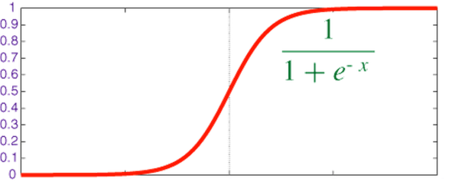

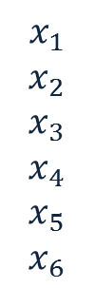
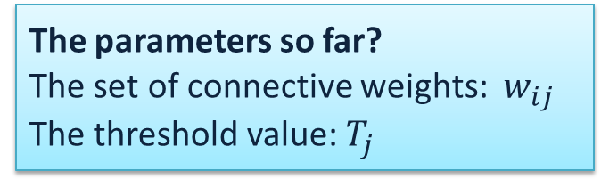
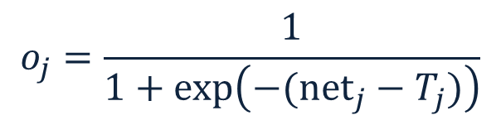



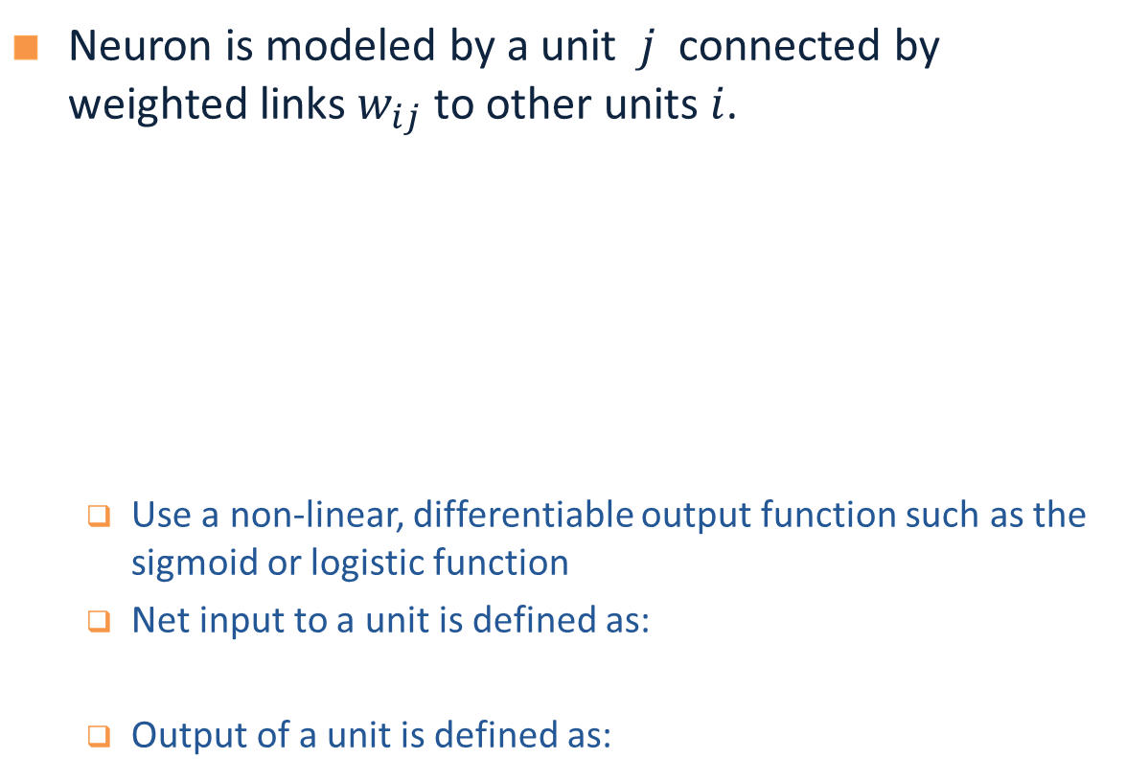

Model Neuron (Logistic)
Neuron is modeled by a unit $j$ connected by weighted links $w_{ij}$ to other units $i$.
  Use a non-linear, differentiable output function such as the sigmoid or logistic function
  Net input to a unit is defined as:
  Output of a unit is defined as:
The parameters so far?
The set of connective weights: $w_{ij}$ The threshold value: $T_{j}$
$$x_{1}$$
$$x_{2}$$
$$x_{3}$$
$$x_{4}$$
$$x_{5}$$
$$x_{6}$$
$$w_{17}$$
$$x_{7}$$
$$o_{j}$$
$$w_{67}$$
Neuron Definition
$${net}_{j}=∑w_{ij}.x_{i}$$
$$o_{j}=\frac{1}{1+exp\left(−({net}_{j}−T_{j})\right)}$$

Slide 40
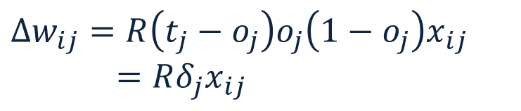





Derivation of Learning Rule (3)
Weights of output units:
  $w_{ij}$ is changed by:
where
$$δ_{j}=\left(t_{j}−o_{j}\right)o_{j}\left(1−o_{j}\right)$$
$$o_{j}$$
$j$
$i$
$$w_{ij}$$
$$Δw_{ij}=R\left(t_{j}−o_{j}\right)o_{j}\left(1−o_{j}\right)x_{ij}=Rδ_{j}x_{ij}$$
$$x_{ij}$$

Slide 41
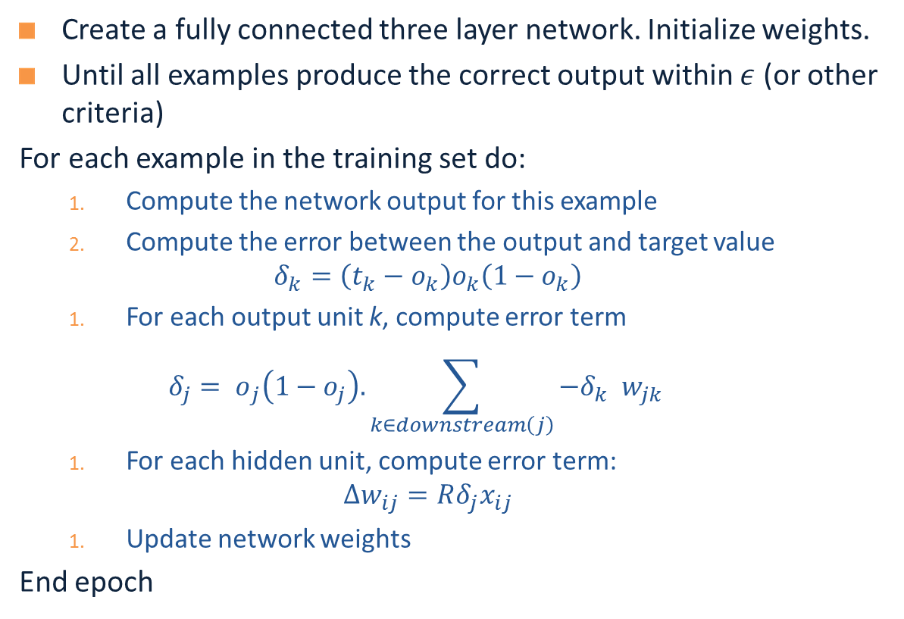
The Backpropagation Algorithm
Create a fully connected three layer network. Initialize weights.
Until all examples produce the correct output within $ε$ (or other criteria)
For each example in the training set do:
  Compute the network output for this example
  Compute the error between the output and target value
  $$δ_{k}=\left(t_{k}−o_{k}\right)o_{k}\left(1−o_{k}\right)$$
  For each output unit k, compute error term
  $${δ_{j}= o}_{j}\left(1−o_{j}\right).\sum_{k∈downstream\left(j\right)}{−δ_{k} w_{jk} }$$
  For each hidden unit, compute error term:
  $$Δw_{ij}=Rδ_{j}x_{ij}$$
  Update network weights
End epoch

Slide 42
Computational Learning Theory
What general laws constrain inductive learning ?
  What learning problems can be solved ?
  When can we trust the output of a learning algorithm ?
We seek theory to relate
  Probability of successful Learning
  Number of training examples
  Complexity of hypothesis space
  Accuracy to which target concept is approximated
  Manner in which training examples are presented

Slide 43
Computational Issues
Assume the data is linearly separable.
Sample complexity:
  Suppose we want to ensure that our LTU has an error rate (on new examples) of less than ε with high probability (at least (1-δ))
  How large does m (the number of examples) must be in order to achieve this ? It can be shown that for n dimensional problems
m = O(1/ ε [ln(1/ δ) + (n+1) ln(1/ ε) ].
Computational complexity: What can be said?
  It can be shown that there exists a polynomial time algorithm for finding consistent LTU (by reduction from linear programming).
  [Contrast with the NP hardness for 0-1 loss optimization]
  (On-line algorithms have inverse quadratic dependence on the margin)
Algorithms
Notes:
The problem of minimizing 0-1 loss is NP hard in the non-separable case: (Ben-David, Simon et al. 2001).

Slide 44
PAC Learnability
Consider a concept class C defined over an instance space X (containing instances of length n), and a learner L using a hypothesis space H.
C is PAC learnable by L using H if
  for all f ∈ C,
  for all distribution D over X, and fixed 0< ε, δ < 1,
L, given a collection of m examples sampled independently according to D produces
  with probability at least (1- δ) a hypothesis h ∈ H with error at most ε, (ErrorD = PrD[f(x) : = h(x)])
where m is polynomial in 1/ ε, 1/ δ, n and size(H)
C is efficiently learnable if L can produce the hypothesis in time polynomial in 1/ ε, 1/ δ, n and size(H)
Definition

Slide 45
Occam’s Razor (1)
We want this probability to be smaller than δ, that is:
|H|(1- ε) < δ
ln(|H|) + m ln(1- ε) < ln(δ)
(with e^{-x} = 1-x+x²/2+…; e^{-x} > 1-x; ln (1- ε) < - ε; gives a safer δ)
(gross over estimate)
It is called Occam’s razor, because it indicates a preference towards small
hypothesis spaces
What kind of hypothesis spaces do we want ? Large ? Small ?
To guarantee consistency we need H ⊇ C. But do we want the smallest H possible ?
m
What do we know now about the Consistent Learner scheme?
We showed that a m-consistent hypothesis generalizes well (err< ²) (Appropriate m is a function of |H|, ², ±)

Slide 46
Consistent Learners
Immediately from the definition, we get the following general scheme for PAC learning:
Given a sample D of m examples
  Find some h ∈ H that is consistent with all m examples
    We showed that if m is large enough, a consistent hypothesis must be close enough to f
    Check that m is not too large (polynomial in the relevant parameters) : we showed that the “closeness” guarantee requires that
    m > 1/² (ln |H| + ln 1/±)
  Show that the consistent hypothesis h ∈ H can be computed efficiently
In the case of conjunctions
  We used the Elimination algorithm to find a hypothesis h that is consistent with the training set (easy to compute)
  We showed directly that if we have sufficiently many examples (polynomial in the parameters), than h is close to the target function.
We need to show that m is polynomial in n when |H| is a function of n. That is, showing ln|H| is polynomial in n

Slide 47
Infinite Hypothesis Space
The previous analysis was restricted to finite hypothesis spaces
Some infinite hypothesis spaces are more expressive than others
  E.g., Rectangles, vs. 17- sides convex polygons vs. general convex polygons
  Linear threshold function vs. a conjunction of LTUs
Need a measure of the expressiveness of an infinite hypothesis space other than its size
The Vapnik-Chervonenkis dimension (VC dimension) provides such a measure.
Analogous to |H|, there are bounds for sample complexity using VC(H)

Slide 48
Shattering
We say that a set S of examples is shattered by a set of functions H if
for every partition of the examples in S into positive and negative examples
there is a function in H that gives exactly these labels to the examples
Half-spaces in the plane:
sets of one, two or three points can be shattered
but there is no set of four points that can be shattered
+
+
+
+
-
-
-
-
+
-
All sets of three?
-
1. If the 4 points form a convex polygon… (if not?)
2. If one point is inside the convex hull defined by the other three…
(if not?)
+
Notes:
Case of 4 points: If three of the points are on the same line, label the middle one differently that the others.
O/w: no three on the same line.
- Form the convex hull. If all points are on it, label them +,-,+,- walking around the convex hull
- if one is inside the convex hull, label it + and the rest –

Slide 49
VC Dimension
We say that a set S of examples is shattered by a set of functions H if
for every partition of the examples in S into positive and negative examples
there is a function in H that gives exactly these labels to the examples
The VC dimension of hypothesis space H over instance space X
is the size of the largest finite subset of X that is shattered by H.
If there exists a subset of size d that can be shattered, then VC(H) >=d
If no subset of size d can be shattered, then VC(H) < d
VC(Half intervals) = 1 (no subset of size 2 can be shattered)
VC( Intervals) = 2 (no subset of size 3 can be shattered)
VC(Half-spaces in the plane) = 3 (no subset of size 4 can be shattered)
Even if only one subset of this size does it!
Some are shattered, but some are not

Slide 50
Sample Complexity & VC Dimension
Using VC(H) as a measure of expressiveness we have an Occam algorithm
for infinite hypothesis spaces.
Given a sample D of m examples
Find some h ∈ H that is consistent with all m examples
If
Then with probability at least (1-δ), h has error less than ε.
(that is, if m is polynomial we have a PAC learning algorithm;
to be efficient, we need to produce the hypothesis h efficiently.
Notice that to shatter m examples it must be that: |H|>2^{m}, so log(|H|)¸VC(H)
What if H is finite?

Slide 51
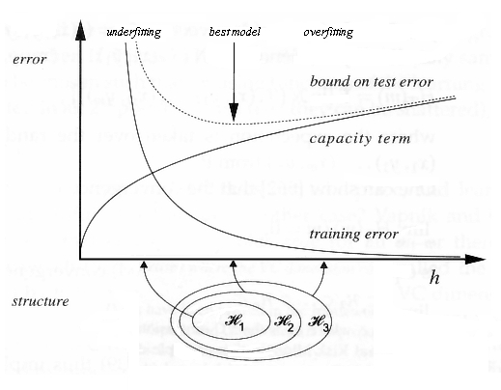
COLT approach to explaining Learning
No Distributional Assumption
Training Distribution is the same as the Test Distribution
Generalization bounds depend
on this view and affects
model selection.
Err_{D}(h) < Err_{TR}(h) +
P(VC(H), log(1/±),1/m)
This is also called the
“Structural Risk Minimization” principle.

Slide 52
Theoretical Motivation of Boosting
“Strong” PAC algorithm:
  for any distribution
  8 ², ± > 0
  Given polynomially many random examples
  Finds hypothesis with error · ² with probability ¸ (1-±)
“Weak” PAC algorithm
  Same, but only for ² · ½ - °
[Kearns & Valiant ’88]:
  Does weak learnability imply strong learnability?
  Anecdote: the importance of the distribution free assumption
    It does not hold if PAC is restricted to only the uniform distribution, say

Slide 53
A Formal View of Boosting
Given training set (x₁, y₁), … (x_{m}, y_{m})
y_{i} 2 {-1, +1} is the correct label of instance x_{i} 2 X
For t = 1, …, T
  Construct a distribution D_{t} on {1,…m}
  Find weak hypothesis (“rule of thumb”)
  h_{t} : X ! {-1, +1}
  with small error ²_{t} on D_{t}:
  ²_{t} = Pr_{D} [h_{t} (x_{i}) := y_{i}]
Output: final hypothesis H_{final}

Slide 54
Adaboost
Think about unwrapping it all the way to 1/m
  Constructing D_{t} on {1,…m}:
  D₁(i) = 1/m
  Given D_{t} and h_{t} :
  D_{t+1} = D_{t}(i)/z_{t} £ e^{-®t} if y_{i} = h_{t}(xi)
  D_{t}(i)/z_{t} £ e^{+®t} if y_{i} := h_{t}(xi)
  = D_{t}(i)/z_{t} £ exp(-®_{t} y_{i} h_{t} (x_{i}))
  where z_{t} = normalization constant
  and
  ®_{t} = ½ ln{ (1- ²_{t})/²_{t} }
Final hypothesis: H_{final} (x) = sign (∑_{t} ®_{t} h_{t}(x) )
< 1; smaller weight
> 1; larger weight
Notes about ®_{t}:
Positive due to the weak learning assumption
Examples that we predicted correctly are demoted, others promoted
Sensible weighting scheme: better hypothesis (smaller error) → larger weight

Slide 55
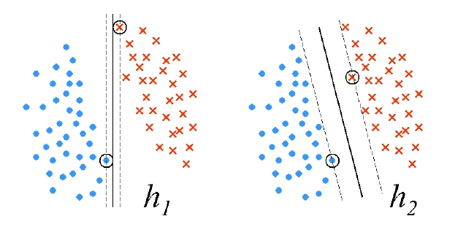
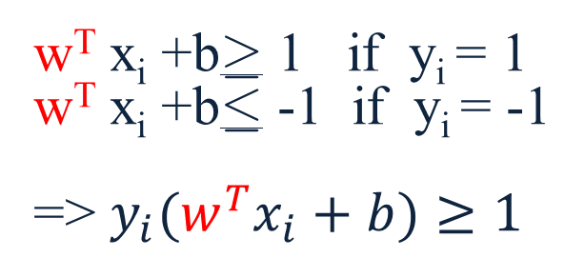
Margin of a Separating Hyperplane
A separating hyperplane: w^{T} x+b = 0
Assumption: data is linear separable
Distance between
w^{T} x+b = +1 and -1 is 2 / ||w||
Idea:
Consider all possible w with different angles
Scale w such that the constraints are tight
Pick the one with largest margin
  w^{T} x_{i} +b¸ 1 if y_{i} = 1
  w^{T} x_{i} +b· -1 if y_{i} = -1
  => $y_{i}(w^{T}x_{i}+b)≥1$
w^{T} x+b = 1
w^{T} x+b = 0
w^{T} x+b = -1

Slide 56
Maximal Margin
The margin of a linear separator
w^{T} x+b = 0
is 2 / ||w||
max 2 / ||w|| = min ||w||
= min ½ w^{T}w
  $\min_{w,b} \frac{1}{2}w^{T}w$
  s.t $y_{i}{(w}^{T}x_{i}+b)≥1, ∀\left(x_{i},y_{i}\right)∈S$

Slide 57
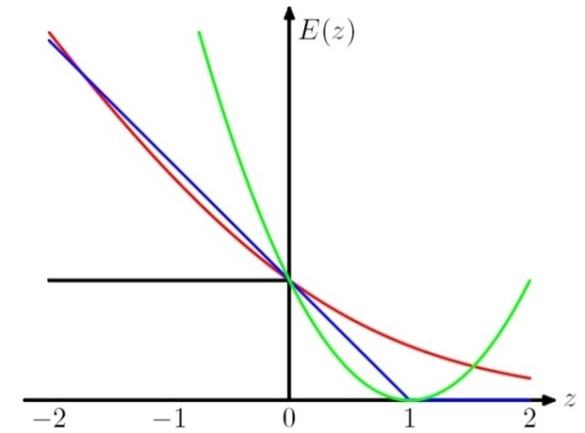
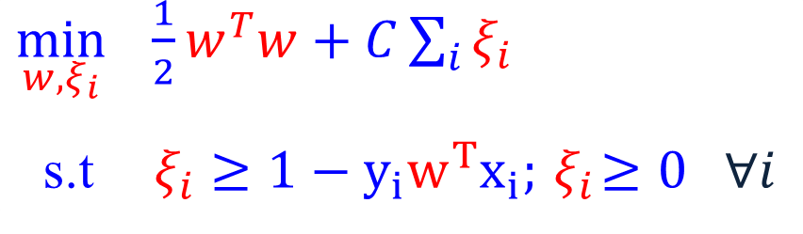

Soft SVM (2)
Now, we want to solve:
Which can be written as:
$$\min_{w} \frac{1}{2}w^{T}w+C\sum_{i}{\max{(0, 1−y_{i}w^{T}x_{i})}}.$$
What is the interpretation of this?
  $\min_{w, ξ_{i}} \frac{1}{2}w^{T}w+C\sum_{i}{ξ_{i}}$
  s.t $y_{i}w^{T}x_{i}≥1−ξ_{i} ;ξ_{i}≥0 ∀i$
  $\min_{w, ξ_{i}} \frac{1}{2}w^{T}w+C\sum_{i}{ξ_{i}}$
  s.t$ξ_{i}≥1−y_{i}w^{T}x_{i};{ ξ}_{i}≥0 ∀i$
In optimum, $ξ_{i}=\max{(0, 1−y_{i}w^{T}x_{i})}$

Slide 58
SVM Objective Function
The problem we solved is:
Min ½ ||w||² + c ∑ »_{i}
Where »_{i} > 0 is called a slack variable, and is defined by:
  » _{i} = max(0, 1 – y_{i} w^{t}x_{i})
  Equivalently, we can say that: y_{i} w^{t}x_{i} ¸ 1 - »; » ¸ 0
And this can be written as:
Min ½ ||w||² + c ∑ »_{i}
General Form of a learning algorithm:
  Minimize empirical loss, and Regularize (to avoid over fitting)
  Theoretically motivated improvement over the original algorithm we’ve see at the beginning of the semester.
Regularization term
Empirical loss
Can be replaced by other regularization functions
Can be replaced by other loss functions

Slide 59
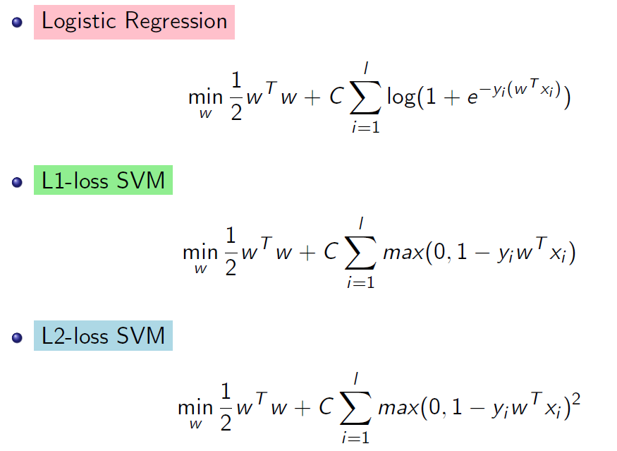
What Do We Optimize?

Slide 60
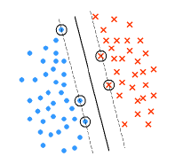
Duality
This, and other properties of Support Vector Machines are shown by moving to the dual problem.
Theorem: Let w* be the minimizer of
the SVM optimization problem (***)
for S = {(x_{i}, y_{i})}.
Let I= {i: y_{i} (w^{*T}x_{i} +b)= 1}.
Then there exists coefficients ®_{i} >0
such that:
w* = ∑_{i 2 I} ®_{i} y_{i} x_{i}

Slide 61
(recap) Kernel Perceptron
If n’ is large, we cannot represent w explicitly. However, the weight vector w can be written as a linear combination of examples:
Where $α_{j}$ is the number of mistakes made on $x^{(j)}$
Then we can compute f(x) based on ${\{x}^{(j)}\}$ and $α$

Slide 62
(recap) Kernel Perceptron
In the training phase, we initialize $α$ to be an all-zeros vector.
For training sample ${ (x}^{(k)}, y^{(k)}),$ instead of using the original Perceptron update rule in the $R^{n^{′}}$ space
we maintain $α$by
based on the relationship between $w$ and $α$:

Slide 63
Embedding
Whether
Weather
New discriminator in functionally simpler

Slide 64
Making data linearly separable
f(x) = 1 iff x₁² + x₂² ≤ 1

Slide 65
Making data linearly separable
In order to deal with this, we introduce two new concepts:
  Dual Representation
  Kernel (& the kernel trick)
Transform data: x = (x₁, x₂ ) => x’ = (x₁², x₂² )
f(x’) = 1 iff x’₁ + x’₂ ≤ 1

Slide 66
Kernels – General Conditions
Kernel Trick: You want to work with degree 2 polynomial features, Á(x). Then, your dot product will be in a space of dimensionality n(n+1)/2. The kernel trick allows you to save and compute dot products in an n dimensional space.
Can we use any K(.,.)?
  A function K(x,z) is a valid kernel if it corresponds to an inner product in some (perhaps infinite dimensional) feature space.
Take the quadratic kernel: k(x,z) = (x^{T}z)²
Example: Direct construction (2 dimensional, for simplicity):
K(x,z) = (x₁ z₁ + x₂ z₂)² = x₁² z₁² +2x₁ z₁ x₂ z₂ + x₂² z₂²
= (x₁², sqrt{2} x₁x₂, x₂²) (z₁², sqrt{2} z₁z₂, z₂²)
= ©(x)^{T} ©(z) → A dot product in an expanded space.
It is not necessary to explicitly show the feature function Á.
General condition: construct the Gram matrix {k(x_{i} ,z_{j})}; check that it’s positive semi definite.
Kernel: Example

Slide 67
Good Luck ☺ !!

