Slide 1
Neural Networks
CS 446 Machine Learning

Slide 2

Dan is traveling

Slide 3
Administrative
Midterms were shown yesterday, and will be shown tomorrow
Once you leave with your midterms, we don’t take any regrade requests

Slide 4




Gradient
What is gradient of a function
Rate of change of function
with respect to input
What is gradient of multiple variable function
This is a vector. What is the magnitude ? What is the direction ?
Direction : direction of steepest increase
Magnitude : rate of change in that direction

Slide 5



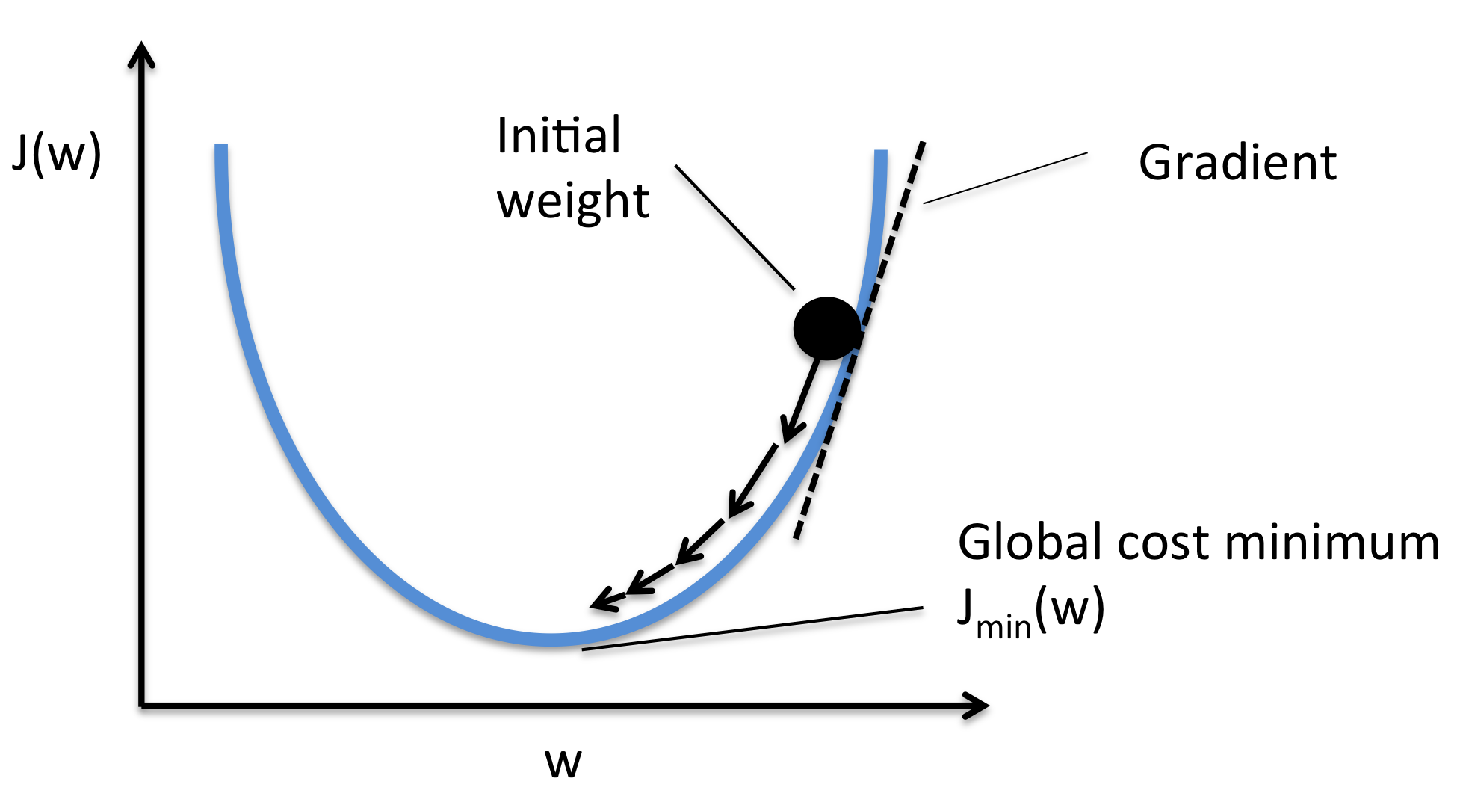
Gradient Descent
Since gradient vector gives me direction of steepest increase, we should go in the reverse direction to get lower function value
Update :
where
For each element, we have
Works well when you have convex functions, guaranteed to reach global minima

Slide 6
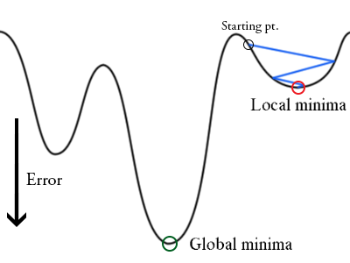
Gradient Descent
What happens when function is non-convex ?
Ohh no ! Algorithm gets stuck in local minima
Till now, you have applied gradient descent on convex functions, today we will apply it on non-convex problem

Slide 7




A different view of LMS
For d^{th} example
Define error
Perform gradient descent updates
x1
Each input xi is connected to
a unit (blue circle) by weight wi
w1
x2
w2
Think of the input to unit from i^{th}
connection to be wi xi
od
wn
The unit (blue circle) is summing
all these inputs and outputting the
sum
xn

Slide 8
Expressivity by Depth
However linear threshold units like last slide can only
deal with linear functions of input x
We now want to learn non-linear functions of the input. You already know some methods to learn non-linear functions of the input. Can you name them ?
Decision trees, kernels
Neural networks another way of doing that, stack several
layers of threshold elements, each layer using the output of the previous layer as input

Slide 9






Basic Unit : Neuron
x1
w1
x2
w2
o
wn
xn
Lets define a variable called net
Then we have

Slide 10
Stack them up
x1
o1
x2
ok
Output Layer
xn
Input Layer
Hidden Layer
Feedforward Neural Network

Slide 11
Feedforward Neural Network
x1
7
o1
x2
ok
3
Output Layer
xn
Input Layer
Hidden Layer
Lets number all circles / nodes with number ids.
Connection between node i and node j is denoted as wij , net input to node j is netj , output from node j is xj or oj
Connection (yellow arrow) between node 3 and node 7 is denoted by w37
Output of node 7 is x7 or o7
Net Input to node 7 is net7

Slide 12

Feedforward Neural Network
x1
7
o1
x2
ok
3
Output Layer
xn
Input Layer
Hidden Layer
For k^{th} output node

Slide 13
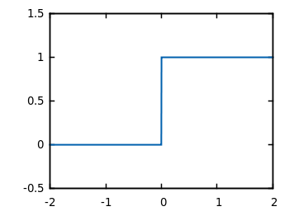
Alternatives
x1
o1
x2
ok
xn
What if we use identity function (like LMS example) instead of sigmoid function for activation ?
Becomes a Linear Model
What if we use step function (like Perceptron) then ?
Non-differentiable, not suitable for gradient descent

Slide 14
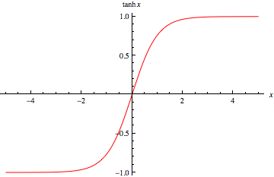
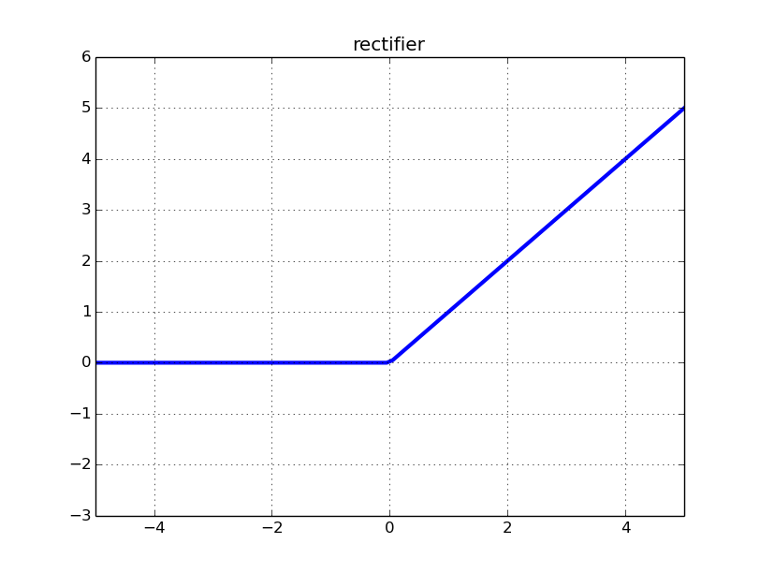
Alternatives
x1
o1
x2
ok
xn
However there are other non-linear differentiable functions you can use
tanh
relu

Slide 15

Error
We will use squared error
Here D is the set of training examples, and K is the set of output units

Slide 16

Remember Gradient Descent
In order to compute
You need to compute partial derivatives w.r.t each element in w above
Whats w here ? What are the parameters of the model you want to train ?
Connection weights wij
Thresholds at each unit Ti

Slide 17









Do you remember derivatives ?
Function
Derivative

Slide 18
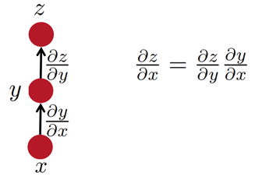
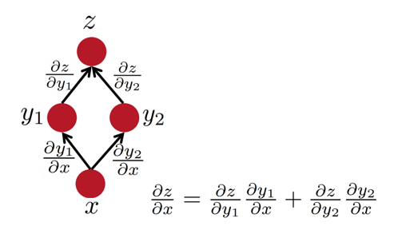
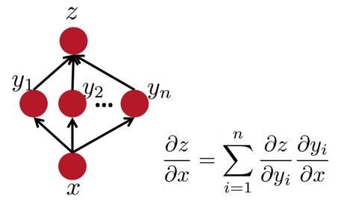
Some facts from real analysis

Slide 19
Reminder : Neuron
x1
w1
x2
w2
o
wn
xn
Lets define a variable called net
you can think of it as net input to a unit
Then we have

Slide 20


Slide 21

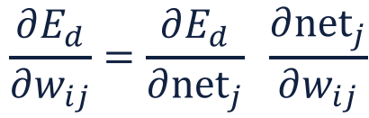
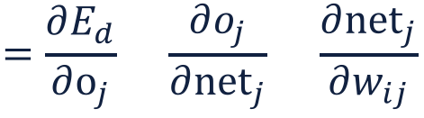


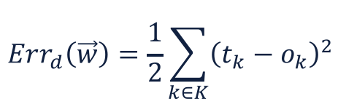
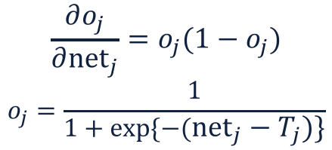

Derivation of Learning Rule
i
j
Connection wij between hidden and output layer (influences output only through netj)
=

Slide 22


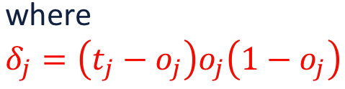

Derivation of Learning Rule
i
j
Connection wij between hidden and output layer is updated as

Slide 23
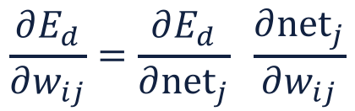
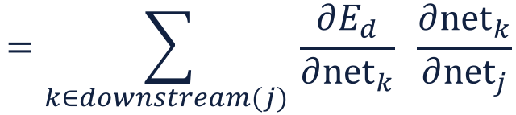
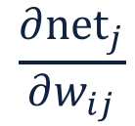
Derivation of Learning Rule
j
i
Connection wij between input and hidden layer (shown in orange)
Influences the output only through those output units which are connected to node j (shown connected by yellow arrows to j )

Slide 24
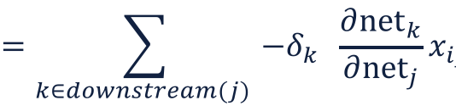

Derivation of Learning Rule
j
i

Slide 25
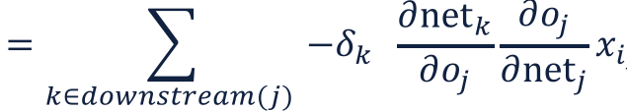
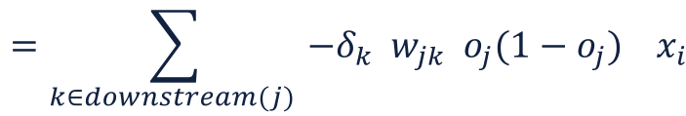
Derivation of Learning Rule
j
i

Slide 26
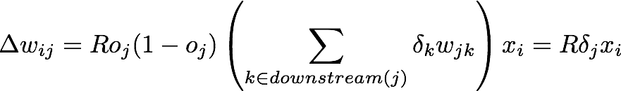
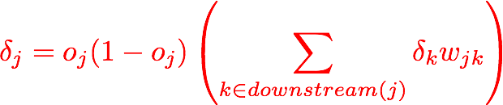
Derivation of Learning Rule
j
i
Connection wij between input and hidden layer is updated as
where
First determine the error for the output units. Then, back propagate this error layer by layer through the network, changing weights appropriately in each layer

Slide 27


The Backpropagation Algorithm
For each example in the training set, do:
Compute the network output for this example
Compute the error term between he output and target values
For each output unit j, compute error term:
4. For each hidden unit, compute error term
5. Update weights by

Slide 28
A few small things
We computed gradient for a single example. So, you can directly use it if you perform stochastic gradient descent
Do you know how to convert this information to gradient descent ?
We only showed updated for connection weights. Do you know how to derive updates for the thresholds T ?
Usually, for neural networks, people use stochastic gradient descent with mini-batches (and not with one example at a time)

Slide 29

Alternatives
You already saw that you can use a lot of other activation functions
You can also use any loss function. The example you saw uses squared loss
Squared loss is actually not that good for neural nets, due to training slowdown.
A better loss function is cross entropy
Exercise : Try to compute its back propagation terms

Slide 30
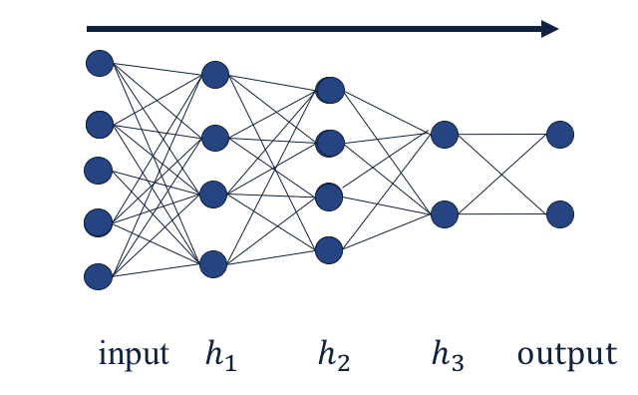
More Hidden Layers
Same algorithm holds for more hidden layers

Slide 31
Deep Learning Libraries
Tensorflow
Torch
Theano
Pytorch
Dynet
They allow automatic
differentiation. You can just
write the network, get the gradients for free.
Lets look at Tensorflow demo

Slide 32
Comments on Training
No guarantee of convergence, may oscillate or reach a local minima
In practice, many large networks can be trained on large amounts of data for realistic problems
Termination criteria : Number of epochs; Threshold on training set error; No decrease in error; Increase error on a validation set
To avoid local minima : several trials with different random initial weights with majority or voting techniques

Slide 33
Over-fitting Prevention
Running too many epochs may over-train the network and result in overfitting.
Keep a held out validation set and test accuracy after each epoch, maintain weights for the best performing network on the validation set, and return it when performance decreases significantly beyond that.
Too few hidden units can prevent the data from adequately fitting the data, too many hidden units lead to overfitting. You can tune to get the best number of hidden units for your task.
Another approach to prevent overfitting : Change error function to include a term for the sum of squares of the weights in the network.

Slide 34
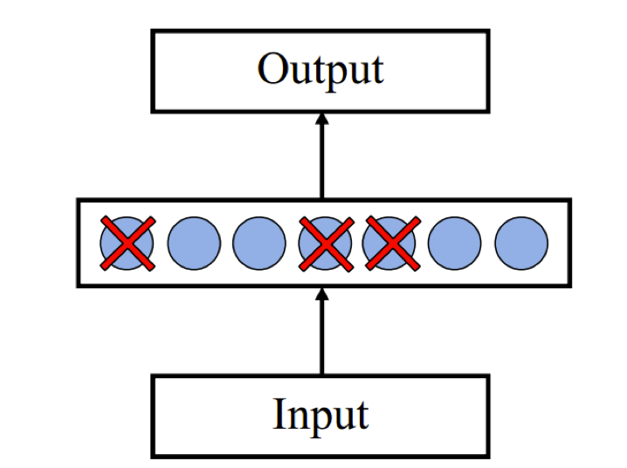
Dropout Training
Proposed by Hinton et al 2012
Each time, decide on whether to delete a hidden unit with some probability p

Slide 35
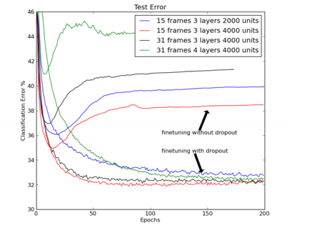
Dropout Training
Dropout of 50% of hidden units, and 20% of input units

Slide 36
Story Time

Slide 37
Some History
Inspired by biological systems, but don’t take this seriously
Computation : McCollough and Pitts (1943) showed how linear threshold units can be used to compute logical functions
Learning Rules
Hebb (1949) suggested that if two units are both active (firing) then the weights between them should increase.
Rosenblatt (1959) suggested that when a target output value is provided for a single neuron with fixed input, it can incrementally change weights and learn to produce the output using the Perceptron learning rule..

Slide 38


Rise and Fall and Rise and Fall of Neural Nets
1959
Rosenblatt’s Perceptron
1969
Minsky and Papert’s book
1986
Backpropagation work
SVM’s and deep nets not being trainable
1995
Hinton’s deep belief net paper
2006
See: http://people.idsia.ch/~juergen/who-invented-backpropagation.html

Slide 39
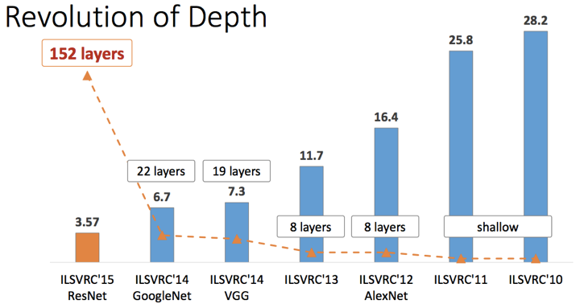
Deep Learning
Object Recognition Performance on Imagenet

Slide 40
Next Class
We will learn about some deep learning architectures

