Slide 1
Neural Networks 2
CS446 Machine Learning

Slide 2
Administrative
HW 5 is out. Due on April 11
No class on Thursday
Slides are released. Try to follow the pdf.
(since these slides are made in keynote, and exporting to ppt does not work well)
Corrections regarding derivative in the last slide

Slide 3
What did we learn in last class ?

Slide 4






Basic Unit : Neuron
x1
w1
x2
w2
o
wn
xn
Note that we can write this as

Slide 5
Stack them up
x1
o1
x2
ok
Output Layer
xn
Input Layer
Hidden Layer
Feedforward Neural Network
This allows us to capture complex non-linear functions of the input data

Slide 6



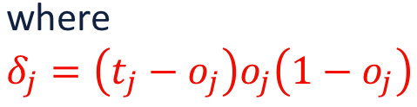

Derivation of Learning Rule
i
j
Connection wij between hidden and output layer is updated as

Slide 7
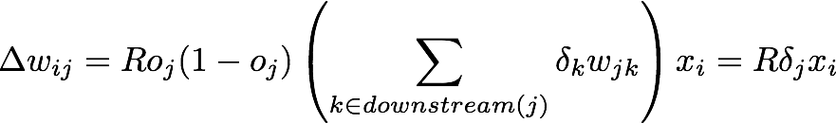
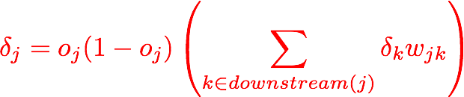
Derivation of Learning Rule
j
i
Connection wij between input and hidden layer is updated as
where
First determine the error for the output units. Then, back propagate this error layer by layer through the network, changing weights appropriately in each layer

Slide 8


The Backpropagation Algorithm
For each example in the training set, do:
Compute the network output for this example
Compute the error term between he output and target values
For each output unit j, compute error term:
4. For each hidden unit, compute error term
5. Update weights by
Questions ??

Slide 9
Today’s Plan
Recurrent Neural Networks
(and applications to NLP)
Convolutional Neural Networks
(and applications to Vision)

Slide 10
Recurrent
Neural Networks

Slide 11
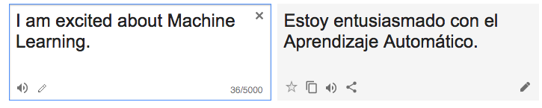
Motivation
Not all problems can be converted into one with fixed length inputs and outputs
Machine Translation : translating English sentence to other language
Speech Recognition : translating spoken sentence to written sentence
Hard or impossible to choose a large enough window, there can always be a new sentence longer than anything seen

Slide 12
Recurrent Neural Networks
Recurrent Neural Networks take as input each element of a sequence one by one. (Think of this as taking input x1 at time step 1, x2 at time step 2, etc)
Recurrent Neural Networks take the previous output or hidden states as inputs.
The composite input at time t has some historical information about the happenings at time T < t
RNNs are useful as their intermediate values (state) can store information about past inputs for a time that is not fixed a priori

Slide 13
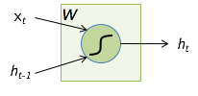

RNN cell
Input at time t is xt
State at the end of time (t-1) is ht-1
State at the end of time t is ht
You can obviously replace tanh by your favorite non-linear differentiable function
How is it different from a standard neuron ??

Slide 14



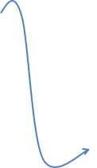


Feeding a sequence to an RNN
You can output yt at each time step (based on your problem), based on ht
often linear function of ht
Finally define error Et based on yt and the target output at time t
GTt is target at time t

Slide 15
RNNs
Note that the weights are shared over time
Essentially, copies of the RNN cell are made over time (unrolling/unfolding), with different inputs at different time steps

Slide 16
Sentiment Classification
Classify a restaurant review from Yelp or movie review from IMDB as positive or negative
Inputs : Multiple words, one or more sentences
Outputs : Positive or negative classification
“The food was really good”
“Don’t try the pizza, its so good you will come back everyday. I hate this place. ”

Slide 17
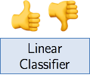
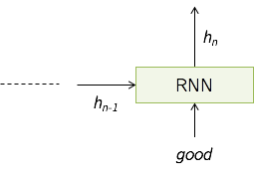
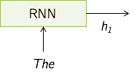

Sentiment Classification

Slide 18
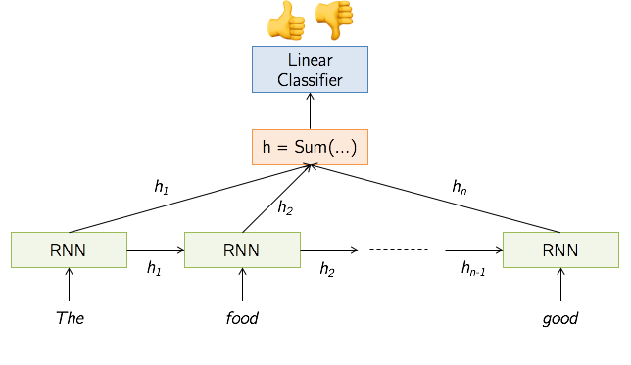

Sentiment Classification

Slide 19




Input Output Scenario
Feed-forward network
Image captioning
Sentiment classification
Translation

Slide 20
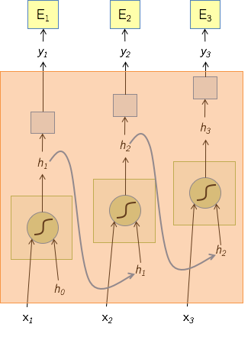
Backpropagation though Time
Treat the unfolded network as one big feed-forward network
This unfolded network accepts the whole time series as input
The weight update is computed for each copy in the unfolded network, then summed (or averaged) and then applied to RNN weights

Slide 21
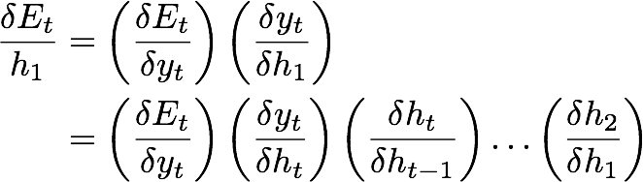

An Issue With RNNs
Recall, back propagation requires computation of gradients with respect to each variable. For RNNs, consider the gradient of Et with respect to h1
Product of a lot of terms can shrink to zero (vanishing gradient) or explode to infinity (exploding gradient). Exploding gradients are often controlled by clipping the values to a max value. One way to handle vanishing gradient problem is to try to have some relationship between ht and ht-1 such that each
Long Short Term Memory (LSTM) try to do that, but vanishing gradients still a problem. As a result, capturing long range dependencies is still challenging.

Slide 22
Summary
RNNs allow for processing of variable length inputs and outputs by maintaining state information across time steps
Various input / output scenarios possible (Single / Multiple)
Exploding gradients are handled by gradient clipping, LSTMs are a way towards handling vanishing gradients.
You can read more about LSTMs at http://arunmallya.github.io/ . A major part of RNN slides were taken from there.
Questions ??

Slide 23
Convolutional
Neural Networks

Slide 24
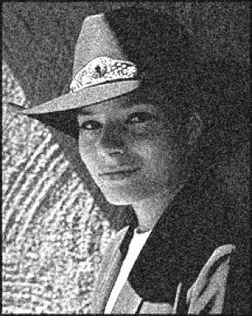
Motivation
Grayscale Image is rectangular matrix of pixel values (intensity values)
How to remove the noise in the photograph ?
This picture and many others taken from slides of Prof. Lana Lazebnik

Slide 25
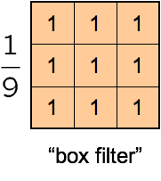
Moving Average
Lets replace each pixel with a weighted average of its neighborhood
The weights are called the filter kernel
What are the weights for the average of a 3 * 3 neighborhood ?
For each pixel p, place this matrix with the pixel p at the center. Perform point wise multiplication of matrix with pixel values, and average them. Make this the new value of pixel p.

Slide 26


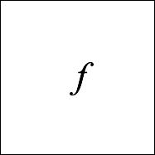
Convolution
Let f be the image and g be the kernel. The output of convolving f with g is denoted f*g
Convention: kernel is flipped

Slide 27
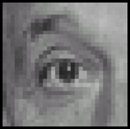
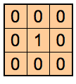
Practice with Linear Filters
Original
Filtered (No change)

Slide 28
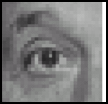
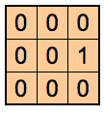
Practice with Linear Filters
Original
Shifted left by 1 pixel

Slide 29
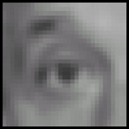
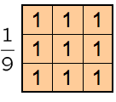
Practice with Linear Filters
Original
Blur (with a box filter)

Slide 30
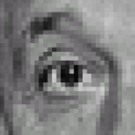
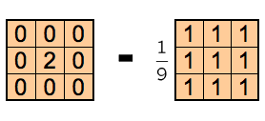
Practice with Linear Filters
Original
Sharpening filter - increases differences with local average

Slide 31
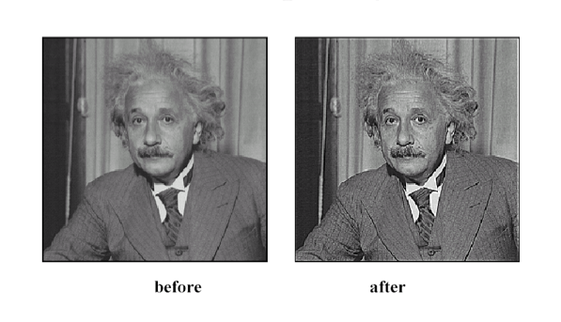
Sharpening Filter
Filters can be used for sharpening, edge detection and extracting many other properties. See https://en.wikipedia.org/wiki/Kernel_(image_processing) for more examples.
Main idea behind Convolutional Neural Networks: use learned filters

Slide 32
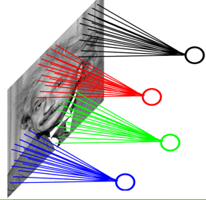
Convolution Layer
Each local region of the image is connected to a node in the next layer
Weights are shared. Distribution of weight in the red connections will be the same as the weight distribution of the green connections, and so on, because they represent the same filter.
Much less number of parameters than fully connected layers we saw in last class

Slide 33




Convolution Layer
You can also use multiple filters on your image, all of them will be learnt
You can add non-linearity at the output of a convolutional layer

Slide 34
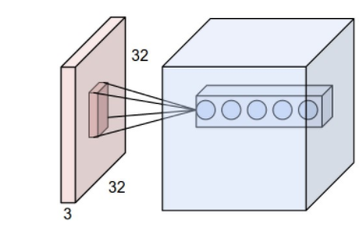
Convolution Layer
Colored images have 3 channels for RGB, so the input is a 3D matrix instead of 2D matrix. How to compute convolution there ?
You will now need to perform 2D convolution with a 3D filter / kernel matrix. The third dimension of the filter matrix has to match the number of channels.
Each neuron in the convolutional layer is connected only to a local region in the input volume spatially, but to the full depth (i.e. all color channels).
Questions ??

Slide 35
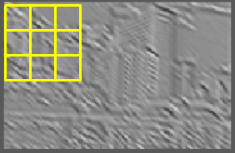
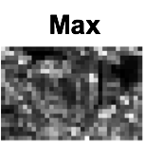
Pooling Layer
Look at each window and compute max value
Function is to progressively reduce the spatial size of the representation to reduce the amount of parameters and computation in the network, and hence to also control overfitting
You can use other functions for pooling, like average, L2 norm, etc. but max is the most popular now

Slide 36
Some Facts
Both the convolutional layer and the pooling layer can reduce the size of the input. How ?
Stride : You do not have to apply filter to each consecutive pixel. You can only apply filter once every 2 pixels (stride = 2), etc.
Usually convolution layers use stride of 1, so does not reduce image response size
Pooling layers use stride of 2, halves the height and width of image response.
Deep CNNs usually apply multiple convolution and pooling layers to compute rich features as well as reduce the image/response size

Slide 37
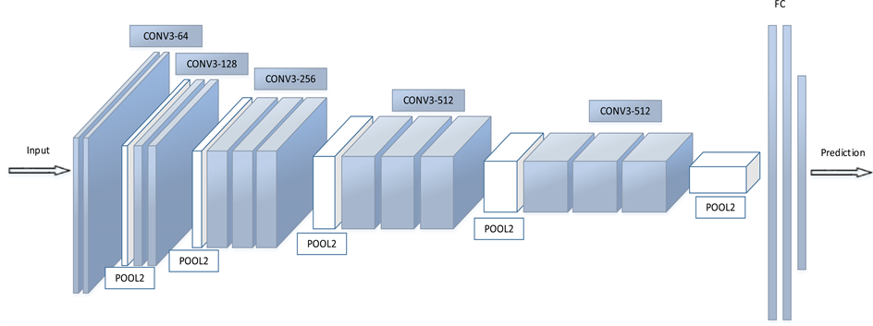
An example: VGG
Thickness of each block corresponds to number of channels of the response / output. Height and width correspond to height and width of response / output.
Think of this as stacking several feature extractors, higher stages compute more global, more invariant features
138 million parameters

Slide 38
An example: VGG
CONV 3-64 : convolutional layer with filters 3*3*(number of input channels), and 64 such filters are used. Each filter output also passed through Relu activation.
Convolutions have stride of 1, so size remains same.

Slide 39
An example: VGG
POOL2 : Max pooling done on windows of 2*2 with stride of 2, so the height, width gets halved
FC : indicates fully connected layer, as you saw in standard feed forward network

Slide 40
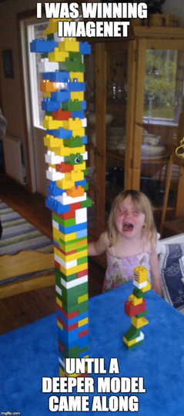
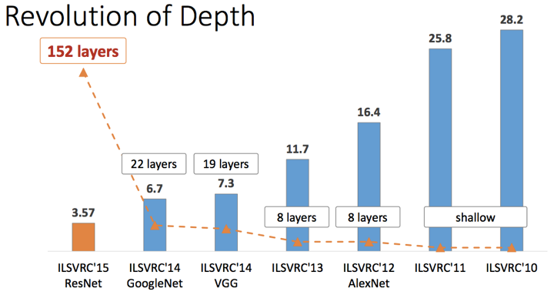
Object Detection Performance
ImageNet Challenge Top 5 error

Slide 41
Summary
Filters are used to extract different properties of an image
Convolution neural networks use multiple layers of learned filters (convolution layers)
Convolution layers used along side pooling layers (eg.VGG net)
Each layer may or may not have parameters (e.g. CONV / FC do, RELU / POOL don’t)

Slide 42
