Slide 1
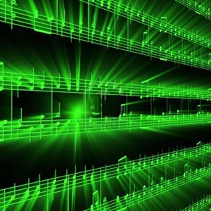


Lecture #1 - Course Introduction / Intro to Digital Audio
ESE 150 –
Digital Audio Basics
Notes:
http://www.startrek.com/watch_episode/lRRlMleoSJ9m
Maybe: https://www.youtube.com/watch?v=RJ314bJVt28 (will need to queue up relevant piece)

Slide 2
Lecture Topics
History & Motivation
  Computing and Digital Audio
Overview of Class Schedule
  Big picture of our class goals
Course Introduction / Goals of Class
  Syllabus; Laboratory; Grading
Week 1: Intro to Sound Waves
  Week by week breakdown of class itself
Summary

Slide 3
History & Motivation
History & Motivation
Short Story / Overview
Course Introduction
Learning Styles
Long Story / Intro to Sound
Summary

Slide 4
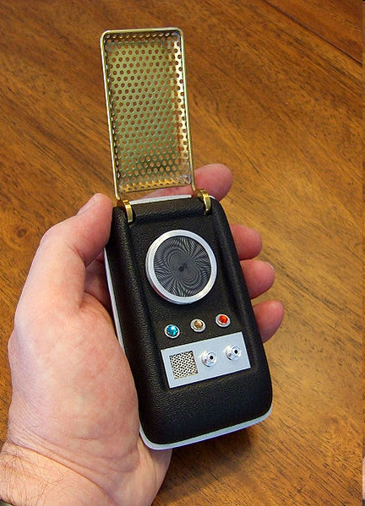
Star Trek Technology
Forward looking Science Fiction
Envisioned many wonderful things
  Warp Drive
  Transporter
  Phasor
  …and a hand-held
  communicator
  Tricorder
  Holodeck (TNG)
  Replicator (TNG)
http://en.wikipedia.org/wiki/File:20090704-1971_StarTrekTOSCommunicatorReplica.jpg

Slide 5
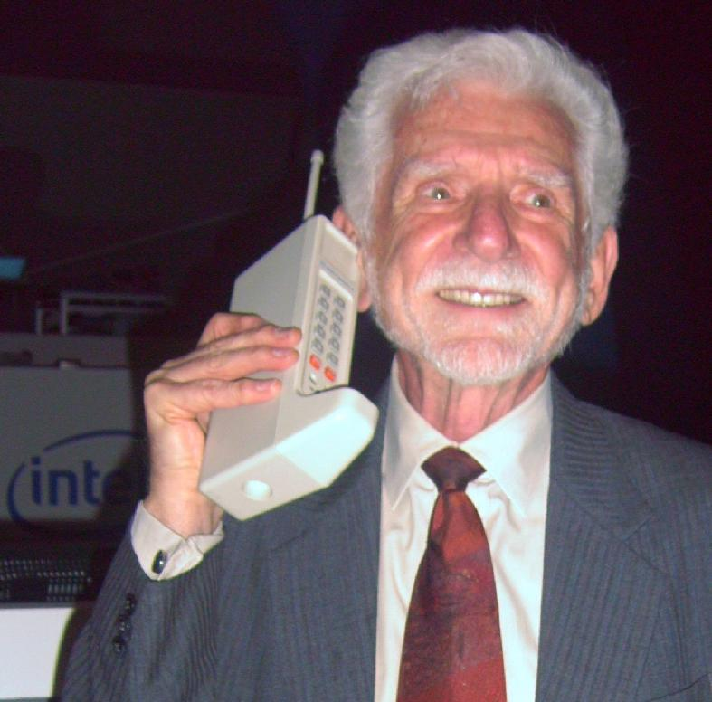
Historical Context: 1966
Star Trek debut
20lb. in-car phone: 1965
  2.5lb. cell phone: Motorola 1973
  Martin Cooper beats AT&T ☺
Long distance was expensive
Computers owned by companies and universities
  20 years after ENIAC, 10 years before Apple
Internet was conceived (but 3 yrs to first node)
Cameras used film
Beatles release “Yesterday and Today” on LP
  And you had to go to a record store to buy it
One year after Gordon Moore hypothesized his famous “Law”
http://en.wikipedia.org/wiki/File:2007Computex_e21Forum-MartinCooper.jpg

Slide 6
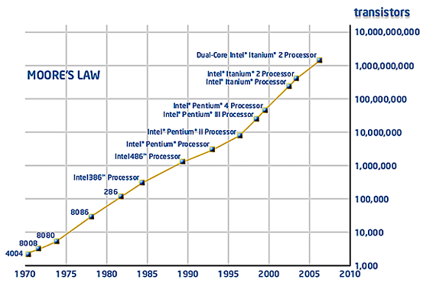
Things were brewing…
Moore’s Law: Every 18 months, size of transistor will be halved
  Who cares?
    In same area, can fit twice as many transistors, twice the computing power!
    Also, generally: if you make a transistor smaller, it gets a bit faster

Slide 7
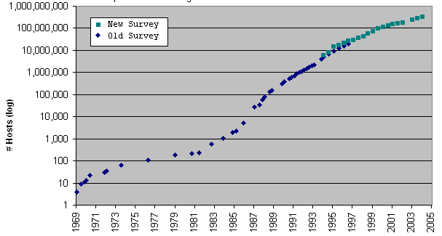
Things were brewing…
Moore’s Law
Internet Grew
Copyright ©2006 Robert H Zakon
http://www.zakon.org/robert/interview/timeline

Slide 8
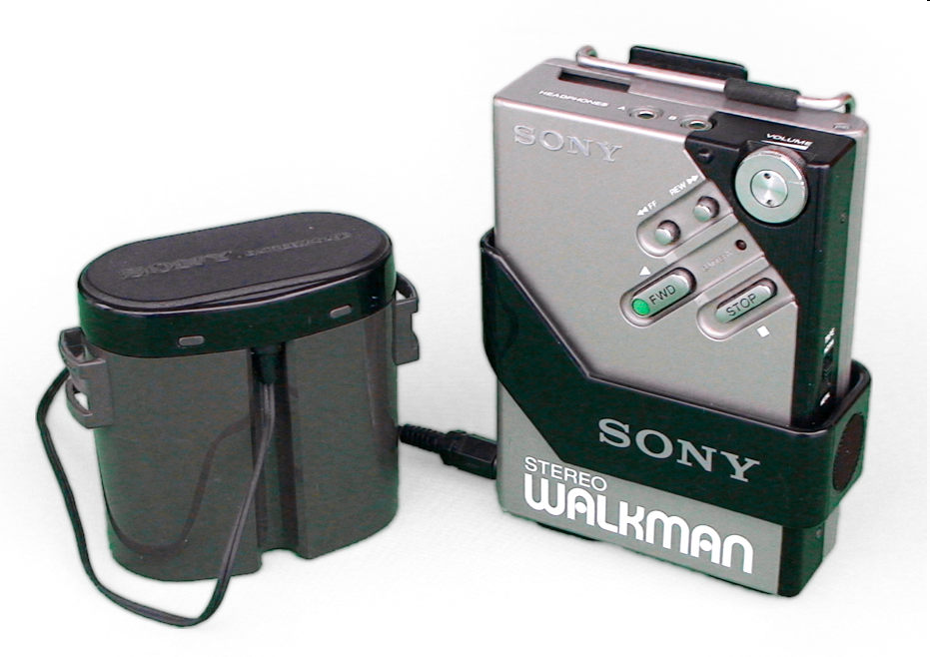
Things were brewing…
Moore’s Law
Internet Grew
Personal Stereo
  Sony Walkman 1979
  AT&T licenses transistor to Sony in 1955
http://en.wikipedia.org/wiki/File:Sony_Walkman_WM-2.jpg

Slide 9

Things were brewing…
Moore’s Law
Internet Grew
Personal Stereo
  Sony Walkman 1979
Compact Discs 1982
  700MB, 80 minutes music
http://en.wikipedia.org/wiki/File:Compact_disc.svg

Slide 10
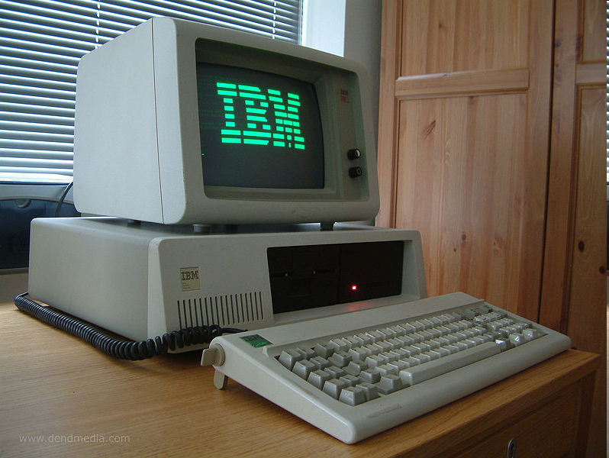
Things were brewing…
Moore’s Law
Internet Grew
Personal Stereo
  Sony Walkman 1979
Compact Discs 1982
  700MB, 80 minutes music
IBM PC/XT 1983
  10MB Hard Disk
http://en.wikipedia.org/wiki/File:Ibm_px_xt_color.jpg

Slide 11
Poll
How many of you have:
  Cell phone ?
  Digital Music Player (separate from phone?)
  Digital camera (separate from phone?)
Use GPS?
How do you obtain music?
Communicate with friends outside of school?
  Voice phone, e-mail, text message, facebook, skype?
Where do you go to find answers?
  Google

Slide 12
In your lifetime…
1998: Google, First commercial MP3 player
2001: iPod, Wikipedia launched
2003: iTunes launched, Skype released
2004: Facebook launched
2005: YouTube launched
2006: Twitter launched
2010: Instagram
2011: Siri, Snapchat, Google driverless cars, Uber
2012: Makerbot Replicator
2013: Google Glass
2015: iWatch

Slide 13
Cool Stuff of Today…
Today’s “must have” technology is:
  computerized, networked, and based on digital media
Cell phones - smaller than ST Communicator
MP3 players (Digital Audio Players) - make walkman bulky
  Internet enabled
Digital cameras and video recorders (part of phones!)
Realistic Video Games
Integrated (e.g. iPhone, iPad)
DVRs (e.g. TiVo)
E-book readers (e.g. Kindle)
3D printers (e.g. Makerbot)
  Circuit Scribe – draw actual circuits, electric ink!
  Replicator…
Augmented Reality (e.g. Jedi Challenge,Pokemon-Go)
  Holodeck…
What else
add to this list?

Slide 14
What do these things involve?
Computation
Communications
Hardware
Substantial software
➔ Products of Computer Engineers

Slide 15

Changing World: Small World
Ubiquitous Internet
  This changed everything
  Smartphone let us carry Internet with us
Facebook
  Allowed us instantly find anyone!
  United the world in many ways

Slide 16
Changing World: Easy Sharing
Easy Instant sharing and storage
Photos, videos, writing
Web, Facebook, Youtube, Blogs
Backed up, Cloud
Accessible anywhere in the world
Indexed and searchable
Can carry it with you

Slide 17
Changing World: Instant Gratification
Search engines
  Instant access to knowledge
iTunes
  Instant access to music/casts/apps/video too
Streaming video
  Instant access to video/news/visual information
  Internet services/Netflix/On-Demand/etc.
Amazon.com
  Instant access to nearly any product, ~drone delivery!

Slide 18
Changing World: New Wealth, New Players
Microsoft founded 1975
  World’s richest man…for a while
Apple founded 1976
  Highest valued company
Oracle 1977
CISCO 1984
NVIDIA 1993
Amazon.com 1994
  New world’s richest man…
E-Bay 1995
Google 1998
Facebook 2004
Twitter 2006
Bitcoin 2009

Slide 19
Convergence
Big Ideas and Advanced Technology
  Digitize Everything
  Cheap Digital Processing
  Cheap Storage
  Cheap Digital Bandwidth

Slide 20
Enabled by Visionary Engineers
Hard work, inspiration, and competition
  …would not have just happened
  Certain applications/products tie many things together
    No one realized facebook/music would be “killer app” for smartphone revolution
Most inconceivable just prior
  Compare how archaic the “future” looks in most movies just 20 years old
What’s next?
How can we harness to make the world better?

Slide 21
Short Story
History & Motivation
Short Story / Overview
Course Introduction
Learning Styles
Long Story / Intro to Sound
Summary

Slide 22
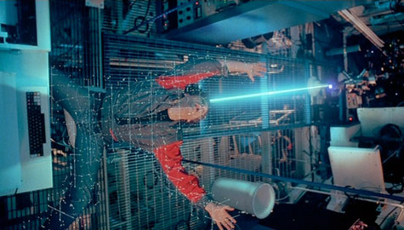

Virtualization of the World
Can represent things as bits
  sound, pictures, movies
  location, situation, …
  shapes, circuits, drugs, DNA
Cheap/powerful ways to
automatically manipulate
  …and reproduce

Slide 23



Class Story: One Slide
domain
conversion
Compress
sample
freq
pyscho-
acoustics
Sound can be converted to/from bits
  and compressed, without loss of information
More information can be discarded without humans noticing → fewer bits
Process this information with inexpensive machines
  Store it for retrieval
Send it between machines
  Even if not directly connected

Slide 24
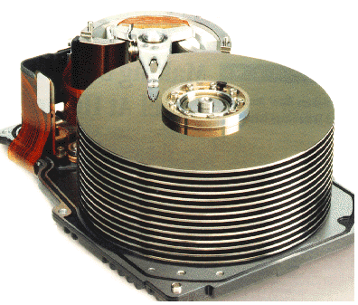







Course Map
7,8,9
10101001101
MIC
CPU
File-
System
A/D
10
10101001101
NIC
Music
1
domain
conversion
5,6
Numbers correspond to course weeks
compress
sample
freq
pyscho-
acoustics
3
2
4
13
11
EULA
----------------click
OK
D/A
NIC
speaker
MP3 Player / iPhone / Droid
12

Slide 25
Course Introduction
History & Motivation
Short Story / Overview
Course Introduction
Learning Styles
Long Story / Intro to Sound
Summary

Slide 26
About the Course
ESE 150: Digital Audio Basics
  But really: “Introduction to Computer Engineering”
Our Goals:
  Deliver 13 lectures on 13 topics in Comp. Eng.
    Each lecture…maps to nearly 13 different courses!
  Expose you to the big topics in Comp. Eng.
    You won’t like them all…but you will probably love 1 or 2!
    Help you figure out which path in Comp. Eng. to take
  Use digital audio as common theme between lectures
    This information goes way beyond digital audio
  Tie theory to practice (“feel-the-bits”) through a weekly lab
    To see concepts discussed in lecture in a lab environment
    Labs are not perfect, connections sometimes not obvious at first
      You might think lab is “stand-alone”…not really true!

Slide 27
The Big Picture…
    Computer Engineering
      very large field of engineering
    Seeing the top 13 ideas…through the guise of digital audio
      helps you see the big picture of comp. eng.
    We want you to see the “big picture” of comp eng.
      before taking a lot of unnecessary courses
    Miss one lecture…miss a lot!
      Common complaint…I don’t need lecture to succeed in lab
        You might be right! … but it should make it more meaningful.
    Help us help you…
      If you don’t see how lecture/lab fit together, tell us!! Help us improve course

Slide 28
Mechanics of the Class
Wednesday: Lecture
  Introduce theory
  Help paint the big picture
Monday: Lab
  Put theory into practice
  Apply 1 big concept in real world
    Many concepts may appear in lecture…
    One will be put to use in guise of digital audio in the lab
  Work in teams of 2
  Individual lab report write-ups
Friday: Lab Report due
  (except formal one – Sunday)

Slide 29
Grading
10% - Class Participation and Quizzes (if necessary)
  Based on assigned reading material
50% - Weekly Lab Report Writeup
  Work in groups of 2 (we assign and mix up week-to-week)
  Some labs may have “prelab” work to do – counted as part of lab writeup
  Drop lowest score on attempted labs
20% - Formal Lab Report
5% - Midterm Exam
  Warmup for final
15% - Final Exam
  Based on reading material, lecture material, lab work
Read web page for policies
  Not hard, but must show up, engage, do the work

Slide 30
Components
Lecture slides online morning of lecture
Big Idea – 1p’er for every lecture
Reading
Preclass – available beginning (ideally 4:25pm)
  Work through to get you thinking about the topic
  …and gives you some of the questions will ask in lecture
“Warm” Calls
  Promote interaction/engagement
Feedback sheets
  Turn in at end of lecture
  Help me tune lecture for class

Slide 31
Class Goals
Provide digital audio background for ESE350
  …build an actual digital audio platform
Context and motivation for CMPE major
Appreciate how CMPE, EE, CIS:
  Work together
  How they impact today’s world
Start thinking like an engineer!

Slide 32
Outcomes
Able to conduct experiments
  Psychoacoustic, network, hardware
Able to optimize information encoding
Able to design file system for multiple views
Able to quantify quality vs. size tradeoffs in audio
Able to use oscilloscope, matlab, arduino
Able to write formal lab report
Understand role of Intellectual Property
Appreciate User Interface design
Understand technology enables new capabilities

Slide 33
Learning Styles
(interlude)
History & Motivation
Short Story / Overview
Course Introduction
Learning Styles
Long Story / Intro to Sound
Summary

Slide 34
How do people come out?
Create Histogram
How I came out…
Count numbers by students:
  Bin: 9+, 8-4, 3-1, 0, 1-3, 4-8, 9+
Histograms:
  Active/Reflective
  Sensing/Intuitive
  Visual/Verbal
  Sequential/Global

Slide 35
Dimensions
Active (ACT) vs. Reflective (REF)
  Doing vs. thinking
Sensing (SEN) vs. Intuitive (INT)
  Facts and methods vs. abstractions and innovation
Visual (VIS) vs. Verbal (VRB)
  Pictures, diagrams vs. descriptions
Sequential (SEQ) vs. Global (GLO)
  Linear steps vs. context and connections
http://www4.ncsu.edu/unity/lockers/users/f/felder/public/ILSdir/styles.htm

Slide 36
Active vs. Reflective
Active learners tend to retain and understand information best by doing something active with it
  "Let's try it out and see how it works" is an active learner's phrase
Reflective learners prefer to think about it quietly first.
  "Let's think it through first" is the reflective learner's response.
Active learners tend to like group work more than reflective learners, who prefer working alone.
Sitting through lectures without getting to do anything physical but take notes is hard for both learning types, but particularly hard for active learners.
http://www4.ncsu.edu/unity/lockers/users/f/felder/public/ILSdir/styles.htm

Slide 37
Sensing vs. Intuitive (1 of 2)
Sensing learners tend to like learning facts
Intuitive learners often prefer discovering possibilities and relationships.
Sensors often like solving problems by well-established methods and dislike complications and surprises;
Intuitors like innovation and dislike repetition.
Sensors are more likely than intuitors to resent being tested on material that has not been explicitly covered in class.
http://www4.ncsu.edu/unity/lockers/users/f/felder/public/ILSdir/styles.htm

Slide 38
Sensing vs. Intuitive (2 of 2)
Sensors tend to be patient with details and good at memorizing facts and doing hands-on (laboratory) work
Intuitors may be better at grasping new concepts and are often more comfortable than sensors with abstractions and mathematical formulations.
Sensors tend to be more practical and careful than intuitors;
Intuitors tend to work faster and to be more innovative than sensors.
Sensors don't like courses that have no apparent connection to the real world;
Intuitors don't like "plug-and-chug" courses that involve a lot of memorization and routine calculations.
http://www4.ncsu.edu/unity/lockers/users/f/felder/public/ILSdir/styles.htm

Slide 39
Visual vs. Verbal
Visual learners remember best what they see
  pictures, diagrams, flow charts, time lines, films, and demonstrations.
Verbal learners get more out of words--written and spoken explanations.

Slide 40
Sequential vs. Global
Sequential learners tend to gain understanding in linear steps, with each step following logically from the previous one.
Global learners tend to learn in large jumps, absorbing material almost randomly without seeing connections, and then suddenly "getting it.”
Sequential learners tend to follow logical stepwise paths in finding solutions;
Global learners may be able to solve complex problems quickly or put things together in novel ways once they have grasped the big picture, but they may have difficulty explaining how they did it.

Slide 41
Aware of Differences
Differences among people
Differences between faculty and students?
  Claim college courses are biased toward:
    Reflective, intuitive, verbal, sequential
This course:
  Active, sensing?, visual, global
Read explanation
  Being aware and how to cope useful for navigating all your courses at Penn

Slide 42
Long Story
Week 1 & Week to Week
History & Motivation
Short Story / Overview
Course Introduction
Learning Styles
Long Story / Intro to Sound
Summary

Slide 43

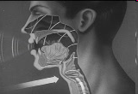
Week 1: Introduction to Sound
Sound is a pressure wave
http://www.archive.org/details/SoundWavesAn

Slide 44
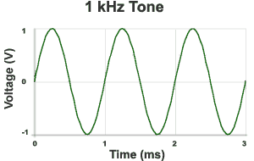

Week 1: Introduction to Sound Waves
Recall from Math: Hertz (Hz) = 1 cycle per second
1kHz = 1000 cycles/s
Source: http://www.mediacollege.com/audio/01/sound-waves.html

Slide 45



Week 1: Pressure to Voltage
Microphones convert pressure to voltage
  (speakers/headphones voltage to pressure)
Parallel plate capacitor with pressure activated plate
  over short time scale:
    charge (Q) is conserved (not changing)
    if d changes, what happens to C?
    and when C changes, Q holds, what happens to V?
V
$$C∝\frac{A}{d}$$
d
$$V=\frac{Q}{C}$$
$$Q=CV$$
      Δd → ΔC → ΔV
Notes:
Δd → ΔC → ΔV

Slide 46
Course Map
10101001101
MIC
CPU
File-
System
A/D
10101001101
NIC
Music
domain
conversion
compress
sample
freq
pyscho-
acoustics
EULA
----------------click
OK
D/A
NIC
speaker
MP3 Player / iPhone / Droid

Slide 47
Course Map: Week 1
MIC
Music
This week: you will do this in the lab!
EULA
----------------click
OK
speaker

Slide 48
Before next slide…Mini-Quiz:
What is a bit (a Binary Digit)?
  Smallest piece of information we can store (on/off)
How many bits in a byte?
  8
Bytes in a Kilobyte?
  2¹⁰ x 1 byte = 1024 bytes
Bytes in a Megabyte?
  2¹⁰ x 1KB = 1,048,576 bytes
Bytes in a Gigabyte?
  2¹⁰ x 1MB = 1,073,741,824 bytes
How many bits to store a typical song?
Notes:
2010: had no basis to answer this
2012: first 3 (new in 2012) – were all over… someone says 1000bits in a byte…
still no basis for bits/song

Slide 49
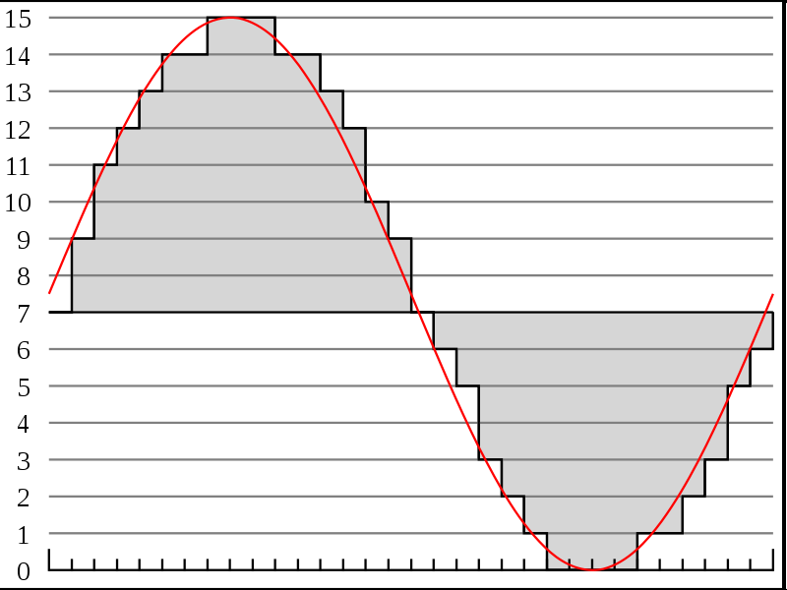
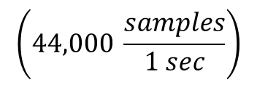
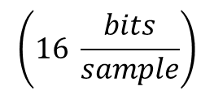



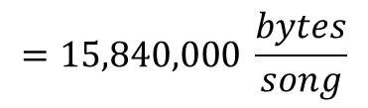
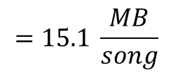
Week 2: Discrete Sampling
http://en.wikipedia.org/wiki/File:Pcm.svg
Discrete
Voltage
Levels
http://en.wikipedia.org/wiki/File:Compact_disc.svg
Voltages can be sampled discretely
  Both in time and amplitude
Can turn sound wave into sequence of bits
  0111 1001 1011 1100 1101 1110 1110 1111 1111 ….
What precision do we need?
  Compact Disks: 16bits at 44KHz
    How many bits is a typical 3-minute song?
$$=\text{126}\text{,}\text{720}\text{,}\text{000}\frac{bits}{song}$$
$$\left(44,000 \frac{samples}{1 sec}\right)$$
$$\left(16 \frac{bits}{sample}\right)$$
$$\left(60 \frac{sec}{1 min}\right)$$
$$\left(3 \frac{min}{song}\right)$$
$$=15,840,000 \frac{bytes}{song}$$
$$=15.1 \frac{MB}{song}$$
Notes:
44,000/s x 2B x 3 m x 60s/m
15,840,000 Bytes
15.8 MB or almost 128Mbits

Slide 50
Course Map
7,8,9
10101001101
MIC
CPU
File-
System
A/D
10
10101001101
NIC
Music
1
domain
conversion
5,6
Numbers correspond to course weeks
compress
sample
freq
pyscho-
acoustics
3
2
4
13
11
EULA
----------------click
OK
D/A
NIC
speaker
MP3 Player / iPhone / Droid
12

Slide 51
Course Map: Week 2
MIC
A/D
Music
1
Numbers correspond to course weeks
sample
2
EULA
----------------click
OK
D/A
speaker

Slide 52
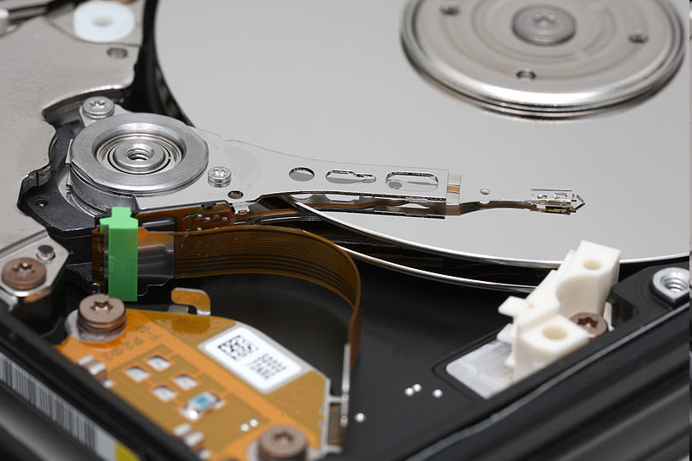
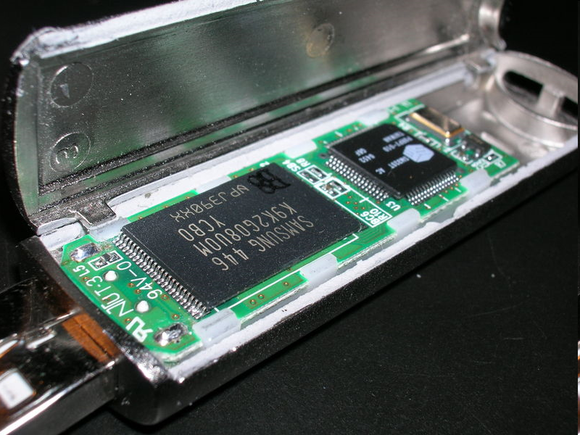
Digital Storage (week 10)
Record bits to non-volatile memory
  Store and reproduce sound
Media: CD, Hard Disk, Flash
http://en.wikipedia.org/wiki/File:Compact_disc.svg
http://en.wikipedia.org/wiki/File:DSCN0411.JPG
http://en.wikipedia.org/wiki/File:Hard_disk_platters_and_head.jpg

Slide 53
Calculating Capacity
How many songs can we fit on a CD?
  How many MB can a CD hold?
    650 MB (for Data)
    About 780 MB (for Audio)
  If 3 minute song = 15.1 MB…
    1 minute audio ~ 5.04MB
    But, we record in stereo: (R/L)
      5.04 MB x 2 = 10.07 MB per minute
    780 MB / 10.0 MB per minute ~ 78 minutes
How much memory does your MP3 player have?
  Given unit of information to store, we can architecture storage!

Slide 54
Course Map
7,8,9
10101001101
MIC
CPU
File-
System
A/D
10
10101001101
NIC
Music
1
domain
conversion
5,6
Numbers correspond to course weeks
compress
sample
freq
pyscho-
acoustics
3
2
4
13
11
EULA
----------------click
OK
D/A
NIC
speaker
MP3 Player / iPhone / Droid
12

Slide 55
Course Map: Week 10
10101001101
MIC
File-
System
A/D
10
Music
1
Numbers correspond to course weeks
sample
2

Slide 56
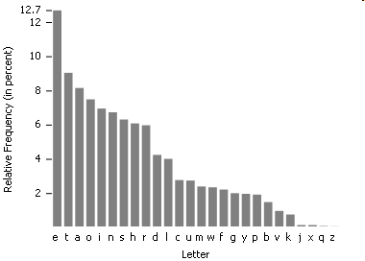
Week 3: Lossless Compression
Enables: Kindle to store 1500 books in 2GB, SMS text
http://en.wikipedia.org/wiki/File:English-slf2.PNG
Statistics of data allow compression
If all symbols (characters, voltages) aren’t equally likely,
  Can assign shorter bit sequences to most common cases
  and reduce bits required to store or transmit!
Famous Example of statistical storage: Morse Code:
THE = — ● ● ● ● ● = 6 symbols (not 18 as you might expect)
Notes:
Where does 18 come from?
Morse Code: 26 letters, 10 numbers = 36
Since its basically binary rep: 2^6 = 64
For 3 symbols, need :3 * 6 bits = 18 bits

Slide 57
Course Map
7,8,9
10101001101
MIC
CPU
File-
System
A/D
10
10101001101
NIC
Music
1
domain
conversion
5,6
Numbers correspond to course weeks
compress
sample
freq
pyscho-
acoustics
3
2
4
13
11
EULA
----------------click
OK
D/A
NIC
speaker
MP3 Player / iPhone / Droid
2

Slide 58
Course Map: Week 3
10101001101
MIC
File-
System
A/D
10
Music
1
Numbers correspond to course weeks
compress
sample
3
2
speaker

Slide 59
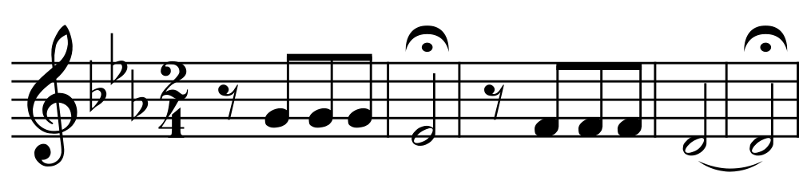
Time-Frequency Conversion
There are other ways to represent
How does the musical staff
representation of sound
differ from time samples?

Slide 60
Week 4: Time-Frequency Conversion
There are other ways to represent
  Frequency representation particularly efficient
392
311
348
294
Frequencies in Hertz
Notes:
G4, E4b, F4, D4

Slide 61
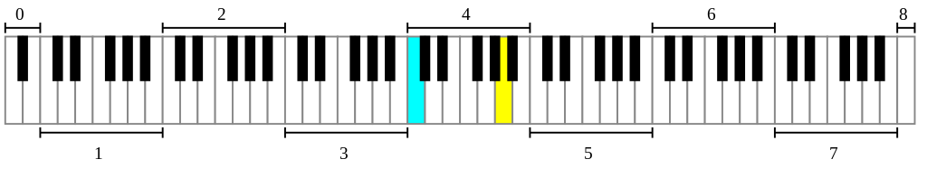
Time-Frequency Conversion
1s / quarter note ➔ 10s of sound
  44K Hz x 16b/sample x 10s = 7040K =7Mbits
How many keys on piano?
  (7b/note+8b/duration) x 7 note = 105 bits?
AlwaysAngry: https://commons.wikimedia.org/wiki/File%3APiano_Frequencies.svg

Slide 62
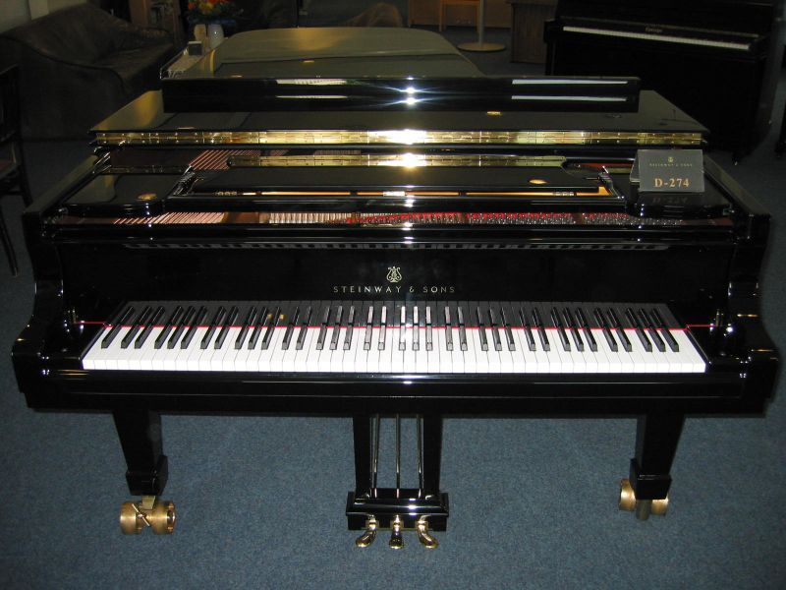
Hamburg Steinway D-274 Piano photo by Karl Kunde
https://commons.wikimedia.org/wiki/File:D274.jpg

Slide 63
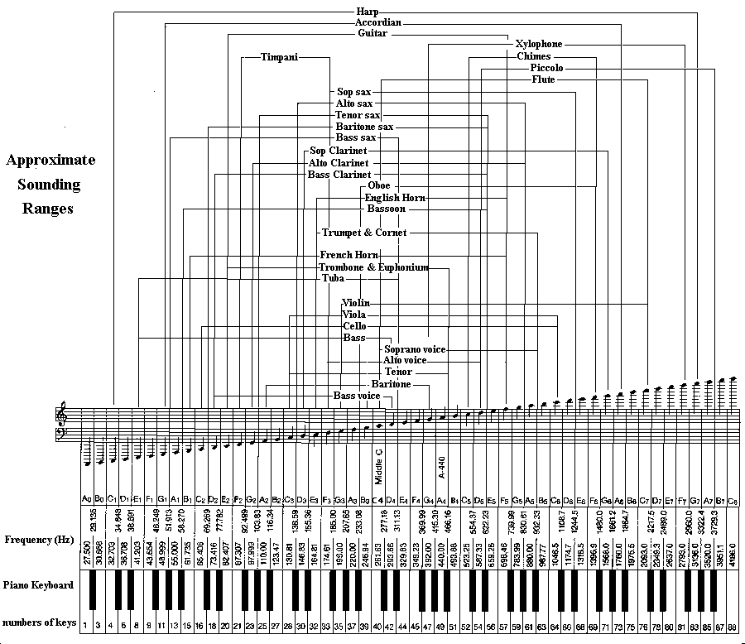
Larry Solomn: http://solomonsmusic.net/insrange.htm

Slide 64
Course Map
7,8,9
10101001101
MIC
CPU
File-
System
A/D
10
10101001101
NIC
Music
1
domain
conversion
5,6
Numbers correspond to course weeks
compress
sample
freq
pyscho-
acoustics
3
2
4
13
11
EULA
----------------click
OK
D/A
NIC
speaker
MP3 Player / iPhone / Droid
12

Slide 65
Course Map: Week 4
10101001101
MIC
File-
System
A/D
10
Music
1
domain
conversion
Numbers correspond to course weeks
compress
sample
freq
3
2
4
D/A
speaker

Slide 66
Week 2: Nyquist-Shannon
Sampling Theorem:
  Only need to sample 2 x maximum frequency component of a signal
Range of human hearing?
  20 Hz -> 20 kHz
How many samples?
  2 x 20 kHz = 40 kHz
CD samples /sec:
  44,000 Samples / sec
http://en.wikipedia.org/wiki/File:Pcm.svg

Slide 67
Course Map
7,8,9
10101001101
MIC
CPU
File-
System
A/D
10
10101001101
NIC
Music
1
domain
conversion
5,6
Numbers correspond to course weeks
compress
sample
freq
pyscho-
acoustics
3
2
4
13
11
EULA
----------------click
OK
D/A
NIC
speaker
MP3 Player / iPhone / Droid
12

Slide 68
Course Map: Week 5
10101001101
MIC
File-
System
A/D
10
Music
1
domain
conversion
Numbers correspond to course weeks
compress
sample
freq
3
2
4
D/A
speaker

Slide 69
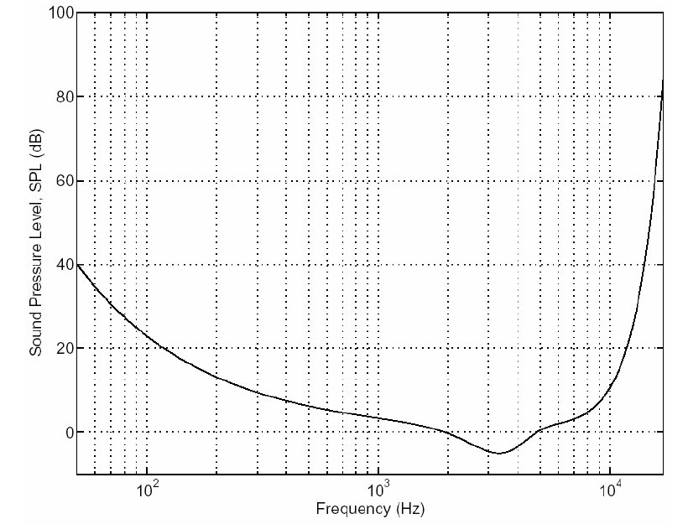
Week 5: Psychoacoustics
The Theory behind MP3
http://www.mp3-tech.org/programmer/docs/mp3_theory.pdf
http://en.wikipedia.org/wiki/File:Pcm.svg
Human input apparatus is limited
If we only care about human perception
  …that reduces the information needed (reduces samples/sec)
Limited maximum frequency

Slide 70
Course Map
7,8,9
10101001101
MIC
CPU
File-
System
A/D
10
10101001101
NIC
Music
1
domain
conversion
5,6
Numbers correspond to course weeks
compress
sample
freq
pyscho-
acoustics
3
2
4
13
11
EULA
----------------click
OK
D/A
NIC
speaker
MP3 Player / iPhone / Droid
12

Slide 71
Course Map: Week 6
10101001101
MIC
File-
System
A/D
10
Music
1
domain
conversion
5,6
Numbers correspond to course weeks
compress
sample
freq
pyscho-
acoustics
3
2
4
D/A
speaker

Slide 72
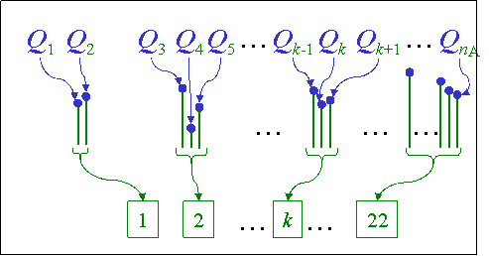
Week 6: Psychoacoustic Compression
MP3 based on putting these together
  Convert to frequencies
  Determine frequencies that don’t matter
  Quantize (fewer than 16b) for less important
Significantly smaller size than raw, sampled bits
Bands
Lossy Coding

Slide 73
Course Map
8,9
10101001101
MIC
CPU
File-
System
A/D
10
10101001101
NIC
Music
1
domain
conversion
6
Numbers correspond to course weeks
compress
sample
freq
pyscho-
acoustics
3
2,5
4
12
11
EULA
----------------click
OK
D/A
NIC
speaker
MP3 Player / iPhone / Droid
13

Slide 74
Course Map: Week 6
10101001101
MIC
File-
System
A/D
10
Music
1
domain
conversion
5,6
Numbers correspond to course weeks
compress
sample
freq
pyscho-
acoustics
3
2
4
D/A
speaker

Slide 75
Week 7: Hardware
CPUs: We’ll look at their operation and architecture
How fast does your laptop or cell phone
run?
Modern chips run 100MHz to 4 GHz
  → only need one multiplier, adder
  Reuse hardware it in time
Notes:
2010: didn’t have a clue about this
…and in 2012 …

Slide 76
Week 8: Hardware
To perform decompression
  For audio playback
Need to perform
  a few million operations
    Operations addition, multiplication
      Calculate cosines
      Scale values
      Add waveforms
  per second of audio
How fast does CPU need
to be to work with audio?

Slide 77
Week 8: iPod
Processor
Early based on PortalPlayer series
  Two ARM7TDMI cores
  80MHz each
Current use ARM7 or ARM8

Slide 78


Week 9: Operating System
This hardware can be virtualized and shared among tasks
  How does OS control hardware?
  Do we need giant OS or small portion for mp3?
App
Dejour

Slide 79
Course Map
7,8,9
10101001101
MIC
CPU
File-
System
A/D
10
10101001101
NIC
Music
1
domain
conversion
5,6
Numbers correspond to course weeks
compress
sample
freq
pyscho-
acoustics
3
2
4
13
11
EULA
----------------click
OK
D/A
NIC
speaker
MP3 Player / iPhone / Droid
12

Slide 80
Course Map: Week 9,10
7,8,9
10101001101
MIC
CPU
File-
System
A/D
10
Music
1
domain
conversion
5,6
Numbers correspond to course weeks
compress
sample
freq
pyscho-
acoustics
3
2
4
D/A
speaker

Slide 81
Week 11: Networking
Bits can be transported between machines
  How fast must network speed to be to stream audio?
  How fast can bits be sent ½ way around earth?
    If c = 300,000 km/s and circumference of earth = 40,075 km
    On an optical fiber, minimum time = 67 ms to go ½ way!
    Speed of light is different in different mediums/equipment is slow too…far slower in reality
Notes:
30ms

Slide 82
Course Map
7,8,9
10101001101
MIC
CPU
File-
System
A/D
10
10101001101
NIC
Music
1
domain
conversion
5,6
Numbers correspond to course weeks
compress
sample
freq
pyscho-
acoustics
3
2
4
13
11
EULA
----------------click
OK
D/A
NIC
speaker
MP3 Player / iPhone / Droid
12

Slide 83
Course Map: Week 11
7,8,9
10101001101
MIC
CPU
File-
System
A/D
10
10101001101
NIC
Music
1
domain
conversion
5,6
Numbers correspond to course weeks
compress
sample
freq
pyscho-
acoustics
3
2
4
11
D/A
NIC
speaker

Slide 84
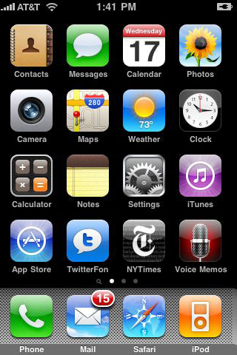
Week 12: User Interfaces
These capabilities can be harnessed by all people
  Not just engineers
…but we must designed for people
  For the non-engineers
iPhone is a classic example:
  product that didn’t do anything new
  BUT, it made everything simple
  thanks to well designed UI

Slide 85
Week 13: Intellectual Property
Who own’s the bits?
What is the law?
Why is the law?
Why should you care (as engineers)?
How is the world changing?

Slide 86
Course Map
7,8,9
10101001101
MIC
CPU
File-
System
A/D
10
10101001101
NIC
Music
1
domain
conversion
5,6
Numbers correspond to course weeks
compress
sample
freq
pyscho-
acoustics
3
13
2
4
11
EULA
----------------click
OK
D/A
NIC
speaker
MP3 Player / iPhone / Droid
12

Slide 87
Summary
History & Motivation
Short Story / Overview
Course Introduction
Learning Styles
Long Story / Intro to Sound
Summary

Slide 88
This course
It is a work in progress:
  Attempts to explain a great deal of Comp Eng
    Without going to far in depth
  Lecture/Lab
    Intent is to tie them together well
    Inevitably, the tie won’t always be obvious
  Help us, help you (and future yous):
    The more feedback you provide, the better we can make this course
    If a tie isn’t obvious, let us help make the connection stronger
    We want you to love Comp Engineering as much as we do ☺
  One form: daily feedback sheets

Slide 89
Changing World
Automated computation changed world
  Faster than we imagined
World being digitized and refitted for computerized control and mediation
  People-to-people, people-to-machines
  Infrastructure from bricks/concrete/steel to networking/computers/software
Enabling new engineering
  Computerization at center
Exciting and dangerous
Computer Engineering at center

Slide 90
Parting Thought
From 1st computer to PCs in 30 years
  Eniac 1946→ Apple 1976
From first PCs to iPhone next 30 years
  Apple 1976→iPhone 2007
What will next 30 years hold?
  Beginning of your career
What will you imagine, create, enable?

