Slide 1
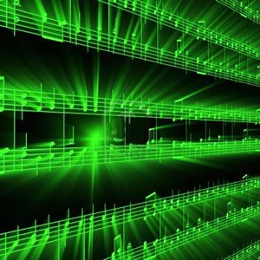


Lecture #1 – A2D, D2A
ESE 150 –
Digital Audio Basics
Notes:
http://www.startrek.com/watch_episode/lRRlMleoSJ9m

Slide 2
Lecture Topics
Where are we on course map?
Sound / Sound Pressure
Sampling & Quantization
Effects of Quantization
Limits of Sampling
System Capacity
Copying vs. Sampling
Summary
References

Slide 3
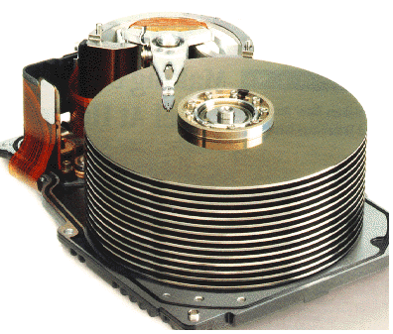










Course Map
7,8,9
10101001101
MIC
CPU
File-
System
A/D
10
10101001101
NIC
Music
1
domain
conversion
5,6
Numbers correspond to course weeks
compress
sample
freq
pyscho-
acoustics
3
2,3
4
13
11
EULA
----------------click
OK
D/A
NIC
speaker
MP3 Player / iPhone / Droid
12

Slide 4
Course Map – Week 2
MIC
A/D
10101001101
Music
1
Numbers correspond to course weeks
sample
2,3
D/A
10101001101
speaker
MP3 Player / iPhone / Droid

Slide 5
What we’ll Do in Lab
D/A
10101001101
speaker
MP3 Player / iPhone / Droid
Microphones / Speaker:
  Convert pressure waves to electric signal (and reverse)
Sound (in nature):
  a “pressure wave” that changes air molecules w/ respect to time
Sound (in our machine):
  a “voltage wave” that changes amplitude w/ respect to time
MP3 player converted digital signal back to an analog signal
  We will look at “voltage wave” on an oscilloscope

Slide 6
Sound Waves

Slide 7

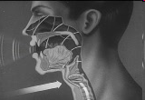
Introduction to Sound
Sound is a pressure wave
http://www.archive.org/details/SoundWavesAn

Slide 8
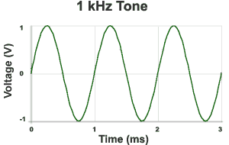

Introduction to Sound Waves
Recall from Math: Hertz (Hz) = 1 cycle per second
1kHz = 1000 cycles/s
Source: http://www.mediacollege.com/audio/01/sound-waves.html

Slide 9



Pressure to Voltage
Microphones convert pressure to voltage
  (speakers/headphones voltage to pressure)
Parallel plate capacitor with pressure activated plate
  over short time scale:
    charge (Q) is conserved (not changing)
    if d changes, what happens to C?
    and when C changes, Q holds, what happens to V?
V
$$C∝\frac{A}{d}$$
d
$$V=\frac{Q}{C}$$
$$Q=CV$$
      Δd → ΔC → ΔV
Notes:
Δd → ΔC → ΔV

Slide 10
Signals

Slide 11
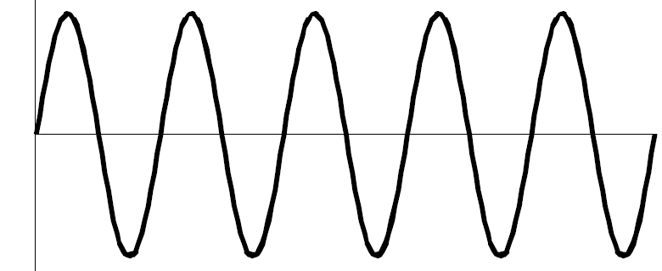
We need to quantify some things
What is a signal?
  Something that carries information
  A description of how one parameter depends on another
    Common Engineering Example:
      Voltage that varies with time
        E.g. Amplitude of voltage changes as time moves forward
      Time = independent variable (x-axis): time
        Depends on nothing!
      Voltage = dependent variable (y-axis): v(t)
        Voltage’s amplitude depends on time
v(t)
time

Slide 12
We need to quantify some things
Most signals encountered in nature…
  …are “continuous” / analog
    Continuous range of values (any real #)
    Examples: 1) Light intensity that changes with distance
    2) Voltage that varies over time v(t)
      We will see in lab this week: MUSIC signal represented with voltage
    3) Chemical reaction rate that depends on temp
  as opposed to “non-continuous” / discrete signals
    Only a discrete range of values possible (limited subset of real #s)
    How a computer must represent signals
      Fundamental unit of information: bit
      Cannot represent all possible real #’s
      Uses binary digit (bit) to represent #’s:
        1-bit, represents 2 things…2-bits, represents 4 things
        What’s the generalization? (n-bits → how many things?)

Slide 13
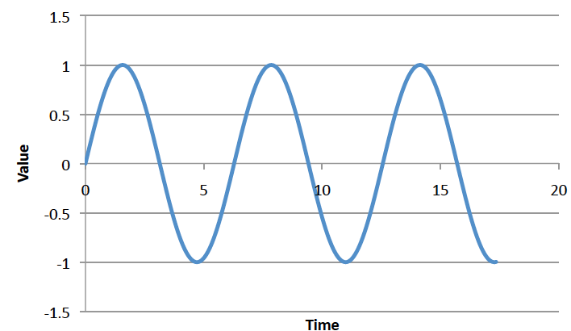
Big Question
How represent and process continuous information on a digital computer with finite memory?
  Note: continuous means signal may take on infinite number of values between any T₁ and T₂
T₁
T₂

Slide 14
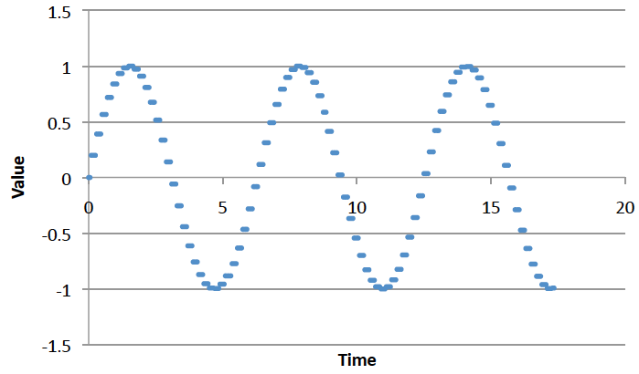
Connect the Dots
Intuition, with enough dots not hard to “connect-the-dots” to reconstruct (understand) the continuous signal.
  What is the continuous signal here? (preclass 3)
  Assumes certain regularity conditions
  What is enough?

Slide 15
Definitions
Analog-to-Digital (ADC) Conversion
  Process of converting continuous signal to discrete signal
  Going from analog to digital “domain”
  Often called: digitization
  Use a subset of real #’s to represent all real #’s
    Involves a lot of approximation (lots of room for error!)
…collecting the dots

Slide 16
Definitions
Digital-to-Analog (DAC) Conversion
  Process of converting discrete signal to continuous signal
  Going from digital to analog “domain”
  Converting “bits” to a continuous waveform
    Our MP3/Music players do this all the time (will do in lab)
(re)connecting
the dots

Slide 17
Sampling & Quantization

Slide 18
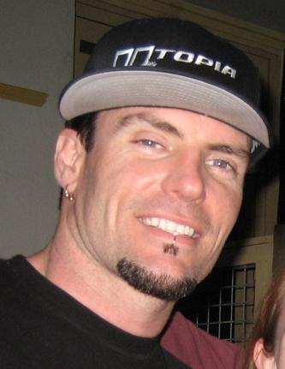
When it comes to music, what is sampling?
When this guy stole a
bassline from David Bowie,
“sampling” became part
of the vernacular…
…but that’s not what we’re
talking about!
Sampling?
No, No Baby

Slide 19
ADC – Sampling & Quantization
Analog-to-Digital (ADC) Conversion
  Converting analog (continuous) signal to digital signal
  Digitization process has two important aspects:
    1) Sampling
      Converting independent variable of signal from continuous to discrete
      e.g.: breaking continuous time down into intervals
    2) Quantization
      Converting dependent variable of signal from continuous to discrete
      e.g.: breaking continuous voltage down into levels

Slide 20
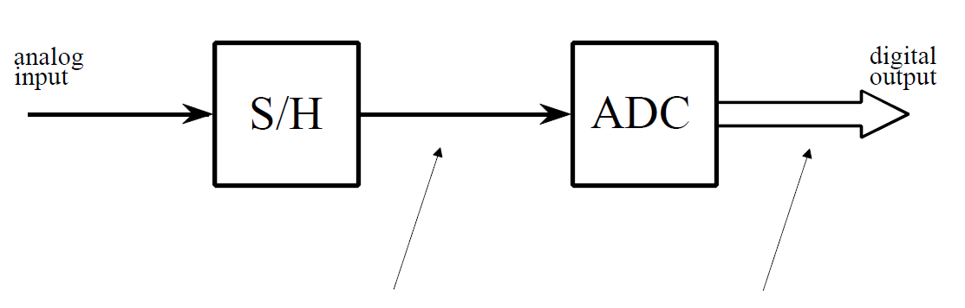
ADC – Broken into two parts
Performs sampling
Performs quantization

Slide 21
Preclass 1 and 2
Frequency of sine wave?
Relationship between period and frequency?

Slide 22

ADC – Sampling
Analog-to-Digital (ADC) Conversion
  Sampling: breaking independent variable (time) into intervals
  Example: Let’s sample our continuous signal @ 1 ms intervals:
Voltage
3
What is our sampling rate?
1000 samples per second
1 kiloSamples / s
time (ms)
1
2
3
4
5
6
7
8
What is frequency of this signal?
$$freq =\frac{1}{period}=\frac{1}{8ms}=125 Hz$$
Spoiler alert:
Relationship between sample rate & frequency!
-3

Slide 23
ADC – Quantization
Analog-to-Digital (ADC) Conversion
  Quantization: breaking dependent variable (voltage) into levels
  Ex: Let’s quantize our range of voltages into 7 levels (1 Volt each)
Voltage
3
2
1
0
time (ms)
1
2
3
4
5
6
7
8
-1
-2
-3

Slide 24
ADC – Sampling & Quantization
Analog-to-Digital (ADC) Conversion
  Let’s collect our samples at the quantized levels
Voltage
Samples:
{ 0 ms, 0 Volts }
3
{ 1 ms, 2 Volts }
2
{ 2 ms, 3 Volts }
1
{ 3 ms, 2 Volts }
time (ms)
{ 4 ms, 0 Volts }
0
1
2
3
4
5
6
7
8
{ 5 ms, -2 Volts }
-1
{ 6 ms, -3 Volts }
-2
{ 7 ms, -2 Volts }
-3
{ 8 ms, 0 Volts }
Notice, we are rounding! Error is inherent in this process

Slide 25
ADC – Digital Conversion / Encoding
Analog-to-Digital (ADC) Conversion
  We’ve converted something continuous into discrete form
  How do we get it to “digital form”? We encode it…(map to another format)
Voltage
Samples:
{ 0 ms, 0 Volts }
3
{ 1 ms, 2 Volts }
2
{ 2 ms, 3 Volts }
1
{ 3 ms, 2 Volts }
time (ms)
{ 4 ms, 0 Volts }
0
1
2
3
4
5
6
7
8
{ 5 ms, -2 Volts }
-1
{ 6 ms, -3 Volts }
-2
{ 7 ms, -2 Volts }
-3
{ 8 ms, 0 Volts }

Slide 26
ADC – Digital Conversion / Encoding
Analog-to-Digital (ADC) Conversion
  We have 7 discrete voltages, # of bits to represent 7 things?
  3-bits! Why? 2^{3-bits} = 8 (1 unused state)
Binary
Encoding:
011
Voltage
Samples:
{ 0 ms, 0 Volts }
110
3
{ 1 ms, 2 Volts }
101
101
2
{ 2 ms, 3 Volts }
110
100
1
{ 3 ms, 2 Volts }
101
011
time (ms)
{ 4 ms, 0 Volts }
011
0
1
2
3
4
5
6
7
8
{ 5 ms, -2 Volts }
001
010
-1
{ 6 ms, -3 Volts }
000
001
-2
{ 7 ms, -2 Volts }
001
000
-3
{ 8 ms, 0 Volts }
011
Encoding: mapping data from one form to another (not always conversion)

Slide 27
ADC – Storing the Data
Analog-to-Digital (ADC) Conversion
  What do we store? Just the encoded bits:
    Our digitized signal: {011, 101, 110, 101, 011, 001, 000, 001, 011}
    It is now discrete & in digital format, store bits in MP3 player!
  Why can we avoid storing the time?
    It’s repetitive! Just store sampling rate: 1 kilo-samples/ sec
    Later, if we wish to restore signal, each “sample” occurred at 1ms
  In this example:
    Sampling rate: 1 k-samples/sec
    Resolution: 3-bits
    Our digitized signal: {011, 101, 110, 101, 011, 001, 000, 001, 011}

Slide 28
ADC – An approximation at Best
Analog-to-Digital (ADC) Conversion
  Continuous analog signal overlaid with discrete digital signal
  At best an approximation of original signal
Voltage
110
3
Ever heard an audiophile complain:
CDs/MP3s/Digital music doesn’t sound
as “real” or as good old records?
Now you know why!
101
2
100
1
011
0
time (ms)
1
2
3
4
5
6
7
8
010
-1
001
-2
000
-3

Slide 29
ADC – Broken into two parts
Performs sampling
Performs quantization
Voltage
Voltage
3
110
3
101
2
100
1
time (ms)
011
0
time (ms)
1
2
3
4
5
6
7
8
1
2
3
4
5
6
7
8
010
-1
001
-2
-3
000
-3

Slide 30
ADC – An approximation at Best
Digital-to-Analog (DAC) Conversion
  Process of converting discrete signal to continuous signal
    How to get back to original signal from bits?
Voltage
110
3
101
2
100
1
011
0
time (ms)
1
2
3
4
5
6
7
8
010
-1
001
-2
000
-3

Slide 31
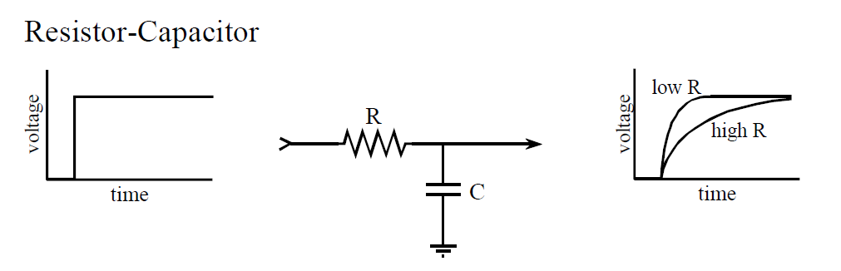
DAC - Filtering
Digital-to-Analog (DAC) Conversion
  What a capacitor does?
  What happens when apply voltage across a resistor/capacitor?
  We call this filtering in EE, (RC delays are everything)
Voltage
110
3
101
2
100
1
011
0
time (ms)
1
2
3
4
5
6
7
8
output circuit of DAC
holds 7 discrete voltages for 1ms
each…applies it to RC filter,
output is “smooth” analog signal
010
-1
001
-2
000
-3

Slide 32
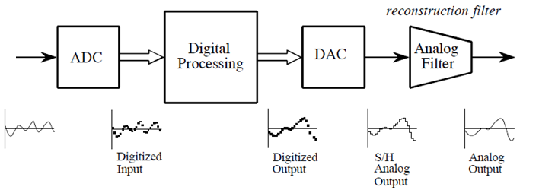
ADC / DAC – The full picture
Analog
Input
Formally:
  Analog input signal that varies with time: s(t)
  Signal processing algorithm to digitize analog input signal: f [s(t)]
  Digitized signal produced by f [ ]: s_{f} (t)

Slide 33
PCM
Quantization & Sampling Technique described:
  Called Pulse-Code-Modulation (PCM)
    Patented in 1943
    PCM process is the ADC process
    Developed for telecommunications

Slide 34
Interlude: 2D Images

Slide 35
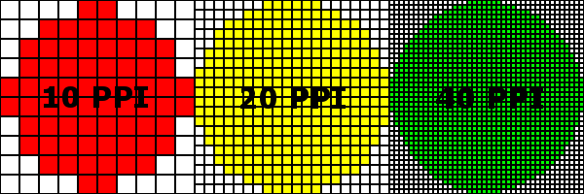
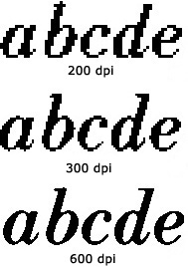
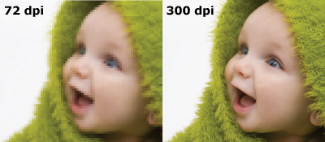
Same phenomena in Images
World continuous
Digital images on projector, TV, paper (even photographs) are discretized – limited resolution
  This projector…
http://www.morefill.com/wpver/wp-content/uploads/2015/08/DPI-abcde.jpg
http://dslrphotographytutorials.com/wp-content/uploads/2014/05/PPI-Compare.png
http://blog.inkjetwholesale.com.au/wp-content/uploads/2015/07/DPI-comparison.png

Slide 36
Apple Retina Display
Why called retina?
Claim (goal): as much resolution as you have in your retina (at typical viewing distance)
We cannot see pixels, because our eyes don’t have any higher resolution
Human eye resolution 0.5 arc-minute (0.02 degrees)
  Around 300 DPI at 20 inches

Slide 37
Effects of Quantization

Slide 38
Quantization Error
In example, quantization algorithm required us to round
  At sample time, t=1ms, input signal was: 2.2V
  It was lower than 2.5V, we rounded down to quantized level of 2.0V
    Side effect of quantization: the introduction of error in digital signal
Voltage
110
3
101
2.2
2.0
100
1
Quantization
Error
011
0
time (ms)
1
2
3
4
5
6
7
8
010
-1
Difference between sampled value
and quantized level
001
-2
000
-3

Slide 39
Quantization Error
How much error?
  In our case, we round up if equal to or above ½ a level…
    …round down if below ½ a level
  Generally, our input signal has 50/50 chance of being above/below
    Error becomes “uniformly distributed”
Voltage
Error
110
3
101
2.2
0.5
2.0
time (ms)
100
1
0.2
011
0
0
1
2
3
4
5
6
7
8
-0.2
1
2
3
4
5
6
7
8
010
-1
001
-2
-0.5
000
-3

Slide 40
Quantization Error / Noise
How much error?
  Looking at the plot of error, looks a lot like random noise
  Sets up a way for us to model quantization error as noisy signal
    Noise due to quantization = sampled signal (red dots) – quantized signal (red line)
    Quantization introduces noise to our sampled signal
Voltage
Error
110
3
101
2.2
0.5
2.0
time (ms)
100
1
0.2
011
0
0
1
2
3
4
5
6
7
8
-0.2
1
2
3
4
5
6
7
8
010
-1
001
-2
-0.5
000
-3

Slide 41
Quantization Error / LSB
“Least Significant Bit”
  How much value is added with each addition of the least-significant bit?
  What is LSB for our example (3V to -3V, 7 levels)?
  Also known as: resolution of ADC
  Quantization error = ± LSB

Slide 42
Quantization Error / Design
Why model quantization error as noise?
There is always noise present
  Wires, electronics, background
  Not gaining much if quantization noise < other noise
Quantization adds noise
  Reduce by increasing sampling, increasing resolution
  More bits → makes more expensive
  Increase until reach desired noise level
    Until other sources dominate quantization noise
SNR = Signal-to-Noise Ratio
  Mean of signal / std. dev. of noise
  Usually what we are optimizing in the system (including ADC)

Slide 43
Limits of Sampling

Slide 44
Sampling
Definition of proper sampling
  If you can exactly reconstruct analog signal from samples,
  you have done the sampling properly
    Essentially: you have captured the key information from the signal to process can be reversed
Milestone of digital signal processing (DSP):
  Nyquist-Shannon Theorem (next week)
    Tells us our sampling rate should be:
      twice the frequency of the signal!

Slide 45
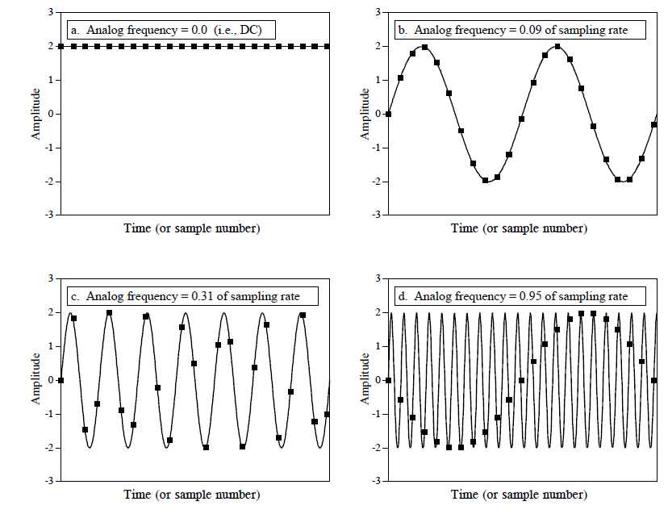
Sampling Rates: How much is necessary?

Slide 46
Sampling Rates: How much is necessary?
Signal can appear to change frequency if not adequately sampled
called: aliasing (next week)

Slide 47
System Capacity

Slide 48
Quantization, Sampling, Capacity
Quantization and Sampling
  Play enormous role in determining storage capacity of digital system
  # of quantization levels = # of bits per sample
    Increasing resolution of ADC, reduces quantization noise…
    But also increases amount of data we must store for each sample
  Sampling rate = how often we collect # of bits per sample
    Typically sampling rate = twice frequency of signal (next week)
    Increasing the rate, increases the amount of data to store!

Slide 49
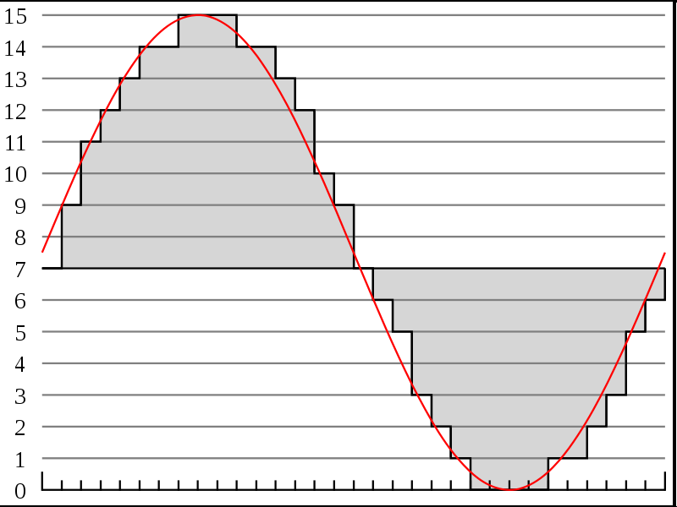

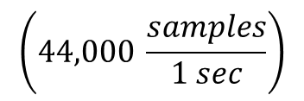



Recall # of bits for typical song
http://en.wikipedia.org/wiki/File:Pcm.svg
Discrete
Voltage
Levels
http://en.wikipedia.org/wiki/File:Compact_disc.svg
Sampling rate & resolution effect on storage
  Compact Disks: 16bits at 44KHz
    How many bits is a typical 3-minute song? (preclass 4)
$$\left(44,000 \frac{samples}{1 sec}\right)$$
$$\left(16 \frac{bits}{sample}\right)$$
$$\left(60 \frac{sec}{1 min}\right)$$
$$=15.1 \frac{MB}{song}$$
Notes:
44,000/s x 2B x 3 m x 60s/m
15,840,000 Bytes
15.8 MB or almost 128Mbits

Slide 50
Calculating Capacity
How many songs can we fit on a CD?
  How many MB can a CD hold?
    650 MB (for Data)
    About 780 MB (for Audio)
  If 3 minute song = 15.1 MB…
    1 minute audio ~ 5.04MB
    But, we record in stereo: (Right, Left audio tracks)
      5.04 MB x 2 = 10.07 MB per minute
    How many minutes do we get on a 780MB CD?

Slide 51
Copying vs. Sampling

Slide 52
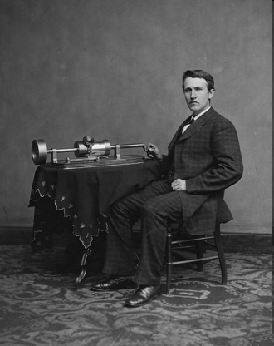
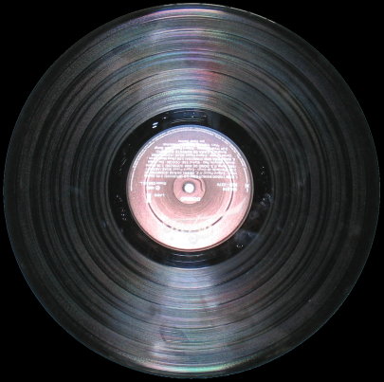
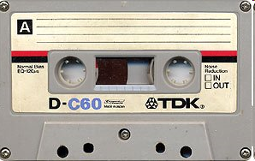
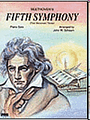
Recording: From Copying to Sampling
Analog Recording: copying
  from tinfoil
  to vinyl
  to metal filings
  … to history …
Digital Recording: sampling
  In time
  In value
[source: wikipedia]
[source: wikipedia]
[source: wikipedia]
[source: sheetmusicplus]
[source: wikipedia]

Slide 53
Compact Disc (CD)
CD (late 20th Century)
  ~ 600 MB capacity
  ~ 1 hour of music
  “Transparent” sound quality
    Indistinguishable from best analog recording
    To “almost all” humans
[source: wikipedia]

Slide 54
This week in Lab
Look at Sound of waveforms
Sample and Quantize sounds waveforms
TAs
Remember:
  Read Lab
  Work Prelab
  Bring USB Flash Drive to lab
  Partner assignments…out by Monday morning

Slide 55
Learn More
ESE215 – basic analog circuitry, RLC circuits, simple filters
ESE568 – Mixed Signal Integrated Circuits
  Build A2D, D2A

Slide 56
Big Ideas
Approximate continuous waveform on digital media by
  Discretize in all dimension
  For audio: in time and amplitude
Allows us to store audio signal as sequence of bits
Reconstruct by “connecting-the-dots”
  If our dots are frequent enough to represent the signal
Introduce error → noise
  Reason about tolerable (or noticeable) noise

Slide 57
Admin
Reading for today, next Wednesday on syllabus
In Lab (Detkin) on Monday
  Read lab, work prelab
  Bring USB flash drive
Remember feedback
  Including office hour polling

Slide 58
References
S. Smith, “The Scientists and Engineer’s Guide to Digital Signal Processing,” 1997.
Wikipedia, http://en.wikipedia.org/wiki/Analog-to-digital_converter
Wikipedia: http://en.wikipedia.org/wiki/Pulse-code_modulation

