Slide 1
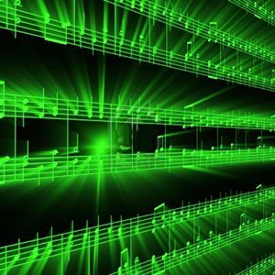


Lecture #2 – Nyquist-Shannon Sampling Theorem
ESE 150 –
Digital Audio Basics

Slide 2
Lecture Topics
Where are we on course map?
What we did in lab last week
  How it relates to this week
Sampling/Quantization Review
Nyquist Shannon Sampling Rate
Next Lab
References

Slide 3
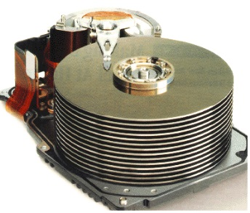










Course Map
7,8,9
10101001101
MIC
CPU
File-
System
A/D
10
10101001101
NIC
Music
1
domain
conversion
6
Numbers correspond to course weeks
compress
sample
freq
pyscho-
acoustics
4
2,3
5
13
11
EULA
----------------click
OK
D/A
NIC
speaker
MP3 Player / iPhone / Droid
12

Slide 4
Course Map – Week 3
MIC
A/D
10101001101
Music
1
Numbers correspond to course weeks
sample
2,3
D/A
10101001101
speaker
MP3 Player / iPhone / Droid

Slide 5
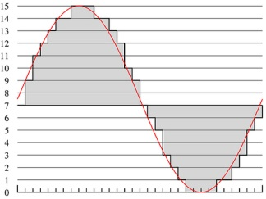
What we did in Lab…
Analog
input
ADC
Digital
Output
Week 1: Converted Sound to analog voltage signal
    a “pressure wave” that changes air molecules w/ respect to time
    a “voltage wave” that changes amplitude w/ respect to time
  Sample: Break up independent variable, take discrete ‘samples’
  Quantize: Break up dependent variable into n-levels (need 2^{n} bits to digitize)

Slide 6
Sampling vs Quantization Review

Slide 7
ADC – Sampling & Quantization
Analog-to-Digital (ADC) Conversion
  Converting analog (continuous) signal to digital signal
  Digitization process has two important aspects:
    1) Sampling
      Converting independent variable of signal from continuous to discrete
      e.g.: breaking continuous time down into intervals
    2) Quantization
      Converting dependent variable of signal from continuous to discrete
      e.g.: breaking continuous voltage down into levels

Slide 8
ADC – Sampling
Sampling: breaking independent variable (time) into intervals
  Quantization: breaking dependent variable (voltage) into levels
Voltage
Samples
@ 1ms intervals:
Quantized
into 7 levels
Levels digitized
into 3-bits
3
{ 0 ms, 0 Volts }
{ 0 ms, 0 Volts }
011
{ 1 ms, 2.2 Volts }
{ 1 ms, 2 Volts }
101
2
{ 2 ms, 3 Volts }
{ 2 ms, 3 Volts }
110
1
time (ms)
{ 3 ms, 2.2 Volts }
{ 3 ms, 2 Volts }
101
0
{ 4 ms, 0 Volts }
{ 4 ms, 0 Volts }
011
1
2
3
4
5
6
7
8
{ 5 ms, -2.2 Volts }
{ 5 ms, -2 Volts }
001
-1
{ 6 ms, -3 Volts }
{ 6 ms, -3 Volts }
000
-2
{ 7 ms, -2.2 Volts }
{ 7 ms, -2 Volts }
001
-3
{ 8 ms, 0 Volts }
{ 8 ms, 0 Volts }
011

Slide 9
Two Knobs
Quantization level (bits/sample)
Sampling rate (samples/second)

Slide 10
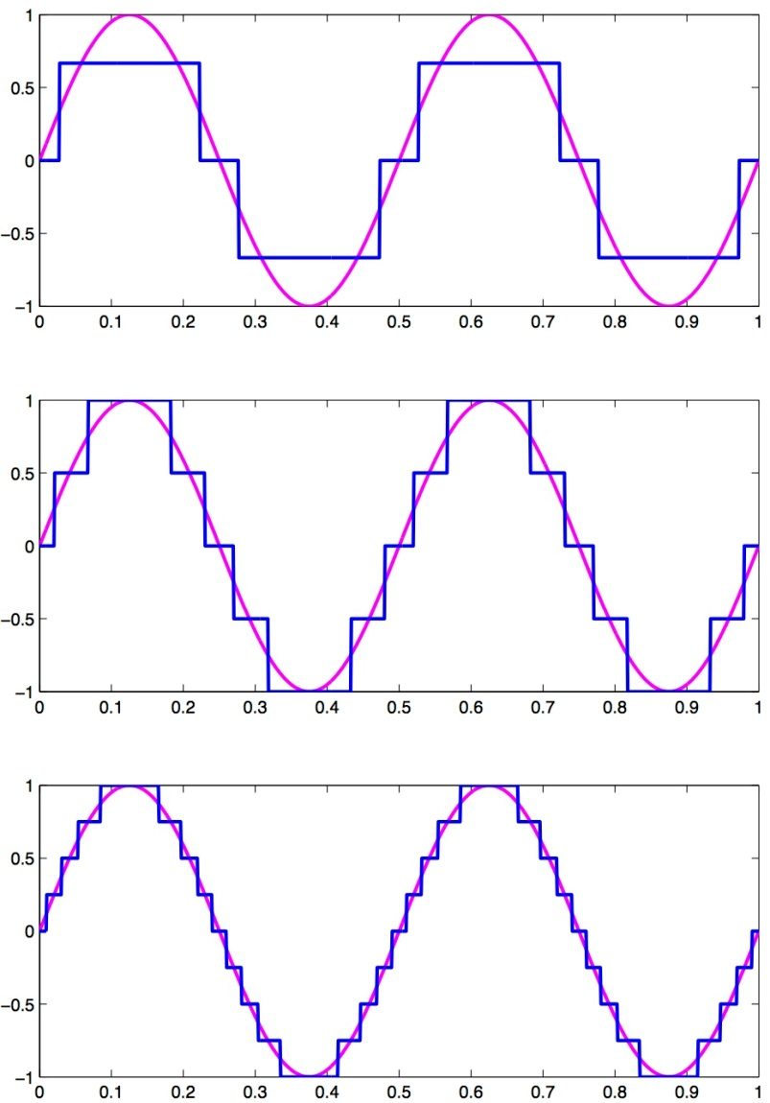
Effect of increasing Quantization
Dividing dependent variable up into more levels
  Increasing resolution at each sample
  Doesn’t change the # of samples itself!

Slide 11
Effect of increasing Sampling Rate
Increasing how often we take samples also helps
  Much like quantization…
    1 bit was too few, 16 bits was more than enough
    Is there a sweet spot for the sampling rate?

Slide 12
Both (Quantization, Sampling) impact storage
How many bytes for 3 minute song sampled at 8b precision and 1000 samples/s?
at 2000 samples/s?
16b precision at 2000 samples/s?

Slide 13
Key Question
What sampling rate should we use?

Slide 14
Definition of Good Sampling
Definition of proper sampling:
  Let’s say you’ve sampled an analog signal…
  If you can exactly reconstruct the analog signal from the samples
    You have done the sampling properly!
  Essentially: if you can reverse the process…
    You’ve capture enough information about the signal
Can we formalize this a bit more?
  Yes, next few slides will try….

Slide 15
Preclass
Identify frequencies
Samples
What’s indistinguishable at various sample rates?

Slide 16
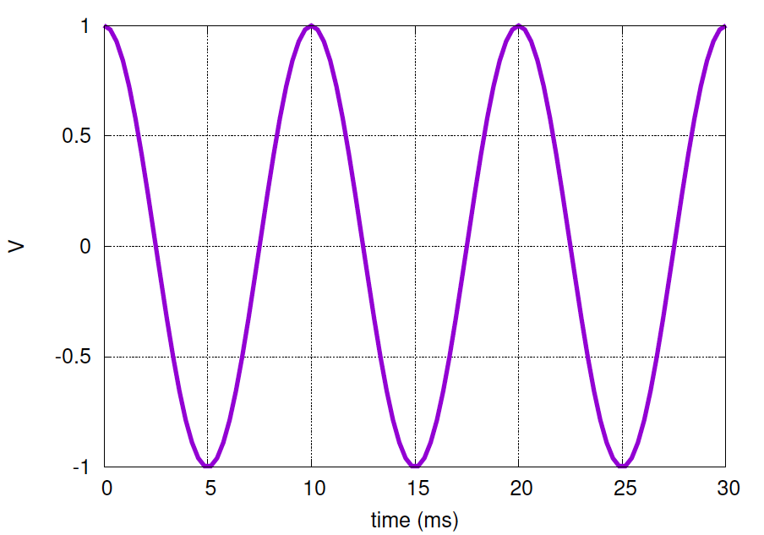
Sampling – What is the minimum?

Slide 17
Sampling – What is the minimum?
How much do we need to capture to reconstruct it?
  If we sample at 200 Hz, capture peaks & troughs of signal
  Sample rate: 2 x frequency = 200 Hz

Slide 18
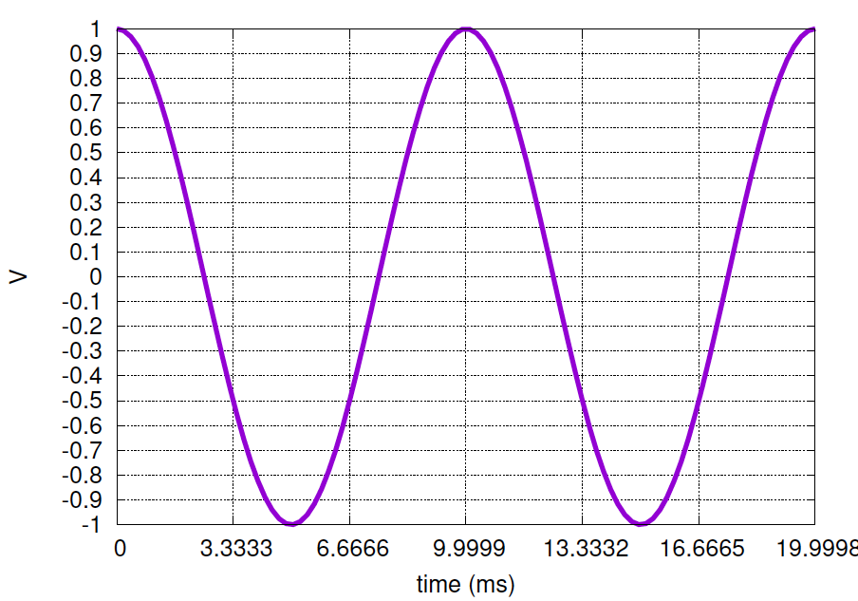
Sampling – What is the minimum?
How much do we need to capture to reconstruct it?
  If we sample at 3 x frequency or 300 Hz
    more than enough samples to capture it!
  We are actually wasting space!
  …more samples…more bits per sample…more storage required

Slide 19
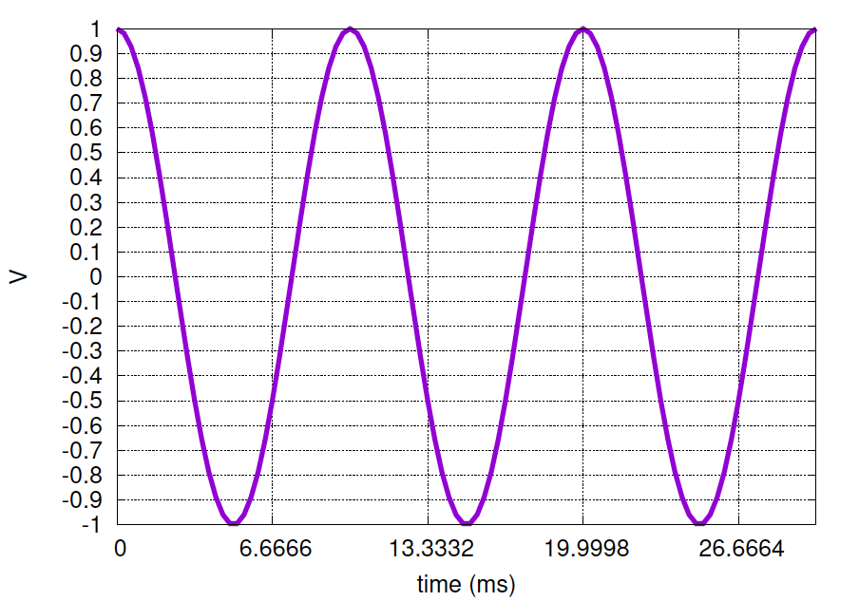
Sampling – What is the minimum?
Could we go lower?
  If we sample at rate 1.5 x frequency or 150 Hz
    We aren’t capturing all peaks/troughs of signal
  Yes, we lose information
    but it gets worse!

Slide 20
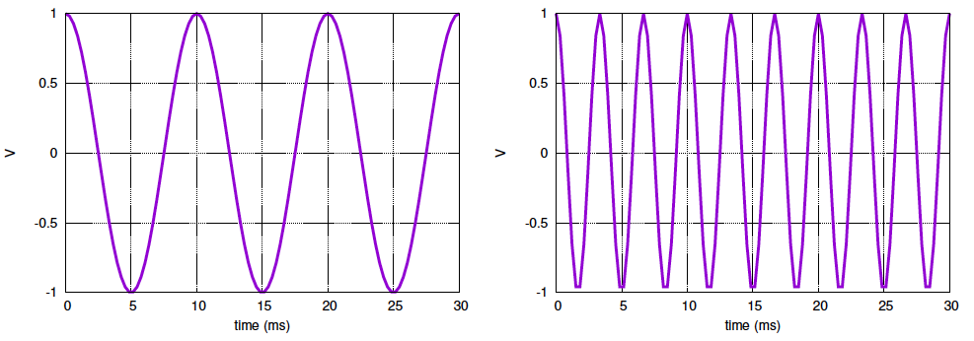
200 Hz Sample
What happened here?

Slide 21
200 Hz Sample
Cannot let signal “wiggle” around between samples
Sample too infrequently, can miss signal behavior

Slide 22
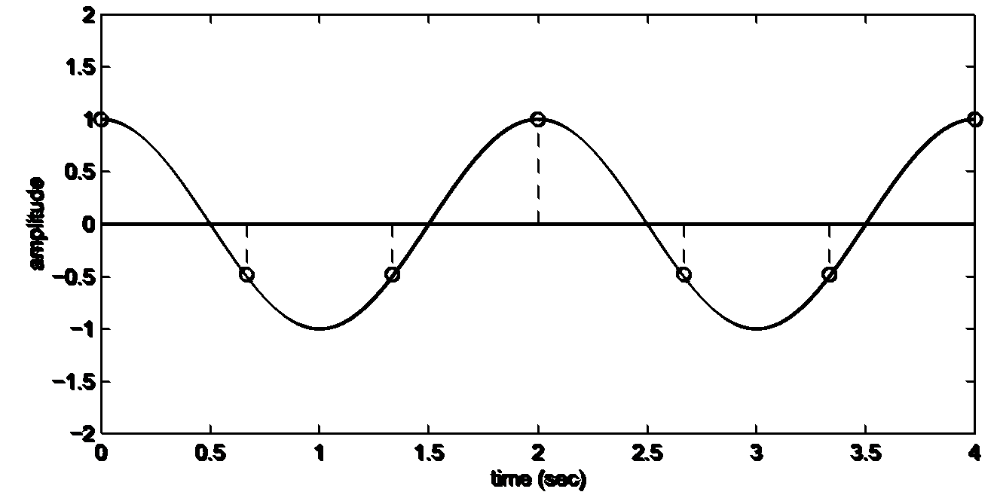
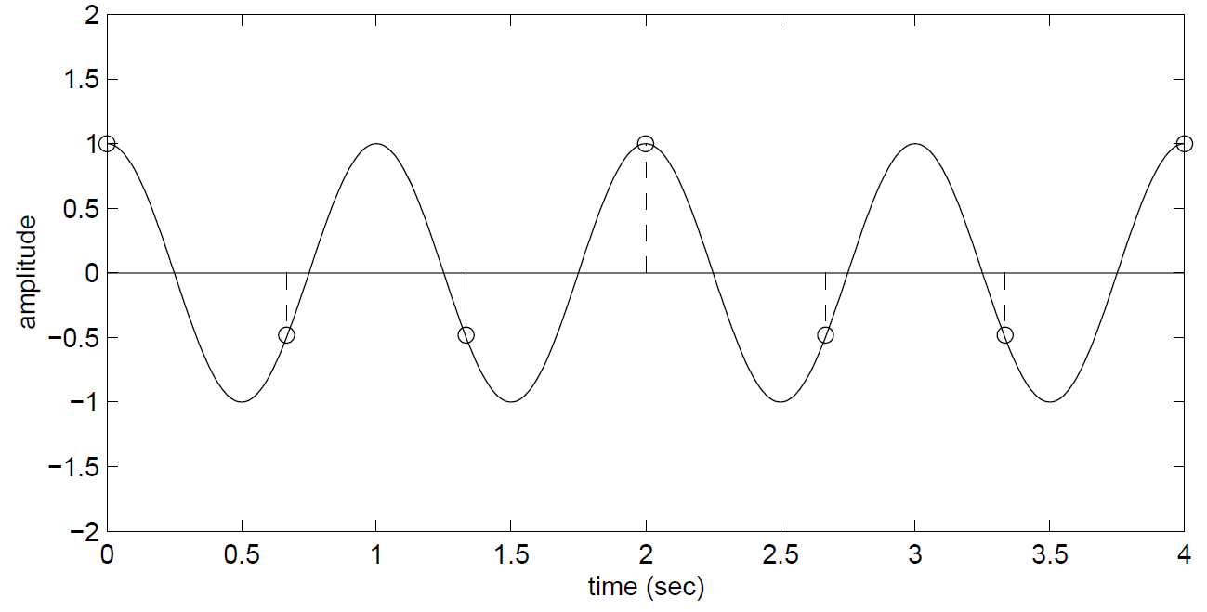
Sampling – What is the minimum?
Cannot sample lower without reconstruction error
  We not only lose information…
    …but when we ‘reconstruct’ the signal from the samples alone…
    We will reconstruct at a lower frequency!
    This phenomenon is called: aliasing

Slide 23
Sampling – What is the minimum?
Original Signal: 1 Hz
Aliased (Folded) Signal: 0.5 Hz
What frequency does aliasing occur?
  Original Signal’s Frequency: 1 Hz
    Sampling Rate: 1.5 Hz
  Aliasing occurs at: 1.5 Hz – 1 Hz = 0.5 Hz
    Also referred to as “Folding” – signal has “folds over” as if it were lower frequency

Slide 24
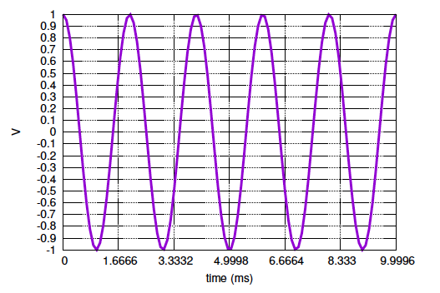
Preclass 3 – 500Hz
Properly sampled?
What did we get?

Slide 25
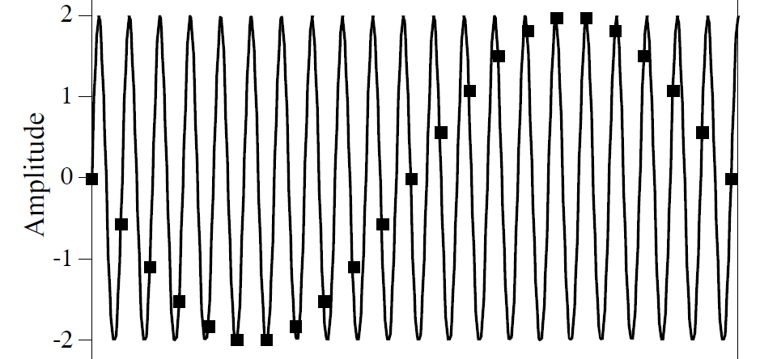
Sampling – What is the minimum?
Another example/effect of aliasing
  The dots represent the samples, we can see an inverse sine-wave
  Not only has the frequency of the original signal changed…
    But phase of the signal has changed too!
    Original signal: sine wave + 0º phase
    Aliased signal: sine wave w/different frequency + 180º phase shift!

Slide 26
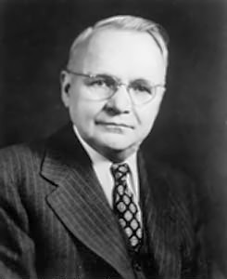
Sampling – What is the minimum?
Harry Nyquist
  Electronic Engineer for AT&T from 1917 to 1954
  Published paper in 1928 defining the: Sampling Theorem
    Nyquist Sampling Rate = 2 x frequency of signal
      Anything less: under-sampling – leads to aliasing
      Anything more: over-sampling – waste of space?

Slide 27
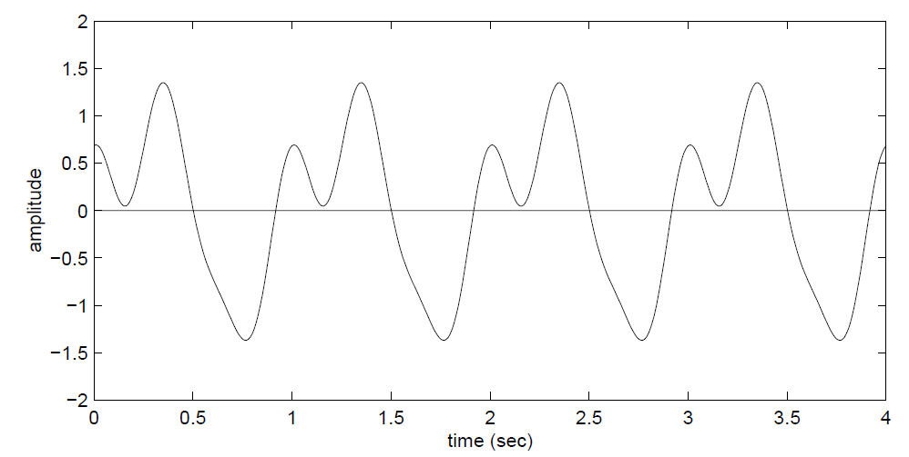
What about Multirate Signals?
Fourier’s Theorem (week 4 preview!):
  We can decompose continuous signal in terms of a sum of sines and cosines at different frequencies
  This waveform: sum of sine waves at 1 Hz, 2 Hz, 3 Hz
    What’s the Nyquist Sampling Rate then?

Slide 28
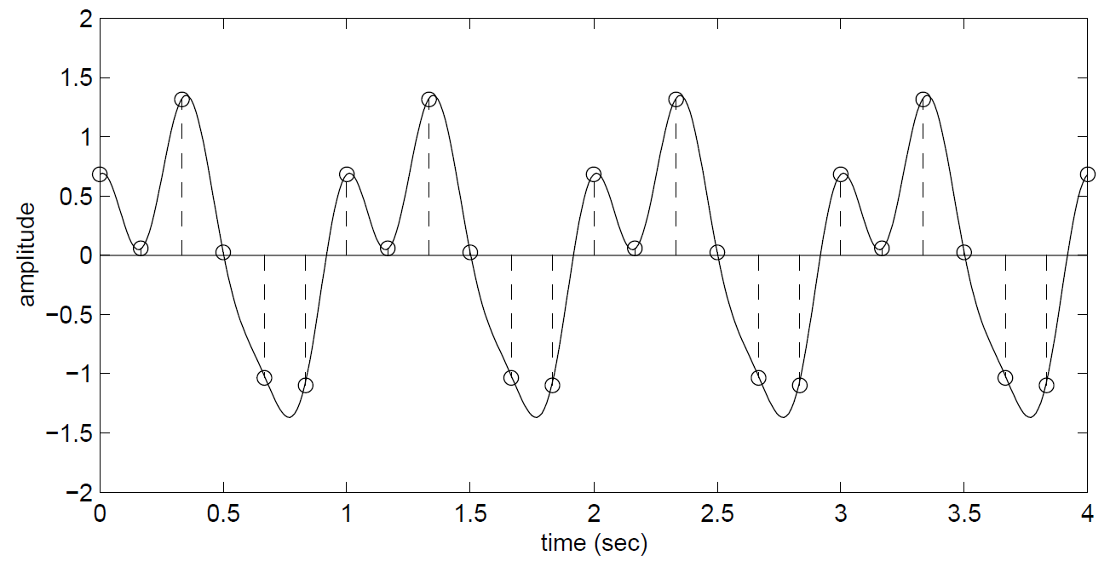
What about Multirate Signals?
Fourier’s Theorem & Nyquist Rate:
  Highest component’s frequency: 3 Hz
  What is Nyquist Sampling Rate?
    2 x highest frequency contained in the signal = 6 Hz
    Sampling at this rate: avoids aliasing problem

Slide 29
Nyquist Rate vs Frequency
Nyquist Sampling Rate:
  f_{s} = 2 x highest frequency component of signal
    Minimum sampling rate that satisfies: Nyquist Sampling Criterion for a given signal or family of signals
    Minimum sampling rate that avoids aliasing
    Property of a continuous-time signal
Nyquist Frequency:
  ½ f_{s} = ½ sampling rate
    Highest frequency that can be recovered from samples
    Property of a discrete-time signal

Slide 30
Interlude

Slide 31
Video
http://www.youtube.com/watch?v=jHS9JGkEOmA

Slide 32
Aliasing in Movies
Called visual aliasing
  See it all the time on TV/Film
    Wheels tend to move backwards on moving cars…why?
  What is it?
    Primer: Movies are just pictures (frames) flying by quickly
    Movies “sample” real life at roughly 24 frames per second
  What do we know from Nyquist Sampling Theorem?
    Aliasing will occur if changes occur faster than ½ f_{s}
    Film Example:
      If light to dark transitions occur faster than ½ f_{s} aka: 12 frame/sec
      Aliasing will occur…

Slide 33
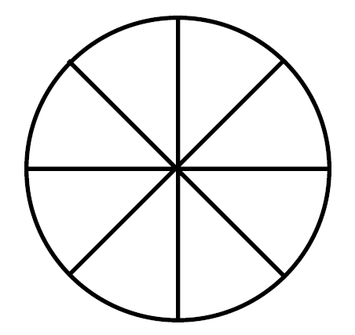
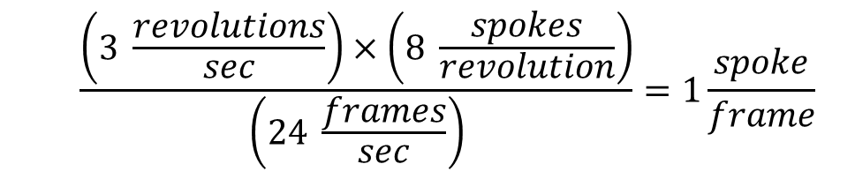
The “Wagon Wheel” Effect
Consider a wagon with 8 spokes:
  Let’s say it turns at a rate of 3 revolutions per second clockwise
    That’s 180 rpm
  On film this wheel will appear to stand still! Why?
  $$\frac{\left(3 \frac{revolutions}{sec}\right)×\left(8 \frac{spokes}{revolution}\right)}{\left(24 \frac{frames}{sec}\right)}=1\frac{spoke}{frame}$$

Slide 34
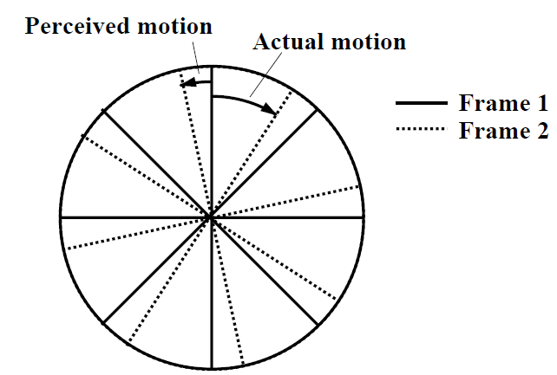
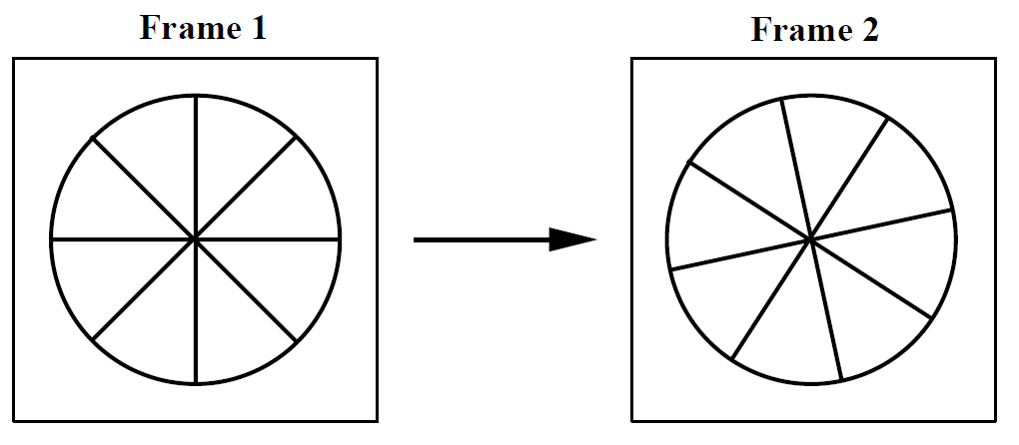
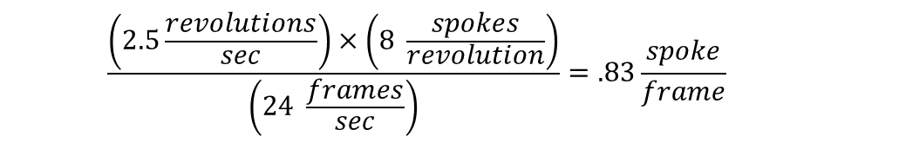
The “Wagon Wheel” Effect
What if it moved a little slower?
  Let’s say it turns at a rate of 2.5 revolutions per second clockwise
  Our brain could interpret this in two possible ways:
    Wheel has moved clockwise by 83% of spoke interval in clockwise direction
    OR: wheel has moved counter-clockwise by 17%
      Our brains prefer this view! So we see the wheel moving backwards! (thanks aliasing!)
  $$\frac{\left(2.5\frac{revolutions}{sec}\right)×\left(8 \frac{spokes}{revolution}\right)}{\left(24 \frac{frames}{sec}\right)}=.83\frac{spoke}{frame}$$
Fool your brain: http://www.youtube.com/watch?v=jHS9JGkEOmA

Slide 35
Effects of Aliasing

Slide 36
Aliasing in Music…
Multirate Signals and Aliasing
  Imagine the above is a music signal (1 Hz, 2 Hz and 3 Hz chord)
    What happens if we undersample? Should sample at 6 Hz, but instead 4 Hz
    The 1Hz & 2Hz signals will be sampled just fine (as 4 Hz is 2 x 2Hz)
    But what happens to 3 Hz Signal?
      Fold baby fold!

Slide 37
Aliasing in Music…
Multirate Signals and Aliasing
  Imagine the above is a music signal (1 Hz, 2 Hz and 3 Hz chord)
    Where will folding occur?
      folding occurs at: 4 Hz – 3 Hz = 1 Hz
      Sample rate – frequency = aliasing/folding frequency
    But what happens to 3 Hz signal? It will “fold over” and sound like a 1 Hz signal!
    To us that can sound like a low frequency noise in our music

Slide 38
Anti-Aliasing

Slide 39
How do we fix this?
It’s simple…sample at the Nyquist Rate
  But…what if your rate is fixed? Like 24 frames/sec?
  Or our eye’s sampling rate: 60 cycles/degree
    Spatial variations finer than this are undetectable!

Slide 40
How to Avoid Aliasing with Digital Music?
If we simply sample at 2 x highest frequency of signal…
  (AKA: Nyquist Rate)
  …we won’t encounter aliasing!
But how do we guarantee highest frequency of our signal?
  Audio: this is easy!
    We know the range of human ear: 20 Hz to 20 kHz…
    The highest frequency component in music is then: 20 kHz
    …so, before sound goes into ADC, we apply a filter!
      Blocks any frequency above 20 kHz from going into ADC
    Essentially, we are fixing our sampling rate & ‘bluring’ or filtering our incoming signal

Slide 41
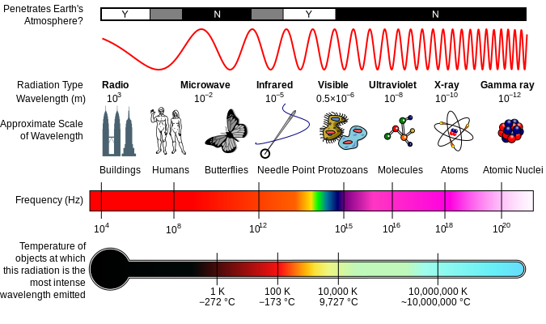

We know how to avoid aliasing…
What is a filter you ask?
  Imagine a coffee filter…
Signals ranging
in frequencies
from 20Hz to 40kHz
go into filter
Water,
Ground coffee
beans go into
Filter…
WATER
grinds
grinds
Electronic
Filter
Called a “low pass” filter
Has a “cutoff” frequency
of 20 kHz
Coffee Filter
COFFEE
Only “delicious”
signals ranging
from 20Hz to 20kHz
pass through filter
(aka Audio Signals)
Only delicious
coffee passes
through filter…
“grinds” cannot pass

Slide 42
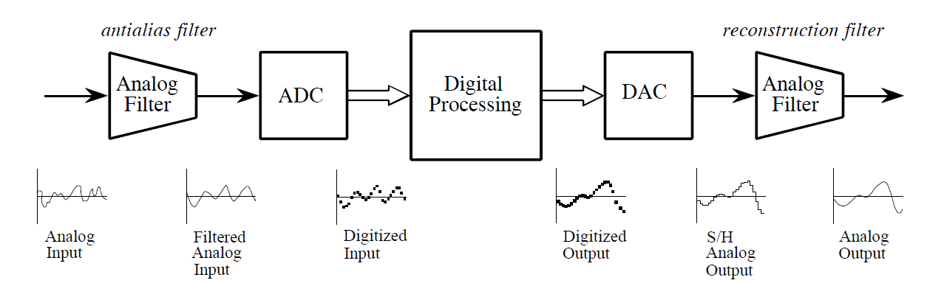
Full Block Diagram of DSP System
Before ADC, we put music signal through antialias filter
  Filter blocks any signals higher than 20 kHz (prevents aliasing!)
  Then our ADC can safely sample at 2 x 20 kHz without aliasing
    What is our Nyquist Rate?
      f_{s}=2 x 20 kHz = 40 kHz, or 40 thousand samples per second!
    What is our Nyquist Frequency?
      ½ f_{s} = 20 kHz
  Cutoff frequency of our filter? Has to be the Nyquist Frequency

Slide 43
Why do we need the antialias filter?
If we can’t hear anything above 20kHz…
  Why do we need to filter it out?
    Dog’s can hear from 40 Hz to 60 kHz
      so clearly there are sounds above 20 kHz
  Let’s imagine a high frequency noise in music studio
    Let’s say it’s a vibration occurring at 25 kHz
      No human can hear it, why filter it out?
    Because of aliasing:
      Frequency aliasing/folding will occur:
      Sample rate – frequency = aliasing/folding frequency
      40 kHz - 25 kHz = 15 kHz
      The 25 kHz vibration will fold-over to a 15 kHz “hum” or audible noise
        It will ruin our recording and source of noise wouldn’t be obvious!

Slide 44
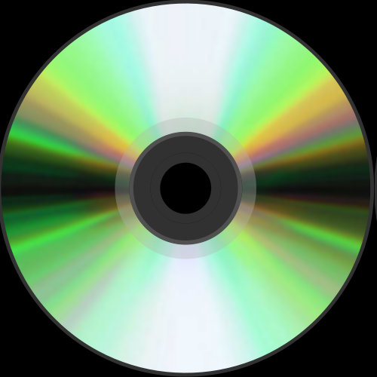
Compact Disc (CD)
CD (late 20th century)
  First form of digitized music
    ADC → DSP → DAC
  Up until this time, music was…
    …exact reproduction (record, tape)
  Nyquist Sampling Rate: 44.1 kHz
  Nyquist Frequency: ½ (44.1 kHz) = 22.05 kHz
    AKA – upper range of audio
    22.05 = cutoff frequency for low-pass antialias filter

Slide 45
Compact Disc (CD)
CD (late 20th century)
  Quick Math:
  Sampling Rate: 44.1 kHz
  Sampling Rate: 44,100 Hz
  That means we collect 44,100 Samples in 1 second!
    In 60 seconds, we collect: 2,646,000 samples
      (44,100 samples/sec * 60 sec) =2,646,000 samples/minute
    For a 3 minute song: 7,938,000 samples / song!
      (2,646,000 samples/minute) * (3 minutes) = 7,938,000 samples/song
    If each sample requires 16-bits to store:
      (7,938,000 samples/song) * (16 bits/sample) = 127,008,000 bits/song
      That’s 15,876,000 bytes per song
      15,504 kB = 15.14 MB per song!
    What about stereo recordings? Double that!
      30.28 MB per 3 minute stereo song!!
    This is why a CD can only hold about 80 minutes of digital audio!

Slide 46
Big Ideas
Sample at twice the maximum frequency
  Can reconstruct perfectly
If have frequencies > sample_freq/2
  Will get aliasing … as high frequencies fold
Avoid aliasing with analog Anti-Alias prefilter before sampling

Slide 47
This Week In Lab
Lab 2: D2A – play back the samples you recorded last week

Slide 48
Piazza
Signup piazza (half not)
  Reminders and administrivia
  Answer questions from lecture

Slide 49
Learn More
ESE224 – Signal Processing

Slide 50
References
  S. Smith, “The Scientists and Engineer’s Guide to Digital Signal Processing,” 1997.
  http://en.wikipedia.org/wiki/Nyquist_frequency
  http://en.wikipedia.org/wiki/Nyquist_rate
  http://en.wikipedia.org/wiki/Oversampling
  http://en.wikipedia.org/wiki/Sampling_rate
  http://en.wikipedia.org/wiki/Hearing_range
  http://electronics.howstuffworks.com/telephone6.htm
  B. Olshausen, “Aliasing”, PSC 129 – Sensory Processes Course Notes, UC Davis

