Slide 1
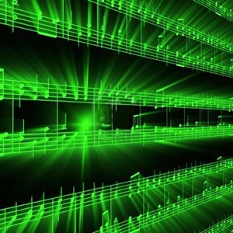


Lecture #4 – Converting from time to frequency domain
ESE 150 –
Digital Audio Basics

Slide 2
Teaser
Play this on piano:

Slide 3
Teaser
Play
4 quarter notes
1 whole note
Cheat: A5, B5, G5, G4, D5
Notes:
A5, B5, G5, G4, D5

Slide 4
Information
1s / quarter note ➔ 8s of sound
How many bits to represent 8s of sound with 16b samples and 44KHz sampling?
  44K Hz x 16b/sample x 8s = 5632K =5Mbits

Slide 5
Representation
How does musical staff represent sound?
  What does vertical position represent?
  Note shape?

Slide 6
Frequency Representation
There are other ways to represent
  Frequency representation particularly efficient
880
988
784
392
587
Frequencies in Hertz
Notes:
A5, B5, G5, G4, D5

Slide 7
Frequency Representation
How much information is this musical staff communicating?
How many keys on piano? → bits/note

Slide 8
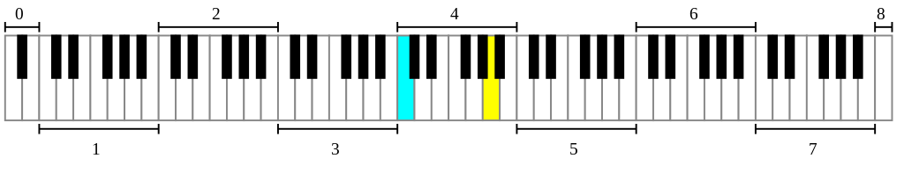
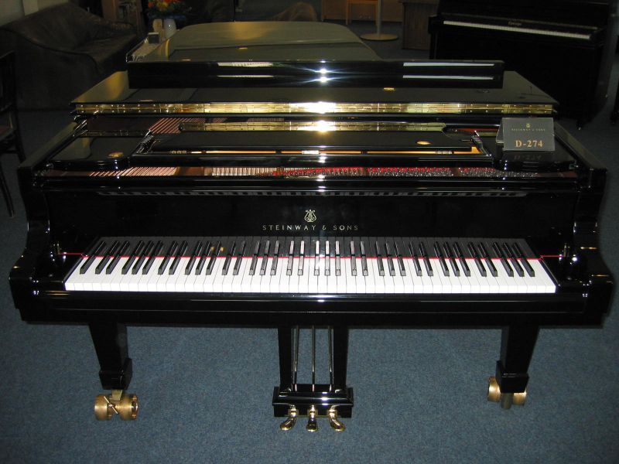
Hamburg Steinway D-274 Piano photo by Karl Kunde
https://commons.wikimedia.org/wiki/File:D274.jpg

Slide 9
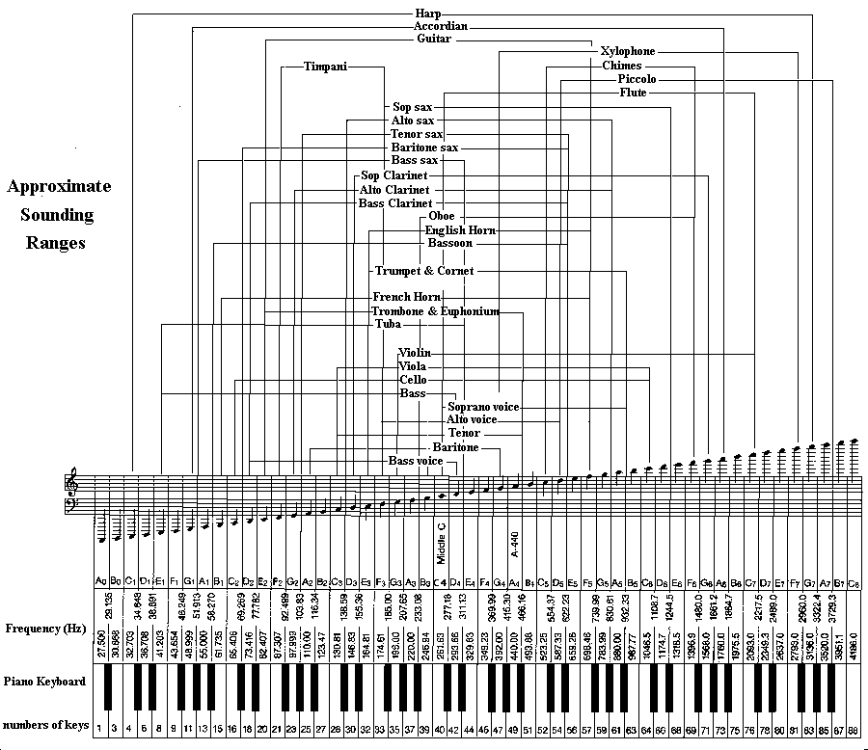
Larry Solomn: http://solomonsmusic.net/insrange.htm

Slide 10
Frequency Representation
How much information is this musical staff communicating?
How many keys on piano? → bits/note
Let’s say 8b duration
How many bits for 5 notes?
  (7b/note+8b/duration) x 5 note = 75 bits?

Slide 11
Lab 2 postlab
You reproduced 800 samples of a 300Hz sine wave at 1000Hz with 8b precision
  6400b
What did you need to specify to do that?
How may bits to represent that?

Slide 12
Conclude
Can represent common sounds much more compactly in frequency domain than in time-sample domain
  Frequency domain ~ 75b
  Time-sample domain ~ 5Mb

Slide 13
Lecture Topics
Teaser: frequency representation
Where are we on course map?
What we did in lab last week
  How it relates to this week
The Fourier Series – can represent any signal
The Discrete Fourier Transform (DFT) – can translate
  Change of basis
Next Lab
References
Notes:
http://toxicdump.org/stuff/FourierToy.swf
http://betterexplained.com/examples/fourier/
https://www.youtube.com/watch?v=QVuU2YCwHjw&feature=youtu.be (homer simpson drawn!)

Slide 14
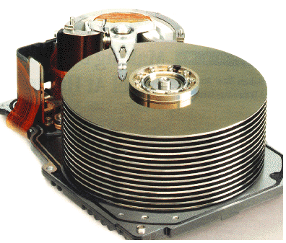










Course Map
7,8,9
10101001101
MIC
CPU
File-
System
A/D
10
10101001101
NIC
Music
1
domain
conversion
5,6
Numbers correspond to course weeks
compress
sample
freq
pyscho-
acoustics
3
2
4
13
11
EULA
----------------click
OK
D/A
NIC
speaker
MP3 Player / iPhone / Droid
12

Slide 15
Course Map – Week 5
MIC
A/D
10101001101
Music
1
domain
conversion
Numbers correspond to course weeks
compress
sample
freq
3
2
4
D/A
10101001101
speaker
MP3 Player / iPhone / Droid

Slide 16
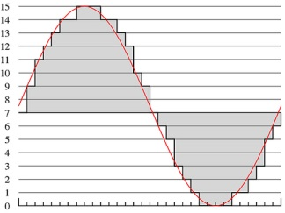
What we did in Lab…
Analog
input
ADC
Digital
Output
compress
Week 1: Converted Sound to analog voltage signal
    a “pressure wave” that changes air molecules w/ respect to time
    a “voltage wave” that changes amplitude w/ respect to time
Week 2: Sampled voltage, then quantized it to digital sig.
  Sample: Break up independent variable, take discrete ‘samples’
  Quantize: Break up dependent variable into n-levels (need 2^{n} bits to digitize)
Week 3: Compress digital signal
  Use even less bits without using sound quality!
Week 4 (upcoming): Before we compress…
  Put our ‘digital’ data into another form…BEFORE we compress…less stuff to compress!

Slide 17
What is the Frequency Domain?
Background

Slide 18
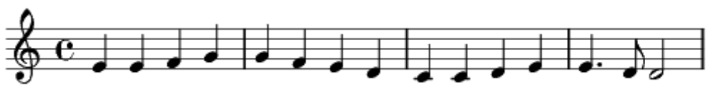
Musical Representation
With this compact notation
  Could communicate a sound to pianist
  Much more compact than 44KHz time-sample amplitudes (fewer bits to represent)
  Represent frequencies

Slide 19
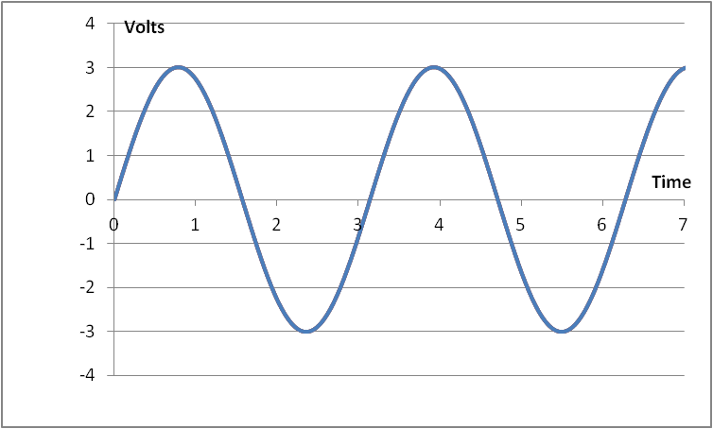
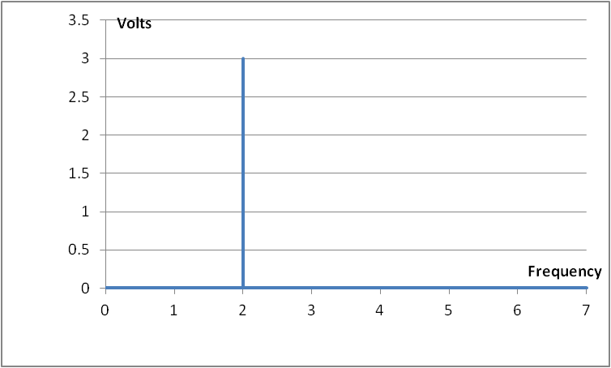


Time-Domain & Frequency-domain
As an example…let’s say we have a pure tone
  If period: T = $π$ and Amplitude = 3 Volts
  $s\left(t\right)=A sin\left(2πft\right)=$
$$3 sin\left(2t\right)$$
Time domain representation
Frequency domain representation
Notes:
Note x-axis of frequency domain representation is actually: angular frequency: 2*pi*f
So if T=pi, then 2*pi*F = 2 rad/sec
The graph shows a spike at 2 rad/sec

Slide 20
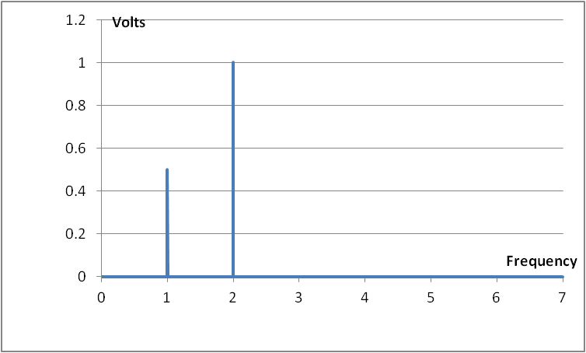

Frequency-domain
Of course, not all signals are this simple
For example, consider $s\left(t\right)=sin\left(2t\right)+\frac{1}{2}sin(t)$
  Question: What will the frequency representation look like?
  Above is called an “amplitude spectrum” plot, we also have
  “phase spectrum” plots in the frequency domain

Slide 21
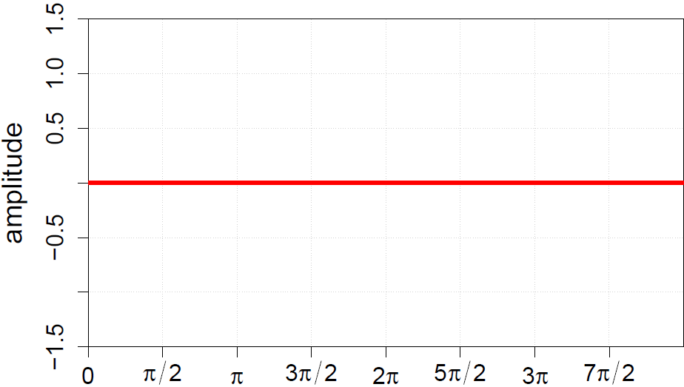
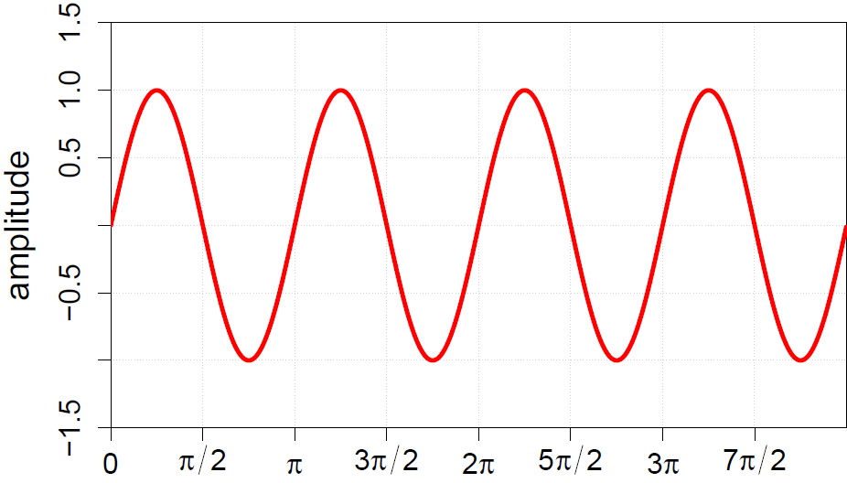
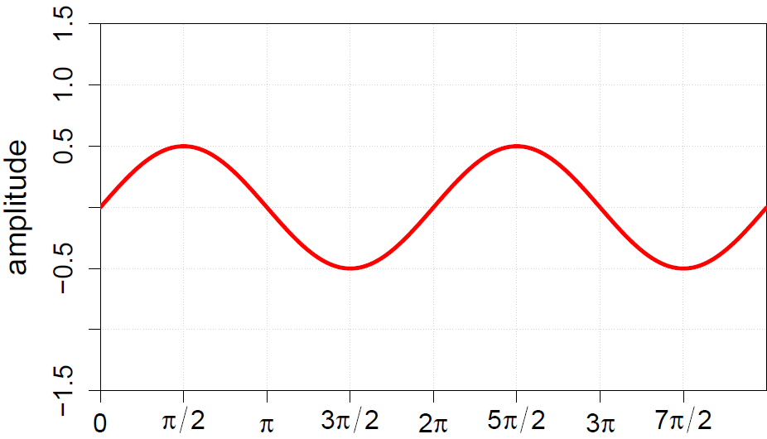
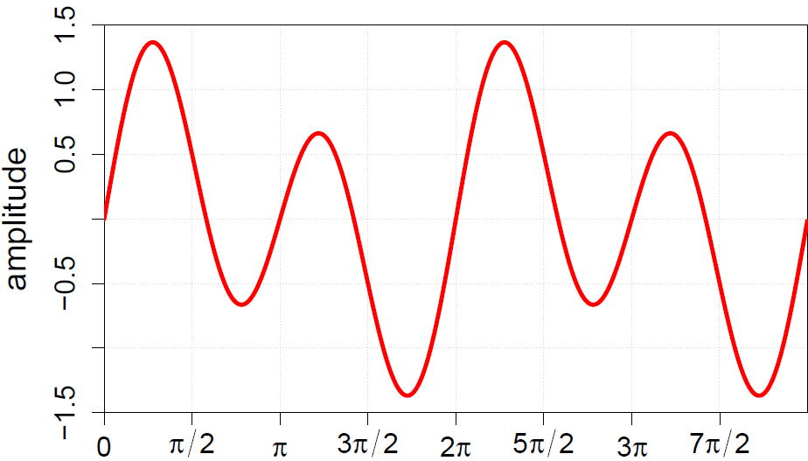
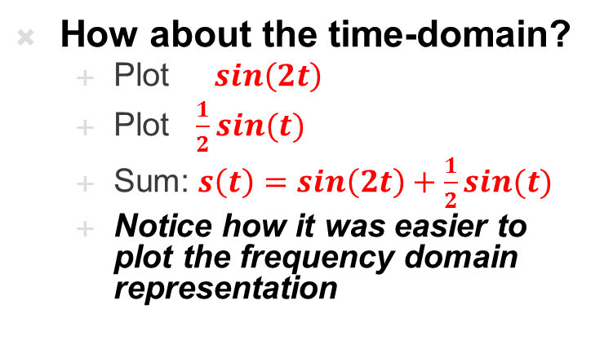
Frequency-domain
How about the time-domain?
  Plot $sin\left(2t\right)$
  Plot $\frac{1}{2}sin(t)$
  Sum: $s\left(t\right)=sin\left(2t\right)+\frac{1}{2}sin(t)$
  Notice how it was easier to plot the frequency domain representation

Slide 22
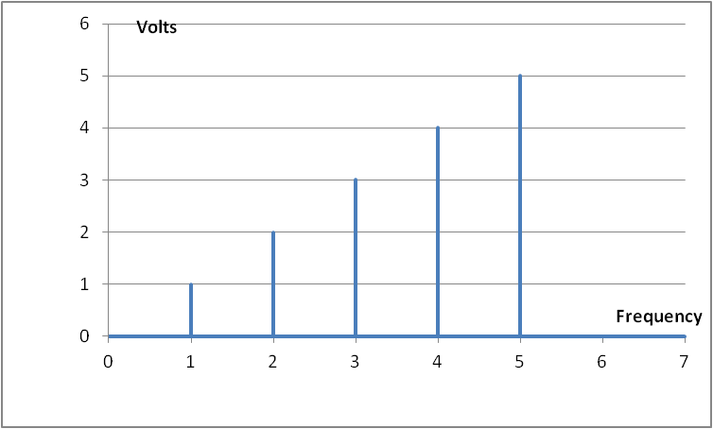
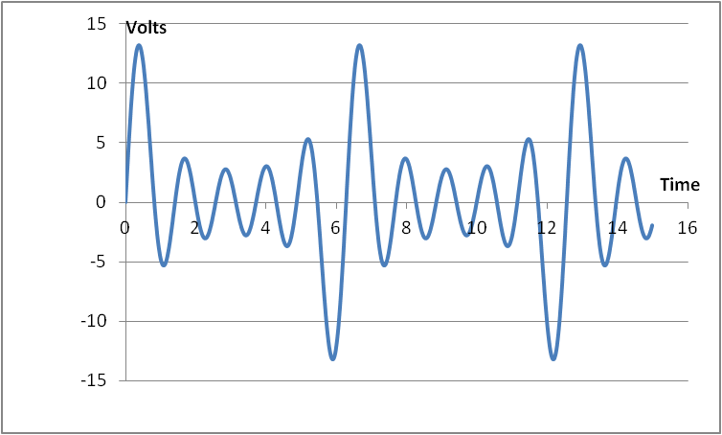
Frequency-domain
Another example
The time domain plot on the right is really the sum of 5 sinusoids,
where 5 Hz is the strongest component of the signal

Slide 23
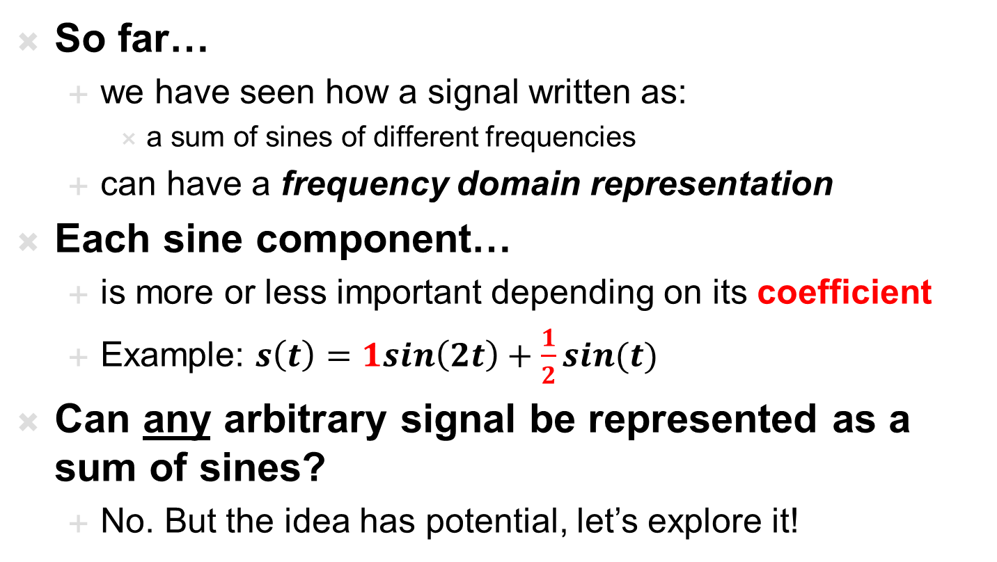
Frequency-domain
So far…
  we have seen how a signal written as:
    a sum of sines of different frequencies
  can have a frequency domain representation
Each sine component…
  is more or less important depending on its coefficient
  Example: $s\left(t\right)=1sin\left(2t\right)+\frac{1}{2}sin(t)$
Can any arbitrary signal be represented as a sum of sines?
  No. But the idea has potential, let’s explore it!

Slide 24
The Fourier Series
The frequency domain &

Slide 25
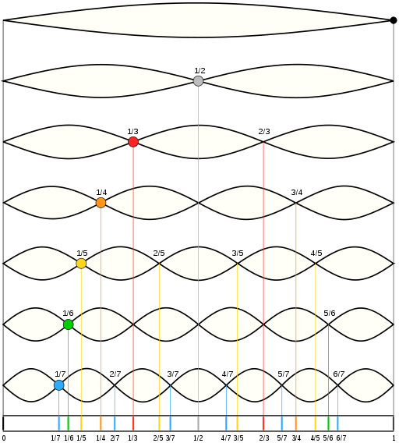
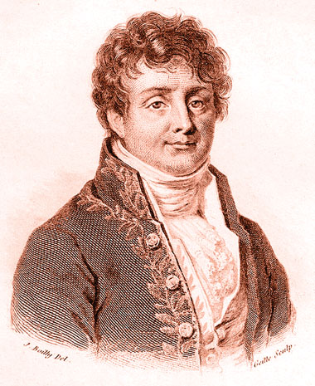
History…
Fourier series:
  Any periodic signal can be represented as a sum of simple periodic functions: sin and cos
  sin(nt) and cos(nt)
  where n = 1, 2, 3, …
  These are called the harmonics of the signal
Jean Baptiste Joseph Fourier, wikipedia

Slide 26
Fourier Series in a nutshell
States that any PERIODIC function can be written as a sum of sines and cosines!
  This is huge!
  It also gives us a way to breakup a periodic function into its sine/cosine parts
Why do we care?
  Well if music was periodic, we could break it into its sine/cosine pieces and store only the amp/freq/phase
    Huge storage advantage
  But also, once we break it down, we could modify them
    Say we want to enhance the bass or treble of a signal?
    By increasing amplitude of bass frequencies, we’ll get more bass

Slide 27
Fourier Series in a nutshell
Other implications…
  If a signal is periodic, we can convert it from time to frequency
Imagine anything periodic
  If Earthquake vibrations could be separated into sinusoids…
    Think vibrations at different speeds and strengths
  We could design buildings/bridges to avoid interacting with the strongest frequency vibrations (and not just “all of them”)
  If a radio-wave is our signal and its periodic
    We could hone in on a particular “channel” and listen only to that one…like a radio/TV!
  It has endless applications in: communications, astronomy, geology, optics
There is one problem…
  The above examples aren’t exactly periodic!
  But we’ll address that soon…first let’s see the Fourier series

Slide 28
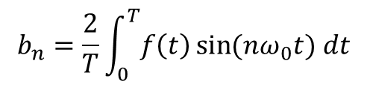
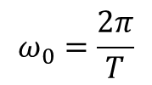
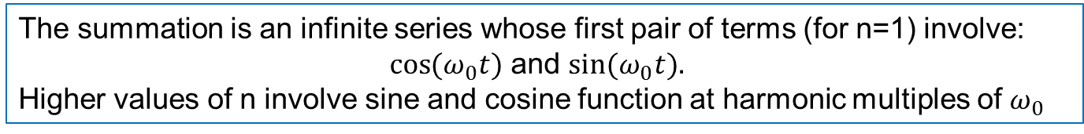
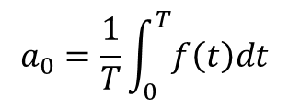
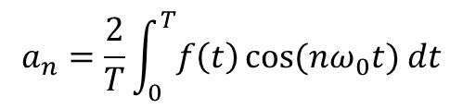
Fourier Series – more formally
The Fourier Theorem states that any periodic function f(t) of period T can be cast in the form:
$$ω_{0}=\frac{2π}{T}$$
Where $ω_{0}$ is the fundamental angular frequency of $f\left(t\right)$
The summation is an infinite series whose first pair of terms (for n=1) involve:
$\cos{(ω_{0}t})$ and $\sin{(ω_{0}t}).$
Higher values of n involve sine and cosine function at harmonic multiples of $ω_{0}$
The constants: $a_{0}$, $a_{n}$ , and $b_{n}$ are called the Fourier coefficients of f(t)
Their values are determined by evaluating integral expressions involving f(t)
$$a_{0}=\frac{1}{T}\int_{0}^{T}{f\left(t\right)dt}$$
$$a_{n}=\frac{2}{T}\int_{0}^{T}{f\left(t\right)}\cos{(nω_{0}t}) dt$$
$$b_{n}=\frac{2}{T}\int_{0}^{T}{f\left(t\right)}\sin{(nω_{0}t}) dt$$
$a_{n}$ and $b_{n}$ act as the “weights” for contributions for each harmonic
Notes:
For more…
https://www.youtube.com/watch?v=ObklYbQaX24
A0 is the time-average value of f(t), its called the DC component of f(t) because the average values of the ac component are zero

Slide 29
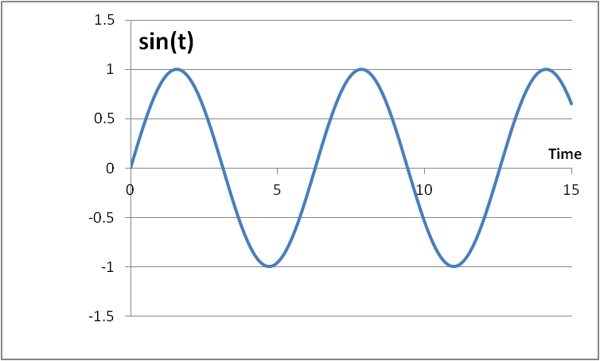
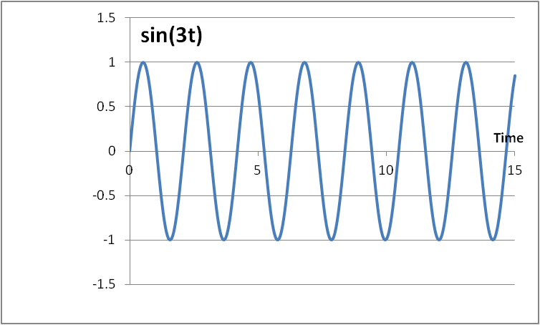
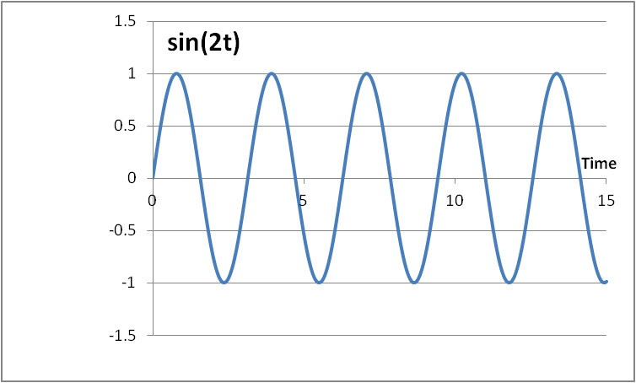
Fourier Series – Why does it work?
  The cos(nx) and sin(nx) functions form an orthogonal basis:
    allow us to represent any periodic signal by taking a linear combination
    of the basis functions without interfering with one another
    AKA: superposition works!

Slide 30
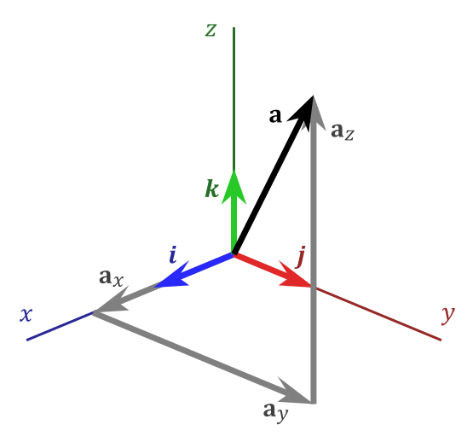
Orthogonal basis
What is an orthogonal basis?
Example: 3D space
  Basis: [i j k]
  Linear combination: xi + yj + zk
  Coordinate representation: [x y z]
Example: Quadratic polynomials
  Basis: [x² x 1]
  Linear combination: ax² + bx + c
  Coordinate representation: [a b c]
All vectors in the space can be represented as sequences of coordinates, or ordered coefficients of the basis vectors
  This is what the Fourier Series does…
    just uses cos(nt) and sin(nt) as its “Basis”

Slide 31
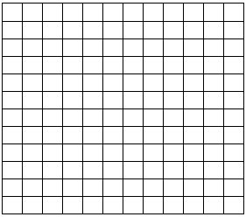
Fourier Series has Infinite Basis…
10
  Consider the xy-plane:
  We can address a point by its two coordinates (x,y)
    the grey point is located at (10, 3)
5
0
0 5 10
  In Fourier series, we have a basis with infinite dimension!
    so we sum up over an infinite number of harmonics
    harmonics are 1, cos(t), cos(2t), cos(3t), …, sin(t), sin(2t), …

Slide 32
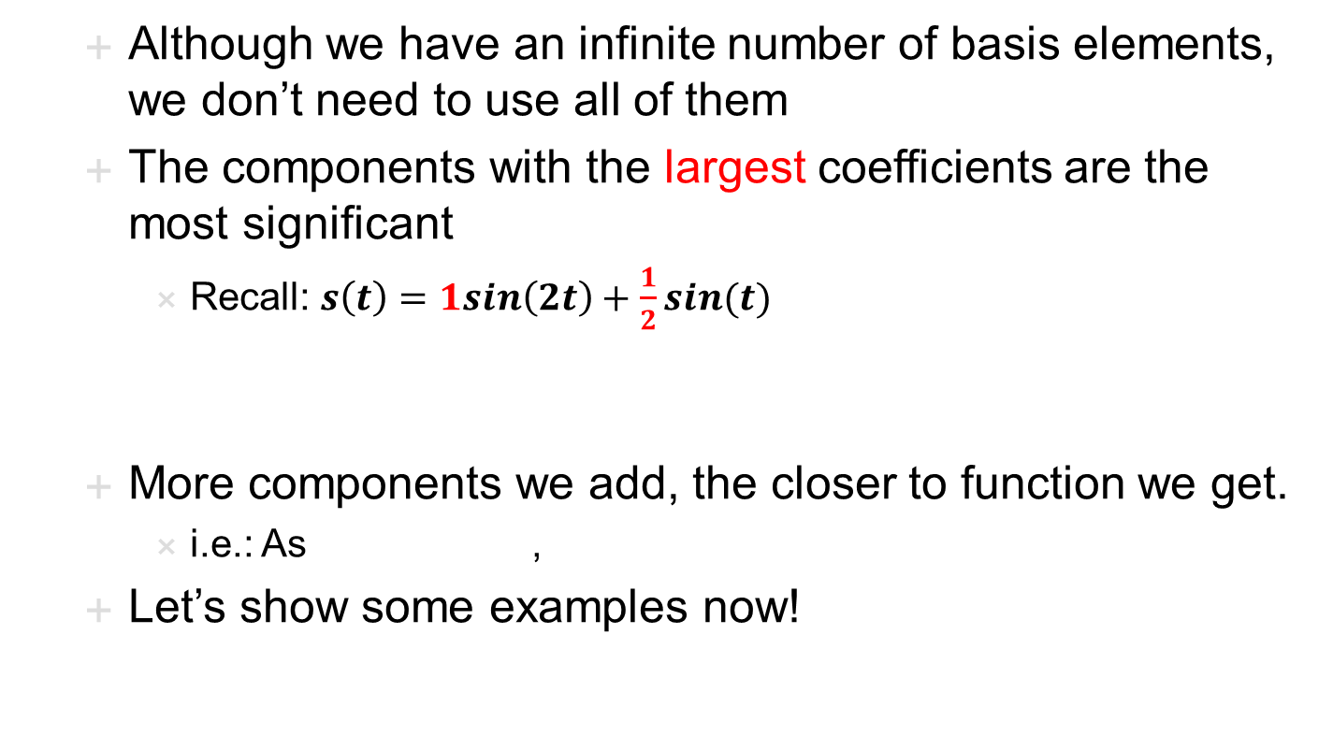
Fourier Series has Infinite Basis…
  Although we have an infinite number of basis elements, we don’t need to use all of them
  The components with the largest coefficients are the most significant
    Recall: $s\left(t\right)=1sin\left(2t\right)+\frac{1}{2}sin(t)$
  More components we add, the closer to function we get.
    i.e.: As ,
  Let’s show some examples now!

Slide 33
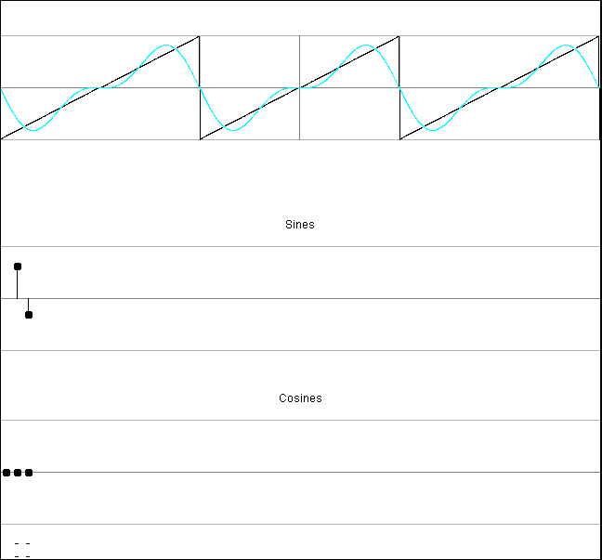
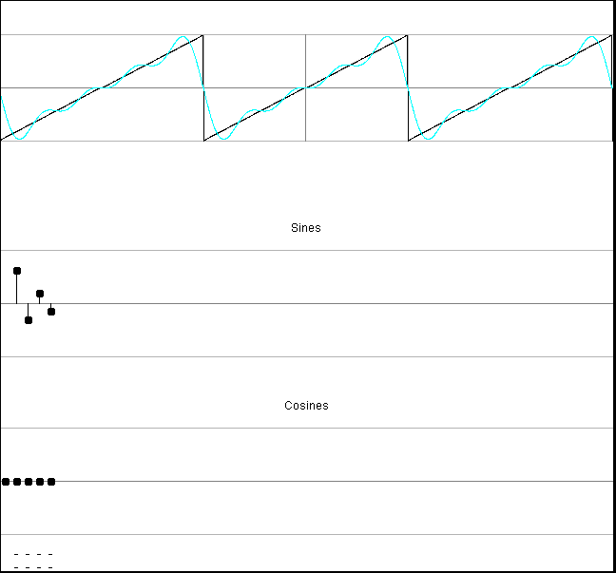
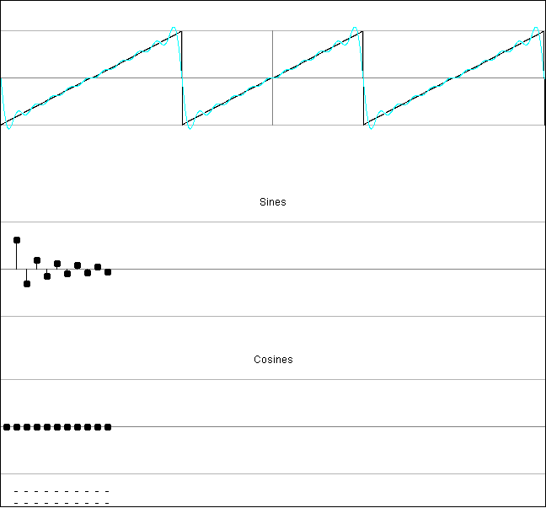
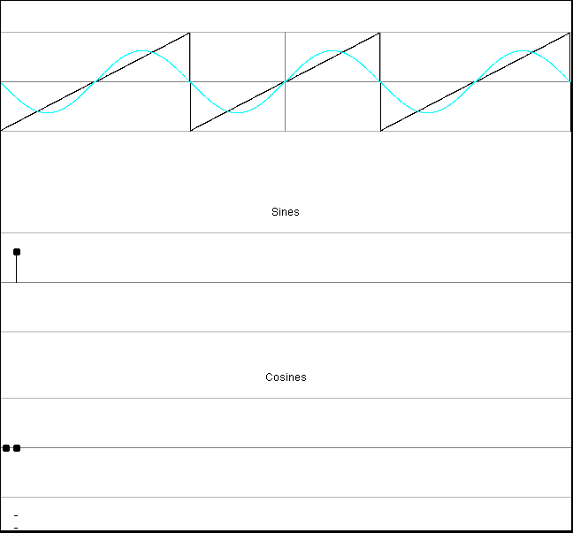
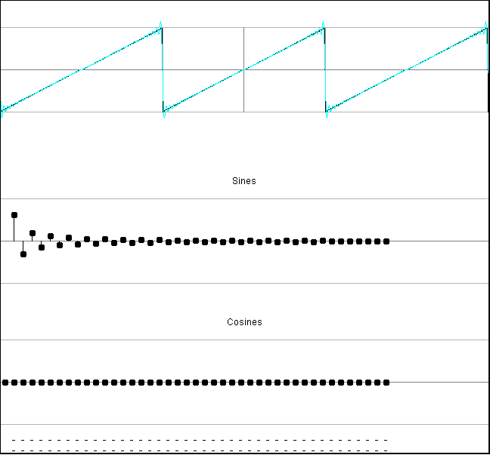
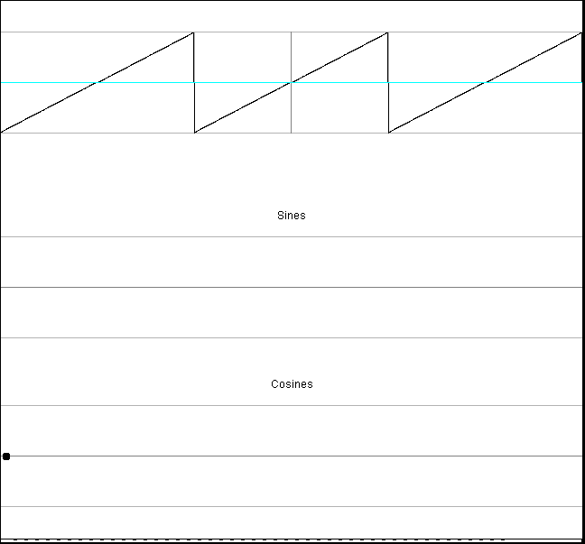
Fourier Series – Sawtooth wave
(falstad.com/fourier/)

Slide 34
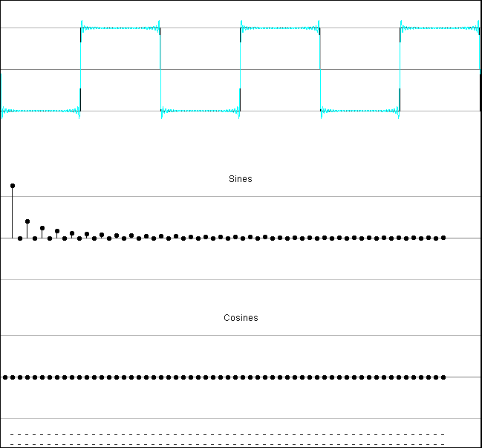
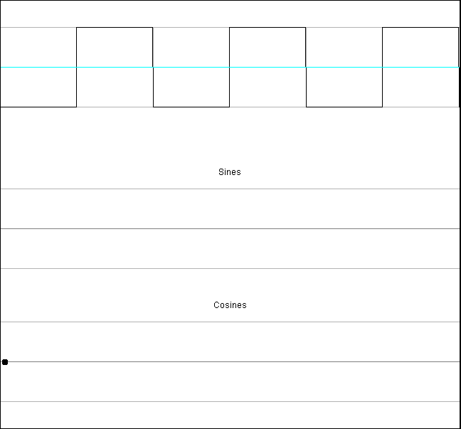
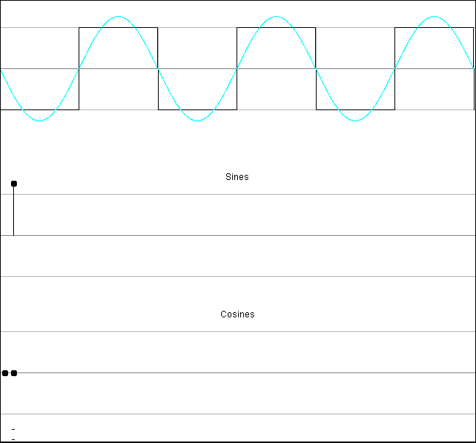
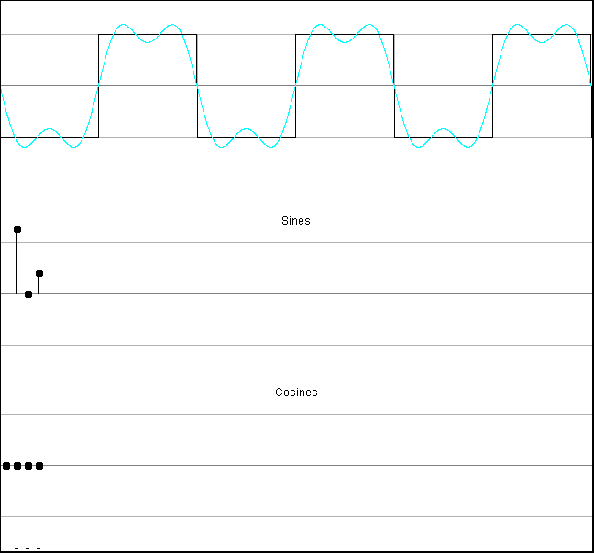
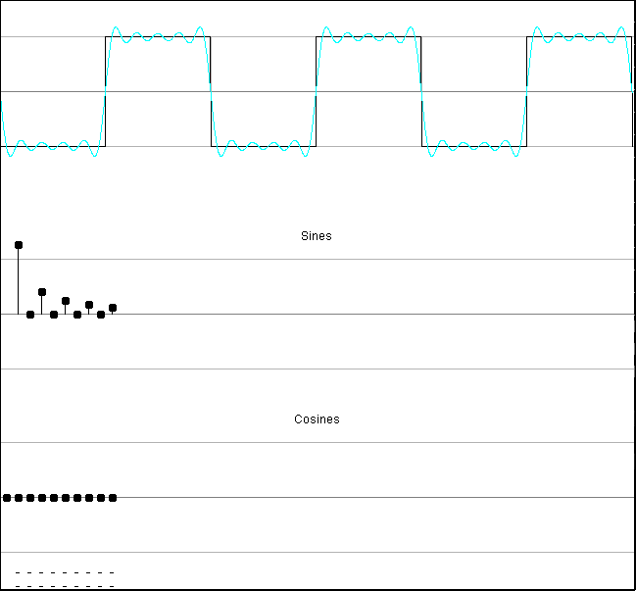
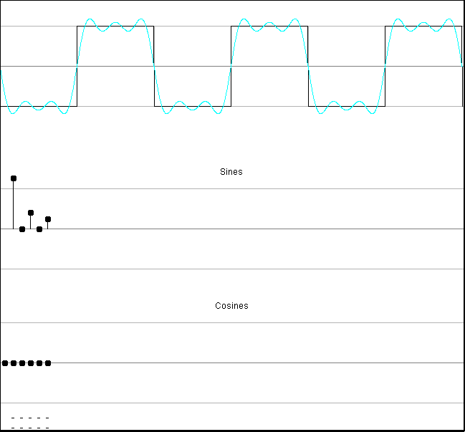
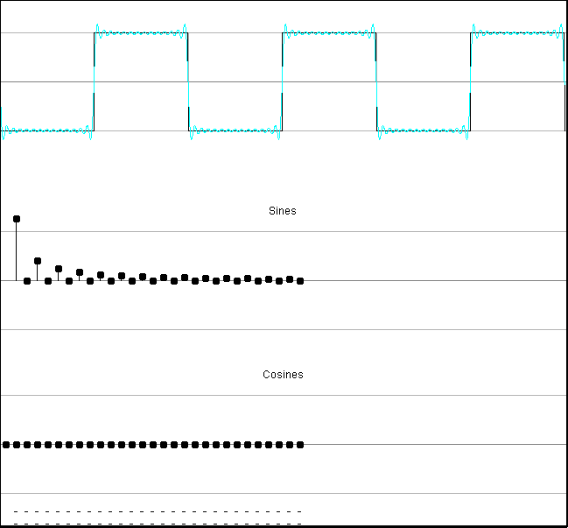
Fourier Series – Square Wave
(falstad.com/fourier/)

Slide 35
Fourier Series (Review of key points)
The idea of the series:
  Any PERIODIC wave can be represented as simple sum of sine waves
2 Caveats:
  Linearity:
    The series only holds while the system it is describing is linear because it relies on the superposition principle
    -aka – adding up all the sine waves is superposition in action
  Periodicity:
    The series only holds if the waves it is describing are periodic
    Non-periodic waves are dealt with by the Fourier Transform
      We will examine that in the 2nd half of lecture

Slide 36
Nyquist
Remember we said we needed to sample at twice the maximum frequency
  Now see all signals can be represented as a linear sum of frequencies
  …and the frequency components are orthogonal
    Can be extracted and treated independently

Slide 37
Interlude
Close Encounters Mothership
https://www.youtube.com/watch?v=S4PYI6TzqYk

Slide 38
The Fourier Transform

Slide 39
What now?
In the first half of the lecture we introduced:
  The idea of frequency domain
  The Fourier Series
In the second half of the lecture:
  Fourier Transform
  See how to perform this time-frequency translation
  Examples

Slide 40
Preclass 4
Compute Dot Products with frequencies
  (equivalently, compute Fourier Components)
i | 0 | 1 | 2 | 3 | 4 | 5 | 6 | 7 | 8 | 9 | 10
time | 0.0 | 0.1 | 0.2 | 0.3 | 0.4 | 0.5 | 0.6 | 0.7 | 0.8 | 0.9 | 1.0
Sample | 0 | 0.95 | 0.59 | -0.59 | -0.95 | 0 | 0.95 | 0.59 | -0.59 | -0.95 | 0
i | 0 | 1 | 2 | 3 | 4 | 5 | 6 | 7 | 8 | 9 | 10
k=1 | 0.00 | 0.59 | 0.95 | 0.95 | 0.59 | 0.00 | -0.59 | -0.95 | -0.95 | -0.59 | 0.00
k=2 | 0.00 | 0.95 | 0.59 | -0.59 | -0.95 | 0.00 | 0.95 | 0.59 | -0.59 | -0.95 | 0.00
k=3 | 0.00 | 0.95 | -0.59 | -0.59 | 0.95 | 0.00 | -0.95 | 0.59 | 0.59 | -0.95 | 0.00
k=4 | 0.00 | 0.59 | -0.95 | 0.95 | -0.59 | 0.00 | 0.59 | -0.95 | 0.95 | -0.59 | 0.00
k=5 | 0.00 | 0.00 | 0.00 | 0.00 | 0.00 | 0.00 | 0.00 | 0.00 | 0.00 | 0.00 | 0.00

Slide 41
Observe
Can identify frequencies with dot product
  Identifying projection onto each basis vector
  in Fourier Series
Works because they are orthogonal
Performing a change of basis
  From time-sample basis
  To Fourier (sine, cosine) basis

Slide 42
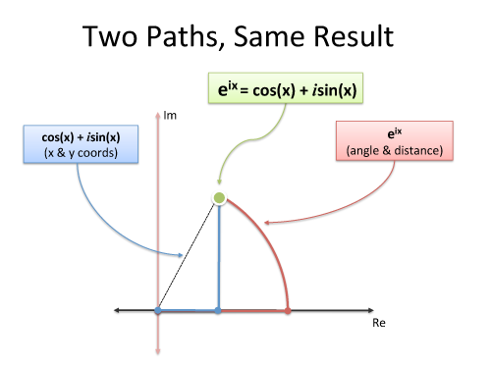
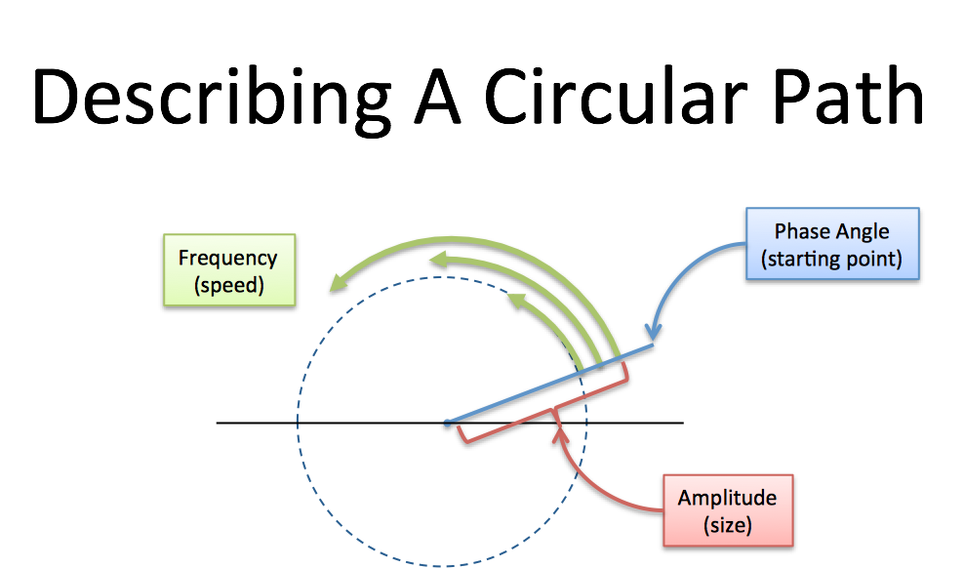
Euler’s Formula
Another choice of bases.
Change of basis.

Slide 43
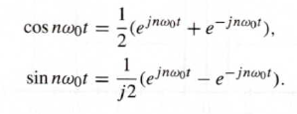
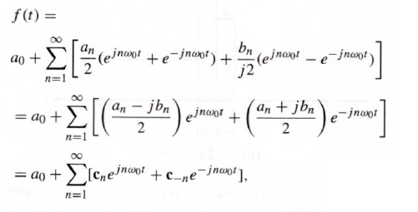



Exponential Fourier Series
Euler’s Identity:
Fourier Series:
Euler’s Identity in the Fourier Series:

Slide 44

Fourier Series/Transform/DFT
Fourier Series
Output: Frequency Domain
Fourier Transform – for continuous functions:
Input: Time Domain

Slide 45
Visual Demonstration
Instead of thinking only in sinusoids…
  Complex sinusoids can be thought of as cycles…
  Let’s visual complex #s a bit…
  http://betterexplained.com/examples/fourier/

Slide 46
Frequency-domain
How to make a song appear “periodic:”
  Treat the entire song as 1 period of a very complicated sinusoid!
  This is the assumption of the Fourier Transform

Slide 47




Fourier Series in general form:
  $$sin\left(2t\right)$$
Given this periodic function: $f\left(t\right)$
Fourier Series says it can be broken
into simple sine waves
$$\frac{1}{2}sin(t)$$
Fourier Series for this f(t):
  $$f\left(t\right)=sin\left(2t\right)+\frac{1}{2}sin(t)$$
Fourier Series – decomposes f(t) into a “weighted sum” of sine waves
We only need to store amplitude and frequency of each harmonic of the fund. freq.

Slide 48

Time Domain to Frequency Domain
Periodic Function in Time Domain
Periodic Function in Frequency Domain
Fourier Series for this f(t):
Store only frequency information:
  $$f\left(t\right)=sin\left(2t\right)+\frac{1}{2}sin(t)$$
  1st Fundamental amplitude: 0.5
  2nd Fundamental amplitude: 1
  And so on…
Alternate view of Fourier Series
…converting signals in the “time domain” to the “frequency domain”

Slide 49





Discrete Fourier Transforms
Fourier Transforms are nice,
  but we want to store and process our signals with computers
We extend Fourier Transforms into Discrete Fourier Transforms, or DFT
  We know our music signal is now discrete: $x\left(t\right)→ x_{n}$
  The signal contains N samples: $0 ≤n ≤N−1$
  Again Euler’s formula helps us: $e^{it}=\cos\left(t\right)+i sin⁡(t)$ ?
Discrete Time to Frequency:
$$DFT\left(x_{n}\right)=X_{k}=\sum_{n=0}^{N−1}{x_{n}×e^{−i\frac{2π k n}{N}}}$$
The frequency-domain signal: $X_{k}$
also has N-1 elements: $0≤k≤N−1$
Frequency back to Time:
$${DFT}^{−1}\left(X_{k}\right)=x_{n}=\frac{1}{N}\sum_{k=0}^{N−1}{X_{k}×e^{i\frac{2π k n}{N}}}$$
The time-domain signal: $x_{n}$
can be reconstructed from $X_{k}$

Slide 50


Discrete Fourier Transforms
A DFT transforms N samples of a signal in time domain
  into a (periodic) frequency representation with N samples
  So we don’t have to deal with real signals anymore
We work with sampled signals (quantized in time),
  and the frequency representation we get is also quantized in time!
Music Signal in Discrete Time →
$$DFT\left(x_{n}\right)=X_{k}=\sum_{n=0}^{N−1}{x_{n}×e^{−i\frac{2π k n}{N}}}$$
Music Signal “Transformed” To Frequency Domain →
(sepwww.stanford.edu/oldsep/hale/FftLab.html)

Slide 51
Discrete Fourier Transforms
A smaller sampling period means:
-> more points to represent the signal
larger N
-> more harmonics used in DFT
N harmonics
-> Smaller error compared to actual analog
signal we capture/produce
DFTs are extensively used in practice, since computers can handle them

Slide 52
Approximating the Sampled Signal
A signal sampled in time can be approximated arbitrarily closely from the time-sampled values
With a DFT, each sample gives us knowledge of one harmonic
Each harmonic is a component used in the reconstruction of the signal
The more harmonics we use, the better the reconstruction
, Sin[2t], Cos[2t]
, Sin[3t], Cos[3t] }
{ Cos[0t], Sin[1t], Cos[1t]

Slide 53






Usually Computed, Not “Solved”
7 Samples; 7 Harmonics
11 Samples
; 11 Harmonics
15 Samples; 15 Harmonics
DFT
DFT
DFT

Slide 54

Yet Another Sampled (Real) Signal
Measured Data:
Sampled Signal:
v
t

Slide 55
Some Signals Dislike Some Harmonics
Approximate Reconstruction
  although always achievable
  may require a lot of samples
  to get good performance
Sometimes time is better than frequency!
15 Samples & Harmonics
21 Samples & Harmonics
31 Samples & Harmonics

Slide 56
Saving resources
However, N can get very large
  e.g., with a sampling rate of 48,000Hz
  How big is N for a 4 minute song?
How many operations does this translate to?
  To compute one frequency component?
  To compute all N frequency components?
This is not practical. Instead, we use a window of values to which we apply the transform
  Typical size: …, 512, 1024, 2048, …

Slide 57



A Window Operation
In the example below, we traverse the signal but only look at 64 samples at a time
Time
Freq
(sepwww.stanford.edu/oldsep/hale/FftLab.html)

Slide 58
Reconstruction
Not really connect-the-dots in time
Recall near Nyquist rate
  Could often miss the peak
  Get poor sine waves
    …look like peak moves around even if sampled above Nyquist rate
Better reconstruction
  Convert to frequency
    Which can perfectly represent up to half sampling rate
  Reconstruct from frequency basis

Slide 59
Big Ideas
Can represent signals in frequency domain
  Different basis – basis vectors of sines and cosines
Often more convenient and efficient than time domain
  Remember musical staff
Can convert between time and frequency domain
  Using a dot-product to calculate time or frequency components

Slide 60
This Week In Lab
Lab 4:
  You will identify Frequency components using FFT in Matlab
Remember:
  Lab 3 report is due on Friday

Slide 61
Learn More
ESE325 – whole course on Fourier Analysis
ESE224 – signal processing
ESE215, 319, 419 – reason about behavior of circuits in time and frequency domains

Slide 62
References
S. Smith, “The Scientists and Engineer’s Guide to Digital Signal Processing,” 1997.
https://betterexplained.com/articles/an-interactive-guide-to-the-fourier-transform/

