Slide 1
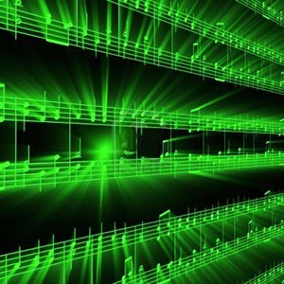


Lecture #6 – Psychoacoustic Model/Compression/MP3
ESE 150 –
Digital Audio Basics

Slide 2
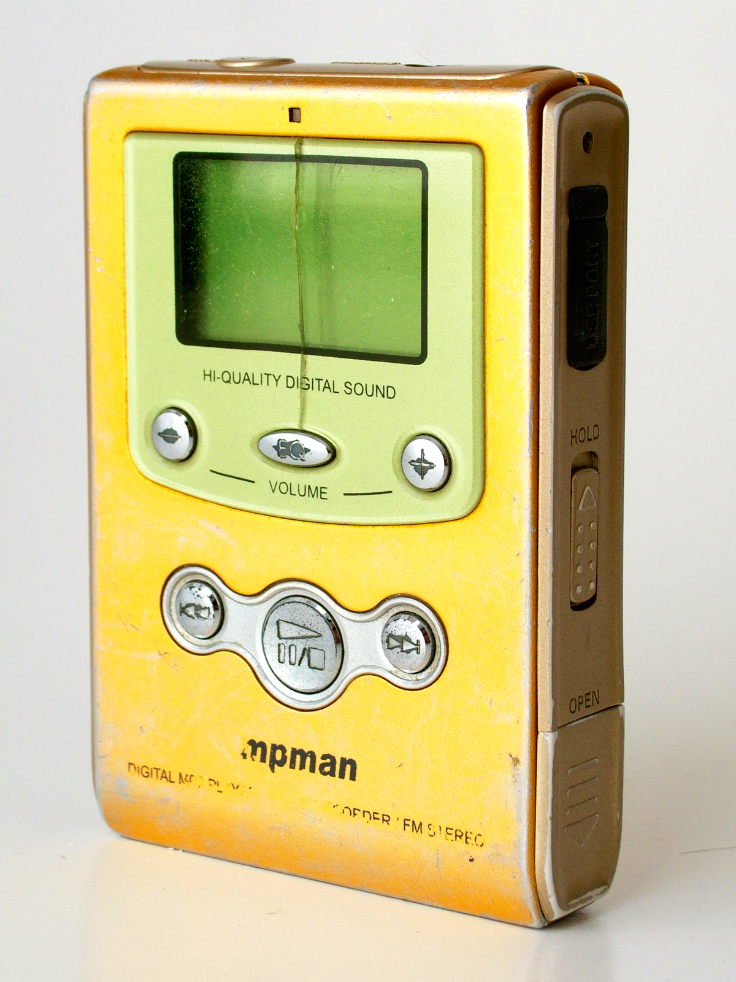
First MP3 Player
MpMan -- 1998
SaeHan Information Systems
  South Korea
32MB of Flash memory

Slide 3
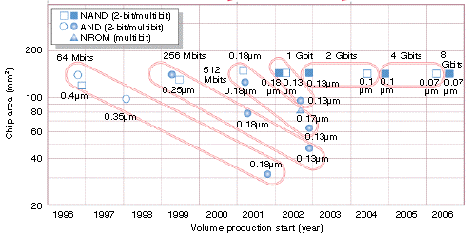
Flash Scaling

Slide 4

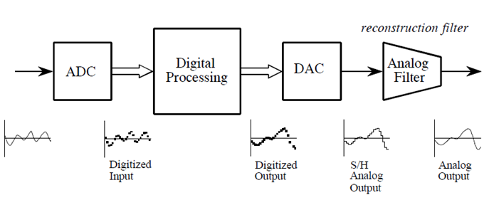
PCM and CD Audio
antialias filter
reconstruction filter
PCM – Pulse Code Modulation
  CD-Quality Audio – state-of-the-art 1990s
    Filtering/Sampling/Quantizing/Encoding using ADC
    DAC/Reconstruction Filter
  CD Quality Digital Audio uses PCM (uncompressed, lots of storage!)
    44,100 samples per second, each sample 16-bits
    1 sec. of music: 44,100 x 16bits = 705,600 bits or 86 kB
    60 seconds of music: 705,600 x 60 = 42,336,000 bits = 5167 kB = 5 MB
    3 minute song: 42,336,000 x 3 = 127,008,000 bits = 15 MB !
    You want it in stereo??? 15 MB x 2 = 30 MB! (no compression!)

Slide 5
Observe
If we kept the CD Audio encoding format
  Could hold one song on the 1998 MpMan
  (maybe 2 on the 64MB version)
For solid-state audio to be viable
  Needed more compact encoding for music

Slide 6
First MP3 Player
MpMan -- 1998
SaeHan Information Systems
  South Korea
32MB of Flash memory
Held 6 songs (MP3)
(12 on 64MB version)
3 years before Apple iPod
  October 2001
  Initially hard disk
Diamond Rio later 1998

Slide 7
Lecture Topics
Teaser
Where are we?
Preclass
How do we take advantage of psychoacoustics in MP3
Achieve this 6—12x reduction from CD Audio
  Review Tricks
  Formulate Optimization
  Adaptation
Next Lab
References

Slide 8
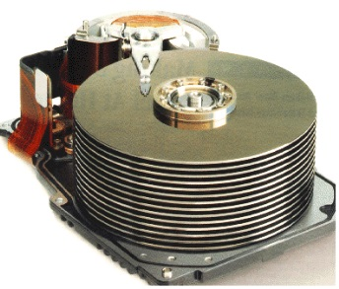








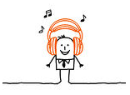

Course Map
7,8,9
10101001101
MIC
CPU
File-
System
A/D
10
10101001101
NIC
Music
1
domain
conversion
5,6
Numbers correspond to course weeks
compress
sample
freq
pyscho-
acoustics
3
2
4
13
11
EULA
----------------click
OK
D/A
NIC
speaker
MP3 Player / iPhone / Droid
12

Slide 9
Course Map – Week 7
MIC
A/D
10101001101
Music
1
domain
conversion
5,6
Numbers correspond to course weeks
compress
sample
freq
pyscho-
acoustics
3
2
4
EULA
----------------click
OK
D/A
10101001101
speaker
MP3 Player / iPhone / Droid

Slide 10
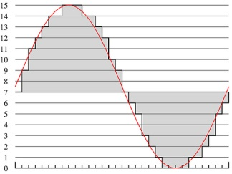
What we did in Lab…
Analog
input
ADC
Digital
Output
compress
Week 1: Converted Sound to analog voltage signal
    a “pressure wave” that changes air molecules w/ respect to time
    a “voltage wave” that changes amplitude w/ respect to time
Week 2: Sampled voltage, then quantized it to digital sig.
  Sample: Break up independent variable, take discrete ‘samples’
  Quantize: Break up dependent variable into n-levels (need 2^{n} bits to digitize)
Week 3: Compress digital signal
  Use even less bits without using sound quality!
Week 4: Before we compress…
  Put our ‘digital’ data into another form…BEFORE we compress…less stuff to compress!
Week 5: Psychoacoustics
  Measured limits of human hearing; measured masking

Slide 11
Preclass

Slide 12
Preclass
4 critical bands
10 frequencies
16b amplitude
Preclass 1: Bits to represent (no further encode)?

Slide 13
Preclass
4 critical bands
10 frequencies
16b amplitude
80b encoding budget
Preclass 2: amplitude quantization necessary to achieve budget?
Preclass 3: frequencies (reduced sampling rate) can keep to achieve budget?

Slide 14
Preclass
4 critical bands
10 frequencies
16b amplitude
80b encoding budget
Preclass 4
  Bits to represent which frequency?
  Bits to encode (frequency, amplitude) pair?
  Number of (frequency,amplitude) pairs fit within budget?

Slide 15
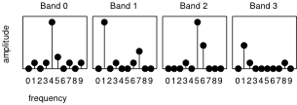
Preclass
4 critical bands
10 frequencies
16b amplitude
80b encoding budget
Preclass 5
  Which frequencies do we keep?

Slide 16
Preclass
4 critical bands
10 frequencies
16b amplitude
80b encoding budget
Preclass 6: which likely to sound best?
  Amplitude quantization
  Frequency quantization (reduce sampling rate)
  Frequency selection based on masking

Slide 17
Tricks for Compression
Quantization
Sampling Rate / Frequency Quantization
Critical Band Masking
  Selective frequency dropping
Other tricks?

Slide 18
Background

Slide 19

The MPEG-1 Standard
ISO (International Standards Organization)
  Looking for ways to reduce transmission requirements for digital video and audio (low bandwidth transmission of digital media)
  1988 – establishes a sub-committee of ISO:
    Moving Picture Experts Group (MPEG)
    Goal: Develop common standard for coding/compressing audio/video
      To reduce size of data to transmit without sacrificing quality
      Fraunhofer Institute and German University of Erlangen
        Lots of basic research in Digital Audio Broadcast, tapped to be MPEG
  Result: 1992: Finalized Standard called: MPEG-1 (Phase I)
    3 Parts: Audio/Video/System
    Audio component: defined 3 layers: 1, 2, 3
      Increasing levels of compression and complexity
      MPEG-1, layer 3 achieves 12:1 compression ratio! (for short MP3)

Slide 20
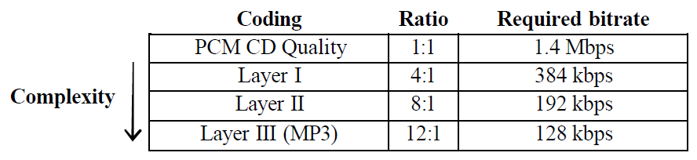
The MPEG-1 Standard
MPEG-1, (3) Layers for Audio Coding:
Why is PCM CD Quality 1.4 Mbps?
  Recall: 1 sec. of music: 44,100 x 16bits = 705,600 bits
  Don’t forget stereo (R/L): 2 x 706,600 = 1,413,200 (1.4Mbs)
    Defines bandwidth requirements of network
  Notice: 128 kbps was just about double modem speed in 1992
    Enables transmission of audio (MP3) via modem! (Napster!)

Slide 21
The MPEG-1 Standard
How did MP3 achieve a 12:1 compression ratio?
  Psychoacoustics was the key
    Becomes a scheme for lossy encoding
    But we don’t lose things human’s can actually here!
    Makes human a part of the “decompression” scheme
  CD Audio PCM is lossless coding of digital audio
    But human beings can’t hear all sounds
  MP3 Encoding is lossy coding scheme
    But we don’t lose things average human’s can actually here!
    We don’t sacrifice high frequencies (sampling rate preserved)
    The trick: drop quantization level when it doesn’t matter!
      The key is taking advantage of masking (frequency/temporal)
  MP3 Combines: Psychoacoustics (lossy compression)
    and Huffman coding (lossless compression)

Slide 22
They kept on going: MPEG-1, 2, 4, 7
MPEG is actually family of encoding standards for digital multimedia information
  They all use Psychoacoustics to achieve high compression
MPEG-1: a standard for storage and retrieval of moving pictures and audio on storage media (e.g., CD-ROM).
    MPEG-1 Layer 3: (MP3)
MPEG-2: standard for digital television, including high-definition television (HDTV), and for addressing multimedia applications.
    Advanced Audio Coding (AAC)
MPEG-4: a standard for multimedia applications, with very low bit-rate audio-visual compression for those channels with very limited bandwidths (e.g., wireless channels).
MPEG-7: a content representation standard for information search
Notes:
“.mp3”, originally the file extension created by Windows MPEG-1 Layer III encoder and decoder, has become the name for an entire line technology.
MPEG-3 is not MP3.
(Click)
In fact, I can’t find any MPEG-3. The standards go from MPEG-1 to MPEG-2 and jumps to MPEG-4, then MPEG-7.
(Click)
MPEG-1 Audio (ISO/IEC 11172-3)
provides single-channel ('mono') and two-channel ('stereo' or 'dual mono') coding at 32, 44.1, and 48 kHz sampling rate.
MPEG-2 Audio (ISO/IEC 13818-3)
provides a backwards compatible multi-channel extension to MPEG-1; up to 5 main channels plus a 'low frequent enhancement' (LFE) channel can be coded.
MPEG-2 AAC (ISO/IEC 13818-7)
Provides a very high-quality audio coding standard for 1 to 48 channels at sampling rates of 8 to 96 kHz, with multi-channel, multi-lingual, and multi-program capabilities.
MPEG-4 Audio (ISO/IEC 14496-3)
Provides coding and composition of natural and synthetic audio objects at a very wide range of bit rates.
MPEG-7
Nowadays, more and more audiovisual information is available, from many sources around the world. Also, there are people who want to use this audiovisual information for various purposes. However, before the information can be used, it must be located. MPEG-7 will be a standardized description of various types of multimedia information. This description will be associated with the content itself, to allow fast and efficient searching for material that is of interest to the user. MPEG-7 is formally called ‘Multimedia Content Description Interface’.

Slide 23
Some Knowledge of Digital Audio Formats
.WAV & .AIFF
  Uncompressed PCM (lossless) CD-Audio Quality
.MPA
  MPEG-1 Layer 2
  Compressed PCM using Psychoacoustics (lossy)
.MP3
  MPEG-1 Layer 3
  Compressed PCM using Psychoacoustics (lossy)
.M4A (Audio only Apple’s iTunes format)
  MPEG-4 Part 14 (MP4)
  Compressed PCM using Psychoacoustics

Slide 24
Some Terminology
Psychoacoustics
  Research into how brain interprets sounds from ear
Perceptual Coding
  An audio encoding technique that takes advantage of psychoacoustics
  CD delivers all recorded sounds to your ear…
    …but your brain can’t actually interpret them
  Perceptual coded audio delivers sounds to your ear…
    …that your brain can actually interpret!
CODEC
  Coder/Decoder
MP3 is a standard for a perceptual audio codec…
  That takes advantage of frequency/time masking to encode audio data!

Slide 25
Optimizing Encoding

Slide 26
Knobs we can turn
Amplitude quantization
Frequency quantization
Frequencies kept (per critical band)
  Too soft
  Masked
…and can perform lossless compression

Slide 27
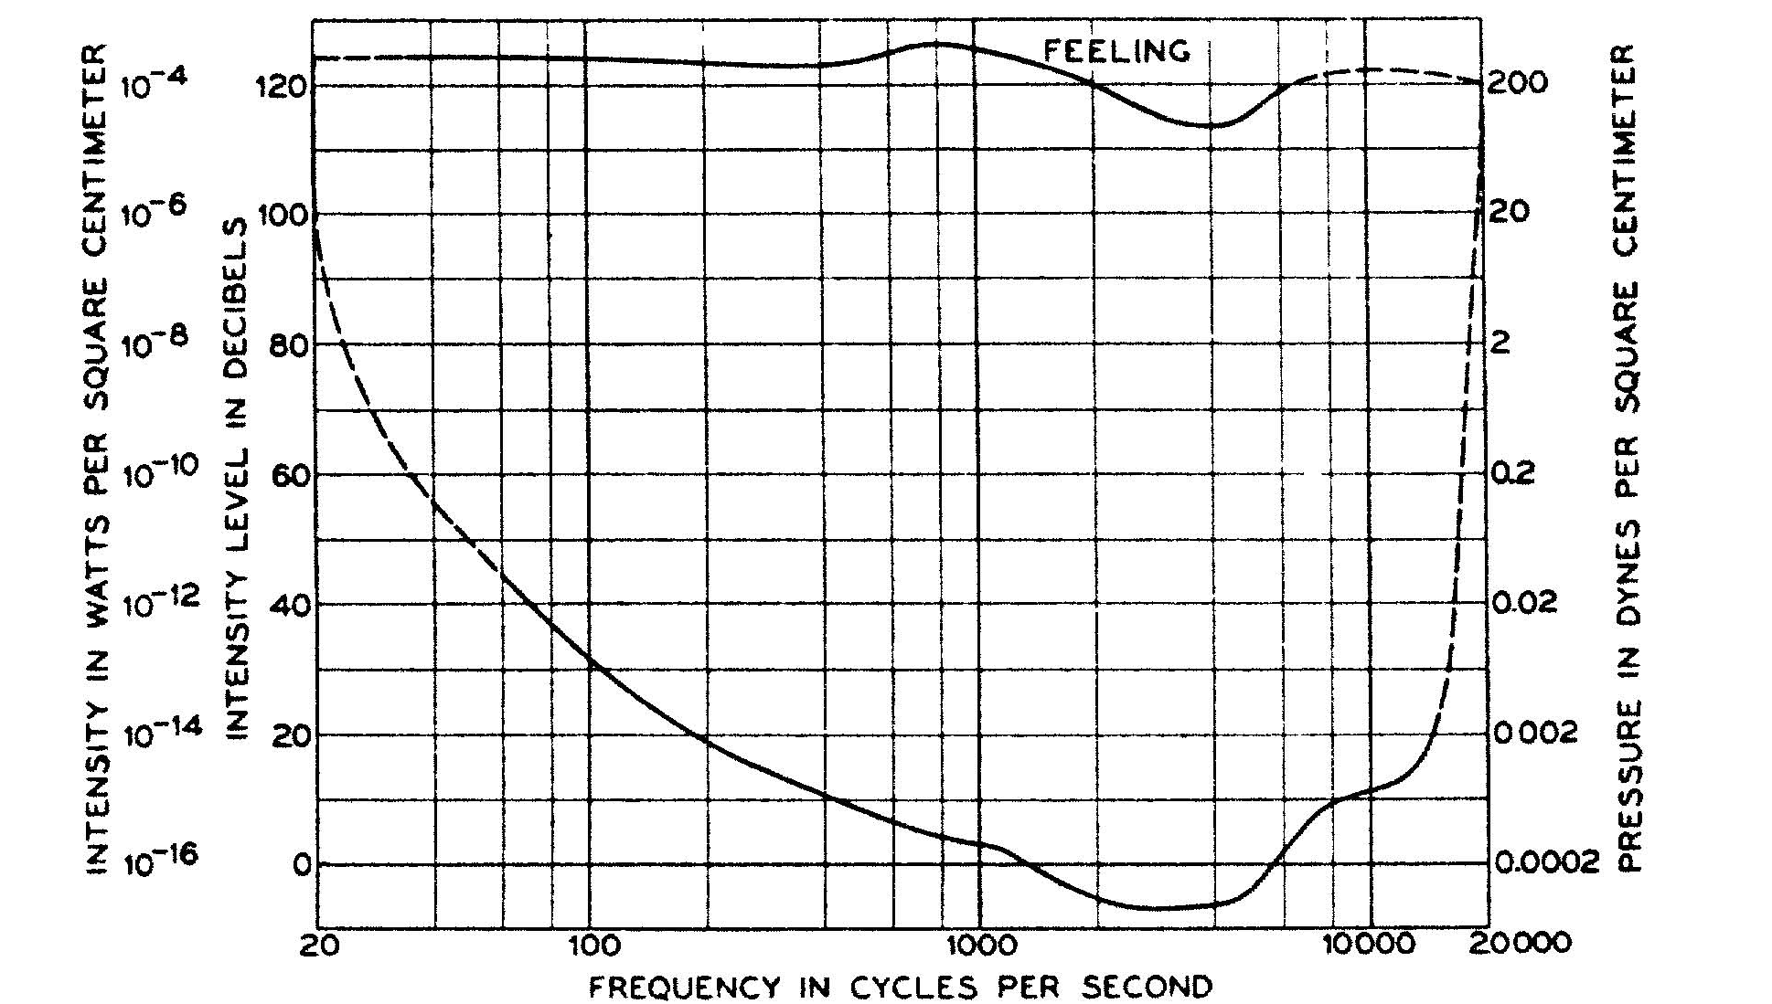
Bands vary in importance
Not equally sensitive across bands
If quantize bands
differently, where
want finer
resolution?
Where tolerate more
quantization?

Slide 28
Knobs we can turn
Amplitude quantization
  Per band
Frequency quantization
  Per band?
Frequencies kept (per critical band)
  Per band
…and can perform lossless compression

Slide 29
Opportunities/Challenges
Trying to hit fixed bit rate, what challenge does lossless compression impose?
  Encounter many common frequencies?
  Encounter many uncommon frequencies?

Slide 30
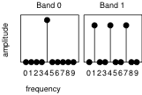
Opportunities/Challenges
What challenge/opportunities might these band spectra represent?

Slide 31
Suggest
May want to do something smarter than
  Allocating fixed number of frequencies per band
  Allocating fixed quantization to a band
Like to adapt our encoding to the data
  If more Huffman compressible, we get more frequencies
  If fewer frequencies suffice for one band,
    Allow more frequencies for another
    …or allocate less quantization

Slide 32
Optimization Problem
How fit in the resource constraints (128Kb/s) while maximizing goodness (sound quality)?
Optimization problems central to engineering

Slide 33
Optimization Problem
How fit in the resource constraints (128Kb/s) while maximizing goodness (sound quality)?
Quantify bits used
Quantify goodness

Slide 34
Quantifying Bit cost
Simple, fixed sample: Frequencies × Bits/freq
Fixed frequencies per Band:
  Bands × (Frequencies/Band) × Bits/freq
Variable Frequencies per Band:
Variable Frequencies and quantization per Band:
Huffman means different
bits/frequency

Slide 35
Goodness/Sound Quality
Error(freq) = |OrigFreq Amplitude – Encoded|
  Whole OrigFreq if dropped
  |OrigFreq-Quantize(OrigFreq,bits)| if quantized
W(freq)
  0 if below hearing threshold
  0 if masked
  Value between 0 and 1 if partially masked in critical band
  Really depend on what
  already encoded

Slide 36
Optimization Problem
How fit in the resource constraints (128Kb/s) while maximizing goodness (sound quality)?
Quantify bits used
Quantify goodness

Slide 37
Approach
Start with nothing
Start with bitbudget
While(bitbudget>0)
  Identify Largest Error component: Error(freq)×W(freq)
  What do to reduce error?

Slide 38
Approach (Greedy)
Start with nothing
Start with bitbudget
While(bitbudget>0)
  Identify Largest Error component
  Allocate some bits to reduce error
    Add frequency
    Add quantization bits to band
    Pick one to most reduce the error

Slide 39
Approach (Refine Greedy)
Start with nothing
Start with bitbudget
While(bitbudget>0)
  Identify Largest Δerror/Δbits
Why might prefer?
Large error, might take many bits to improve
  Maybe could be better spending those bits to fix many problems?

Slide 40
Adaptive Refinement
Rediscovering where to allocate everything every time may be laborious
Maybe we can get close and adjust?

Slide 41
Approach (Adaptive)
Start with budget guess
  Quantization in bands
  Frequencies to keep in each band
Encode, compress
What do if haven’t used up all bits?
What do if over budget?

Slide 42
PERCEPTUAL CODING & MP3

Slide 43
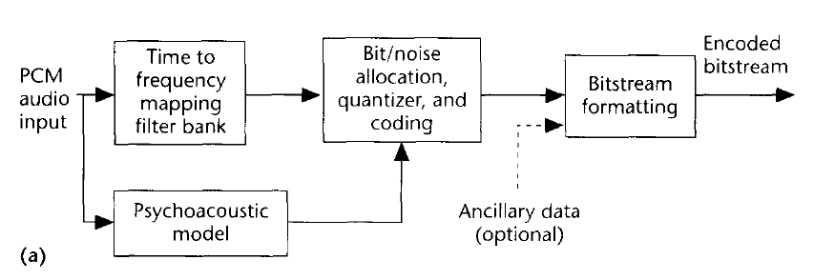
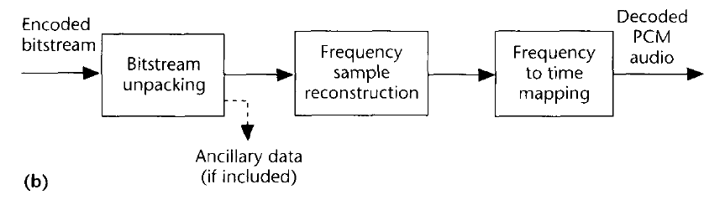
MP3 Flow Chart (Encoding/Decoding)
Basic MP3 Encoding Scheme
A type of DFT is performed
Data is
stored in
frequency domain rep.
Even Huffman coded too!
We use psychoacoustic
model to control quantization!
(how we achieve compression)
MP3 Decoding Scheme
Notice: Psychoacoustics is embedded
Your brain is involved in decoding!

Slide 44

MP3 Encoding Process
All MP3 files broken into “Frames”
  Each frame stores 1152 Audio Samples
  Lasts for 26 ms
  Frame also divided further into 2 “granuels”
    Each granuel contains 576 samples
Bitrate determines size of each sample
  Increase the bitrate, increase the size of the frame!
Sampling rate also impacts frame size
Formula:
  Example: frame size = 144 x 128kbs / 44.1kHz = 417

Slide 45
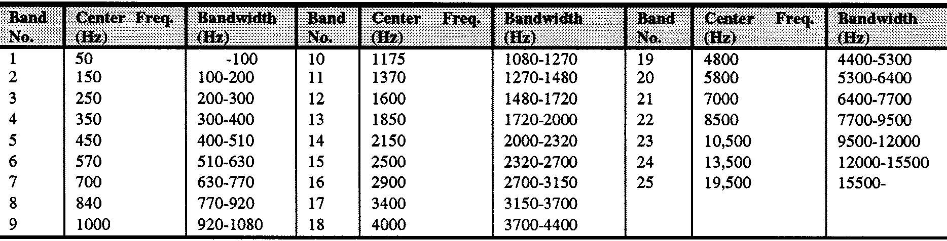
MP3 Encoding Process
Q
…
…
acquire & transform “frame”
Bring in 1152 PCM samples
Use DFT/MDCT to transform to frequency-domain
- n_{S}
- n_{A}
n_{A}
n_{S}
DFT
Bands
Q₁
Q₂
Q₃
Q₄
Q₅
…
Q_{k-1}
Q_{k}
Q_{k+1}
…
Q_{nA}
assign frequencies to bands
use psychoacoustic model lookup
  to determine frequency bandwidth
  of each critical band
  separate samples into bands
…
…
…
1
2
…
…
k
23

Slide 46
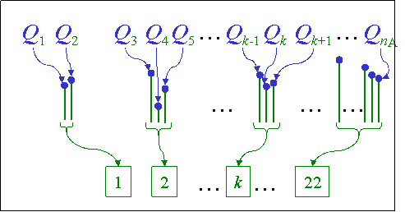
MP3 Encoding Process – Compress
Compress based off masking model
  Goal: minimize bits per critical band
  C_{band k(j)} = Round[Q_{band k(j)} , Level]
  by appeal to “masking” models
    Q_{band k} = C_{band k} + D_{band k}
    where distortion (“perceptual noise”)
  D_{band k}
    between retained signal
  C_{band k}
  and actual signal
  Q_{band k}
    should be “masked” by retained signal
Bands
Lossy Coding

Slide 47
Compress – Up close
Real Input
SPL
more bits yields larger
signal-to-mask-ratio
E.g., Look at k^{th} band
  Q_{band k} = (Q_{band k(1)} , … ,,Q_{band k(m)} )
Determine masking paradigm:
  tone-masking-noise
  noise-masking-tone
  noise-masking-noise
E.g., for tone masker,
  Pick tone frequency, band k (j)
  at maximal amplitude in the band
Choose quantization level and compute compressed signal
  C_{band k(j)} = Round[Q_{band k(j)} , Level]
  C_{band k} = (0_{band k(1)} , … , C_{band k(j)} , … , 0_{band k(m)} )
Assess noise magnitude, | D_{band k} |
  D_{band k} =
  (Q_{band k(1)} , … , Q_{band k(j)} , … ,,Q_{band k(m)} )
  - (0_{band k(1)} , … , C_{band k(j)} , …, 0_{band k(m)}
Use psychoacoustic model
  to determine whether compressed signal
  will mask the distortion noise for that band
frequency
2 bit Signal
2 bit | Noise |
SPL
SPL
2 bit
SMR
frequency
frequency
1 bit Signal
1 bit | Noise |
SPL
SPL
1 bit
SMR
frequency
frequency

Slide 48
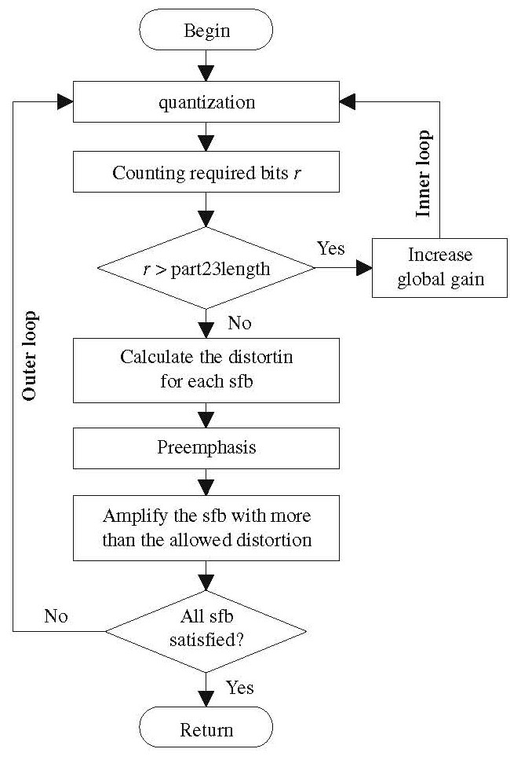
Formal MP3 Perceptual Coding Algorithm
Commit to Observation Window
  “Long” (complex sound; frequency resolution)
  “Short” (transient sound; temporal resolution)
Estimate Perceptual Entropy
  Analyze Each Critical Band
  Characterize Masker
  Estimate Mask-to-Noise Threshold
  Update “bit reservoir”
Spectral Quantization/Coding Loop
  Allocate bits per critical band
  Quantize band to bits-allowed levels
  Run Huffmann & count actual bits
[You & Chen. Multim.Tools & Appl., 40(3):341–359, 2008.]

Slide 49
Big Ideas
Can use pyschoacoustics to compress audio
  Eliminate portions of signal that human’s don’t notice
Optimization
  Identify Design Space (knobs)
  Identify Costs and Constraints
  Formulate quantitatively
  Algorithms to approach
  Iterative/adaptive approach
    Deal with effects that aren’t completely predictable

Slide 50
Learn More
Optimization –
  continuous mathematical optimization ESE204, ESE504, ESE605
  discrete optimization CIS121, CIS320
Signal processing – ESE224

Slide 51
Next Week
Monday start of 2 week lab:
  Perform perceptual compression
    Convergence of everything seen first 6 weeks
  Formal lab report on this 2 week lab
  No weekly lab report Friday
Wednesday: midterm (class time)
Office Hours:
  Cancel Wed. and Thursday evening
  Add Tuesday 5-9pm
  Wed. 1-3pm remain

Slide 52
Midterm – In Class
Topics
Data representation in bits
Sounds waves
Sampling
Quantization
Nyquist
Lossy/lossless compression
Common case
Frequency domain
Psychoacoustics
Perceptual coding
Closed book, no notes
Calculators allowed
4:35pm-5:50pm
5% of grade
  prepare for final
Last year’s final on syllabus
  Will be a bit different

Slide 53
References
Tutorials on Psychoacoustic Coding (in increasing order of abstraction and generality)
  D. Pan, M. Inc, and I. L. Schaumburg. A tutorial on MPEG/audio compression. IEEE multimedia, 2(2):60–74, 1995.
  Nikil Jayant, James Johnston, and Robert Safranek. Signal compression based on models of human perception. Proceedings of the IEEE, 81(10):1385–1422, 1993.
  V. K. Goyal. Theoretical foundations of transform coding. IEEE Signal Processing Magazine, 18(5):9–21, 2001.
Lightweight Overview of MP3
  Rassol Raissi. The theory behind mp3. Technical report, MP3’ Tech, December 2002.
Scientific Basis of MP3 Coding Standard
  J. D. Johnston. Transform coding of audio signals using perceptual noise criteria. IEEE Journal on selected areas in communications, 6(2):314–323, 1988.

