Slide 1



Lecture #7 – Digital Logic
ESE 150 –
Digital Audio Basics
Based on slides © 2009--2018
DeHon

Slide 2








So far
MIC
A/D
10101001101
DFT
Identify Masking
Huffman encoding
Music
1
domain
conversion
5,6
Numbers correspond to course weeks
compress
sample
freq
pyscho-
acoustics
3
2
4
Huffman Decode
IDFT
EULA
----------------click
OK
D/A
10101001101
speaker
MP3 Player / iPhone / Droid

Slide 3
How Process
How do we build a machine to perform these operations?
  From Digital Samples → compressed digital data → Digital Samples
Down to bottom
  If we can build one kind of primitive element,
    …and connect together large collections of them
  can build a machine to perform any digital computation

Slide 4
Lecture Topics
Setup
Where are we?
Combinational Logic
Sequential Logic
FPGAs
Next Lab

Slide 5
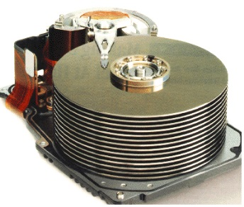


Course Map
7,8,9
10101001101
MIC
CPU
File-
System
A/D
10
10101001101
NIC
Music
1
domain
conversion
5,6
Numbers correspond to course weeks
compress
sample
freq
pyscho-
acoustics
3
2
4
13
11
EULA
----------------click
OK
D/A
NIC
speaker
MP3 Player / iPhone / Droid
12

Slide 6

Course Map – Week 8
MIC
A/D
10101
Music
1
domain
conversion
5,6
Numbers correspond to course weeks
compress
sample
freq
pyscho-
acoustics
3
2
4
EULA
----------------click
OK
D/A
10101001101
speaker
MP3 Player / iPhone / Droid

Slide 7
Combinational Logic

Slide 8
Gate
Primitive binary function
  Computes a binary output from a small number of binary inputs
Can specify function with a Truth Table
  Defines the output for each input combination
Input 0 | Input 1 | Output
0 | 0
0 | 1
1 | 0
1 | 1

Slide 9

AND Gate
AND
  Output is 1 (true) when all inputs are 1 (true)
Input 0 | Input 1 | AND
0 | 0 | 0
0 | 1 | 0
1 | 0 | 0
1 | 1 | 1

Slide 10

NOT Gate
Not
  Output is opposite of input
input | NOT
0 | 1
1 | 0

Slide 11

OR Gate
OR
  Output is 1 (true) when any input is 1 (true)
  (fillin truth table for OR)
Input 0 | Input 1 | OR
0 | 0
0 | 1
1 | 0
1 | 1

Slide 12
Claim
Can compute any Boolean Function from AND, OR, NOT
  (actually from NAND)

Slide 13
Model: Combinational Logic
Compute some “function”
  f(i₀,i₁,…i_{n}) → o₀,o₁,…o_{m}
Each unique input vector
  implies a particular, deterministic, output vector

Slide 14
Big AND
AND
  Output is 1 (true) when all inputs are 1 (true)
How built n-input AND from AND2 gates?

Slide 15
Big OR
OR
  Output is 1 (true) when any input is 1 (true)
How build n-input OR from OR2?

Slide 16
Input Condition
How can we create an expression that is true for a specific input case?
  E.g. have a function of 4 inputs: a, b, c, d
How many potential values for a, b, c, d?
  Rows in our truth table
Give one example of values for a, b, c, d?
How create an expression that is true for that case?

Slide 17
Single Output Digital Function
Given have logic to implement each input case
How implement entire function?
a | b | c | F(a,b,c)
0 | 0 | 0 | 1
0 | 0 | 1 | 0
0 | 1 | 0 | 0
0 | 1 | 1 | 0
1 | 0 | 0 | 0
1 | 0 | 1 | 0
1 | 1 | 0 | 0
1 | 1 | 1 | 1

Slide 18
Multiple Output Function
What do you do if your Digital Function needs multiple output bits?

Slide 19
Combinational Logic as Gates
Start with truth table
Single output {0, 1}
  Use inverters to produce complements of inputs
  For each input case
    If output is a 1
      Develop an AND to detect that case
        Decompose AND into gates
  OR together the output of all such AND functions
    Decompose OR into gates
Multiple outputs
  Repeat for each output
This solution won’t typically be the smallest or fastest…

Slide 20
Conclude
Can implement any combinational logic function out of a collection of
  OR2, AND2, NOT gates

Slide 21

NAND2 Gate
NAND = NOT AND
  Output is 0 (true) when all inputs are 1 (true); 0 otherwise
Input 0 | Input 1 | NAND
0 | 0 | 1
0 | 1 | 1
1 | 0 | 1
1 | 1 | 0

Slide 22

NAND Universality
Can implement
  AND2 from NAND2
  NOT from NAND2
  OR2 from NAND2
Can implement any combinational logic function out of a collection of
  OR2, AND2, NOT gates
Therefore: Can implement any combinational logic function out of a collection of NAND2 gates

Slide 23

Multiplexer Gate
MUX
  When S=0, output=i0
  When S=1, output=i1
S | i0 | i1 | Mux2(S,i0,i1)
0 | 0 | 0
0 | 0 | 1
0 | 1 | 0
0 | 1 | 1
1 | 0 | 0
1 | 0 | 1
1 | 1 | 0
1 | 1 | 1
Truth Table?
AND, OR, NOT
Implementation?

Slide 24
Arithmetic
Addition is also a digital logic function
  Maps set of inputs (a3 a2 a1 a0 b3 b2 b1 b0)
  To an output bit vector (c4 c3 c2 c1 c0)
…as is subtraction, multiplication, division, square root….

Slide 25

Full Adder
Adds 3 inputs to produce 2b output
  Can produce truth table and logic (Lab)

Slide 26
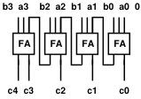
N-Bit Adder
Given Full Adders
  Can build N-bit adder by connecting N full adders

Slide 27
Sequential Logic

Slide 28
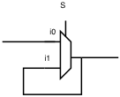
Mux with Feedback
What happens when S=0?
What happens when S=1?

Slide 29
Mux with Feedback
Assuming i0 doesn’t change
what happens when S goes from 0 to 1?

Slide 30

Latch
Element that can hold a
previous value of an input

Slide 31
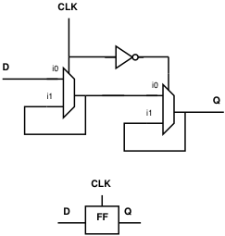
Flip-Flop (FF)
Use a pair to create a flip-flop
  Also call register
Sample D input on 0→1
transition of clock (CLK)
Never an open path from
D→Q
  One of the mux latches always
  in hold state

Slide 32
State Element
Latch or Register is a state element
Allows circuit to remember a value
Build computations that
  Depend on past inputs
  Reuse hardware in time

Slide 33
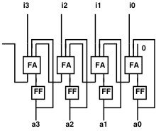
Accumulator
What does this do?

Slide 34
Accumulator
while (true)
  a=a+getInput();
Accumulates
input values i
  Integration or
  summation

Slide 35
State for Sequencing and Control
Useful when trying to control things
  E.g. Perform a sequence of operations
Robot
  Open-gripper
  Move-forward
  Close-gripper
  Lift

Slide 36
State for Conditional Control
Useful when need to behave differently based on something in the past
  Remember if elevator going up or down
  Remember/count coins from consumer
  Remember some mode set by user
    Displaying in Centigrade or Fahrenheit
Idea
  Store state
  Use as input to logic

Slide 37
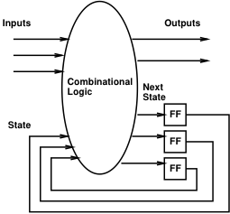
Finite-State Machine (FSM)
Sequential model of computation
State (in registers) + combinational logic
Compute outputs and next state
from inputs and state

Slide 38
FSM Example
Simplified Vending Machine
  Only input quarters
  Only vend one item (output signal to indicate vending)
  Item costs 2 quarters
  Coin Return request and control
Two states: waiting, one-quarter (one)
Two inputs: quarter, coin-return (creturn)
Two outputs: vend, return-quarter (qreturn)

Slide 39
Truth Table Model
state | quarter | creturn | vend | qreturn | next
waiting | 0 | 0 | 0 | 0 | waiting
waiting | 0 | 1 | 0 | 0 | waiting
waiting | 1 | 0 | 0 | 0 | one
waiting | 1 | 1 | 0 | 1 | waiting
one | 0 | 0 | 0 | 0 | one
one | 0 | 1 | 0 | 1 | waiting
one | 1 | 0 | 1 | 0 | waiting
one | 1 | 1 | 0 | 1 | one

Slide 40
Switch-Statement Model
While (true)
switch (state) {
case waiting:
if (quarter && !creturn)
state=one;
else
state=waiting;
qreturn=quarter && creturn;
vend=0;
break;

Slide 41
Switch-Statement Model (cont.)
case one:
if ((quarter && !creturn)||
(!quarter&&creturn))
state=waiting;
else
state=one;
qreturn=creturn;
vend=quarter&& !creturn;
break;
} // switch
} // while

Slide 42
FSM Graph Model
!quarter/
vend=0, qreturn=0
quarter&creturn/
vend=0, qreturn=1
waiting
quarter&!creturn/
vend=1, qreturn=0
quarter&!creturn/
vend=0, qreturn=0
!quarter&creturn/
vend=0, qreturn=1
one
!quarter&!creturn/
vend=0, qreturn=0
!quarter&!creturn/
vend=0, qreturn=0

Slide 43
Programmable Logic

Slide 44
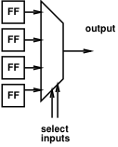
Mux can be a programmable Gate
Programmable Gate
  Can be programmed to act as any gate
  Use state (e.g. FF) to “program” truth table of a gate
Input 0 | Input 1 | Output
0 | 0
0 | 1
1 | 0
1 | 1

Slide 45
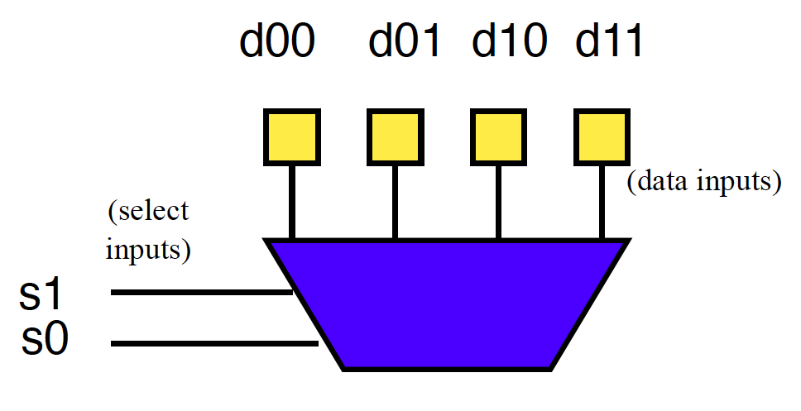
Example: AND
How do we program to behave as AND2?

Slide 46
Example: OR
How do we program to behave as OR2?

Slide 47
Look-Up Table (LUT)
Can generalize to any number of inputs

Slide 48
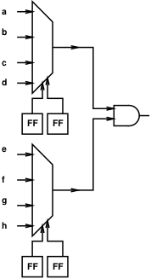
Mux can be Programmable Interconnect

Slide 49
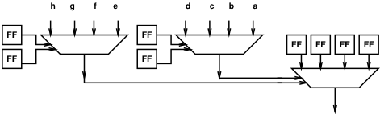
Programmable Blocks

Slide 50
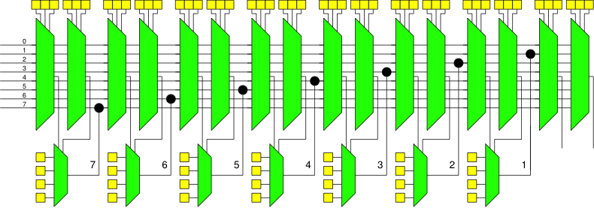
Programmable Gates and Interconnect

Slide 51
Field-Programmable Gate Array
Collection of Programmable Gates
  Can “program” by setting state bits
  LUTs that can be programmed to be any gate
    With optional Flip-Flops to use for state
  Programmable interconnect to “wire” the gates together

Slide 52
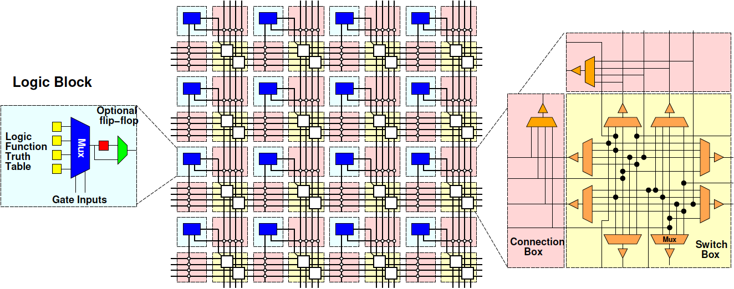
Field-Programmable Gate Array (FPGA)

Slide 53
Next Lab
Program an FPGA in Verilog
  Build an adder
  Build an FSM

Slide 54
Big Ideas
Can implement any combinational digital logic function from nand2 gates
Can implement any FSM from nand2 gates and registers
Can build a single chip that can be programmed to behave as any collection of gates
  As long as don’t need more gates than it provides

Slide 55
Learn More
CIS240 – do a bit more logic
ESE370 – how to implement gates, latches, and memories from transistors
ESE532 – how to build large-scale computations from logic

Slide 56
Reminder
Formal Lab Report Due Sunday

