Slide 1



Lecture #8 – Stored-Program Processors
ESE 150 –
Digital Audio Basics
Based on slides © 2009--2018
DeHon

Slide 2









So Far
MIC
A/D
10101
Music
1
domain
conversion
5,6
Numbers correspond to course weeks
compress
sample
freq
pyscho-
acoustics
3
2
4
EULA
----------------click
OK
D/A
10101001101
speaker
MP3 Player / iPhone / Droid

Slide 3
How Process
How do we build a machine to perform these operations?
  From Digital Samples → compressed digital data → Digital Samples
With simple gates and registers
  can build a machine to perform any digital computation
  …if we have enough of them.

Slide 4
Economy and Universality
What if we only have a small number of gates?
OR … how many physical gates do we really need?
  How do we perform computation with minimal hardware?
How do we change the computation performed by our hardware?

Slide 5
Lecture Topics
Setup
Where are we?
Memory
One-gate processor
Wide-Word, Stored-Program Processor
Contemporary Processors: ARM, Arduino
Next Lab

Slide 6
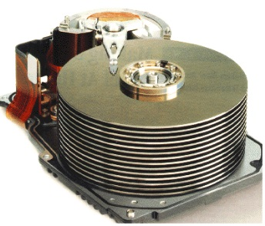


Course Map
7,8,9
10101001101
MIC
CPU
File-
System
A/D
10
10101001101
NIC
Music
1
domain
conversion
5,6
Numbers correspond to course weeks
compress
sample
freq
pyscho-
acoustics
3
2
4
13
11
EULA
----------------click
OK
D/A
NIC
speaker
MP3 Player / iPhone / Droid
12

Slide 7
Course Map – Week 9
MIC
A/D
Music
1
domain
conversion
5,6
Numbers correspond to course weeks
compress
sample
freq
pyscho-
acoustics
3
2
4
EULA
----------------click
OK
D/A
10101001101
speaker
MP3 Player / iPhone / Droid

Slide 8
Quick Reminder

Slide 9

Multiplexer Gate
MUX
  When S=0, output=i0
  When S=1, output=i1
S | i0 | i1 | Mux2(S,i0,i1)
0 | 0 | 0 | 0
0 | 0 | 1 | 0
0 | 1 | 0 | 1
0 | 1 | 1 | 1
1 | 0 | 0 | 0
1 | 0 | 1 | 1
1 | 1 | 0 | 0
1 | 1 | 1 | 1

Slide 10
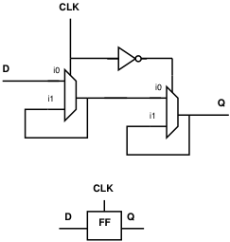
State Element
Latch or Register is a state element
Allows circuit to remember a value
Build computations that
  Depend on past inputs
  Reuse hardware in time

Slide 11
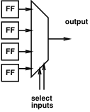
Mux can be a programmable Gate
Programmable Gate
  Can be programmed to act as any gate
  Use state (e.g. FF) to “program” truth table of a gate
Input 0 | Input 1 | Output
0 | 0
0 | 1
1 | 0
1 | 1

Slide 12
NAND Universality
Can implement any combinational logic function out of a collection of NAND2 gates
  Or AND, OR, NOT combination
  Or Programmable MUX gates (OR)

Slide 13
Preclass 1
What Function?
  o1=a&b | b&c | a&c;
  o2=a^b^c;
How many gates?

Slide 14
Memory

Slide 15
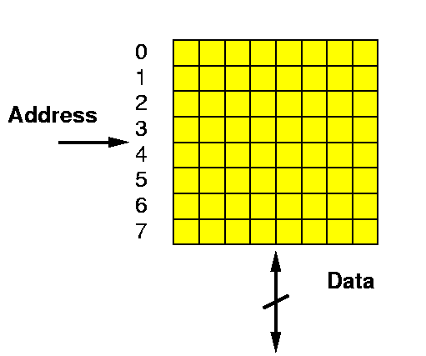
Random Access Memory
A Memory:
  Series of locations
  Can write values a slot (specified by address)
  Read values from (by address)
  Return last value written

Slide 16
Two Pieces of a Memory
Element to remember a value
Way to address/select that element

Slide 17
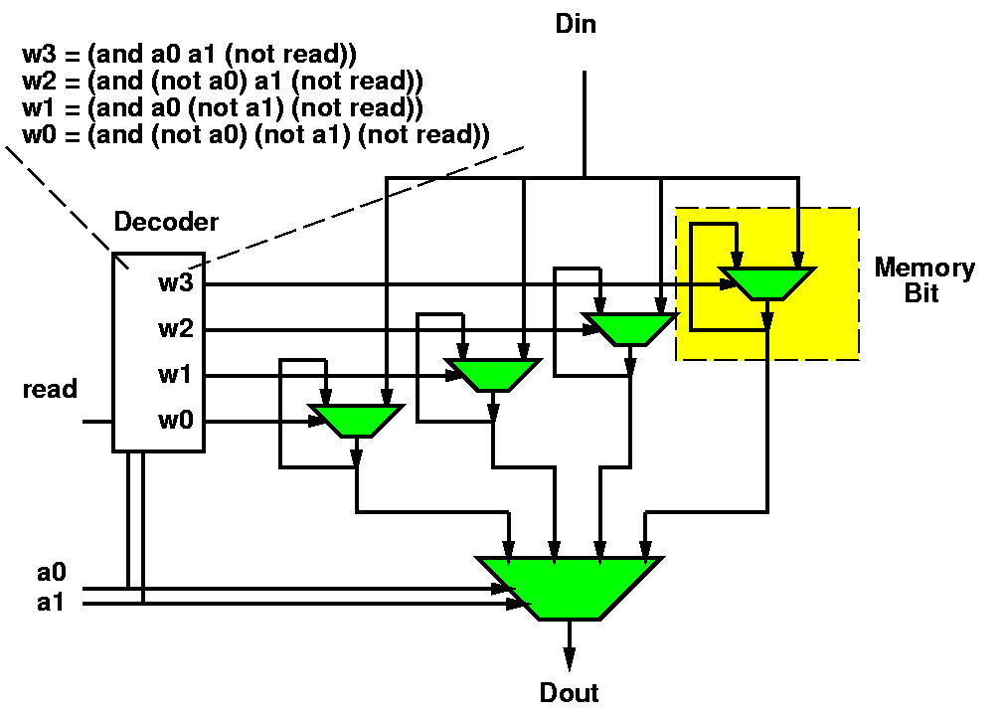
Could build Memory w/ Muxes & latches
… collection of registers

Slide 18
Random Access Memory (RAM) with Capacitor Memories
Din
Decoder
Read
Address
Learn more: ESE370
Dout

Slide 19
Key Engineering Property
Store state compactly in memory
A(memory cell) small
  A(mem) < A(gate)
Depends on few
inputs/outputs
  Memory cells share
  inputs and ouptuts

Slide 20
One-Gate Processor

Slide 21
Idea
Store register and gate outputs in memory
Compute one gate at a time
  Using a single physical gate

Slide 22
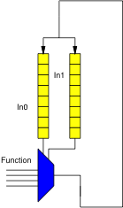
Basic Idiom
Repeat:
Read gate value from memory
Perform operation on gate
Write result back to memory

Slide 23
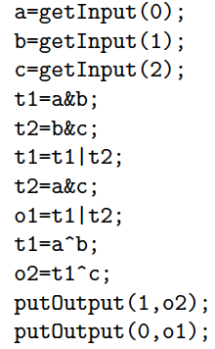

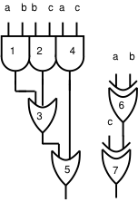
Operation

Slide 24
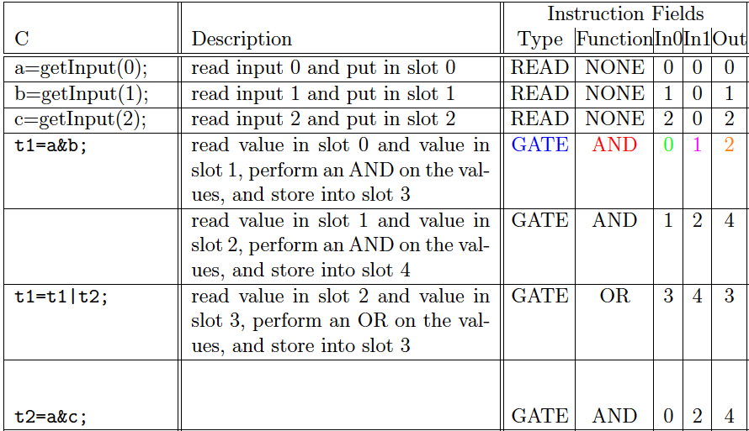
Operation Sequence
Missing
C step?
Missing description?

Slide 25
Observe
We can sequentialize operations,
reusing the single gate
As long as we can specify the
operation to be performed
What are we specifying?
  (break it down, what information need?)

Slide 26
Instruction
Call this specification an instruction
Instructs the programmable,
reusable operators on what to perform

Slide 27
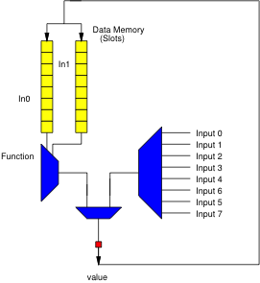
Expanding the Structure: Input
Add a multiplexer to bring in inputs
Allow as option to write into data memory

Slide 28
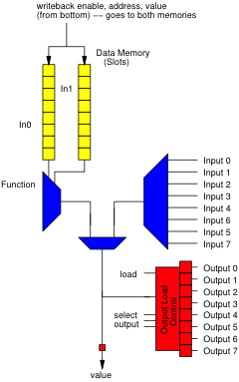
Expanding the Structure: Output
Add way to load a designated output register

Slide 29
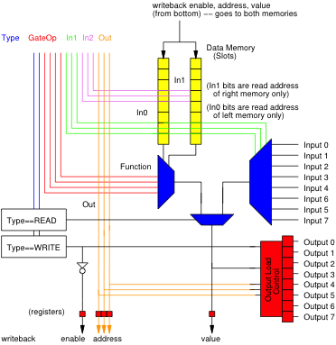
Expanded Control = Instruction
Group the full control into instruction
Set of bits that tells the structure what to do

Slide 30
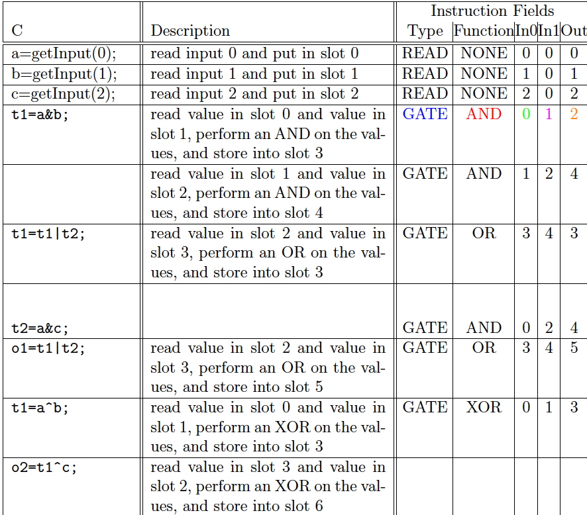
Fillin missing Instruction

Slide 31

Instruction Bits
Instructions are just a set of bits
Type – 2 bits
GateOp – 4 bits
In1 – 3 bits
  Assume 8 slots
In2 – 3 bits
Out – 3 bits

Slide 32
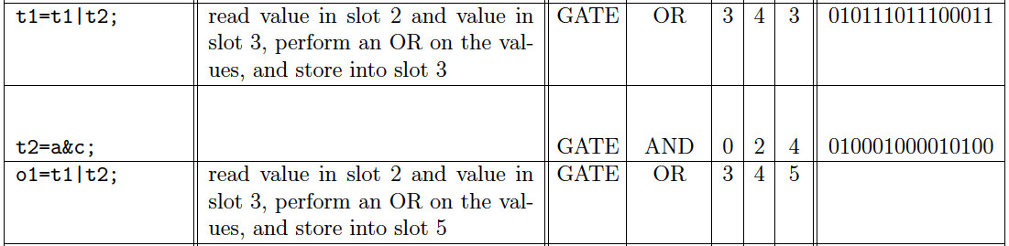
Instruction Bits Example
Fillin Missing

Slide 33
Instruction Sequence Control
How provide the sequence of instructions?

Slide 34
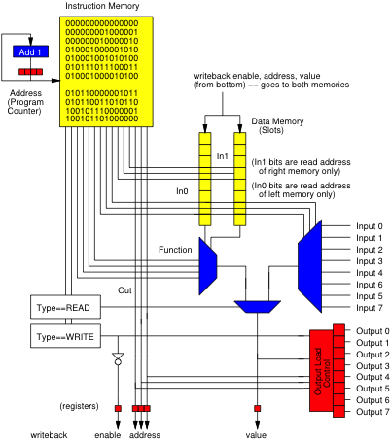
Instruction
Memory
Add Memory to hold set of Instructions
Counter to sequence instructions

Slide 35
Universal
Processor
Can change computation simply be changing contents of instruction memory

Slide 36
Review
Single active compute element (programmable gate)
Sequence in time
Store state in memory
Use Instruction memory to select and sequence operations

Slide 37
Stored-Program Processor

Slide 38
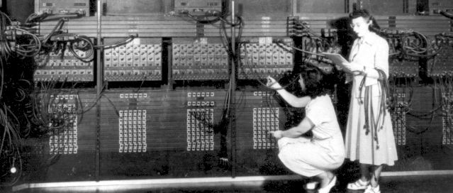
“Stored Program” Computer
Can build physical machines that perform any computation.
Can be built with limited hardware that is reused in time.
Historically: this was a key contribution of Penn’s Moore School
  ENIAC→ EDVAC
  Computer Engineers:
  Eckert and Mauchly
  (often credited to
  Von Neumann)

Slide 39
Basic Idea
Express computation
in terms of a few primitives
  E.g. Add, Multiply, OR, AND, NAND
Provide one of each hardware primitive
Store intermediates in memory
Sequence operations on hardware to perform larger computation
Store description of operation sequence in memory as well – hence “Stored Program”
By filling in memory, can program to perform any computation

Slide 40
Building Out
How limited?
How might improve?

Slide 41
Beyond Single Gate
Single gate extreme to make the high-level point
  Except in some particular cases, not practical
Usually reuse larger blocks
  Adders
  Multipliers
Get more done per cycle than one gate
Now it’s a matter of engineering the design point
  Where do we want to be between one gate and full circuit extreme?
  How many gate evaluations should we physically compute each cycle?

Slide 42
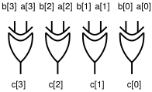
Word-Wide Processors
Common to compute on multibit words
  Add two 16b numbers
  Multiply two 16b numbers
  Perform bitwise-XOR on two 32b numbers
More hardware
  16 full adders, 32 XOR gates
All programmable gates doing the same thing
  So don’t require more instruction bits

Slide 43

Multibit Bus Symbols

Slide 44
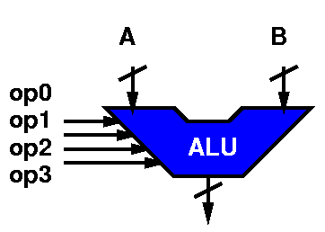
Arithmetic and Logic Unit (ALU)
A common primitive logic is the ALU
  Can perform any of a number of operations on a series of words (strings of bits)
  Operations: Add, subtract, shift-left, shift-right, bitswise xor, and, or, invert, ….
  Operates on “words”
Identify a set of control bits that select the operation it forms
  Makes it “programmable”

Slide 45
ALU Ops (on 8bit words)
XOR 00011000 00010100 =
    xor 0x18 to 0x14 result is:
ADD 00011000 00010100 =
  Add 0x18 to 0x14 result is:
  Add 24 to 20 result is:
SUB 00011000 00010100 =
  Subtract 0x14 from 0x18 …result is:
INV 00011000 XXXXXXXX =
  Invert the bits in 0x18 ...gives us:
SLL 00011000 XXXXXXXX =
  Shift left 0x18 … gives us:

Slide 46
ALU Encoding
Each operation has some bit sequence
ADD 0000
SUB 0010
INV 0001
SLL 1110
SLR 1100
AND 1000

Slide 47
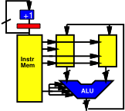
ALU-based Word-Wide Processor

Slide 48
Beyond Linear Sequence
So far, processor can run a fixed sequence
Might like to
  Repeat sequence
  Conditionally execute
  instruction or sequence

Slide 49
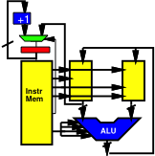
Branching
Allow PC to be loaded
Add Instruction bits
(or instruction) to
control loading
BRANCH Slot=In0

Slide 50
Branching
How
  Branch to top of loop?
  Conditionally branch
  to top of loop?
  Implement if-then?

Slide 51
Branching
Conditional in slot 4
Slot 7 – true target
Slot 8 – false target
S5=S4<<1
S4=S5|S4
(repeat width)
S5=!S4
S6=S4*S7 // 0 or S7
S5=S5*S8 // S8 or 0
S5=S5+S6 // target
BRANCH S5

Slide 52
Contemporary Processors

Slide 53
iPod Processor
Compare ARM7

Slide 54
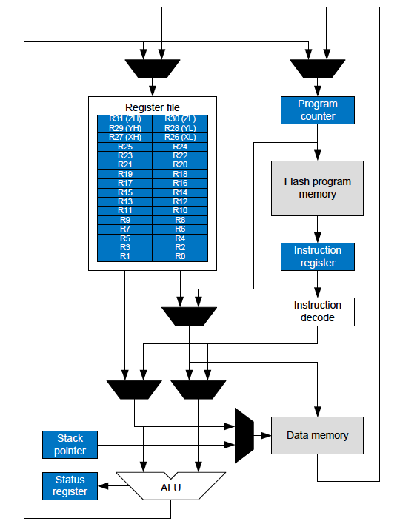
Arduino
AVR
ATmega328/P Datasheet

Slide 55
Arduino
AVR
Adds separate Data Memory from Register File
(common, omitted above for simplicity)
ATmega328/P Datasheet

Slide 56
Arduino
AVR
8-bit architecture
  8b wide ALU
32x8 Register File
  32 register
  8b wide
16b instructions
  “most” instructions
32KB program memory
  Flash2KB data memory
  SRAM
ATmega328/P Datasheet

Slide 57
Instructions: Two Operand
Typically 2-operand, where one operation is both source and destination
ADD R1, R2
  Says: R1←R1+R2
Use to make code more compact

Slide 58
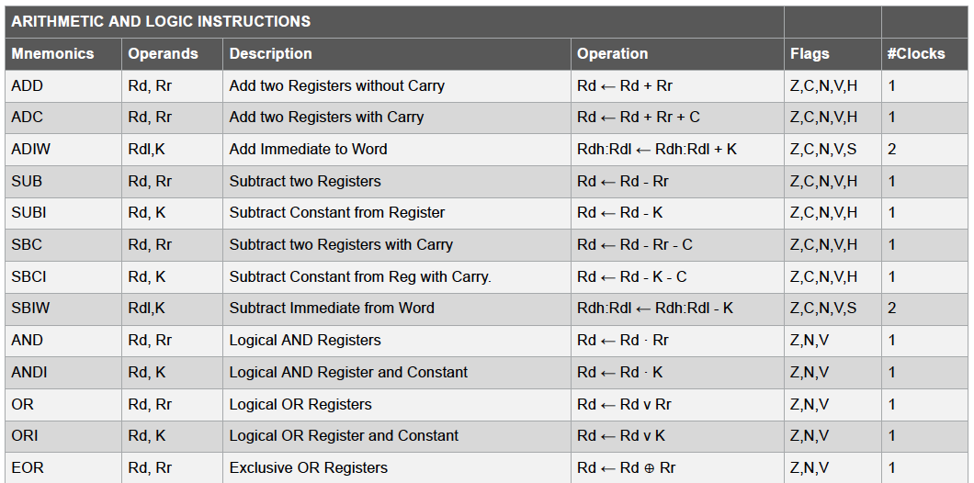
AVR Instructions
ATmega328/P Datasheet

Slide 59
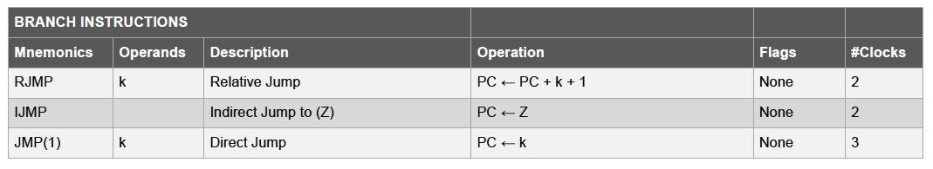
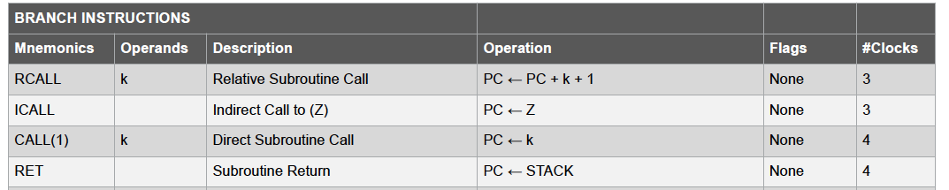
Branching Instructions
ATmega328/P Datasheet

Slide 60
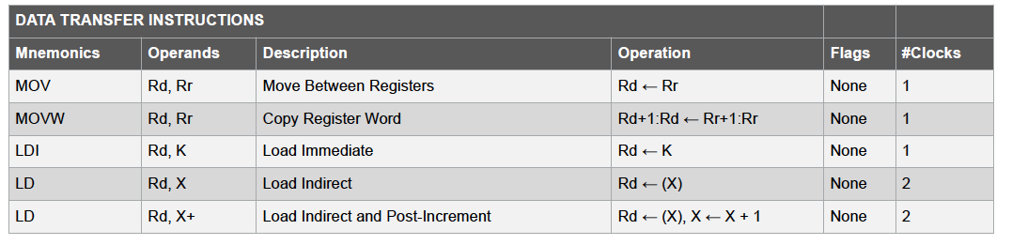
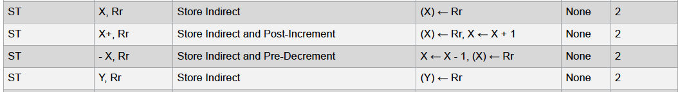
Data Memory Read / Write (Load/Store)
ATmega328/P Datasheet

Slide 61
Next Lab
Look at Instruction-Level code for Arduino
Understand performance from instruction-level code
But first…
  Lecture back here on Wednesday

Slide 62
Big Ideas
Memory stores data compactly
Can implement large computations on small hardware by reusing hardware in time
  Storing computational state in memory
Can store program control in instruction memory
  Change program by reprogramming memory
  Universal machine: Stored-Program Processor

Slide 63
Learn More
CIS240 – processor organization and assembly
CIS371 – implement and optimize processors
  Including FPGA mapping in Verilog
ESE370 – implement memories (and gates) using transistors

