Slide 1



Lecture #11 – Storage/Filesystems
ESE 150 –
Digital Audio Basics

Slide 2
Lecture Topics
Where are we on course map?
Overview of Today’s Lecture
How/Where do we store our digital music?
  Persistent Storage Technology
  Filesystems
    Abstraction 1 : files/directories
    Abstraction 2: b-nodes/i-nodes
    Abstraction 3: filesystems
Next Lab

Slide 3
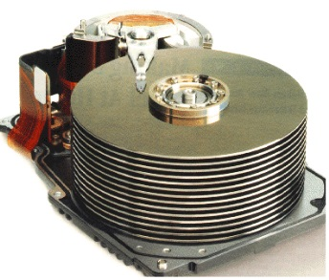










Course Map
7,8,9
10101001101
MIC
CPU
OS/File-
System
A/D
11
10101001101
NIC
Music
1
domain
conversion
6
Numbers correspond to course weeks
compress
sample
freq
pyscho-
acoustics
3
2,5
4
10
12
EULA
----------------click
OK
D/A
NIC
speaker
MP3 Player / iPhone / Droid
13

Slide 4
Course Map – Week 10
7,8,9
10101001101
MIC
CPU
OS/File-
System
A/D
11
Music
1
domain
conversion
6
Numbers correspond to course weeks
compress
sample
freq
pyscho-
acoustics
3
2,5
4
D/A
speaker
MP3 Player / iPhone / Droid

Slide 5
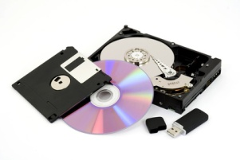
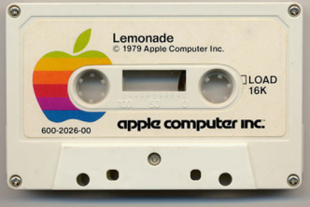
What We’ll Cover Today…
10101001101
The mighty
File System!
Last Lecture…
  We discussed the idea of an OS
    Virtualizes Hardware
  Key part of any OS is its filesystem…we’ll talk about that today
  From floppy disk/hard disk/compact disc/flash drive… “virtually” the same!

Slide 6
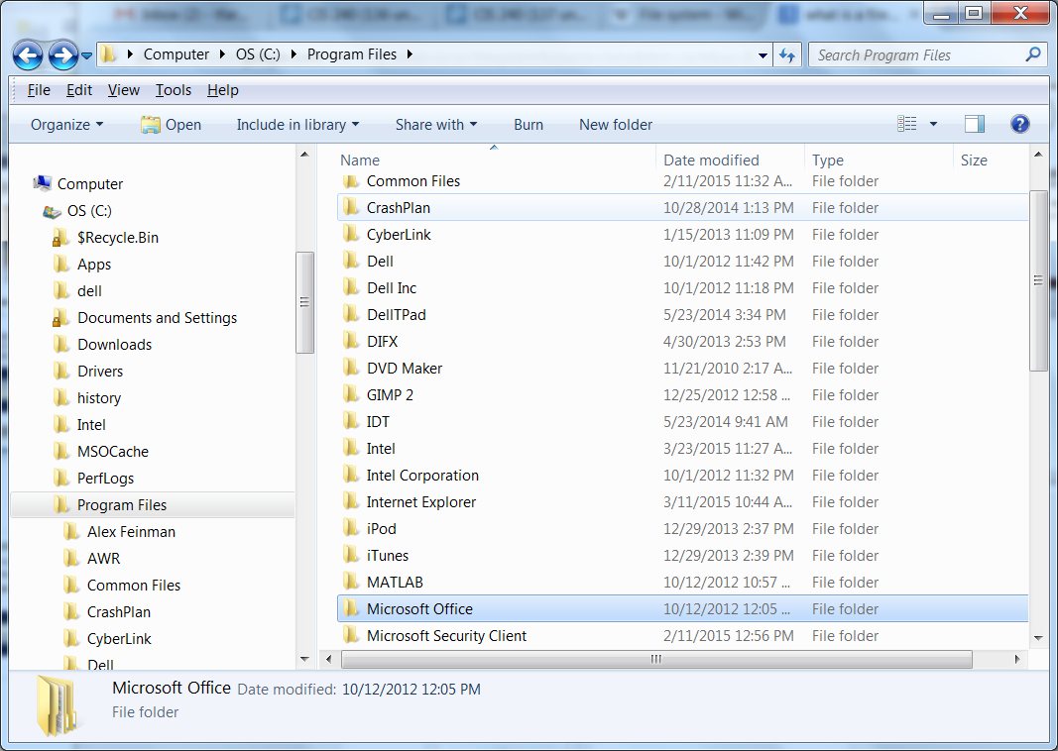
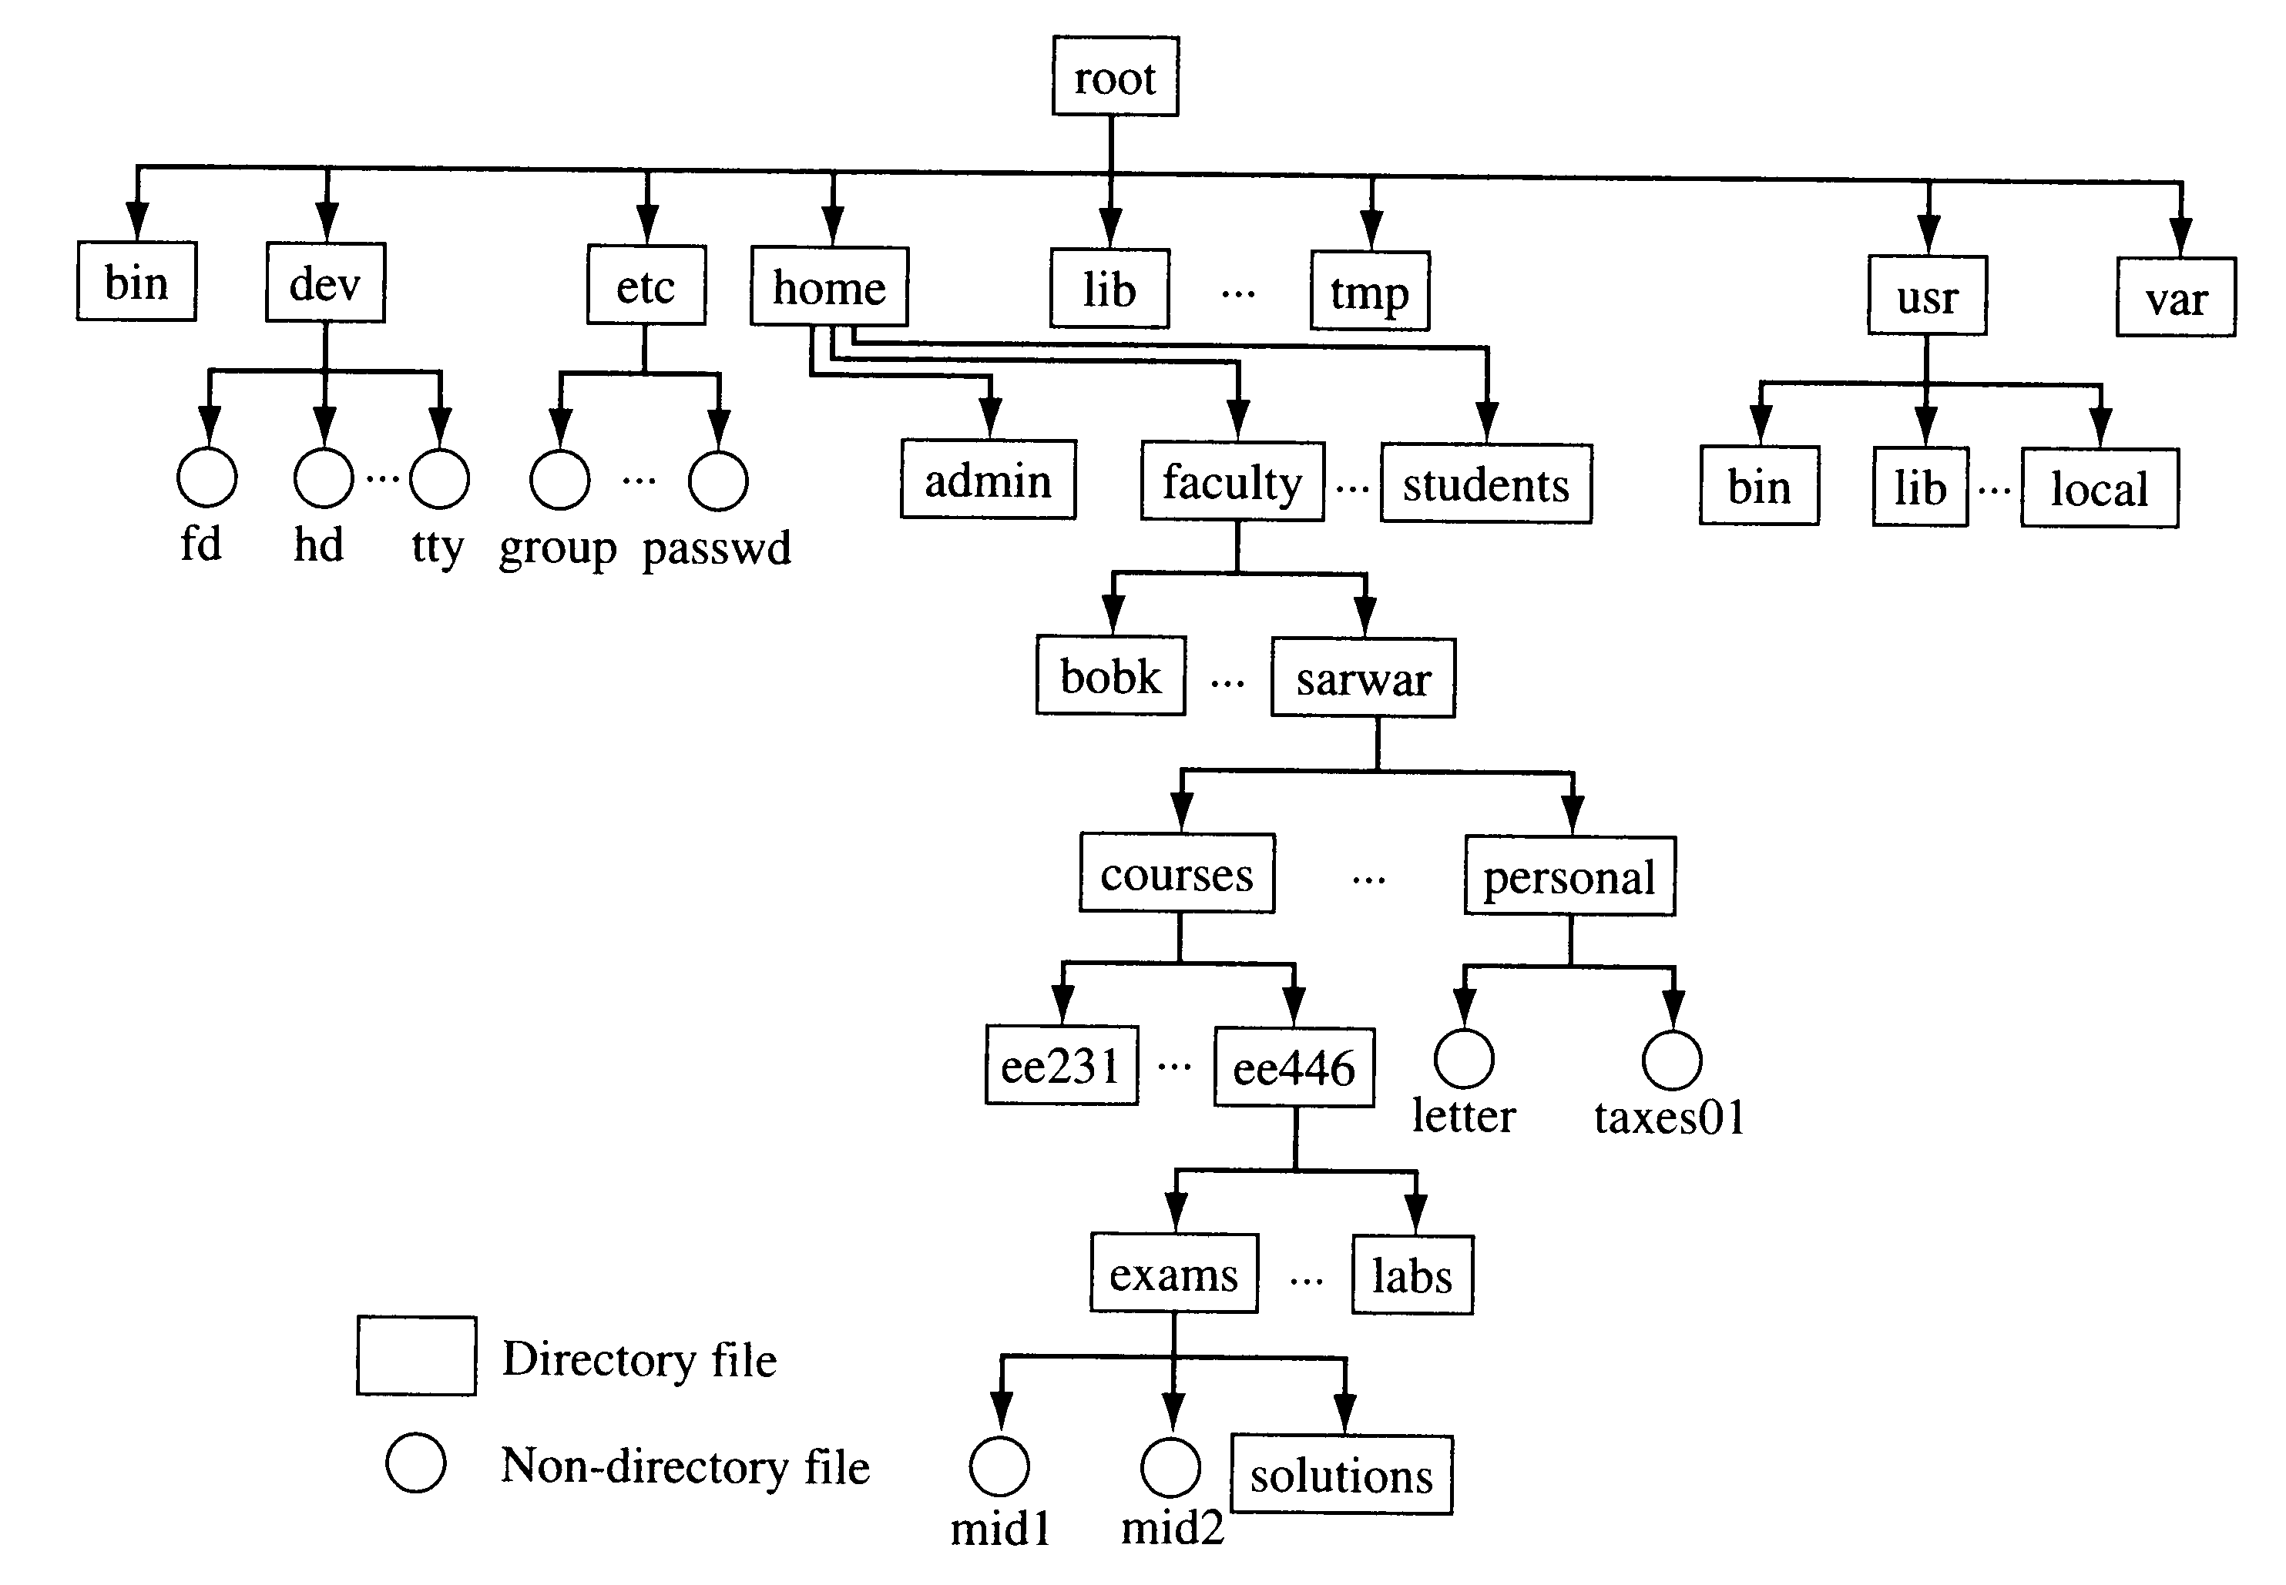
Store and find data
MP3 encoded Songs on Smart Phone
Assignments on your laptop
Programs on eniac

Slide 7
Persistent Storage Technology
Flash-drives / Hard-drives

Slide 8
Persistent Storage
Persistent Storage vs. non-persistent storage
  We’ve discussed “memory” in a computer (regFile/cache/RAM)
    This is considered non-persistent storage
    Turn off computer, information is lost
  Persistent Storage – long term storage
    Information/data stored across on/off cycles of the machine
    Power goes off, data doesn’t disappear!
Persistent Storage Technology
  Many different kinds:
    Flash drives/SSD drives/Floppy disk/Hard drive/compact discs/etc.

Slide 9
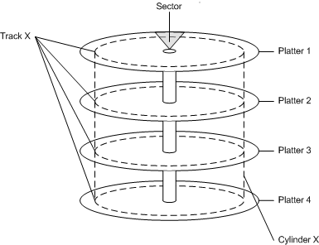
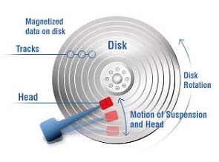
Hard Drives / Hard Disks (HD)
A collection of metallic “platters”
Each platter covered with magnetic material
Magnetic charge ‘stores’ 1 bit of information
Can vary charge across platter!

Slide 10

Hard Disk
Disk with magnetic material on its surface

Slide 11

Hard Disk
Disk with magnetic material on its surface
Divided into tracks (circles)
Modern disks
  300,000 TPI
  TPI = Tracks Per Inch

Slide 12

Hard Disk
Disk with magnetic material on its surface
Divided into bit regions
Modern disks
  1.5M BPI
  BPI= bits per inch

Slide 13
Hard Disk
Each bit located at a position (R,Θ)
R = select track
Θ = select bit from track
disk spins
  Traces through Θ

Slide 14

Hard Disk
Each bit located at a position (R,Θ)
Add arm to move head

Slide 15
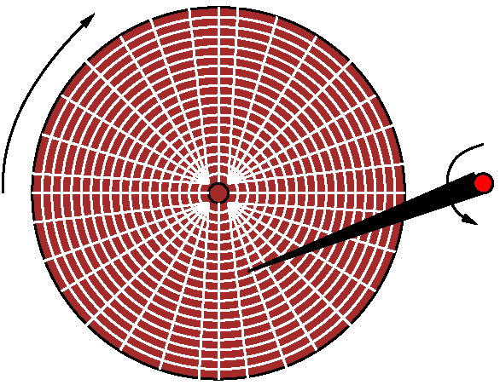
Hard Disk
Each bit located at a position (R,Θ)
Head arm moves
  Varies R

Slide 16
Disk Bandwidth (preclass 1, 2)
Typical Disk speed
  15,000 RPM
  Time for revolution in seconds?
At R=1 inch and 1.5M BPI,
  How many bits in revolution?
  How many bits/second?

Slide 17
Disk Bandwidth
Typical Disk speed?
  15,000 RPM
  One rotation every
    60s/15,000=4ms
At R=1 inch and 1.5M BPI,
How many bits/second?
  2 π × 1 in × 1.5MB/in / 4ms
  9Mbits/4ms = 2.25Gb/s
    ≈ 280 MB/s
https://www.youtube.com/watch?v=3owqvmMf6No

Slide 18
Disk Access Time
Move head in R?
  Also a few milliseconds: 6
How long to access a
random bit?

Slide 19
Disk Access Time
Move head in R?
  Also a few milliseconds: 6
Typical Data access: ~10ms
  E.g. 4ms rotate +6ms seek
Random bit
throughput (b/s) ?
Note: CD-ROMs
similar mechanism

Slide 20
Disk Read/write Performance
Typical Data access: ~10ms
  E.g. 4ms rotate +6ms seek
Throughput reading
  4KB sequential chunk
  1MB sequential chunk

Slide 21
Throughput and Implications
Disk throughput and access time
  10ms latency
  280MB/s throughput (~1B/4ns)
Observations?
  Throughput faster than access time
  10ms seek → Random bit access 100b/s
  Sequential access 280MB/s
Conclude:
  Want to exploit sequential access!
    Read blocks of data

Slide 22
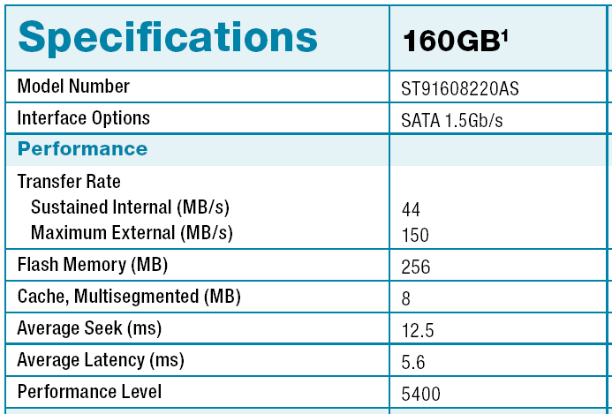
Seagate 2.5” Disk Drive
5400 RPM
http://www.seagate.com/docs/pdf/datasheet/disk/ds_momentus_5400_psd.pdf

Slide 23
Persistent Storage Technology
Flash-drives / Hard-drives

Slide 24
Flash Memory
A little like memory circuits we have learned about…
  Except it is non-volatile or simply…persistent storage
  Data won’t go away when power is turned off
  Based on the “floating gate” transistor
Today’s Examples
  Persistent storage in your MP3 player, cell phone
    FYI: first iPod had a hard disk…
  USB Flash drive
  Solid-State Disk (SSD)

Slide 25
Flash Memory
w0
bitline
bitline
bselect
w1
w0
w2
w1
w3
w2
Two ways to configure FG transistors in Flash Memory
  NOR/NAND
NOR -- Read like other memories
  Fast, but not very dense…used when speed is a must
NAND – Sequential read within “page”
  Denser than NOR, but slower, use when area is a must
Can only “erase” in blocks
  4KB, 64KB→256KB
Once erased can write byte (page) at a time
  Write time variable
  Typically need feedback to sense when written
w3
gndselect

Slide 26
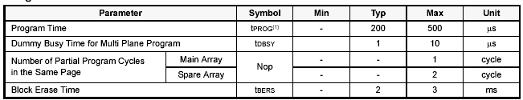
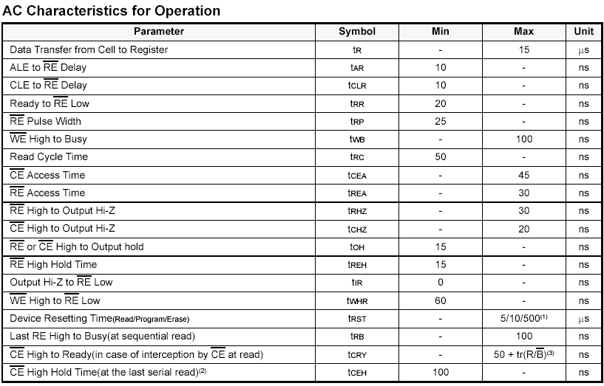
Samsung 256Mx8 NAND Flash
http://www.datasheetcatalog.com/datasheets_pdf/K/9/E/2/K9E2G08U0M.shtml

Slide 27


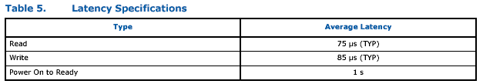
Intel Solid-State Drive (SSD)
35,000/s x 4KB = 140MB/s
SSDhttp://download.intel.com/design/flash/nand/extreme/extreme-sata-ssd-datasheet.pdf

Slide 28
Flash Memory
Similar phenomenon
  T ~= A + B×N
  Large fixed expense A
    Move in R and Θ for disk ~ 10ms
    Erase block for flash ~ 3ms
  High bandwidth B for sequential data
    Both … ~100s of MB/s
Conclude
  More efficient to operate on large chunks of data

Slide 29
FILE

Slide 30
How Organize data
Have technology to store bits
  GB, TB of data
How do we find our data?
  Remembering a (R,Θ) pair could be hard
  Even remembering a 40b address
How do we distinguish used/unused storage?
  Make sure someone doesn’t overwrite our data

Slide 31

FILE
Example File: my_file.txt (14 characters)
I LOVE ESE150!
X49 x20 x4C x4F x56 x45 x20 x45 x53 x45 x31 x35 x30 x21
01001001 00100000 01001100 01001111 01010110 01000101 …
A file is simply a collection of bits
  Whether it’s an ASCII file or a binary file (.docx, pdf, etc)
  A program gives the bits meaning
  Sequential access to bits efficient → useful to group together so can read all at once

Slide 32
Files → Blocks → Physical Disk
Mapping physical storage media to “bit/bytes/blocks”

Slide 33
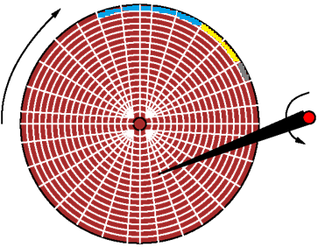
How is a file stored?
A file is an abstraction of the physical storage media
  Media “independent”
  Don’t care how technology is implemented, just read/write file!
Recall a file consists of:
  A bunch of bits
  Logically related
  Ex: my_report.docx, etc
A file system is responsible
for providing this
abstraction of the disk
  On storage media, at lowest
  level, file is in “blocks” of bits

Slide 34
How we store files on physical media
As we write data to a disk, we do it sequentially…
  Data in File 1 = blue, Data in File 2 = yellow, Data in file 3 = grey…
Sequentially written files have huge advantage in terms of seek time…
  Head/needle only moves once,
  then disk spins and
  we read many bits at a time

Slide 35
How we store files on physical media
First Model
File
  start address
  Length
Allocate space sequentially
  Keep track of first
  free address
But what happens when…
  we delete file?
  Append to a file?

Slide 36
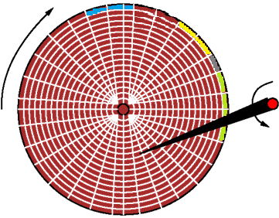
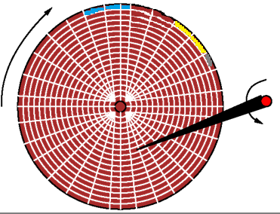
Fragmentation
Let’s say we shorten file1 (blue file)…
  We now have 2 open spaces (blocks) on disk
  What happens when write a 4th file of 4 blocks?
  The freespace is now
  “fragmented”
    Still usable,
    just fragmented

Slide 37
How we store files on physical media
We could also lengthen file1 (blue file)…
  Ex. Need 2 more open spaces (blocks) to store file
  How accommodate?

Slide 38
Fragmentation
We could also lengthen file1 (blue file)…
  Ex. Need 2 more open spaces (blocks) to store file
  Should we actually move it on the disk?
    Expensive
    Now the address change
      How programs and
      people find the file
      when it needs to
      move?

Slide 39
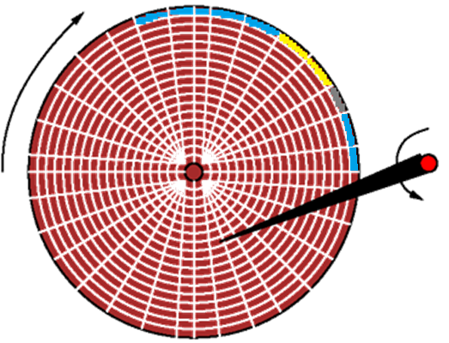
Fragmentation
We could also lengthen file1 (blue file)…
  What if we need 2 more open spaces (blocks) to store file
  Should we actually move it on the disk? expensive…
    Or instead…find 2 other open
    spaces
    and create a link
  The file is no longer
  sequential
    Take longer to access
    but functional;
    still one “logical” file
    (abstraction of media itself!)

Slide 40
Fragmentation
Fragmentation is a fact of life
  But who is keeping track of all this fragmentation?
    Filesystem!
    Note: disk de-fragmentation software built into OSs now

Slide 41
What is a filesystem?

Slide 42
Formation of a File / Filesystem
Represent File
  Not always just a sequence of bits on the media
When files become fragmented…
  How account for and manage fragmentation?
How do we know where freespace is?
For that matter…
  How are all the files kept track of, or even found on the disk?
The file system
  Part of the operating system that organizes/keeps track of the disk
  To understand what its keeping track of, we need to see what a file is…

Slide 43
File Representation
File is not just a sequence of bits
Contains some data about it
  Length
  Type
  Timestamp, ….
Set of pointers to the data (when large)
  Allowing the data to be non-sequential

Slide 44
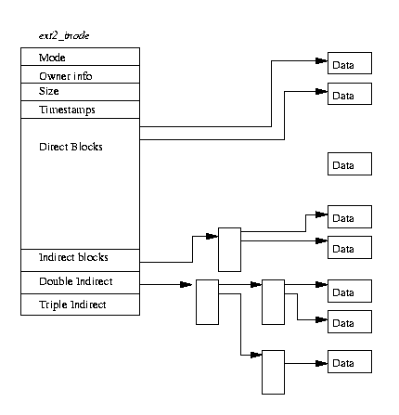
Files → i-nodes → b-nodes/blocks
i-node
B-nodes/
blocks
In the Linux OS
  Popular filesystem named: ext3
  Derived from original
  Unix File System (UFS)
  Uses i-nodes
What is an i-node?
  A data-structure that represents a file on the storage media
  Consists of file information:
    Owner, size, timestamp, etc.
  Also 15 pointers
    12 pointers that point directly to “blocks”
    3 additional pointer that point to other pointers! (indirect blocks)
(12 pointers)
Indirect blocks
B-nodes/
blocks
Notes:
http://www.tldp.org/LDP/tlk/fs/filesystem.html

Slide 45
Files → i-nodes → b-nodes/blocks
i-node
B-nodes/
blocks
How does it work?
  If a file only needs 12 blocks on disk…
    12 direct block pointers are used
    Each of them point to a “bnode” or “block” of data on the disk
  If a file requires 13 blocks…
    12 direct blocks are set/allocated
    1 indirect block is also needed
(12 pointers)
Indirect blocks
B-nodes/
blocks
Notes:
http://www.tldp.org/LDP/tlk/fs/filesystem.html

Slide 46
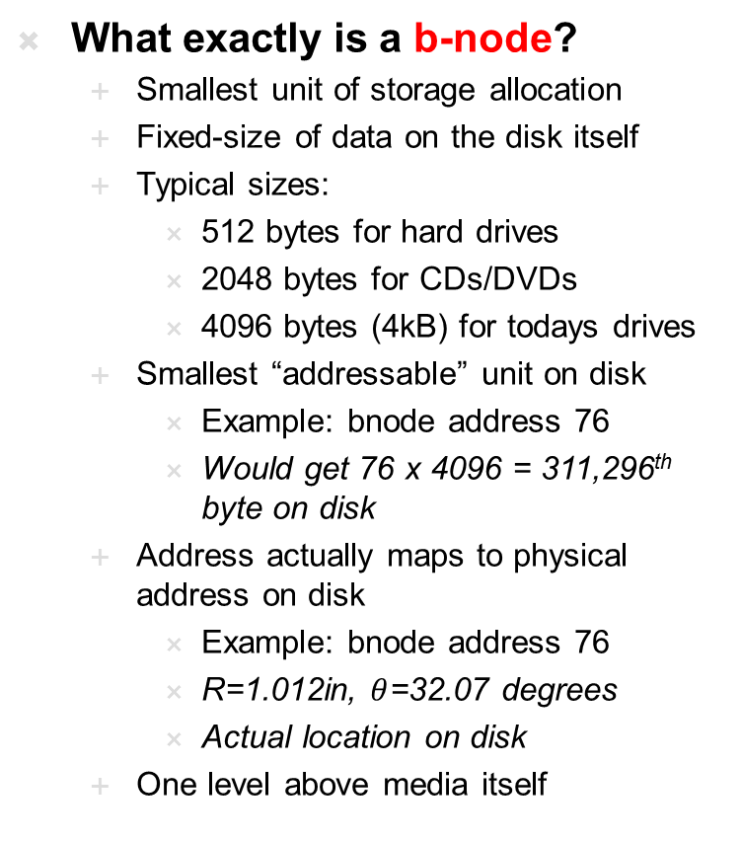
Files → i-nodes → b-nodes/blocks
i-node
B-nodes/
blocks
What exactly is a b-node?
  Smallest unit of storage allocation
  Fixed-size of data on the disk itself
  Typical sizes:
    512 bytes for hard drives
    2048 bytes for CDs/DVDs
    4096 bytes (4kB) for todays drives
  Smallest “addressable” unit on disk
    Example: bnode address 76
    Would get 76 x 4096 = 311,296th byte on disk
  Address actually maps to physical address on disk
    Example: bnode address 76
    R=1.012in, $θ$=32.07 degrees
    Actual location on disk
  One level above media itself
(12 pointers)
Indirect blocks
B-nodes/
blocks
Notes:
http://www.tldp.org/LDP/tlk/fs/filesystem.html

Slide 47
Files → i-nodes → b-nodes/blocks
i-node
B-nodes/
blocks
At 4KB / Bnode
How large a file can represent using only Direct Blocks?
  (assuming get full 4KB block for data)
(12 pointers)
Indirect blocks
B-nodes/
blocks
Notes:
http://www.tldp.org/LDP/tlk/fs/filesystem.html

Slide 48
Files → i-nodes → b-nodes/blocks
Bnode’s structure:
  Bnode contains metadata (like a header)
    Description of data to follow
    Block type, File type, length
  Bnode contains data itself (contents)
    This is actual data for the file in question
    Example shows only a 3172 block file (could use all 4072 bytes)
Type/ length
24 Bytes metadata
Example:
4096 Byte
bnode
3172 Bytes
Block contents
900 Bytes unused

Slide 49
Files → i-nodes → b-nodes/blocks
Bnode’s structure:
  bnode contains metadata (like a header)
    Description of data to follow
    Block type, File type, length
  Alternatively…can be table of pointers (indirect block)
    Can be a multi-level tree if necessary (doubly/triply indirect)
Type/ length
24 Bytes metadata
76:
77:
mp3, 12MB
1024
obj, 15,791
3172 Bytes
Block contents
78:
900 Bytes unused
79:
80:

Slide 50
Files → i-nodes → b-nodes/blocks
How help with shortening or appending to file?
Type/ length
24 Bytes metadata
76:
77:
mp3, 12MB
1024
obj, 15,791
3172 Bytes
Block contents
78:
900 Bytes unused
79:
80:

Slide 51
Size of b-node/block representation
Why not make block sizes smaller? (say 1-bit)
  How about 1 bit at a time? Addressing each bit wouldn’t be easy…
    1 TB disk ~ 9 trillion bits…9 trillion addresses!
  Most times files are larger than just a few bits
Why not make block sizes larger? (512, 2048, 4096 bytes)
  Usually, we transfer “blocks” of data to/from media at a time
  Why not go larger?
  Remember, block size is, smallest unit of addressable space
Type/ length
24 Bytes metadata
In this 4kB block, 900 bytes are wasted
“Internally fragmented”
No way to ‘un-fragment’
unless file itself grows
Example:
4096 Byte
bnode
3172 Bytes
Block contents
900 Bytes unused

Slide 52
B-Node/Block Size
Performance: Balance
  Number of blocks need to read
  Efficiency of reading large blocks
Space efficiency: Balance
  Internal fragmentation
  Overhead for metadata and links

Slide 53
EXT3 File size limitations
Limits?
  i-node is an array of (15) 32-bit pointers
  If block = 4 KB, first 12 pointers represent 48 KB file
  13th pointer – single Indirect bnode, 1024 pointers
    Why 1024 pointers?
    file size?
  14th pointer – double indirect: file size?
  15th pointer – triple indirect: file size?
Will that become a limit?
(Hint, welcome ext4 file system!)

Slide 54

Levels of Abstraction
B-nodes/
blocks
Levels of abstraction
i-node
Lowest Level to Highest Level of Abstraction
Physical Location on disk
    R=1.012in, $θ$=32.07 degrees
Block of data
4096 continuous bytes on disk
B-node
Datastructure representing block of data
i-node / file
Datastructure representing many blocks
of data
Programmers work here (file level)
saves us from knowing about physical
details which may change across
storage technologies
(12 pointers)
Indirect blocks
B-nodes/
blocks

Slide 55
How keep track of files?
Add another file that tells us where the files are
  Directory
On ext3 filesystem…
  Directories are just files themselves!
  Pairs of (Name, i-node)
  Contain pointers to other nodes
…and since files can be directories
  Directories can contain directory files
  …which can contain directory files…
Leading to a directory hierarchy

Slide 56
Unix System File Structure
/
This is called the “root” directory
bin
usr
home1
etc
. . .
Below “home” is up to eniac admins
a
b
c
. . .
t
. . .
z
teyvonia
…
teyvonia
…
tfarmer
…
tzheng
ESE150 “Home directory” is /home1/e/ese150 or simply: ~
Because the structure under “home” is typically different on all unix systems,
~ is a convention, and is always points to your home directory
Notes:
/bin – typically holds all the “commands/utilities” built into unix, e.g. date, cat, grep, all the shells (bash, csh, ksh, sh)
/usr – typically holds programs we install on the system, e.g. cc (the compiler), clang, valgrind
/etc – usually holds all the “etcetera” stuff, mainly files admins will edit to configure the system, password files, etc.

Slide 57
Preclass 4
10⁹ data items
Assume at bottom of balanced tree
Each tree-node has c leaves
Directory i-node to hold c leaves needs
  32×c Bytes
How many tree nodes must visit?
How long to read a tree node?
Time to lookup item (traverse tree)?
  c=2, c=10³, c=10⁹

Slide 58
Looking at inodes
All directories start from “root” or / directory
ese150@plus:/> cd /
ees150@plus:/> ls -al
total 164
drwxr-xr-x 25 root root 4096 Mar 31 05:44 .
drwxr-xr-x 25 root root 4096 Mar 31 05:44 ..
drwxr-xr-x 2 root root 4096 Mar 31 05:44 bin
drwxr-xr-x 4 root root 4096 Mar 31 05:40 boot
drwxr-xr-x 18 root root 4020 Feb 19 13:37 dev
ese150@plus:/> ls -ali
total 164
2 drwxr-xr-x 25 root root 4096 Mar 31 05:44 .
2 drwxr-xr-x 25 root root 4096 Mar 31 05:44 ..
393222 drwxr-xr-x 2 root root 4096 Mar 31 05:44 bin
2 drwxr-xr-x 4 root root 4096 Mar 31 05:40 boot
1025 drwxr-xr-x 18 root root 4020 Feb 19 13:37 dev
First block of disk is inode 1, called “masterblock” / “superblock”

Slide 59
Superblock
For bootstrapping and file system management
  Each file system has a master block in a canonical location (first block on device)
  Describes file-system type
  Root bnode
  Keeps track of free lists …at least the head pointers to (bnodes, blocks)
Corruption on superblock makes file system unreadable
  ➔Store backup copies on disk

Slide 60
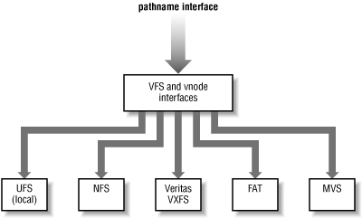
Higher Level ex: Virtual File System (VFS)
Provides common interface to many different underlying filesystems!
cd /home/d/data may live on NFS (on a server) or on local disk/CD-rom!

Slide 61
Format disk
Identify all non-defective bnodes
  Defective blocks skipped
  ➔ those addresses not assigned to bnodes
Create free bnode data structure
Create superblock

Slide 62
Disk Data Security
How is security enforced?
  OS demands credentials for login
  User doesn’t get direct access to hardware
  OS intermediates

Slide 63
Security Caveats
On standard Unix/Windows setups
  Without the OS to provide protection,
  all the data is accessible
    Sometimes good for recovery
  On standard Unix/Windows setups
    rm/del doesn’t make the data go away
      Also sometimes useful for recovery
  Even format does not guarantee data overwritten
See: Remembrance of Data Passed: A Study of Disk Sanitization Practices
What about iPhone?

Slide 64
Security Example: File Permissions in Unix
Best to show with an example:
  Assuming you been typing in examples thus far, type:
  cd ~/ese150
    Puts you into the “ese150” subdirectory of your “~” home directory
  ls -al
    Passes two “arguments” to the ls command:
    “a” (shows all files/even hidden)
    “l” (stands for long formatted listing, you will see)
  ls –al will return the following directory listing:
  student@minus:~/ese250> ls -al
  total 12
  drwxr-x--- 2 tfarmer tfarmer 4096 Nov 8 21:25 .
  drwxr-x--x 36 tfarmer tfarmer 8192 Nov 8 21:24 ..
  -rw-r----- 1 tfarmer tfarmer 0 Nov 8 21:25 file1.txt
  -rw-r----- 1 tfarmer tfarmer 0 Nov 8 21:24 file2.txt

Slide 65
Security Example: File Permissions in Unix
File’s size
File’s last modification date
Let’s examine that last result:
  -rwxr-x--- 1 tfarmer tfarmer 0 Nov 8 21:24 file2.txt
File’s name
The “group” that has rights to this file
The permissions set
for this file
The “owner” of this file
rwx r-x --- ➔ in binary: 111 101 000 ➔ in decimal: 750
Everyone else on
system’s permission (none)
Group’s permission
(read & execute only)
Owner’s permission
(read, write, and execute)

Slide 66
Security Example: File Permissions in Unix
To change permission on a file (or directory) you own:
  -rwxr-x--- 1 tfarmer tfarmer 0 Nov 8 21:24 file2.txt
  Type:
  chmod 700 file2.txt
  ls –al shows the change:
  -rwx------ 1 tfarmer tfarmer 0 Nov 8 21:24 file2.txt
  Notice, the group lost its permission to see this file! (700, convert to binary)
To change ownership on a file you own:
  Type:
  chown edin:ese-facu file2.txt (changes owner & group)
  Careful, now your TA Edin, owns the file (and you don’t!!):
  -rwx------ 1 edin ese-facu 0 Nov 8 21:24 file2.txt

Slide 67
OS’s and their Filesystems
    Typically an OS has a native filesystem it supports:
      Early PC OS: DOS (Disk Operating System)
        File system: FAT (File Allocation Table)
      Early Apple OS: Macintosh’s “System”
        File system: MFS (Machintosh File System)
      Today’s PC OS: Windows
        File System: NTFS (New Technology File System)
      Today’s Apple OS: Mac OSx
        File System: HFS+ (Hierarchical File System)
      Today’s Linux OS: Ubutnu, Debian, Fedora, Red Hat, SUSE, etc)
        File System: EXT (Extended File System)
    Now a days, many OS include support for more than one file system
      Example…CDs/DVDs have their own file system:
        CDs: CDFS (Compact Disc File System): ISO 9660
        DVDs: UDF (Universal Disk Format)

Slide 68
Big Ideas…Filesystem
Filesystem
  Responsible for governing/organizing the persistent storage media (harddrive/flash/etc)
  Provides a logical/common abstraction of the media to the OS and eventually the programmer/user
  Provides structures to keep data on disk logically organized
    Files may be all over the place physically, but programmer would never know!
  Provides mechanism for securing files on physical disk
    Security not always respected without presence of OS

Slide 69
This Week In Lab
Lab 10: Design multi-view file system
  As might want for MP3 player
In Ketterer again
Lab posted

Slide 70
Learn More at Penn!
Online reading/pointers
  Unix File System Tutorial
  Flash, SSD, Hard drive data sheets
  Data found on hard drive articles
Courses
  CIS121 – efficient data structures
  CIS380 – operating systems

