Slide 1
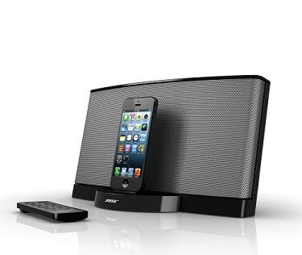
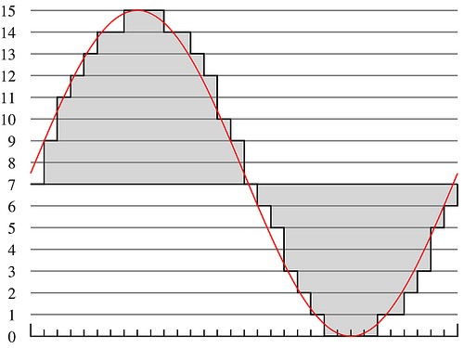
Lecture #5 – Psychoacoustics
ESE 150 – Digital Audio Basics

Slide 2
Teaser
Dog Whistle
Silent to us
Dogs can hear
Familiar item provides evidence of limits of human hearing

Slide 3
Observe
There are sounds we cannot hear
Depends on frequency

Slide 4
Psychoacoustics

Slide 5
What is Psychoacoustics?
Scientific study of sound perception
Branch of science studying the psychological and physiological responses associated with sound
Also, considered a branch of: psychophysics
Human physical (and neurological) mechanism for sound perception
Why study sound & human’s perception?
Example: FREQUENCY vs. PITCH
Frequency of sound: “how often” air particles vibrate (Hz)
Pitch of sound: the sensation of frequency
How our brains “interpret” the frequency of a sound
Things may “sound” one way…
…but be interpreted by our brains very differently!

Slide 6
Psychoacoustics & Digital Music
How does psychoacoustics relate to MP3?
The “consumer” of an MP3 is the human ear…
Knowing more about brain’s interpretation of sound…
…helps us remove things human’s can’t hear anyway
We’ve used some of this in our system already:
Limit of human perception of sound: 20 Hz to 20,000 Hz
We put an anti-aliasing filter limiting incoming audio
Fixes our sampling rate, less data to store as a result!

Slide 7
Our study of Psychoacoustics
Structure of Human Ear / encoding signals to brain
Human Hearing Limits
Critical Bands
Frequency Bins
Masking (Spatial vs. Temporal)
Applied Psychoacoustics (mostly next lecture)
Using all of the above to build...the “Psychoacoustical Model”
Perceptual Coding in MP3 (using the model to compress MP3s)

Slide 8
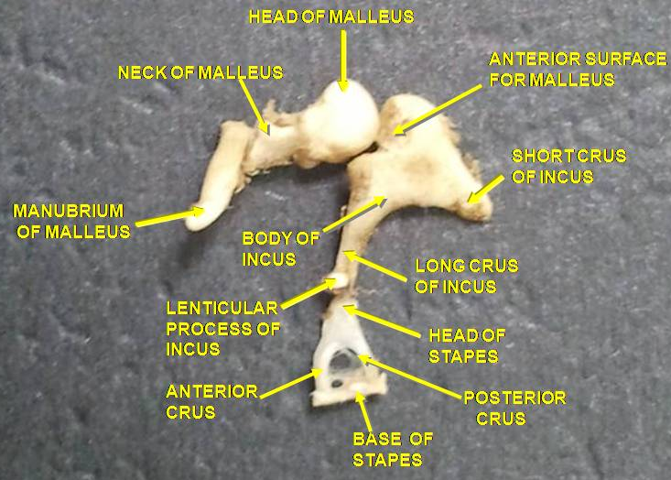
The Physical Ear
Outer Ear
Guides sound waves into ‘auditory canal’
Middle Ear
Ear Drum – transmits sound from air to 3 bones in inner ear: ossicles (hammer, anvil, stirrup)
Inner Ear
Ossicles – transmit sound from air to fluid-filled “chochlea”
Converts vibrations in air (sound) into
mechanical motion in the middle-ear!
Notes:
Ossicles – group of 3 bones: malleus (hammer) the incus (anvil), and the stapes (stirrup) of the middle ear. Smallest bones in body

Slide 9
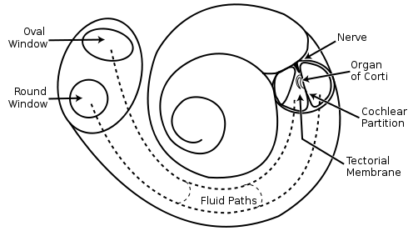
The Physical Ear – “Cochlea”
Cochlea – “snail shell”
Fluid-filled “labyrinth”
Located in: “inner-ear”
Spiral Shaped (snail shell)
Hair inside cochlea ‘resonates’ according to incoming vibrations in the liquid
Stereovilli (name of hair)
Hairs convert vibration into nerve impulses
Picture above – uncoiled cochlea…
-- different stereovilli (Hairs) resonate at different frequencies
-- our ear performs Fourier Transform!
http://www.youtube.com/watch?v=zeg4qTnYOpw
Notes:
Snail shell is latin translation

Slide 10
Cochlea Animation
https://www.youtube.com/watch?v=dyenMluFaUw

