Slide 1
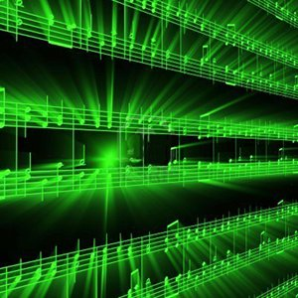
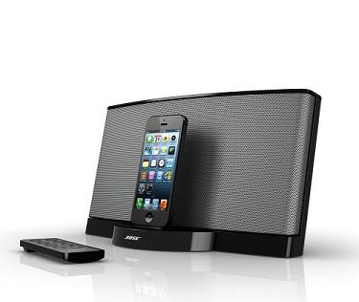
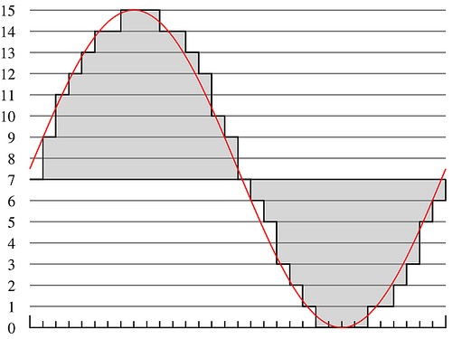
Lecture #5 – Psychoacoustics
ESE 150 – Digital Audio Basics

Slide 2
Time-Domain Masking (Temporal)
Two types:
pre-masking (backwards)
post-masking (forwards)

Slide 3
Temporal Masking - Forwards
Easier to understand…
A sudden masker noise…
Makes inaudible other sounds following noise…for up to 200ms
(imagine the compression possibilities!)

Slide 4
Temporal Masking - Backwards
Not as intuitive an explanation…
A sudden masker noise…
Makes inaudible other sounds preceding noise!
Why does this happen?
One thought: takes time for your brain to interpret sound
Think of it like a buffer…
Throws out contents of buffer when a loud sound comes in
to concentrate on only the loud sound (masker in this case)

Slide 5
Big Ideas
Human hearing mechanism directly encodes frequency
By position on Cochlea
Differential sensitivity by frequency
Hear some frequencies louder than others
Frequency Masking
Limit to what we can simultaneously perceive in critical bands – loud frequencies can hide others
Temporal Masking
Loud signals can hide sounds that come after (or before) them

Slide 6
Coming up
In Lab
Measure sensitivity and masking effects
Bring head phones
Next Lecture
Put this together to compress audio
Derive key features of MP3

