Slide 1
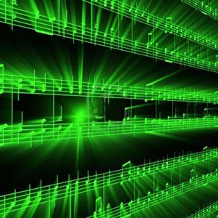


Lecture #1 - Course Introduction / Intro to Digital Audio
ESE 150 –
Digital Audio Basics

Slide 2
Lecture Topics
History & Motivation
  Computing and Digital Audio
Overview of Class Schedule
  Big picture of our class goals
Course Introduction / Goals of Class
  Syllabus; Laboratory; Grading
Course Content Overview
  Week by week breakdown of class itself
Summary

Slide 3
History & Motivation
History & Motivation
Short Story / Overview
Course Introduction
Learning Styles
Long Story / Intro to Sound
Summary

Slide 4
Poll
How many of you have:
  Cell phone ?
  Digital Music Player (separate from phone?)
  Digital camera (separate from phone?)
Use GPS?
How do you obtain music?
Communicate with friends outside of school?
  Voice phone, e-mail, text message, facebook, skype?
Where do you go to find answers?
  Google

Slide 5
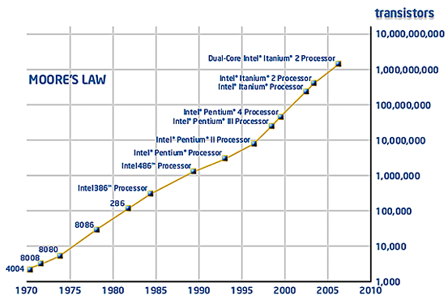
Chaning World
Moore’s Law: Every 18 months, size of transistor will be halved
  Who cares?
    In same area, can fit twice as many transistors, twice the computing power!
    Also, generally: if you make a transistor smaller, it gets a bit faster

Slide 6
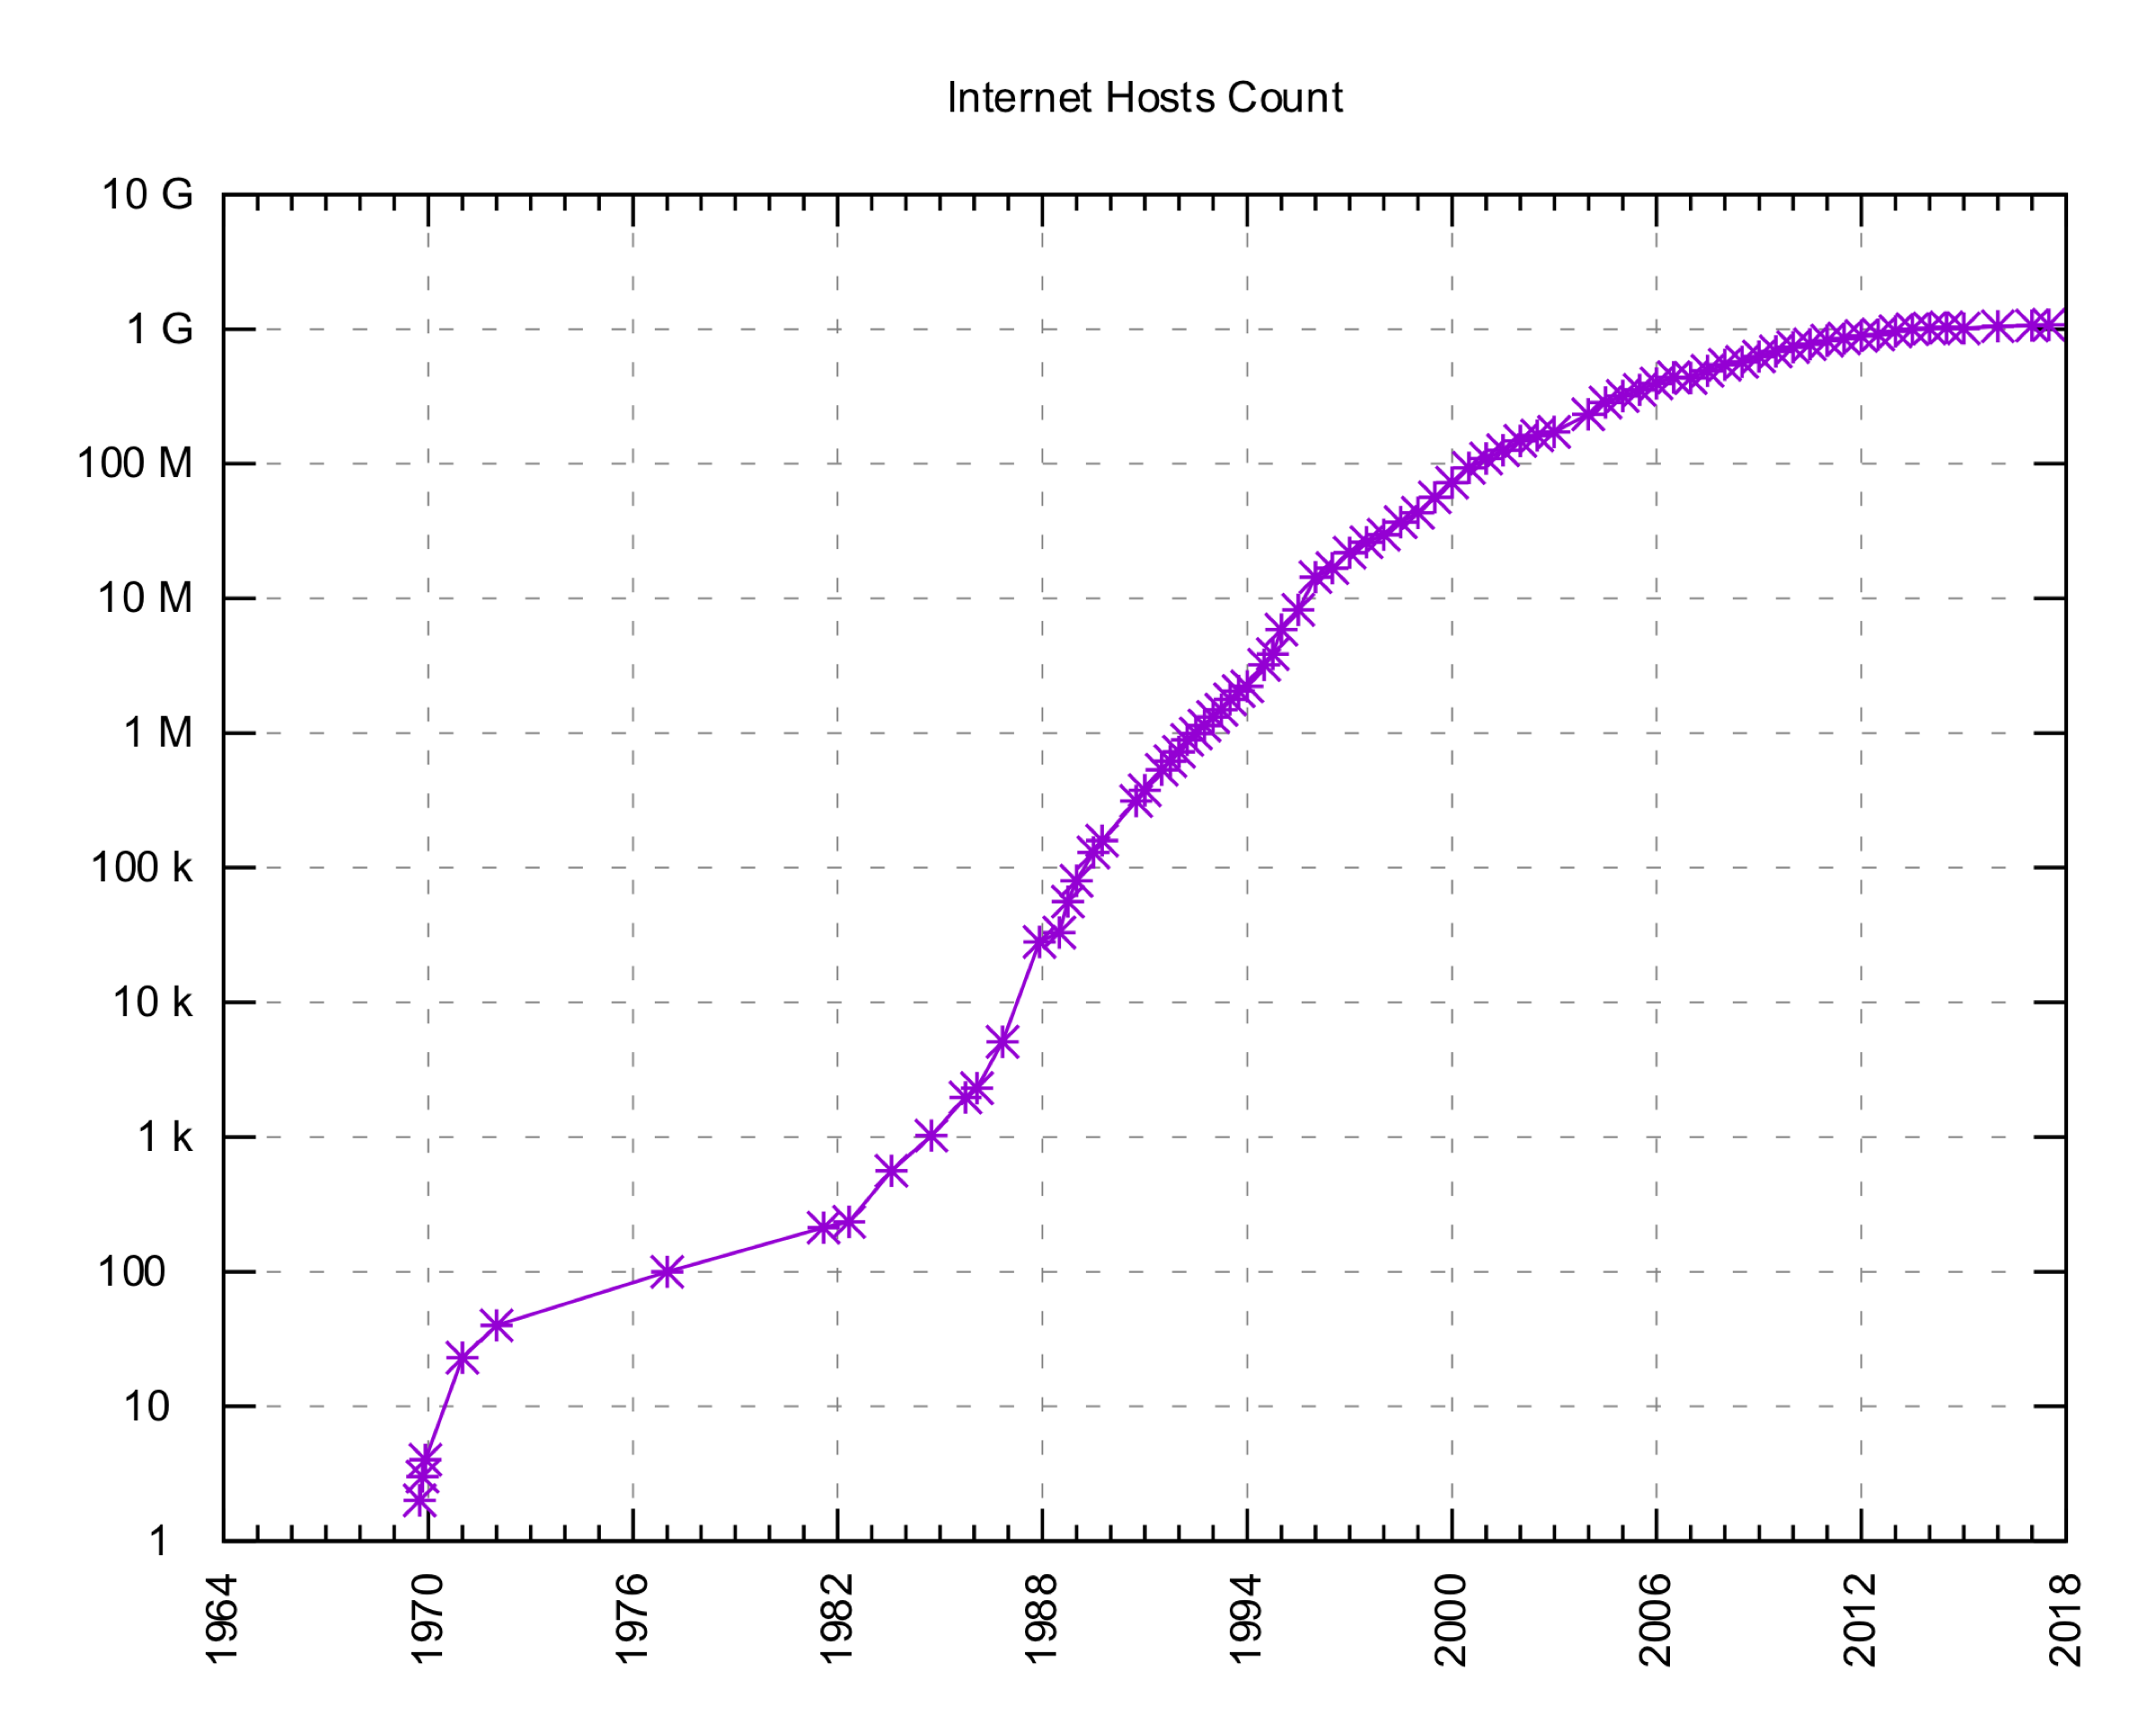
Chaning World
Moore’s Law
Internet Grew
By Kopiersperre , Ke4roh - Own work, CC BY-SA 3.0, https://commons.wikimedia.org/w/index.php?curid=36391402

Slide 7
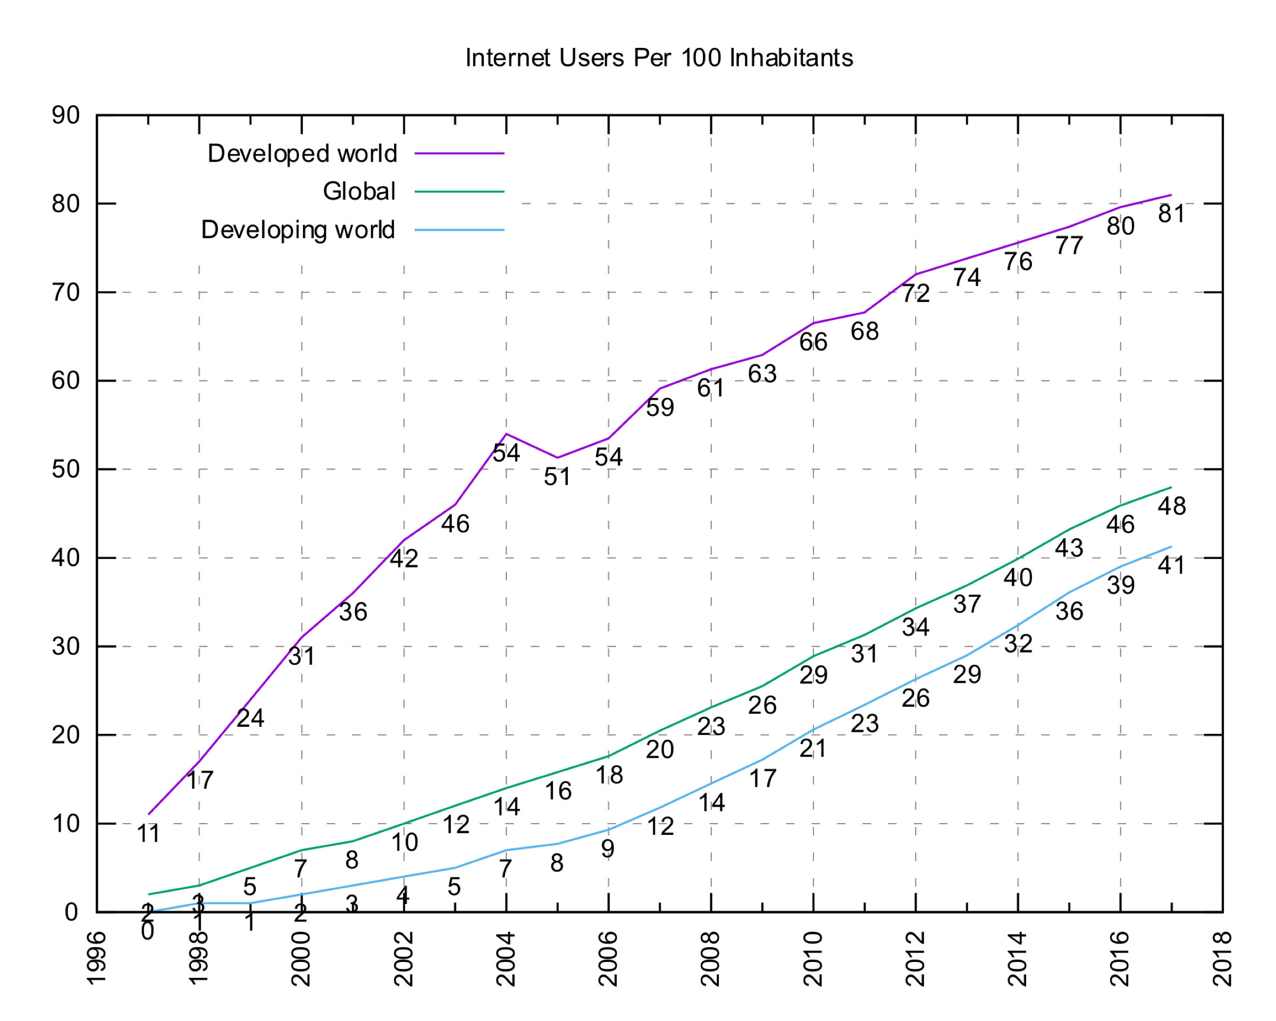
Connecting the World
By Jeff Ogden (W163) and Jim Scarborough (Ke4roh) - Own work, CC BY-SA 3.0, https://commons.wikimedia.org/w/index.php?curid=18972898

Slide 8
In your lifetime…
1998: Google, First commercial MP3 player
2001: iPod, Wikipedia launched
2003: iTunes launched, Skype released
2004: Facebook launched
2005: YouTube launched
2006: Twitter launched
2008: Bitcoin
2010: Instagram
2011: Siri, Snapchat, Google driverless cars, Uber
2012: Makerbot Replicator
2013: Google Glass
2015: iWatch

Slide 9
Cool Stuff of Today…
Today’s “must have” technology is:
  computerized, networked, and based on digital media
Cell phones
MP3 players (Digital Audio Players)
  Internet enabled
Digital cameras and video recorders (part of phones!)
Realistic Video Games
Integrated (e.g. iPhone, iPad)
DVRs (e.g. TiVo)
E-book readers (e.g. Kindle)
3D printers (e.g. Makerbot)
  Circuit Scribe – draw actual circuits, electric ink!
  Replicator…
Augmented Reality (e.g. Jedi Challenge, Pokemon-Go)
  Holodeck…
What else
add to this list?

Slide 10
What makes us safer, live longer?
Transportation
  Anti-lock brakes
  Traction control
  Blind-side assist
Watch over
  Security cameras
  Baby monitors
Medical Devices
  Ultrasound
  MRI
  DNA sequencing
  Pacemakers

Slide 11
What do these things involve?
Computation
Communications
Hardware
Substantial software
➔ Products of Computer Engineers

Slide 12

Changing World: Small World
Ubiquitous Internet
  This changed everything
  Smartphone let us carry Internet with us
Facebook
  Allowed us instantly find anyone!
  United the world in many ways

Slide 13
Changing World: Easy Sharing
Easy Instant sharing and storage
Photos, videos, writing
Web, Facebook, Youtube, Blogs
Backed up, Cloud
Accessible anywhere in the world
Indexed and searchable
Can carry it with you

Slide 14
Changing World: Instant Gratification
Search engines
  Instant access to knowledge
iTunes
  Instant access to music/casts/apps/video too
Streaming video
  Instant access to video/news/visual information
  Internet services/Netflix/On-Demand/etc.
Amazon.com
  Instant access to nearly any product, ~drone delivery!

Slide 15
Changing World: New Wealth, New Players
Microsoft founded 1975
  World’s richest man…for a while
Apple founded 1976
  Highest valued company
Oracle 1977
CISCO 1984
NVIDIA 1993
Amazon.com 1994
  New world’s richest man…
E-Bay 1995
Google, Netflix 1998
Facebook 2004
Twitter 2006
Bitcoin 2008

Slide 16
Convergence
Big Ideas and Advanced Technology
  Digitize Everything
  Cheap Digital Processing
  Cheap Storage
  Cheap Digital Bandwidth
Driven by Moore’s Law
  Store and compute more bits per $$

Slide 17
Enabled by Visionary Engineers
Hard work, inspiration, and competition
  …would not have just happened
  Certain applications/products tie many things together
    No one realized facebook/music would be “killer app” for smartphone revolution
Most inconceivable just prior
  Compare how archaic the “future” looks in most movies just 20 years old
What’s next?
How can we harness to make the world better?

Slide 18
Short Story
History & Motivation
Short Story / Overview
Course Introduction
Learning Styles
Long Story / Intro to Sound
Summary

Slide 19
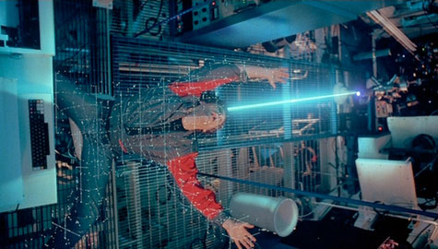

Virtualization of the World
Can represent things as bits
  sound, pictures, movies
  location, situation, …
  shapes, circuits, drugs, DNA
Cheap/powerful ways to
automatically manipulate
  …and reproduce

Slide 20



Class Story: One Slide
domain
conversion
Compress
sample
freq
pyscho-
acoustics
Sound can be converted to/from bits
  and compressed, without loss of information
More information can be discarded without humans noticing → fewer bits
Process this information with inexpensive machines
  Store it for retrieval
Send it between machines
  Even if not directly connected

Slide 21
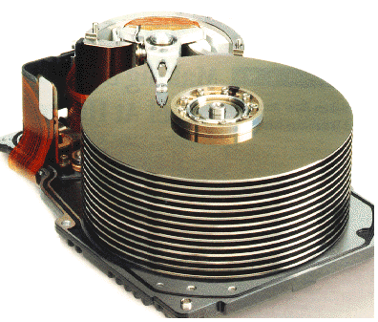







Course Map
7,8,9
10101001101
MIC
CPU
File-
System
A/D
10
10101001101
NIC
Music
1
domain
conversion
5,6
Numbers correspond to course weeks
compress
sample
freq
pyscho-
acoustics
3
2
4
13
11
EULA
----------------click
OK
D/A
NIC
speaker
MP3 Player / iPhone / Droid
12

Slide 22
Course Introduction
History & Motivation
Short Story / Overview
Course Introduction
Learning Styles
Long Story / Intro to Sound
Summary

Slide 23
About the Course
ESE 150: Digital Audio Basics
  But really: “Introduction to Computer Engineering”
Our Goals:
  Deliver 13 lectures on 13 topics in Comp. Eng.
    Each lecture full course on later; 13 different courses!
  Expose you to the big topics in Comp. Eng.
    You won’t like them all…but you will probably love 1 or 2!
    Help you figure out which path in Comp. Eng. to take
  Use digital audio as common theme between lectures
    This information goes way beyond digital audio
  Tie theory to practice (“feel-the-bits”) through a weekly lab
    To see concepts discussed in lecture in a lab environment
    Labs are not perfect, connections sometimes not obvious at first
      You might think lab is “stand-alone”…not really true!

Slide 24
The Big Picture…
    Computer Engineering
      very large field of engineering
    Seeing the top 13 ideas…through the guise of digital audio
      helps you see the big picture of comp. eng.
    We want you to see the “big picture” of comp eng.
      before taking a lot of unnecessary courses
    Miss one lecture…miss a lot!
      Common complaint…I don’t need lecture to succeed in lab
        You might be right! … but it should make it more meaningful.
    Help us help you…
      If you don’t see how lecture/lab fit together, tell us!! Help us improve course.

Slide 25
Mechanics of the Class
Wednesday: Lecture
  Introduce concepts (theory)
  Help paint the big picture
Monday: Lab
  Put theory into practice
  Apply 1 big concept in real world
    Many concepts may appear in lecture…
    One will be put to use in guise of digital audio in the lab
  Work in teams of 2
  Individual lab report write-ups
Friday: Lab Report due
  (except formal one – Sunday)

Slide 26
Lecture Timeline
4:25pm – target to setup, have preclass available
  Start working on preclass as you arrive
4:35pm – start lecture
5:55pm – end lecture
  Need to leave earlier, go ahead.

Slide 27
Grading
10% - Class Participation and Quizzes (if necessary)
  Based on assigned reading material
50% - Weekly Lab Report Writeup
  Work in groups of 2 (we assign and mix up week-to-week)
  Some labs may have “prelab” work to do – counted as part of lab writeup
  Drop lowest score on attempted labs
20% - Formal Lab Report
5% - Midterm Exam
  Warmup for final
15% - Final Exam
  Based on reading material, lecture material, lab work
Read web page for policies
  Not hard, but must show up, engage, do the work

Slide 28
Components
Lecture slides online morning of lecture
Big Idea – 1p’er for every lecture
Reading
Preclass – available beginning (ideally 4:25pm)
  Work through to get you thinking about the topic
  …and gives you some of the questions will ask in lecture
  Won’t be available later, online → get them in lecture
“Warm” Calls
  Promote interaction/engagement
Feedback sheets
  Turn in at end of lecture
  Help me tune lecture for class

Slide 29
Class Goals
Context and motivation for CMPE major
Appreciate how CMPE, EE, CIS, SSE:
  Work together
  How they impact today’s world
Start thinking like an engineer!

Slide 30
Outcomes
Able to conduct experiments
  Psychoacoustic, network, hardware
Able to optimize information encoding
Able to design file system for multiple views
Able to quantify quality vs. size tradeoffs in audio
Able to use oscilloscope, matlab, arduino
Able to write formal lab report
Understand role of Intellectual Property
Appreciate User Interface design
Understand technology enables new capabilities

Slide 31
Learning Styles
(interlude)
History & Motivation
Short Story / Overview
Course Introduction
Learning Styles
Long Story / Intro to Sound
Summary

Slide 32
How do people come out?
Create Histogram
How I came out…
Count numbers by students:
  Bin: 9+, 8-4, 3-1, 0, 1-3, 4-8, 9+
Histograms:
  Active/Reflective
  Sensing/Intuitive
  Visual/Verbal
  Sequential/Global

Slide 33
Dimensions
Active (ACT) vs. Reflective (REF)
  Doing vs. thinking
Sensing (SEN) vs. Intuitive (INT)
  Facts and methods vs. abstractions and innovation
Visual (VIS) vs. Verbal (VRB)
  Pictures, diagrams vs. descriptions
Sequential (SEQ) vs. Global (GLO)
  Linear steps vs. context and connections
See reading link on syllabus.

Slide 34
Active vs. Reflective
Active learners tend to retain and understand information best by doing something active with it
  "Let's try it out and see how it works" is an active learner's phrase
Reflective learners prefer to think about it quietly first.
  "Let's think it through first" is the reflective learner's response.
Active learners tend to like group work more than reflective learners, who prefer working alone.
Sitting through lectures without getting to do anything physical but take notes is hard for both learning types, but particularly hard for active learners.
See reading link on syllabus.

Slide 35
Sensing vs. Intuitive (1 of 2)
Sensing learners tend to like learning facts
Intuitive learners often prefer discovering possibilities and relationships.
Sensors often like solving problems by well-established methods and dislike complications and surprises;
Intuitors like innovation and dislike repetition.
Sensors are more likely than intuitors to resent being tested on material that has not been explicitly covered in class.
See reading link on syllabus.

Slide 36
Sensing vs. Intuitive (2 of 2)
Sensors tend to be patient with details and good at memorizing facts and doing hands-on (laboratory) work
Intuitors may be better at grasping new concepts and are often more comfortable than sensors with abstractions and mathematical formulations.
Sensors tend to be more practical and careful than intuitors;
Intuitors tend to work faster and to be more innovative than sensors.
Sensors don't like courses that have no apparent connection to the real world;
Intuitors don't like "plug-and-chug" courses that involve a lot of memorization and routine calculations.
See reading link on syllabus.

Slide 37
Visual vs. Verbal
Visual learners remember best what they see
  pictures, diagrams, flow charts, time lines, films, and demonstrations.
Verbal learners get more out of words--written and spoken explanations.

Slide 38
Sequential vs. Global
Sequential learners tend to gain understanding in linear steps, with each step following logically from the previous one.
Global learners tend to learn in large jumps, absorbing material almost randomly without seeing connections, and then suddenly "getting it.”
Sequential learners tend to follow logical stepwise paths in finding solutions;
Global learners may be able to solve complex problems quickly or put things together in novel ways once they have grasped the big picture, but they may have difficulty explaining how they did it.

Slide 39
Aware of Differences
Differences among people
Differences between faculty and students?
  Claim college courses are biased toward:
    Reflective, intuitive, verbal, sequential
This course:
  Active, sensing?, visual, global
Read explanation
  Being aware and how to cope useful for navigating all your courses at Penn

Slide 40
Long Story
Week 1 & Week to Week
History & Motivation
Short Story / Overview
Course Introduction
Learning Styles
Long Story / Intro to Sound
Summary

Slide 41

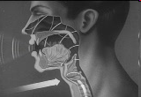
Week 1: Introduction to Sound
Sound is a pressure wave
http://www.archive.org/details/SoundWavesAn

Slide 42
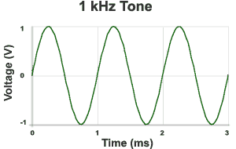

Week 1: Introduction to Sound Waves
Cycle = 1 iteration of sine wave
Hertz (Hz) = 1 cycle per second
1kHz = 1000 cycles/s
Source: http://www.mediacollege.com/audio/01/sound-waves.html

Slide 43
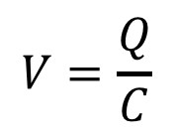

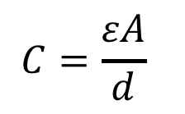
Week 1: Pressure to Voltage
Microphones convert pressure to voltage
  (speakers/headphones voltage to pressure)
  Physical position to voltage
Reason as parallel place capacitor
  ESE 112 or PHYS 151
      Δd → ΔC → ΔV
V
d
$$C=\frac{εA}{d}$$
$$V=\frac{Q}{C}$$
$$Q=CV$$
Notes:
Δd → ΔC → ΔV

Slide 44
Course Map
10101001101
MIC
CPU
File-
System
A/D
10101001101
NIC
Music
domain
conversion
compress
sample
freq
pyscho-
acoustics
EULA
----------------click
OK
D/A
NIC
speaker
MP3 Player / iPhone / Droid

Slide 45
Course Map: Week 1
MIC
Music
you will do this in first lab!
EULA
----------------click
OK
speaker

Slide 46
Before next slide…Mini-Quiz:
What is a bit (a Binary Digit)?
  Smallest piece of information we can store (on/off)
How many bits in a byte?
  8
Bytes in a Kilobyte?
  2¹⁰ x 1 byte = 1024 bytes
Bytes in a Megabyte?
  2¹⁰ x 1KB = 1,048,576 bytes
Bytes in a Gigabyte?
  2¹⁰ x 1MB = 1,073,741,824 bytes
How many bits to store a typical song?
Notes:
2010: had no basis to answer this
2012: first 3 (new in 2012) – were all over… someone says 1000bits in a byte…
still no basis for bits/song
2018: first few answers for byte were 1000, 1024 … so they don’t know this.
even MB, GB was getting things all over the place – so , really do need to ask this!

Slide 47
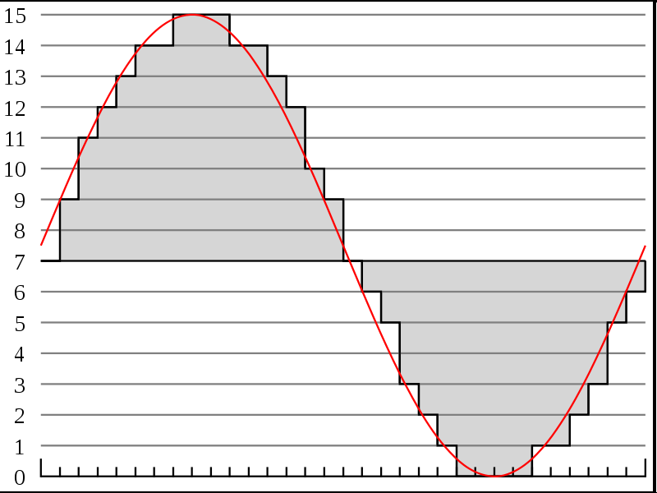



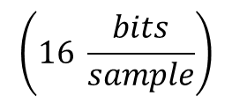
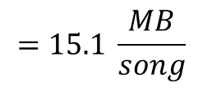
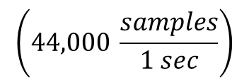
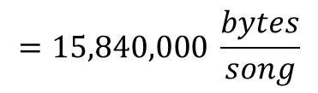

Week 2: Discrete Sampling
http://en.wikipedia.org/wiki/File:Pcm.svg
Discrete
Voltage
Levels
http://en.wikipedia.org/wiki/File:Compact_disc.svg
Voltages can be sampled discretely
  Both in time and amplitude
Can turn sound wave into sequence of bits
  0111 1001 1011 1100 1101 1110 1110 1111 1111 ….
What precision do we need?
  Compact Disks: 16bits at 44KHz
    How many bits is a typical 3-minute song?
$$=\text{126}\text{,}\text{720}\text{,}\text{000}\frac{bits}{song}$$
$$\left(44,000 \frac{samples}{1 sec}\right)$$
$$\left(16 \frac{bits}{sample}\right)$$
$$\left(60 \frac{sec}{1 min}\right)$$
$$\left(3 \frac{min}{song}\right)$$
$$=15,840,000 \frac{bytes}{song}$$
$$=15.1 \frac{MB}{song}$$
Notes:
44,000/s x 2B x 3 m x 60s/m
15,840,000 Bytes
15.8 MB or almost 128Mbits

Slide 48
Course Map
7,8,9
10101001101
MIC
CPU
File-
System
A/D
10
10101001101
NIC
Music
1
domain
conversion
5,6
Numbers correspond to course weeks
compress
sample
freq
pyscho-
acoustics
3
2
4
13
11
EULA
----------------click
OK
D/A
NIC
speaker
MP3 Player / iPhone / Droid
12

Slide 49
Course Map: Week 2
MIC
A/D
Music
1
Numbers correspond to course weeks
sample
2
EULA
----------------click
OK
D/A
speaker

Slide 50
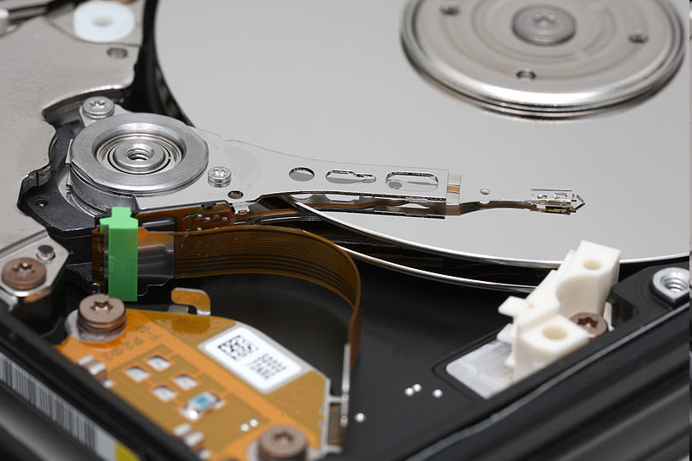
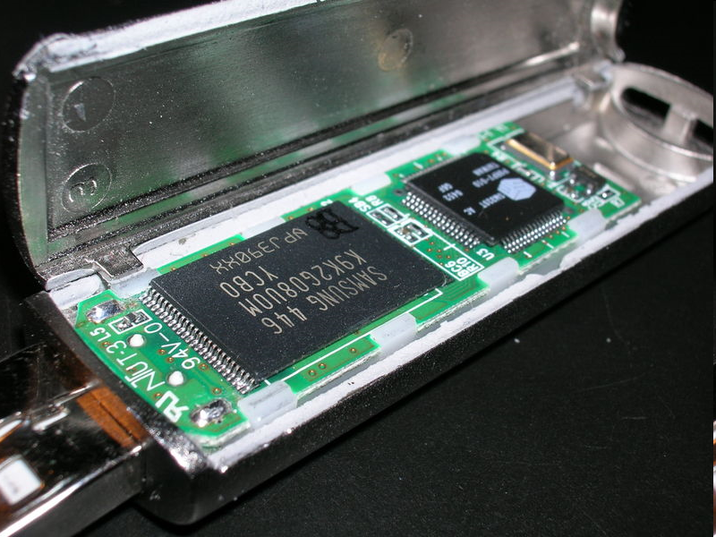
Digital Storage (week 10)
Record bits to non-volatile memory
  Store and reproduce sound
Media: CD, Hard Disk, Flash
http://en.wikipedia.org/wiki/File:Compact_disc.svg
http://en.wikipedia.org/wiki/File:DSCN0411.JPG
http://en.wikipedia.org/wiki/File:Hard_disk_platters_and_head.jpg

Slide 51
Calculating Capacity
How many songs can we fit on a CD?
  How many MB can a CD hold?
    650 MB (for Data)
    About 780 MB (for Audio)
  If 3 minute song = 15.1 MB…
    1 minute audio ~ 5.04MB
    But, we record in stereo: (R/L)
      5.04 MB x 2 = 10.07 MB per minute
    780 MB / 10.0 MB per minute ~ 78 minutes
How much memory does your MP3 player have?
  Given unit of information to store, we can architecture storage!

Slide 52
Course Map
7,8,9
10101001101
MIC
CPU
File-
System
A/D
10
10101001101
NIC
Music
1
domain
conversion
5,6
Numbers correspond to course weeks
compress
sample
freq
pyscho-
acoustics
3
2
4
13
11
EULA
----------------click
OK
D/A
NIC
speaker
MP3 Player / iPhone / Droid
12

Slide 53
Course Map: Week 10
10101001101
MIC
File-
System
A/D
10
Music
1
Numbers correspond to course weeks
sample
2

Slide 54
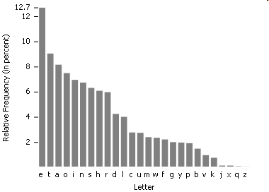
Week 3: Lossless Compression
Enables: Kindle to store 1500 books in 2GB, SMS text
http://en.wikipedia.org/wiki/File:English-slf2.PNG
Statistics of data allow compression
If all symbols (characters, voltages) aren’t equally likely,
  Can assign shorter bit sequences to most common cases
  and reduce bits required to store or transmit!
Famous Example of statistical storage: Morse Code:
THE = — ● ● ● ● ● = 6 symbols (not 18 as you might expect)
Notes:
Where does 18 come from?
Morse Code: 26 letters, 10 numbers = 36
Since its basically binary rep: 2^6 = 64
For 3 symbols, need :3 * 6 bits = 18 bits

Slide 55
Course Map
7,8,9
10101001101
MIC
CPU
File-
System
A/D
10
10101001101
NIC
Music
1
domain
conversion
5,6
Numbers correspond to course weeks
compress
sample
freq
pyscho-
acoustics
3
2
4
13
11
EULA
----------------click
OK
D/A
NIC
speaker
MP3 Player / iPhone / Droid
2

Slide 56
Course Map: Week 3
10101001101
MIC
File-
System
A/D
10
Music
1
Numbers correspond to course weeks
compress
sample
3
2
speaker

Slide 57
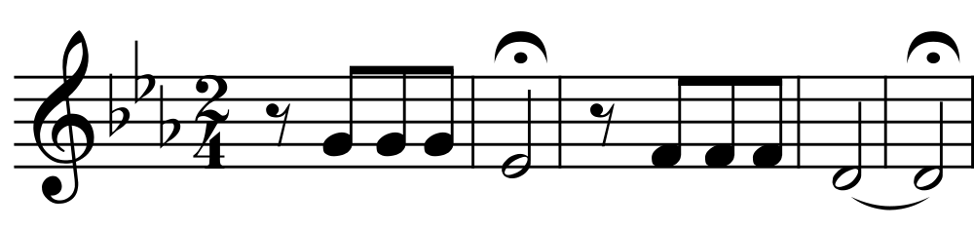
Time-Frequency Conversion
There are other ways to represent
How does the musical staff
representation of sound
differ from time samples?

Slide 58
Week 4: Time-Frequency Conversion
There are other ways to represent
  Frequency representation particularly efficient
392
311
348
294
Frequencies in Hertz
Notes:
G4, E4b, F4, D4

Slide 59
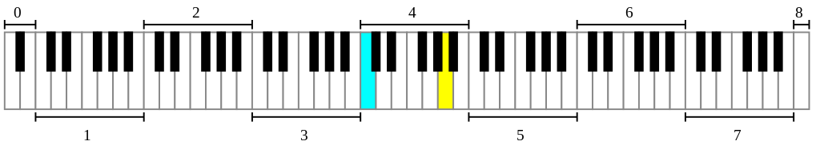
Time-Frequency Conversion
1s / quarter note ➔ 10s of sound
  44K Hz x 16b/sample x 10s = 7040K =7Mbits
How many keys on piano?
  (7b/note+8b/duration) x 7 note = 105 bits?
AlwaysAngry: https://commons.wikimedia.org/wiki/File%3APiano_Frequencies.svg

Slide 60
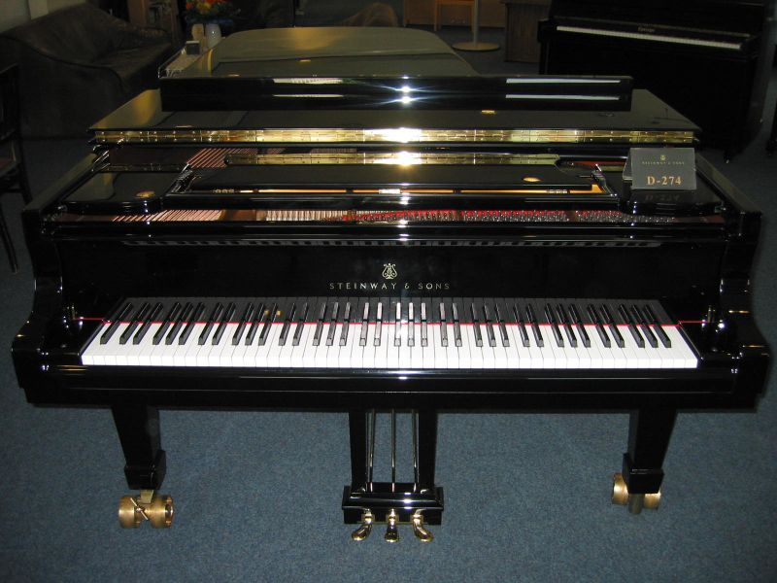
Hamburg Steinway D-274 Piano photo by Karl Kunde
https://commons.wikimedia.org/wiki/File:D274.jpg

Slide 61
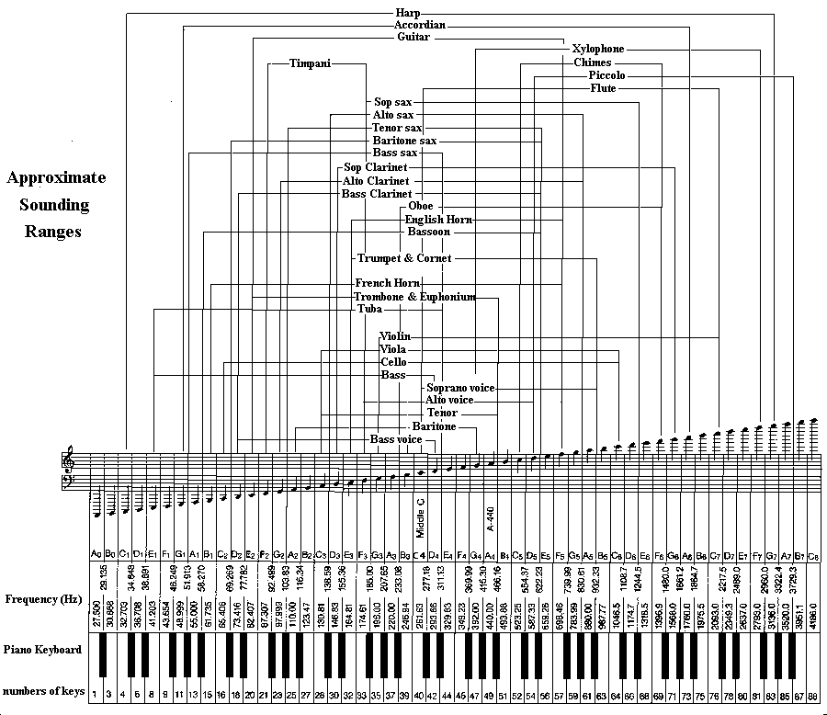
Larry Solomn: http://solomonsmusic.net/insrange.htm

Slide 62
Course Map
7,8,9
10101001101
MIC
CPU
File-
System
A/D
10
10101001101
NIC
Music
1
domain
conversion
5,6
Numbers correspond to course weeks
compress
sample
freq
pyscho-
acoustics
3
2
4
13
11
EULA
----------------click
OK
D/A
NIC
speaker
MP3 Player / iPhone / Droid
12

Slide 63
Course Map: Week 4
10101001101
MIC
File-
System
A/D
10
Music
1
domain
conversion
Numbers correspond to course weeks
compress
sample
freq
3
2
4
D/A
speaker

Slide 64
Week 2: Nyquist-Shannon
Sampling Theorem:
  Only need to sample 2 x maximum frequency component of a signal
Range of human hearing?
  20 Hz → 20 kHz
How many samples?
  2 x 20 kHz = 40 kHz
CD samples /sec:
  44,000 Samples / sec
http://en.wikipedia.org/wiki/File:Pcm.svg

Slide 65
Course Map
7,8,9
10101001101
MIC
CPU
File-
System
A/D
10
10101001101
NIC
Music
1
domain
conversion
5,6
Numbers correspond to course weeks
compress
sample
freq
pyscho-
acoustics
3
2
4
13
11
EULA
----------------click
OK
D/A
NIC
speaker
MP3 Player / iPhone / Droid
12

Slide 66
Course Map: Week 5
10101001101
MIC
File-
System
A/D
10
Music
1
domain
conversion
Numbers correspond to course weeks
compress
sample
freq
3
2
4
D/A
speaker

Slide 67
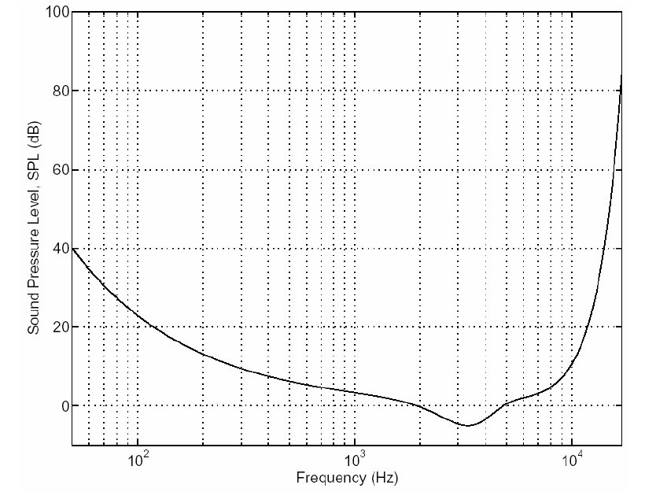
Week 5: Psychoacoustics
The Theory behind MP3
http://www.mp3-tech.org/programmer/docs/mp3_theory.pdf
http://en.wikipedia.org/wiki/File:Pcm.svg
Human input apparatus is limited
If we only care about human perception
  …that reduces the information needed (reduces samples/sec)
Limited maximum frequency

Slide 68
Course Map
7,8,9
10101001101
MIC
CPU
File-
System
A/D
10
10101001101
NIC
Music
1
domain
conversion
5,6
Numbers correspond to course weeks
compress
sample
freq
pyscho-
acoustics
3
2
4
13
11
EULA
----------------click
OK
D/A
NIC
speaker
MP3 Player / iPhone / Droid
12

Slide 69
Course Map: Week 6
10101001101
MIC
File-
System
A/D
10
Music
1
domain
conversion
5,6
Numbers correspond to course weeks
compress
sample
freq
pyscho-
acoustics
3
2
4
D/A
speaker

Slide 70
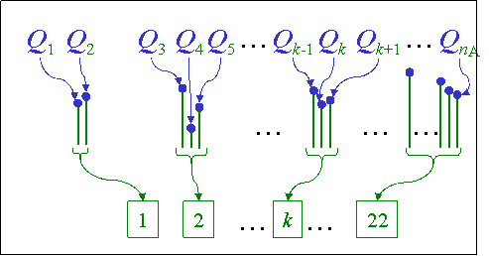
Week 6: Psychoacoustic Compression
MP3 based on putting these together
  Convert to frequencies
  Determine frequencies that don’t matter
  Quantize (fewer than 16b) for less important
Significantly smaller size than raw, sampled bits
Bands
Lossy Coding

Slide 71
Course Map
8,9
10101001101
MIC
CPU
File-
System
A/D
10
10101001101
NIC
Music
1
domain
conversion
6
Numbers correspond to course weeks
compress
sample
freq
pyscho-
acoustics
3
2,5
4
12
11
EULA
----------------click
OK
D/A
NIC
speaker
MP3 Player / iPhone / Droid
13

Slide 72
Course Map: Week 6
10101001101
MIC
File-
System
A/D
10
Music
1
domain
conversion
5,6
Numbers correspond to course weeks
compress
sample
freq
pyscho-
acoustics
3
2
4
D/A
speaker

Slide 73
Week 7: Hardware
CPUs: We’ll look at their operation and architecture
How fast does your laptop or cell phone
run?
Modern chips run 100MHz to 4 GHz
  → only need one multiplier, adder
  Reuse hardware it in time
Notes:
2010: didn’t have a clue about this
…and in 2012 …

Slide 74
Week 8: Hardware
To perform decompression
  For audio playback
Need to perform
  a few million operations
    Operations addition, multiplication
      Calculate cosines
      Scale values
      Add waveforms
  per second of audio
How fast does CPU need
to be to work with audio?

Slide 75
Week 8: iPod
Processor
Early based on PortalPlayer series
  Two ARM7TDMI cores
  80MHz each
Current use ARM7 or ARM8

Slide 76


Week 9: Operating System
This hardware can be virtualized and shared among tasks
  How does OS control hardware?
  Do we need giant OS or small portion for mp3?
App
Dejour

Slide 77
Course Map
7,8,9
10101001101
MIC
CPU
File-
System
A/D
10
10101001101
NIC
Music
1
domain
conversion
5,6
Numbers correspond to course weeks
compress
sample
freq
pyscho-
acoustics
3
2
4
13
11
EULA
----------------click
OK
D/A
NIC
speaker
MP3 Player / iPhone / Droid
12

Slide 78
Course Map: Week 9,10
7,8,9
10101001101
MIC
CPU
File-
System
A/D
10
Music
1
domain
conversion
5,6
Numbers correspond to course weeks
compress
sample
freq
pyscho-
acoustics
3
2
4
D/A
speaker

Slide 79
Week 11: Networking
Bits can be transported between machines
  How fast must network speed to be to stream audio?
  How fast can bits be sent ½ way around earth?
    If c = 300,000 km/s and circumference of earth = 40,075 km
    On an optical fiber, minimum time = 67 ms to go ½ way!
    Speed of light is different in different mediums/equipment is slow too…far slower in reality
Notes:
30ms

Slide 80
Course Map
7,8,9
10101001101
MIC
CPU
File-
System
A/D
10
10101001101
NIC
Music
1
domain
conversion
5,6
Numbers correspond to course weeks
compress
sample
freq
pyscho-
acoustics
3
2
4
13
11
EULA
----------------click
OK
D/A
NIC
speaker
MP3 Player / iPhone / Droid
12

Slide 81
Course Map: Week 11
7,8,9
10101001101
MIC
CPU
File-
System
A/D
10
10101001101
NIC
Music
1
domain
conversion
5,6
Numbers correspond to course weeks
compress
sample
freq
pyscho-
acoustics
3
2
4
11
D/A
NIC
speaker

Slide 82
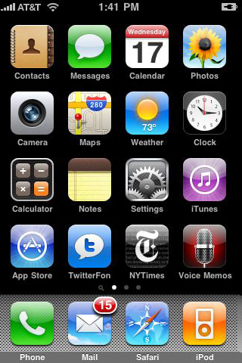
Week 12: User Interfaces
These capabilities can be harnessed by all people
  Not just engineers
…but we must designed for people
  For the non-engineers
iPhone is a classic example:
  product that didn’t do anything new
  BUT, it made everything simple
  thanks to well designed UI

Slide 83
Week 13: Intellectual Property
Who own’s the bits?
What is the law?
Why is the law?
Why should you care (as engineers)?
How is the world changing?

Slide 84
Course Map
7,8,9
10101001101
MIC
CPU
File-
System
A/D
10
10101001101
NIC
Music
1
domain
conversion
5,6
Numbers correspond to course weeks
compress
sample
freq
pyscho-
acoustics
3
13
2
4
11
EULA
----------------click
OK
D/A
NIC
speaker
MP3 Player / iPhone / Droid
12

Slide 85
Summary
History & Motivation
Short Story / Overview
Course Introduction
Learning Styles
Long Story / Intro to Sound
Summary

Slide 86
This course
It is a work in progress:
  Attempts to explain a great deal of Comp Eng
    Without going to far in depth
  Lecture/Lab
    Intent is to tie them together well
    Inevitably, the tie won’t always be obvious
  Help us, help you (and future students):
    The more feedback you provide, the better we can make this course
    If a tie isn’t obvious, let us help make the connection stronger
    We want you to love Comp Engineering as much as we do ☺
  One form: daily feedback sheets

Slide 87
Changing World
Automated computation changed world
  Faster than we imagined
World being digitized and refitted for computerized control and mediation
  People-to-people, people-to-machines
  Infrastructure from bricks/concrete/steel to networking/computers/software
Enabling new engineering
  Computerization at center
Exciting and dangerous
Computer Engineering at center

Slide 88
Parting Thought
From 1st computer to PCs in 30 years
  Eniac 1946→ Apple 1976
From first PCs to iPhone next 30 years
  Apple 1976→iPhone 2007
What will next 30 years hold?
  Beginning of your career
What will you imagine, create, enable?

