Slide 1



Lecture #3 – Compression
ESE 150 –
Digital Audio Basics

Slide 2
Lecture Topics
Where are we on course map?
What we did in lab last week
  How it relates to this week
Lossless Compression
  What is it, examples, classifications
  Probability-based lossless compression
    Huffman Encoding
  Entropy
    Shannon Limits
Next Lab
References

Slide 3



What we did in Lab…
Analog
input
S/H
ADC
Digital
Output
Week 1: Converted Sound to analog voltage signal
    a “pressure wave” that changes air molecules w/ respect to time
    a “voltage wave” that changes amplitude w/ respect to time
  Sample: Break up independent variable, take discrete ‘samples’
  Quantize: Break up dependent variable into n-levels (need 2^{n} bits to digitize)
Week 2: Reconstructed analog signal from digital

Slide 4



Course Map – Week 3
MIC
CPU
A/D
10101001101
Music
1
Numbers correspond to course weeks
compress
sample
3
2,4
D/A
10101001101
speaker

Slide 5
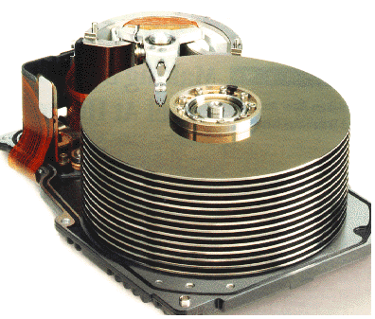




Course Map
7,8,9
10101001101
MIC
CPU
File-
System
A/D
10
10101001101
NIC
Music
1
domain
conversion
5
Numbers correspond to course weeks
compress
sample
freq
pyscho-
acoustics
4
2,3
4
13
11
EULA
----------------click
OK
D/A
NIC
speaker
MP3 Player / iPhone / Droid
12

Slide 6
Preclass

Slide 7
Preclass
Tell me and I forget, teach me and I may remember, involve me and I learn
  -- Benjamin Franklin
73 symbols (fancy, more general term for letters)
19 unique (ignoring case)
  (A, B, C, D, E, F, G, H, I, L, M, N, O, R, T, V, Y, space, comma)
  How many bits to represent each symbol?
How many bits to encode quote?

Slide 8
Preclass
Tell me and I forget, teach me and I may remember, involve me and I learn
  -- Benjamin Franklin
73 symbols
19 unique (ignoring case)
If symbols occurrence equally likely, how many occurrences of each symbol should we expect in quote?
How many e’s are there in the quote?

Slide 9
Preclass
Tell me and I forget, teach me and I may remember, involve me and I learn
  -- Benjamin Franklin
73 symbols
19 unique (ignoring case)
Conclude
  Symbols do not occur equally
  Symbol occurrence is not uniformly random

Slide 10
Preclass
Tell me and I forget, teach me and I may remember, involve me and I learn
  -- Benjamin Franklin
Using fixed encoding (question 1)
How many bits to encode first 10 symbols?
How many bits using encoding given?

Slide 11
Preclass
Tell me and I forget, teach me and I may remember, involve me and I learn
  -- Benjamin Franklin
Using fixed encoding (question 1)
How many bits to encode first 24 symbols?
How many bits using encoding given?

Slide 12
Preclass
Tell me and I forget, teach me and I may remember, involve me and I learn
  -- Benjamin Franklin
Using fixed encoding (question 1)
How many bits to encode al 73 symbols?
How many bits using encoding given?

Slide 13
Conclude
Can encode with (on average) fewer bits than log₂(unique-symbols)

Slide 14
Intro to Compression

Slide 15
Data Compression
What is compression?
  Encoding information using fewer bits than the original representation
Why do we need compression?
  Most digital data is not sampled/quantized/represented in the most compact form
    It takes up more space on a hard drive/memory
    It takes longer to transmit over a network
  Why? Because data is represented in so that it is easiest to use
Two broad categories of compression algorithms:
  Lossless – when data is un-compressed, data is its original form
    No data is lost or distorted
  Lossy – when data is un-compressed, data is in approximate form
    Some of the original data is lost

Slide 16
Representation of Data
Letter | Numeric Encoding
A | 0
B | 1
C | 2
D | 3
E | 4
F | 5
G | 6
H | 7
I | 8
J | 9
K | 10
L | 11
M | 12
Letter | Numeric Encoding
N | 13
O | 14
P | 15
Q | 16
R | 17
S | 18
T | 19
U | 20
V | 21
W | 22
X | 23
Y | 24
Z | 25
How to encode alphabet?
Easy to map/encode:
A→0 and Z→25

Slide 17
How many Bits to represent all letters?
Letter | Binary Encoding
A | 00000
B | 00001
C | 00010
D | 00011
E | 00100
F | 00101
G | 00110
H | 00111
I | 01000
J | 01001
K | 01010
L | 01011
M | 01100
Letter | Binary Encoding
N | 01101
O | 01110
P | 01111
Q | 10000
R | 10001
S | 10010
T | 10011
U | 10100
V | 10101
W | 10110
X | 10111
Y | 11000
Z | 11001
Including upper and lower case?
…and numbers, how many bits?

Slide 18
ASCII Encoding (7-bit encoding)
Letter | ASCII Code | Binary | Letter | ASCII Code | Binary
a | 097 | 01100001 | A | 065 | 01000001
b | 098 | 01100010 | B | 066 | 01000010
c | 099 | 01100011 | C | 067 | 01000011
d | 100 | 01100100 | D | 068 | 01000100
e | 101 | 01100101 | E | 069 | 01000101
f | 102 | 01100110 | F | 070 | 01000110
g | 103 | 01100111 | G | 071 | 01000111
h | 104 | 01101000 | H | 072 | 01001000
i | 105 | 01101001 | I | 073 | 01001001
j | 106 | 01101010 | J | 074 | 01001010
k | 107 | 01101011 | K | 075 | 01001011
l | 108 | 01101100 | L | 076 | 01001100
m | 109 | 01101101 | M | 077 | 01001101
n | 110 | 01101110 | N | 078 | 01001110
o | 111 | 01101111 | O | 079 | 01001111
p | 112 | 01110000 | P | 080 | 01010000
q | 113 | 01110001 | Q | 081 | 01010001
r | 114 | 01110010 | R | 082 | 01010010
s | 115 | 01110011 | S | 083 | 01010011
t | 116 | 01110100 | T | 084 | 01010100
u | 117 | 01110101 | U | 085 | 01010101
v | 118 | 01110110 | V | 086 | 01010110
w | 119 | 01110111 | W | 087 | 01010111
x | 120 | 01111000 | X | 088 | 01011000
y | 121 | 01111001 | Y | 089 | 01011001
z | 122 | 01111010 | Z | 090 | 01011010
ASCII:
American Standard
Code for Information
Interchange
2⁷=128 combinations
Standard encoding,
developed in the 1960’s
Didn’t take into account
international standards!
UNICODE
8-bit encoding
2⁸=256 possibilities!

Slide 19
Example of Lossless Compression
A simple form of compression would be the following:
  ORIGINAL TEXT (13-characters): I Love ESE150
  ASCII Encoding (13-bytes = 104 bits):
  01001001 00100000 01001100 01101111 01110110 01100101 00100000 01000101 01010011 01000101 00110010 00110101 00110000
  Convenient to write programs that read/write files 1-byte at a time
  But, since ASCII only needs 7-bits (not 8):
    We could write a compression program that strips the leading 0
  Output of Compression Program (91 bits ~ 11.375 bytes):
  1001001 0100000 1001100 1101111 1110110 1100101 0100000 1000101 1010011 1000101 0110010 0110101 0110000
  Compression ratio: 104 bits in / 91 bits out = 1.14 :1
  Lossless because we can easily restore exact original

Slide 20
Compression Process
Original
Program
Compression
Program
De-Compression
Program
Original
Program
output
input
output
input
output
input
Original
Output
File
Compressed
Output
File
Original
Output
File
13-bytes
11.375-bytes
13-bytes
Why not compress all the time?
Inconvenient; expensive in terms of microprocessor cycles
Leads to tradeoff: compute vs. storage

Slide 21
Recall ADC Process?
Analog-to-Digital (ADC) Conversion
  We have 7 discrete voltages, # of bits to represent 7 things?
  3-bits! Why? 2^{3-bits} = 8 (1 unused state)
Binary
Encoding:
011
Voltage
Samples:
{ 0 ms, 0 Volts }
110
3
{ 1 ms, 2 Volts }
101
101
2
{ 2 ms, 3 Volts }
110
100
1
{ 3 ms, 2 Volts }
101
011
time (ms)
{ 4 ms, 0 Volts }
011
0
1
2
3
4
5
6
7
8
{ 5 ms, -2 Volts }
001
010
-1
{ 6 ms, -3 Volts }
000
001
-2
{ 7 ms, -2 Volts }
001
000
-3
{ 8 ms, 0 Volts }
011
Encoding: mapping data from one form to another (not always conversion)

Slide 22
Example of Lossy Compression
    Sample Rate: 1000 samples/sec, Resolution: 3-bits per sample
    Our Sampled Signal: {0, 2.2V, 3V, 2.2V, 0, -2.2V, -3, -2.2V, 0}
    Our Quantized Signal: {0, 2V, 3, 2V, 0, -2, -3, -2, 0}
    Our 3-bit Digitized Data: {011, 101, 110, 101, 011, 001, 000, 001, 011}
      space required to store/transmit: 27 bits
ADC related compression algorithm:
  CS&Q (Coarser Sampling AND/OR Quantization)
    Either reduce number of bits per sample AND/OR discard a sample completely
  Example with our digitized data:
  Our 3-bit Digitized Data: {011, 101, 110, 101, 011, 001, 000, 001, 011}
  If we drop the sampling rate by a factor of 2, how effect number of bits needed?
  Lossy because we cannot restore exact original

Slide 23
De-Compression of Signal:
Decompression & DAC Process
  Original digital signal: {011, 101, 110, 101, 011, 001, 000, 001, 011}
  Original Sampling Rate: 1000 samples/sec
Voltage
110
3
101
2
100
1
011
0
time (ms)
1
2
3
4
5
6
7
8
010
-1
001
-2
000
-3
Original Signal (recall ADC/DAC is approximation at best anyway!)

Slide 24
De-Compression of Signal:
Decompression & DAC Process
  Original compressed signal: {011, , 110, , 011, , 000, , 011}
  New Sampling Rate Due to Compression: 500 samples/sec
Effect of CS&Q compression:
Lowered Sampling Rate
Added “noise” to signal
Listeners might not notice!
Lossy Compression:
One can achieve high
Compression ratios
Frequently used for Audio:
MP3 format uses lossy
compression algorithm
Voltage
110
3
101
2
100
1
011
0
time (ms)
1
2
3
4
5
6
7
8
010
-1
001
-2
000
-3
Lossy: Compression removed every other sample

Slide 25
Two forms of classification
Compression Algorithms
Lossy
Lossless
Compression Algorithms
Fixed Group Size
Variable Group Size
Examples of Fixed Group Size:
Take in 2 samples: (6-bits) always spit out: (3-bits)
Take in 8-bit ASCII character (group), spit out 7-bit ASCII character (group)

Slide 26
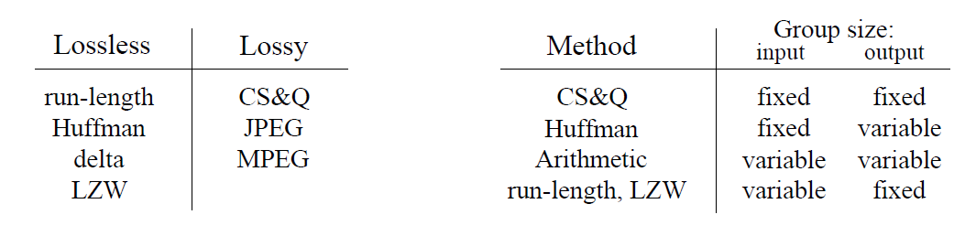
Algorithms Classified
These two tables show popular compression algorithms
  Sorted by the two forms of classifications
  Notice: JPG, and MPEG are actually forms of compression!
    Not just a file format for pictures or video
    We will also learn: MP3 is a form of lossy compression as well

Slide 27
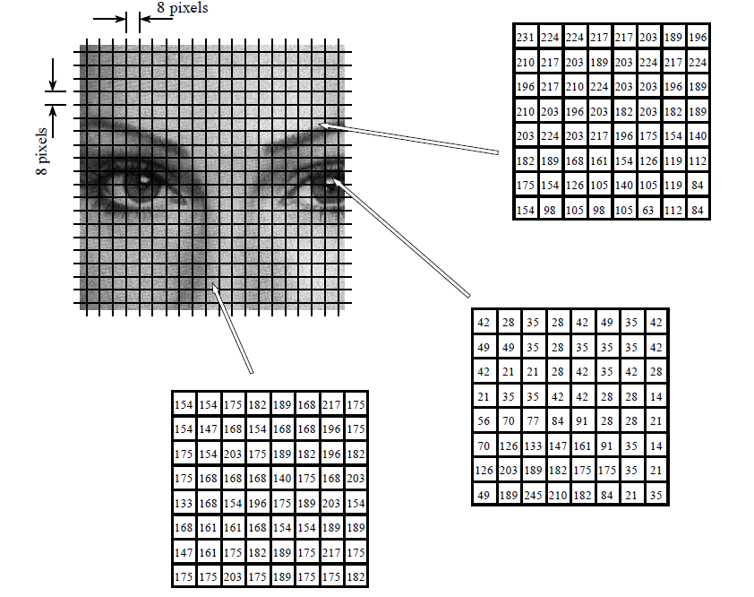
JPG Compression
JPG
  Uses “transform”
  We will study in week 4
  Each pixel is 8-bits
    1 byte per pixel
  Breaks pic into 8x8
    Treats as a 64-byte group
  Lossy algorithm
    Reduces each group to 2 to 20 bytes
  Substantial savings
    Not as sharp a pic as BMP

Slide 28
Interlude (time permitting)
SNL – 5 minute University
  Father Guido Sarducci
https://www.youtube.com/watch?v=kO8x8eoU3L4
What form of compression here?

Slide 29
For Computer Engineering?
Make the common case fast
Make the frequent case small

Slide 30
Probability-Based Lossless Compression

Slide 31
Information Content
Does each character contain the same amount of “information”?
Notes:
31

Slide 32
Statistics
How often does each character occur?
  Capital letters versus non-capitals?
  How many e’s in a preclass quote?
  How many z’s?
  How many q’s?
Notes:
32

Slide 33
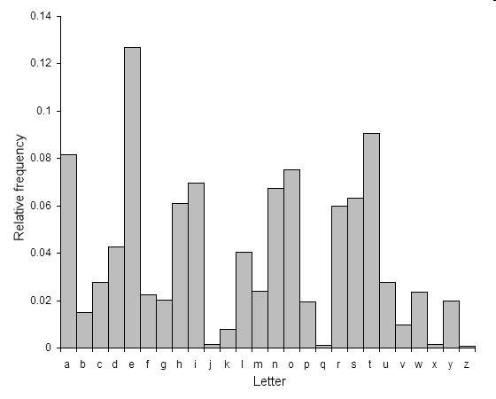
English Letter Frequency
http://en.wikipedia.org/wiki/File:English-slf.png
Notes:
33

Slide 34
Huffman Encoding
Developed in 1950’s (D.A. Huffman)
Takes advantage of frequency of stream of bits occurrence in data
  Can be done for ASCII (8-bits per character)
    Characters do not occur with equal frequency.
    How can we exploit statistics (frequency) to pick character encodings?
  But can also be used for anything with symbols occurring frequently
    E.g., Music (drum beats…frequently occurring data)
  Example of variable length compression algorithm
    Takes in fixed size group – spits out variable size replacement

Slide 35
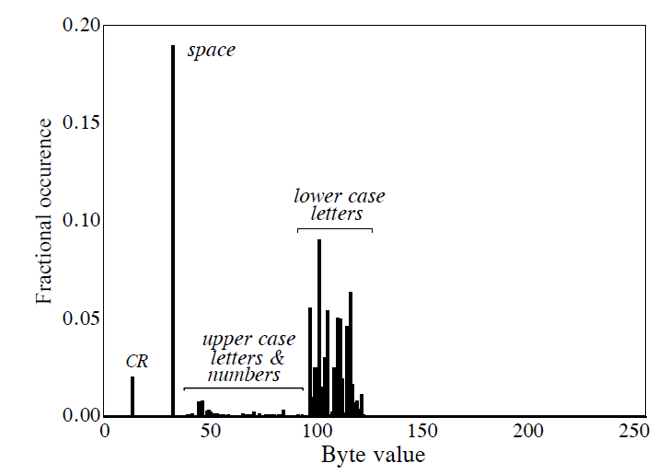
Huffman Encoding – The Basics
Example: more than 96% of file consists of 31 characters
Idea: Assign frequently used characters fewer bits
  31 common characters get 5b codes 00000--11110
  Rest get 13b: 11111+original 8b code
How many bits do we need on average per original byte?

Slide 36
Calculation
Bits = #5b-characters * 5 + #13b-character * 13
Bits=#bytes*0.96*5 + #bytes*0.04*13
Bits/original-byte = 0.96*5+0.04*13
Bits/original-byte = 5.32

Slide 37
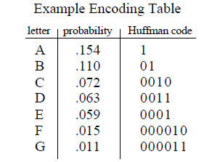
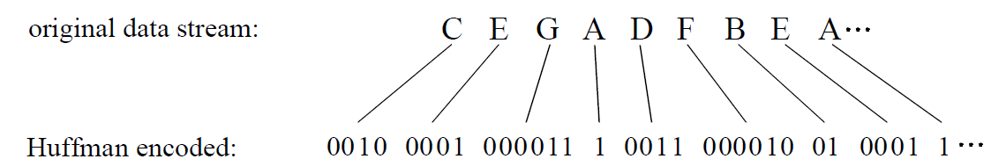
Huffman Encoding – More Advanced
Huffman goes further: Assign MOST used characters least # of bits:
  Most frequent: A= 1, least frequent: G=00011, etc.
  Example:

Slide 38
Preclass Encoding
symbol | encode | occur
(space) | 00 | 15
A | 1110
B | 100100
C | 100101
D | 10110
E | 110 | 11
F | 011010
G | 011011
H | 011000
I | 0111
symbol | encode | occur
L | 0100
M | 1111
N | 1010
O | 10011
R | 0101
T | 10111
V | 10000
Y | 011001
, | 10001

Slide 39
Preclass Encoding
symbol | encode | occur
(space) | 00 | 15
A | 1110 | 6
B | 100100
C | 100101
D | 10110
E | 110 | 11
F | 011010
G | 011011
H | 011000
I | 0111 | 4
symbol | encode | occur
L | 0100 | 4
M | 1111 | 6
N | 1010 | 5
O | 10011
R | 0101 | 4
T | 10111
V | 10000
Y | 011001
, | 10001

Slide 40
Preclass Encoding
symbol | encode | occur
(space) | 00 | 15
A | 1110 | 6
B | 100100
C | 100101
D | 10110 | 3
E | 110 | 11
F | 011010
G | 011011
H | 011000
I | 0111 | 4
symbol | encode | occur
L | 0100 | 4
M | 1111 | 6
N | 1010 | 5
O | 10011 | 2
R | 0101 | 4
T | 10111 | 3
V | 10000 | 2
Y | 011001
, | 10001 | 2

Slide 41
Preclass Encoding
symbol | encode | occur
(space) | 00 | 15
A | 1110 | 6
B | 100100 | 1
C | 100101 | 1
D | 10110 | 3
E | 110 | 11
F | 011010 | 1
G | 011011 | 1
H | 011000 | 1
I | 0111 | 4
symbol | encode | occur
L | 0100 | 4
M | 1111 | 6
N | 1010 | 5
O | 10011 | 2
R | 0101 | 4
T | 10111 | 3
V | 10000 | 2
Y | 011001 | 1
, | 10001 | 2
See how variable length encoding saved bits?
Questions?

Slide 42
Many Types of Frequency
Previous example:
  Simply looked at letters in isolation, determined frequency of occurrence
More advanced models:
  Predecessor context: What’s probability of a symbol occurring, given: PREVIOUS letter.
Ex: What’s most likely character to follow a T?

Slide 43
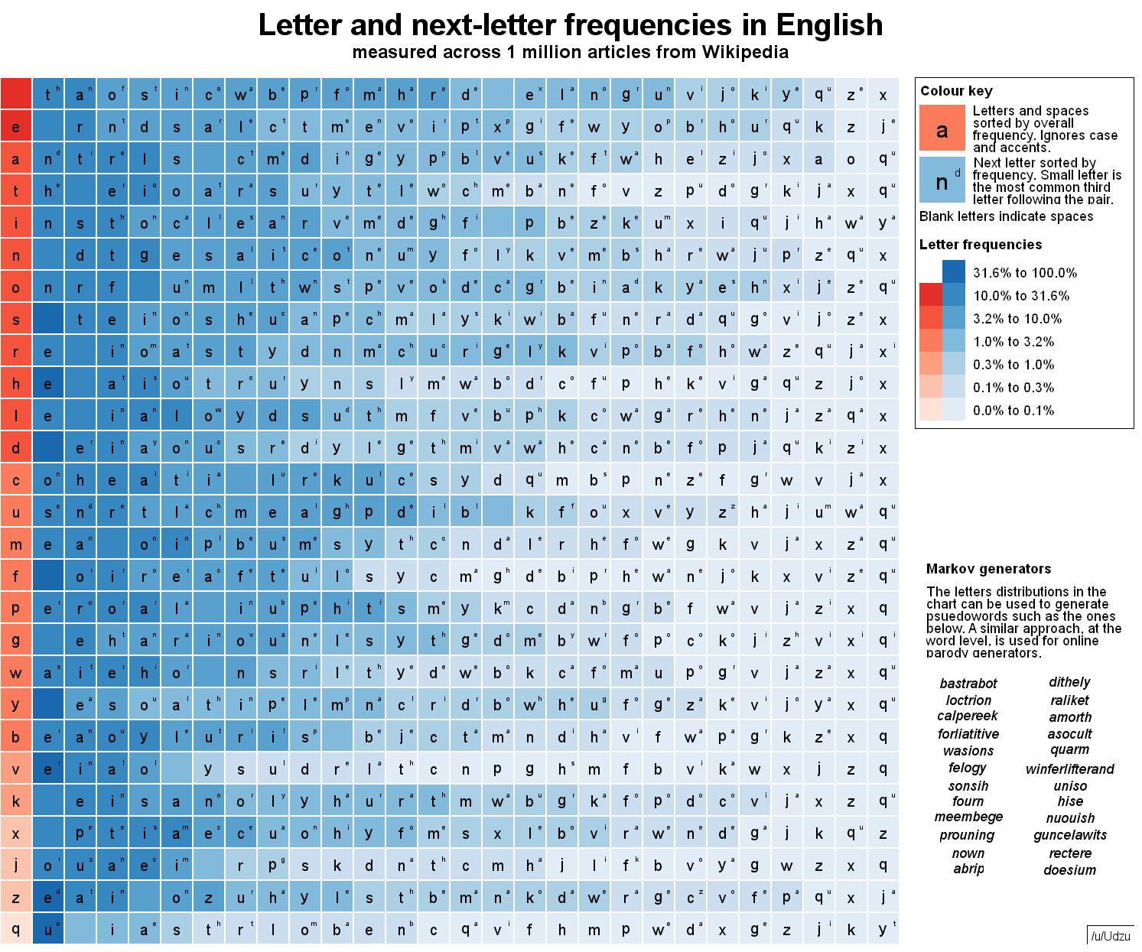
Found: https://www.reddit.com/r/dataisbeautiful/comments/6rk2yr/letter_and_nextletter_frequencies_in_english_oc/

Slide 44
Models
Many models for compression
  Context-independent letter frequency
  Context-dependent on previous letter
  Context-dependent on multiple previous letters
  Previous occurs of multi-letter strings…
Compressibility will depend on model employed
  More context
    More compressibility
    Must hold on to more state
    More complex to encode/decode

Slide 45
Compressibility
45
Compressibility depends on non-randomness (uniformity)
  Structure
  Non-uniformity
If every character occurred with same freq:
  There’s no common case
  To which character do we assign the shortest encoding?
    No clear winner
  For everything we give a short encoding,
    Something else gets a longer encoding
The less uniformly random data is…
  the more opportunity for compression
Notes:
45

Slide 46
Common Case
Big idea in optimization engineering
  Make the common case inexpensive
Shows up throughout computer systems
  Computer architecture
    Caching, instruction selection, branch prediction, …
  Networking and communication, data storage
    Compression, error-correction/retransmission
  Algorithms and software optimization
  User Interfaces
    Where things live on menus, shortcuts, …
    How you organize your apps on screens

Slide 47
Entropy
Is there a lower bound for compression?

Slide 48
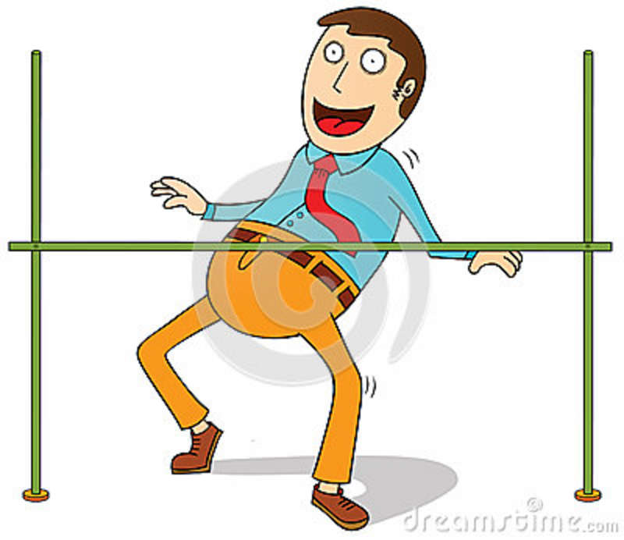
How low can we go with compression?
What is the least # of bits required to encode information?

Slide 49
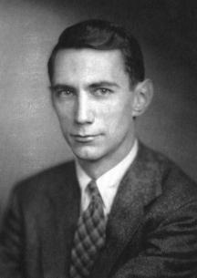
Claude Shannon
Father of Information Theory, brilliant mathematician
While at AT&T Bell Labs, landmark paper in 1948
Determined exactly how low we can go with compression!

Slide 50
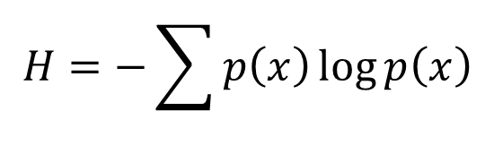
Shannon’s Entropy
What is entropy?
  Chaos/Disorganization/Randomness/Uncertainty
Shannon’s Famous Entropy Formula:
$$H=−\sum{p\left(x\right)\log{p\left(x\right)}}$$
Shannon’s
Entropy
(measured in bits)
Probability of each outcome
X
log₂ of (probability of each outcome)
Negative Sum Of:

Slide 51
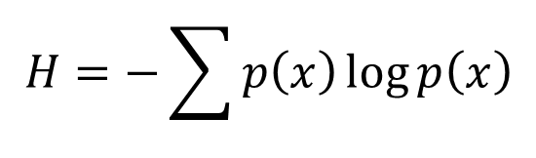

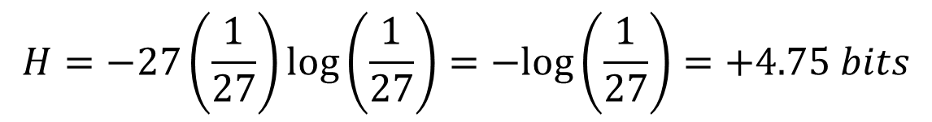
Estimating Entropy of English Language
27 Characters (26 letters + space)
If we assume all characters are equally probable:
$p\left(each character\right)=\frac{1}{27}$
Information Entropy per character:
$$H=−\sum{p\left(x\right)\log{p\left(x\right)}}$$
$$H=−27\left(\frac{1}{27}\right)\log\left(\frac{1}{27}\right)=−log\left(\frac{1}{27}\right)=+4.75 bits$$
Same thing we got when we said we needed log₂(unique_things) bits

Slide 52
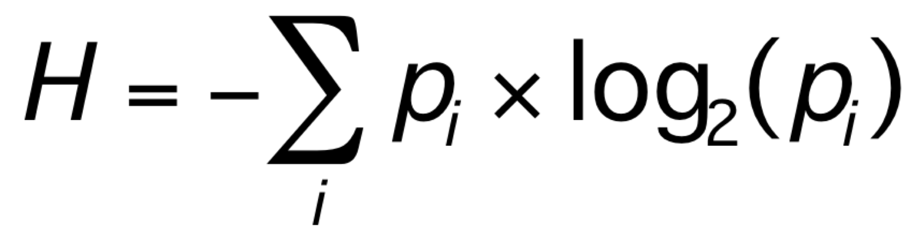
Shannon Entropy
Essentially says
  Should be able to encode with log(1/p) bits
Where did we calculate Average Bits earlier in lecture?

Slide 53
Recall:
Not all letters are equally probable
in English Language
http://en.wikipedia.org/wiki/File:English-slf.png
Notes:
53

Slide 54
Shannon Entropy English Letters
letter | p | -log₂(p) | -p*log₂(p)
a | 8.17% | 3.61 | 0.30
b | 1.49% | 6.07 | 0.09
c | 2.78% | 5.17 | 0.14
d | 4.25% | 4.56 | 0.19
e | 12.70% | 2.98 | 0.38
f | 2.23% | 5.49 | 0.12
z | 0.07% | 10.40 | 0.01
sum | 100.00% |  | 4.18

Slide 55
Shannon Entropy Preclass Quote
Symbol | Bits | Occur | P | -log₂(p) | -p*log₂(p) | p*bits
(space) | 2 | 15 | 0.21 | 2.28 | 0.47 | 0.41
A | 4 | 6 | 0.08 | 3.60 | 0.30 | 0.33
B | 6 | 1 | 0.01 | 6.19 | 0.08 | 0.08
C | 6 | 1 | 0.01 | 6.19 | 0.08 | 0.08
D | 5 | 3 | 0.04 | 4.60 | 0.19 | 0.21
E | 3 | 11 | 0.15 | 2.73 | 0.41 | 0.45
, | 5 | 2 | 0.03 | 5.19 | 0.14 | 0.14
 |  |  |  | sum | 3.74 | 3.77

Slide 56
Summing it up: Shannon & Compression
Shannon’s Entropy represents a lower limit for lossless data compression
  It tells us the minimum amount of bits that can be used to encode a message without loss (according to a particular model)
Shannon’s Source Coding Theorem:
  A lossless data compression algorithm cannot compress messages to have (on average) more than 1 bit of Shannon’s Entropy per bit of encoded message

Slide 57
To consider
Assumed know statistics
What if you don’t?
What if it changes?
How could we adapt the code to changing statics?

Slide 58
This week in Lab
Implement Compression!
  Implement Huffman Compression
  Note: longer prelab with MATLAB intro; plan accordingly
Remember:
  Lab 2 report is due on canvas on Friday.
Office Hours:
  Moved T2:30 → R4:30
  Moved R2:30 → R7:00

Slide 59
Big Ideas
Lossless Compression
  Exploit non-uniform statistics of data
  Given short encoding to most common items
Common Case
  Make the common case inexpensive
Shannon’s Entropy
  Gives us a formal tool to define lower bound for compressibility of data

Slide 60
Learn More
ESE 301– Probability
  Central to understanding probabilities
    What cases are common and how common they are
ESE 674 – Information Theory
Most all computer engineering courses
  Deal with common-case optimizations
  CIS240, CIS371, CIS380, ESE407, ESE532….

Slide 61
References
S. Smith, “The Scientists and Engineer’s Guide to Digital Signal Processing,” 1997.
Shannon’s Entropy (excellent video) http://www.youtube.com/watch?v=JnJq3Py0dyM
  Used heavily in the creation of entropy slides

