Slide 1



Lecture #8 – Stored-Program Processors
ESE 150 –
Digital Audio Basics
Based on slides © 2009--2019 DeHon

Slide 2









So Far
MIC
A/D
10101
Music
1
domain
conversion
5,6
Numbers correspond to course weeks
compress
sample
freq
pyscho-
acoustics
3
2
4
EULA
----------------click
OK
D/A
10101001101
speaker
MP3 Player / iPhone / Droid

Slide 3
How Process
How do we build a machine to perform these operations?
  From Digital Samples → compressed digital data → Digital Samples
With simple gates and registers
  can build a machine to perform any digital computation
  …if we have enough of them.

Slide 4
Economy and Universality
What if we only have a small number of gates?
OR … how many physical gates do we really need?
  How do we perform computation with minimal hardware?
How do we change the computation performed by our hardware?

Slide 5
Lecture Topics
Setup
Where are we?
Memory
One-gate processor
Wide-Word, Stored-Program Processor
Contemporary Processors: ARM, Arduino
Next Lab

Slide 6
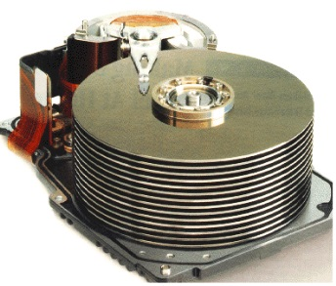


Course Map
7,8,9
10101001101
MIC
CPU
File-
System
A/D
10
10101001101
NIC
Music
1
domain
conversion
5,6
Numbers correspond to course weeks
compress
sample
freq
pyscho-
acoustics
3
2
4
13
11
EULA
----------------click
OK
D/A
NIC
speaker
MP3 Player / iPhone / Droid
12

Slide 7
Course Map – Week 9
MIC
A/D
Music
1
domain
conversion
5,6
Numbers correspond to course weeks
compress
sample
freq
pyscho-
acoustics
3
2
4
EULA
----------------click
OK
D/A
10101001101
speaker
MP3 Player / iPhone / Droid

Slide 8
Quick Reminder

Slide 9

Multiplexer Gate
MUX
  When S=0, output=i0
  When S=1, output=i1
S | i0 | i1 | Mux2(S,i0,i1)
0 | 0 | 0 | 0
0 | 0 | 1 | 0
0 | 1 | 0 | 1
0 | 1 | 1 | 1
1 | 0 | 0 | 0
1 | 0 | 1 | 1
1 | 1 | 0 | 0
1 | 1 | 1 | 1

Slide 10
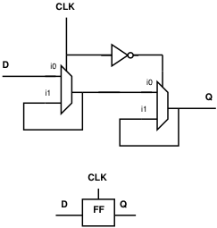
State Element
Latch or Register is a state element
Allows circuit to remember a value
Build computations that
  Depend on past inputs
  Reuse hardware in time

Slide 11
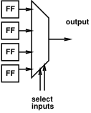
Mux can be a programmable Gate
Programmable Gate
  Can be programmed to act as any gate
  Use state (e.g. FF) to “program” truth table of a gate
Input 0 | Input 1 | Output
0 | 0
0 | 1
1 | 0
1 | 1

Slide 12
NAND Universality
Can implement any combinational logic function out of a collection of NAND2 gates
  Or AND, OR, NOT combination
  Or Programmable MUX gates (OR)

Slide 13
Preclass 1
What Function?
  o1=a&b | b&c | a&c;
  o2=a^b^c;
How many gates?

Slide 14
Preclass 1 in Gates

Slide 15
Memory

Slide 16
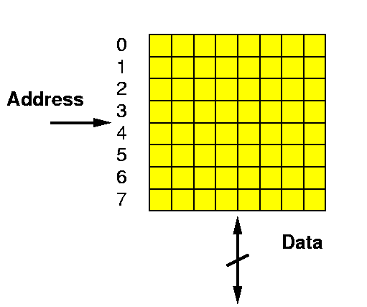
Random Access Memory
A Memory:
  Series of locations (slots)
  Can write values a slot (specified by address)
  Read values from (by address)
  Return last value written
Notation:
slash on wire
means multiple bits wide

Slide 17
Two Pieces of a Memory
Element to remember a value
Way to address/select that element

Slide 18
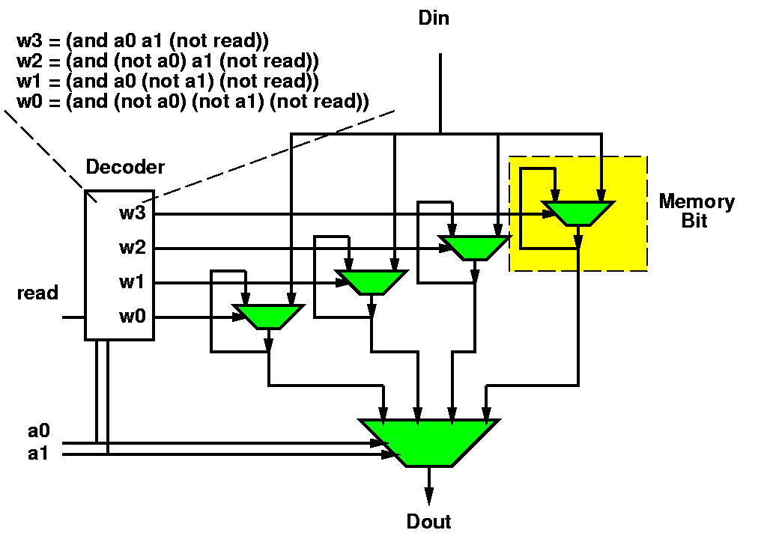
Could build Memory w/ Muxes & latches
… collection of registers

Slide 19
Random Access Memory (RAM) with Capacitor Memories
Din
Decoder
Read
Address
Learn more: ESE370
Dout

Slide 20
Key Engineering Property
Store state compactly in memory
A(memory cell) small
  A(mem) < A(gate)
Depends on few
inputs/outputs
  Memory cells share
  inputs and ouptuts

Slide 21
One-Gate Processor

Slide 22
Idea
Store register and gate outputs in memory
Compute one gate at a time
  Using a single physical gate

Slide 23
Basic Idiom
Repeat:
Read gate value from memory
Perform operation on gate
Write result back to memory

Slide 24
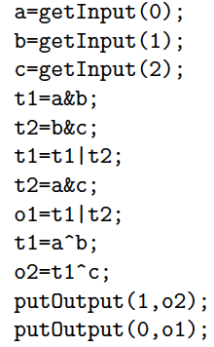

Operation

Slide 25
Operation Sequence
Missing
C step?
Missing description?

Slide 26
Observe
We can sequentialize operations,
reusing the single gate
As long as we can specify the
operation to be performed
What are we specifying?
  (break it down, what information need?)

Slide 27
Instruction
Call this specification an instruction
Instructs the programmable,
reusable operators on what to perform

Slide 28
Expanding the Structure: Input
Add a multiplexer to bring in inputs
Allow as option to write into data memory

Slide 29
Expanding the Structure: Output
Add way to load a designated output register

Slide 30
Expanded Control = Instruction
Group the full control into instruction
Set of bits that tells the structure what to do

Slide 31
Fillin missing Instruction

Slide 32

Instruction Bits
Instructions are just a set of bits
Type – 2 bits
GateOp – 4 bits
In1 – 3 bits
  Assume 8 slots
In2 – 3 bits
Out – 3 bits

Slide 33
Instruction Bits Example
Fillin Missing

Slide 34
Instruction Sequence Control
How provide the sequence of instructions?

Slide 35
Instruction
Memory
Add Memory to hold set of Instructions
Counter to sequence instructions

Slide 36
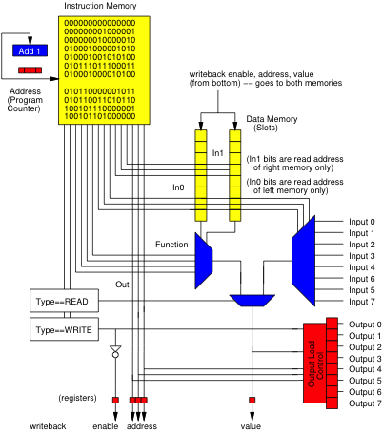
Animate
0
Start at PC=0

Slide 37
Animate
1
0
Start at PC=0
Read Instr. Mem at 0
(also compute next PC by adding 1)
000000000000000
000
000
0000
00
000

Slide 38
Animate
1
0
Start at PC=0
Read Instr. Mem at 0
Decode
000000000000000
000
000
a
0000
00
1
1
000

Slide 39
Animate
1
0
Start at PC=0
Read Instr. Mem at 0
Decode
From input
000000000000000
000
000
a
0000
a
00
1
1
000
a

Slide 40
Animate
a
1
Start at PC=0
Read Instr. Mem at 0
Decode
From input
Write Back
Update PC
a
000000000000000
a
000
000
a
0000
a
00
1
1
000
a
a

Slide 41
Animate
a
2
1
PC=1
Read Instr. Mem at 1
a
000000001000001
a
000
001
a
b
0000
a
00
1
1
001
a
a

Slide 42
Animate
a
2
1
PC=1
Read Instr. Mem at 1
Decode
From Input
a
000000001000001
a
000
001
a
b
0000
b
00
1
1
001
b
a

Slide 43
Animate
a
2
PC=1
Read Instr. Mem at 1
Decode
From Input
Writeback and update PC
a
000000001000001
a
000
b
b
001
a
b
0000
b
00
1
1
001
b
a

Slide 44
Animate
a
3
2
PC=2
Another read
a
000000010000010
a
000
b
b
010
a
b
0000
c
c
00
1
1
010
c
a

Slide 45
Animate
a
3
PC=2
Another read
Writeback, update PC
a
000000010000010
a
000
b
b
c
c
010
a
b
0000
c
c
00
1
1
010
c
a

Slide 46
Animate
a
3
PC=3
a
010001000001011
a
001
b
b
c
c
000
a
a
b
b
0001
c
a&b
01
0
1
011
a&b
a

Slide 47
Animate
a
4
PC=3
Writeback and update PC
a
010001000001011
a
001
b
b
c
c
a&b
000
a
a
b
b
0001
c
a&b
01
0
1
011
a&b
a

Slide 48
Processor
Continue this sequence
  Given PC
  Read from Instruction Memory
  Instruction bits control the datapath (memories, function, muxes)
    Read from data memory
    Perform operation
  Write results back to memory; update PC

Slide 49
Basic Idiom
Repeat:
Read gate value from memory
Perform operation on gate
Write result back to memory

Slide 50
Universal
Processor
Can change computation simply be changing contents of instruction memory

Slide 51
Review
Single active compute element (programmable gate)
Sequence in time
Store state in memory
Use Instruction memory to select and sequence operations

Slide 52
Stored-Program Processor

Slide 53
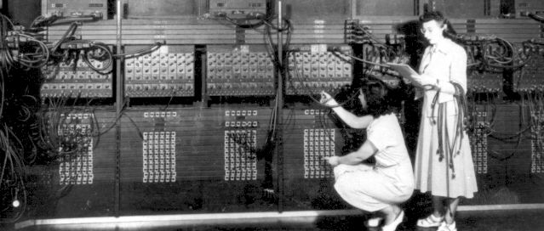
“Stored Program” Computer
Can build physical machines that perform any computation.
Can be built with limited hardware that is reused in time.
Historically: this was a key contribution of Penn’s Moore School
  ENIAC→ EDVAC
  Computer Engineers:
  Eckert and Mauchly
  (often credited to
  Von Neumann)

Slide 54
Basic Idea
Express computation
in terms of a few primitives
  E.g. Add, Multiply, OR, AND, NAND
Provide one of each hardware primitive
Store intermediates in memory
Sequence operations on hardware to perform larger computation
Store description of operation sequence in memory as well – hence “Stored Program”
By filling in memory, can program to perform any computation

Slide 55
Building Out
How limited?
How might improve?

Slide 56
Beyond Single Gate
Single gate extreme to make the high-level point
  Except in some particular cases, not practical
Usually reuse larger blocks
  Adders
  Multipliers
Get more done per cycle than one gate
Now it’s a matter of engineering the design point
  Where do we want to be between one gate and full circuit extreme?
  How many gate evaluations should we physically compute each cycle?

Slide 57
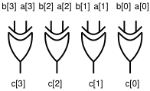
Word-Wide Processors
Common to compute on multibit words
  Add two 16b numbers
  Multiply two 16b numbers
  Perform bitwise-XOR on two 32b numbers
More hardware
  16 full adders, 32 XOR gates
All programmable gates doing the same thing
  So don’t require more instruction bits

Slide 58
Multibit Bus Symbols

Slide 59
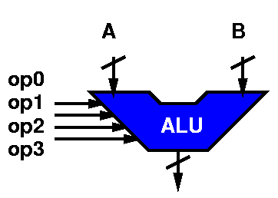
Arithmetic and Logic Unit (ALU)
A common logic primitive is the ALU
  Can perform any of a number of operations on a series of words (strings of bits)
  Operations: Add, subtract, shift-left, shift-right, bitswise xor, and, or, invert, ….
  Operates on “words”
Identify a set of control bits that select the operation it forms
  Makes it “programmable”

Slide 60
ALU Ops (on 8bit words)
XOR 00011000 00010100 =
    xor 0x18 to 0x14 result is:

Slide 61
ALU Ops (on 8bit words)
XOR 00011000 00010100 = 0001100
    xor 0x18 to 0x14 = 0x0C
  ADD 00011000 00010100 =
  Add 0x18 to 0x14 result is:
  Add 24 to 20

Slide 62
ALU Ops (on 8bit words)
XOR 00011000 00010100 = 0001100
    xor 0x18 to 0x14 = 0x0C
  ADD 00011000 00010100 = 00101100
  Add 0x18 to 0x14 =0x2C0
  Add 24 to 20 =44
SUB 00011000 00010100 = 00000100
  Subtract 0x14 from 0x18 .. 0x04
INV 00011000 XXXXXXXX =
  Invert the bits in 0x18 ...gives us:

Slide 63
ALU Ops (on 8bit words)
XOR 00011000 00010100 = 0001100
    xor 0x18 to 0x14 = 0x0C
  ADD 00011000 00010100 = 00101100
  Add 0x18 to 0x14 =0x2C0
  Add 24 to 20 =44
SUB 00011000 00010100 = 00000100
  Subtract 0x14 from 0x18 .. 0x04
INV 00011000 XXXXXXXX = 11100111
  Invert the bits in 0x18 …0xD7
SLL 00011000 XXXXXXXX =
  Shift left 0x18 … gives us:

Slide 64
ALU Ops (on 8bit words)
XOR 00011000 00010100 = 0001100
    xor 0x18 to 0x14 = 0x0C
  ADD 00011000 00010100 = 00101100
  Add 0x18 to 0x14 =0x2C0
  Add 24 to 20 =44
SUB 00011000 00010100 = 00000100
  Subtract 0x14 from 0x18 .. 0x04
INV 00011000 XXXXXXXX = 11100111
  Invert the bits in 0x18 …0xD7
SLL 00011000 XXXXXXXX = 00110000
  Shift left 0x18 …0x30

Slide 65
ALU Encoding
Each operation has some bit sequence
ADD 0000
SUB 0010
INV 0001
SLL 1110
SLR 1100
AND 1000

Slide 66
ALU-based Word-Wide Processor

Slide 67
Beyond Linear Sequence
So far, processor can run a fixed sequence
Cannot
  Implement a loop
  Implement an if-then-else

Slide 68
Branching
Allow PC to advance
by value other than 1
  Could be negative
Allow data to impact
selection
  Only load when data bit is 1
Add Instruction bits
(or instruction) to
control loading
BRANCH if (SRC1[0]==1) to PC+SRC2

Slide 69
Branching
How
  Branch to top of loop?
  Conditionally branch
  to top of loop?
  Implement if-then?

Slide 70
Contemporary Processors

Slide 71
iPod Processor
Compare ARM7

Slide 72
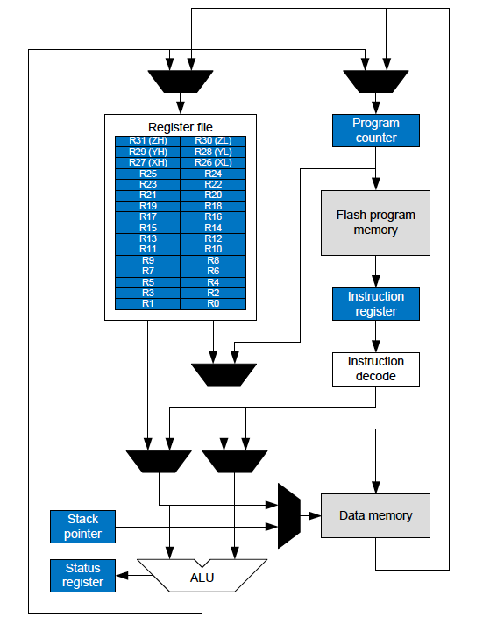
Arduino
AVR
ATmega328/P Datasheet

Slide 73
Arduino
AVR
Adds separate Data Memory from Register File
(common, omitted above for simplicity)
ATmega328/P Datasheet

Slide 74
Arduino
AVR
8-bit architecture
  8b wide ALU
32x8 Register File
  32 register
  8b wide
16b instructions
  “most” instructions
32KB program memory
  Flash2KB data memory
  SRAM
ATmega328/P Datasheet

Slide 75
Instructions: Two Operand
Arduino (AVR) has 2-operand, where one operation is both source and destination
ADD R1, R2
  Says: R1←R1+R2
Use to make code more compact

Slide 76
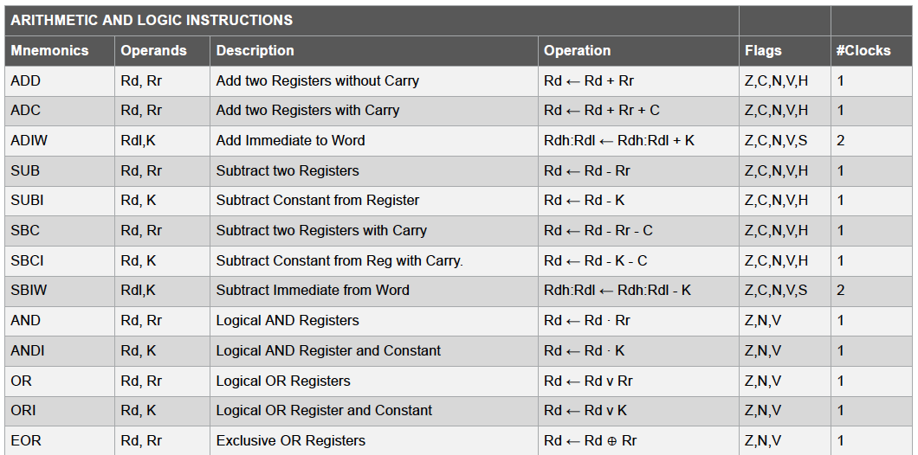
AVR Instructions
ATmega328/P Datasheet

Slide 77
AVR Instructions (Lab Appendix)
Instruction Encoding | Instruction Description | Number of Cycles to execute
add Rd, Rr | Add without carry: Rd = Rr + Rd and C is set to the carry-out bit | 1
adc Rd, Rr | Add with carrying: Rd = Rd + Rr + C (which was previously set); C is set to the new carry-out bit | 1
and Rd, Rr | Logical And: Rd = Rd AND Rr | 1
brne OFFSET | Branch Not Equal: If Z=0, Move the instruction execution (back or forward) by OFFSET. | 1/2
brpl OFFSET | Branch if Positive: If N=0, Move the instruction execution (back or forward) by OFFSET. | 1/2

Slide 78
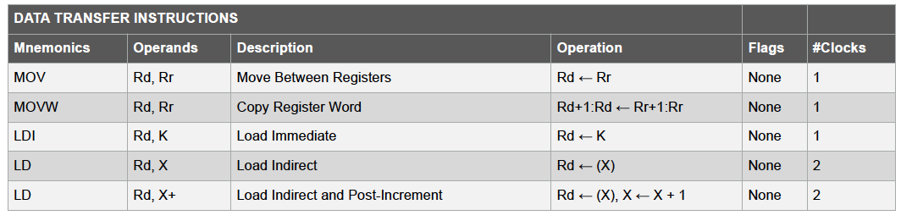
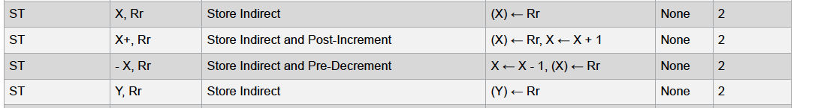
Data Memory Read / Write (Load/Store)
ATmega328/P Datasheet

Slide 79
Next Lab
Look at Instruction-Level code for Arduino
Understand performance from instruction-level code

Slide 80
Big Ideas
Memory stores data compactly
Can implement large computations on small hardware by reusing hardware in time
  Storing computational state in memory
Can store program control in instruction memory
  Change program by reprogramming memory
  Universal machine: Stored-Program Processor

Slide 81
Learn More
CIS240 – processor organization and assembly
CIS371 – implement and optimize processors
  Including FPGA mapping in Verilog
ESE370 – implement memories (and gates) using transistors

