Slide 1



Lecture #11 – Networking
ESE 150 –
Digital Audio Basics

Slide 2
Today’s Seating (for inclass exercise)
Screen
First Row
Student
(empty)
Student
Student
(empty)
Student
Student
Student
Student
Student
(empty)
Student
Student
(empty)
Student

Slide 3
Lecture Topics
Where are we on course map?
Networks
  Communicating Between Machines
  Bandwidth Requirements
  Technology Costs
  Network Layering
    Transport
    Network – Routing – what can go wrong?
    Physical (physical layer independence)
    By end: seen TCP/IP basics
Next Lab

Slide 4
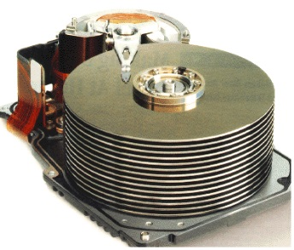










Course Map
7,8,9
10101001101
MIC
CPU
OS/File-
System
A/D
10
10101001101
NIC
Music
1
domain
conversion
6
Numbers correspond to course weeks
compress
sample
freq
pyscho-
acoustics
3
2,5
4
13
11
EULA
----------------click
OK
D/A
NIC
speaker
MP3 Player / iPhone / Droid
12

Slide 5
Course Map – Week 12
7,8,9
10101001101
MIC
CPU
OS/File-
System
A/D
10
10101001101
NIC
Music
1
domain
conversion
6
Numbers correspond to course weeks
compress
compress
sample
freq
pyscho-
acoustics
3
3
2,5
4
11
D/A
NIC
speaker
MP3 Player / iPhone / Droid

Slide 6
What We’ll Cover Today…
Device A
Device B
NIC
NIC
Established can
  represent things (sound, computations, images, movies, 3D objects…) as bits
  Store and reconstruct from bits
If we can send bits between machines…
  Communicate (from MP3 player to Cell Phone)
  Transport (from scanner and 3D printer to a transporter?)

Slide 7
Communicating between Machines
Fundamentals of Networks

Slide 8
Networked Systems
Today
  We expect our computers to be networked
    Google, wikipedia, Email, IM, …
  Can work stand alone
    Airplane mode?
  But, are crippled when not connected
  Phone isn’t a phone unless its networked

Slide 9
Minimal Setup
Have two computers
  think raw processors for the moment
Want them to communicate
  Send an mp3 file from A to B
.MP3

Slide 10
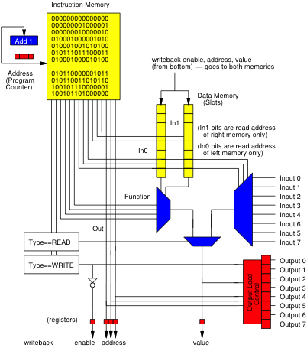
Physical Connection
Place an I/O datapath in each computer
String wire between computer’s IO peripheral
  E.g. one wire from A→B, another B→A

Slide 11
Physical Connection
Place an I/O datapath in each computer
String wire between computer’s IO peripheral
  E.g. one wire from A→B, another B→A

Slide 12
Signaling
Communicate with Voltage pulses
  A pulls line low (0)
  B senses low (0) line
Data encoded as series of pulses/voltages on line
Oscilloscope/
Logic Analyzer

Slide 13
Communication Basic Steps
Start program on B to receive data (file)
Start program on A to send data (file)
B waits for valid symbols
A sends data
B receives
A sends out-of-band signal to end transmission
(as we did to communicate
between Windows PC
and Arduino)

Slide 14
Preclass 1
How many computers does your laptop communicate with?
  E-mail
  Weather
  Canvas, Piazza
  Source code repositories (svn, git, …)
  eniac
  Web servers
    Seas, news, facebook, youtube, wikipedia, google, ….
  iTunes, Windows Update

Slide 15
Multiple Tasks – Multiple Wires?
Back to wired connections
E.g. download song and browse
  Could have a separate interface/wire for each application
  Process allocates hardware when needs to communicate
  Holds exclusive access during transfer

Slide 16
Connect to Multiple Machines
Add interface/wire for every machine want to talk to
  Talk to machine through its dedicated wire

Slide 17
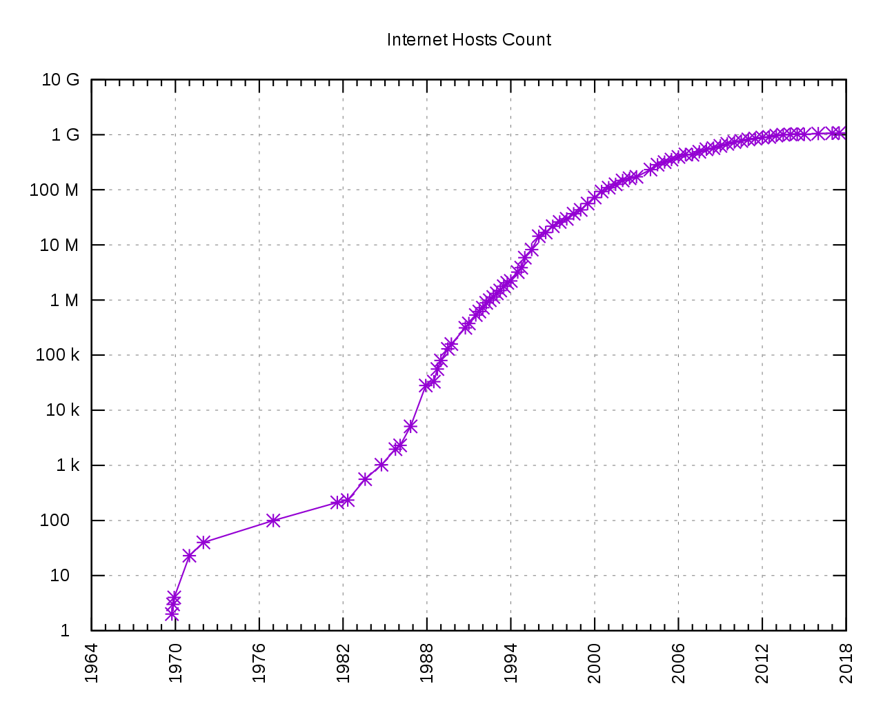
Scalability
[Source: Kopiesperre CC Share-alike 3.0
https://wikivisually.com/wiki/File:Internet_Hosts_Count_log.svg]
Do we like where this
is going?
Hosts on Internet
How many things are connected to Internet?
  Estimate as of 8 Billion connected devices!
  Growing to 50—100 Billion in next few years…

Slide 18
How many connections?
Conclusion: need to look at capacity as well as scalability of a network solution

Slide 19
Bandwidth Requirements and Costs

Slide 20
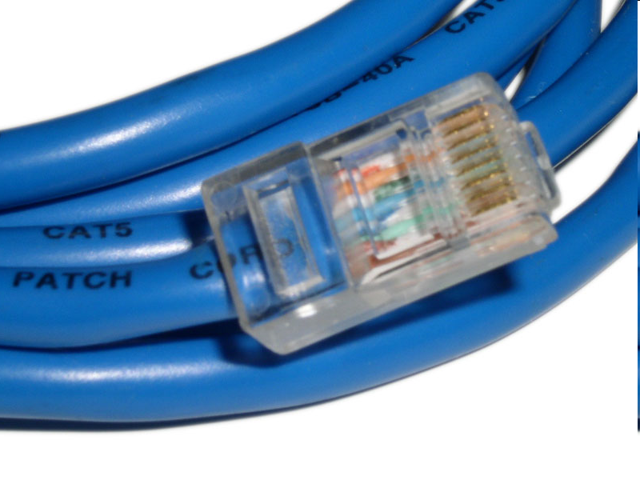
Wires
How fast can I send data over a wire?
Consider a Category-5 Ethernet cable
  Bandwidth (bits/s)
    1Gbit/s – 1000Base-T (Gigabit ethernet)
  Latency/transit time (distance/time)
    0.64 c [c=speed of light = 3×10⁸ m/s]
    0.192 m/ns or roughly 5ns/m
[image: http://en.wikipedia.org/wiki/File:Cat_5.jpg]

Slide 21
Comparison: Audio (Preclass 3)
Real-Time stereo (2-channel) MP3
  128Kbits/s
  How many can share 1Gbit/s link?
How long to download 3 minute song at full rate?
How long for first bit to travel across 4000km wire at 0.6 × speed-of-light?

Slide 22
Comparison: Video (Preclass 3)
HDTV compressed
  Around 36Mbits/s
  How many can share 1 Gbit/s link?

Slide 23
Costs (Preclass 4)
Cat 5e per foot ~ $0.20/foot
  Say $0.60/m
  Raw wire
    Ignoring handling to run
    Ignoring rent/lease/buy land to run
  Philly → San Francisco: ~4,000km
  Wire cost?

Slide 24
Implications?
Today’s wire bandwidth exceeds the throughput needs of any real-time single-stream data
  Can afford to share the wire
Wires are not cheap
  Cannot afford not to share the wire

Slide 25
Sharing (Virtualizing) Connections

Slide 26
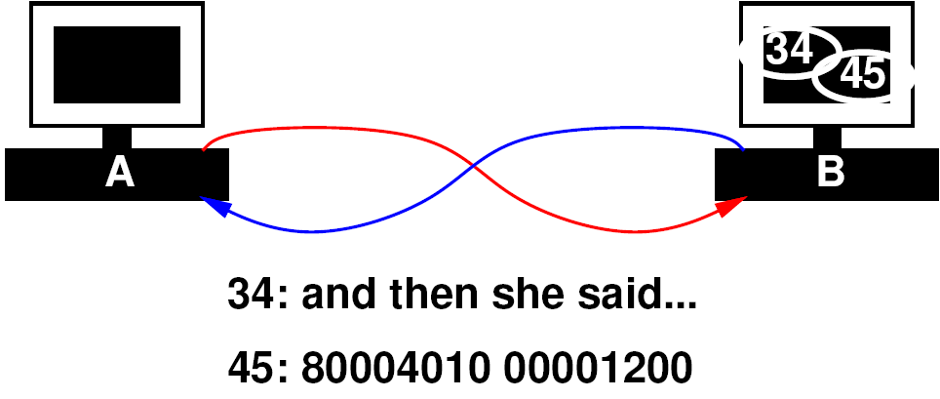
Sharing Link
Idea: Tag data with target
  “this is for process 34”
  “this is for process 45”
Have transport layer deal with…
  Mixing data from separate streams
  Separating data out into individual streams
  Delivering to individual processes

Slide 27
Packet
Begin to form a packet
  Header: says where to go
  Payload: the data to send
Header:
  Added, consumed by network handling in routing
Payload:
  Only thing seen by the application processes

Slide 28
Packets

Slide 29
Transport Layer
Call this the “Transport” Layer
  responsible for delivering data to the individual application process on the computer

Slide 30
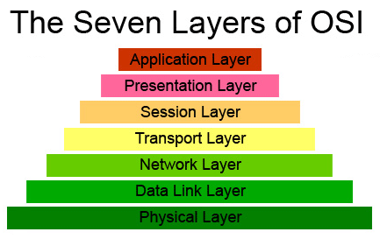
OSI Model of a Network
Layer we just
discussed
OSI – Open Systems Interconnection Reference Model
  Developed in 1980’s; maintained by ISO
  Abstract different functions of a network into layers
    Each layer only knows about layer above and below (at the interface level)
  Think of it like this: your “Application” doesn’t know if its on a wired or wireless network (physical layer)…but it knows it needs a network!

Slide 31
Possible Role Assignment
SA1
SA2
SA3
SA4
T1
T3
N1
N3
W1/R2
R1
R3
T2
N4
N2
T4
CA1
CA2
CA3
CA4

Slide 32
Possible Role Assignment
SA1
SA2
SA3
SA4
T1
N1
N3
T3
W1/R2
R1
R3
T2
N2
N4
T4
CA1
CA2
CA3
CA4

Slide 33
Simulation 1
Server
Send 4 verses or digits from each
  from song-server-app, even-server-app
  to song-listener-app, even-consumer
All go through one wire W1
T1 – Transport tagging
T2 – Transport sorting
SA1
SA2
T1
Host
W1
Host
T2
CA1
CA2
Client

Slide 34
Virtualize Physical Wires

Slide 35
Start Simple
Add more computers to same pair of wires
  All computers on wire see all the data on the wire
  How do computers know who the message is for?

Slide 36
Extended Packet
Extend our packet header:
  Destination computer
  Process on destination computer
  Sending computer
  Process on sending computer

Slide 37
Network Layer
responsible for end-to-end (source to destination) packet delivery

Slide 38
Virtualization Effect
Each pair of processes on different computers
  Has the view of a point-to-point connection
  Each process, thinks it “owns the network” and has a dedicated connection to the other node

Slide 39
[Device Driver]

Slide 40
Simulation 2
Send 4 verses or digits from each
  from song-server serving 2 songs
  And digit-server serving 2 fundamental constants
  To two clients

Slide 41
Simulation 2
SA1
Server
SA2
SA3
Server
SA4
T1
T3
N1
N3
Host
Host
W1
N2
Host
Host
N4
T2
T4
CA1
CA2
CA3
CA4
Client
Client

Slide 42
Simulation 2
SA1
Server
SA2
SA3
Server
SA4
T1
T3
N1
N3
Host
Host
W1
N2
Host
Host
N4
T2
T4
CA1
CA2
CA3
CA4
Client
Client

Slide 43
Simulation 2
N1, N3
  Add network-layer source/destination packet headers
W1 – Wire
  Duplicate packets to both destinations
  Simulate shared wire
N2, N4
  Look at network-layer source/destination header
  Discard packets not destined for this computer

Slide 44
Simulation 2
SA1
Server
SA2
SA3
Server
SA4
T1
T3
N1
N3
Host
Host
W1
N2
Host
Host
N4
T2
T4
CA1
CA2
CA3
CA4
Client
Client

Slide 45
Extending the Virtual Link

Slide 46
Indirect Connections
A and B are connected
B and C are connected
How get message from A to C?
  We could add a wire between A and C…
  But with 8+ billion nodes on network…

Slide 47
Indirect Connections
Run program/process on B to forward messages from A to C
  Call it a “routing” program! Routes messages on network

Slide 48
Routing
B runs a general program
  If packet destined for B, takes it
  Otherwise, sends on to (toward) destination
Extension of the network handling process that is sorting data to processes

Slide 49
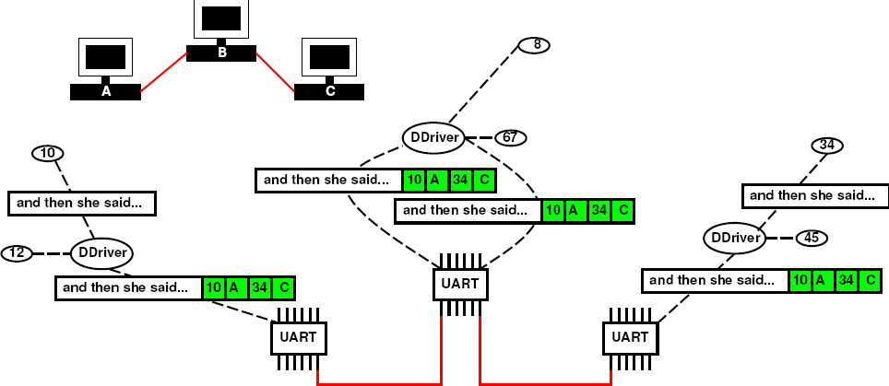
Routing

Slide 50
Reachability
If everyone plays along
  We can communicate with any computer reachable transitively from my computer
Don’t need direct connections

Slide 51
Routing → Route Tables
To make efficient
  Each computer should route close to destination
  …and not route in circles
E.g. compute all-pairs shortest paths (CIS160,121)
  Store result, each machine knows where to send packet next
  How much storage?
    Cleverness to compress/summarize
  Additional cleverness to compute incremental updates
    When add a computer or a link breaks

Slide 52
Network Layer
Responsible for end-to-end packet delivery
  Source to Destination
  This includes routing packets through intermediate hosts

Slide 53
Simulation 3
Send 4 verses or digits from each
  from song-server serving 2 songs
  And digit-server serving 2 fundamental constants
  To two clients
R1 – pass along packets to R2 (for now)
R2 – look at address and send to N2 or N4

Slide 54
Sim
3
Server
SA1
Server
SA2
SA3
SA4
T1
T3
N1
N3
Host
Host
R1
Simulation 3
R2
N2
Host
Host
N4
T2
T4
CA1
CA2
CA3
CA4
Client
Client

Slide 55
Simulation 4
Send 4 verses or digits from each
  from song-server serving 2 songs
  And digit-server serving 2 fundamental constants
  To two clients
Roles:
  4 server apps
  Network Interface, 2 servers
  3 routers
    R1 – flip a coin and send to R2 or R3
    R2, R3 – send to N2, N4 based on address
  Network Interface for each of 2 clients
  4 client apps
R1
R2
R3

Slide 56
Sim
4
Server
SA1
Server
SA2
SA3
SA4
T1
T3
N1
N3
Host
Host
R1
Simulation 4
R2
R3
N2
Host
Host
N4
T2
T4
CA1
CA2
CA3
CA4
Client
Client

Slide 57
Where are we now?
Can communicate
  From one process on a computer
  to any other process on any other computer
  if the two are transitively connected
    By a set of participating computers which route data
Layers have provided “Abstraction”
  Processes just see streams of data between the endpoints

Slide 58
Layers
Application
Application
(abstraction)
Transport
Transport
Network
Network
Link
Link
Physical
Physical

Slide 59
Protocols
So far, we’ve discussed a protocol called IP:
  IP = Internet Protocol
Delivery to processes (rather than hosts): UDP
  UDP = Unreliable Datagram Protocol

Slide 60
Simulation 5
Send 4 verses or digits from each
  from song-server serving 2 songs
  And digit-server serving 2 fundamental constants
  To two clients
Deliberately delay data through R3
  Model non-determinism in route timing

Slide 61
Sim
5
Server
SA1
Server
SA2
SA3
SA4
T1
T3
N1
N3
Host
Host
R1
Simulation 5
R2
R3
R3 delayed
N2
Host
Host
N4
T2
T4
CA1
CA2
CA3
CA4
Client
Client

Slide 62
What can go wrong?
Packets arrive out of order
Solution?
  Add a sequence number

Slide 63
Simulation 6
Send 4 verses or digits from each
  from song-server serving 2 songs
  And digit-server serving 2 fundamental constants
  To two clients
T1/T3 – add sequence number to packet
T2/T4 – hold packets, reorder, and deliver in order of sequence number
R3 – still delaying packets

Slide 64
Sim
6
Server
SA1
Server
SA2
SA3
SA4
T1
T3
N1
N3
Host
Host
R1
Simulation 6
R2
R3
R3 delayed
N2
Host
Host
N4
T2
T4
CA1
CA2
CA3
CA4
Client
Client

Slide 65
Abstracting Physical Layer
Application, transport, network
  Don’t really care how the bits are moved from machine-to-machine
What are other ways we send bits?
  Beyond wires
  Optically
  RF/wireless
  Pneumatic tubes, passing paper notes, SMS Text messages…
Application
Application
Transport
Transport
Network
Network
Link
Link
Physical
Physical

Slide 66
Simulation 7
Send 4 verses or digits from each
  from song-server serving 2 songs
  And digit-server serving 2 fundamental constants
  To two clients
Roles:
  4 server apps
  Network Interface for each of 2 servers
  3 routers, connect to both servers and endpoints
    One link is via text messaging
  Network Interface for each of 2 clients
  4 client apps

Slide 67
Sim
7
Server
SA1
Server
SA2
SA3
SA4
T1
T3
N1
N3
Host
Host
R1
Simulation 7
wireless
R2
R3
N2
Host
Host
N4
T2
T4
CA1
CA2
CA3
CA4
Client
Client

Slide 68
What else can go wrong?
Bits get corrupted
Intermediate machines holding messages can crash
Messages can get misrouted

Slide 70
Data Corruption
How do we deal with data corruption?
  Use redundancy
Two strategies:
  Use enough redundancy to correct
  Use just enough redundancy to detect it
    Have the sender resend

Slide 71
Data Corruption
Relatively uncommon
  Most packets are fine
We have efficient (low overhead) ways to detect
  Compute a hash of the message data
  Highly unlikely one (few) message bit errors will result in same hash
  → checksum

Slide 72
Revised Packet
Header
Data payload
Checksum

Slide 73
Lost Packet
How can we deal with lost packets?

Slide 74
Lost Packet Strategy
Sender sends packet
  But keeps a copy
Receiver gets packet
  Checks checksum
  OK, uses packet and sends ACK
    “got your last packet in tact”
  Not ok, discard packet
Sender
  Receives ACK, can discard packet and send next
  No ACK (after timeout), resend packet

Slide 75
Retransmission Discipline
Don’t depend on receiver to request retransmission
  Why?
Header may be corrupted
  Not deliver to receiver
Only know receiver got it
when it says it got it

Slide 76
Corrupted ACK
What if the ack is lost?
  Sender resends
Receiver receives a second copy
  Oops, don’t want that to be interpreted as new data
  i.e. send: “rm *; cd ..\n”
    Receive: “rm *; cd ..\n rm *; cd ..\n”

Slide 77
Avoid Duplication
How can we avoid duplication?

Slide 78
Accommodating Duplication
Use packet sequence number
  Keep track of last packet received
  If receive packet again,
    Discard the packet

Slide 79
Sequence Numbers

Slide 80
TCP
TCP = Transmission Control Protocol
  Provides Reliable delivery
  Deals with
    Retransmission
    Duplication
    Out of sequence / resequence / reconstruction

Slide 81
Transport Layer
Call this the “Transport” Layer
  responsible for reliably delivering data to the individual application process on the computer

Slide 82
Layers
Application
Application
(abstraction)
Transport
Transport
Network
Network
Link
Link
Physical
Physical

Slide 83
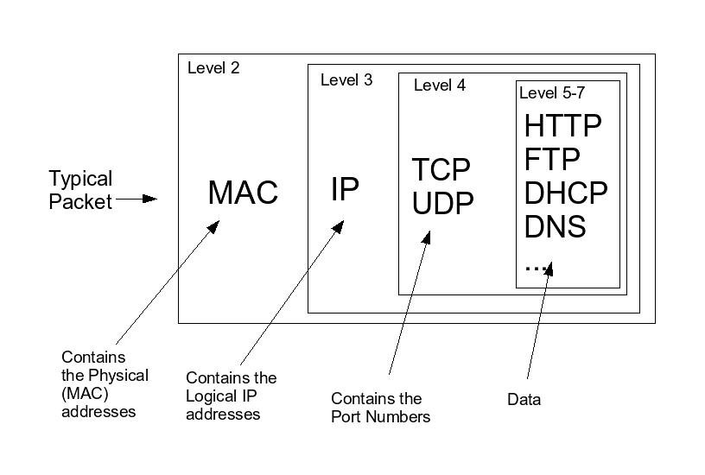
Layers and the Packet

Slide 84
Big Ideas
Sharing – Network interface, wires
  Previously gates, processor, memory
Virtualization – datastream abstracts physical point-to-point link
Layering
  Divide-and-conquer functionality
  Implementation hiding/technology independence
  Reliable communication link from unreliable elements

Slide 85
This Week In Lab
Lab 11:
  Look at naming, addressing, network diagnostics, …
  Including a packet sniffer!
    …see all the bits on the network you aren’t supposed to see!
    Get an appreciation for what is going on, on the lower network layers

Slide 86
Learn More @ Penn
Courses
  ESE407 – Intro Networks and Protocols
  CIS553 – Networked Systems
  CIS549 – Wireless Mobile Communications
CIS553
ESE407
CIS549

