Slide 1
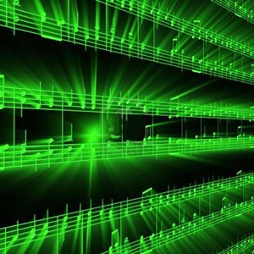



Lecture #13 – Intellectual Property
ESE 150 –
Digital Audio Basics

Slide 2
Preclass
Cost to develop and write a book?
  200 days @ $500/day
Cost per book (assume $1 to print book)
  Total volume 1
  Total volume 10,000
  Total volume 1 million
Book sells $10
  Value added by writer?
  Copies sold to break even at $2/copy to writer?

Slide 3
Economic Terms
Production cost – expense to produce
Price – what consume will pay for it
  Value to consumer
Profit = Price – cost

Slide 4
Observe
Creative / Intellectual work produces most of value
At least in volume, physical costs of reproduction is small part of product price

Slide 5
Preclass Continued
Cost to photocopy 200 page book at $0.05/page?
Cost to scan book at 10page/minute?
Cost to retype book (50 words/minute type)?
Cost to perform a 10s copy onto flash drive?
Cost of portion of flash drive used
  $8 for 16GB drive, 0.5MB file

Slide 6
Observe
With digital representation
  Cost of “physical” reproduction trends to 0

Slide 7
Past
Much of value in physical construction of objects
  Bridge, house, car, screwdriver
Expensive to reproduce / copy
Reproductions imperfect
  5th generation analog recording
  4th generation photocopy of text
Inherent barrier to making copies
  Value to buying original

Slide 8
Digital representation
Can represent perfectly in bits
  Including sound, words
Can make perfect copies
Bits are cheap…and getting cheaper
  Copying “free”
Intellectual value disconnected from physical reproduction

Slide 9
What else has this property?
Digital Intellectual Property | Physical IP Renderer
Novel | eReader
Song (MP3) | MP3 Player
JPEG Photo
 | Video Player
Video Game
 | Arduino or Personal Computer
Verilog digital circuit
 | Web Server
STL (3D CAD drawing)
DNA Sequence | DNA Printer

Slide 10
Intellectual Property
Intangible creations of human intellect
Have value
Don’t necessarily have physical embodiment on their own

Slide 11
Intellectual Property Creators
As Engineers
  Program, develop algorithms, design circuits
Almost everything we create will have this property
  Value added is intellectual
  Can be represented digitally in bits
  Can (increasingly) be copied/reproduced cheaply
Easy to have impact
  Our solutions can reach millions, billions
  Decreasing physical barriers to propagation of solutions
Challenge to protect and reward IP creators

Slide 12
Outline
Setup Need / Opportunity – What is IP
Where are we
Rationale for IP Protection – Why Protect
How protect?
  Patents
  Copyrights
  Open Source
  NDA
  Licensing

Slide 13
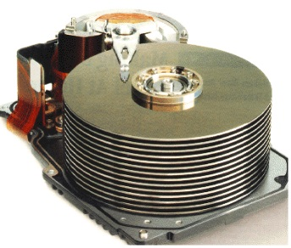










Course Map
7,8,9
10101001101
MIC
CPU
File-
System
A/D
10
10101001101
NIC
Music
1
domain
conversion
5,6
Numbers correspond to course weeks
compress
sample
freq
pyscho-
acoustics
3
2
4
13
11
EULA
----------------click
OK
D/A
NIC
speaker
MP3 Player / iPhone / Droid
12

Slide 14
Rationale

Slide 15
Pricing challenge
When cost of copying → 0
  Inventor/author must recover development cost
    Price must include develop cost + copy cost
  Copier does not have development cost
    Price = copy cost + epsilon
    Competition of copiers will drive epsilon down near 0
  Inventor/author not compensated for development
    Remove incentive/reward for development
Demand: developers need way to exclude others from copying to incentivize creation

Slide 16
Arrow’s Information Paradox
Customer not know how to value information until see information (see details of product)
  Enough information to decide to buy
  Enough information to decide what will pay for it
Once show customer information, sufficient detail, they have enough information to reproduce
  Could walk away and produce their own without paying for it
Disclosure of what effectively transfers technology
Demand: protection for developer
Arrow, Kenneth J. Economic Welfare and the Allocation of Resources for Invention, in The Rate and Direction of Inventive Activity, 609 (Nat’l Bureau of Econ. Research ed. 1962).

Slide 17
Balance Individual and Societal good
Individual should benefit form their own effort
Society advances with the accumulation of knowledge

Slide 18
Before copying was an issue
Concern that new developments/ideas would be lost when inventor die
  Techniques could remain secret for decades!
Incentive to make inventions known
  Advance the general welfare

Slide 19
US Constitution
Article 1, Section 8, Clause 8:
  To promote the Progress of Science and useful Arts, by securing for limited Times to Authors and Inventors the exclusive Right to their respective Writings and Discoveries

Slide 20
Mechanisms (To support)
Patents
  Cover inventions
  E.g., Flying Machine (US 821,393) ENIAC (US 3,120,606),
Copyrights
  Creative expression
  E.g., novel, song, movie

Slide 21
Mechanisms for Protection
Messy and imperfect
Haven’t kept up with technology
Likely need (and will need) innovation and refinement

Slide 22
Interlude: NIL
Nikolai Ivanovich Lobachevsky
Notes:
https://www.youtube.com/watch?v=gXlfXirQF3A

Slide 23
Patents

Slide 24
Patent
Inventions
Non-obvious to one “ordinary skill in art”
Reduced to practice
Cannot patent
  Abstract ideas
  Laws of nature
US: First to file
  (prior to 2013 was first to invent)
Exclusive rights 20 years from filing

Slide 25
What might be tricky / non-satisfying?
First to file? (even invent?)
20 year term?

Slide 26
Patent
Identification of problem is part of invention
Claims
  Define the invention
  Technical coverage
Requires disclosure
  If really believe no one else will figure it out…or can copy it, maybe better to keep as a trade secret
License to litigate
  Recover damages is through litigation
  Establish violation
  Validity of many patents overturned in litigation

Slide 27
Patent Process
US have one year from first-public disclosure to file
  Many places – public disclosure prevent patent
  https://www.uspto.gov/web/offices/pac/mpep/s2153.html
May file provisional patent to get filing date
File patent with claims
Reviewed by examiner
Examiner reports on what may be allowable
  As-is
  With tighter qualifications
  Not-at-all
  On a per-claim basis
Typically requires several iterations
Often year(s) before patent issues
Filing costs thousands of dollars
  With lawyer/legal fees tens to hundreds of thousands

Slide 30
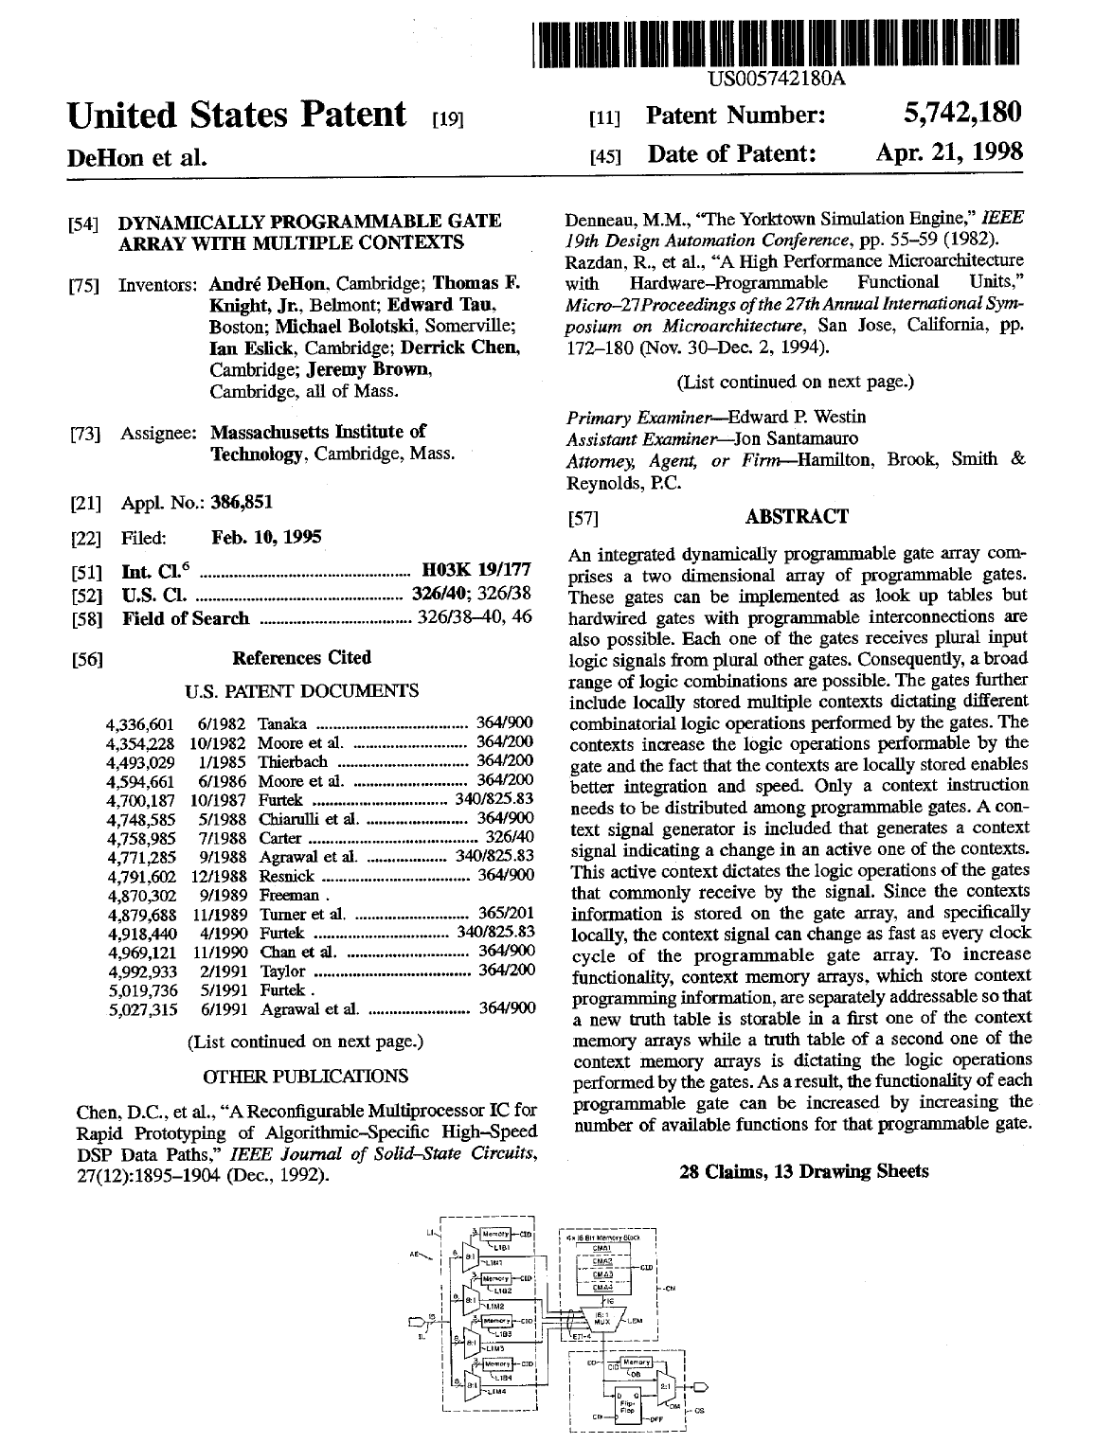

Slide 31
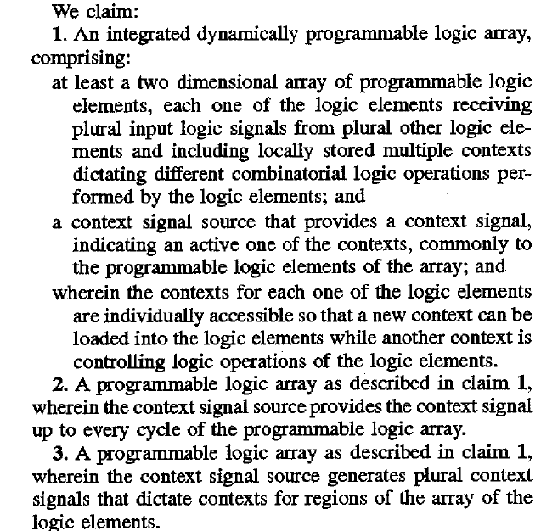
Claims

Slide 32
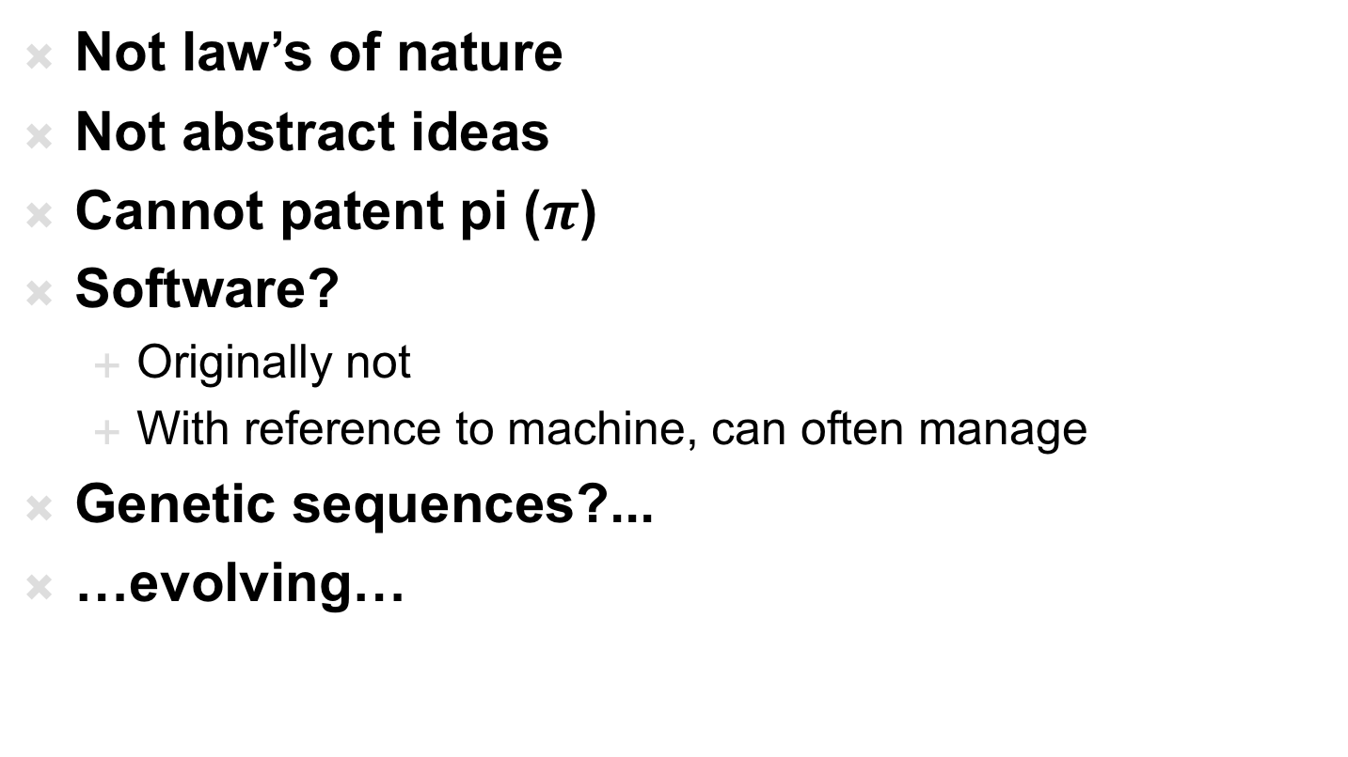
What’s Patentable
Not law’s of nature
Not abstract ideas
Cannot patent pi ($π$)
Software?
  Originally not
  With reference to machine, can often manage
Genetic sequences?...
…evolving…

Slide 33
Administrative Interlude: Final

Slide 34
Final
Final Office Hours:
  Saturday 6pm
  Sunday 4pm and 5pm
Final: Monday (5/6) 3-5pm in Moore 212
  Same Rules as midterm
    Calculators allowed (work that out in advance)
    Closed book, notes
  15% of grade
  Comprehensive
  Last year final and answers linked to Spring 2018 syllabus
    Probably mix ideas from first and second half

Slide 35
Final Topics
Pre Midterm
Data representation in bits
Sounds waves
Sampling
Quantization
Nyquist
Lossy/lossless compression
Common case
Frequency domain
Psychoacoustics
Perceptual coding
Post midterm
Combinational Logic
Finite-State Machines
Stored-Program Processors
Processing Requirements
Process Virtualization
Persistent Storage
File Systems
Networking
User Interface
Intellectual Property

Slide 36
Copyright

Slide 37
Copyright
Cover particular, original expression
  Including software
Technically don’t need to register
  But should…
  Must register before sue for infringement
  $35
  No review, just registration
Life of author + 70 years
Work for hire: 95 years from publication

Slide 38
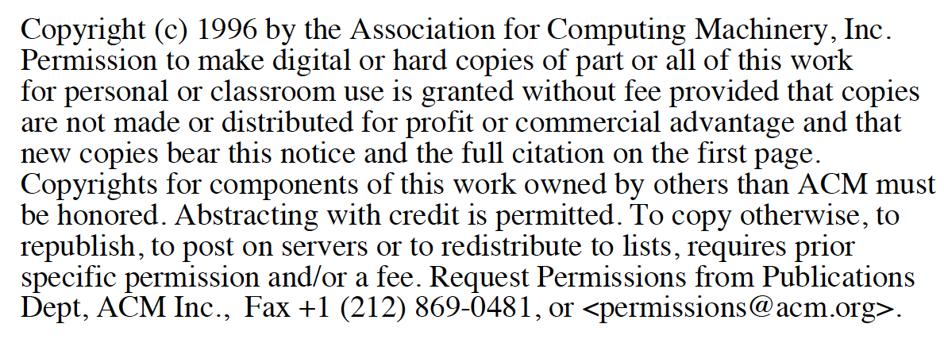
Traditionally: transfer copyright …
Publish in ACM, IEEE journal
  Transfer copyright to them, they license you back rights for derived work and post on person web site.

Slide 39
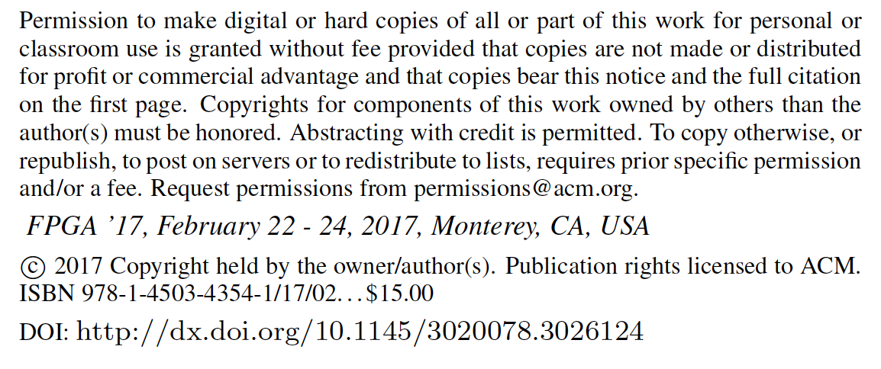
Recent: license to ACM, IEEE
Author retain copyright, license to publisher

Slide 40
Licensing

Slide 41
License
Where have you seen licenses?

Slide 42
Licenses
How get right to use
  Something patented, copyrighted by someone else
Between companies
  Get IP need to build a product
To consumers
  Technically, most software is licensed, not sold
  …shrink-wrap licensing agreements…
Define terms of use
  What you are paying for (one copy, many, resale…)
  What uses (dis)allowed

Slide 43
Direct Licensing/Sales

Slide 44
Past
Selling a product require huge infrastructure and up-front capital costs
  Manufacture (physical things)
  Marketing
  Distribution
  Sales
Demand large business to support infrastructure
Not easy for individual

Slide 45
Today (emerging)
Eliminate infrastructure needs with ubiquitous networking, IP products, service businesses
  Manufacture (physical things) → not issue for IP
    …or licensed manufacturing
  Marketing → still need to get the word out
    …can use web at low cost
  Distribution → not an issue for IP
    …leverage common carriers
  Sales
    Handle online, eBusiness support
Becomes possible for individuals/small businesses to sell IP directly to consumers

Slide 46
Direct IP Businesses today
Examples?

Slide 47
Direct IP Businesses today
Kindle Direct Publishing
App Store
AWS Marketplace
Café Press
Shapeways

Slide 48
Open Source / Creative Commons

Slide 49
Sharing
Sometimes we want to share
  Isn’t it great doesn’t cost us anything to give away digital products?
  Isn’t it great can build on work of others without necessary cost?
  Cooperation on standards create opportunities for everyone, for an industry

Slide 50
Challenge
Patents cost money
Business (people making money) will spend money to patent things
  …and typically incentivized to patent everything they can
Company (individual) could patent something and grant free license
How does individual, non-profit, etc.
  Create something and protect right to share?
Variety of Open-Source/Public Domain licenses

Slide 51
Creative Commons
Framework and set of licenses for clearly expressing intent
Issues
  Attribution
  Share-Alike
  (Non-)commercial
  (No)Derivatives
Apps to choose, logos to show, legal backing to define precisely
https://creativecommons.org/share-your-work/licensing-types-examples/

Slide 52
Non-Disclosure Agreement (NDA)

Slide 53
NDA
Tool for protecting IP
Legal agreement that you won’t disclose someone information shared with you
  Prevent loss of IP
Typical for collaborating companies
Typical for employers
In part to make sure sharing with you doesn’t count as “disclosure” to preclude patents
Define scope of disclosure

Slide 54
Who Owns IP?

Slide 57
Work Scenarios
Hired/paid by company to invent
  Belongs to company
Invent on side on free time
  …may depend on employment agreement
  …whether or not subject matter overlaps with company
Consultant
  By default yours, but consulting agreement may define

Slide 58
University
Based on grant funds and resources
  Typically goes to university and funding source
  Right of first refusal…won’t always pursue
Undergraduate
  Invent in class, senior-design → yours
Graduate students paid RA from grant
  Typically funded by grant and go to University
Undergraduate paid research (employee)
  Typically funded by grant and go to University
Graduate students in class, using class resources
  Goes to University

Slide 59
Lab Due
Note: Lab due Today (by midnight)
  Last day of classes (not have due during reading period)
  Final office hours now to 8pm

Slide 60
Big Ideas
We (engineers…particularly in computing space) are knowledge workers, producing IP
IP carries great value
  That is less and less tied to physical objects
Need to equitably reward and encourage IP creation
Patents, Copyrights, Licenses …
  Attempts to provide framework for IP ownership, sharing, monetization
  …probably not the final answer, particularly as technology landscape continues to evolve.

Slide 61
Learn More
EAS 507 – IP and Business Law for Engineers
EAS 545 – Engineering Entrepreneurship
  Has sections on IP

Slide 62
Topic | CIS | CMPE | EE | SSE
Analog Circuits |  | ESE215 | ESE215
Compress | CIS121 | CIS121
Nyquist, Fourier |  |  | ESE224, ESE325 | ESE224, ESE325
Optimization | CIS320 | (many) |  | ESE204
Digital Logic | CIS240 | CIS240, ESE370, ESE532
Processor | CIS371 | CIS371
OS | CIS380 | CIS380
File System | CIS380, CIS121 | CIS380, CIS121
IP |  | EAS545 | ESE545 | ESE545
Networking |  | ESE407 or CIS553 | ESE407 | ESE407
Embedded |  | ESE350 CIS441 | ESE350 | ESE350
UI |  |  |  | ESE543

Slide 63
(Notes for previous slide)
Bold – required
Not bold – restricted elective
Simplified to fit on one slide
  (e.g. should show many more analog circuits courses as restricted-electives for EE)

