Slide 1
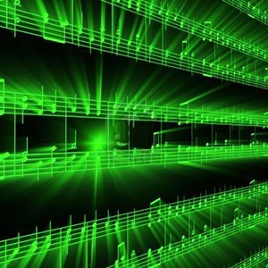


Lecture #1 – A2D, D2A
ESE 150 –
Digital Audio Basics

Slide 2
Lecture Topics
Where are we on course map?
Sound / Sound Pressure
Sampling & Quantization
<interlude>
Effects of Quantization
Limits of Sampling
System Capacity
Summary
References

Slide 3
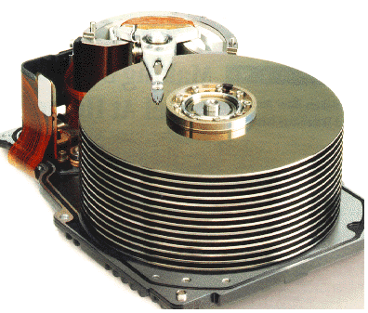










Course Map
7,8,9
10101001101
MIC
CPU
File-
System
A/D
10
10101001101
NIC
Music
1
domain
conversion
5,6
Numbers correspond to course weeks
compress
sample
freq
pyscho-
acoustics
3
2,3
4
13
11
EULA
----------------click
OK
D/A
NIC
speaker
MP3 Player / iPhone / Droid
12

Slide 4
Course Map – Week 2
MIC
A/D
10101001101
Music
1
Numbers correspond to course weeks
sample
2,3
D/A
10101001101
speaker
MP3 Player / iPhone / Droid

Slide 5
What we’ll Do in Lab
D/A
10101001101
speaker
MP3 Player / iPhone / Droid
Microphones / Speaker:
  Convert pressure waves to electric signal (and reverse)
Sound (in nature):
  a “pressure wave” that changes air molecules w/ respect to time
Sound (in our machine):
  a “voltage wave” that changes amplitude w/ respect to time
MP3 player converted digital signal back to an analog signal
  We will look at “voltage wave” on an oscilloscope

Slide 6
Sound Waves

Slide 7

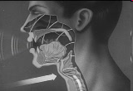
Introduction to Sound
Sound is a pressure wave
http://www.archive.org/details/SoundWavesAn

Slide 8
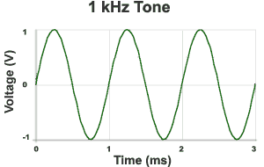

Week 1: Introduction to Sound Waves
Cycle = 1 iteration of sine wave
Hertz (Hz) = 1 cycle per second
1kHz = 1000 cycles/s
Source: http://www.mediacollege.com/audio/01/sound-waves.html

Slide 9
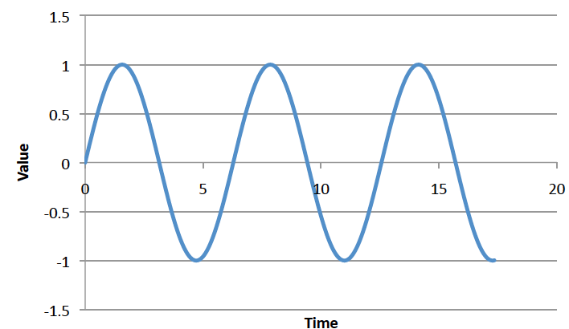
Preclass 1 and 2
Frequency of sine wave?
Relationship between period and frequency?
ms

Slide 10
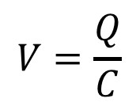

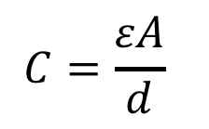
Week 1: Pressure to Voltage
Microphones convert pressure to voltage
  (speakers/headphones voltage to pressure)
  Physical position to voltage
Reason as parallel place capacitor
  ESE 112 or PHYS 151
      Δd → ΔC → ΔV
V
d
$$C=\frac{εA}{d}$$
$$V=\frac{Q}{C}$$
$$Q=CV$$
Notes:
Δd → ΔC → ΔV

Slide 11
Signals

Slide 12
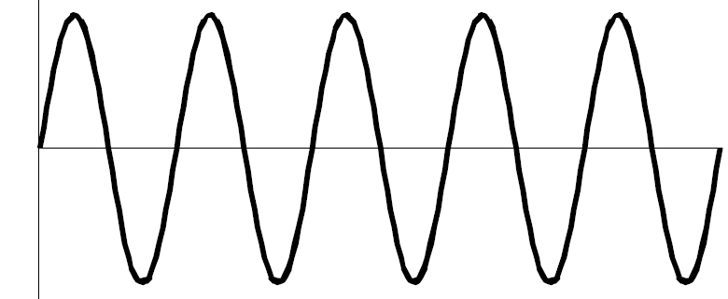
We need to quantify some things
What is a signal?
  Something that carries information
  A description of how one parameter depends on another
    Common Engineering Example:
      Voltage that varies with time
        E.g. Amplitude of voltage changes as time moves forward
      Time = independent variable (x-axis): time
        Depends on nothing!
      Voltage = dependent variable (y-axis): v(t)
        Voltage’s amplitude depends on time
v(t)
time

Slide 13
We need to quantify some things
Most signals encountered in nature…
  …are “continuous” / analog
    Continuous range of values (any real #)
    Examples: 1) Light intensity that changes with distance
    2) Voltage that varies over time v(t)
      We will see in lab this week: MUSIC signal represented with voltage
    3) Chemical reaction rate that depends on temperature
  as opposed to “non-continuous” / discrete signals
    Only a discrete range of values possible (limited subset of real #s)
    How a computer must represent signals
      Fundamental unit of information: bit
      Cannot represent all possible real #’s
      Uses binary digit (bit) to represent #’s:
        1-bit, represents 2 things…2-bits, represents 4 things
        What’s the generalization? (n-bits → how many things?)

Slide 14
Big Question
How represent and process continuous information on a digital computer with finite memory?
  Note: continuous means signal may take on infinite number of values between any T₁ and T₂
T₁
T₂

Slide 15
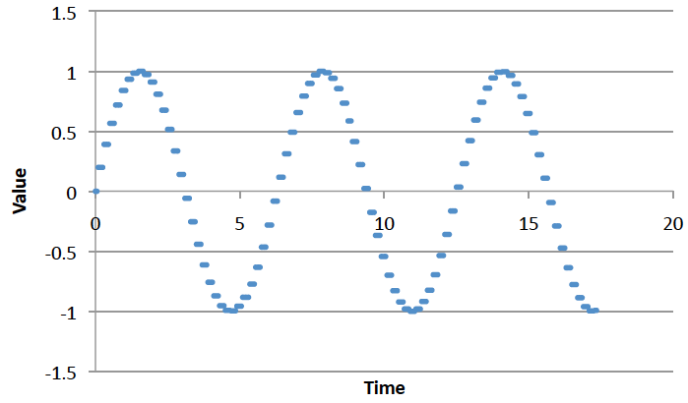
Connect the Dots
Intuition, with enough dots, not hard to “connect-the-dots” to reconstruct (understand) the continuous signal.
  What is the continuous signal here? (preclass 3)
  Assumes certain regularity conditions
  What is enough?

Slide 16
Definitions
Analog-to-Digital (ADC) Conversion
  Process of converting continuous signal to discrete signal
  Going from analog to digital “domain”
  Often called: digitization
  Use a subset of real #’s to represent all real #’s
    Involves a lot of approximation (lots of room for error!)
…collecting the dots

Slide 17
Definitions
Digital-to-Analog (DAC) Conversion
  Process of converting discrete signal to continuous signal
  Going from digital to analog “domain”
  Converting “bits” to a continuous waveform
    Our MP3/Music players do this all the time (will do in lab)
(re)connecting
the dots

Slide 18
Sampling & Quantization

Slide 19
ADC – Sampling & Quantization
Analog-to-Digital (ADC) Conversion
  Converting analog (continuous) signal to digital signal
  Digitization process has two important aspects:
    1) Sampling
      Converting independent variable of signal from continuous to discrete
      e.g.: breaking continuous time down into intervals
    2) Quantization
      Converting dependent variable of signal from continuous to discrete
      e.g.: breaking continuous voltage down into levels

Slide 20
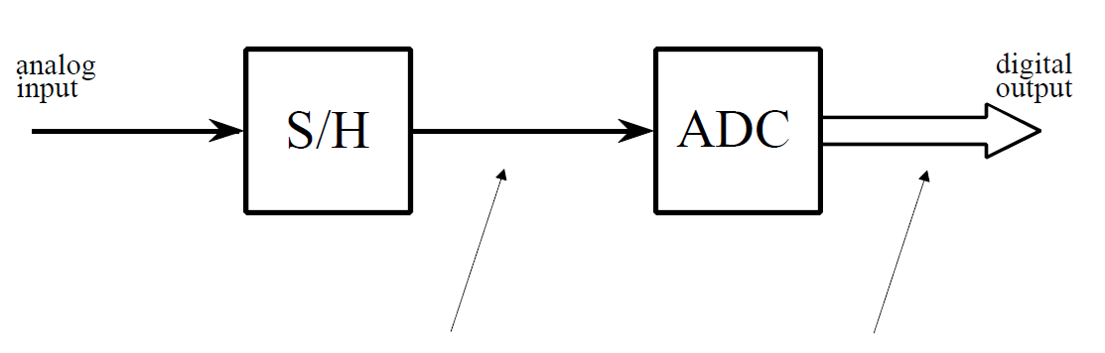
ADC – Broken into two parts
Sample/Hold
Performs sampling
Performs quantization
Figures from reading: The Scientist and Engineer's Guide to
Digital Signal Processing, By Steven W. Smith

Slide 21
ADC – Broken into two parts
Sample/Hold
Performs sampling
Performs quantization

Slide 22

ADC – Sampling
Analog-to-Digital (ADC) Conversion
  Sampling: breaking independent variable (time) into intervals
  Example: Let’s sample our continuous signal @ 1 ms intervals:
Voltage
What is our sampling rate?
(How many samples per second?)
3
1000 samples per second
1 kiloSamples / s
time (ms)
1
2
3
4
5
6
7
8
What is frequency of this signal?
$$freq =\frac{1}{period}=\frac{1}{8ms}=125 Hz$$
Spoiler alert:
Relationship between sample rate & frequency!
-3

Slide 23
ADC – Quantization
Analog-to-Digital (ADC) Conversion
  Quantization: breaking dependent variable (voltage) into levels
  Ex: Let’s quantize our range of voltages into 7 levels (1 Volt each)
Voltage
3
2
1
0
time (ms)
1
2
3
4
5
6
7
8
-1
-2
-3

Slide 24
ADC – Sampling & Quantization
Analog-to-Digital (ADC) Conversion
  Let’s collect our samples at the quantized levels
Voltage
Samples:
{ 0 ms, 0 Volts }
3
{ 1 ms, 2 Volts }
2
{ 2 ms, 3 Volts }
1
{ 3 ms, 2 Volts }
time (ms)
{ 4 ms, 0 Volts }
0
1
2
3
4
5
6
7
8
{ 5 ms, -2 Volts }
-1
{ 6 ms, -3 Volts }
-2
{ 7 ms, -2 Volts }
-3
{ 8 ms, 0 Volts }
Notice, we are rounding! Error is inherent in this process

Slide 25
ADC – Digital Conversion / Encoding
Analog-to-Digital (ADC) Conversion
  We’ve converted something continuous into discrete form
  How do we get it to “digital form”? We encode it…(map to another format)
Voltage
Samples:
{ 0 ms, 0 Volts }
3
{ 1 ms, 2 Volts }
2
{ 2 ms, 3 Volts }
1
{ 3 ms, 2 Volts }
time (ms)
{ 4 ms, 0 Volts }
0
1
2
3
4
5
6
7
8
{ 5 ms, -2 Volts }
-1
{ 6 ms, -3 Volts }
-2
{ 7 ms, -2 Volts }
-3
{ 8 ms, 0 Volts }

Slide 26
ADC – Digital Conversion / Encoding
Analog-to-Digital (ADC) Conversion
  We have 7 discrete voltages, # of bits to represent 7 things?
  3-bits! Why? 2^{3-bits} = 8 (1 unused state)
Binary
Encoding:
011
Voltage
Samples:
{ 0 ms, 0 Volts }
110
3
{ 1 ms, 2 Volts }
101
101
2
{ 2 ms, 3 Volts }
110
100
1
{ 3 ms, 2 Volts }
101
011
time (ms)
{ 4 ms, 0 Volts }
011
0
1
2
3
4
5
6
7
8
{ 5 ms, -2 Volts }
001
010
-1
{ 6 ms, -3 Volts }
000
001
-2
{ 7 ms, -2 Volts }
001
000
-3
{ 8 ms, 0 Volts }
011
Encoding: mapping data from one form to another (not always conversion)

Slide 27
ADC – Storing the Data
Analog-to-Digital (ADC) Conversion
  What do we store? Just the encoded bits:
    Our digitized signal: {011, 101, 110, 101, 011, 001, 000, 001, 011}
    It is now discrete & in digital format, store bits in MP3 player!
  Why can we avoid storing the time?
    It’s repetitive! Just store sampling rate: 1 kilo-samples/ sec
    Later, if we wish to restore signal, each “sample” occurred at 1ms
  In this example:
    Sampling rate: 1 k-samples/sec
    Resolution: 3-bits
    Our digitized signal: {011, 101, 110, 101, 011, 001, 000, 001, 011}

Slide 28
ADC – An approximation at Best
Analog-to-Digital (ADC) Conversion
  Continuous analog signal overlaid with discrete digital signal
  At best an approximation of original signal
Voltage
110
3
Ever heard an audiophile complain:
CDs/MP3s/Digital music doesn’t sound
as “real” or as good old records?
Now you know why!
101
2
100
1
011
0
time (ms)
1
2
3
4
5
6
7
8
010
-1
001
-2
000
-3

Slide 29
ADC – Broken into two parts
Sample/Hold
Performs sampling
Performs quantization
Voltage
Voltage
3
110
3
101
2
100
1
time (ms)
011
0
time (ms)
1
2
3
4
5
6
7
8
1
2
3
4
5
6
7
8
010
-1
001
-2
-3
000
-3

Slide 30
ADC – An approximation at Best
Digital-to-Analog (DAC) Conversion
  Process of converting discrete signal to continuous signal
    How to get back to original signal from bits?
Voltage
110
3
101
2
100
1
011
0
time (ms)
1
2
3
4
5
6
7
8
010
-1
001
-2
000
-3

Slide 31
ADC – An approximation at Best
Digital-to-Analog (DAC) Conversion
  Process of converting discrete signal to continuous signal
    How to get back to original signal from bits?
Voltage
110
3
Simplest – connect the dots
linear interpolation between points.
101
2
100
1
011
0
time (ms)
1
2
3
4
5
6
7
010
-1
With more sophistication
(and typical circuits)
can make smoother links.
001
-2
000
-3

Slide 32
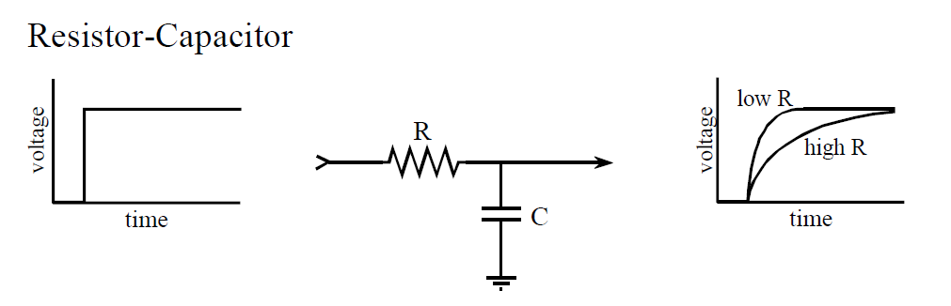
DAC - Filtering
Digital-to-Analog (DAC) Conversion
  What does a capacitor do?
  What happens when apply voltage across a resistor/capacitor?
  We call this filtering in EE, (RC delays are everything)
Voltage
110
3
101
2
100
1
011
0
time (ms)
1
2
3
4
5
6
7
8
output circuit of DAC
holds 7 discrete voltages for 1ms
each…applies it to RC filter,
output is “smooth” analog signal
010
-1
001
-2
000
-3
Notes:
Capacitors will come in ESE112/Physics151 (not had yet), and filtering to come in ESE215.
So, this story is more than we’re generally ready for in ESE 150.

Slide 33
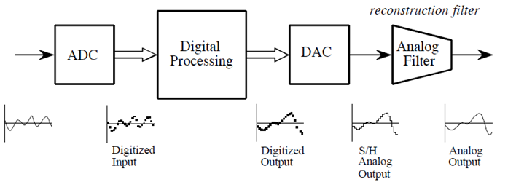
ADC / DAC – The full picture
Analog
Input
Figures from reading: The Scientist and Engineer's Guide to
Digital Signal Processing, By Steven W. Smith

Slide 34
ADC / DAC – The full picture
Analog
Input
Formally:
  Analog input signal that varies with time: s(t)
  Signal processing algorithm to digitize analog input signal:
    f[i]=Round(s(i*T))
      T is sample period
  Digitized signal produced by f [ ]: s_{f} (t)

Slide 35
PCM
Quantization & Sampling Technique described:
  Called Pulse-Code-Modulation (PCM)
    Patented in 1943
    PCM process is the ADC process
    Developed for telecommunications

Slide 36
Interlude: 2D Images

Slide 37
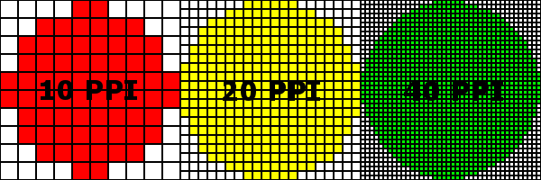
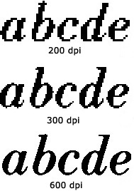
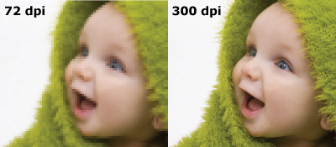
Same phenomena in Images
World continuous
Digital images on projector, TV, paper (even photographs) are discretized – limited resolution
  This projector…
http://www.morefill.com/wpver/wp-content/uploads/2015/08/DPI-abcde.jpg
http://dslrphotographytutorials.com/wp-content/uploads/2014/05/PPI-Compare.png
http://blog.inkjetwholesale.com.au/wp-content/uploads/2015/07/DPI-comparison.png

Slide 38
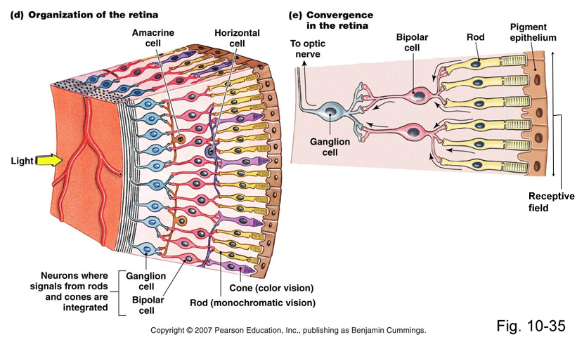
Apple Retina Display
Why called retina?
Claim (goal): as much resolution as you have in your retina (at typical viewing distance)
We cannot see pixels, because our eyes are themselves
discrete!

Slide 39
Apple Retina Display
Why called retina?
Claim (goal): as much resolution as you have in your retina (at typical viewing distance)
We cannot see pixels, because our eyes have discrete photo receptors (rods, cones)
Human eye resolution 0.5 arc-minute (0.02 degrees)
  Around 300 DPI at 20 inches

Slide 40
Effects of Sampling and Quantization

Slide 41
Noise -- ``Formal” Definition
Noise – difference between our ideal signal and the actual signal
  The one that we actually hear
  The one that shows up when we transmit data
  The one we store or reconstruct
Sometimes will see
  R(t) = S(t) + n(t)
    Noise n(t) is added to the ideal signal S(t)
  Or, equivalently:
    n(t)=S(t)-R(t)

Slide 42
Quantization Error
In example, quantization algorithm required us to round
  At sample time, t=1ms, input signal was: 2.2V
  It was lower than 2.5V, we rounded down to quantized level of 2.0V
    Side effect of quantization: the introduction of error in digital signal
Voltage
110
3
101
2.2
2.0
100
1
Quantization
Error
011
0
time (ms)
1
2
3
4
5
6
7
8
010
-1
Difference between sampled value
and quantized level
001
-2
000
-3

Slide 43
Quantization Error
How much error?
  In our case, we round up if equal to or above ½ a level…
    …round down if below ½ a level
  Generally, our input signal has 50/50 chance of being above/below
    Error becomes “uniformly distributed”
Voltage
Error
110
3
101
2.2
0.5
2.0
time (ms)
100
1
0.2
011
0
0
1
2
3
4
5
6
7
8
-0.2
1
2
3
4
5
6
7
8
010
-1
001
-2
-0.5
000
-3

Slide 44
Quantization Error / Noise
How much error?
  Looking at the plot of error, looks random
  Sets up a way for us to model quantization error as noisy signal
    Noise due to quantization = sampled signal (red dots) – quantized signal (red line)
    Quantization introduces noise to our sampled signal
Voltage
Error
110
3
101
2.2
0.5
2.0
time (ms)
100
1
0.2
011
0
0
1
2
3
4
5
6
7
8
-0.2
1
2
3
4
5
6
7
8
010
-1
001
-2
-0.5
000
-3

Slide 45
Quantization Error / LSB
“Least Significant Bit”
  How much value is added with each addition of the least-significant bit?
  What is LSB for our example (3V to -3V, 7 levels)?
  Also known as: resolution of ADC
    What is the smallest difference the ADC can represent
  Quantization error = ± LSB/2
LSB = InputRange/(Levels-1)

Slide 46
Least Significant Bit
Quantization error = ± LSB/2
The LSB is our resolution
  Like the DPI
  Or, more accurately, the distance between pixels (1/DPI)
How close do we get to the original signal?
What is the magnitude of the error introduced due to quantization?

Slide 47
Quantization Error / Design
Why model quantization error as noise?
There is always noise present
  Something other than the signal we intend
  Wires, electronics, background
  Not gaining much if quantization noise < other noise
Quantization adds noise
  Reduce by increasing sampling, increasing resolution
  More levels → bits → makes more expensive
  Increase until reach desired noise level
    Until other sources dominate quantization noise
SNR = Signal-to-Noise Ratio
  How much larger is the signal compare to noise?
  Mean (average) value of signal / std. dev. of noise
  Usually what we are optimizing in the system (including ADC)

Slide 48
Engineering
“An Engineer can do for a dime what anyone else can do for a dollar.”
Engineering is about optimization and efficiency
Bits are costly
Engineer ask: how few bits can I use without sacrificing quality?
Engineering is about tradeoffs
  Quality vs. Cost

Slide 49
Limits of Sampling

Slide 50
Sampling
Definition of proper sampling
  If you can exactly reconstruct analog signal from samples,
  you have done the sampling properly
    Essentially: you have captured the key information from the signal to process can be reversed
Milestone of digital signal processing (DSP):
  Nyquist-Shannon Theorem (next week)
    Tells us our sampling rate should be:
      twice the frequency of the signal!

Slide 51
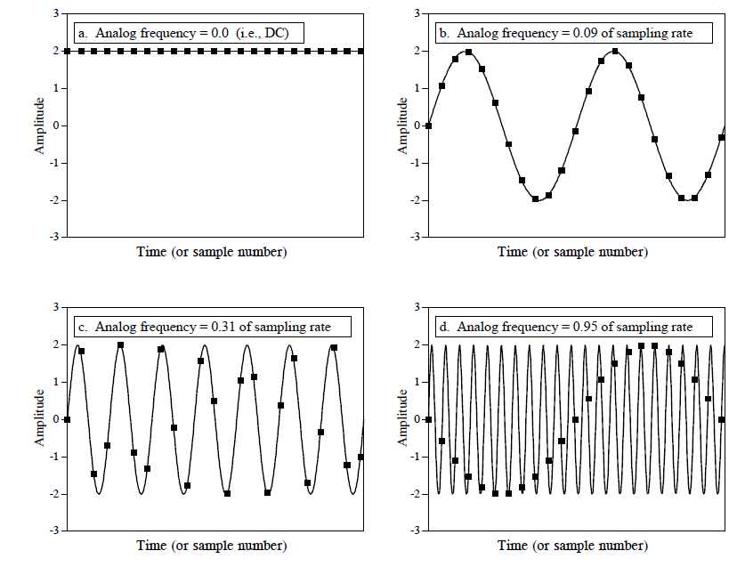
Sampling Rates: How much is necessary?
Figures from reading: The Scientist and Engineer's Guide to
Digital Signal Processing, By Steven W. Smith

Slide 52
Sampling Rates: How much is necessary?
Signal can appear to change frequency if not adequately sampled
called: aliasing (next week)
Figures from reading: The Scientist and Engineer's Guide to
Digital Signal Processing, By Steven W. Smith

Slide 53
System Capacity

Slide 54
Quantization, Sampling, Capacity
Quantization and Sampling
  Play enormous role in determining storage capacity of digital system
  # of quantization levels ➔ # of bits per sample
    Increasing resolution of ADC, reduces quantization noise…
    But also increases amount of data we must store for each sample
  Sampling rate = how often we collect # of bits per sample
    Typically sampling rate = twice frequency of signal (next week)
    Increasing the rate, increases the amount of data to store!

Slide 55
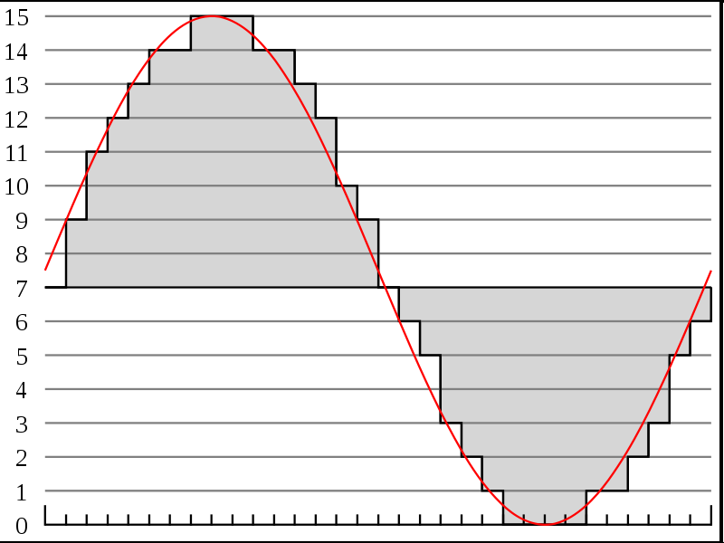




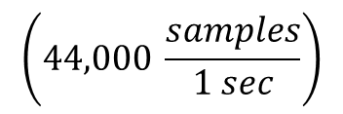

Recall # of bits for typical song
http://en.wikipedia.org/wiki/File:Pcm.svg
Discrete
Voltage
Levels
http://en.wikipedia.org/wiki/File:Compact_disc.svg
Sampling rate & resolution effect on storage
  Compact Disks: 16bits at 44KHz
    How many bits is a typical 3-minute song? (preclass 4)
$$\left(44,000 \frac{samples}{1 sec}\right)$$
$$\left(16 \frac{bits}{sample}\right)$$
$$\left(60 \frac{sec}{1 min}\right)$$
$$\left(3 \frac{min}{song}\right)$$
$$=15.1 \frac{MB}{song}$$
Notes:
44,000/s x 2B x 3 m x 60s/m
15,840,000 Bytes
15.8 MB or almost 128Mbits

Slide 56
Problem Decomposition
Powerful Engineering technique
  Formulate a parameterized solution strategy
  Then identify the right parameters
Divides the problem
Here
  Strategy of sampling and quantization
  Then identify the right sampling rate, quantization level
Once have strategy, reduces to a well-defined optimization problem
Parameterization admits to tuning for tradeoffs

Slide 57
This week in Lab
Look at waveforms of Sound
Sample and Quantize sounds waveforms
Remember:
  Read Lab
  Work Prelab
  Bring USB Flash Drive to lab
  Partner assignments…out by Monday morning

Slide 58
Learn More
ESE215 – basic analog circuitry, RLC circuits, simple filters
  Including why typical circuits give smoother (not linear) connection of dots
ESE568 – Mixed Signal Integrated Circuits
  Build A2D, D2A

Slide 59
Big Ideas
Approximate continuous waveform on digital media by
  Discretize in all dimension
  For audio: in time and amplitude
    Sample in time; quantize voltage
Allows us to store audio signal as sequence of bits
Reconstruct by “connecting-the-dots”
  If our dots are frequent enough to represent the signal
Introduce error → noise
  Reason about tolerable (or noticeable) noise

Slide 60
Admin
Reading for today, next Wednesday on syllabus
In Lab (Detkin) on Monday
  Lab posted
  Read lab, work prelab
  Bring USB flash drive
Remember feedback

Slide 61
References
S. Smith, “The Scientists and Engineer’s Guide to Digital Signal Processing,” 1997.
Wikipedia, http://en.wikipedia.org/wiki/Analog-to-digital_converter
Wikipedia: http://en.wikipedia.org/wiki/Pulse-code_modulation

