Slide 1
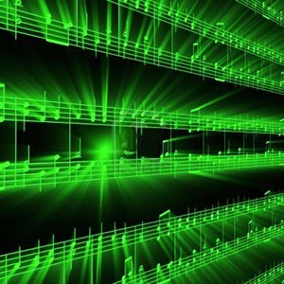
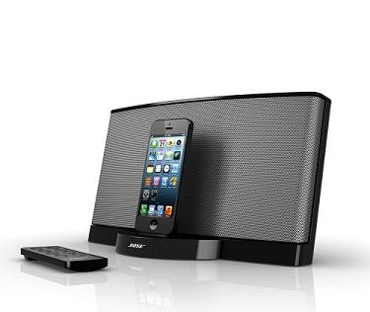
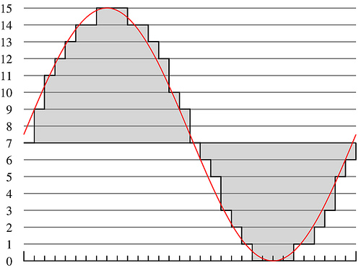
Lecture #5 – Psychoacoustics
ESE 150 –
Digital Audio Basics

Slide 2
Teaser
Can hear whistle?
Can you hear mouse eliminator?

Slide 3
Observe
There are sounds we cannot hear
  Depends on frequency

Slide 4
Lecture Topics
Where are we on course map?
What we did in lab last week
Psychoacoustics
  Structure of Human Ear / encoding signals to brain
  Human Hearing Limits
  Critical Bands (Frequency bins)
  Masking
Next Lab
References

Slide 5
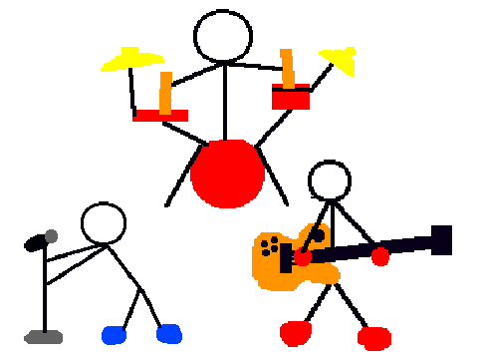
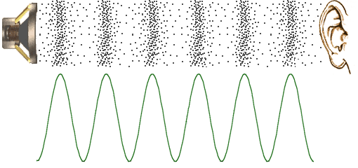
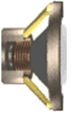

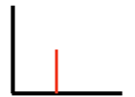
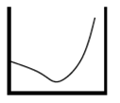
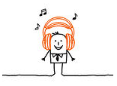

Course Map – Week 6
MIC
A/D
10101001101
Music
1
domain
conversion
5
Numbers correspond to course weeks
compress
sample
freq
pyscho-
acoustics
3
2
4
D/A
10101001101
speaker
MP3 Player / iPhone / Droid

Slide 6
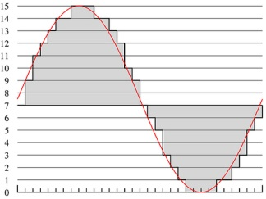
What we did in Lab…
Analog
input
ADC
Digital
Output
compress
Week 1: Converted Sound to analog voltage signal
    a “pressure wave” that changes air molecules w/ respect to time
    a “voltage wave” that changes amplitude w/ respect to time
Week 2: Sampled voltage, then quantized it to digital sig.
  Sample: Break up independent variable, take discrete ‘samples’
  Quantize: Break up dependent variable into n-levels (need 2^{n} bits to digitize)
Week 3: Compress digital signal
  Use even less bits without using sound quality!
Week 4: Frequency Domain Transform before we compress…
  Put our ‘digital’ data into another form…BEFORE we compress…less stuff to compress!

Slide 7
Psychoacoustics

Slide 8
What is Psychoacoustics?
Scientific study of sound perception
  Branch of science studying the psychological and physiological responses associated with sound
  Also, considered a branch of: psychophysics
  Human physical (and neurological) mechanism for sound perception
Why study sound & human’s perception?
  Example: FREQUENCY vs. PITCH
    Frequency of sound: “how often” air particles vibrate (Hz)
    Pitch of sound: the sensation of frequency
      How our brains “interpret” the frequency of a sound
Things may “sound” one way…
  …but be interpreted by our brains very differently!

Slide 9
Psychoacoustics & Digital Music
How does psychoacoustics relate to MP3?
The “consumer” of an MP3 is the human ear…
  Knowing more about brain’s interpretation of sound…
  …helps us remove things human’s can’t hear anyway
We’ve used some of this in our system already:
  Limit of human perception of sound: 20 Hz to 20,000 Hz
    We put an anti-aliasing filter limiting incoming audio
  Fixes our sampling rate, less data to store as a result!

Slide 10
Our study of Psychoacoustics
Structure of Human Ear / encoding signals to brain
Human Hearing Limits
Critical Bands
Frequency Bins
Masking (Spatial vs. Temporal)
Applied Psychoacoustics (mostly next lecture)
  Using all of the above to build...the “Psychoacoustical Model”
  Perceptual Coding in MP3 (using the model to compress MP3s)

Slide 11
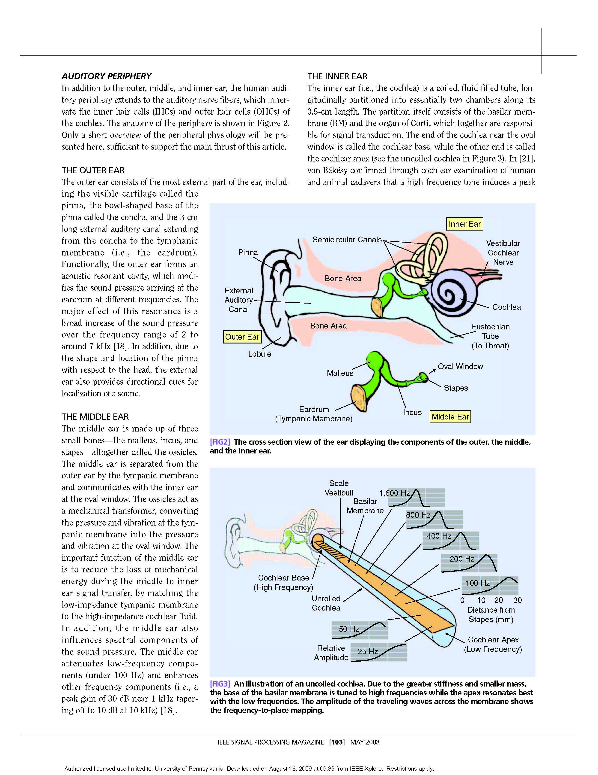
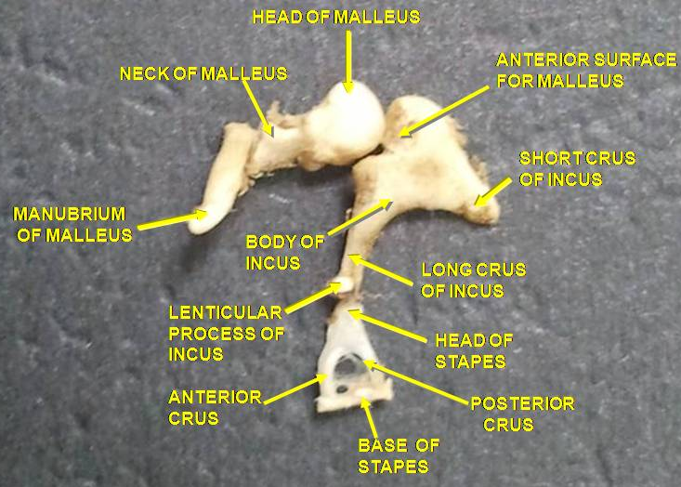
The Physical Ear
Outer Ear
  Guides sound waves into ‘auditory canal’
Middle Ear
  Ear Drum – transmits sound from air to 3 bones in inner ear: ossicles (hammer, anvil, stirrup)
Inner Ear
  Ossicles – transmit sound from air to fluid-filled “chochlea”
Converts vibrations in air (sound) into
mechanical motion in the middle-ear!
Notes:
Ossicles – group of 3 bones: malleus (hammer) the incus (anvil), and the stapes (stirrup) of the middle ear. Smallest bones in body

Slide 12
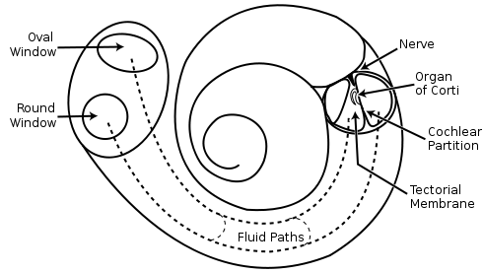
The Physical Ear – “Cochlea”
Cochlea – “snail shell”
  Fluid-filled “labyrinth”
  Located in: “inner-ear”
  Spiral Shaped (snail shell)
  Hair inside cochlea ‘resonates’ according to incoming vibrations in the liquid
    Stereovilli (name of hair)
  Hairs convert vibration into nerve impulses
Picture above – uncoiled cochlea…
-- different stereovilli (Hairs) resonate at different frequencies
-- our ear performs Fourier Transform!
http://www.youtube.com/watch?v=zeg4qTnYOpw
Notes:
Snail shell is latin translation

Slide 13
Cochlea Animation
https://www.youtube.com/watch?v=dyenMluFaUw

Slide 14
The Physical Ear – Take-away
Cochlea
  directly senses frequencies
  Captures frequency domain
  …not time domain
Frequency sensitive locations
  activated by sound waves
Neurons sense activation
Picture above – uncoiled cochlea…
-- different stereovilli (Hairs) resonate at different frequencies
-- our ear performs Fourier Transform!
Notes:
Snail shell is latin translation

Slide 15
Take-away
Our ear works in the frequency domain.
We could consider devices that
  Directly recorded frequencies
    Collection of resonators?
  Directly produced frequencies
    Collection of vibrators
      Tuning forks
      Strings
      Pipes
      …sound familiar?

Slide 16
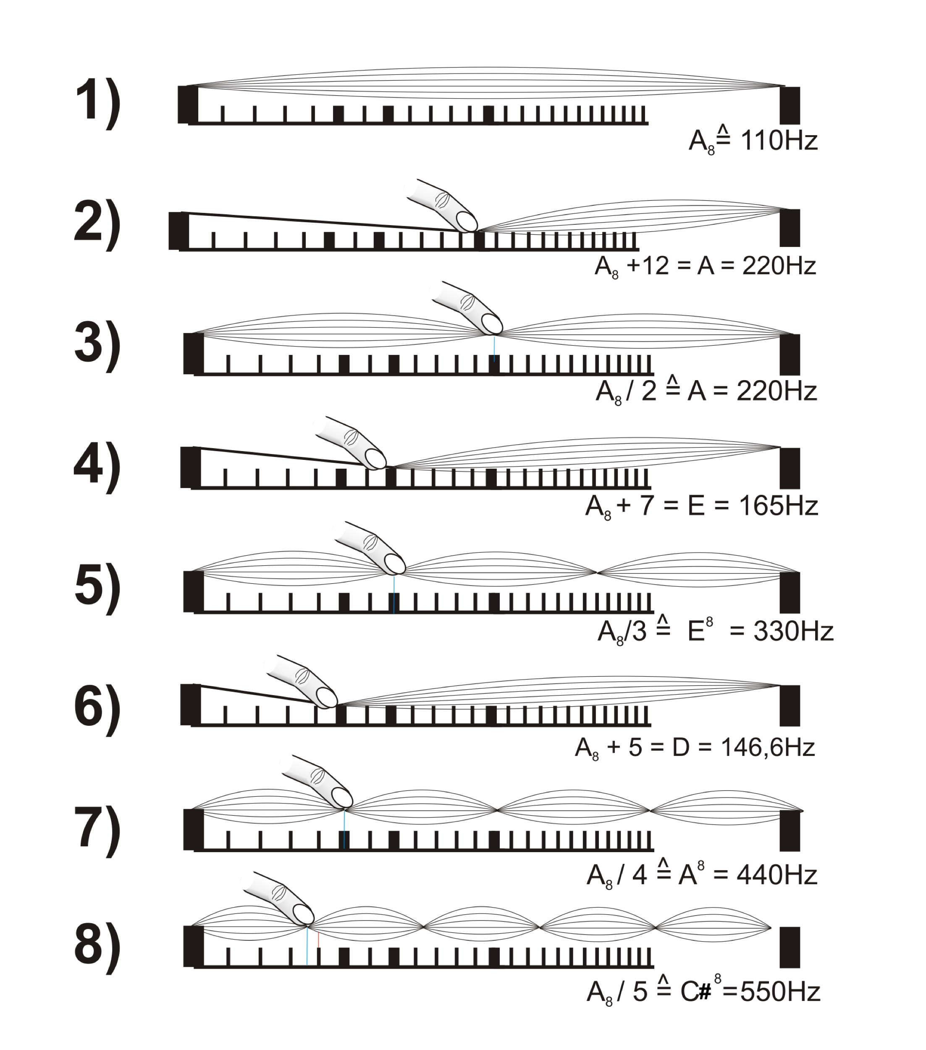
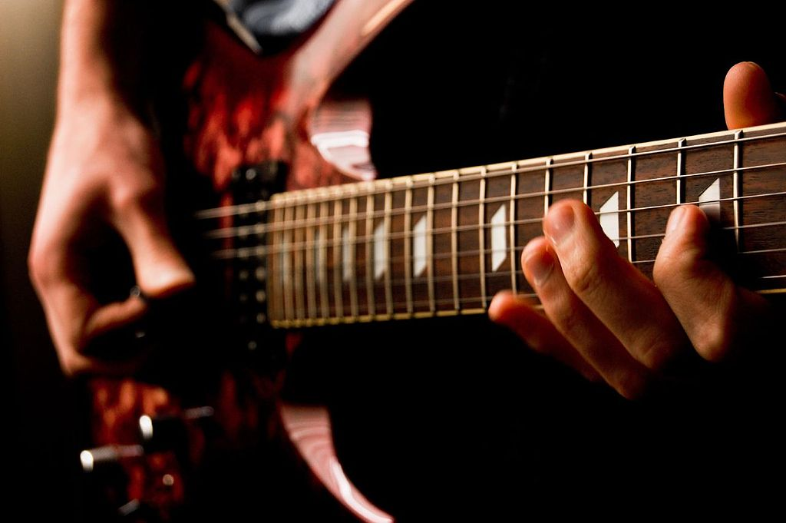
Direct Frequency Generation
All traditional musical instruments work that way!
  Piano, guitar, violin – vibrating strings
Feliciano Guimarães from Guimarães, Portugal / CC BY
(https://creativecommons.org/licenses/by/2.0)
By user:Mjchael - made by me (Corel-Draw), CC BY-SA 2.5,
https://commons.wikimedia.org/w/index.php?curid=1251597
More: Lhttps://www.zmescience.com/science/physics/guitar-strings-vibrate/

Slide 17
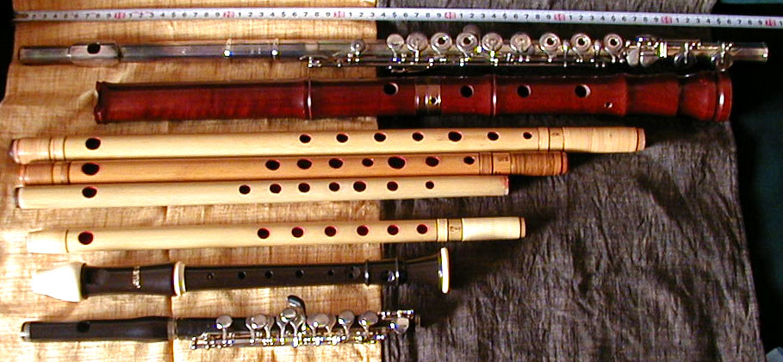


Direct Frequency Generation
All traditional musical instruments work that way!
  Piano, guitar, violin – vibrating strings
  Flute, trumpet, pipe organ – pipes
    http://newt.phys.unsw.edu.au/jw/woodwind.html
    http://newt.phys.unsw.edu.au/jw/fluteacoustics.html (below, right)
By Photo by Yasuhiko Sano, Nov 2005 - http://homepage2.nifty.com/iwatake/,
Public Domain, https://commons.wikimedia.org/w/index.php?curid=435915

Slide 18
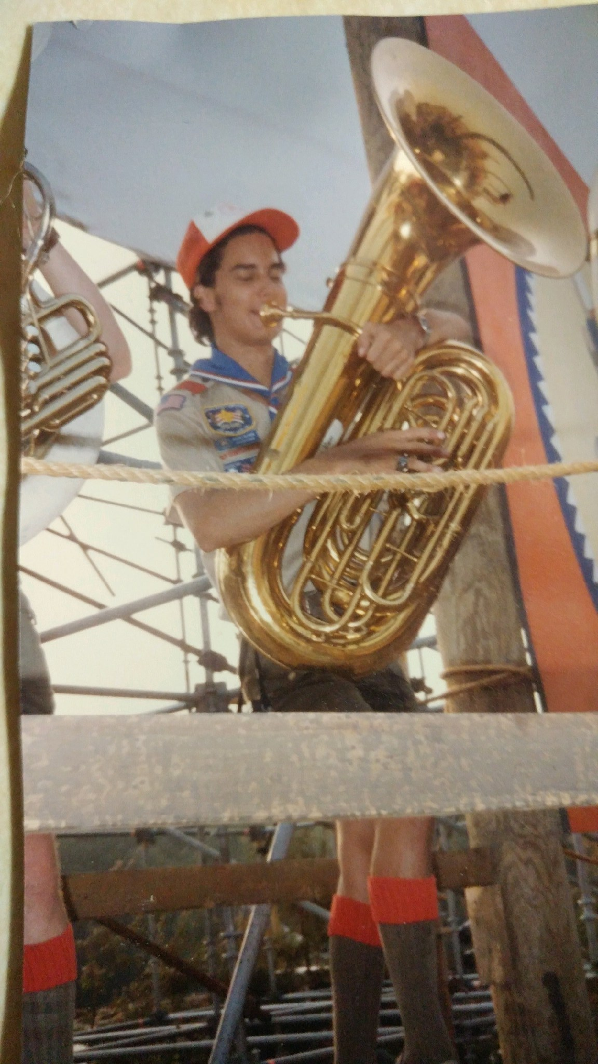
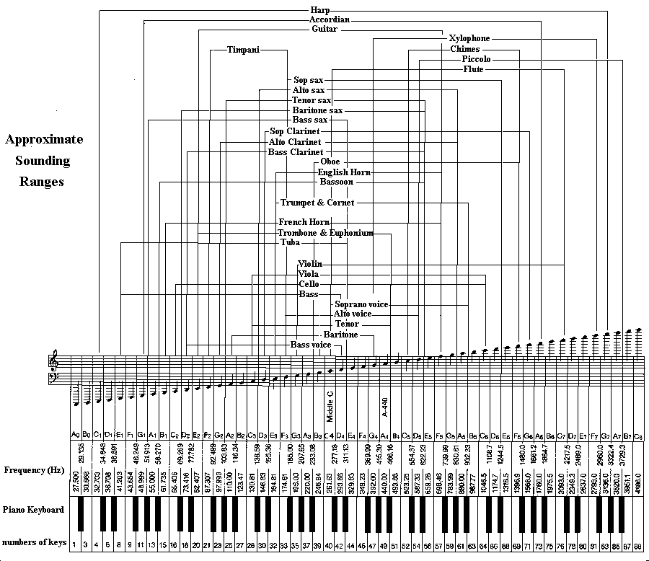
Time Domain Advantage?
Larry Solomn: http://solomonsmusic.net/insrange.htm

Slide 19
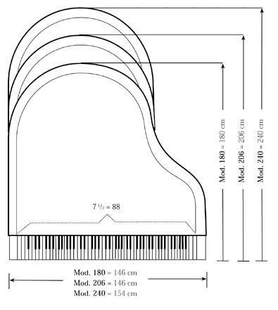
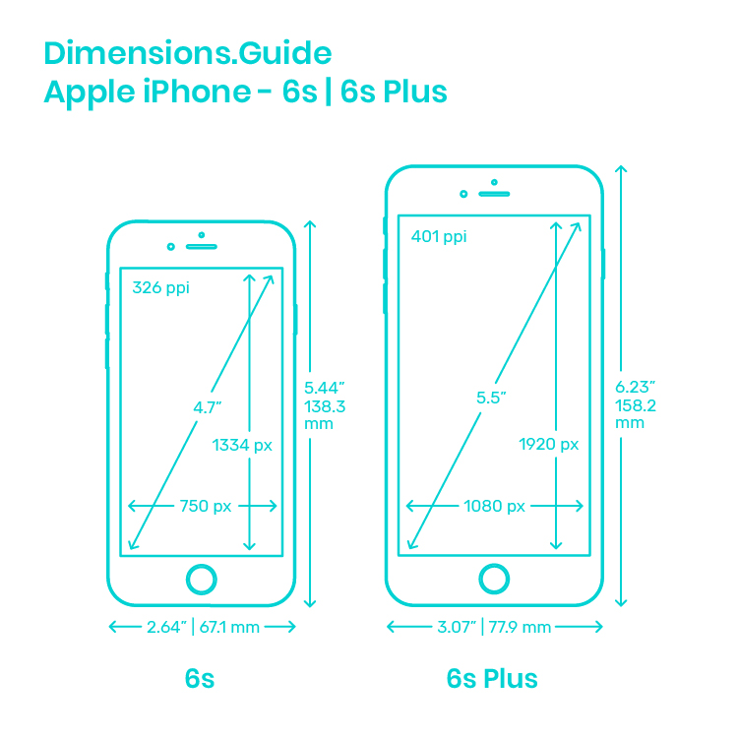
Time Domain Advantage?
1.5m x 2.4m
0.007m x 0.014m
http://www.bluebookofpianos.com/types.html
https://www.dimensions.guide/element/apple-iphone-6s-6s-plus

Slide 20
Time Domain Advantage?
Can produce (receive) many frequencies
  Without large number of strings (vibrators, pipes)
  Without large footprint for strings and resonant cavities
Smaller/cheaper
  Exploiting cheep processing
  from Moore’s Law
http://www.bluebookofpianos.com/types.html
https://www.dimensions.guide/element/apple-iphone-6s-6s-plus

Slide 21
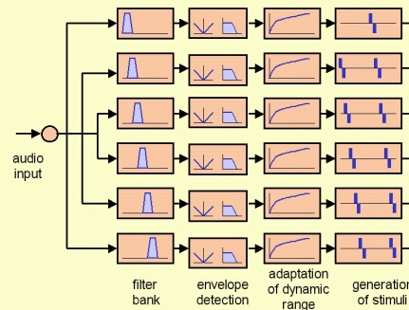
Physical Ear to Engineering Model
With knowledge of structure/function of ear:
  We can model cochlea’s behavior as bank of filters / bandpass filters
    Cochlea breaks down auditory input into frequency ranges
    Sends different frequencies down different nerve pathways!
Each Frequency
encoded independently
on the auditory nerve
Brain ultimately
“interprets” these
Encoded signals
as sound

Slide 22
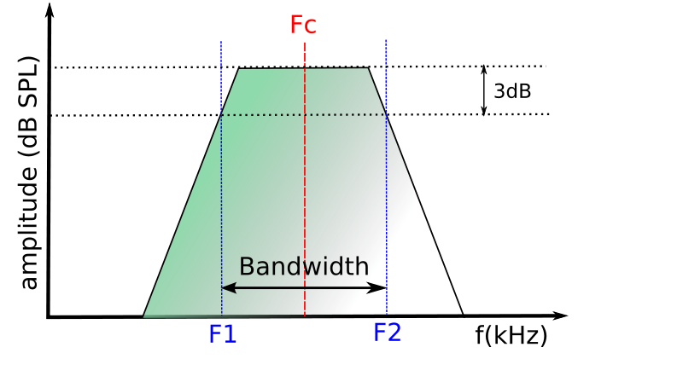
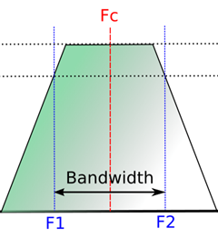
Physical Ear – Limits of Human Perception
Critical Frequency Bands
  Refers to ‘frequency bandwidth’ of each filter in the ear
    A ‘sharply tuned’ filter has good frequency resolution
      Allows frequencies in band pass well, but not others
      Brain can then ‘resolve’ different frequencies

Slide 23
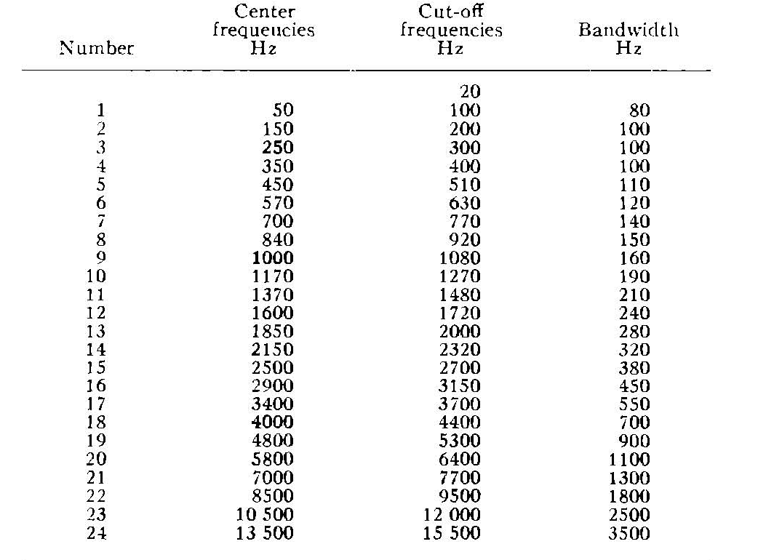
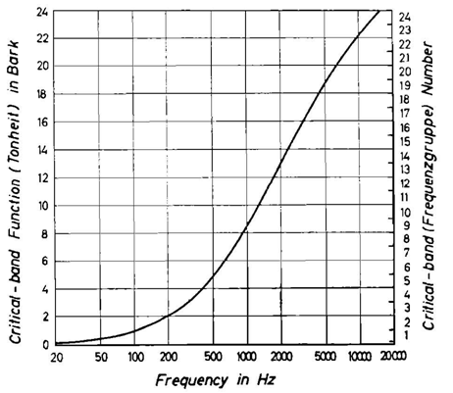
Critical Frequency Bands – How many?
“Bark” scale –
  Maps frequency intervals into their respective critical band number
  24 frequency bins (or “barks”), get wider as frequency increases!

Slide 24

OK, now…some tests…
How well can you hear? (range)
  20 Hz to 20kHz – frequency increasing over 20 seconds
  Can you hear tone the entire time, or do is it appear to go
  silent at some point?
  Tells you how high (and maybe how low) of frequencies you can hear
    Probably need to switch to audacity on laptop to see when still playing…
Notes:
1) Used audacity (free download) for class demo: generate a chirp from 20 Hz to 20kHz for 20 seconds
2) Put 400 Hz on left channel put 1000 Hz on right channel
3) Generate a 1500 Hz tone, then a 1502 Hz tone…play separately…can’t hear difference
---but, play them at the same time and we can ‘perceive’ beats

Slide 25
OK, now…some tests…
Can you hear two frequencies at once? (selectivity)
  Let’s try: 400 Hz and 1000 Hz
  First independent references
  Then together
Notes:
1) Used audacity (free download) for class demo: generate a chirp from 20 Hz to 20kHz for 20 seconds
2) Put 400 Hz on left channel put 1000 Hz on right channel
3) Generate a 1500 Hz tone, then a 1502 Hz tone…play separately…can’t hear difference
---but, play them at the same time and we can ‘perceive’ beats

Slide 26
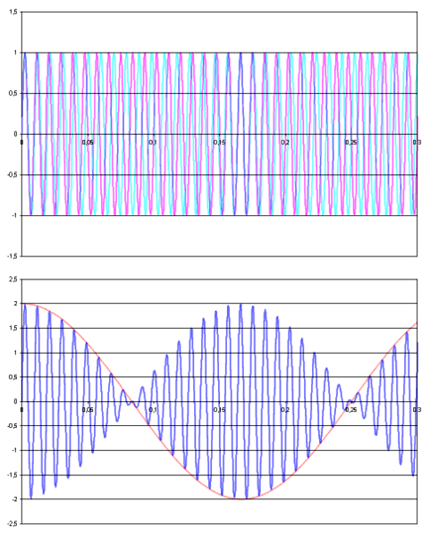
OK, now…some tests…
Frequency Resolution…(bands)
  In 1000 Hz to 2000 Hz octave…
    Brain can’t perceive changes in frequency
    smaller than 3.6 Hz
  Plays 1500Hz tone then 1502Hz
    Aside from maybe a click in the middle,
    can you tell difference between tones?
    Keep same tones, but add a 1500Hz tone
    on second track playing whole time.
    Now hear interference demonstrating
    that first track did change tones.
Notes:
1) Used audacity (free download) for class demo: generate a chirp from 20 Hz to 20kHz for 20 seconds
2) Put 400 Hz on left channel put 1000 Hz on right channel
3) Generate a 1500 Hz tone, then a 1502 Hz tone…play separately…can’t hear difference
---but, play them at the same time and we can ‘perceive’ beats

Slide 27
Physical Ear to Engineering Model
Limits of Human Hearing…easy to see from Cochlea
  Cochlea only so long…
    lowest frequencies: 20 Hz
    Highest frequencies: 20 kHz
Also helps us understand ‘selectivity’
  Our brain can choose to ‘listen’ to output of various filters
  Example: At a party, but you can concentrate on conversation!
Notes:
Average length of choclea: 31.5mm long!

Slide 28
Sound Intensity & Loudness
(refresh)

Slide 29
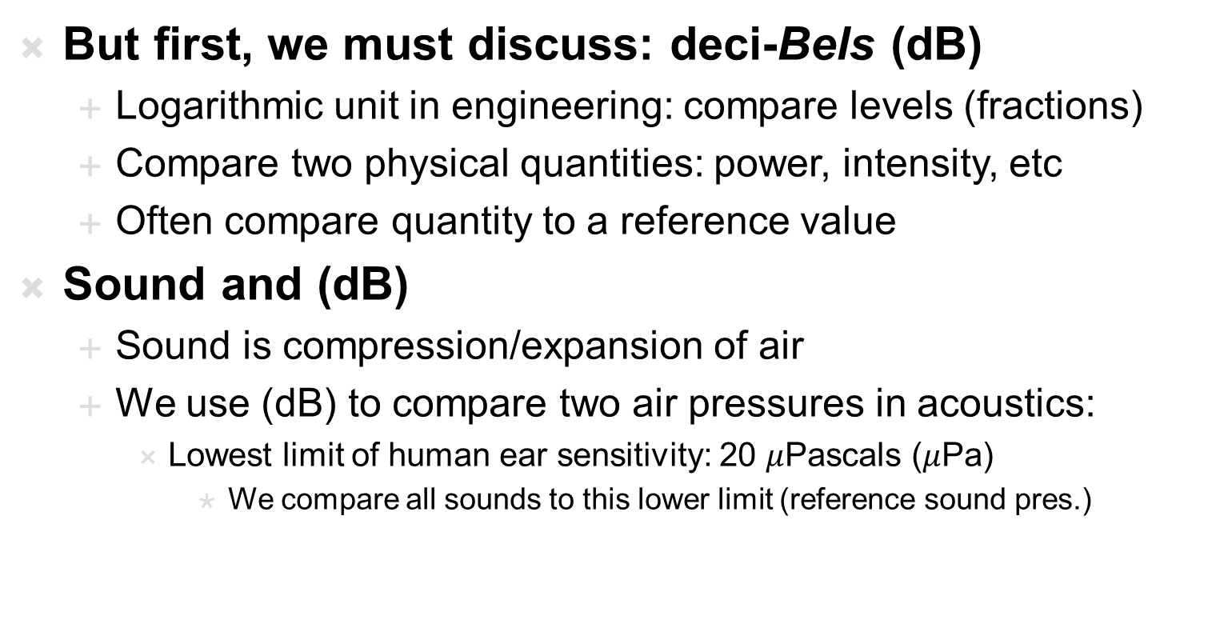
Sound Intensity – “Loudness”
But first, we must discuss: deci-Bels (dB)
  Logarithmic unit in engineering: compare levels (fractions)
  Compare two physical quantities: power, intensity, etc
  Often compare quantity to a reference value
Sound and (dB)
  Sound is compression/expansion of air
  We use (dB) to compare two air pressures in acoustics:
    Lowest limit of human ear sensitivity: 20 $μ$Pascals ($μ$Pa)
      We compare all sounds to this lower limit (reference sound pres.)
(unitless)
(unitless)
Loudness-Sound Pressure Level (L_{SPL}) = $20∗\log_{10}\left(\frac{Sound pressure }{Reference Sound pressure}\right)$ in dB
(unitless)

Slide 30
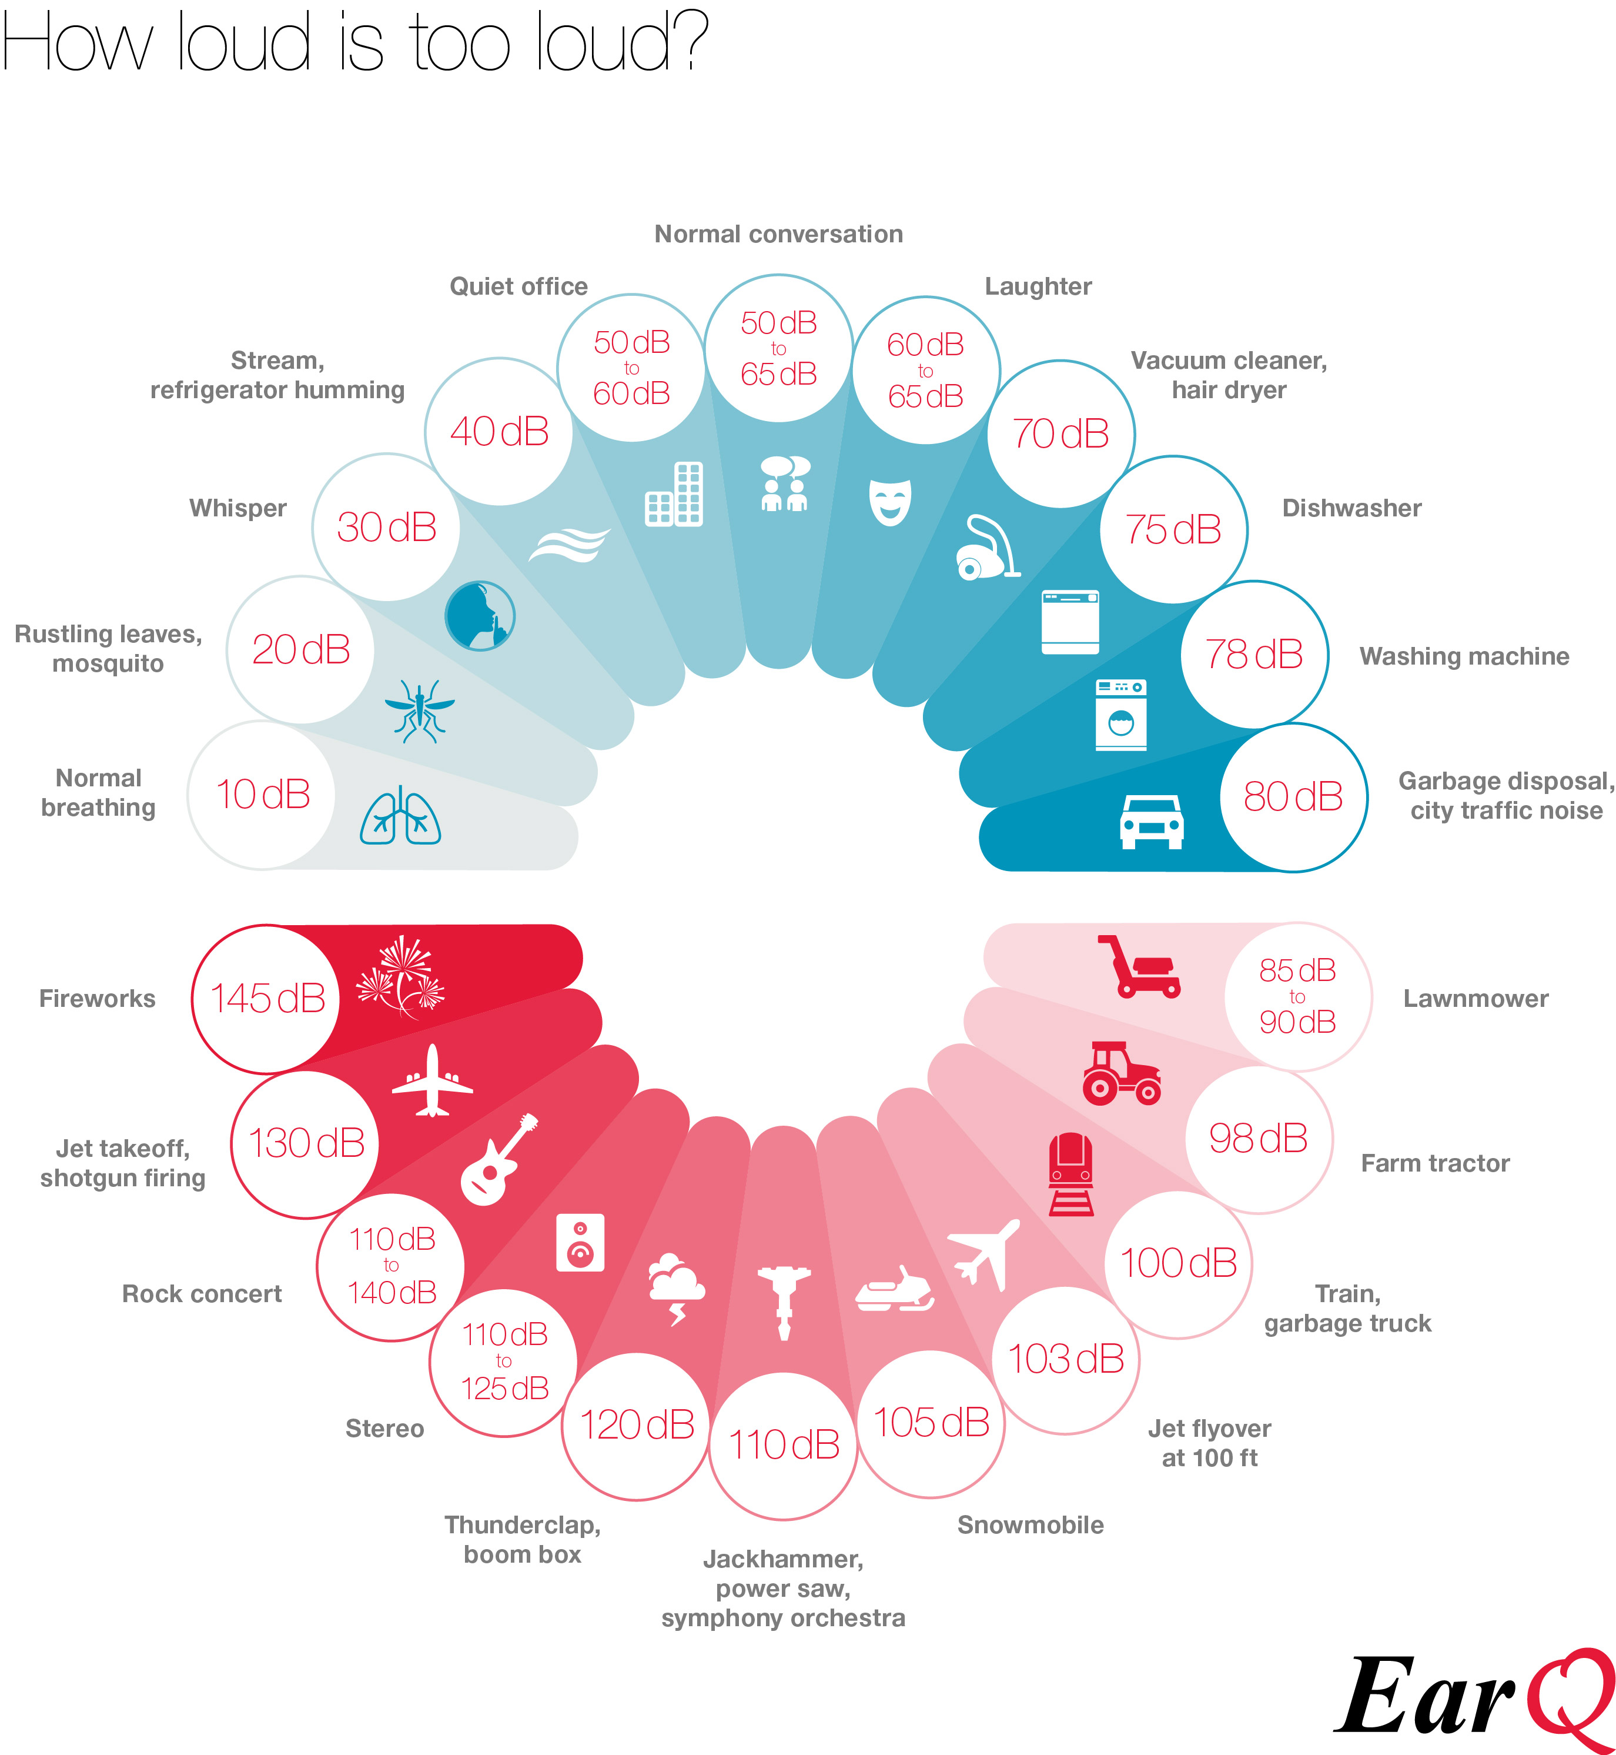
Sound Intensity in (dB) – “Loudness”
Preclass 4: Ratio of pressure between 20dB and 140dB?
Notes:
Could also calculate actual value of sound pressure. dB in this context is an absolute

Slide 31
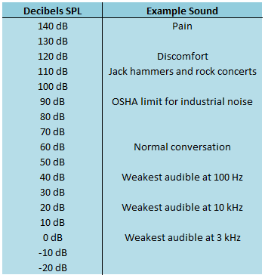







Sound Intensity in (dB) – “Loudness”
If sound intensity level is:
140 dB 20 dB
Divide both sides by 20:
Sound with intensity of 140dB:
  has a sound pressure 10 million times greater than the quietist sound we can hear (which is 20 uPa) -- OUCH!
$$20log\left(\frac{P2}{P0}\right)=140dB$$
$$20log\left(\frac{P1}{P0}\right)=20dB$$
$$\log\left(\frac{P2}{P0}\right)=7$$
$$\log\left(\frac{P1}{P0}\right)=1$$
$$\frac{P2}{P0}={10}^{7}$$
$$\frac{P1}{P0}={10}^{1}$$
$$\frac{P2}{P1}=1,000,000$$
Notes:
Could also calculate actual value of sound pressure. dB in this context is an absolute

Slide 32
Sound Intensity in (dB) – “Loudness”
Loudness –
  subjective perception of intensity of sound
Intensity –
  Sound power per unit area
Does loudness change with frequency?
  Yes! Scientist: Harvey Fletcher (1940)
    Measured loudness vs. frequency (Auditory Thresholds)
    Same ‘amplitude’ sound can sound very quite or really loud
      All depends on its frequency
  Turns out…
    We are very sensitive to frequencies from 1kHz to 5kHz
      They don’t have to be ‘intense’ for us to hear them…why??

Slide 33
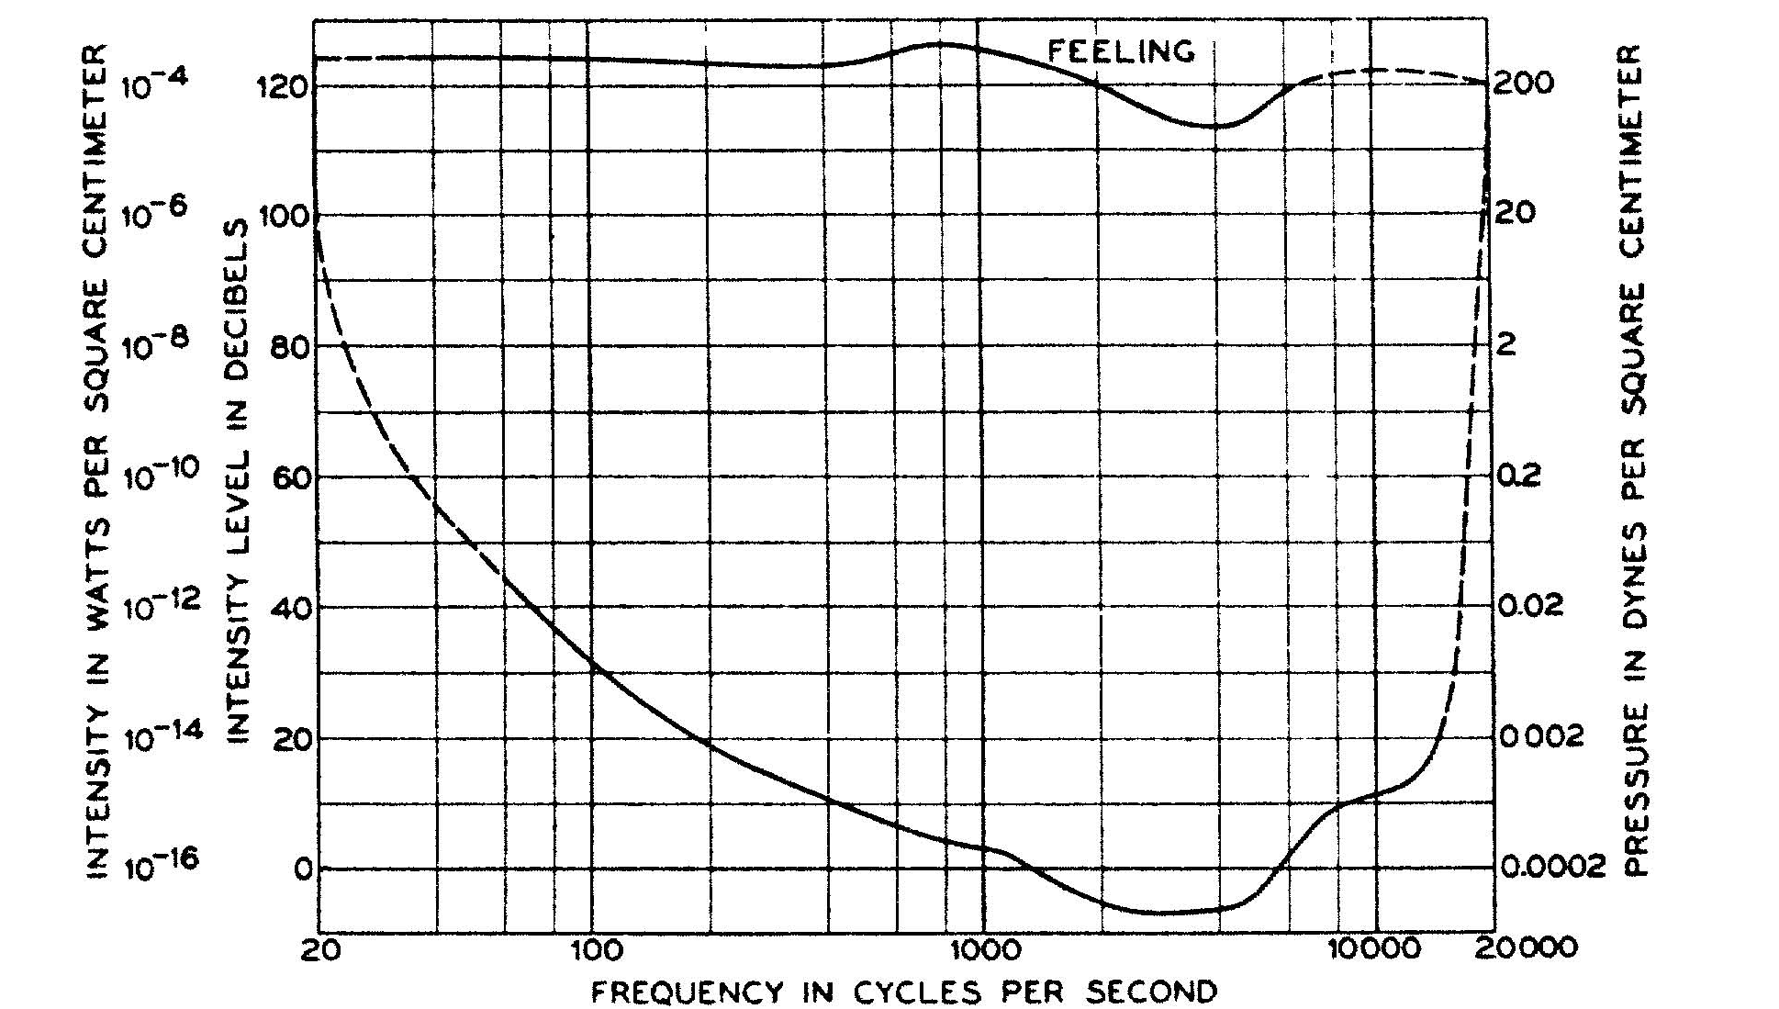
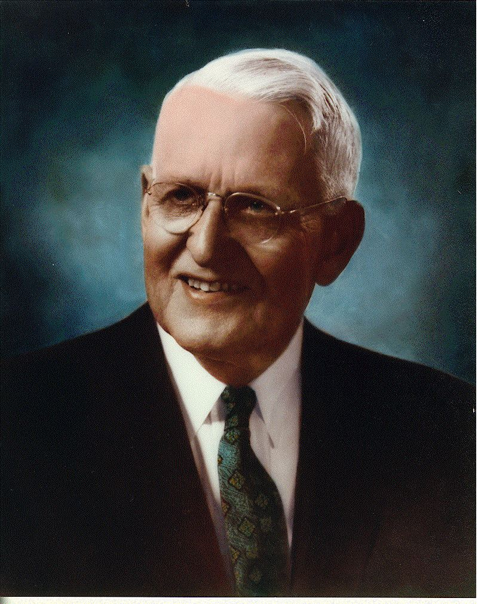
Auditory Thresholds – Measured by Fletcher
Low frequency & very high frequency sounds
must be intense for us to interpret them as
“loud” as sounds with frequencies in 1k to 5k range

Slide 34
Demonstration
Same demo as before: 1 Hz to 20kHz
  Instead of thinking about frequency cutoff (range)
  Think instead about how “loud” the sounds at different frequencies are…
    Which ‘band’ sounds ‘loudest’ to you?
    Note: they are all at same amplitude, so equally intense
    But we perceive sounds in 1 kHz to 5 kHz to be louder!

Slide 35
Auditory Masking

Slide 36
Masking
Auditory Masking
  When the perception of one sound is affected by the presence of another
    Remember…perception
Two types:
  Frequency Domain Based:
    Frequency Masking, simultaneous masking, spectral masking
  Time Domain Based:
    Temporal Masking / non-simultaneous masking

Slide 37
Frequency Domain Masking
Masking illustrates the limits of ear selectivity
  In fact, we measure ear selectivity using masking!
Vocabulary:
  Masker – The noise ‘masking’ the maskee
  Maskee – The signal being ‘masked’ by masker

Slide 38
On-Frequency Masking
Greatest/worst form of frequency masking
  Occurs when maskee & masker are the same frequency

Slide 39
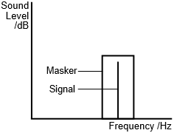
On-Frequency Masking
Greatest/worst form of frequency masking
  Occurs when maskee & masker are the same frequency
  Also strong when masker and signal are within same auditory filter

Slide 40
On-Frequency Masking
Greatest/worst form of frequency masking
  Occurs when maskee & masker are the same frequency
  Also strong when masker and signal are within same auditory filter
  Think about Cochlea vibrating:
Nearby hair cells vibrating
will cause some vibration.
Interpreted by brain as caused
by large vibration, not a separate
frequency.

Slide 41
On-Frequency Masking
Greatest/worst form of frequency masking
  Occurs when maskee & masker are the same frequency
  Also strong when masker and signal are within same auditory filter
  Think about Cochlea vibrating:
  Listener cannot distinguish between
  them, perceived as one sound
  Preclass 5: audience noise masks
  movie line

Slide 42
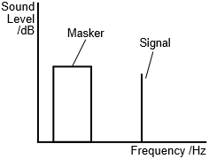
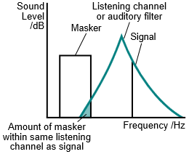
Off-Frequency Masking
Off-frequency masking
  Masker has different frequency than signal
  Masker still has effect…
    …if it’s in same auditory filter band as signal

Slide 43
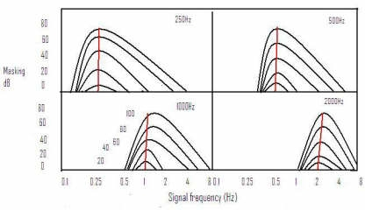
Frequency Masking and Intensity
Effect of masking as masker signal grows more intense
  More intense the masker, wider the band of masking
    Note: These “masking patterns” are called: audiograms
Plotting maskee amplitude
vs bandwidth
With separate curve
for each masker
amplitude
Notes:
The black contours represent how wide masking pattern is, given intensity of masking signal
More intense masker is, wider its masking pattern
See “Similar Frequencies” on https://en.wikipedia.org/wiki/Auditory_masking

Slide 44
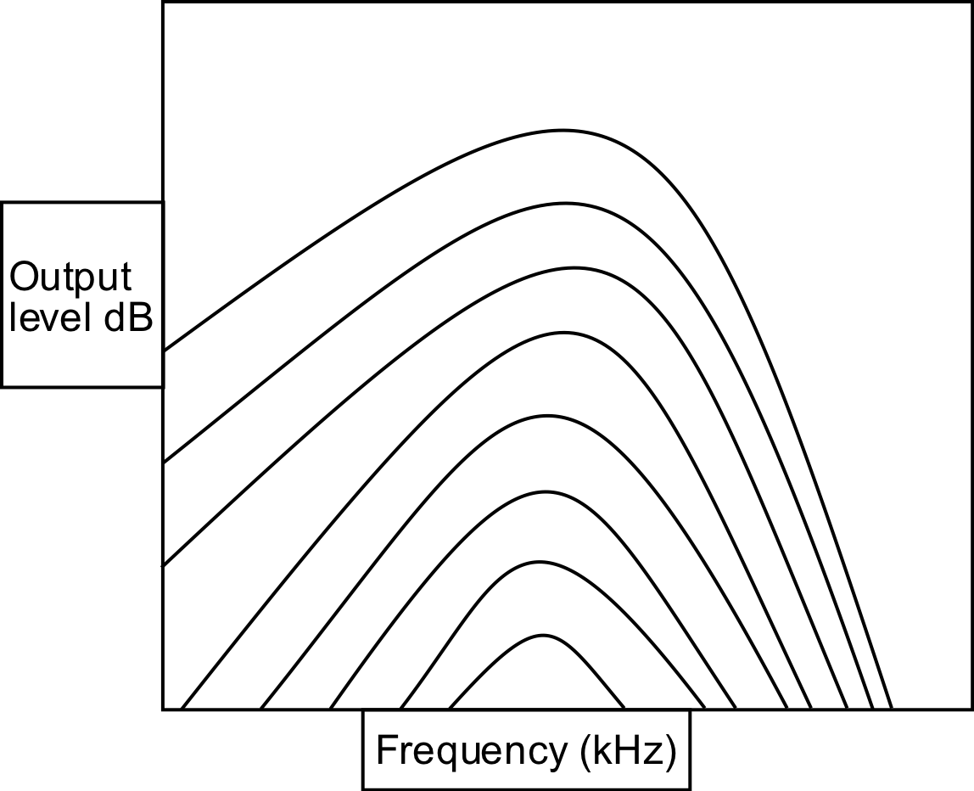
Frequency Masking
Given a signal at a frequency
How strong must a signal (or noise) at a difference frequency be in order to be heard?
General trend:
  Larger the frequency difference
  The less strong it must be (the less masking)
https://commons.wikimedia.org/wiki/File:OutputlevelMoore.svg

Slide 45
Frequency Masking Example
1000
2000
4000
80
Freq | Strength
1000 | 80
2000 | 70
4000 | 20
70
20
https://commons.wikimedia.org/wiki/File:OutputlevelMoore.svg

Slide 46
Demonstration
Generate 900 Hz Tone (left channel) (maskee)
  Turn gain all the way down (-36 dB)
Generate 1000 Hz Tone (right channel) (masker)
  Keep gain at 0 dB
Play sound…
  Bring intensity of 900 Hz tone up so we can hear both tones
  Mute masker and play it again…
    Maskee was always there, just couldn’t hear it
    Even though it was at different frequency of masker
Notes:
Used audacity for these demos

Slide 47
Demonstration
Generate 1000 Hz Tone (masker) [band 9]
Sweep frequency 700Hz to 1600 Hz (masked)
  About 20% of level of masker
  Bands 7--11
Both constant loudness
Reference without Masker
Play sound…
  When hear second signal?
See diminished masking effects as frequencies get further apart
Notes:
Used audacity for these demos

Slide 48
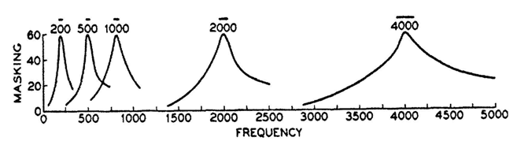
Frequency Masking @ Higher Frequencies
Plots of masking at several different frequencies:
  Effect of masking is ‘worse’ at higher frequencies
  Masking band gets wider at higher frequencies

Slide 49
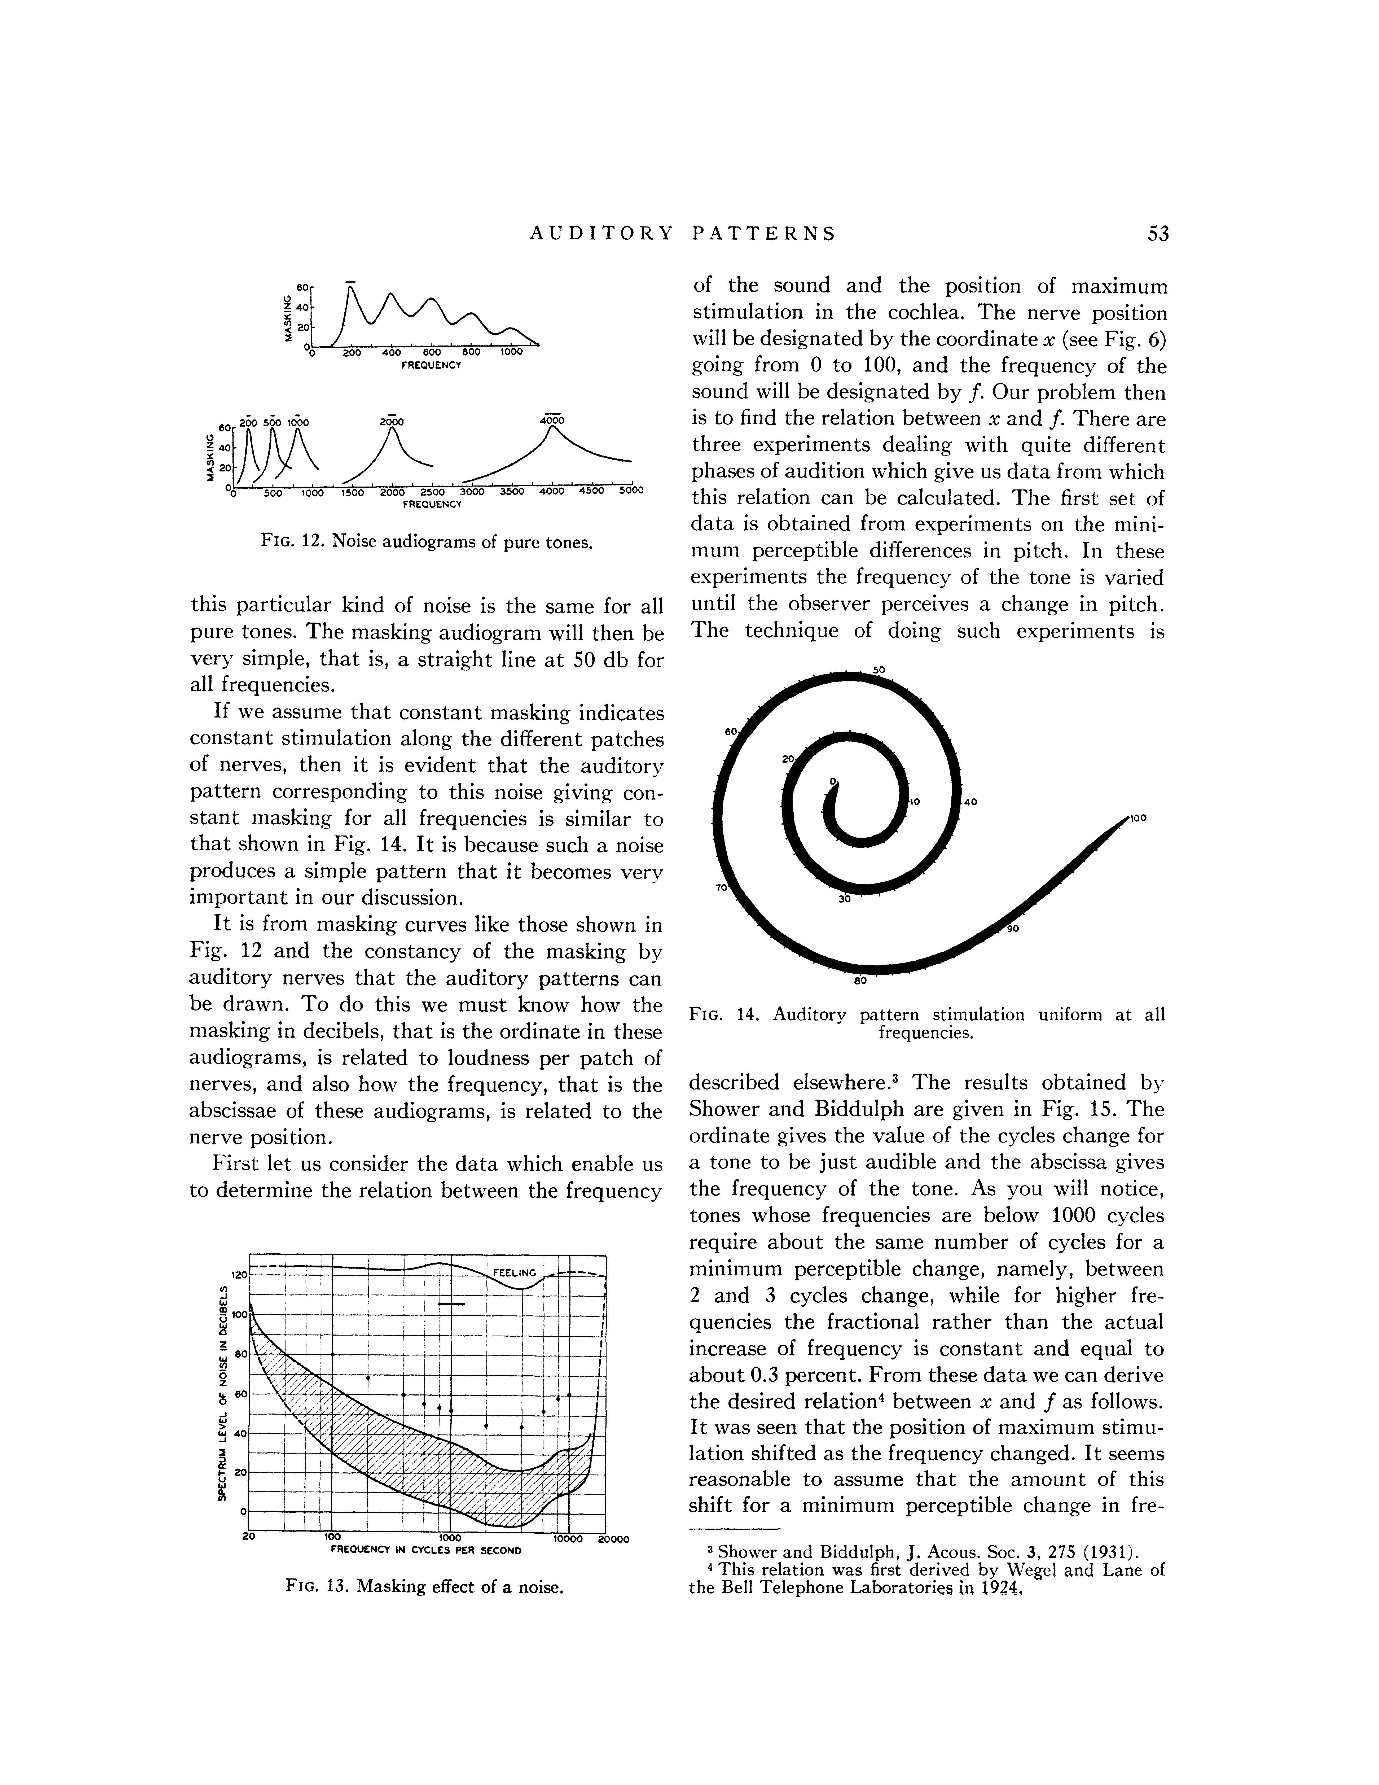
Frequency Masking and Harmonics
Masking can also occur at the harmonics of masker…
  Example has a masker at 200 Hz
  While effect of masker is greatest at 200 Hz…
    Also effects harmonics of masker signal!

Slide 50
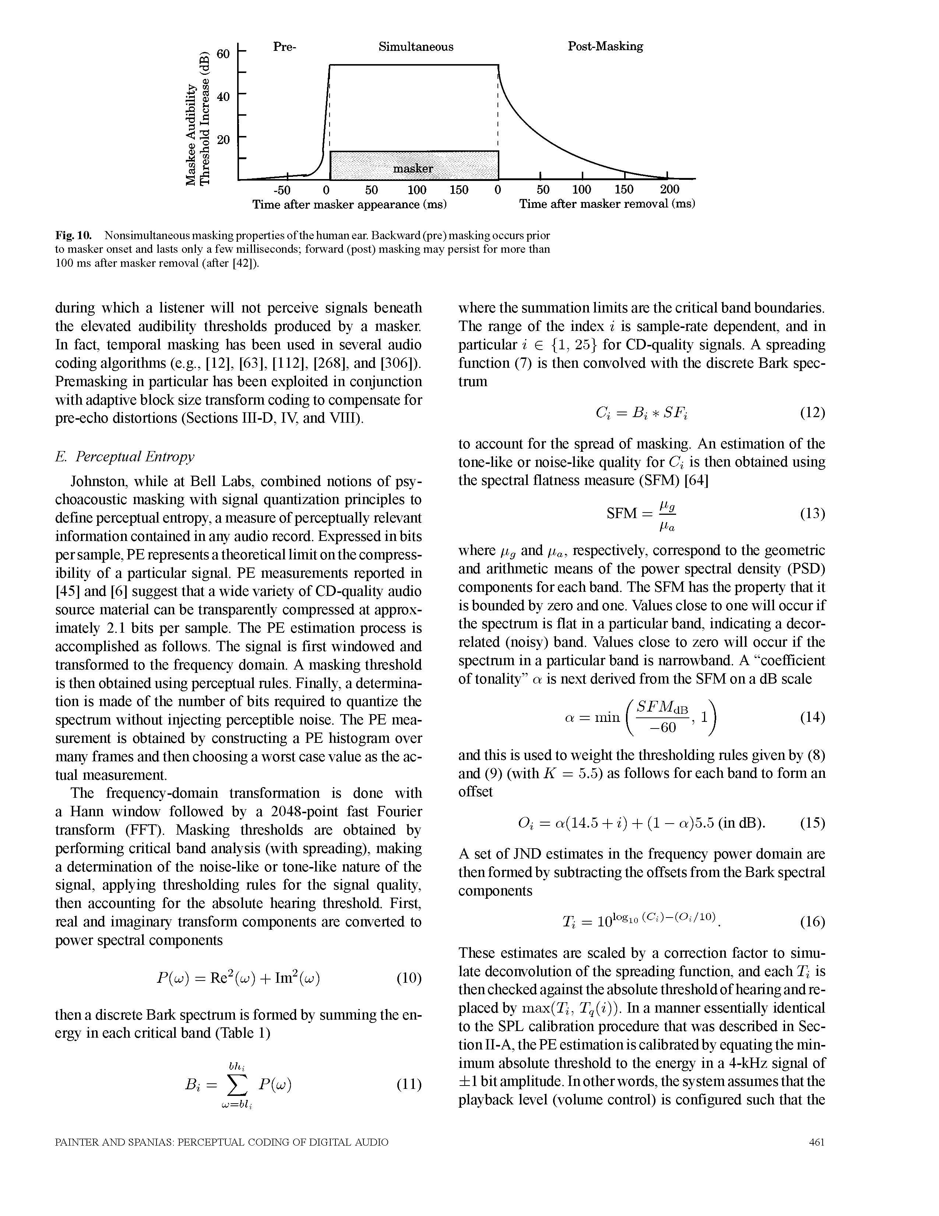
Time-Domain Masking (Temporal)
Two types:
  pre-masking (backwards)
  post-masking (forwards)

Slide 51
Temporal Masking - Forwards
Easier to understand…
  A sudden masker noise…
    Makes inaudible other sounds following noise…for up to 200ms
      Physical: hair cells in Cochlea don’t stop vibrating instantly
        Brain accounts for the fact their vibration will decay over time after incident sound goes away
      (imagine the compression possibilities!)

Slide 52
Temporal Masking - Backwards
Not as intuitive an explanation…
  A sudden masker noise…
    Makes inaudible other sounds preceding noise!
    Why does this happen?
      One thought: takes time for your brain to interpret sound
      Think of it like a buffer…
      Throws out contents of buffer when a loud sound comes in
        to concentrate on only the loud sound (masker in this case)
      Also, hair vibrations likely take time to come up to full amplitude

Slide 53
Using Psychoacoustics in Digital Audio

Slide 54
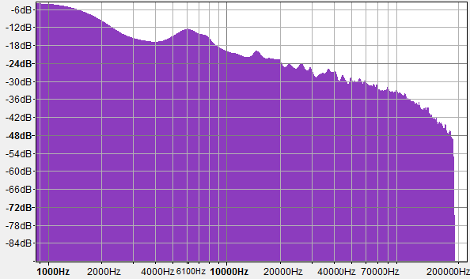
How do we use psychoacoustics in digital music compression? (range)

Slide 55
How do we use psychoacoustics in digital music compression? (masking)
120
dB
100
80
60
40
20
Masked
0
Frequency
193 194 196 197 198 199 201 202 203 204 206 207 208

Slide 56
How do we use psychoacoustics in digital music compression? (masking)
120
dB
100
80
60
40
20
0
Frequency
193 194 196 197 198 199 201 202 203 204 206 207 208

Slide 57
Big Ideas
Human hearing mechanism directly encodes frequency
  By position on Cochlea
Differential sensitivity by frequency
  Hear some frequencies louder than others
Frequency Masking
  Limit to what we can simultaneously perceive in critical bands – loud frequencies can hide others
Temporal Masking
  Loud signals can hide sounds that come after (or before) them

Slide 58
Learn More
BIBB417 – Visual Processing
  Same kind of look at physiology, but for vision
LING520 – Phonetics 1
  Focus on speech, includes both hearing and production

Slide 59
Coming up
Feedback
  Note – one unique question about this lecture and last
In Lab
  Measure sensitivity and masking effects
  Bring head phones
Next Lecture
  Put this together to compress audio
  Derive key features of MP3

Slide 60
References
Physical Ear:
  R. Munkong and B.-H. Juang. IEEE Sig. Proc. Mag., 25(3):98–117, 2008
Filter Bank:
  http://www.ugr.es/~atv/web_ci_SIM/en/seccion_4_en.htm
Bark Scale:
  [E. Zwicker. J. Acoust. Soc.Am., 33(2):248, February 1961]
DB Chart:
  http://www.dspguide.com/ch22/1.htm
Masking Discussion:
  Wikipedia: PsychoAcoustics Article

