Slide 1



Lecture #7 – Digital Logic
ESE 150 –
Digital Audio Basics
Based on slides © 2009--2020 DeHon

Slide 2








So far
MIC
A/D
10101001101
DFT
Identify Masking
Huffman encoding
Music
1
domain
conversion
5,6
Numbers correspond to course weeks
compress
sample
freq
pyscho-
acoustics
3
2
4
Huffman Decode
IDFT
EULA
----------------click
OK
D/A
10101001101
speaker
MP3 Player / iPhone / Droid

Slide 3
How Process
How do we build a machine to perform these operations?
  From Digital Samples → compressed digital data → Digital Samples
Down to bottom
  If we can build one kind of primitive element,
    …and connect together large collections of them
  can build a machine to perform any digital computation

Slide 4
Lecture Topics
Setup
Where are we?
Combinational Logic
Sequential Logic
FPGAs
Next Lab

Slide 5
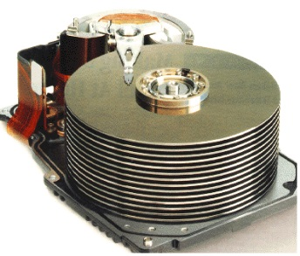


Course Map
7,8,9
10101001101
MIC
CPU
File-
System
A/D
10
10101001101
NIC
Music
1
domain
conversion
5,6
Numbers correspond to course weeks
compress
sample
freq
pyscho-
acoustics
3
2
4
13
11
EULA
----------------click
OK
D/A
NIC
speaker
MP3 Player / iPhone / Droid
12

Slide 6

Course Map – Week 8
MIC
A/D
10101
Music
1
domain
conversion
5,6
Numbers correspond to course weeks
compress
sample
freq
pyscho-
acoustics
3
2
4
EULA
----------------click
OK
D/A
10101001101
speaker
MP3 Player / iPhone / Droid

Slide 7
Combinational Logic

Slide 8
Gate
Primitive binary function
  Computes a binary output from a small number of binary inputs
Can specify function with a Truth Table
  Defines the output for each input combination
Input 0 | Input 1 | Output
0 | 0
0 | 1
1 | 0
1 | 1

Slide 9
AND Gate
AND
  Output is 1 (true) when all inputs are 1 (true)
Input 0 | Input 1 | AND
0 | 0 | 0
0 | 1 | 0
1 | 0 | 0
1 | 1 | 1

Slide 10
NOT Gate
Not
  Output is opposite of input
input | NOT
0 | 1
1 | 0

Slide 11
OR Gate
OR
  Output is 1 (true) when any input is 1 (true)
  (fillin truth table for OR)
Input 0 | Input 1 | OR
0 | 0
0 | 1
1 | 0
1 | 1

Slide 12
Claim
Can compute any Boolean Function from AND, OR, NOT
  (actually from NAND)

Slide 13
Model: Combinational Logic
Compute some “function”
  f(i₀,i₁,…i_{n}) → o₀,o₁,…o_{m}
Each unique input vector
  implies a particular, deterministic, output vector

Slide 14
Big AND
AND
  Output is 1 (true) when all inputs are 1 (true)
How build n-input AND from AND2 gates?

Slide 15
Big OR
OR
  Output is 1 (true) when any input is 1 (true)
How build n-input OR from OR2?

Slide 16
Input Case
How can we create an expression that is true for a specific input case?
  E.g. have a function of 4 inputs: a, b, c, d
How many potential values for a, b, c, d?
  Rows in our truth table
Give one example of values for a, b, c, d?
How create an expression that is true for that case?

Slide 17
Single Output Digital Function
Given have logic to implement each input case
How implement entire function?
a | b | c | F(a,b,c)
0 | 0 | 0 | 1
0 | 0 | 1 | 0
0 | 1 | 0 | 0
0 | 1 | 1 | 0
1 | 0 | 0 | 0
1 | 0 | 1 | 0
1 | 1 | 0 | 0
1 | 1 | 1 | 1

Slide 18
Multiple Output Function
What do you do if your Digital Function needs multiple output bits?

Slide 19
Combinational Logic as Gates
Start with truth table
Single output {0, 1}
  Use inverters to produce complements of inputs
  For each input case
    If output is a 1
      Develop an AND to detect that case
        Decompose AND into gates
  OR together the output of all such AND functions
    Decompose OR into gates
Multiple outputs
  Repeat for each output
This solution won’t typically be the smallest or fastest…

Slide 20
Conclude
Can implement any combinational logic function out of a collection of
  OR2, AND2, NOT gates

Slide 21
NAND2 Gate
NAND = NOT AND
  Output is 0 (true) when all inputs are 1 (true); 0 otherwise
Input 0 | Input 1 | NAND
0 | 0 | 1
0 | 1 | 1
1 | 0 | 1
1 | 1 | 0

Slide 22
NAND Universality
How implement
  What function does each circuit implement?

Slide 23
NAND Universality
Can implement
  NOT from NAND2
  AND2 from NAND2
  OR2 from NAND2
Can implement any combinational logic function out of a collection of
  OR2, AND2, NOT gates
Therefore: Can implement any combinational logic function out of a collection of NAND2 gates

Slide 24
Multiplexer Gate
MUX
  When S=0, output=i0
  When S=1, output=i1
S | i0 | i1 | Mux2(S,i0,i1)
0 | 0 | 0
0 | 0 | 1
0 | 1 | 0
0 | 1 | 1
1 | 0 | 0
1 | 0 | 1
1 | 1 | 0
1 | 1 | 1
Truth Table?
AND, OR, NOT
Implementation?

Slide 25
Arithmetic
Addition is also a digital logic function
  Maps set of inputs (a3 a2 a1 a0 b3 b2 b1 b0)
  To an output bit vector (c4 c3 c2 c1 c0)
…as is subtraction, multiplication, division, square root….

Slide 26
Full Adder
Adds 3 inputs to produce 2b output
  Binary inputs: a, b, c
  Binary outputs: carry, sum
  Two bit result:
  carry*2 +sum = a+b+c
  Can produce truth table and logic (Lab)

Slide 27
Example: Bit-Level Addition
Addition
  Base 2 example
  Work together
C: 1011010000
A: 01101101010
B: 01100101100
S: 010010110
C: 11011010000
A: 01101101010
B: 01100101100
S: 1010010110
C: 000
A: 01101101010
B: 01100101100
S: 10
C: 0000
A: 01101101010
B: 01100101100
S: 110
C: 10000
A: 01101101010
B: 01100101100
S: 0110
C: 010000
A: 01101101010
B: 01100101100
S: 10110
C: 1010000
A: 01101101010
B: 01100101100
S: 010110
C: 11010000
A: 01101101010
B: 01100101100
S: 0010110
C: 011010000
A: 01101101010
B: 01100101100
S: 10010110
C: 11011010000
A: 01101101010
B: 01100101100
S: 11010010110
A: 01101101010
B: 01100101100
S:
C: 0
A: 01101101010
B: 01100101100
S:
C: 00
A: 01101101010
B: 01100101100
S: 0

Slide 28
N-Bit Adder
Given Full Adders
  Can build N-bit adder by connecting N full adders

Slide 29
Sequential Logic

Slide 30
Mux with Feedback
What happens when S=0?
What happens when S=1?

Slide 31
Mux with Feedback
Assuming i0 doesn’t change
what happens when S goes from 0 to 1?

Slide 32
Latch
Element that can hold a
previous value of an input

Slide 33
Flip-Flop (FF)
Use a pair to create a flip-flop
  Also call register
What happens when
  CLK is low (0) ?
  CLK is high (1) ?
  CLK transitions from 0 to 1?

Slide 34
Flip-Flop (FF)
Use a pair to create a flip-flop
  Also call register
Sample D input on 0→1
transition of clock (CLK)
Never an open path from
D→Q
  One of the mux latches always
  in hold state

Slide 35
State Element
Latch or Register is a state element
Allows circuit to remember a value
Build computations that
  Depend on past inputs
  Reuse hardware in time

Slide 36
Accumulator
Sum a sequence of values

Slide 37
Accumulator
Start with an Adder

Slide 38
Accumulatop
Store running sum
as state in registers

Slide 39
Accumulator
Wrap register outputs
back to inputs

Slide 40
Accumulator
Maybe extend accumulator bits to hold larger sum
Maybe more…

Slide 41
Accumulator
What happens:
  Start with a3:a0 at 0
  CLK low
  I3:i0=2 (0010)
  FF inputs?

Slide 42
Accumulator
What happens:
  Start with a3:a0 at 0
  CLK low
  I3:i0=2 (0010)
  FF inputs?
  CLK goes high: a3:a0?

Slide 43
Accumulator
What happens:
  Start with a3:a0 at 0
  CLK low
  I3:i0=2 (0010)
  CLK goes high: a3:a0?
  I3:0=3 (0011)
  FF inputs?

Slide 44
Accumulator
What happens:
  Start with a3:a0 at 0
  CLK low
  I3:i0=2 (0010)
  CLK goes high: a3:a0?
  I3:0=3 (0011)
  FF inputs?
  CLK goes high: a3:a0?

Slide 45
Accumulator
a=0
while (true)
  a=a+getInput();
Accumulates
input values i
  Integration or
  summation

Slide 46
State for Sequencing and Control
Useful when trying to control things
  E.g. Perform a sequence of operations
Robot
  Open-gripper
  Move-forward
  Close-gripper
  Lift

Slide 47
State for Conditional Control
Useful when need to behave differently based on something in the past
  Remember if elevator going up or down
  Remember/count coins from consumer
  Remember some mode set by user
    Displaying in Centigrade or Fahrenheit
Idea
  Store state
  Use as input to logic

Slide 48
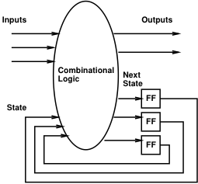
Finite-State Machine (FSM)
Sequential model of computation
State (in registers) + combinational logic
Compute outputs and next state
from inputs and state

Slide 49
FSM Example
Simplified Vending Machine
  Only input quarters
  Only vend one item (output signal to indicate vending)
  Item costs 2 quarters
  Coin Return request and control
Two states: waiting, one-quarter (one)
Two inputs: quarter, coin-return (creturn)
Two outputs: vend, return-quarter (qreturn)

Slide 50
Truth Table Model
Complete together
state | quarter | creturn | vend | qreturn | next
waiting | 0 | 0 | 0 | 0 | waiting
waiting | 0 | 1
waiting | 1 | 0 | 0 | 0 | one
waiting | 1 | 1
one | 0 | 0
one | 0 | 1
one | 1 | 0
one | 1 | 1

Slide 51
Truth Table Model
Complete together
state | quarter | creturn | vend | qreturn | next
waiting | 0 | 0 | 0 | 0 | waiting
waiting | 0 | 1 | 0 | 0 | waiting
waiting | 1 | 0 | 0 | 0 | one
waiting | 1 | 1
one | 0 | 0
one | 0 | 1
one | 1 | 0
one | 1 | 1

Slide 52
Truth Table Model
Complete together
state | quarter | creturn | vend | qreturn | next
waiting | 0 | 0 | 0 | 0 | waiting
waiting | 0 | 1 | 0 | 0 | waiting
waiting | 1 | 0 | 0 | 0 | one
waiting | 1 | 1 | 0 | 1 | waiting
one | 0 | 0
one | 0 | 1
one | 1 | 0
one | 1 | 1

Slide 53
Truth Table Model
Complete together
state | quarter | creturn | vend | qreturn | next
waiting | 0 | 0 | 0 | 0 | waiting
waiting | 0 | 1 | 0 | 0 | waiting
waiting | 1 | 0 | 0 | 0 | one
waiting | 1 | 1 | 0 | 1 | waiting
one | 0 | 0 | 0 | 0 | one
one | 0 | 1
one | 1 | 0
one | 1 | 1

Slide 54
Truth Table Model
Complete together
state | quarter | creturn | vend | qreturn | next
waiting | 0 | 0 | 0 | 0 | waiting
waiting | 0 | 1 | 0 | 0 | waiting
waiting | 1 | 0 | 0 | 0 | one
waiting | 1 | 1 | 0 | 1 | waiting
one | 0 | 0 | 0 | 0 | one
one | 0 | 1 | 0 | 1 | waiting
one | 1 | 0
one | 1 | 1

Slide 55
Truth Table Model
Complete together
state | quarter | creturn | vend | qreturn | next
waiting | 0 | 0 | 0 | 0 | waiting
waiting | 0 | 1 | 0 | 0 | waiting
waiting | 1 | 0 | 0 | 0 | one
waiting | 1 | 1 | 0 | 1 | waiting
one | 0 | 0 | 0 | 0 | one
one | 0 | 1 | 0 | 1 | waiting
one | 1 | 0 | 1 | 0 | waiting
one | 1 | 1

Slide 56
Truth Table Model
state | quarter | creturn | vend | qreturn | next
waiting | 0 | 0 | 0 | 0 | waiting
waiting | 0 | 1 | 0 | 0 | waiting
waiting | 1 | 0 | 0 | 0 | one
waiting | 1 | 1 | 0 | 1 | waiting
one | 0 | 0 | 0 | 0 | one
one | 0 | 1 | 0 | 1 | waiting
one | 1 | 0 | 1 | 0 | waiting
one | 1 | 1 | 0 | 1 | one

Slide 57
Switch-Statement Model
While (true)
switch (state) {
case waiting:
if (quarter && !creturn)
state=one;
else
state=waiting;
qreturn=quarter && creturn;
vend=0;
break;

Slide 58
Switch-Statement Model (cont.)
case one:
if ((quarter && !creturn)||
(!quarter&&creturn))
state=waiting;
else
state=one;
qreturn=creturn;
vend=quarter&& !creturn;
break;
} // switch
} // while

Slide 59
FSM Graph Model
!quarter/
vend=0, qreturn=0
quarter&creturn/
vend=0, qreturn=1
waiting
quarter&!creturn/
vend=1, qreturn=0
quarter&!creturn/
vend=0, qreturn=0
!quarter&creturn/
vend=0, qreturn=1
one
!quarter&!creturn/
vend=0, qreturn=0
!quarter&!creturn/
vend=0, qreturn=0

Slide 60
Programmable Logic

Slide 61
Mux can be a programmable Gate
Programmable Gate
  Can be programmed to act as any gate
  Use state (e.g. FF) to “program” truth table of a gate
Input 0 | Input 1 | Output
0 | 0
0 | 1
1 | 0
1 | 1

Slide 62
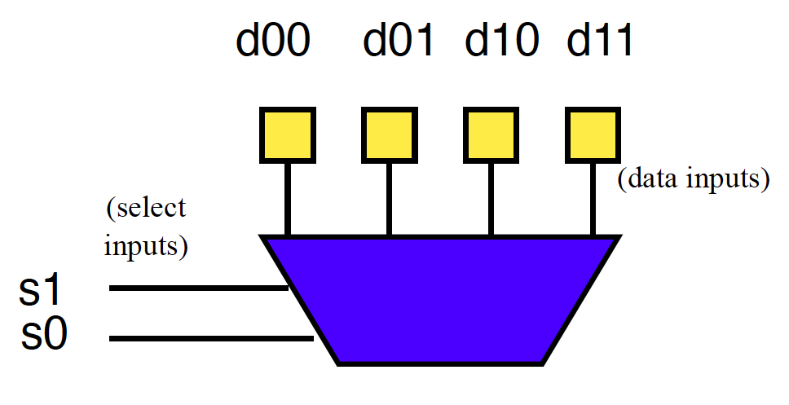
Example: AND
How do we program to behave as AND2?

Slide 63
Example: OR
How do we program to behave as OR2?

Slide 64
Look-Up Table (LUT)
Can generalize to any number of inputs

Slide 65
Connecting Gates
Once we can build gates
…still need to connect the gates together.
Select which gate outputs become inputs to other gates.

Slide 66
Mux can be Programmable Interconnect
Trick: Use multiplexer
to programmably
select gate input.

Slide 67
Programmable Blocks

Slide 68
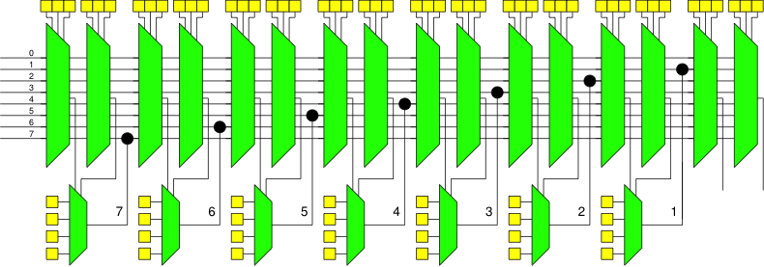
Programmable Gates and Interconnect
If time permits:
How program (fill in yellow programmable cells) to implement a full adder?

Slide 69
Field-Programmable Gate Array (FPGA)
Collection of Programmable Gates
  Can “program” by setting state bits
  LUTs that can be programmed to be any gate
    With optional Flip-Flops to use for state
  Programmable interconnect to “wire” the gates together

Slide 70
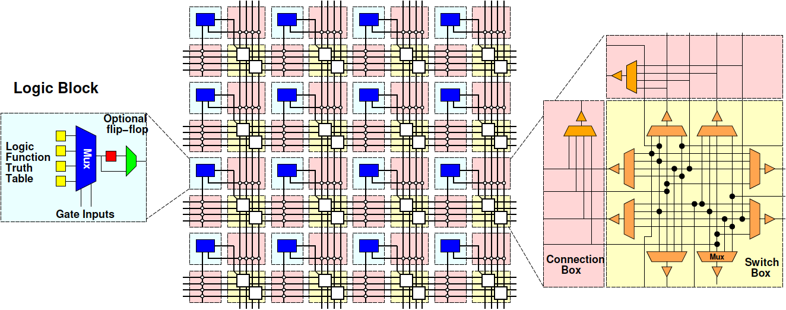
Field-Programmable Gate Array (FPGA)

Slide 71
Next Lab
Program an FPGA in Verilog
  Build an adder
  Build an accumulator
Should have hardware
Will need to install software on your computer

Slide 72
Big Ideas
Can implement any combinational digital logic function from nand2 gates
Can implement any FSM from nand2 gates and registers
Can build a single chip that can be programmed to behave as any collection of gates
  As long as don’t need more gates than it provides

Slide 73
Learn More
CIS240 – do a bit more logic
ESE370 – how to implement gates, latches, and memories from transistors
ESE532 – how to build large-scale computations from logic

Slide 74
Reminder
Formal Lab Report Due Sunday (11:59pm PDT)
Extra Lab Session to help
  Don’t get stuck for hours on any piece
Lecture/Lab Feedback forms in Google Docs
  Linked from syllabus

