Slide 1



Lecture #9 – Operating Systems (OS)
ESE 150 –
Digital Audio Basics
Based on slides © 2009--2020 DeHon

Slide 2
Motivation
What things can your phone do while you are listening to an MP3?

Slide 3
Observation
We want our devices (including our phones) to do many things at once.

Slide 4
Multiple tasks
We could…
  Dedicate a separate processor for every task we want to perform
How many would we need?
Maybe
  Need dozen processors for our Phone

Slide 5
But….
MP3 Play
  44,000 samples per second decoded
  500 cycles to decode a sample
  How many instructions per second require?
What fraction of a 10⁹ instruction per second processor does this use?

Slide 6
Observation
If we dedicate a processor to MP3 decoding
  It will sit idle most of the time
MP3 decoding (and many other things) do not consume a modern processor
Idea: Maybe we can share the processor among tasks?

Slide 7
Outline
Setup Need / Opportunity
Where are we
Role of Operating System
Virtualization

Slide 8
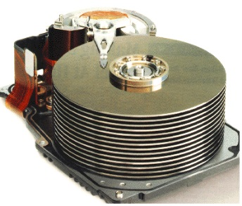










Course Map
7,8,9
10101001101
MIC
CPU
File-
System
A/D
10
10101001101
NIC
Music
1
domain
conversion
5,6
Numbers correspond to course weeks
compress
sample
freq
pyscho-
acoustics
3
2
4
13
11
EULA
----------------click
OK
D/A
NIC
speaker
MP3 Player / iPhone / Droid
12

Slide 9



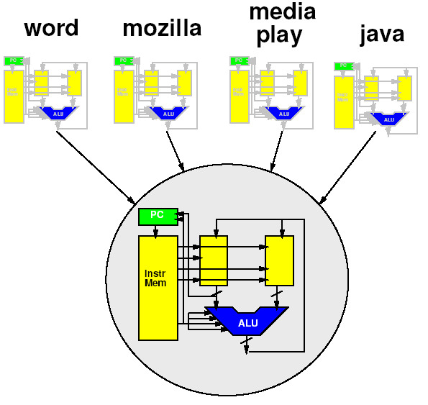
Course Map – Week 10
MIC
A/D
Music
1
domain
conversion
5,6
Numbers correspond to course weeks
compress
sample
freq
pyscho-
acoustics
3
2
4
EULA
----------------click
OK
D/A
10101001101
speaker
MP3 Player / iPhone / Droid

Slide 10
“Stored-Program” Processor
By filling in memory, can program to perform any computation

Slide 11
Role of Operating System

Slide 12
Programming the Processor
Think about: How do we change the program in the memory
  What if had to reboot machine… for every application?
  Change flash card
  Download over USB
    …that is what we have to do for the Arduino…

Slide 13
More than one Program?
How could we have multiple applications?
  (just run one at a time for now)

Slide 14
Coordination?
Does every program need to
know about every other
program?
  Implications and Viability?
IoT device that runs
3 unchanging tasks?
Smart phone that allows
3rd party apps
  Think: AppStore, Google Play

Slide 15
Role of Operating System
Higher-level, shared support for all programs
  Could put it in program, but most programs need it!
  Needs to be abstracted from program
Resource sharing
  Processor, memory, “devices” (net, printer, audio)
Polite sharing
  Isolation and protection
  Fences make Good Neighbors – R. Frost
Idea: Expensive/limited resources can be shared in time – OS manages this sharing

Slide 16
Virtualization

Slide 17
Virtualization
Providing an abstract view separate from the physical view
Hides physical view
Provides abstract view to software
  Abstract from physical resource limits

Slide 18
Idea
Virtualize the processor
  Make it look like we have multiple processors
  With each program running on its own processor
“Own” processor
  Can put data in memory where it wants
  Doesn’t have to worry about another program scribbling over its memory
  Its state is preserved and isolated
  Looks like it runs all the time on the processor
    Doesn’t need to be programmed to allow other programs to run

Slide 19
Terminology: Process
Process
  A virtualization of the physical processor
    an instance of a program in execution
  Virtual processor

Slide 20
What does our program see?
Physically
  One processor
    One PC
    One data memory
    One instruction memory
  These are its state
    Terminology: context

Slide 21
Executing the Program
To execute program
  Keep track of state of machine
    Value of counter
    Contents of instruction memory
    Contents of data memory
(Program counter)

Slide 22
Preclass: Execution Exercise
We’re going to simulate the computer and watch the processor state

Slide 23
Execution: Getting Started
0
5
35
255
66
1
5
35
0
66
2
5
1
0
66

Slide 24
Execution Exercise
Simulate one of the 2 cases (as indicated on your worksheet) for the 12 cycles shown.

Slide 25
Execution Exercise
What is the state for the +12 cycle? (A, B)
What is the state for the +6 cycle? (A, B)

Slide 26
One Processor, One Program
On the physical machine, can only run one program
  Why?
    One PC
    One memory

Slide 27
Virtualization
Make it look like we have multiple resources
  Multiple processors
Provide abstraction of large* number of processors
  Each program gets its own processor
    Each program gets its own machine state
  * “large” enough to approximate infinite

Slide 28
Virtualization

Slide 29
Key Idea
Can capture state of a processor
  All the information that defines the current point in the computation

Slide 30
Remember
State of the processor
  Value of Program Counter (PC)
  Contents of instruction memory
  Contents of data memory

Slide 31
Key Idea
Can capture state of a processor
  All the information that defines the current point in the computation
  i.e. program counter, data and instruction memory
Can save that in memory
  A different memory from what the process sees
  (could be different range of addresses)
Fully represents the running program
Can restore that from memory to the processor
Can save/restore without affecting the functional behavior of the program

Slide 32
State in Memory

Slide 33
Sharing Processor
Now that we can save/restore the state
Can share processor among processes
  (Restore state; run for time; save state)
Isolation: none of the processes need to know about each other
  Each thinks it has the a whole machine
  Just need to restore/save state
  around epochs where the process
  gets to run on the processor

Slide 34
Memory?
“save all of memory” ?
  Must have more memory
  Enough to hold all the memory of all the running programs == all the processes
Each program has view that it owns machine
  Each may put program in same place?
  Shouldn’t have to know about other programs, where they use memory

Slide 35
Saving Memory?
Each program has view that it owns machine
  Each may put program in same place?
  Shouldn’t have to know about other programs, where their stacks are…
Could:
  Have programs operate 0…max_process_mem
  Copy data in and out of this range
  Keep elsewhere
    more memory not visible to program
    On disk

Slide 36
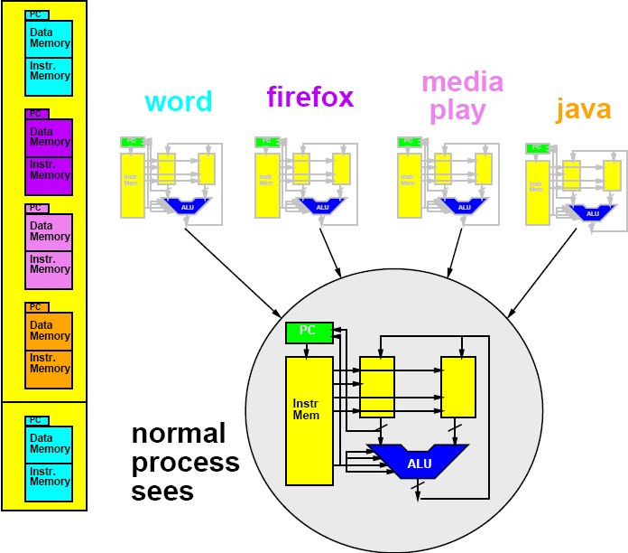
Memory Save/Restore
Memory Save/Restore

Slide 37
Memory Save/Restore
Memory Save/Restore
Save

Slide 38
Memory Save/Restore

Slide 39
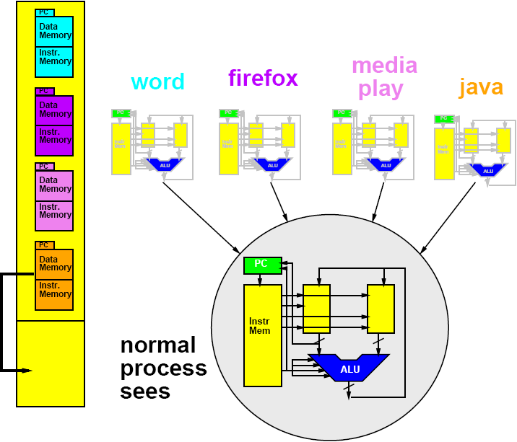
Memory Save/Restore
Restore

Slide 40
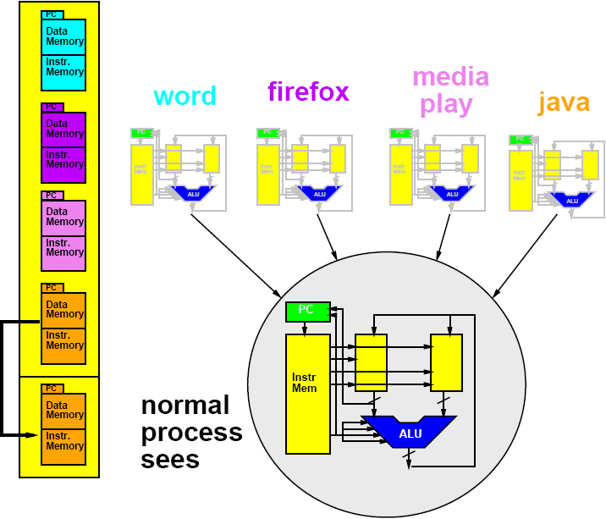
Memory Save/Restore
Restore

Slide 41
Saving Memory?
Each program has view of it owns machine
  Each may put program in same place
  Shouldn’t have to know about other programs…
    where their stacks are…etc.
Can do better
  Avoid copying
  Virtualizing Memory as well
    Translate processor addresses

Slide 42
Process Base Offset Register
Add Offset Register
  Holds base of memory space for process
Add this to all memory references
Change memory seen by process by changing offset regsiter

Slide 43
Management Program
Need another program → process
  Manage swap of running processes
  Decide what to run next
  Decide when to stop a process
…process manager/scheduler

Slide 44
Time-Sliced Sharing
Simplest version:
  Run each process for 10,000 cycles
  Then swap to next process
  Looks like each of n process runs on a processor 1/n-th the speed of the real processor
More sophisticated:
  Assign uneven time to processes
  Also change when process…
    waits for input
  What are cases where
    Uneven time appropriate?
    Valuable to switch on input?

Slide 45
Time Switch Exercise Demo
Simulating a case:
Processor runs A for 6 cycles
  Then stores off to memory.
Processor runs B for 6 cycles
  Then stores off to memory
Processor reads A state from memory and runs for another 6 cycles
Processor reads B state from memory and runs for another 6 cycles
What should happen? (results should we get?)

Slide 46
Time Switch Exercise
Flip to back of Preclass worksheet
Write down the +6 cycle state from the opposite case
  This is your “swap back in” of task

Slide 47
Time Switch Exercise
Simulate from +6 cycles
What is the state for the +12 cycle?
Compare earlier solutions

Slide 48
Review: Key Idea
Can capture state of a processor
  All the information that defines the current point in the computation
  i.e. program counter, data and instruction memory…
Can save that in memory
  A different memory from what the process sees
  (could be different range of addresses)
Fully represents the running program
Can restore that from memory to the processor
Can save/restore without affecting the functional behavior of the program

Slide 49
iPod Processor
Early based on PortalPlayer series
  Two ARM7TDMI cores
  80MHz each
Guesses are ARM7 or ARM8

Slide 50
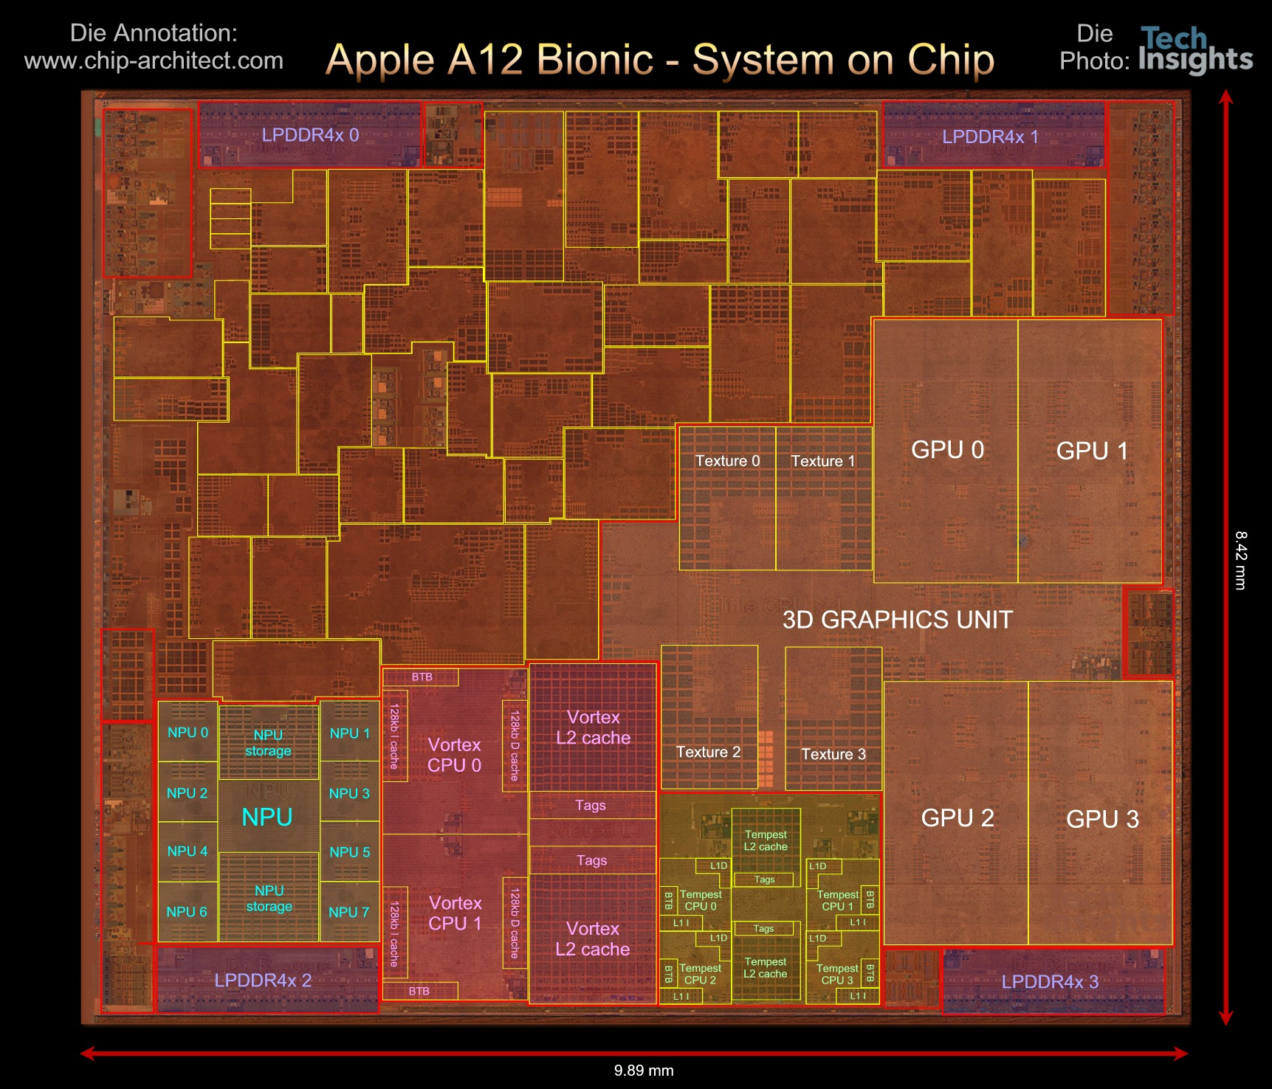

Slide 51
Apple A12
84mm², 7nm
7 Billion Tr.
iPhone XS
6 ARM cores
  2 fast
  4 low energy
4 custom GPUs
Neural Engine
  5 Trillion ops/s?

Slide 52
Upcoming Lab
Explore linux OS and processes on linux
  See processes sharing processors
  Lab out

Slide 53
Big Ideas
Virtualize hardware
  Identify state; save/restore from memory
Program view: owns complete machine
Allows programs to share limited physical hardware (e.g. processor)
  Provide illusion of unlimited hardware
Operating System is the program that manages this sharing

Slide 54
Learn More
CIS380 – Operating Systems

