Slide 1
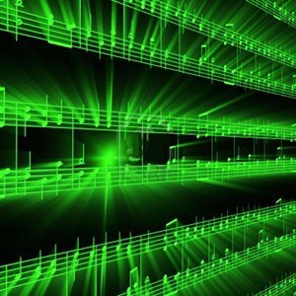


Lecture #12 – User Interface
ESE 150 –
Digital Audio Basics

Slide 2
User Interface
When a user sees a product
  See the interface
  Not the underlying design
    ….and that’s the way it should be
Interface determines if the user can get job done
  …or will walk away frustrated
Successful interface
  Make it easy, pleasant to use
  Hide all the complexity that makes it work

Slide 3
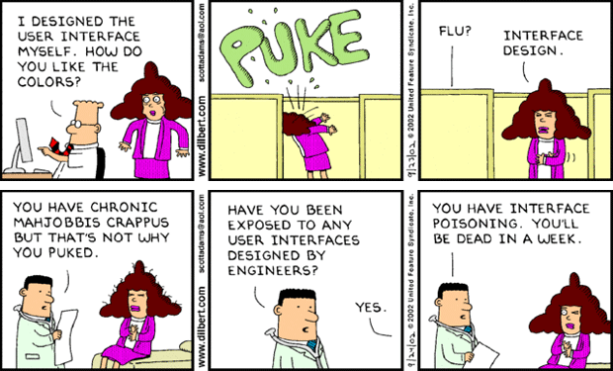
Dilbert Diagnosis
http://dilbert.com/strip/2002-09-23
http://dilbert.com/strip/2002-09-24

Slide 4
Lecture Topics
Where are we on course map?
User Interface
  Motivation
  Issues and Principals
  Developer vs. User
  Design Choices
  Approaches and Prototyping
  Advancing/Enabling Technology

Slide 5
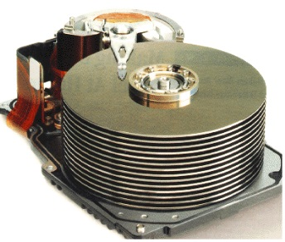










Course Map
7,8,9
10101001101
MIC
CPU
OS/File-
System
A/D
10
10101001101
NIC
Music
1
domain
conversion
6
Numbers correspond to course weeks
compress
sample
freq
pyscho-
acoustics
3
2,5
4
13
11
EULA
----------------click
OK
D/A
NIC
speaker
MP3 Player / iPhone / Droid
12

Slide 6
Course Map
7,8,9
10101001101
MIC
CPU
OS/File-
System
A/D
10
10101001101
NIC
Music
1
domain
conversion
6
Numbers correspond to course weeks
compress
sample
freq
pyscho-
acoustics
3
2,5
4
11
EULA
----------------click
OK
D/A
NIC
speaker
MP3 Player / iPhone / Droid
12

Slide 7
Dilbert Diagnosis
http://dilbert.com/strip/2002-09-23
http://dilbert.com/strip/2002-09-24

Slide 8
Self Awareness
I’m an Engineer
I have a different perspective and understanding of technology than lay public
My view of what’s obvious/non-obvious probably not representative of intended user base
…how do I (or team I’m in) compensate for that?
This lecture, I’m talking about my weakness
  And need for help
  Not my strength
  Won’t do justice with solution…but maybe in raising issues, need for help
Nonetheless, I am frustrated by bad design from others as much as anyone else…
  Want “us” to do better.

Slide 9
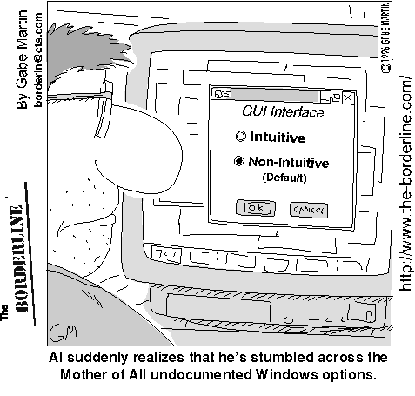
The Problem is that Humans are Half of the User Interface
http://www.nevtron.si/borderline/archive2/intuiti.gif

Slide 10
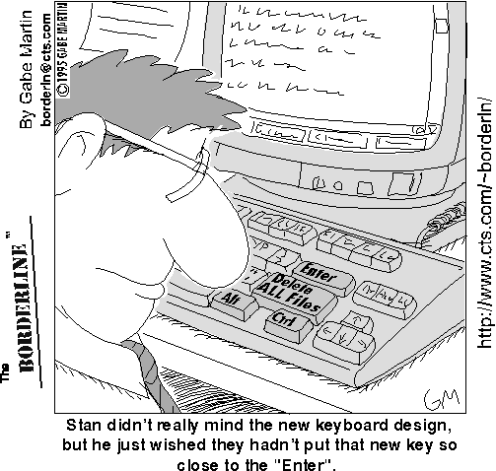
And Even if Intuitive and Clear, User Interface Might not be so Good…
http://www.nevtron.si/borderline/delete.gif

Slide 11
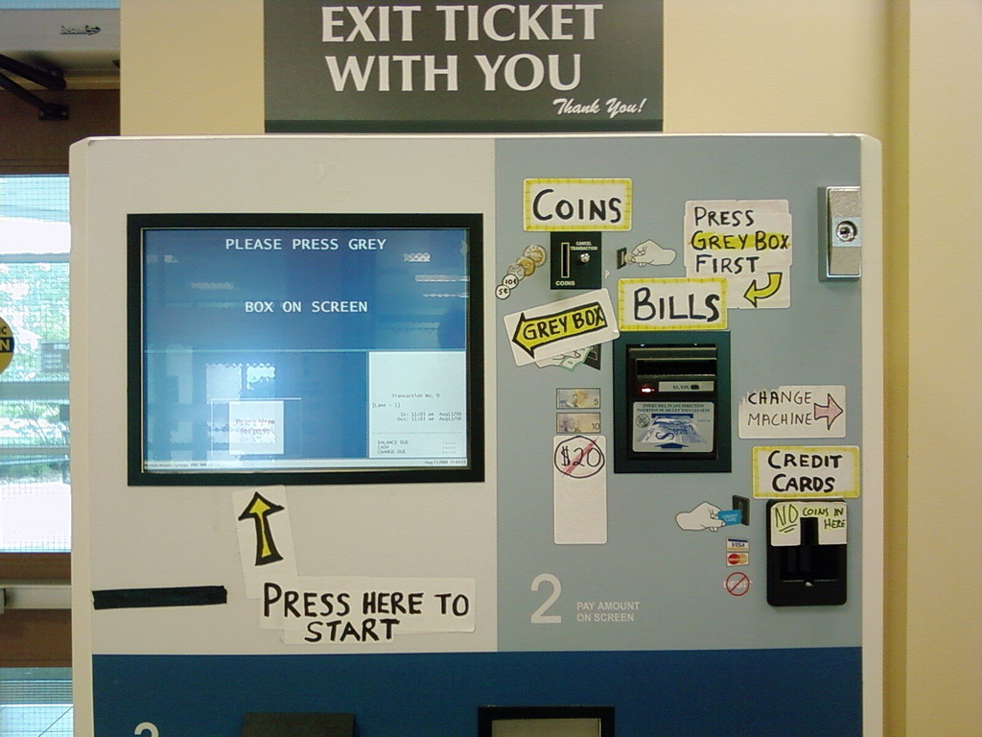
And it’s not just about our Workstation Interfaces…
http://www.uselog.com/2008/11/users-fix-parking-ticket-machine-ui.html

Slide 12
Who’s to Blame for Usability Failures?
Most Returned Products Work Fine: Study Says Only 5 percent of returned products are genuinely defective: Yardena Arar, PC World, June 2, 2008 4:00 pm
Only 5 percent of consumer electronics products returned to retailers are malfunctioning --yet many people who return working products think they are broken, a new study indicates.
The report by technology consulting and outsourcing firm Accenture pegs the costs of consumer electronics returns in 2007 at $13.8 billion in the United States alone, with return rates ranging from 11 percent to 20 percent, depending on the type of product.
http://www.pcworld.com/article/146576/most_returned_products_work_fine_study_says.html

Slide 13
UI Examples: BAD
Examples of infuriating / bad UIs?

Slide 14
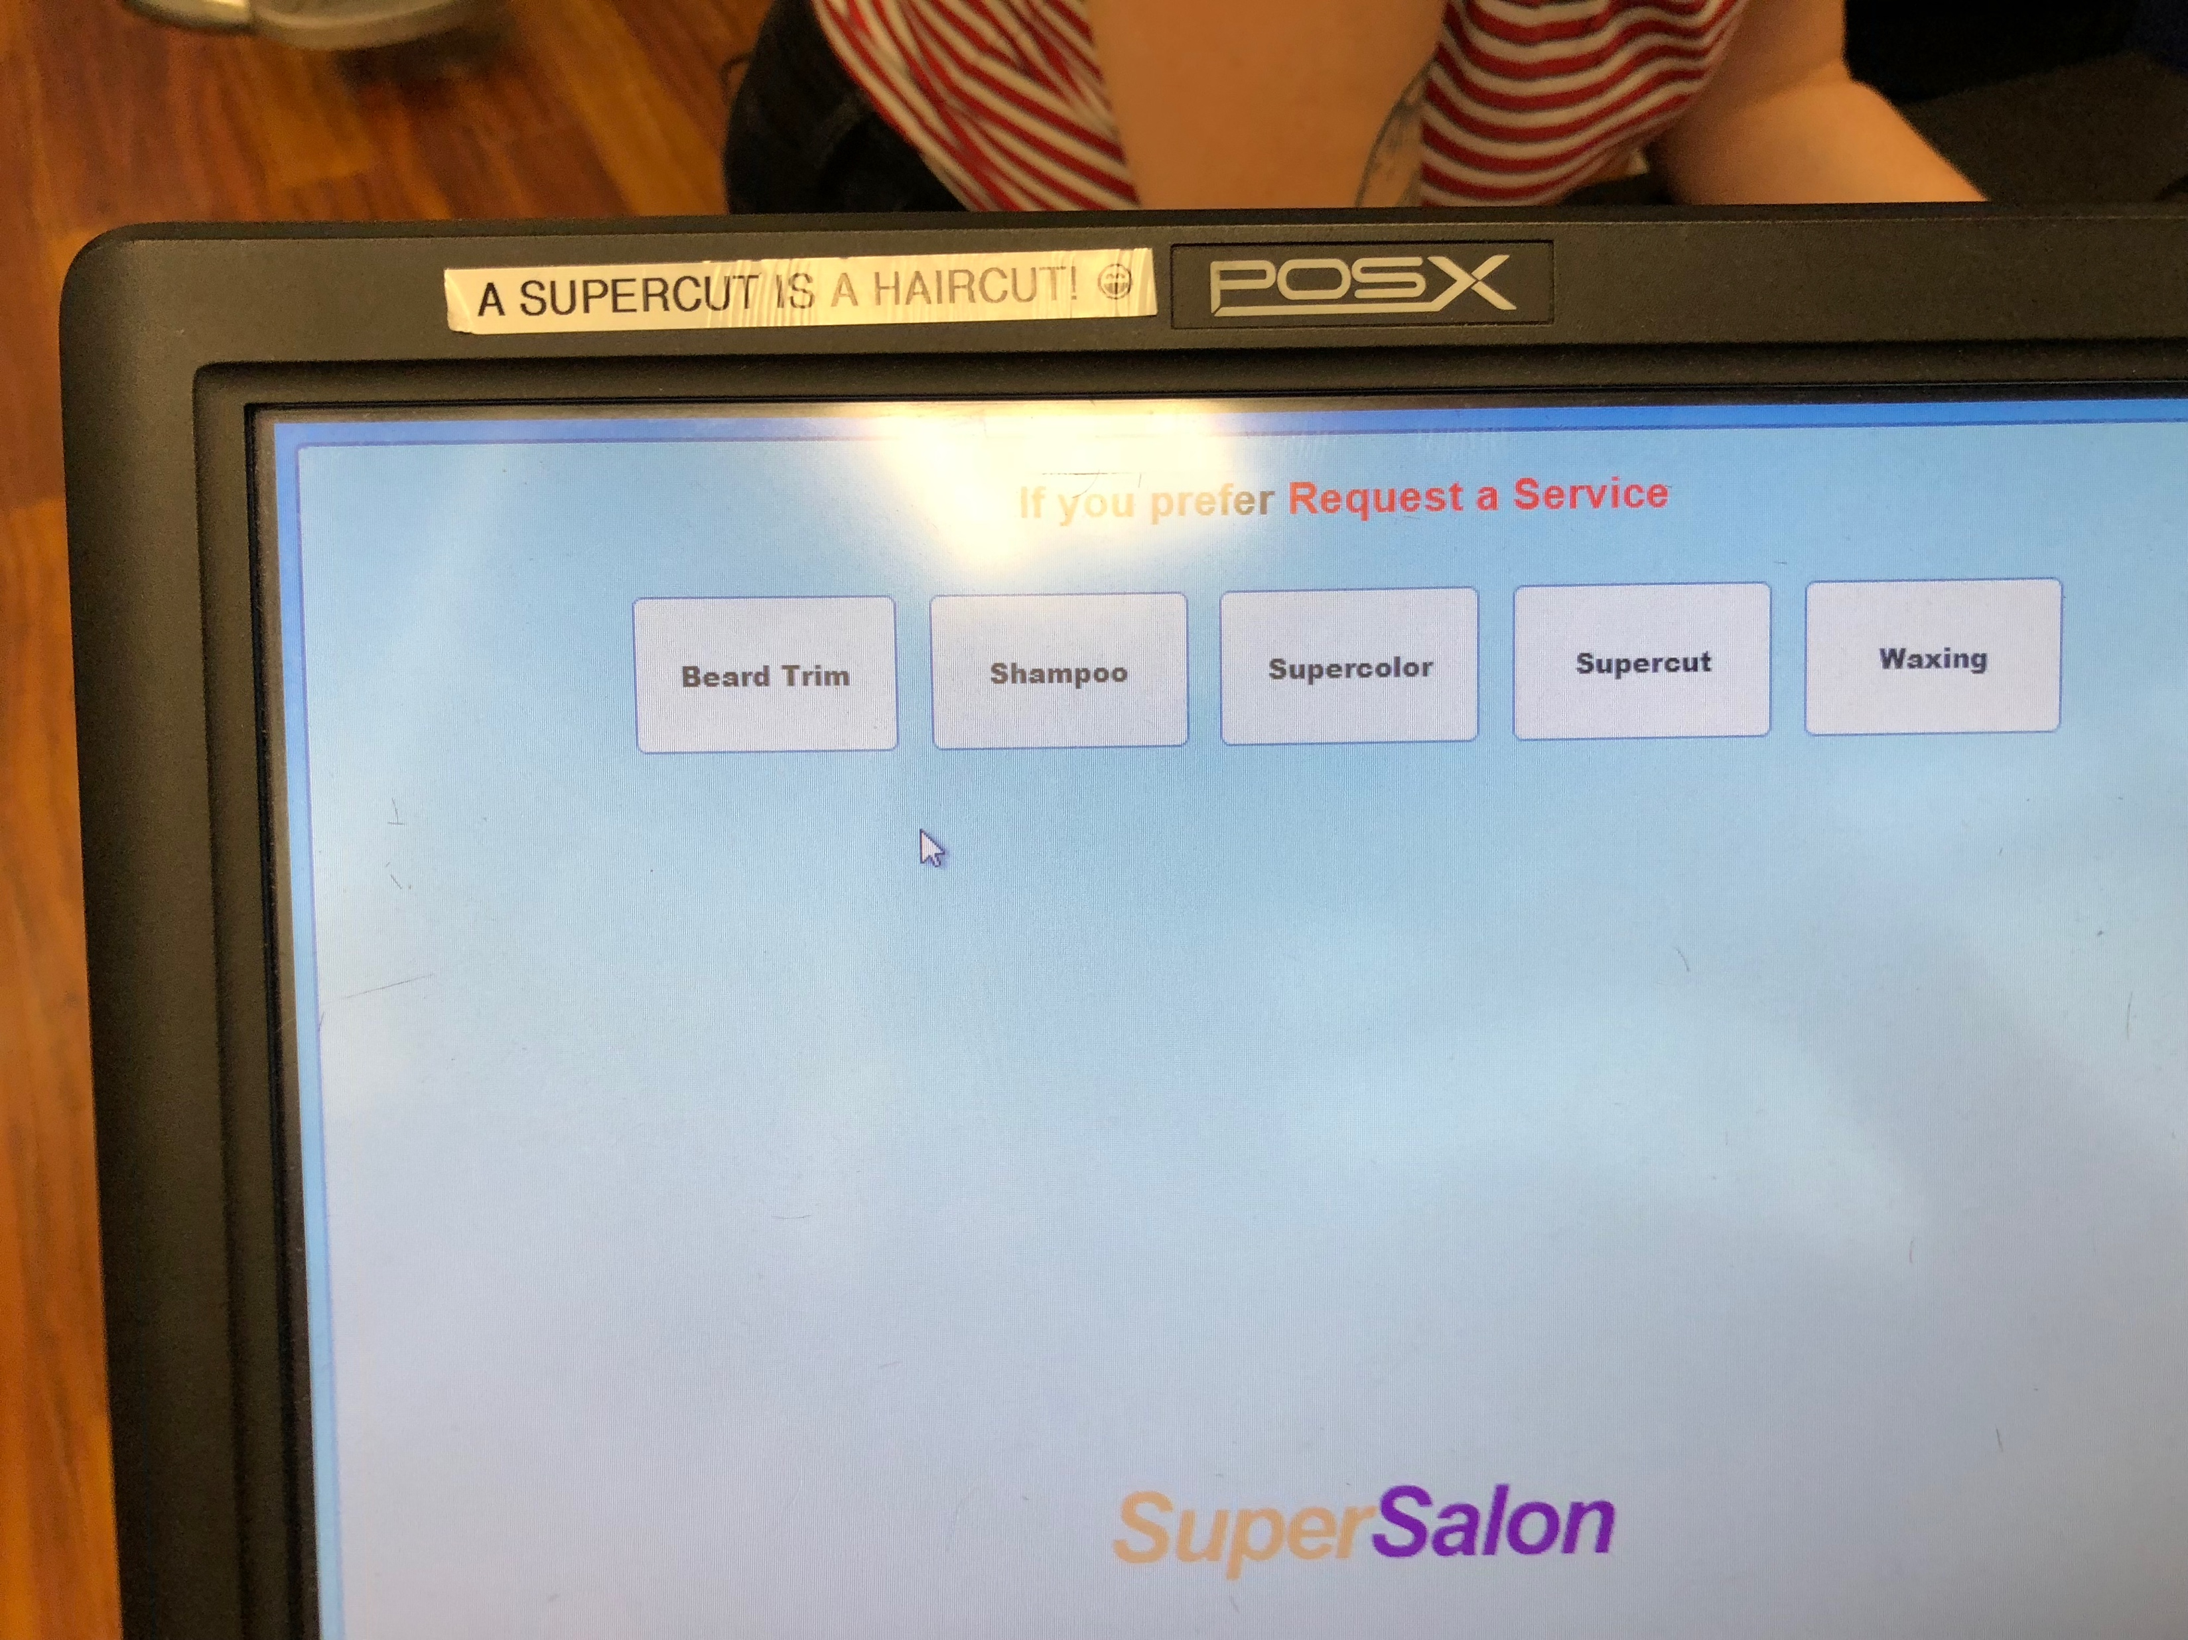
Local Example

Slide 15
UI Examples: Good
Examples of pleasant/good UIs?

Slide 16
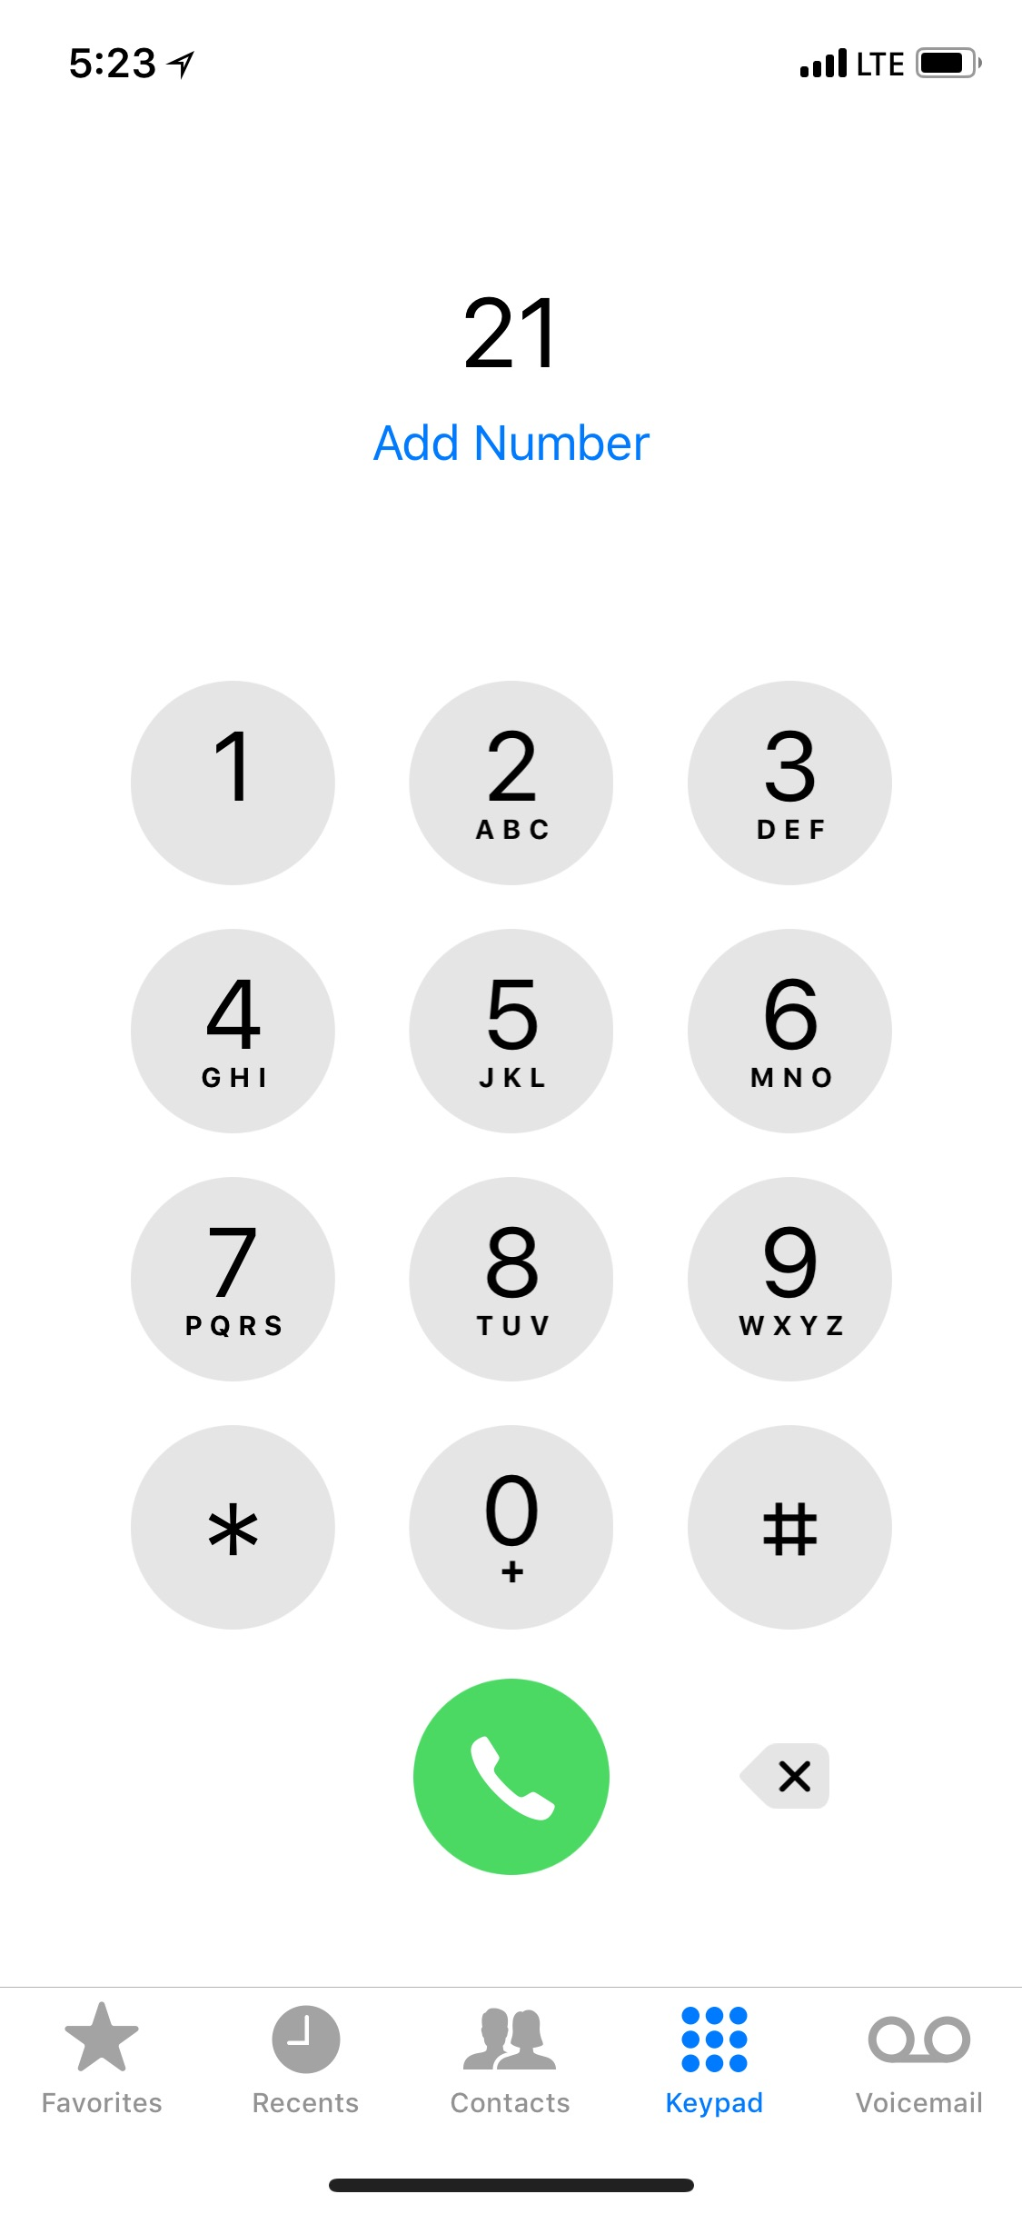
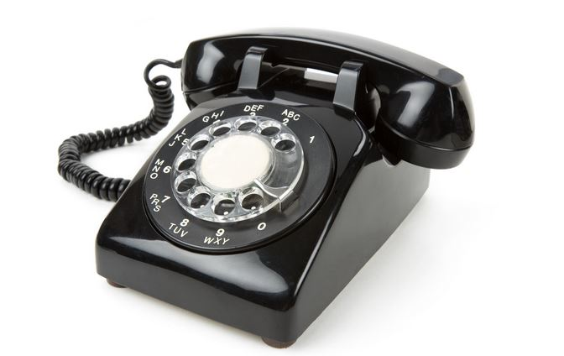
Phone
How is a cell-phone dialing interface better than a conventional POTS phone?
…and how often do you dial on a cell phone?
  Alternative? Better?
How cell phone interface worse?

Slide 17
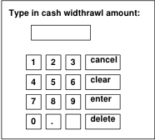
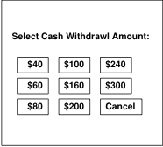
Preclass 2
Which interface easier? Why?
  Limit to vend $20, $300/day

Slide 18
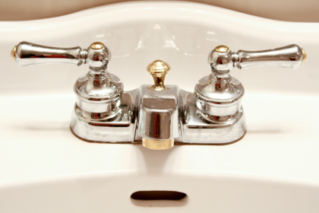
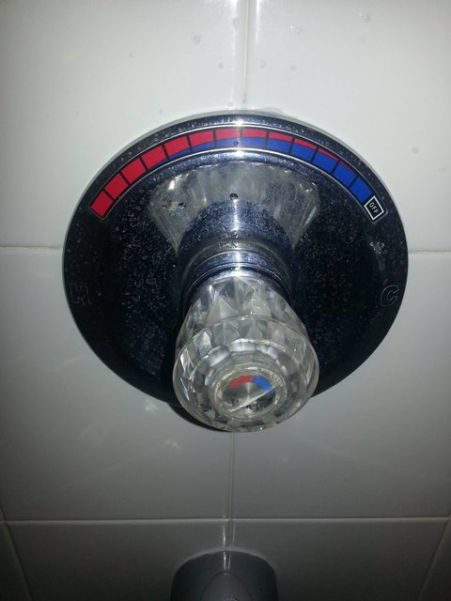
Hot/Cold Water Interface
Old: two knobs
  Hot
  Cold
Newer: one knob
  Tune heat
  (maybe also volume)
Why built this way?

Slide 19
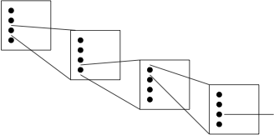
Make common case fast
…not buried deep in menus
  Minimize mouse clicks?

Slide 20
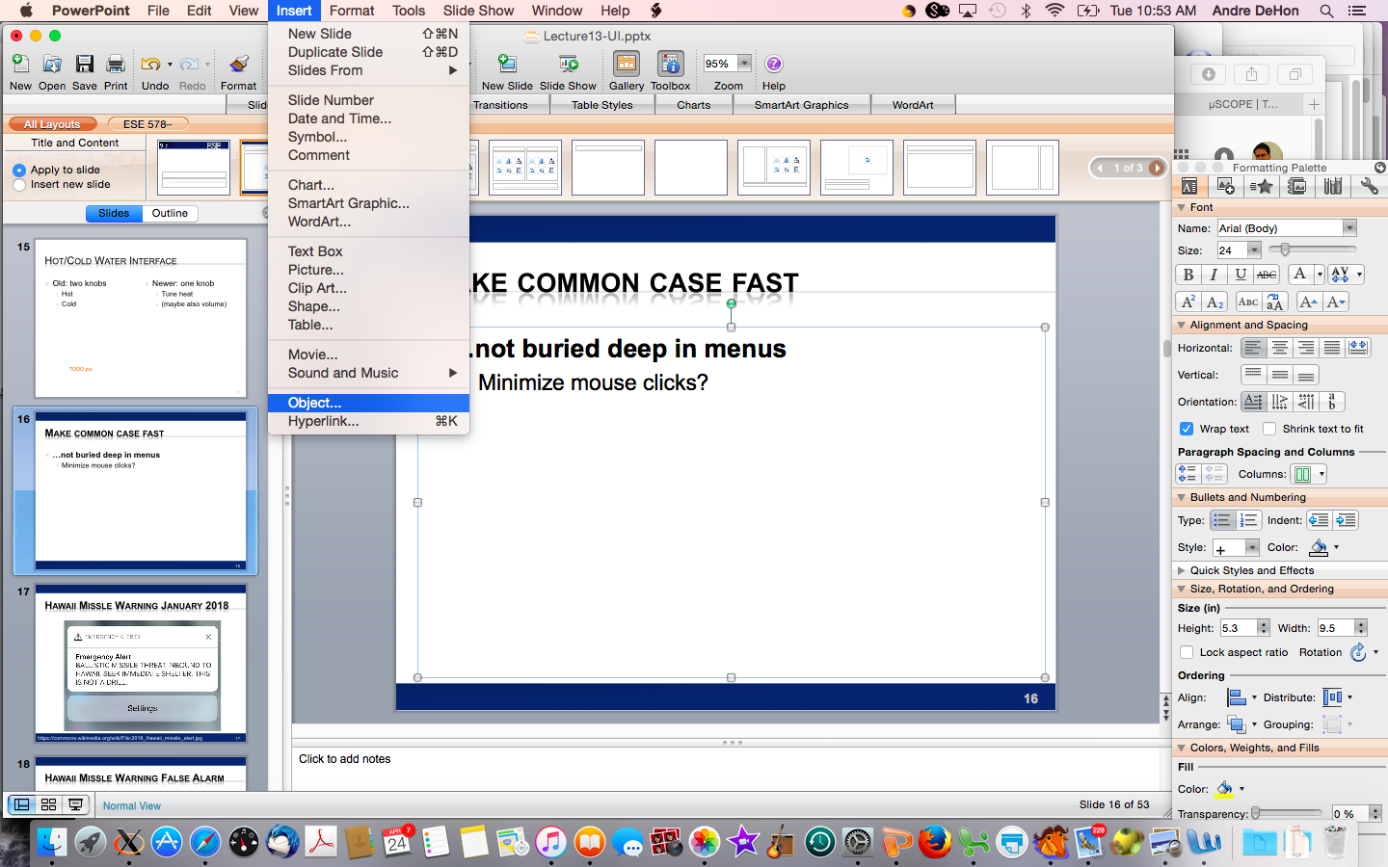
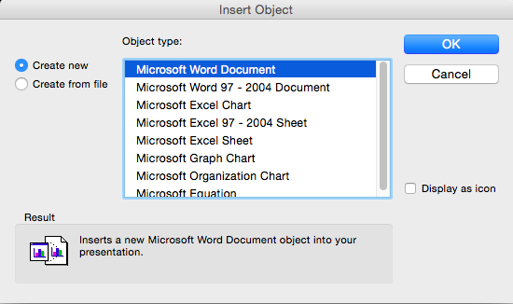
Power Point: Add Equation

Slide 21
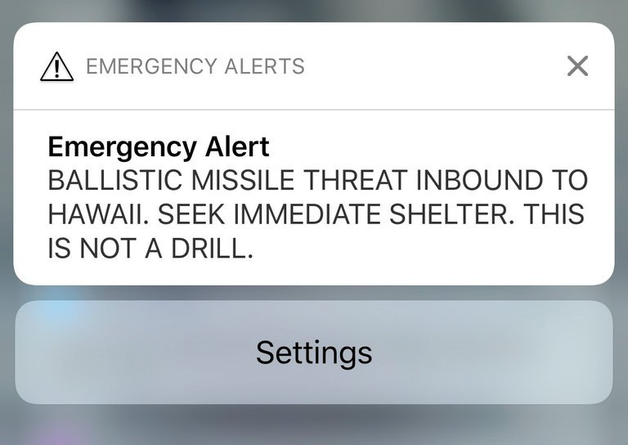
Hawaii Missle Warning January 2018
https://commons.wikimedia.org/wiki/File:2018_Hawaii_missile_alert.jpg

Slide 22
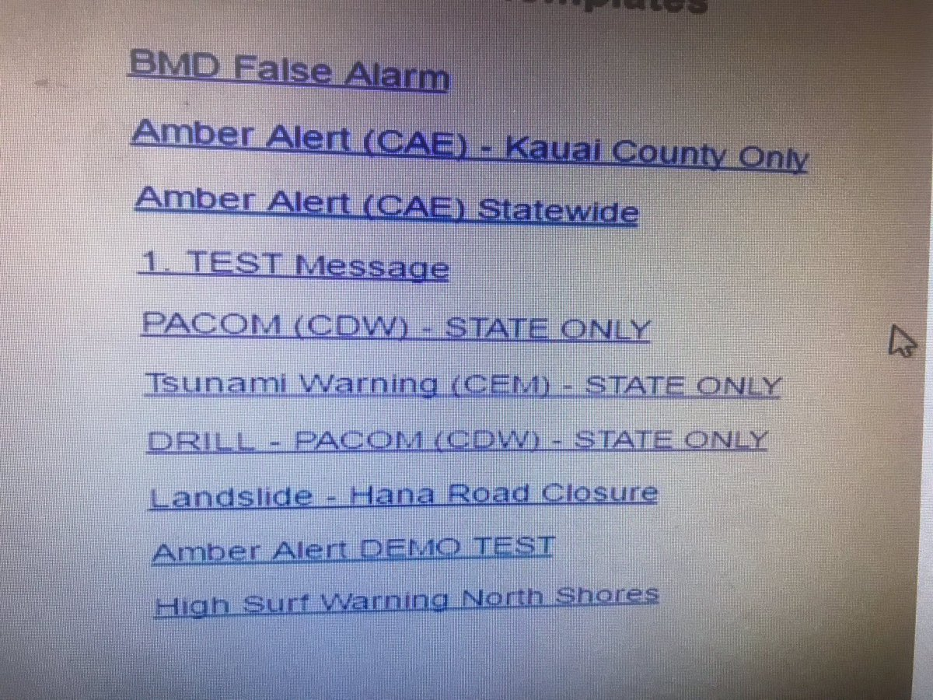
Hawaii Missle Warning False Alarm
Added after
incident
What selected
What intended
https://www.theverge.com/2018/1/16/16896368/hawaii-false-missile-alert-system-confusing-interface-poor-design

Slide 23
Issues to be concerned with?

Slide 24
Issues
Time to learn
Easy to figure out how to use
Clarity of what happened
  Why something didn’t happen
Safety
Time to perform task
Ease of recovery
User stress

Slide 25
Donald Norman: UI Guru
Referring to Norman’s book: Design of Everyday Things
Visibility – visible functions aid user awareness; invisible functions are more difficult to find and know how to use.
Feedback – return information about what action has been done and what has been accomplished.
Constraints – restricting the kind of user interaction that can take place at a given moment.
Mapping – the (functional, geometric, appearance) relationship between controls and their effects in the world.
Consistency – use similar operations and use similar elements for achieving similar tasks.
Affordance – an attribute of an object that allows people to know how to use it.
Add: Tolerance – reducing cost of mistakes, allowing recovery.
http://twobenches.wordpress.com/2008/06/05/don-normans-design-principles/

Slide 26
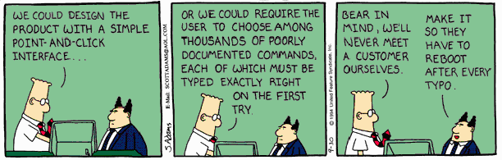
Interface Design

Slide 27
Constantine and Lockwood
The structure principle. Your design should organize the user interface purposefully, in meaningful and useful ways based on clear, consistent models that are apparent and recognizable to users, putting related things together and separating unrelated things, differentiating dissimilar things and making similar things resemble one another. The structure principle is concerned with your overall user interface architecture.
The simplicity principle. Your design should make simple, common tasks simple to do, communicating clearly and simply in the user’s own language, and providing good shortcuts that are meaningfully related to longer procedures.
The visibility principle. Your design should keep all needed options and materials for a given task visible without distracting the user with extraneous or redundant information. Good designs don’t overwhelm users with too many alternatives or confuse them with unneeded information.
The feedback principle. Your design should keep users informed of actions or interpretations, changes of state or condition, and errors or exceptions that are relevant and of interest to the user through clear, concise, and unambiguous language familiar to users.
The tolerance principle. Your design should be flexible and tolerant, reducing the cost of mistakes and misuse by allowing undoing and redoing, while also preventing errors wherever possible by tolerating varied inputs and sequences and by interpreting all reasonable actions reasonable.
The reuse principle. Your design should reuse internal and external components and behaviors, maintaining consistency with purpose rather than merely arbitrary consistency, thus reducing the need for users to rethink and remember.
http://www.ambysoft.com/essays/userInterfaceDesign.html

Slide 28
Interaction Styles
Style | Main Advantages | Main Disadvantages | Applications
Direct manipulation | Fast and intuitive interaction; easy to learn | Only suitable where there is a visual metaphor for tasks and objects | Video games; CAD systems
Menu selection | Avoids user error; little typing required | Slow for experienced user; can become complex if many menu options | Most general purpose systems
Form fill-in | Simple data entry; easy to learn; checkable | Takes up much screen space; causes problems where user options do not match the form fields | Ordering
Command language | Powerful and flexible | Hard to learn; poor error management | Operating systems, command and control systems
Natural language | Accessible to casual user; easily extended | Requires typing; NL understanding systems may be unreliable | Information retrieval and Q/A systems
Ian Sommerville: Software Engineering, 7th Ed., 2004

Slide 29
Implementer vs. User

Slide 30
User vs. Implementer
Thesis: Engineer who implements something is seldom the right person to judge the goodness of the user interface
  Knows how should work
  Has a mental model of inner workings
  Motivated to reduce implementation complexity
Contrast user
  Doesn’t know how works – shouldn’t have to?
  Benefit from reduced use complexity
    Reduced cognitive load

Slide 31
Foolproof quote
You cannot make something foolproof,
because fools are so ingenious!
  George Cox

Slide 32
example (Foolproof)
Coders: The Making of a New Tribe and the Remaking of the World
  Clive Thompson
  "It turns out a user had made a mistake. Someone out there had used the service to find their balance, as is normal. But instead of inputting their card [phone] number—which is what they were supposed to do—the user had accidentally sent in the number of the phonebot service itself. So the software got stuck in a loop. “The service was texting itself back and forth, back and forth, back and forth,” Guarino says. It was, he admits, ultimately his mistake, a flaw in how he’d written the code for the textbot. He could have easily written a rule checking to make sure that someone didn’t accidentally text the bot its own phone number. But it never occurred to him that a real live person would ever do that. “Users,” he says ruefully, “will find a way.” You might think you’ve stamped out your bugs, but they find new ones."

Slide 33
Issue
Hard to put aside what you know and see how it will look to an uninitiated user
How could anyone not know?
  When program crashes, it leaves a lock file around that needs to be cleaned up…
    Happens to ESE150 students in Detkin!
  Naming a variable “foo-bar” might be interpreted as subtraction
  “NC” means not connected
    (user named their next state variables NA NB NC ND)
Why would anyone
  Put a ’ in a name?

Slide 34
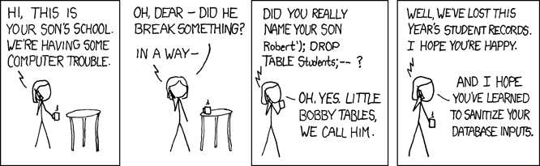
Why would anyone
https://xkcd.com/327/

Slide 35
Approach

Slide 36
Donald Norman: UI Guru
Referring to Norman’s book: Design of Everyday Things
Visibility – visible functions aid user awareness; invisible functions are more difficult to find and know how to use.
Feedback – return information about what action has been done and what has been accomplished.
Constraints – restricting the kind of user interaction that can take place at a given moment.
Mapping – the (functional, geometric, appearance) relationship between controls and their effects in the world.
Consistency – use similar operations and use similar elements for achieving similar tasks.
Affordance – an attribute of an object that allows people to know how to use it.
Add: Tolerance – reducing cost of mistakes, allowing recovery.
http://twobenches.wordpress.com/2008/06/05/don-normans-design-principles/

Slide 37
How use Principles and Goals?
Principles are generally:
Descriptive, comparative and analytical (i.e., how alternatives compare; test and refine paradigm)
  Give us some idea how to evaluate a UI
Not constructive (i.e., do not define the process of developing user interface design)
  No automated (good) interface design tools exist (e.g., that could have predicted the iPod user interface design)

Slide 38
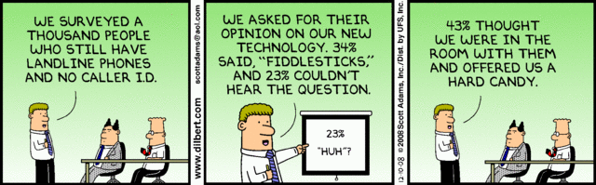
Principles Must Be Considered in the Context of User Population
Principles define an optimization problem where the (target) user population is not uniform in skill, cognitive ability, needs, experience, learning style, or motivation.
http://dilbert.com/strip/2008-12-10

Slide 39
Task-Centered Design
Identify users
Analysis
Note ESSENTIAL iterative loops!
Choose tasks
Look at other
systems
Turn tasks
into scenarios
Design
Turn scenarios
into storyboards
Evaluate
Make sure testers are REAL
users from REPRESENTATIVE user populations, not just SELF!
Build the design
Evaluate
Implementation
http://www.comp.rgu.ac.uk/staff/sw/materials/cm2006/Interface%20design.L4.ppt
Notes:
We briefly looked at task-centred design a couple of weeks earlier, in Lecture 02. Now we’re going to look at the method in a bit more detail, and try to turn it into a complete design method that you can use to transform ideas into a complete and effective interface design. If you want, you can even implement it!!
The animation shows how you can consider the different parts of the interface design process. It is worth noting that there isn’t usually a clear boundary between analysis and design in this kind of task-centred process. We’ll look at why in a moment. There is definitely a blurred boundary between design and implementation, because evaluation refines the design even as the implementation progresses.

Slide 40
User Analysis
If you don’t understand what the users want to do with a system, you have no realistic prospect of designing an effective interface.
User analyses must be described in terms that users and other designers can understand.
  E.g. -- Scenarios where you describe typical episodes of use
Ian Sommerville: Software Engineering, 7th Ed., 2004

Slide 41
Analysis Techniques
Task analysis
  Models the steps involved in completing a task.
Interviewing and questionnaires
  Asks the users about the work they do.
Ethnography
  Observes the user at work.
Ian Sommerville: Software Engineering, 7th Ed., 2004

Slide 42
Task Analysis
Need to determine what tasks must be accomplished.
Understand user’s intentions: What user wants (or needs) to do, not necessarily how to do it.
Task analysis breaks problem into individual task components.
Top-down task analysis.
Tasks still need to be wrapped in a UI.

Slide 43
Example Task Analysis: Using PowerPoint
0 Prepare a slide
using PowerPoint
Plan 0:
1-2-3-4
1 Start
PowerPoint
2 Enter text
3 Draw
diagrams
4 Save slide
Plan 2: According
to requirements
Further redescribed
Further redescribed
1 Enter text
using keyboard
2 Copy text
from a slide
3 Add text to
existing slide
Plan 2.2:
1-2-3-4
Further redescribed
1 Select text block
2 Choose copy
command
3 Choose insert
position
4 Choose paste
command
Further redescribed
http://www.comp.rgu.ac.uk/staff/sw/materials/cm2006/Interface%20design.L4.ppt
Notes:
Task analysis

Slide 44
Interviewing
Design semi-structured interviews based on open-ended questions.
Users can then provide information that they think is essential; not just information that you have thought of collecting.
Group interviews or focus groups allow users to discuss with each other what they do.
Ian Sommerville: Software Engineering, 7th Ed., 2004

Slide 45
Ethnography
Involves an external observer watching users at work and questioning them in an unscripted way about their work.
Valuable because many user tasks are intuitive and users find these very difficult to describe and explain.
Also helps understand the role of social and organizational influences on work.
Ian Sommerville: Software Engineering, 7th Ed., 2004

Slide 46
Ethnographic Records
Air traffic control involves a number of control ‘suites’ where the suites controlling adjacent sectors of airspace are physically located next to each other. Flights in a sector are represented by paper strips that are fitted into wooden racks in an order that reflects their position in the sector. If there are not enough slots in the rack (i.e. when the airspace is very busy), controllers spread the strips out on the desk in front of the rack.
When we were observing controllers, we noticed that controllers regularly glanced at the strip racks in the adjacent sector. We pointed this out to them and asked them why they did this. They replied that, if the adjacent controller has strips on their desk, then this meant that they would have a lot of flights entering their sector. They therefore tried to increase the speed of aircraft in the sector to ‘clear space’ for the incoming aircraft.
Ian Sommerville: Software Engineering, 7th Ed., 2004

Slide 47
Insights from Ethnography
Controllers had to see all flights in a sector. Therefore, scrolling displays where flights disappeared off the top or bottom of the display should be avoided.
The interface had to have some way of telling controllers how many flights were in adjacent sectors so that they could plan their workload.
Ian Sommerville: Software Engineering, 7th Ed., 2004

Slide 48
Prototyping
Turn scenarios
into storyboards
Evaluate
Build the design
Evaluate

Slide 49
User Interface Prototyping
Aim: allow users to experience the interface.
Without such direct experience,
  it is impossible to judge the usability of an interface.
Prototyping often a two-stage process:
  Early: paper prototypes
  Refine to increasingly sophisticated automated prototypes
Ian Sommerville: Software Engineering, 7th Ed., 2004

Slide 50
Paper Prototyping
Work through scenarios using sketches of the interface.
Use a storyboard to present a series of interactions with the system.
Paper prototyping to get user reactions to a design proposal.
Ian Sommerville: Software Engineering, 7th Ed., 2004

Slide 51
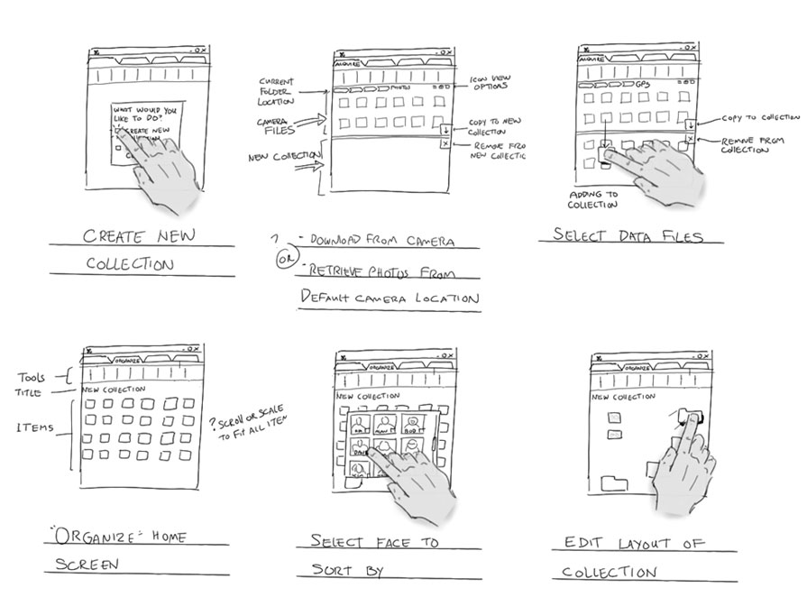
Storyboard
From Microsoft Hilo Chapter 4:
https://msdn.microsoft.com/en-us/library/windows/desktop/ff800706.aspx

Slide 52
Storyboard
Arctouch arctouch.com

Slide 53
Prototyping Techniques
Use PowerPoint as a substitute for an editable script.
  Can include links to different slides/displays
Script-driven prototyping
  Develop a set of scripts and screens using a UI design tool. When the user interacts with these, the screen changes to the next display.
Internet-based prototyping
  Use a web browser and associated scripts.
Visual programming
  Language designed for rapid development such as Visual Basic.
  Python+GTK (will use in lab)
Ian Sommerville: Software Engineering, 7th Ed., 2004

Slide 54
User Interface Evaluation
Some evaluation of a user interface design
should be carried out to assess its suitability.
Full scale evaluation is very expensive and
impractical for most systems.
Ideally, an interface should be evaluated against a usability specification.
  However, it is rare for such specifications to be produced.
Can evaluate against a “design principles” list.
Ian Sommerville: Software Engineering, 7th Ed., 2004

Slide 55
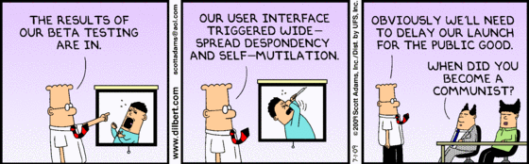
User Testing

Slide 56
Sample Usability Attributes
Attribute | Description
Learnability | How long does it take a new user to become productive with the system?
Speed of Operation (use) | How well does the system response match the user’s work practice and task requirements?
Robustness | How tolerant is the system of user error?
Recoverability | How good is the system at recovering from user errors?
Adaptability | How closely is the system tied to a single model of work?
Ian Sommerville: Software Engineering, 7th Ed., 2004

Slide 57
Technology Change

Slide 58
Preclass 3
How many instructions should we be willing to execute to save a second of human time?
  Cost of second of human time?
    Assume $300K/yr., 250 days/yr, 8 hours/day
  Given Energy cost:
    10⁻¹⁵ cents per instruction
  Number of instructions cost same as human-second?

Slide 59
Impact
Can afford to spend computation to bridge between natural user view (interaction) and underlying implementation view
Energy/op has reduced over time
  Increasing this ratio
Can afford to spend more computation now than in past

Slide 60
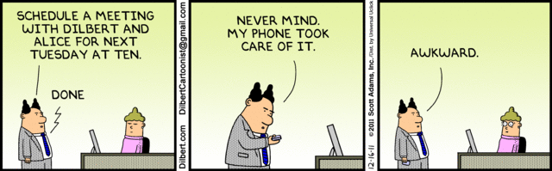
Rise of voice control
Siri
Ok Google
Alexa
Voice Remote
Locally recognize “wake words”
  Ship off to server farm for bulk speech recognition

Slide 61
Preclass 4
How GPS data ease data lookup for bus stop, schedule?
Compared to what must do without GPS data?

Slide 62
Context Awareness
Sense context
  Can reduce information need to explicitly gather from user
  Prioritize/reorder data presented
    Know more about likely common case
Other context examples?

Slide 63
Sensors
Open up new input modes and interaction possibilities

Slide 64
Natural(?) Input
Audio processing
Vision, Radar
Motion (e.g. fitbit, iWatch)
Biometrics
Coupled with signal processing, cheap computation
Opportunity to take input from natural interactions

Slide 65
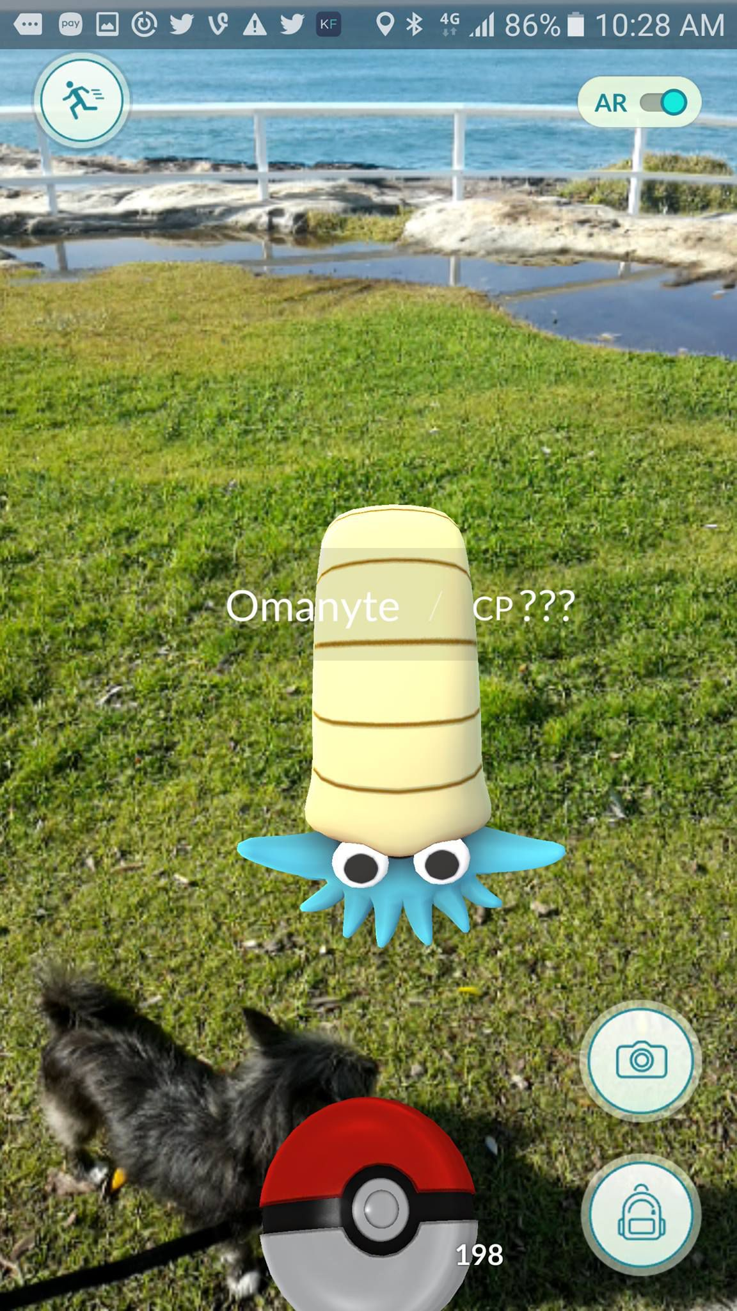
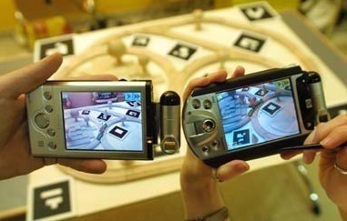
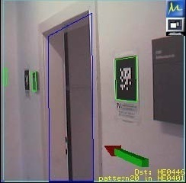
Augmented Reality with Portable Devices (Smartphone)
https://mashable.com/2016/07/10/john-hanke-pokemon-go/#edHFGDBS1kql
Use the embedded camera and overlap synthesized images and animation.
Pokemon Go
Need real-time feature tracking for
registration.
  “Invisible Train”:
  Schmalstieg and
  Reitmayr, 2004
Overlaid
Directions
http://www.youtube.com/watch?v=zOS5Mbk_Iuc

Slide 66
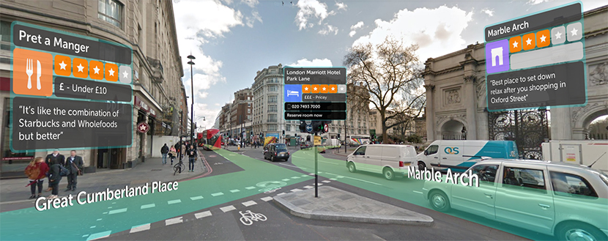
Augmented Reality
(Doctor Who fans: search for augmented reality tardis)
https://blippar.com/en/resources/blog/2017/11/06/welcome-ar-city-future-maps-and-navigation/

Slide 67
Evolution
Dedicated Buttons and Knobs
Keyboard
  With character display
Mouse, graphics
Touch Screens
Accelerometers
Audio, video, …
Augmented Reality
Platforms shrinking
Rooms and Racks
Desktops
Laptops
Tablets/phones
  No physical keyboard
Watch
Glasses?

Slide 68
Big Ideas
User Interface essential
  And worth designing carefully and deliberately
View should match user goals, not internal design
  Spend computing cycles to bridge
  Make simple, safe, intuitive
Implementer seldom a good judge of interface goodness
  Knows too much about how should work
  Conflict of goals
Important to test and get representative user feedback

Slide 69
Next Lab
Develop and analyze User Interface(s) for internet-connected devices
  Networking to control
  Develop GUI
Need to install software
Remember feedback

Slide 70
Final
Monday May 11
  Registrar scheduled 3—5pm
  Will give as Canvas Quiz
    2 hour time limit
    …but can take any time in 24 hr. period of May 11th Eastern time
  Open text, notes, calculators
  Must work alone; no getting help from anyone else
  No communication about test during 24 hour period
    (even not in class or believe to have finished exam)
  Subject to Penn Code of Academic Integrity

Slide 71
Reading
The Design of Everyday Things, Donald Norman -- a classic book on design for usability (broader than just hardware and software)
The Inmates are Running the Asylum, Alan Cooper -- a manifesto calling out computer/software industry for poor design
Set Phasers on Stun: And Other True Tales of Design, Technology, and Human Error, Steven M. Casey -- a series of anecdotes (case-studies) on how bad design and interfaces can go wrong, perhaps even killing people.

Slide 72
Learn More @ Penn
Courses
  ESE543 – Human Factors Engineering

