Slide 1
FUTURE
Ran until 10am (so 5 minutes longer than intended)
  Took questions until 10:05am
  Students asks for
    “More time to ask questions at the end”
Students
  The signal processing algorithm equation was a bit confusing in lecture and in preclass activity.
    -- probably means “idea 2”
  I think today's class pace was a bi slow, however, I feel that this was necessary as we are building foundational concepts that we will work on this semester.
Clarity 0 1 2 4 0 – so no one think crystal clear
Overall 0 0 1 4 2 – not so bad…

Slide 2
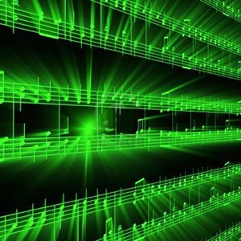
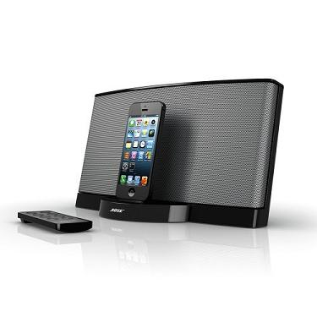
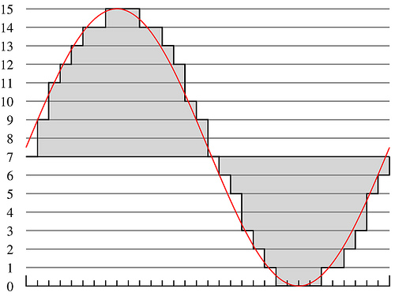
Lecture #2 – A2D
ESE 150 –
Digital Audio Basics

Slide 3
Lecture Topics
Where are we on course map?
Part 1: Sound / Sound Pressure
  Continuous, discrete, ADC, DAC
Part 2: Sampling & Quantization
  Infinite, Continuous signals → Finite, Discrete data in bits

Slide 4
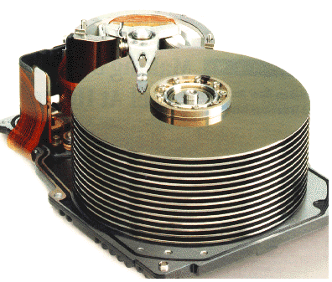
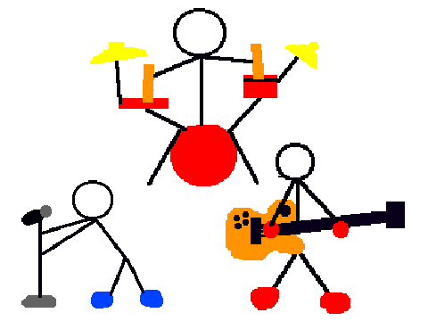
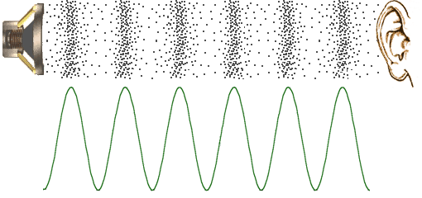
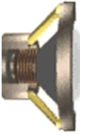


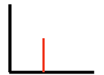
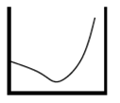



Course Map
7,8,9
10101001101
MIC
CPU
File-
System
A/D
10
10101001101
NIC
Music
1
domain
conversion
5,6
Numbers correspond to course weeks
compress
sample
freq
pyscho-
acoustics
3
2,3
4
13
11
EULA
----------------click
OK
D/A
NIC
speaker
MP3 Player / iPhone / Droid
12

Slide 5
Course Map – Week 1
MIC
A/D
10101001101
Music
1
Numbers correspond to course weeks
sample
2
D/A
10101001101
speaker
MP3 Player / iPhone / Droid

Slide 6
What we’ll Do in Lab
D/A
10101001101
speaker
MP3 Player / iPhone / Droid
Microphones / Speaker:
  Convert pressure waves to electric signal (and reverse)
Sound (in nature):
  a “pressure wave” that changes air molecules w/ respect to time
Sound (in our machine):
  a “voltage wave” that changes amplitude w/ respect to time
MP3 player converted digital signal back to an analog signal
  We will look at “voltage wave” on an oscilloscope

Slide 7
Sound Waves

Slide 8

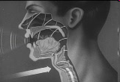
Introduction to Sound
Sound is a pressure wave
http://www.archive.org/details/SoundWavesAn

Slide 9
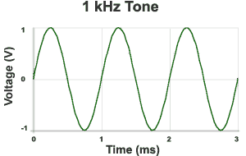

Week 1: Introduction to Sound Waves
Cycle = 1 iteration of sine wave
Hertz (Hz) = 1 cycle per second
1kHz = 1000 cycles/s
Source: http://www.mediacollege.com/audio/01/sound-waves.html

Slide 10
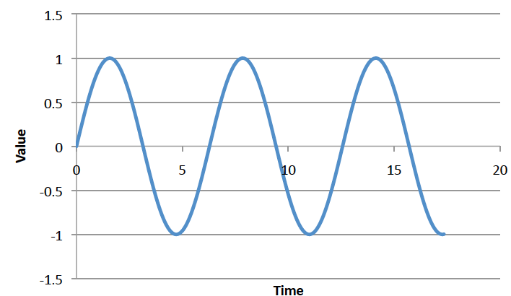
Preclass 1 and 2
Frequency of sine wave?
Relationship between period and frequency?
ms

Slide 11
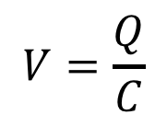

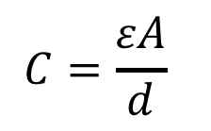
Week 1: Pressure to Voltage
Microphones convert pressure to voltage
  (speakers/headphones voltage to pressure)
  Physical position to voltage
Reason as parallel place capacitor
  ESE 112 or PHYS 151
      Δd → ΔC → ΔV
V
d
$$C=\frac{εA}{d}$$
$$Q=CV$$
$$V=\frac{Q}{C}$$
Voltage is a function of
distance (pressure)
Notes:
Δd → ΔC → ΔV

Slide 12
Signals

Slide 13
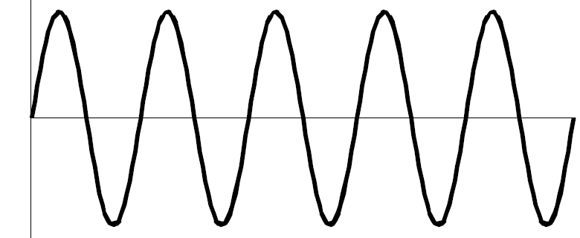
We need to define some terms
What is a signal?
  Something that carries information
  A description of how one parameter depends on another
    Common Engineering Example:
      Voltage that varies with time
        E.g. Amplitude of voltage changes as time moves forward
      Time = independent variable (x-axis): time
        Depends on nothing!
      Voltage = dependent variable (y-axis): v(t)
        Voltage’s amplitude depends on time
v(t)
time

Slide 14
We need to define some terms
Most signals encountered in nature…
  …are “continuous” / analog
    Continuous range of values (any real #)
    Examples: 1) Light intensity that changes with distance
    2) Voltage that varies over time v(t)
      We will see in lab this week: MUSIC signal represented with voltage
    3) Chemical reaction rate that depends on temperature
  as opposed to “non-continuous” / discrete signals
    Only a discrete range of values possible (limited subset of real #s)
    How a computer must represent signals
      Fundamental unit of information: bit
      Cannot represent all possible real #’s
      Uses binary digit (bit) to represent #’s:
        1-bit, represents 2 things…2-bits, represents 4 things
        What’s the generalization? (n-bits → how many things?)

Slide 15
Big Question
How represent and process continuous information on a digital computer with finite memory?
  Note: continuous means signal may take on infinite number of values between any T₁ and T₂
T₁
T₂

Slide 16
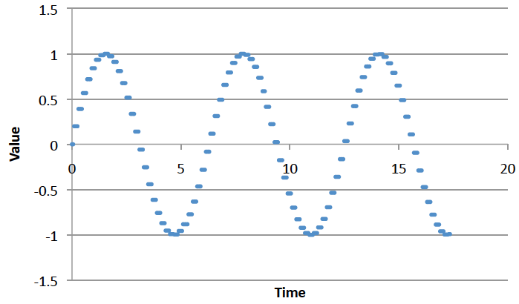
Connect the Dots
Intuition, with enough dots, not hard to “connect-the-dots” to reconstruct (understand) the continuous signal.
  What is the continuous signal here? (preclass 3)
  Assumes certain regularity conditions
  What is enough?
  Not unlike calculus
  Limit as △x→0
  Discrete sum
  approaches Integral

Slide 17
Definitions
Analog-to-Digital (ADC) Conversion
  Process of converting continuous signal to discrete signal
  Going from analog to digital “domain”
  Often called: digitization
  Use a subset of real #’s to represent all real #’s
    Involves a lot of approximation (lots of room for error!)
…collecting the dots

Slide 18
Definitions
Digital-to-Analog (DAC) Conversion
  Process of converting discrete signal to continuous signal
  Going from digital to analog “domain”
  Converting “bits” to a continuous waveform
    Our MP3/Music players do this all the time (will do in lab2)
(re)connecting
the dots

Slide 19
Sampling & Quantization
Part 2

Slide 20
ADC – Sampling & Quantization
Analog-to-Digital (ADC) Conversion
  Converting analog (continuous) signal to digital signal
  Digitization process has two important aspects:
    1) Sampling
      Converting independent variable of signal from continuous to discrete
      e.g.: breaking continuous time down into intervals
      Pick △x
      Look at value ever 1 ms
    2) Quantization
      Converting dependent variable of signal from continuous to discrete
      e.g.: breaking continuous voltage down into levels
      Round value to nearest 0.25 volts

Slide 21
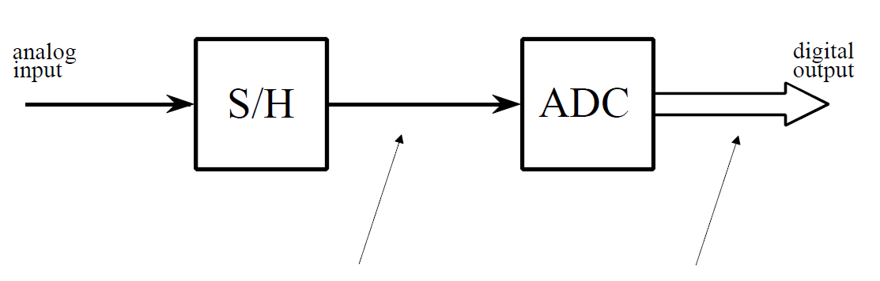
ADC – Broken into two parts
Sample/Hold
Performs sampling
Performs quantization
Figures from reading: The Scientist and Engineer's Guide to
Digital Signal Processing, By Steven W. Smith

Slide 22
ADC – Broken into two parts
Sample/Hold
Performs sampling
Performs quantization

Slide 23

ADC – Sampling
Analog-to-Digital (ADC) Conversion
  Sampling: breaking independent variable (time) into intervals
  Example: Let’s sample our continuous signal @ 1 ms intervals:
Voltage
What is our sampling rate?
(How many samples per second?)
3
1000 samples per second
1 kiloSamples / s
time (ms)
1
2
3
4
5
6
7
8
What is frequency of this signal?
$$freq =\frac{1}{period}=\frac{1}{8ms}=125 Hz$$
Spoiler alert:
Relationship between sample rate & frequency!
-3

Slide 24
ADC – Quantization
Analog-to-Digital (ADC) Conversion
  Quantization: breaking dependent variable (voltage) into levels
  Ex: Let’s quantize our range of voltages into 7 levels (1 Volt each)
Voltage
3
2
1
0
time (ms)
1
2
3
4
5
6
7
8
-1
-2
-3

Slide 25
ADC – Sampling & Quantization
Analog-to-Digital (ADC) Conversion
  Let’s collect our samples at the quantized levels
Voltage
Samples:
{ 0 ms, 0 Volts }
3
{ 1 ms, 2 Volts }
2
{ 2 ms, 3 Volts }
1
{ 3 ms, 2 Volts }
time (ms)
{ 4 ms, 0 Volts }
0
1
2
3
4
5
6
7
8
{ 5 ms, -2 Volts }
-1
{ 6 ms, -3 Volts }
-2
{ 7 ms, -2 Volts }
-3
{ 8 ms, 0 Volts }
Notice, we are rounding! Error is inherent in this process

Slide 26
ADC – Digital Conversion / Encoding
Analog-to-Digital (ADC) Conversion
  We’ve converted something continuous into discrete form
  How do we get it to “digital form”? We encode it…(map to another format)
Voltage
Samples:
{ 0 ms, 0 Volts }
3
{ 1 ms, 2 Volts }
2
{ 2 ms, 3 Volts }
1
{ 3 ms, 2 Volts }
time (ms)
{ 4 ms, 0 Volts }
0
1
2
3
4
5
6
7
8
{ 5 ms, -2 Volts }
-1
{ 6 ms, -3 Volts }
-2
{ 7 ms, -2 Volts }
-3
{ 8 ms, 0 Volts }

Slide 27
ADC – Digital Conversion / Encoding
Analog-to-Digital (ADC) Conversion
  We have 7 discrete voltages, # of bits to represent 7 things?
  3-bits! Why? 2^{3-bits} = 8 (1 unused state)
Binary
Encoding:
011
Voltage
Samples:
{ 0 ms, 0 Volts }
110
3
{ 1 ms, 2 Volts }
101
101
2
{ 2 ms, 3 Volts }
110
100
1
{ 3 ms, 2 Volts }
101
011
time (ms)
{ 4 ms, 0 Volts }
011
0
1
2
3
4
5
6
7
8
{ 5 ms, -2 Volts }
001
010
-1
{ 6 ms, -3 Volts }
000
001
-2
{ 7 ms, -2 Volts }
001
000
-3
{ 8 ms, 0 Volts }
011
Encoding: mapping data from one form to another (not always conversion)

Slide 28
ADC – Storing the Data
Analog-to-Digital (ADC) Conversion
  What do we store? Just the encoded bits:
    Our digitized signal: {011, 101, 110, 101, 011, 001, 000, 001, 011}
    It is now discrete & in digital format, store bits in MP3 player!
  Why can we avoid storing the time?
    It’s repetitive! Just store sampling rate: 1 kilo-samples/ sec
    Later, if we wish to restore signal, each “sample” occurred at 1ms
  In this example:
    Sampling rate: 1 k-samples/sec
    Resolution: 3-bits
    Our digitized signal: {011, 101, 110, 101, 011, 001, 000, 001, 011}

Slide 29
ADC – An approximation at Best
Analog-to-Digital (ADC) Conversion
  Continuous analog signal overlaid with discrete digital signal
  At best an approximation of original signal
Voltage
110
3
Ever heard an audiophile complain:
CDs/MP3s/Digital music doesn’t sound
as “real” or as good old records?
Now you know why!
101
2
100
1
011
0
time (ms)
1
2
3
4
5
6
7
8
010
-1
001
-2
000
-3

Slide 30
ADC – Broken into two parts
Sample/Hold
Performs sampling
Performs quantization
Voltage
Voltage
3
110
3
101
2
100
1
time (ms)
011
0
time (ms)
1
2
3
4
5
6
7
8
1
2
3
4
5
6
7
8
010
-1
001
-2
-3
000
-3

Slide 31
ADC – An approximation at Best
Digital-to-Analog (DAC) Conversion
  Process of converting discrete signal to continuous signal
    How to get back to original signal from bits?
Voltage
110
3
101
2
100
1
011
0
time (ms)
1
2
3
4
5
6
7
8
010
-1
001
-2
000
-3

Slide 32
ADC – An approximation at Best
Digital-to-Analog (DAC) Conversion
  Process of converting discrete signal to continuous signal
    How to get back to original signal from bits?
Voltage
110
3
Simplest – connect the dots
linear interpolation between points.
101
2
100
1
011
0
time (ms)
1
2
3
4
5
6
7
010
-1
With more sophistication
(and typical circuits)
can make smoother links.
001
-2
000
-3

Slide 33
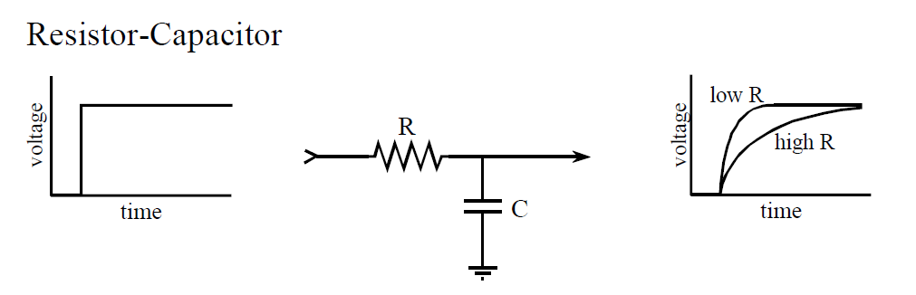
DAC - Filtering
Digital-to-Analog (DAC) Conversion
  What does a capacitor do?
  What happens when apply voltage across a resistor/capacitor?
  We call this filtering in EE, (RC delays are everything)
Voltage
110
3
101
2
100
1
011
0
time (ms)
1
2
3
4
5
6
7
8
output circuit of DAC
holds 7 discrete voltages for 1ms
each…applies it to RC filter,
output is “smooth” analog signal
010
-1
001
-2
000
-3
Notes:
Capacitors will come in ESE112/Physics151 (not had yet), and filtering to come in ESE215.
So, this story is more than we’re generally ready for in ESE 150.

Slide 34
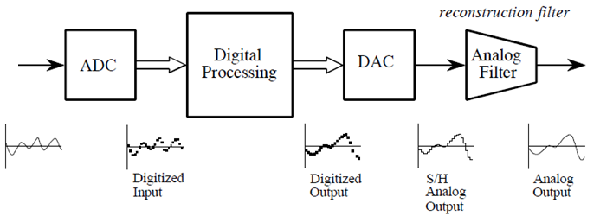
ADC / DAC – The full picture
Analog
Input
Figures from reading: The Scientist and Engineer's Guide to
Digital Signal Processing, By Steven W. Smith

Slide 35
ADC / DAC – The full picture
Analog
Input
Probably applies to this:
The signal processing algorithm equation was a bit confusing in lecture and in preclass activity.
Formally:
  Analog input signal that varies with time: s(t)
  Signal processing algorithm to digitize analog input signal:
    f[i]=Round(s(i*T)/QUANTA)*QUANTA
      T is sample period
  Digitized signal produced by f [ ]: s_{f} (t)

Slide 36
PCM
Quantization & Sampling Technique described:
  Called Pulse-Code-Modulation (PCM)
    Patented in 1943
    PCM process is the ADC process
    Developed for telecommunications

Slide 37
Next Steps
Monday Lab: sample sound waveforms
Wednesday: look more quantitatively at errors from quantization
Friday: Start looking at discrete sampling rates

Slide 38
Learn More
ESE215 – basic analog circuitry, RLC circuits, simple filters
  Including why typical circuits give smoother (not linear) connection of dots
ESE568 – Mixed Signal Integrated Circuits
  Build A2D, D2A

Slide 39
Big Ideas
Approximate continuous waveform on digital media by
  Discretize in all dimension
  For audio: in time and amplitude
    Sample in time; quantize voltage
Allows us to store audio signal as sequence of bits
Reconstruct by “connecting-the-dots”
  If our dots are frequent enough to represent the signal

Slide 40
Admin
Reading for today, next Wednesday on syllabus
In Lab (Detkin) on Monday
  Lab posted
  Lab kit pickup M2-3pm (or today 11:30am-noon)
  Will post lab partners before Monday
  Read lab, work prelab (includes download software)
Remember feedback

Slide 41
References
S. Smith, “The Scientists and Engineer’s Guide to Digital Signal Processing,” 1997.
Wikipedia, http://en.wikipedia.org/wiki/Analog-to-digital_converter
Wikipedia: http://en.wikipedia.org/wiki/Pulse-code_modulation

