Slide 1
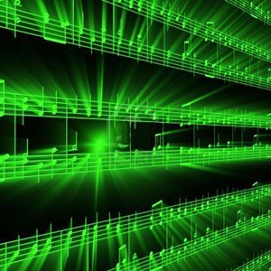


Lecture #3 – Quantization
ESE 150 –
Digital Audio Basics

Slide 2
Lecture Topics
Reminder: Sampling and Quantization
Expressing Mathematically
<interlude: image resolution>
Effects of Quantization
System Capacity
Summary
References

Slide 3
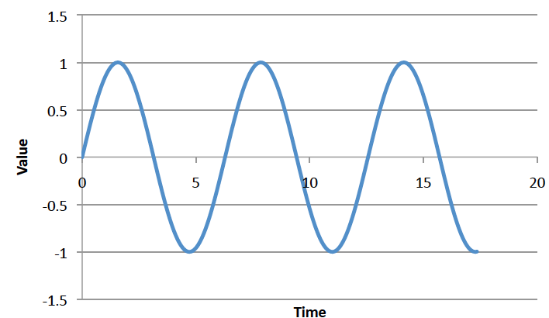
Big Question
How represent and process continuous information on a digital computer with finite memory?
  Note: continuous means signal may take on infinite number of values between any T₁ and T₂
T₁
T₂

Slide 4
Strategy
Sample at periodic time intervals
  Discretize independent variable
Quantize to discrete levels
  Discretize the value of the dependent variable

Slide 5
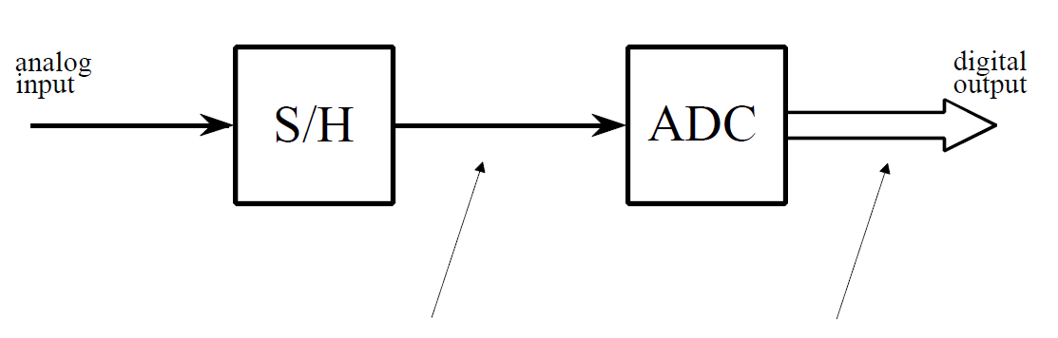
ADC – Broken into two parts
Sample/Hold
Performs sampling
Performs quantization
Voltage
Voltage
3
110
3
101
2
100
1
time (ms)
011
0
time (ms)
1
2
3
4
5
6
7
8
1
2
3
4
5
6
7
8
010
-1
001
-2
-3
000
-3

Slide 6
Problem Decomposition
Powerful Engineering technique
  Formulate a parameterized solution strategy
  Then identify the right parameters
Divides the problem
Here
  Strategy of sampling and quantization
  Then identify the right sampling rate, quantization level
Convergent: limit of infinite samples, levels
Once have strategy, reduces to a well-defined optimization problem
Parameterization admits to tuning for tradeoffs

Slide 7
Mathematical Expression

Slide 8
Round
Rounding – select nearest discrete value as approximation of continuous value
For sake of concreteness, we will define:
  Round(x) – nearest integer to real number x
    Round(0.7) = 1
    Round(-0.1) = 0
    Round(2.4999) = 2
    Round(1.50001) = 2
What is Round(3.3) ?

Slide 9
Quantize
We will quantize to some level L
Define as number of values between integers
So, we have L steps of 1/L between integers
  (or only represent every L’th integer if L<1)
In terms of Round
  Quantize_{L}(x) = Round(L*x)/L
  E.g. Quantize₈(0.7)=Round(8*0.7)/8=6/8=0.75

Slide 10
Preclass 1
 |  | 0.333 | 1.246 | -1.123
L=4 | Quantize_{L}(x)
 | QuantizationError_{L}(x)
L=16 | Quantize_{L}(x)
 | QuantizationError_{L}(x)
Quantize_{L}(x) = Round(L*x)/L

Slide 11
Bits
If we quantize to L levels per integer
Represent values between integers
  Max
  Min
How many bits required per quantized value?

Slide 12
Bits per Quantized Value
Bits = ⌈log₂((Max-Min)*L+1)⌉

Slide 13
Sample Values
Voltage
3
When sample at time interval T
  (for frequency = 1/T)
We collect the points at times:
  0, T, 2T, 3T, 4T, …
For signal f(t), we are collecting values:
  f(0), f(T), f(2T), f(3T), f(4T), …
Or in general, we are collecting the points
  f(i*T) for i=0 to MaxSamples (or MaxTime/T)
time (ms)
1
2
3
4
5
6
7
8
-3

Slide 14
Sample and Quantize Values
Voltage
3
When sample at time interval T
  (for frequency = 1/T)
We collect the points at times:
  0, T, 2T, 3T, 4T, …
For signal f(t), we are collecting:
  f(0), f(T), f(2T), f(3T), f(4T), …
If we then Quantize the values to level L
  Quantize_{L}(f(0)), Quantize_{L}(f(T)), Quantize_{L}(f(2T)), …
time (ms)
1
2
3
4
5
6
7
8
-3

Slide 15
Sample and Quantize Values
If we then Quantize the values to level L
  Quantize_{L}(f(0)), Quantize_{L}(f(T)), Quantize_{L}(f(2T)), …
Or in general, we are collecting the points
  Quantize_{L}(f(i*T)) for i=0 to MaxSamples (or MaxTime/T)
We store them in an array (or vector) F of MaxSamples+1
  For i from 0 to MaxSamples: F[i]= Quantize_{L}(f(i*T))
  This is what you collected on Monday!

Slide 16
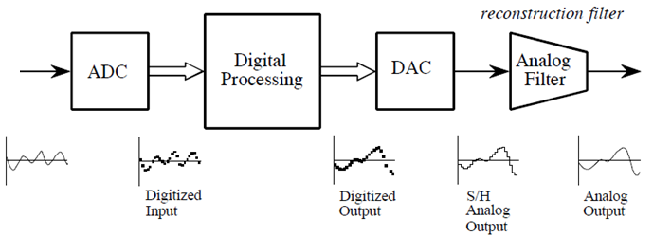
ADC / DAC – The full picture
Analog
Input
Formally:
  Analog input signal that varies with time: s(t)
  Signal processing algorithm to digitize analog input signal:
    F[i]=Round(s(i*T)*L)/L
      T is sample period
  Digitized signal produced by F[ ]: s_{f} (t)

Slide 17
Preclass 2
Sample f(t)=sin(2π*110*t) at T=0.3ms, quantize L=10
i | 0 | 1 | 2 | 3 | 4
i*T | 0 | 0.3ms
Value f(i*T) | 0
F[i] | 0
Quantization Error | 0
Sine goes -1 to 1: how many bits for these 5 samples?

Slide 18
ADC / DAC – The full picture
Analog
Input
Formally:
  Analog input signal that varies with time: s(t)
  Signal processing algorithm to digitize analog input signal:
    F[i]=Round(s(i*T)*L)/L
      T is sample period
  Digitized signal produced by F[ ]: s_{f} (t)

Slide 19
Interlude: 2D Images

Slide 20

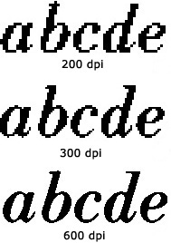
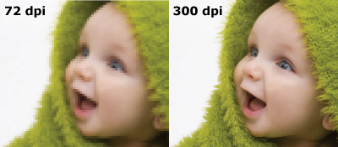
Same phenomena in Images
World continuous
Digital images on Zoom, TV, paper (even photographs) are discretized – limited resolution
  Zoom…
http://www.morefill.com/wpver/wp-content/uploads/2015/08/DPI-abcde.jpg
http://dslrphotographytutorials.com/wp-content/uploads/2014/05/PPI-Compare.png
http://blog.inkjetwholesale.com.au/wp-content/uploads/2015/07/DPI-comparison.png

Slide 21
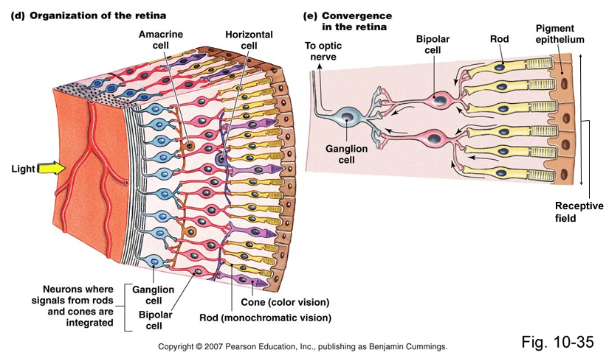
Apple Retina Display
Why called retina?
Claim (goal): as much resolution as you have in your retina (at typical viewing distance)
We cannot see pixels, because our eyes are themselves
discrete!

Slide 22
Apple Retina Display
Why called retina?
Claim (goal): as much resolution as you have in your retina (at typical viewing distance)
We cannot see pixels, because our eyes have discrete photo receptors (rods, cones)
Human eye resolution 0.5 arc-minute (0.02 degrees)
  Around 300 DPI (Dots-Per-Inch) at 20 inches

Slide 23
Effects of Quantization

Slide 24
Noise -- ``Formal” Definition
Noise – difference between our ideal signal and the actual signal
  The one that we actually hear
  The one that shows up when we transmit data
  The one we store or reconstruct
Sometimes will see
  R(t) = S(t) + n(t)
    Noise n(t) is added to the ideal signal S(t)
    R(t) what we receive
  Or, equivalently:
    n(t)=S(t)-R(t)

Slide 25
Quantization Error
In example, quantization algorithm required us to round
  At sample time, t=1ms, input signal was: 2.2V
  It was lower than 2.5V, we rounded down to quantized level of 2.0V
    Side effect of quantization: the introduction of error in digital signal
Voltage
110
3
101
2.2
2.0
100
1
Quantization
Error
011
0
time (ms)
1
2
3
4
5
6
7
8
010
-1
Difference between sampled value
and quantized level
001
-2
000
-3

Slide 26
Quantization Error
How much error?
  In our case, we round up if equal to or above ½ a level…
    …round down if below ½ a level
  Generally, our input signal has 50/50 chance of being above/below
    Error becomes “uniformly distributed”
Voltage
L=2
Error
110
3
Quantize₁=Round(1*x)/1
QuantizeError₁=x-Round(x)
101
2.2
0.5
2.0
time (ms)
100
1
0.2
011
0
0
1
2
3
4
5
6
7
8
-0.2
1
2
3
4
5
6
7
8
010
-1
001
-2
-0.5
000
-3

Slide 27
Quantization Error / Noise
How much error?
  Looking at the plot of error, looks random
  Sets up a way for us to model quantization error as noisy signal
    Noise due to quantization = sampled signal (red dots) – quantized signal (red line)
    Quantization introduces noise to our sampled signal
Voltage
Error
110
3
101
2.2
0.5
2.0
time (ms)
100
1
0.2
011
0
0
1
2
3
4
5
6
7
8
-0.2
1
2
3
4
5
6
7
8
010
-1
001
-2
-0.5
000
-3

Slide 28
Continuous Error
So far, focus on error at sample points
Can also define error at any point
Depends on reconstruction model
  How estimate/create continuous from samples
Simple connect-the-dots model linear interpolation

Slide 29
ADC – An approximation at Best
Digital-to-Analog (DAC) Conversion
  Process of converting discrete signal to continuous signal
    How to get back to original signal from bits?
Voltage
110
3
Simplest – connect the dots
linear interpolation between points.
101
2
100
1
011
0
time (ms)
1
2
3
4
5
6
7
010
-1
001
-2
000
-3

Slide 30
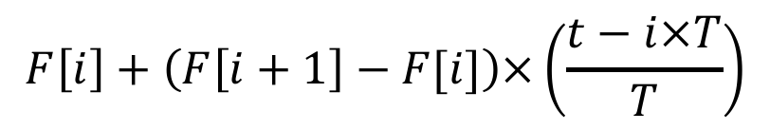
Continous Reconstruction
What is reconstructed signal at time t?
Find samples that bracket --- i: i*T<t<(i+1)*T
Value is between F[i] and F[i+1]
Voltage
$$F\left[i\right]+\left(F\left[i+1\right]−F[i]\right)×\left(\frac{t−i×T}{T}\right)$$
110
3
101
2
100
1
011
0
time (ms)
1
2
3
4
5
6
7
010
-1
001
-2
000
-3

Slide 31
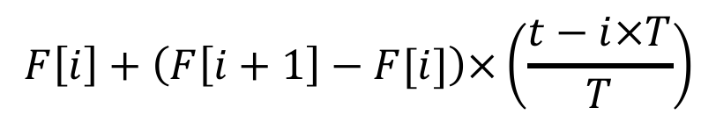
Preclass 3
Sampling and quantization error at t=1ms?
T=0.3ms
i?
F[i], F[i+1]
Reconstructed value?
f(1ms)
Error=f(1ms)-ReconstructedValue(1ms)
$$F\left[i\right]+\left(F\left[i+1\right]−F[i]\right)×\left(\frac{t−i×T}{T}\right)$$

Slide 32
Quantization Error / Design
Why model quantization error as noise?
There is always noise present
  Something other than the signal we intend
  Wires, electronics, background
  Not gaining much if quantization noise < other noise
Quantization adds noise
  Reduce by increasing sampling, increasing resolution
  More levels →(L) bits → makes more expensive
    Bits = ⌈log₂((Max-Min)*L+1)⌉
  Increase L until reach desired noise level
    Until other sources dominate quantization noise
SNR = Signal-to-Noise Ratio
  How much larger is the signal compare to noise?
  Mean (average) value of signal / std. dev. of noise
  Usually what we are optimizing in the system (including ADC)

Slide 33
Engineering
“An Engineer can do for a dime what anyone else can do for a dollar.”
Engineering is about optimization and efficiency
Bits are costly
Anyone: Sample frequently with high resolution
Engineer ask: how few bits can I use without sacrificing quality?
Engineering is about tradeoffs
  Quality vs. Cost

Slide 34
Problem Decomposition
Powerful Engineering technique
  Formulate a parameterized solution strategy
  Then identify the right parameters
Divides the problem
Here
  Strategy of sampling and quantization
  Then identify the right sampling rate, quantization level
Once have strategy, reduces to a well-defined optimization problem
Parameterization admits to tuning for tradeoffs

Slide 35
System Capacity

Slide 36
Quantization, Sampling, Capacity
Quantization and Sampling
  Play enormous role in determining storage capacity of digital system
  # of quantization levels ➔ # of bits per sample
    Increasing resolution of ADC, reduces quantization noise…
    But also increases amount of data we must store for each sample
    Bits/sample = ⌈log₂((Max-Min)*L+1)⌉
  Sampling rate = how often we collect # of bits per sample
    Typically sampling rate = twice frequency of signal (next week)
    Increasing the rate, increases the amount of data to store!

Slide 37
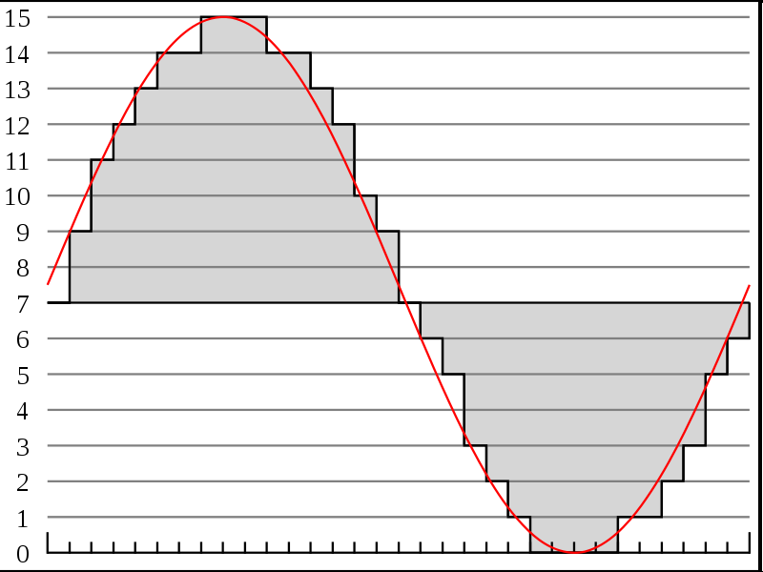




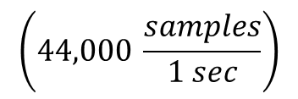

Recall # of bits for typical song
http://en.wikipedia.org/wiki/File:Pcm.svg
Discrete
Voltage
Levels
http://en.wikipedia.org/wiki/File:Compact_disc.svg
Sampling rate & resolution effect on storage
  Compact Disks: 16bits at 44KHz
    How many bits is a typical 3-minute song?
$$\left(44,000 \frac{samples}{1 sec}\right)$$
$$\left(16 \frac{bits}{sample}\right)$$
$$\left(60 \frac{sec}{1 min}\right)$$
$$\left(3 \frac{min}{song}\right)$$
$$=15.1 \frac{MB}{song}$$
Notes:
44,000/s x 2B x 3 m x 60s/m
15,840,000 Bytes
15.8 MB or almost 128Mbits

Slide 38
Limits of Sampling

Slide 39
Sampling
Definition of proper sampling
  If you can exactly reconstruct analog signal from samples,
  you have done the sampling properly
    Essentially: you have captured the key information from the signal to process can be reversed
Milestone of digital signal processing (DSP):
  Nyquist-Shannon Theorem (Friday)
    Tells us our sampling rate should be:
      twice the frequency of the signal!

Slide 40
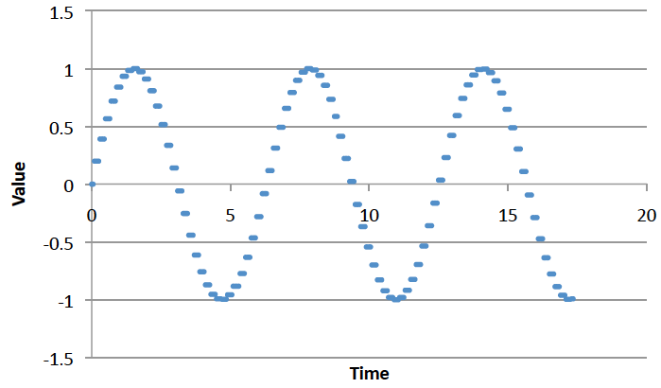
Big Ideas
Approximate continuous waveform on digital media by
  Discretize in all dimension
  For audio: in time and amplitude
    Sample in time; quantize voltage
Allows us to store audio signal as sequence of bits
Reconstruct by “connecting-the-dots”
  If our dots are frequent enough to represent the signal
Introduce error → noise
  Reason about tolerable (or noticeable) noise

Slide 41
Admin
Reading for Friday on syllabus
Remember feedback
  Includes Lab 1
Office Hours
  T7, W2, R8
  Zoom links on Piazza (web, canvas)
Lab 1 Reports due Friday

Slide 42
References
S. Smith, “The Scientists and Engineer’s Guide to Digital Signal Processing,” 1997.
Wikipedia, http://en.wikipedia.org/wiki/Analog-to-digital_converter
Wikipedia: http://en.wikipedia.org/wiki/Pulse-code_modulation

