Slide 1
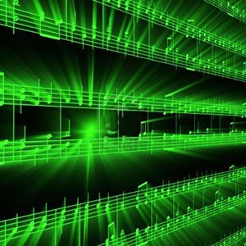


Lecture #12 – Psychoacoustic Compression Algorithm
ESE 150 –
Digital Audio Basics
Based on slides © 2009—2021 DeHon, Koditschek
Additional Material © 2014 Farmer

Slide 2
Lecture Topics
Lab vs. Lecture
Big Picture reminder
Review and preclass
How do we take advantage of psychoacoustics in MP3
Achieve this 6—12x reduction from CD Audio
  Review Tricks
  Formulate Optimization
  Algorithm for Adaptation
References

Slide 3
Compare to Lab
Lab 6
  Capture spirit of reducing frequencies
  Simplified – only taking loudest fraction in each band
    Rather than being rigorous about masking
    Or trying to hit some fixed rate
Lecture 11 & 12
  Help understand more what real MP3 encoding looks like
  Thinking about fixed rate
    And adaptation for variable rate encoding from Huffman
  Formulating masking more explicitly
    But still simplistic
  Illustrating Optimization Approaches

Slide 4
Big Picture: Why Care
MP3 shows
  We can reduce bits needed too accurately represent music by 12x over PCM samples
1998
  Necessary to make MP3 player viable at all on 32MB Flash memory
    Small, affordable by masses
  Also meant lower bandwidth to stream
2006
  Necessary to make Spotify streaming viable
2021
  With 64GB phones, maybe not essential for music on iPhone, but…

Slide 5
Big Picture: Why Care
Networks / Internet bandwidth / Cell capacity
  Allows us to reduce bandwidth needed for audio
  Alternative is
    Building out more wires and capacity
    Fewer cell calls supported simultaneously in a region
  Being efficient with bits
    Reduces physical investment needed in wires
Same ideas enable video
  Viable to store (many) hours of video on phone/tablet
    Of increasing resolution: HD, 4K….
  Viable to stream video into homes
  Zoom, Netflix, AppleTV, … all enabled by compression

Slide 6
Review and Preclass Setup/Reminder

Slide 7
Knobs we can turn
Amplitude quantization
  Per band
Frequency quantization
  Per band?
Frequencies kept (per critical band)
  Per band
…and can perform lossless compression

Slide 8
Preclass 1
44,300 samples/s
16b
26ms window
a) How many bits?
128Kb/s stereo → 64Kb/s per audio channel
b) How many bits per 26ms window?
c) ratio?

Slide 9
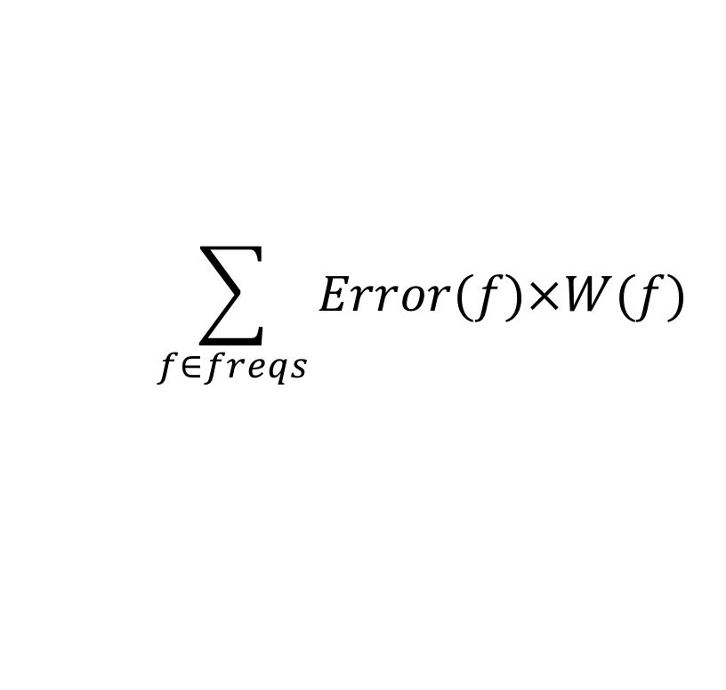
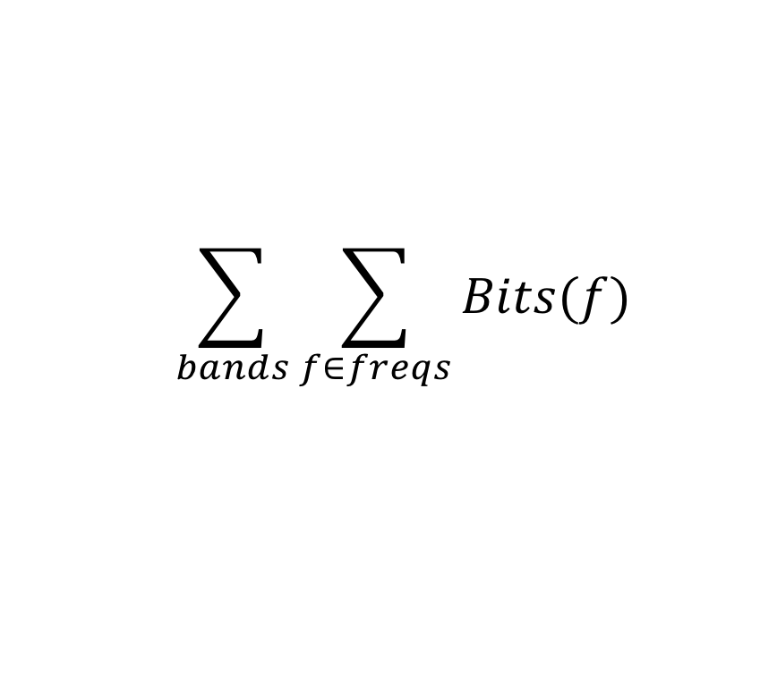
Optimization Problem
How fit in the resource constraints (128Kb/s) while maximizing goodness (sound quality)?
Quantify bits used:
  Cannot exceed 128Kb/s
  = 1,704 b / 26ms frame / channel
Quantify goodness: minimize
$$\sum_{bands}{\sum_{f∈freqs}{Bits(f)}}$$
$$\sum_{f∈freqs}{Error(f)×W(f)}$$

Slide 10
Preclass 2
576 frequencies
16b amplitude
1704b budget
(frequency,amplitude) pairs to represent
How many frequencies can we keep?
Conclude: cannot keep all frequencies and hit budget

Slide 11
Preclass 3
Bits if only have 3 non-masked, non-zero frequencies?
Conclude: some frames won’t use all their bits

Slide 12
Preclass 4 and 5
60dB, 42dB, 30dB each are 25% of amplitudes
Other magnitudes remaining 25%
How many bits to represent 80 non-zero/non-masked frequencies?
If all frequencies equally likely, how many bits to represent 80 non-zero/non-masked frequencies?
Conclude: number of frequencies can keep depends on compressibility

Slide 13
Seen
May want to do something smarter than
  Allocating fixed number of frequencies per band
  Allocating fixed quantization to a band
Like to adapt our encoding to the data
  If more Huffman compressible, we get more frequencies
  If fewer frequencies suffice for one band,
    Allow more frequencies for another
    …or allocate less quantization

Slide 14
Optimization Problem
How fit in the resource constraints (128Kb/s) while maximizing goodness (sound quality)?
Optimization problems central to engineering

Slide 15
Optimization Problem
How fit in the resource constraints (128Kb/s) while maximizing goodness (sound quality)?
Quantify bits used:
  Cannot exceed 128Kb/s
  = 1,704 b / 26ms frame / channel
Quantify goodness: minimize
$$\sum_{bands}{\sum_{f∈freqs}{Bits(f)}}$$
$$\sum_{f∈freqs}{Error(f)×W(f)}$$

Slide 16
Goodness/Sound Quality
Error(Amp) = |Orig Amplitude – Encoded|
  Whole OrigAmplitude if dropped
  |Orig Amplitude-Quantize(OrigAmplitude,bits)| if quantized
W(freq)
  0 if below hearing threshold
  0 if masked
  Value between 0 and 5 if partially masked in critical band
  Really depend on what
  already encoded
$$\sum_{f∈freqs}{Error(f)×W(f)}$$

Slide 17
Example Weight Function W(f)
W(f)=CBWeight*Mask
Mask = 0 if MaxAmp-FreqAmp<4
(MaxAmp-FreqAmp)/MaxAmap otherwise
  1 otherwise
  For example that follows, don’t use second part

Slide 18
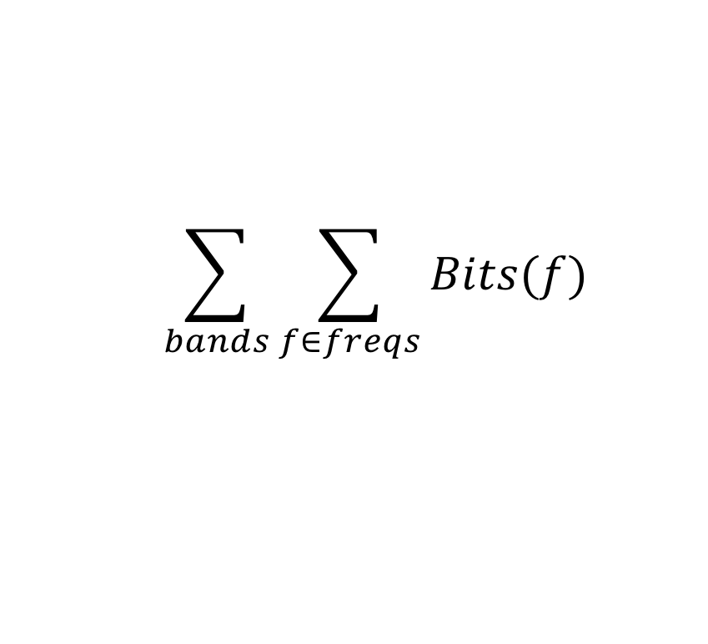
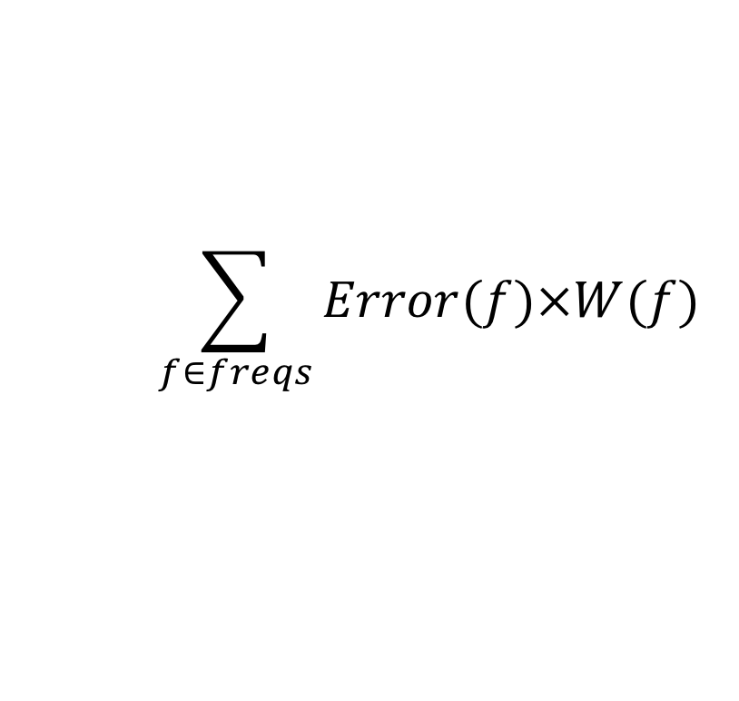
Approach
$$\sum_{bands}{\sum_{f∈freqs}{Bits(f)}}$$
Start with nothing
Start with bitbudget
$$\sum_{f∈freqs}{Error(f)×W(f)}$$

Slide 19
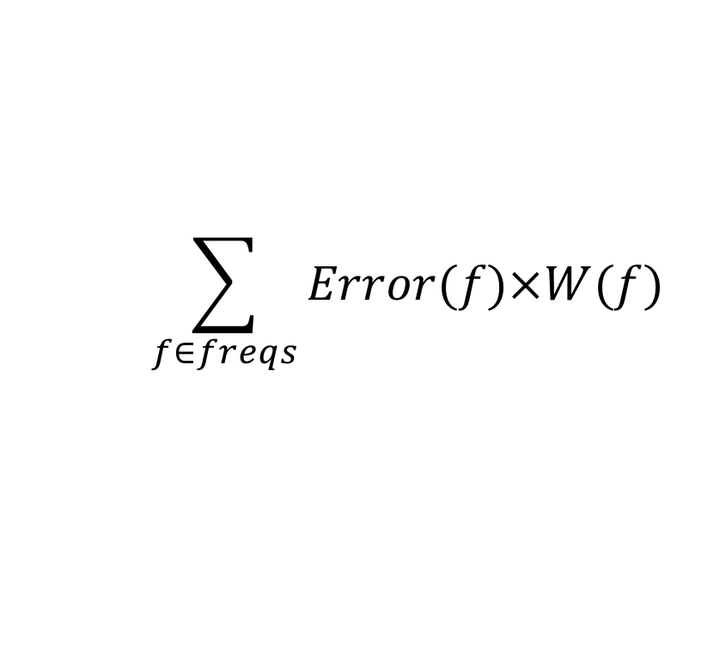
Approach
$$\sum_{bands}{\sum_{f∈freqs}{Bits(f)}}$$
Start with nothing
Start with bitbudget
$$\sum_{f∈freqs}{Error(f)×W(f)}$$
Bits = 0
Error = 190

Slide 20
Approach
$$\sum_{bands}{\sum_{f∈freqs}{Bits(f)}}$$
Start with nothing
Start with bitbudget
While(bitbudget>0)
  Identify Largest Error component: Error(freq)×W(freq)
$$\sum_{f∈freqs}{Error(f)×W(f)}$$
Bits = 0
Error = 190

Slide 21
Approach
$$\sum_{bands}{\sum_{f∈freqs}{Bits(f)}}$$
Start with nothing
Start with bitbudget
$$\sum_{f∈freqs}{Error(f)×W(f)}$$
Bits = 3+6=9
Error = 125

Slide 22
Approach
$$\sum_{bands}{\sum_{f∈freqs}{Bits(f)}}$$
Start with nothing
Start with bitbudget
$$\sum_{f∈freqs}{Error(f)×W(f)}$$
Bits = 18
Error = 60

Slide 23
Approach
$$\sum_{bands}{\sum_{f∈freqs}{Bits(f)}}$$
Start with nothing
Start with bitbudget
$$\sum_{f∈freqs}{Error(f)×W(f)}$$
Bits = 27
Error = 18

Slide 24
Also Quantization
$$\sum_{bands}{\sum_{f∈freqs}{Bits(f)}}$$
To keep simple,
assumed fixed quant.
Incrementally assign
bits
While(bitbudget>0)
  Identify Largest Error component: Error(freq)×W(freq)
  Assign more bits to that frequency
    Go from 0 bits to 1 bit
      1 bit to 2 bits
$$\sum_{f∈freqs}{Error(f)×W(f)}$$

Slide 25
Approach (Greedy)
Start with nothing
Start with bitbudget
While(bitbudget>0)
  Identify Largest Error component
  Allocate some bits to reduce error
    Add frequency or Add quantization bits to band
    Pick one to most reduce the error

Slide 26
Adaptive Refinement
Rediscovering where to allocate everything every time may be laborious
  Often same frequencies persist for more than 26ms
Maybe we can get close and adjust?
  Use critical band allocation from previous frames as a starting point guess
    bits, frequencies, quantization
  Try initial encoding with that

Slide 27
Approach (Adaptive)
Start with budget guess
  Quantization in bands
  Frequencies to keep in each band
Encode, compress
What do if haven’t used up all bits?
What do if over budget?

Slide 28
PERCEPTUAL CODING & MP3
Roundup

Slide 29
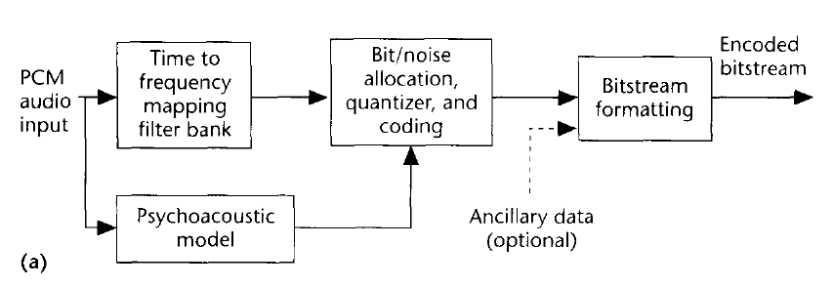
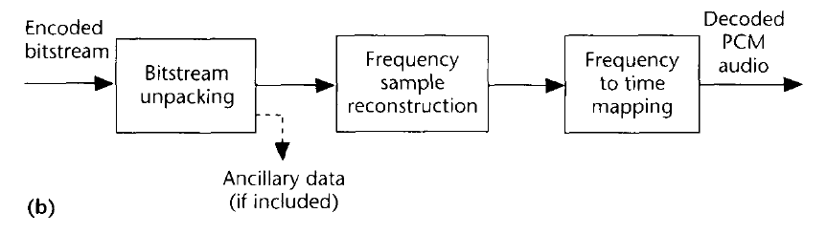
MP3 Flow Chart (Encoding/Decoding)
Basic MP3 Encoding Scheme
A type of DFT is performed
Data is
stored in
frequency domain rep.
Even Huffman coded too!
We use psychoacoustic
model to control quantization!
(how we achieve compression)
MP3 Decoding Scheme
Notice: Psychoacoustics is embedded
Your brain is involved in decoding!

Slide 30
MP3 Encoding Process
All MP3 files broken into “Frames”
  Each frame stores 1152 Audio Samples
  Lasts for 26 ms
  Frame also divided further into 2 “granuels”
    Each granuel contains 576 samples

Slide 31
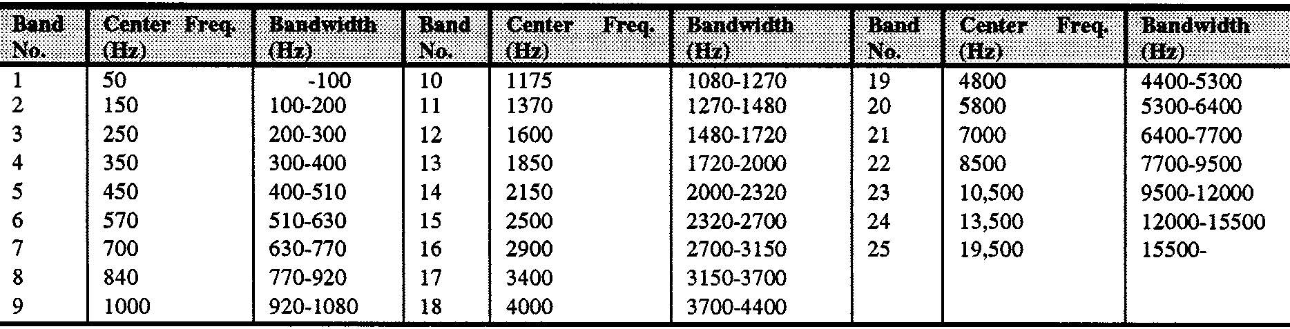
MP3 Encoding Process
Q
…
…
acquire & transform “frame”
Bring in 1152 PCM samples
Use DFT/MDCT to transform to frequency-domain
- n_{S}
- n_{A}
n_{A}
n_{S}
DFT
Bands
Q₁
Q₂
Q₃
Q₄
Q₅
…
Q_{k-1}
Q_{k}
Q_{k+1}
…
Q_{nA}
assign frequencies to bands
use psychoacoustic model lookup
  to determine frequency bandwidth
  of each critical band
  separate samples into bands
…
…
…
1
2
…
…
k
23

Slide 32
Big Ideas
Can use pyschoacoustics to compress audio
  Eliminate portions of signal that human’s don’t notice
Optimization
  Identify Design Space (knobs)
  Identify Costs and Constraints
  Formulate quantitatively
  Algorithms to approach
  Iterative/adaptive approach
    Deal with effects that aren’t completely predictable

Slide 33
Learn More
Optimization –
  continuous mathematical optimization ESE204, ESE504, ESE605
  discrete optimization CIS121, CIS320
Signal processing – ESE224

Slide 34
Coming Up
Feedback (including Lab 6 part 1)
No lab due today
Monday: Lab 6 continued
Wednesday: Spring Break?!? – no lecture
  No office hours
  Thursday: no office hours
Next Friday: back for Lecture
Saturday 2-3pm and 6-7pm office hours
Sunday (3/14) formal Lab Due

Slide 35
References
Tutorials on Psychoacoustic Coding (in increasing order of abstraction and generality)
  D. Pan, M. Inc, and I. L. Schaumburg. A tutorial on MPEG/audio compression. IEEE multimedia, 2(2):60–74, 1995.
  Nikil Jayant, James Johnston, and Robert Safranek. Signal compression based on models of human perception. Proceedings of the IEEE, 81(10):1385–1422, 1993.
  V. K. Goyal. Theoretical foundations of transform coding. IEEE Signal Processing Magazine, 18(5):9–21, 2001.
Lightweight Overview of MP3
  Rassol Raissi. The theory behind mp3. Technical report, MP3’ Tech, December 2002.
Scientific Basis of MP3 Coding Standard
  J. D. Johnston. Transform coding of audio signals using perceptual noise criteria. IEEE Journal on selected areas in communications, 6(2):314–323, 1988.

