Slide 1



Lecture #14 – Sequential Logic, FPGAs
ESE 150 –
Digital Audio Basics
Based on slides © 2009--2021 DeHon

Slide 2
Lecture Topics
Setup
Where are we?
Review: Combinational Logic
Sequential Logic
FPGAs
Next Lab

Slide 3









Course Map – Week 8
MIC
A/D
10101
Music
1
domain
conversion
5,6
Numbers correspond to course weeks
compress
sample
freq
pyscho-
acoustics
3
2
4
EULA
----------------click
OK
D/A
10101001101
speaker
MP3 Player / iPhone / Droid

Slide 4
Combinational Logic

Slide 5
Gate
Primitive binary function
  Computes a binary output from a small number of binary inputs
Can specify function with a Truth Table
  Defines the output for each input combination
Input 0 | Input 1 | Output
0 | 0
0 | 1
1 | 0
1 | 1

Slide 6
Conclude
Can implement any combinational logic function out of a collection of
  OR2, AND2, NOT gates

Slide 7
Arithmetic
Addition is also a digital logic function
  Maps set of inputs (a3 a2 a1 a0 b3 b2 b1 b0)
  To an output bit vector (c4 c3 c2 c1 c0)
…as is subtraction, multiplication, division, square root….

Slide 8
Sequential Logic

Slide 9
Mux with Feedback
What happens when S=0?
What happens when S=1?

Slide 10
Mux with Feedback
Assuming i0 doesn’t change
what happens when S goes from 0 to 1?

Slide 11
Latch
Element that can hold a
previous value of an input

Slide 12
Flip-Flop (FF)
Use a pair to create a flip-flop
  Also call register

Slide 13
Flip-Flop (FF)
Use a pair to create a flip-flop
  Also call register
What happens when
  CLK is low (0) ?

Slide 14
Flip-Flop (FF)
Use a pair to create a flip-flop
  Also call register
What happens when
  CLK is high (1) ?

Slide 15
Flip-Flop (FF)
Use a pair to create a flip-flop
  Also call register
What happens when
  CLK transitions from 0 to 1?

Slide 16
Flip-Flop (FF)
Use a pair to create a flip-flop
  Also call register
Sample D input on 0→1
transition of clock (CLK)
Never an open path from
D→Q
  One of the mux latches always
  in hold state

Slide 17
State Element
Latch or Register is a state element
Allows circuit to remember a value
Build computations that
  Depend on past inputs
  Reuse hardware in time

Slide 18
Accumulator Revisited
Maybe extend accumulator bits to hold larger sum
Maybe more…

Slide 19
State for Sequencing and Control
Useful when trying to control things
  E.g. Perform a sequence of operations
Robot
  Open-gripper
  Move-forward
  Close-gripper
  Lift

Slide 20
State for Conditional Control
Useful when need to behave differently based on something in the past
  Remember if elevator going up or down
  Remember/count coins from consumer
  Remember some mode set by user
    Displaying in Centigrade or Fahrenheit
Idea
  Store state
  Use as input to logic

Slide 21
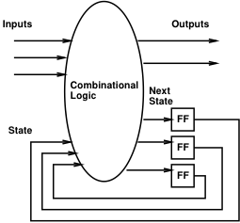
Finite-State Machine (FSM)
Sequential model of computation
State (in registers) + combinational logic
Compute outputs and next state
from inputs and state

Slide 22
FSM Example
Simplified Vending Machine
  Only input quarters
  Only vend one item (output signal to indicate vending)
  Item costs 2 quarters
  Coin Return request and control
Two states: waiting, one-quarter (one)
Two inputs: quarter, coin-return (creturn)
Two outputs: vend, return-quarter (qreturn)

Slide 23
Truth Table Model
Complete together
state | quarter | creturn | vend | qreturn | next
waiting | 0 | 0 | 0 | 0 | waiting
waiting | 0 | 1
waiting | 1 | 0 | 0 | 0 | one
waiting | 1 | 1
one | 0 | 0
one | 0 | 1
one | 1 | 0
one | 1 | 1

Slide 24
Truth Table Model
Complete together
state | quarter | creturn | vend | qreturn | next
waiting | 0 | 0 | 0 | 0 | waiting
waiting | 0 | 1 | 0 | 0 | waiting
waiting | 1 | 0 | 0 | 0 | one
waiting | 1 | 1
one | 0 | 0
one | 0 | 1
one | 1 | 0
one | 1 | 1

Slide 25
Truth Table Model
Complete together
state | quarter | creturn | vend | qreturn | next
waiting | 0 | 0 | 0 | 0 | waiting
waiting | 0 | 1 | 0 | 0 | waiting
waiting | 1 | 0 | 0 | 0 | one
waiting | 1 | 1 | 0 | 1 | waiting
one | 0 | 0
one | 0 | 1
one | 1 | 0
one | 1 | 1

Slide 26
Truth Table Model
Complete together
state | quarter | creturn | vend | qreturn | next
waiting | 0 | 0 | 0 | 0 | waiting
waiting | 0 | 1 | 0 | 0 | waiting
waiting | 1 | 0 | 0 | 0 | one
waiting | 1 | 1 | 0 | 1 | waiting
one | 0 | 0 | 0 | 0 | one
one | 0 | 1
one | 1 | 0
one | 1 | 1

Slide 27
Truth Table Model
Complete together
state | quarter | creturn | vend | qreturn | next
waiting | 0 | 0 | 0 | 0 | waiting
waiting | 0 | 1 | 0 | 0 | waiting
waiting | 1 | 0 | 0 | 0 | one
waiting | 1 | 1 | 0 | 1 | waiting
one | 0 | 0 | 0 | 0 | one
one | 0 | 1 | 0 | 1 | waiting
one | 1 | 0
one | 1 | 1

Slide 28
Truth Table Model
Complete together
state | quarter | creturn | vend | qreturn | next
waiting | 0 | 0 | 0 | 0 | waiting
waiting | 0 | 1 | 0 | 0 | waiting
waiting | 1 | 0 | 0 | 0 | one
waiting | 1 | 1 | 0 | 1 | waiting
one | 0 | 0 | 0 | 0 | one
one | 0 | 1 | 0 | 1 | waiting
one | 1 | 0 | 1 | 0 | waiting
one | 1 | 1

Slide 29
Truth Table Model
state | quarter | creturn | vend | qreturn | next
waiting | 0 | 0 | 0 | 0 | waiting
waiting | 0 | 1 | 0 | 0 | waiting
waiting | 1 | 0 | 0 | 0 | one
waiting | 1 | 1 | 0 | 1 | waiting
one | 0 | 0 | 0 | 0 | one
one | 0 | 1 | 0 | 1 | waiting
one | 1 | 0 | 1 | 0 | waiting
one | 1 | 1 | 0 | 1 | one

Slide 30
Switch-Statement Model
While (true)
switch (state) {
case waiting:
if (quarter && !creturn)
state=one;
else
state=waiting;
qreturn=quarter && creturn;
vend=0;
break;

Slide 31
Switch-Statement Model (cont.)
case one:
if ((quarter && !creturn)||
(!quarter&&creturn))
state=waiting;
else
state=one;
qreturn=creturn;
vend=quarter&& !creturn;
break;
} // switch
} // while

Slide 32
FSM Graph Model
!quarter/
vend=0, qreturn=0
quarter&creturn/
vend=0, qreturn=1
waiting
quarter&!creturn/
vend=1, qreturn=0
quarter&!creturn/
vend=0, qreturn=0
!quarter&creturn/
vend=0, qreturn=1
one
!quarter&!creturn/
vend=0, qreturn=0
!quarter&!creturn/
vend=0, qreturn=0

Slide 33
Programmable Logic

Slide 34
Preclass 2
How build 4-input mux from 2-input muxes?

Slide 35
Preclass 3
What function of s0, s1 is this circuit configuration computing?

Slide 36
Mux can be a programmable Gate
Programmable Gate
  Can be programmed to act as any gate
  Use state (e.g. FF) to “program” truth table of a gate
Input 0 | Input 1 | Output
0 | 0
0 | 1
1 | 0
1 | 1

Slide 37
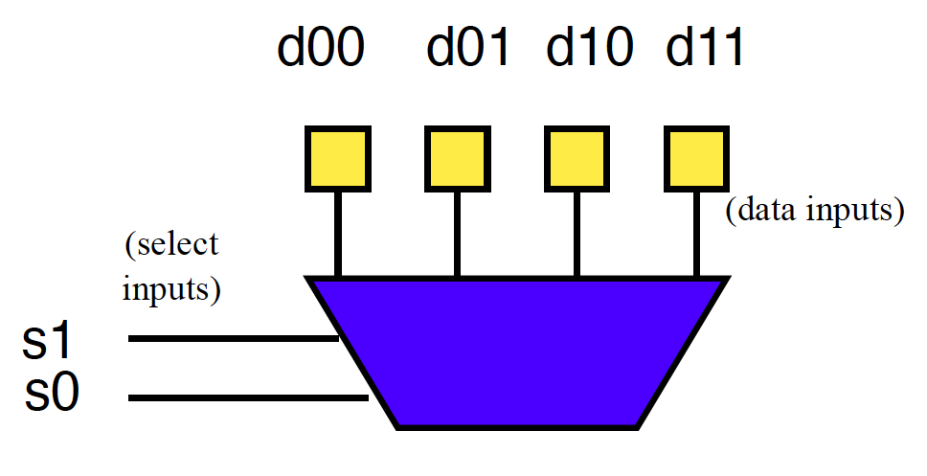
Example: OR (preclass 4)
How do we program to behave as OR2?

Slide 38
Look-Up Table (LUT)
Can generalize to any number of inputs

Slide 39
Connecting Gates
Once we can build gates
…still need to connect the gates together.
Select which gate outputs become inputs to other gates.

Slide 40
Mux can be Programmable Interconnect
Trick: Use multiplexer
to programmably
select gate input.

Slide 41
Programmable Blocks

Slide 42
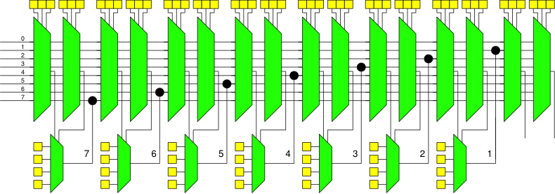
Programmable Gates and Interconnect
If time permits:
How program (fill in yellow programmable cells) to implement a full adder?

Slide 43
Field-Programmable Gate Array (FPGA)
Collection of Programmable Gates
  Can “program” by setting state bits
  LUTs that can be programmed to be any gate
    With optional Flip-Flops to use for state
  Programmable interconnect to “wire” the gates together

Slide 44
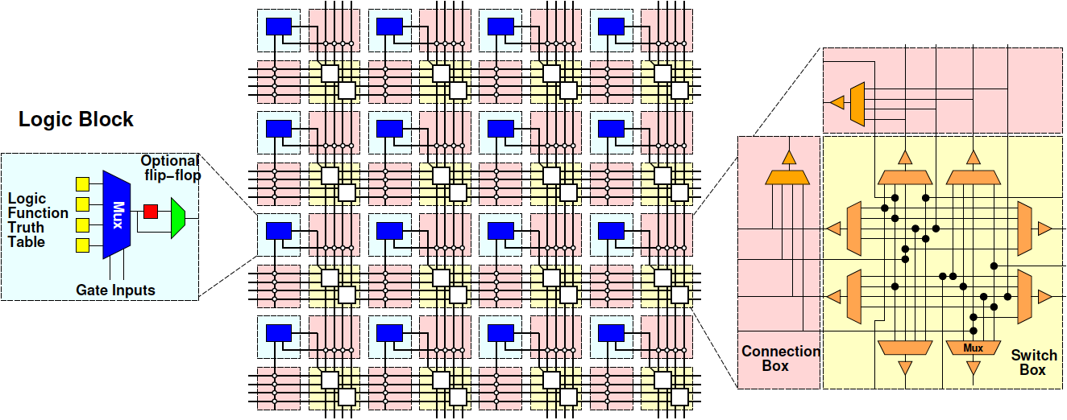
Field-Programmable Gate Array (FPGA)

Slide 45
Big Ideas
Can implement any combinational digital logic function from nand2 gates
Can implement any FSM from nand2 gates and registers
Can build a single chip that can be programmed to behave as any collection of gates
  As long as don’t need more gates than it provides

Slide 46
Learn More
CIS240 – do a bit more logic
ESE370 – how to implement gates, latches, and memories from transistors
ESE532 – how to build large-scale computations from logic

Slide 47
Reminder
Feedback
Lab 7 due on Friday

