Slide 1

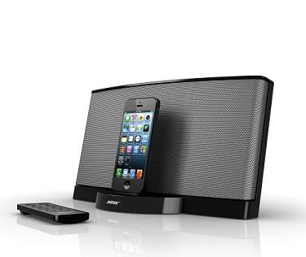
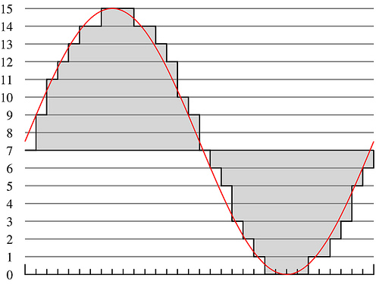
Lecture #15 – Minimal Processor
ESE 150 –
Digital Audio Basics
Based on slides © 2009--2021 DeHon

Slide 2

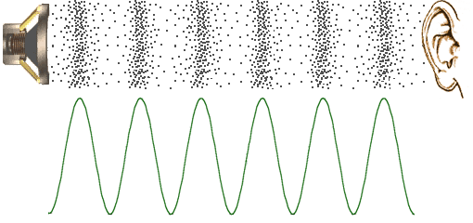



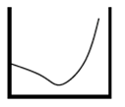



So Far
MIC
A/D
10101
Music
1
domain
conversion
5,6
Numbers correspond to course weeks
compress
sample
freq
pyscho-
acoustics
3
2
4
EULA
----------------click
OK
D/A
10101001101
speaker
MP3 Player / iPhone / Droid

Slide 3
How Process
How do we build a machine to perform these operations?
  From Digital Samples → compressed digital data → Digital Samples
With simple gates and registers
  can build a machine to perform any digital computation
  …if we have enough of them.

Slide 4
Economy and Universality
What if we only have a small number of gates?
OR … how many physical gates do we really need?
  How do we perform computation with minimal hardware?
How do we change the computation performed by our hardware?

Slide 5
Lecture Topics
Setup
Where are we?
Memory
One-gate processor
Next Lab

Slide 6
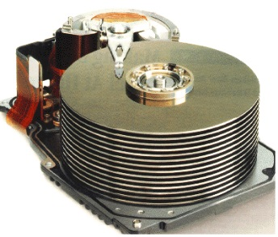


Course Map
7,8,9
10101001101
MIC
CPU
File-
System
A/D
10
10101001101
NIC
Music
1
domain
conversion
5,6
Numbers correspond to course weeks
compress
sample
freq
pyscho-
acoustics
3
2
4
13
11
EULA
----------------click
OK
D/A
NIC
speaker
MP3 Player / iPhone / Droid
12

Slide 7
Course Map – Week 9
MIC
A/D
Music
1
domain
conversion
5,6
Numbers correspond to course weeks
compress
sample
freq
pyscho-
acoustics
3
2
4
EULA
----------------click
OK
D/A
10101001101
speaker
MP3 Player / iPhone / Droid

Slide 8
Quick Reminder

Slide 9

Multiplexer Gate
MUX
  When S=0, output=i0
  When S=1, output=i1
S | i0 | i1 | Mux2(S,i0,i1)
0 | 0 | 0 | 0
0 | 0 | 1 | 0
0 | 1 | 0 | 1
0 | 1 | 1 | 1
1 | 0 | 0 | 0
1 | 0 | 1 | 1
1 | 1 | 0 | 0
1 | 1 | 1 | 1

Slide 10
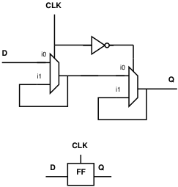
State Element
Latch or Register is a state element
Allows circuit to remember a value
Build computations that
  Depend on past inputs
  Reuse hardware in time

Slide 11
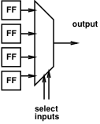
Mux can be a programmable Gate
Programmable Gate
  Can be programmed to act as any gate
  Use state (e.g. FF) to “program” truth table of a gate
Input 0 | Input 1 | Output
0 | 0
0 | 1
1 | 0
1 | 1

Slide 12
NAND Universality
Can implement any combinational logic function out of a collection of NAND2 gates
  Or AND, OR, NOT combination
  Or Programmable MUX gates

Slide 13
Preclass 1
What Function?
  o1=a&b | b&c | a&c;
  o2=a^b^c;
How many gates?

Slide 14
Preclass 1 in Gates

Slide 15
Memory

Slide 16
Random Access Memory
A Memory:
  Series of locations (slots)
  Can write values a slot (specified by address, WA)
  Read values from (by address, RA)
  Return last value written
Notation:
slash on wire
means multiple bits wide

Slide 17
Key Engineering Property
Store state compactly in memory
A(memory cell) small
  A(mem) < A(gate)
Depends on few
inputs/outputs
  Memory cells share
  inputs and outputs
Look inside next time

Slide 18
One-Gate Processor

Slide 19
Idea
Store logical (simulated) register and gate outputs in memory
Compute one gate at a time
  Using a single physical gate

Slide 20
Basic Idiom
Memory
Repeat:
Read gate value from memory
Perform operation on gate
Write result back to memory
Physical, Programmable Gate

Slide 21

Operation
a=getInput(0);
b=getInput(1);
c=getInput(2);
t1=a&b; // 1
t2=b&c; // 2
t1=t1|t2; // 3
t2=a&c; // 4
o1=t1|t2; // 5
t1=a^b; // 6
o2=t1^c; // 7
putOutput(1,o2);
putOutput(0,o1);
t1
t2
t2
t1
t1
o1
o2

Slide 22
Operation Sequence
Missing
C step?
Missing description?

Slide 23
Observe
We can sequentialize operations,
reusing the single gate
As long as we can specify the
operation to be performed
What are we specifying?
  (break it down, what information need?)

Slide 24
Instruction
Call this specification an instruction
Instructs the programmable,
reusable operators on what to perform

Slide 25
Instruction
Call this specification an instruction
Instructs the programmable,
reusable operators on what to perform

Slide 26
Expanding the Structure: Input
Add a multiplexer to bring in inputs
Allow as option to write into data memory

Slide 27
Expanding the Structure: Output
Add way to load a designated output register

Slide 28
Expanded Control = Instruction
Group the full control into instruction
Set of bits that tells the structure what to do

Slide 29
Fillin missing Instruction

Slide 30

Instruction Bits
Instructions are just a set of bits
Type – 2 bits
GateOp – 4 bits
In1 – 3 bits
  Assume 8 slots
In2 – 3 bits
Out – 3 bits

Slide 31
Instruction Bits Example
Fillin Missing

Slide 32
Note Write
Note write enable
  Fed back for next cycle
  Also address, value

Slide 33
Instruction Sequence Control
How provide the sequence of instructions?

Slide 34
Instruction
Memory
Add Memory to hold set of Instructions
  Note contents match table on p. 2 of preclass
Counter to sequence instructions

Slide 35
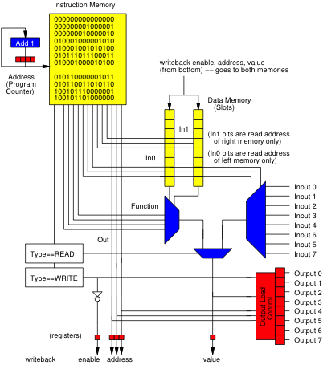
Animate
0
Start at PC=0

Slide 36
Animate
1
0
Start at PC=0
Read Instr. Mem at 0
(also compute next PC by adding 1)
000000000000000
000
000
0000
00
000

Slide 37
Animate
1
0
Start at PC=0
Read Instr. Mem at 0
Decode
000000000000000
000
000
a
0000
00
1
0
000

Slide 38
Animate
1
0
Start at PC=0
Read Instr. Mem at 0
Decode
From input
000000000000000
000
000
a
0000
a
00
1
0
000
a

Slide 39
Animate
a
1
Start at PC=0
Read Instr. Mem at 0
Decode
From input
Write Back
Update PC
a
000000000000000
a
000
000
a
0000
a
00
1
0
000
a
a

Slide 40
Animate
a
2
1
PC=1
Read Instr. Mem at 1
a
000000001000001
a
000
001
a
b
0000
a
00
1
0
001
a
a

Slide 41
Animate
a
2
1
PC=1
Read Instr. Mem at 1
Decode
From Input
a
000000001000001
a
000
001
a
b
0000
b
00
1
0
001
b
a

Slide 42
Animate
a
2
PC=1
Read Instr. Mem at 1
Decode
From Input
Writeback and update PC
a
000000001000001
a
000
b
b
001
a
b
0000
b
00
1
0
001
b
a

Slide 43
Animate
a
3
2
PC=2
Another read
a
000000010000010
a
000
b
b
010
a
b
0000
c
c
00
1
0
010
c
a

Slide 44
Animate
a
3
PC=2
Another read
Writeback, update PC
a
000000010000010
a
000
b
b
c
c
010
a
b
0000
c
c
00
1
0
010
c
a

Slide 45
Animate
a
3
PC=3
a
010001000001011
a
001
b
b
c
c
000
a
a
b
b
0001
c
a&b
01
0
0
011
a&b
a

Slide 46
Animate
a
4
PC=3
Writeback and update PC
a
010001000001011
a
001
b
b
c
c
a&b
000
a
a
b
b
0001
c
a&b
01
0
0
011
a&b
a

Slide 47
Processor
Continue this sequence
  Given PC
  Read from Instruction Memory
  Instruction bits control the datapath (memories, function, muxes)
    Read from data memory
    Perform operation
  Write results back to memory; update PC

Slide 48
Basic Idiom
Repeat:
Read gate value from memory
Perform operation on gate
Write result back to memory

Slide 49
Universal
Processor
Can change computation simply be changing contents of instruction memory

Slide 50
Review
Single active compute element (programmable gate)
Sequence in time
Store state in memory
Use Instruction memory to select and sequence operations
Can compute a large number of gates

Slide 51
Next Lab
Look at Instruction-Level code for ARM
Understand performance from instruction-level code
Lab 8 posted on syllabus

Slide 52
Big Ideas
Can implement large computations on small hardware by reusing hardware in time
  Storing computational state in memory
Can store program control in instruction memory
  Change program by reprogramming memory
  Universal machine: Stored-Program Processor

Slide 53
Learn More
CIS240 – processor organization and assembly
CIS471 – implement and optimize processors
  Including FPGA mapping in Verilog
ESE370 – implement memories (and gates) using transistors

Slide 54
Reminders
Feedback
Lab 7 due today
Lab 8 Monday

