Slide 1



Lecture #16 – Stored-Program Processors
ESE 150 –
Digital Audio Basics
Based on slides © 2009--2021 DeHon

Slide 2
Lecture Topics
Setup
Where are we?
Review
Memory
Wide-Word, Stored-Program Processor
Contemporary Processor: ARM

Slide 3









Course Map – Week 9
MIC
A/D
Music
1
domain
conversion
5,6
Numbers correspond to course weeks
compress
sample
freq
pyscho-
acoustics
3
2
4
EULA
----------------click
OK
D/A
10101001101
speaker
MP3 Player / iPhone / Droid

Slide 4
Quick Reminder

Slide 5
Review
Single active compute element (programmable gate)
Sequence in time
Store state in memory
Use Instruction memory to select and sequence operations
Can compute a large number of gates

Slide 6
Preclass 1
A | T | F | i1 | i2 | o | 0 | 1 | 2 | 3 | 4 | 5 | 6 | 7
4 | G | & | 1 | 2 | 4 | 1 | 1 | 0 | 1 | 0 | 0 | 0 | 0
5 | G | | | 3 | 4 | 3
6 | G | & | 0 | 2 | 4
7 | G | | | 3 | 4 | 5
8

Slide 7
Stored-Program Processor

Slide 8
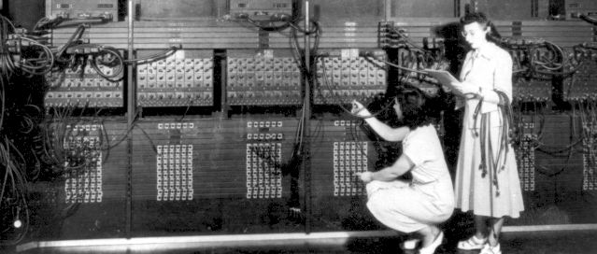
“Stored Program” Computer
Can build physical machines that perform any computation.
Can be built with limited hardware that is reused in time.
Historically: this was a key contribution of Penn’s Moore School
  ENIAC→ EDVAC
  Computer Engineers:
  Eckert and Mauchly
  (often credited to
  Von Neumann)

Slide 9
Basic Idea
Express computation
in terms of a few primitives
  E.g. Add, Multiply, OR, AND, NAND
Provide one of each hardware primitive
Store intermediates in memory
Sequence operations on hardware to perform larger computation
Store description of operation sequence in memory as well – hence “Stored Program”
By filling in memory, can program to perform any computation

Slide 10
Memory

Slide 11
Random Access Memory
A Memory:
  Series of locations (slots)
  Can write values a slot (specified by address, WA)
  Read values from (by address, RA)
  Return last value written
Notation:
slash on wire
means multiple bits wide

Slide 12
Two Pieces of a Memory
Element to remember a value
Way to address/select that element

Slide 13
Could build Memory w/ Muxes & latches
… collection of registers
Use latch to remember (store) values
Perform read select (addressing) with a multiplexer

Slide 14
Could build Memory w/ Muxes & latches
… collection of registers
Perform write select (addressing) with a decoder

Slide 15
Could build Memory w/ Muxes & latches
… collection of registers
Show Decoder logic

Slide 16
Could build Memory w/ Muxes & latches
… collection of registers
Show Decoder logic

Slide 17
Random Access Memory (RAM) with Capacitor Memories
Din
Decoder
Write?
WA
RA
Learn more: ESE370
Dout

Slide 18
Key Engineering Property
Store state compactly in memory
A(memory cell) small
  A(mem) < A(gate)
Depends on few
inputs/outputs
  Memory cells share
  inputs and outputs

Slide 19
Expand Processor

Slide 20
Building Out
How limited?
How might improve?

Slide 21
Processors

Slide 22
Beyond Single Gate
Single gate extreme to make the high-level point
  Except in some particular cases, not practical
Usually reuse larger blocks
  Multi-bit Adders
  Multipliers
Get more done per cycle than one gate
Now it’s a matter of engineering the design point
  Where do we want to be between one gate and full circuit extreme?
  How many gate evaluations should we physically compute each cycle?

Slide 23
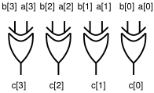
Word-Wide Processors
Common to compute on multibit words
  Add two 16b numbers
  Multiply two 16b numbers
  Perform bitwise-XOR on two 32b numbers
More hardware
  16 full adders, 32 XOR gates
All programmable gates doing the same thing
  So don’t require more instruction bits

Slide 24
Multibit Bus Symbols

Slide 25
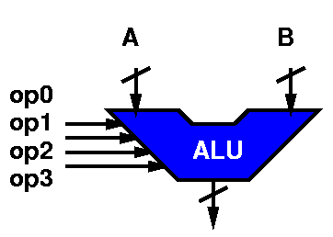
Arithmetic and Logic Unit (ALU)
A common logic primitive is the ALU
  Can perform any of a number of operations on a series of words (strings of bits)
  Operations: Add, subtract, shift-left, shift-right, bitswise xor, and, or, invert, ….
  Operates on “words”
Identify a set of control bits that select the operation it forms
  Makes it “programmable”

Slide 26
ALU Ops (on 8bit words)
  ADD 00011000 00010100 =
  Add 0x18 to 0x14 result is:
  Add 24 to 20

Slide 27
ALU Ops (on 8bit words)
  ADD 00011000 00010100 = 00101100
  Add 0x18 to 0x14 =0x2C0
  Add 24 to 20 =44
SUB 00011000 00010100 = 00000100
  Subtract 0x14 from 0x18 .. 0x04
INV 00011000 XXXXXXXX =
  Invert the bits in 0x18 ...gives us:

Slide 28
ALU Ops (on 8bit words)
XOR 00011000 00010100 = 0001100
    xor 0x18 to 0x14 = 0x0C
  ADD 00011000 00010100 = 00101100
  Add 0x18 to 0x14 =0x2C0
  Add 24 to 20 =44
SUB 00011000 00010100 = 00000100
  Subtract 0x14 from 0x18 .. 0x04
INV 00011000 XXXXXXXX = 11100111
  Invert the bits in 0x18 …0xD7
SRL 00011000 XXXXXXXX =
  Shift right 0x18 … gives us:

Slide 29
ALU Ops (on 8bit words)
  ADD 00011000 00010100 = 00101100
  Add 0x18 to 0x14 =0x2C0
  Add 24 to 20 =44
SUB 00011000 00010100 = 00000100
  Subtract 0x14 from 0x18 .. 0x04
INV 00011000 XXXXXXXX = 11100111
  Invert the bits in 0x18 …0xD7
SRL 00011000 XXXXXXXX = 00001100
  Shift right 0x18 …0x0C

Slide 30
ALU Ops (on 8bit words)
  ADD 00011000 00010100 = 00101100
  Add 0x18 to 0x14 =0x2C0
  Add 24 to 20 =44
SUB 00011000 00010100 = 00000100
  Subtract 0x14 from 0x18 .. 0x04
INV 00011000 XXXXXXXX = 11100111
  Invert the bits in 0x18 …0xD7
SRL 00011000 XXXXXXXX = 00001100
  Shift right 0x18 …0x0C
XOR 00011000 00010100 = 0001100
    xor 0x18 to 0x14 = 0x0C

Slide 31
ALU Encoding
Each operation has some bit sequence
ADD 0000
SUB 0010
INV 0001
SLL 1110
SLR 1100
AND 1000

Slide 32
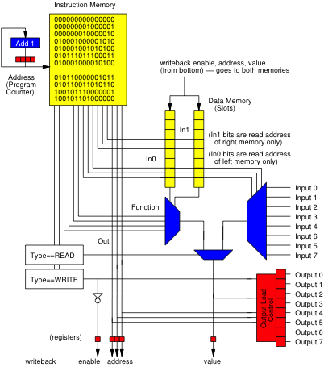
ALU-based Word-Wide Processor

Slide 33
ALU-based Word-Wide Processor

Slide 34
Beyond Linear Sequence
So far, processor can run a fixed sequence
Cannot
  Implement a loop
  Implement an if-then-else

Slide 35
Branching
Allow PC to advance
by value other than 1
  Could be negative
Allow data to impact
selection
  Only load when data bit is 1
Add Instruction bits
(or instruction) to
control loading
BRANCH if (SRC1[0]==1) to PC+SRC2

Slide 36
Branching
How
  Branch to top of loop?
  BR r0 r2 // branch back 12 instrs
    // 1 r0
    // need -12 in r2
  Conditionally branch
  to top of loop?
  BR r0 -12 // branch back 12 instrs
    // compute condition into r0

Slide 37
Branching
How
  Implement if-then?
  Sketch
    // compute condition into r0
    //Need TRUE_OFFSET in r7
    BR r0 r7
    <code else case>
    // 1 in r0
    // load length of true case into r7
    BR r0 r7// branch over true
    <code true case,
    target of TRUE_OFFSET>
    <code after loop>

Slide 38
Contemporary Processors

Slide 39
iPod, ItsyBitsy
Processor
Compare ARM7

Slide 40
Basic Arithmetic
ADD Rd, Rn, Rm
  Means: Rd=Rn+Rm
Similar: OR, XOR, AND, SUB, MUL
MLA – Multiply Accumulate
  MLA Rd,Rm,Rs,Rn
  Means: Rd=Rm*Rs+Rn
  (options to use pair of registers for Rd,Rn)

Slide 41
Large Memory
Add Large Memory for Bulk data storage

Slide 42
Load-Store Archtecture
Add instructions to move data between large memory and small (Register File)
LD Rd,Rsrc
  Means: Rd = Mem[Rsrc]
ST Rsrc1,Rsrc2
  Means: Mem[Rsrc2]=Rsrc1

Slide 43
ARM Load-Store Instructions
LDR Rd, [Rn]
  Mean: Rd=Mem[Rn]
STR Rd, [Rn]
  Mean: Mem[Rn]=Rd

Slide 44
Big Ideas
Memory stores data compactly
Can implement large computations on small hardware by reusing hardware in time
  Storing computational state in memory
Can store program control in instruction memory
  Change program by reprogramming memory
  Universal machine: Stored-Program Processor

Slide 45
Learn More
CIS240 – processor organization and assembly
CIS471 – implement and optimize processors
  Including FPGA mapping in Verilog
ESE370 – implement memories (and gates) using transistors

Slide 46
Reminders
Feeback
Lab 8 due on Friday

