Slide 1



Lecture #18 – Operating Systems (OS)
ESE 150 –
Digital Audio Basics
Based on slides © 2009--2021 DeHon

Slide 2
Observation
We want our phones (and computers) to do many things at once.
If we dedicate a processor to MP3 decoding
  It will sit idle most of the time
MP3 decoding (and many other things) do not consume a modern processor
Idea: Maybe we can share the processor among tasks?

Slide 3
Big Idea
Provide the illusion of (virtually) unlimited processors by sharing single processor in time
Strategy
  Time-share processor
    Store all process (virtual processors) state in memory
    Iterate through processes
      Restore process state
      Run for a number of cycles
      Save process state

Slide 4
Outline
Review
Worksheet: Virtualization In Action

Slide 5



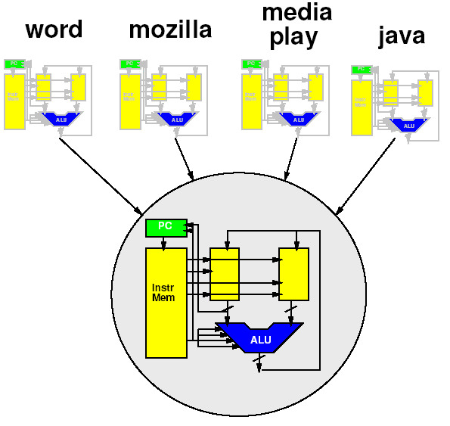








Course Map – Week 10
MIC
A/D
Music
1
domain
conversion
5,6
Numbers correspond to course weeks
compress
sample
freq
pyscho-
acoustics
3
2
4
EULA
----------------click
OK
D/A
10101001101
speaker
MP3 Player / iPhone / Droid

Slide 6
Role of Operating System
Higher-level, shared support for all programs
  Could put it in program, but most programs need it!
  Needs to be abstracted from program
Resource sharing
  Processor, memory, “devices” (net, printer, audio)
Polite sharing
  Isolation and protection
  Fences make Good Neighbors – R. Frost
Idea: Expensive/limited resources can be shared in time – OS manages this sharing

Slide 7
Virtualization

Slide 8
Idea
Virtualize the processor
  Make it look like we have multiple processors
  With each program running on its own processor
“Own” processor
  Can put data in memory where it wants
  Doesn’t have to worry about another program scribbling over its memory
  Its state is preserved and isolated
  Looks like it runs all the time on the processor
    Doesn’t need to be programmed to allow other programs to run

Slide 9
Key Idea
Can capture state of a processor
  All the information that defines the current point in the computation
  i.e. program counter, data and instruction memory
Can save that in memory
  A different memory from what the process sees
  (could be different range of addresses)
Fully represents the running program
Can restore that from memory to the processor
Can save/restore without affecting the functional behavior of the program

Slide 10
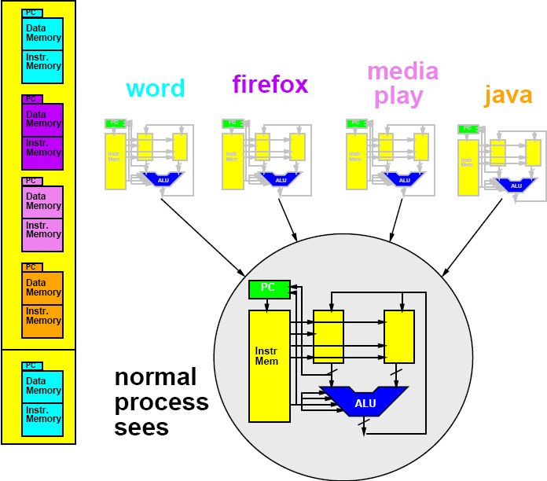
Memory Save/Restore
Memory Save/Restore

Slide 11
Memory Save/Restore
Memory Save/Restore
Save

Slide 12
Memory Save/Restore

Slide 13
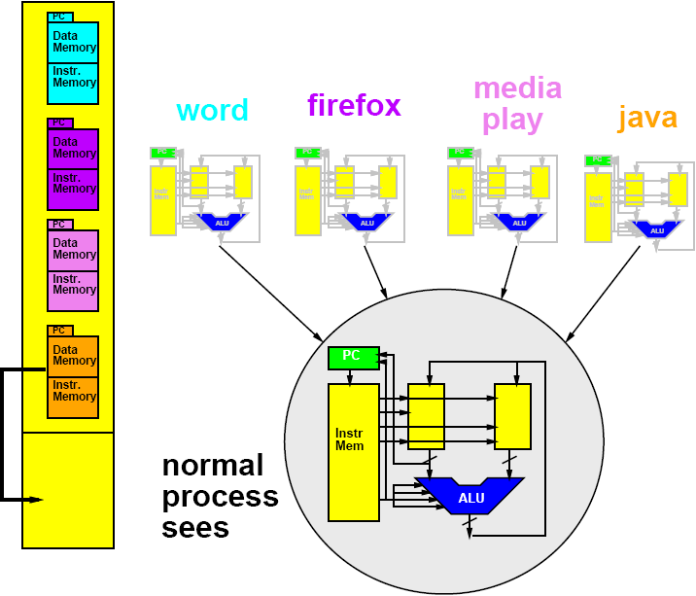
Memory Save/Restore
Restore

Slide 14
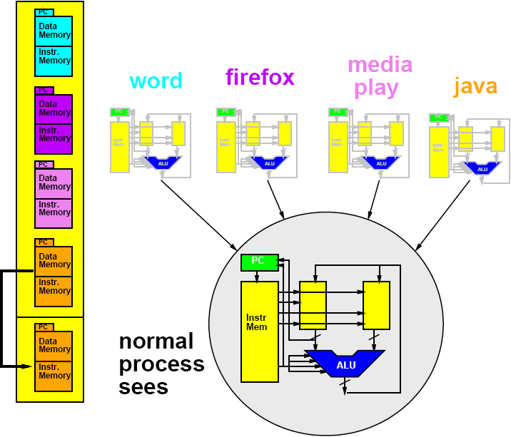
Memory Save/Restore
Restore

Slide 15
Sharing Processor
Now that we can save/restore the state
Can share processor among processes
  (Restore state; run for time; save state)
Isolation: none of the processes need to know about each other
  Each thinks it has the a whole machine
  Just need to restore/save state
  around epochs where the process
  gets to run on the processor

Slide 16
Demonstration
Worksheet Exercise

Slide 17
Worksheet: Execution Exercise
We’re going to simulate the computer and watch the processor state

Slide 18
Execution: Getting Started
0
5
35
255
66
1
5
35
0
66
2
5
1
0
66

Slide 19
Execution Exercise
Google Doc – simulate A for 12 cycles

Slide 20
Simulate Swapping
Imagine we ran A for 6 cycles (and saved state)
Swap and Run B for 6 cycles
Swap and Run A for next 6 cycles
  What should we get?
Swap and Run B for next 6 cycles

Slide 21
Simulate Swapping
Simulate B for 6 cycles
  Individually
What get?

Slide 22
Simulate Swapping
Swap in A+6 and Simulate for 6 cycles (to 12)
  individually
What get?

Slide 23
Simulate Swapping
Swap in B+6 and Simulate for 6 cycles (to 12)
  individually
What get?

Slide 24
Simulate Swapping
Imagine we ran A for 6 cycles (and saved state)
Swap and Run B for 6 cycles
Swap and Run A for next 6 cycles
  What should we get?
Swap and Run B for next 6 cycles

Slide 25
Review: Key Idea
Can capture state of a processor
  All the information that defines the current point in the computation (PC, data and instruction mem)
Can save that in memory
  A different memory from what the process sees
  (could be different range of addresses)
Fully represents the running program
Can restore that from memory to the processor
Can save/restore without affecting the functional behavior of the program
Time-share processor → pretend have unlimited number

Slide 26
Media Processors

Slide 27
iPod Processor
Early based on PortalPlayer series
  Two ARM7TDMI cores
  80MHz each
Guesses are ARM7 or ARM8

Slide 28
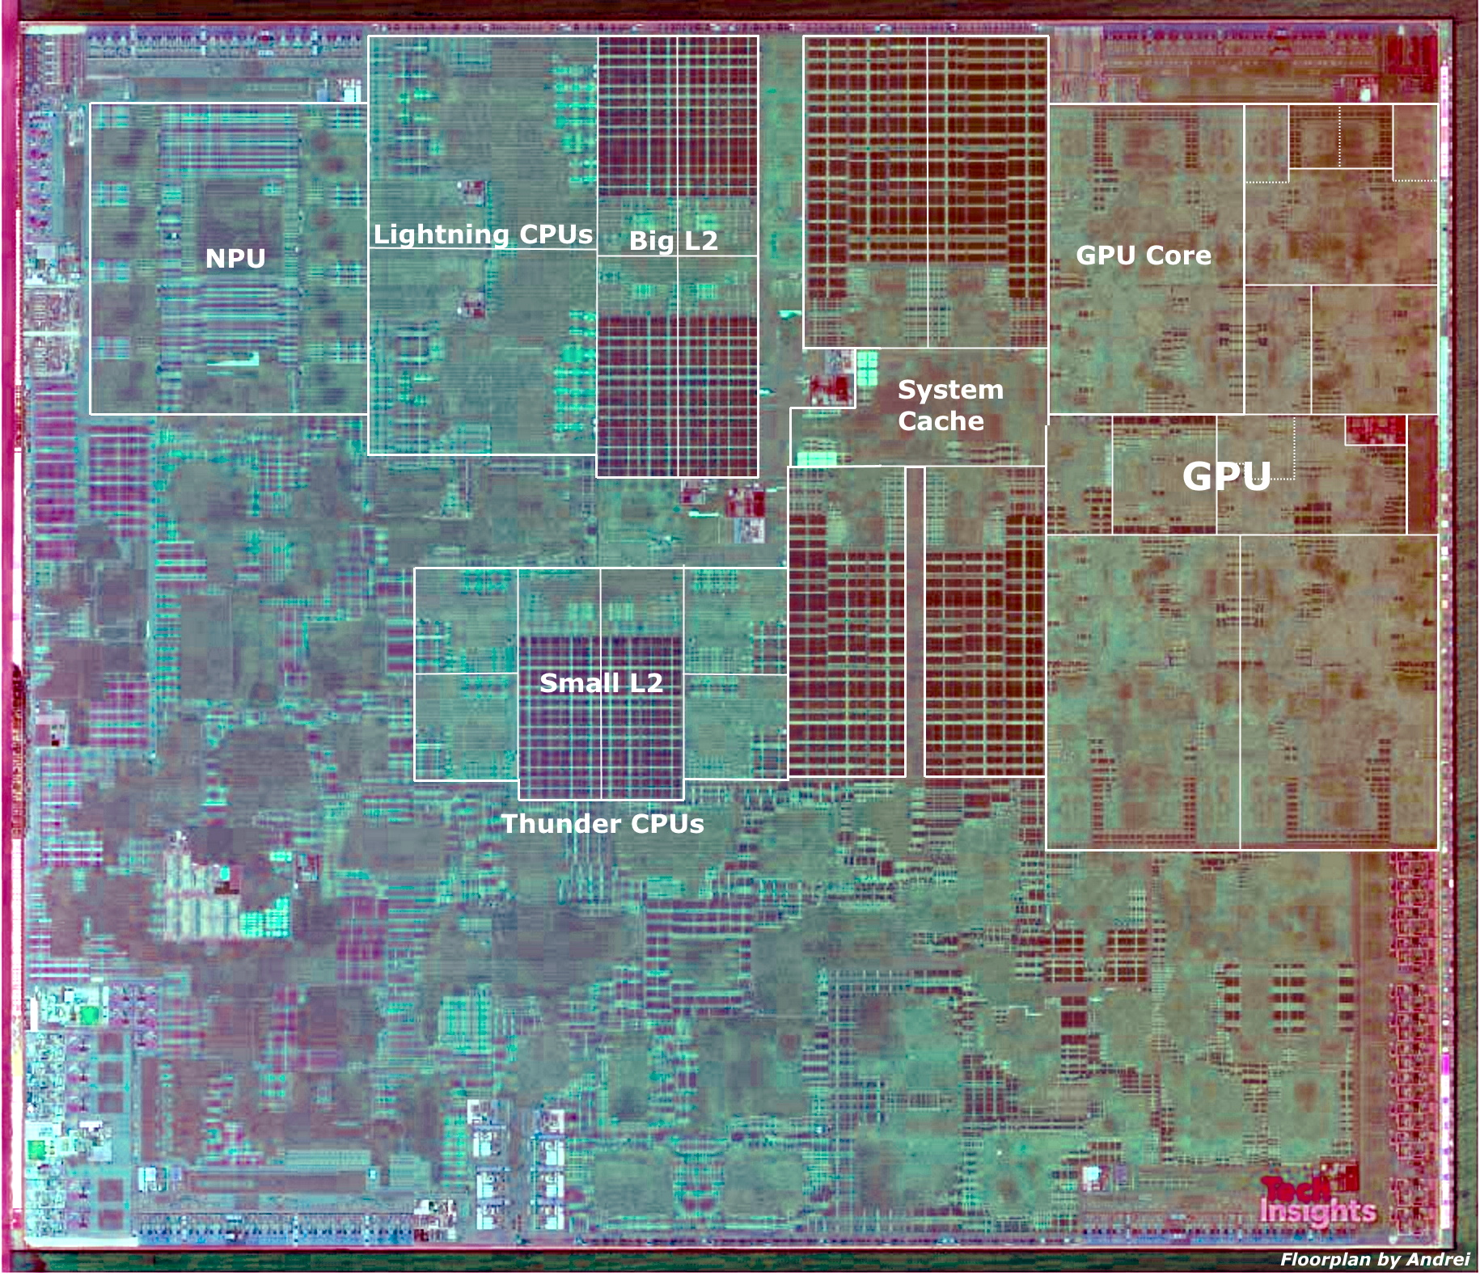
Apple A13 Bionic
98mm², 7nm
8.5 Billion Tr.
iPhone 11 +
6 ARM cores
  2 fast (2.6GHz)
  4 low energy
4 custom GPUs
Neural Engine
  5 Trillion ops/s?

Slide 29
Big Ideas
Virtualize hardware
  Identify state; save/restore from memory
Program view: owns complete machine
Allows programs to share limited physical hardware (e.g. processor)
  Provide illusion of unlimited hardware
Operating System is the program that manages this sharing

Slide 30
Learn More
CIS380 – Operating Systems

Slide 31
Reminders
Feedback
Lab9 due on Friday

