Slide 1



Lecture #20 – Networking
ESE 150 –
Digital Audio Basics

Slide 2
Lecture Topics
Where are we on course map?
Review
Networks
  Network Layering
    Transport
    Network – Routing – what can go wrong?
    Physical (physical layer independence)
    By end: seen TCP/IP basics
Next Lab

Slide 3










Course Map – Week 11
7,8,9
10101001101
MIC
CPU
A/D
10101001101
NIC
Music
1
domain
conversion
6
Numbers correspond to course weeks
compress
compress
sample
freq
pyscho-
acoustics
3
3
2,5
4
10
D/A
NIC
speaker
MP3 Player / iPhone / Droid

Slide 4
Review
Fundamentals of Networks

Slide 5
Networked Systems
Today
  We expect our computers to be networked
    Google, wikipedia, Email, IM, …
  Can work stand alone
    Airplane mode?
  But, are crippled when not connected
  Phone isn’t a phone unless its networked

Slide 6
Implications?
Today’s wire bandwidth exceeds the throughput needs of any real-time single-stream data
  Can afford to share the wire
Wires are not cheap
  Cannot afford not to share the wire

Slide 7
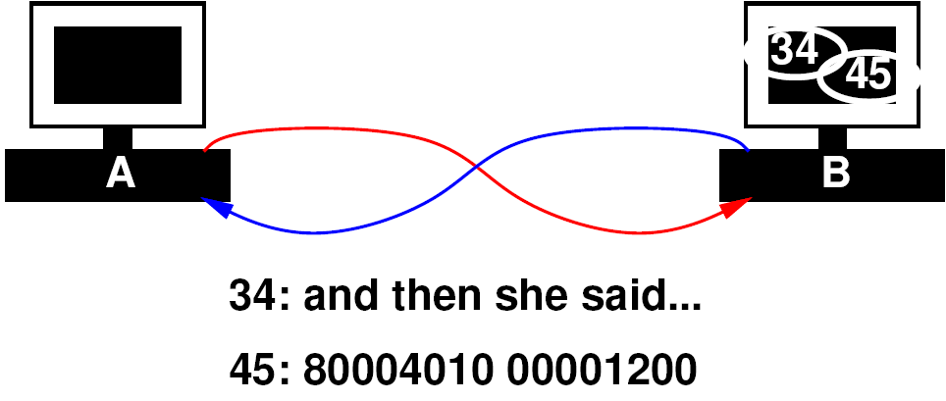
Sharing Link
Idea: Tag data with target
  “this is for process 34”
  “this is for process 45”
Have transport layer deal with…
  Mixing data from separate streams
  Separating data out into individual streams
  Delivering to individual processes

Slide 8
Packet
Begin to form a packet
  Header: says where to go
  Payload: the data to send
Header:
  Added, consumed by network handling in routing
Payload:
  Only thing seen by the application processes

Slide 9
Simulation 1
Server
Send 4 verses or digits from each
  from song-server-app, even-server-app
  to song-listener-app, even-consumer
All go through one wire W1
T1 – Transport tagging
T2 – Transport sorting
SA1
SA2
T1
Host
W1
Host
T2
CA1
CA2
Client

Slide 10
Start Simple
Add more computers to same pair of wires
  All computers on wire see all the data on the wire
  How do computers know who the message is for?

Slide 11
Extended Packet
Extend our packet header:
  Destination computer
  Process on destination computer
  Sending computer
  Process on sending computer

Slide 12
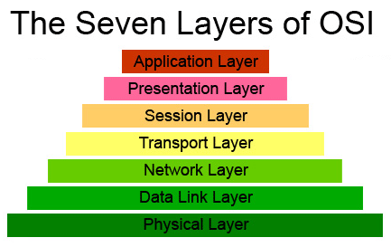
Network Layer
responsible for end-to-end (source to destination) packet delivery

Slide 13
Virtualization Effect
Each pair of processes on different computers
  Has the view of a point-to-point connection
  Each process, thinks it “owns the network” and has a dedicated connection to the other node

Slide 14
Abstractions for Sharing
Virtualized Processor
  Share single processor among multiple tasks
  Make it look like process (program) has its own processor
Virtualized Communication between programs
  Share wires and processors
  Make it look like a dedicated point-to-point link between processes (programs)

Slide 15
Network Simulation

Slide 16
Simulation 2
Send 4 verses or digits from each
  from song-server serving 2 songs
  And digit-server serving 2 fundamental constants
  To two clients

Slide 17
Simulation 2
SA1
Server
SA2
SA3
Server
SA4
T1
T3
N1
N3
Host
Host
W1
N2
Host
Host
N4
T2
T4
CA1
CA2
CA3
CA4
Client
Client

Slide 18
Simulation 2
SA1
Server
SA2
SA3
Server
SA4
T1
T3
N1
N3
Host
Host
W1
N2
Host
Host
N4
T2
T4
CA1
CA2
CA3
CA4
Client
Client

Slide 19
Simulation 2
N1, N3
  Add network-layer source/destination packet headers
W1 – Wire
  Duplicate packets to both destinations
  Simulate shared wire
N2, N4
  Look at network-layer source/destination header
  Discard packets not destined for this computer

Slide 20
Simulation 2
SA1
Server
SA2
SA3
Server
SA4
T1
T3
N1
N3
Host
Host
W1
N2
Host
Host
N4
T2
T4
CA1
CA2
CA3
CA4
Client
Client

Slide 21
Extending the Virtual Link

Slide 22
Indirect Connections
A and B are connected
B and C are connected
How get message from A to C?
  We could add a wire between A and C…
  But with 8+ billion nodes on network…

Slide 23
Indirect Connections
Run program/process on B to forward messages from A to C
  Call it a “routing” program! Routes messages on network

Slide 24
Routing
B runs a general program
  If packet destined for B, takes it
  Otherwise, sends on to (toward) destination
Extension of the network handling process that is sorting data to processes

Slide 25
Routing

Slide 26
Reachability
If everyone plays along
  We can communicate with any computer reachable transitively from my computer
Don’t need direct connections

Slide 27
Routing → Route Tables
To make efficient
  Each computer should route close to destination
  …and not route in circles
E.g. compute all-pairs shortest paths (CIS160,121)
  Store result, each machine knows where to send packet next
  How much storage?
    Cleverness to compress/summarize
  Additional cleverness to compute incremental updates
    When add a computer or a link breaks

Slide 28
Network Layer
Responsible for end-to-end packet delivery
  Source to Destination
  This includes routing packets through intermediate hosts

Slide 29
Simulation 3
Send 4 verses or digits from each
  from letter-server serving 2 strings
  And digit-server serving 2 fundamental constants
  To two clients
R1 – pass along packets to R2 (for now)
R2 – look at address and send to N2 or N4

Slide 30
Sim
3
Server
SA1
Server
SA2
SA3
SA4
T1
T3
N1
N3
Host
Host
R1
Simulation 3
R2
N2
Host
Host
N4
T2
T4
CA1
CA2
CA3
CA4
Client
Client

Slide 31
Simulation 3 Simplification
T1/N1, T3/N3 same as before
Same set of inputs to R1 as we had for W1
  So we will start with those.
T2, T4 gets same inputs
  So, won’t rerun that part.
Focus on R1, R2, N2, N4

Slide 32
Sim
3
Server
SA1
Server
SA2
SA3
SA4
T1
T3
N1
N3
Host
Host
R1
Simulation 3
R2
N2
Host
Host
N4
T2
T4
CA1
CA2
CA3
CA4
Client
Client

Slide 33
Simulation 4
Send 4 verses or digits from each
  from song-server serving 2 songs
  And digit-server serving 2 fundamental constants
  To two clients
Roles:
  4 server apps
  Network Interface, 2 servers
  3 routers
    R1 – flip a coin and send to R2 or R3
    R2, R3 – send to N2, N4 based on address
  Network Interface for each of 2 clients
  4 client apps
R1
R2
R3

Slide 34
Sim
4
Server
SA1
Server
SA2
SA3
SA4
T1
T3
N1
N3
Host
Host
R1
Simulation 4
R2
R3
N2
Host
Host
N4
T2
T4
CA1
CA2
CA3
CA4
Client
Client

Slide 35
Where are we now?
Can communicate
  From one process on a computer
  to any other process on any other computer
  if the two are transitively connected
    By a set of participating computers which route data
Layers have provided “Abstraction”
  Processes just see streams of data between the endpoints

Slide 36
Layers
Application
Application
(abstraction)
Transport
Transport
Network
Network
Link
Link
Physical
Physical

Slide 37
Protocols
Protocol – common discipline used to interoperate smoothly
  rules of the game
  Include
    How to format packets
    How to handle data
So far, we’ve discussed a protocol called IP:
  IP = Internet Protocol
Delivery to processes (rather than hosts): UDP
  UDP = Unreliable Datagram Protocol

Slide 38
Simulation 5
Send 4 verses or digits from each
  from letter-server serving 2 strings
  And digit-server serving 2 fundamental constants
  To two clients
Deliberately delay data through R3
  Model non-determinism in route timing

Slide 39
Simplify Simulation
Again, simulate different core
  R1, R2, R3

Slide 40
Sim
5
Server
SA1
Server
SA2
SA3
SA4
T1
T3
N1
N3
Host
Host
R1
Simulation 5
R2
R3
R3 delayed
N2
Host
Host
N4
T2
T4
CA1
CA2
CA3
CA4
Client
Client

Slide 41
What can go wrong?
Packets arrive out of order
Solution?
  Add a sequence number

Slide 42
Simulation 6
Send 4 verses or digits from each
  from song-server serving 2 songs
  And digit-server serving 2 fundamental constants
  To two clients
T1/T3 – add sequence number to packet
T2/T4 – hold packets, reorder, and deliver in order of sequence number
R3 – still delaying packets

Slide 43
Sim
6
Server
SA1
Server
SA2
SA3
SA4
T1
T3
N1
N3
Host
Host
R1
Simulation 6
R2
R3
R3 delayed
N2
Host
Host
N4
T2
T4
CA1
CA2
CA3
CA4
Client
Client

Slide 44
Abstracting Physical Layer
Application, transport, network
  Don’t really care how the bits are moved from machine-to-machine
What are other ways we send bits?
  Beyond wires
  Optically
  RF/wireless
  Pneumatic tubes, passing paper notes, SMS Text messages…
Application
Application
Transport
Transport
Network
Network
Link
Link
Physical
Physical

Slide 45
Simulation 7
Skip
Send 4 verses or digits from each
  from song-server serving 2 songs
  And digit-server serving 2 fundamental constants
  To two clients
Roles:
  4 server apps
  Network Interface for each of 2 servers
  3 routers, connect to both servers and endpoints
    One link is via text messaging
  Network Interface for each of 2 clients
  4 client apps

Slide 46
Sim
7
Server
SA1
Server
SA2
Skip
SA3
SA4
T1
T3
N1
N3
Host
Host
R1
Simulation 7
wireless
R2
R3
N2
Host
Host
N4
T2
T4
CA1
CA2
CA3
CA4
Client
Client

Slide 47
What else can go wrong?
Bits get corrupted
Intermediate machines holding messages can crash
Messages can get misrouted

Slide 49
Data Corruption
How do we deal with data corruption?
  Use redundancy
Two strategies:
  Use enough redundancy to correct
  Use just enough redundancy to detect it
    Have the sender resend

Slide 50
Data Corruption
Relatively uncommon
  Most packets are fine
We have efficient (low overhead) ways to detect
  Compute a hash of the message data
  Highly unlikely one (few) message bit errors will result in same hash
  → checksum

Slide 51
Revised Packet
Header
Data payload
Checksum

Slide 52
Lost Packet
How can we deal with lost packets?

Slide 53
Lost Packet Strategy
Sender sends packet
  But keeps a copy
Receiver gets packet
  Checks checksum
  OK, uses packet and sends ACK
    “got your last packet intact”
  Not ok, discard packet
Sender
  Receives ACK, can discard packet and send next
  No ACK (after timeout), resend packet

Slide 54
Retransmission Discipline
Don’t depend on receiver to request retransmission
  Why?
Header may be corrupted
  Not deliver to receiver
Only know receiver got it
when it says it got it

Slide 55
Corrupted ACK
What if the ack is lost?
  Sender resends
Receiver receives a second copy
  Oops, don’t want that to be interpreted as new data
  i.e. send: “rm *; cd ..\n”
    Receive: “rm *; cd ..\n rm *; cd ..\n”

Slide 56
Avoid Duplication
How can we avoid duplication?

Slide 57
Accommodating Duplication
Use packet sequence number
  Keep track of last packet received
  If receive packet again,
    Discard the packet

Slide 58
Sequence Numbers

Slide 59
TCP
TCP = Transmission Control Protocol
  Provides Reliable delivery
  Deals with
    Retransmission
    Duplication
    Out of sequence / resequence / reconstruction

Slide 60
Transport Layer
Call this the “Transport” Layer
  responsible for reliably delivering data to the individual application process on the computer

Slide 61
Layers
Application
Application
(abstraction)
Transport
Transport
Network
Network
Link
Link
Physical
Physical

Slide 62
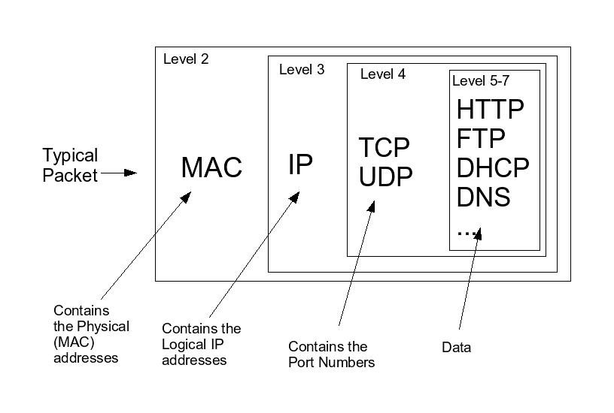
Layers and the Packet

Slide 63
Big Ideas
Sharing – Network interface, wires
  Previously gates, processor, memory
Virtualization – datastream abstracts physical point-to-point link
Layering
  Divide-and-conquer functionality
  Implementation hiding/technology independence
  Reliable communication link from unreliable elements

Slide 64
Learn More @ Penn
Courses
  ESE407 – Intro Networks and Protocols
  CIS553 – Networked Systems
  CIS549 – Wireless Mobile Communications
CIS553
ESE407
CIS549

Slide 65
Remember
Feedback
Lab 10 due Friday

