Slide 1



Lecture #21 – Actuation
ESE 150 –
Digital Audio Basics

Slide 2
Lecture Topics
Where are we on course map?
Review Sound
Sensing
Actuation
  Motor
  Servo
  Control
  PWM

Slide 3










Course Map – Week 12
7,8,9
MIC
CPU
A/D
10
10101001101
NIC
Music
1
domain
conversion
6
Numbers correspond to course weeks
compress
compress
sample
freq
pyscho-
acoustics
3
3
2,5
4
D/A
11
NIC
speaker
MP3 Player / iPhone / Droid

Slide 4
Review

Slide 5
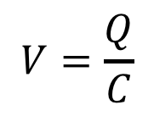

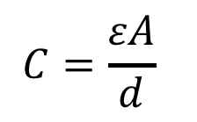
Week 1: Pressure to Voltage
Microphones convert pressure to voltage
  (speakers/headphones voltage to pressure)
  Physical position to voltage
Reason as parallel place capacitor
  ESE 112 or PHYS 151
      Δd → ΔC → ΔV
V
d
$$C=\frac{εA}{d}$$
$$Q=CV$$
$$V=\frac{Q}{C}$$
Voltage is a function of
distance (pressure)
Notes:
Δd → ΔC → ΔV

Slide 6
Speakers/Microphones
Can sense the world
  Physical effect (position)
  Convert to voltage … to bits
Can manipulate the world
  Bits → voltage
  Voltage causes physical movement

Slide 7
Sensing

Slide 8
Switch
Can easily give a high or low input
  Connected short to ground (0)
  Unconnected, weakly pulled up to high (1)
Read on input pin
Use to sense position
  Did something make content to actuate switch?

Slide 9
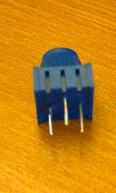
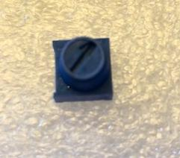
Potentiometer
Variable Resistance
  Based on position, different amount of resistance across
  R = R₀ * length
  R ~= R₀ * 2πr * (degrees/360)

Slide 10
Preclass 1
Voltage at ADC Input
  Rin=10 Ohm ?
  Rin=10K Ohm ?
Vdivide = 1000 / (Rin+1000)

Slide 11
Sense Position
Variable Resistance
  Based on position, different amount of resistance across
Voltage Divider
  Output voltage depends on
  potentiometer position/resistance
Get analog voltage out
Feed to A2D

Slide 12
Actuation

Slide 13
On-Off Switch
Logic produces a 0/1
Can control flow of much larger current
  Stop flow – off
  Enable flow – on
Transistors
  Voltage on input (gate) controls
  current flow (resistance) between
  source and drain

Slide 14
On-Off Switch
Easy to produce 0/1
Can control flow of much larger current
  Stop flow – off
  Enable flow – on
Transistors
  Voltage on input (gate) controls
  current flow (resistance) between
  source and drain
  Simplified model
    Vgate>Vref – R=Rtrans
    Vgate<Vref -- R=infinite

Slide 15
On-Off Switch
Easy to produce 0/1
Can control flow of much larger current
  Stop flow – off
  Enable flow – on
Relay
  Similar model
    Input voltage controls switch
  Mechanical switching
  Lower resistance
  Different (usually larger) voltage range, current

Slide 16
On-Off Powerful
Many things can control just by turning on or off
  How often on or off
  When turn on or off
Examples
  Temperature – when turn on heater (cooler)
  Position – turning on or off motor

Slide 17
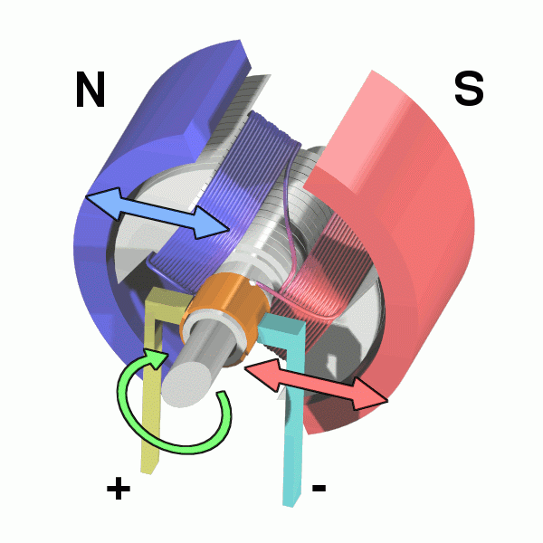
Motor – abstract view
Applying a Voltage (providing current) across a motor causes it to spin
  Magnitude of current determines how fast
Direction of current controls direction
Pictures from:
https://en.wikipedia.org/wiki/Electric_motor#/media/File:Electric_motor.gif
https://commons.wikimedia.org/wiki/File:Electric_motor_cycle_2.png

Slide 18
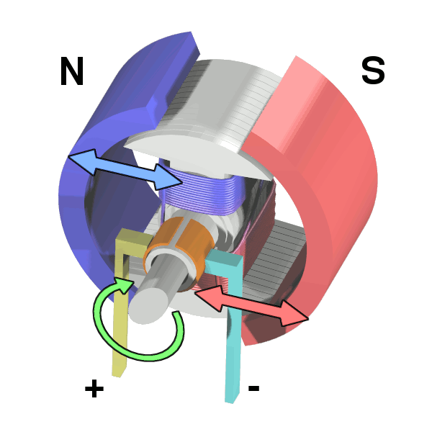
Motor
Exploits magnetic
attraction/repulsion and
electro-magnetic fields
Run current through wire windings
  Induces electromagnet
  Motor turn to line up with external
  magnets
Switch current direction
  Turns again to realign magnet
Continue to switch to cause
continuous rotation

Slide 19
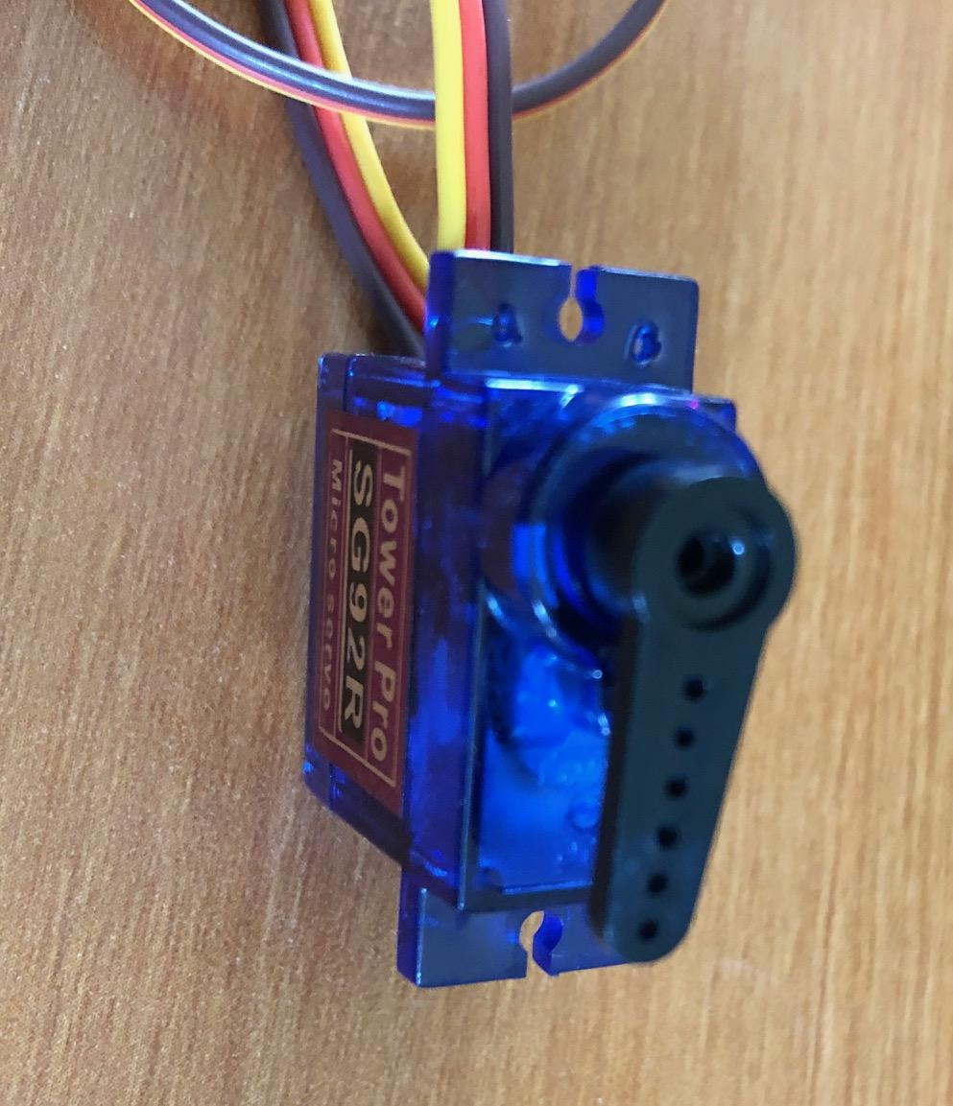
Servo – basic function
Can specify a position (0 to 180 degrees)
Will rotate shaft to position
Applications
  Steering
  Positioning
  Pan/tilt

Slide 20
Servo – How work
Motor + sensor + control
Sense if motor in position
  If not, turn on motor in appropriate direction to move closer to position

Slide 21
Servo - Control
Provide analog input
Sense with potentiometer
Is voltage above or below control target?
To Motor

Slide 22
Motivate Digital Input
Could provide Analog output from microcontroller with D2A
…but, D2A is somewhat expensive
Communicate position using single digital output
  Look at output over time period
  How much of the time period is it high/low?
  Use to communicate more than 1 bit of data

Slide 23
PWM – Pulse Width Modulation
Provide pulses at some fixed frequency (490Hz)
Vary how long the pulse is high
  Vary the width of the high pulse
Use that to communicate value (position)
Time

Slide 24
Servo
Puts some control smarts in servo package
Takes PWM input to specify position
Senses shaft rotation and engages motor to move to specified position

Slide 25
Servo Smarts
Could just do all this control from processor
  Sense position, drive motor
Often cheaper to offload that little control from processor
  Including saves pins on (wires to) processor

Slide 26
PWM encoding with Digital Logic
How convert digital number to PWM?
always @ (posedge PWM_CLK)
  cnt<=cnt+1;
  PWM<=(cnt<=digital_value)

Slide 27
PWM Decoding with Digital Logic
How convert PWM input to digital number?
always @ (posedge PWM_CLK)
  pwm_pos<=pwm_pos+1
  If (PWM) cnt<=cnt+1
  If (pwm_pos==max)
    digital_out<=cnt;
    cnt<=0;
    pwm_pos<=0;

Slide 28
Big Ideas
Information world can interact with physical world
  Sense – read state of physical world into bits for computation
  Actuate – have bits control physical world
    Turn on/off, move, position
Connect sensing and actuation to control
  Even with noisy actuators and external disturbances

Slide 29
Learn More @ Penn
Courses
  ESE350 – Embedded Systems
  ESE421 – Control for Autonomous Robots

Slide 30
Remember
Feedback
Lab 10 due today
Monday (4/12) Engagement Day
  No class
Actuation Lab will be following Monday (4/19)

