Slide 1
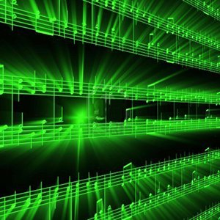
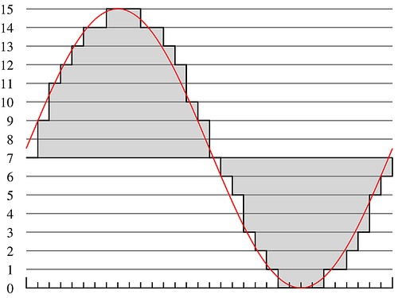
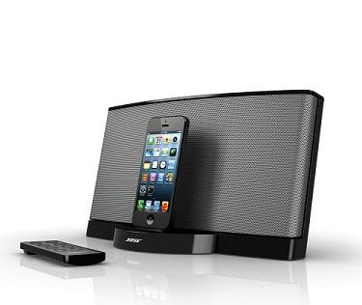
Lecture #25 – Intellectual Property 2
ESE 150 – Digital Audio Basics

Slide 2
Outline
Setup Need / Opportunity – What is IP
Where are we
Rationale for IP Protection – Why Protect
How protect?
Patents
Copyrights
Licensing
Open Source
NDA
Patent Ownership

Slide 3
Review

Slide 4
Intellectual Property Creators
As Engineers
Program, develop algorithms, design circuits
Almost everything we create will have this property
Value added is intellectual
Can be represented digitally in bits
Can (increasingly) be copied/reproduced cheaply
Easy to have impact
Our solutions can reach millions, billions
Decreasing physical barriers to propagation of solutions
Challenge to protect and reward IP creators

Slide 5
Mechanisms (To support)
Patents
Cover inventions
E.g., Flying Machine (US 821,393), ENIAC (US 3,120,606),
Copyrights
Creative expression
E.g., novel, song, movie
Article 1, Section 8, Clause 8:
To promote the Progress of Science and useful Arts, by securing for limited Times to Authors and Inventors the exclusive Right to their respective Writings and Discoveries

Slide 6
Patent
Inventions
Non-obvious to one “ordinary skill in art”
Reduced to practice
Cannot patent
Abstract ideas
Laws of nature
US: First to file
(prior to 2013 was first to invent)
Exclusive rights 20 years from filing

Slide 7
Patents (continued)

Slide 8
Patent
Identification of problem is part of invention
Claims
Define the invention
Technical coverage
Requires disclosure
If really believe no one else will figure it out…or can copy it, may be better to keep as a trade secret
License to litigate
Recover damages is through litigation
Establish violation
Validity of many patents overturned in litigation

Slide 9
Patent Process
US have one year from first-public disclosure to file
Many places – public disclosure prevent patent
https://www.uspto.gov/web/offices/pac/mpep/s2153.html
May file provisional patent to get filing date
File patent with claims
Reviewed by examiner
Examiner reports on what may be allowable
As-is
With tighter qualifications
Not-at-all
On a per-claim basis
Typically requires several iterations
Often year(s) before patent issues
Filing costs thousands of dollars
With lawyer/legal fees tens to hundreds of thousands

Slide 14
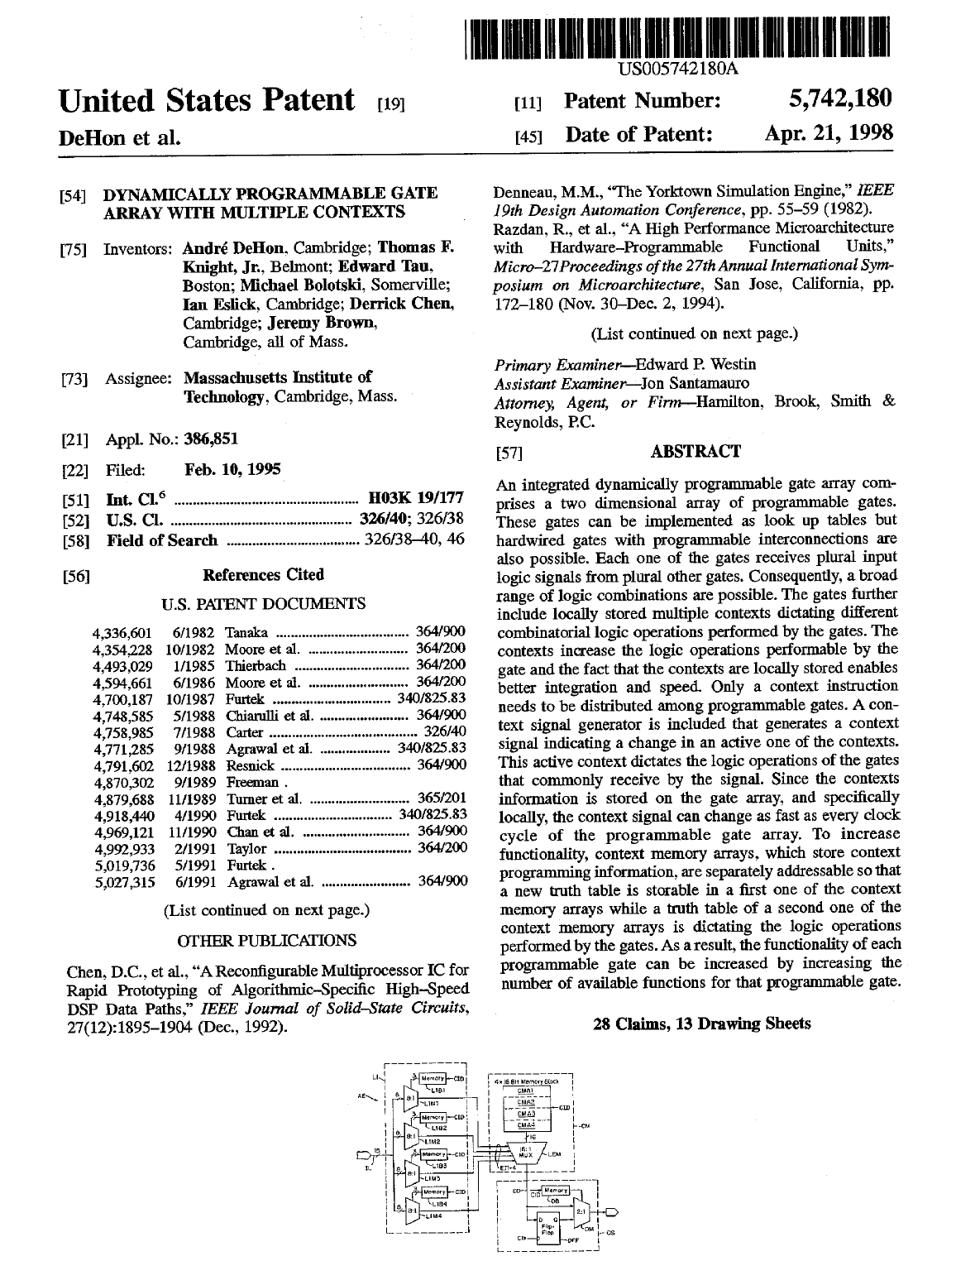

Slide 15
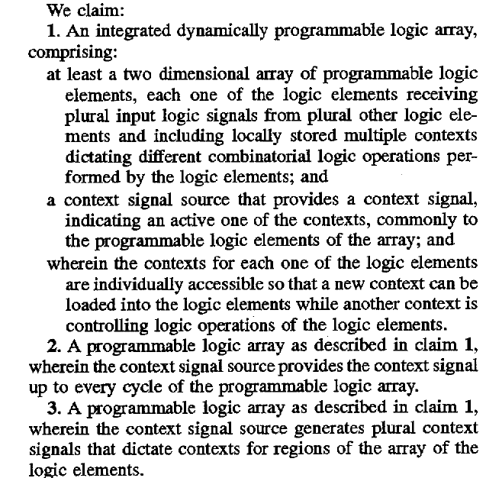
Claims

Slide 16
Xilinx FPGA US 4,870,302
https://patents.google.com/patent/US4870302A/en?oq=us+4870302

Slide 17
Xilinx FPGA Patent
When expire?

Slide 18
ENIAC US 3,120,606
1. MEANS FOR PRODUCING ELECTRIC PULSES IN SEQUENCE, ELECTRONIC MEANS FOR ALTERNATELY TRANSMITTING CERTAIN ONES OF SAID PULSES AS RECURRENT DIFFERENTIATED GROUPS, ELECTRONIC MEANS FOR SELECTING PARTICULAR PULSES FROM ONE OF SAID DIFFERENTIATED GROUPS TO REPRESENT QUANTITATIVE VALUES, ELECTRONIC MEANS FOR SELECTING PARTICULAR PULSES FROM ANOTHER OF SAID DIFFERENTIATED GROUPS TO REPRESENT CERTAIN QUALITATIVE VALUES, READING MEANS RESPONSIVE TO PULSES REPRESENTING BOTH THE QUALITATIVE AND QUANTITATIVE VALUES FOR READING DATA TO BE PROCESSED UPON COMMAND OF AT LEAST ONE OF SAID QUALITATIVE PULSES, STORING THE DATA THUS READ, AND MAKING THE DATA AVAILABLE IN THE FORM OF DATA PULSES IN RESPONSE TO AT LEAST ONE OTHER OF SAID QUALITATIVE PULSES, AND ELECTRONIC MEANS FOR RECEIVING SAID DATA PULSES AND RESPONSIVE THERETO FOR PERFORMING ELECTRICAL SWITCHING OPERATIONS OF A NATURE DETERMINED BY SELECTED ONES OF SAID QUALITATIVE VALUES AND OF A DEGREE DETERMINED BY SELECTED ONES OF SAID QUANTITATIVE VALUES.
https://www.computerhistory.org/revolution/birth-of-the-computer/4/99/387

Slide 19
What’s Patentable
Not law’s of nature
Not abstract ideas
Cannot patent pi ($π$)
Software?
Originally not
With reference to machine, can often manage
Genetic sequences?...
…evolving…

Slide 20
Patents
Who owns patent on GIF?
When did/will it expire?

Slide 21
Copyright

Slide 22
Copyright
Cover particular, original expression
Including software
Technically don’t need to register
But should…
Must register before sue for infringement
$35
No review, just registration
Life of author + 70 years
Work for hire: 95 years from publication

Slide 23
Copyright Terms
Why are there so many Sherlock Holmes related movies and series these days?
Sherlock (BBC), Elementary, Irregulars
Enola Holmes
Sherlock Holmes movies (w/ Robert Downey Jr.)
When does Mickey Mouse copyright expire?

Slide 24
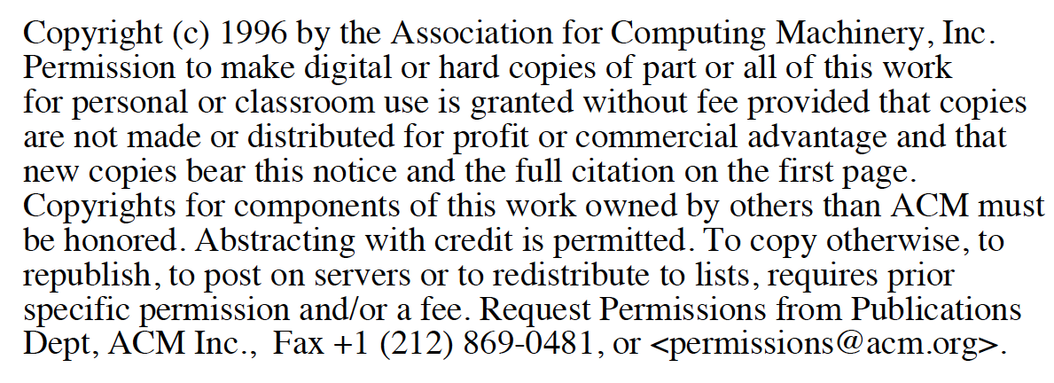
Traditionally: transfer copyright …
Publish in ACM, IEEE journal
Transfer copyright to them, they license you back rights for derived work and post on person web site.

Slide 25
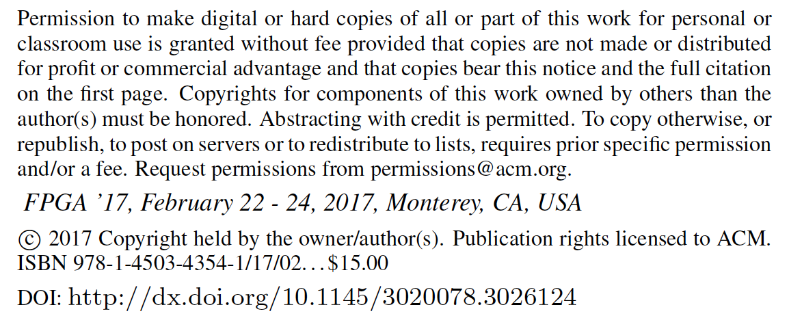
Recent: license to ACM, IEEE
Author retain copyright, license to publisher

Slide 26
Teaser
South Park: Human CenitPad
https://southpark.cc.com/clips/382781/business-casual-g-men

Slide 27
Licensing

Slide 28
License
Where have you seen licenses?

Slide 29
Licenses
How get right to use
Something patented, copyrighted by someone else
Between companies
Get IP need to build a product
To consumers
Technically, most software is licensed, not sold
…shrink-wrap/click-through licensing agreements…
Define terms of use
What you are paying for (one copy, many, resale…)
What uses (dis)allowed

Slide 30
Direct Licensing/Sales

Slide 31
Past
Selling a product require huge infrastructure and up-front capital costs
Manufacture (physical things)
Marketing
Distribution
Sales
Demand large business to support infrastructure
Not easy for individual

Slide 32
Today (emerging)
Eliminate infrastructure needs with ubiquitous networking, IP products, service businesses
Manufacture (physical things) → not issue for IP
…or licensed manufacturing
Marketing → still need to get the word out
…can use web at low cost
Distribution → not an issue for IP
…leverage common carriers
Sales
Handle online, eBusiness support
Becomes possible for individuals/small businesses to sell IP directly to consumers

Slide 33
Direct IP Businesses today
Examples?

Slide 34
Direct IP Businesses today
Kindle Direct Publishing
App Store / Google Play
AWS Marketplace
Café Press
Shapeways

Slide 35
Open Source / Creative Commons

Slide 36
Sharing
Sometimes we want to share
Isn’t it great doesn’t cost us anything to give away digital products?
Isn’t it great can build on work of others without necessary cost?
Cooperation on standards create opportunities for everyone, for an industry

Slide 37
Challenge
Patents cost money
Business (people making money) will spend money to patent things
…and typically incentivized to patent everything they can
Company (individual) could patent something and grant free license
How does individual, non-profit, etc.
Create something and protect right to share?
Variety of Open-Source/Public Domain licenses

Slide 38
Creative Commons
Framework and set of licenses for clearly expressing intent
Issues
Attribution
Share-Alike
(Non-)commercial
(No)Derivatives
Apps to choose, logos to show, legal backing to define precisely
https://creativecommons.org/share-your-work/licensing-types-examples/

Slide 39
Non-Disclosure Agreement (NDA)

Slide 40
NDA
Tool for protecting IP
Legal agreement that you won’t disclose someone information shared with you
Prevent loss of IP
Typical for collaborating companies
Typical for employers
In part to make sure sharing with you doesn’t count as “disclosure” to preclude patents
Define scope of disclosure

Slide 41
Who Owns IP?

Slide 44
Work Scenarios
Hired/paid by company to invent
Belongs to company
Invent on side on free time
…may depend on employment agreement
…whether or not subject matter overlaps with company
Consultant
By default yours, but consulting agreement may define

Slide 45
University
Based on grant funds and resources
Typically goes to university and funding source
Right of first refusal…won’t always pursue
Undergraduate
Invent in class, senior-design → yours
Graduate students paid RA from grant
Typically funded by grant and go to University
Undergraduate paid research (employee)
Typically funded by grant and go to University
Graduate students in class, using class resources
Goes to University

Slide 46
Big Ideas
We (engineers…particularly in computing space) are knowledge workers, producing IP
IP carries great value
That is less and less tied to physical objects
Need to equitably reward and encourage IP creation
Patents, Copyrights, Licenses …
Attempts to provide framework for IP ownership, sharing, monetization
…probably not the final answer, particularly as technology landscape continues to evolve.

Slide 47
Learn More
EAS 507 – IP and Business Law for Engineers
EAS 545 – Engineering Entrepreneurship
Has sections on IP

Slide 48
Remember
Feedback
Lab 11 due today
Lab 12 on Monday
Load software
Some prelab code
Final lecture on Wednesday

