Slide 1
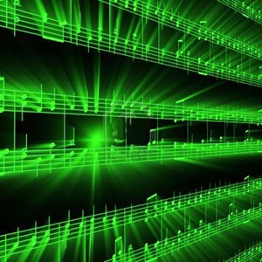


Lecture #26– Wrap Up!
ESE 150 –
Digital Audio Basics

Slide 2
Lecture Topics
Course map review
Generalize
Final
Engineering Disciplines
What’s Next?

Slide 3










Course Map
7,8,9
10101001101
MIC
CPU
A/D
10101001101
NIC
Music
1
domain
conversion
6
10
Numbers correspond to course weeks
compress
sample
freq
pyscho-
acoustics
3
2,5
4
14
EULA
----------------click
OK
D/A
NIC
11
speaker
MP3 Player / iPhone / Droid
13

Slide 4
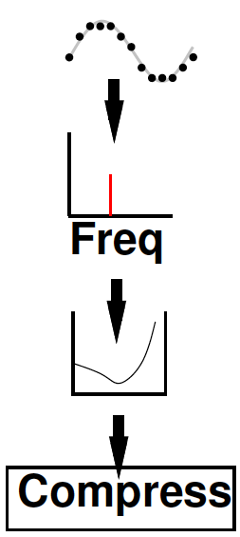
Class Story: One Slide
Sound can be converted to/from bits
  And compressed
  Without loss of information
More information can be discarded without humans noticing → fewer bits
Process this information with inexpensive machines
Store it for retrieval
Send it between machines
  Even if not directly connected

Slide 5
In the Process
Processing Requirements
Sharing hardware (OS)
Networking
Sensing and Actuation
User Interfaces
Intellectual Property
Sampling
Signal Processing
Frequency Domain
Compression
Human Hearing
Optimization

Slide 6
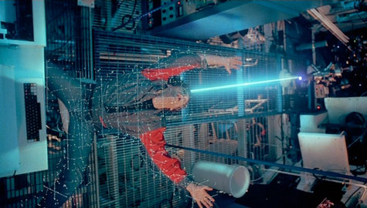
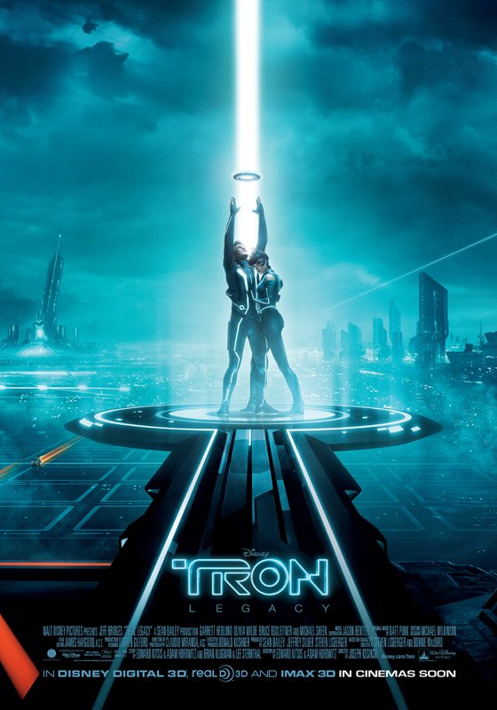
Virtualization of the
World
Can represent things as bits
  Sound, pictures, movies
  Location, situation, …
  shapes, circuits, drugs, DNA
Cheap/powerful ways to
automatically manipulate
  …and reproduce
TRON 1982

Slide 7
Audio
Told detail story in terms of Audio
1D signal
Sample in time
Quantize amplitude
Quantize fine enough
  Lose no information that humans can perceive

Slide 8
Images
2D signal
Quantize in space into pixels
Quantize amplitude of pixels
Quantize fine enough
  Lose no information human can perceive
  0.1 mm at 30cm (50 cycles per degree)
  “Retina” Display 57 pixels per degree
    128 pixels/cm

Slide 9
Image Processing One Slide
Images can be converted to/from bits
  And compressed
  Without loss of information
More information can be discarded without humans noticing → fewer bits
Process this information with inexpensive machines
Store it for retrieval
Send it between machines
  Even if not directly connected

Slide 10
Compress Images
How do we compress images?
  Lossless?
  Lossy?

Slide 11
Motion Pictures
3D signal
Sample in time
Quantize in space into pixels
Quantize amplitude of pixels
Sample fine enough
  Lose no information human can perceive
  30 frames per second

Slide 12
Video Processing One Slide
Motion can be converted to/from bits
  And compressed
  Without loss of information
More information can be discarded without humans noticing → fewer bits
Process this information with inexpensive machines
Store it for retrieval
Send it between machines
  Even if not directly connected

Slide 13
Compress Videos
How do we compress videos?
  Lossless?
  Lossy?

Slide 14
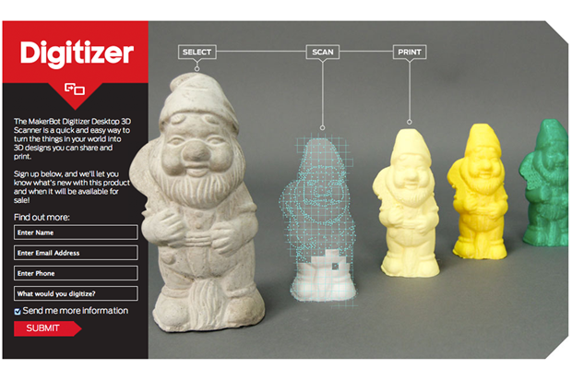
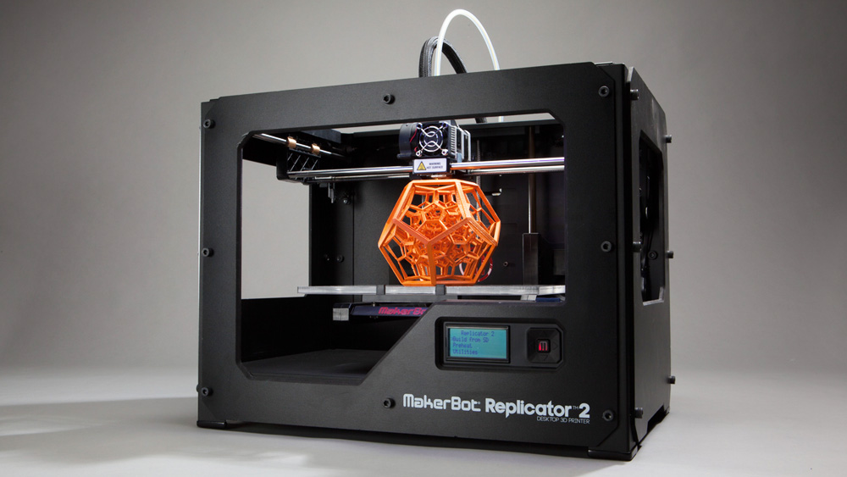
3D Object Capture and Reproduction
makerbot.com

Slide 15
Virtualization of the
World
Can represent things as bits
  Sound, pictures, movies
  Location, situation, …
  shapes, circuits, drugs, DNA
Cheap/powerful ways to
automatically manipulate
  …and reproduce
TRON 1982

Slide 16
World of Bits
What else can we capture as bits?
Reproduce from bits?

Slide 17
http://news.cnet.com/8301-27083_3-20079504-247/prosthetic-dentistry-print-your-own-teeth/
http://phys.org/news/2011-02-3d-bio-printers-skin-body.html

Slide 18
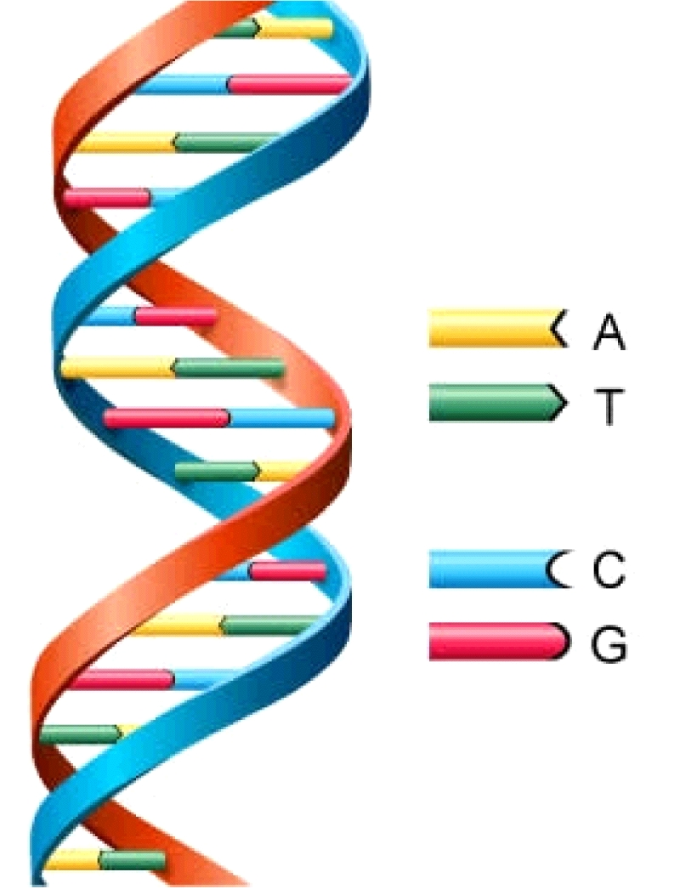
DNA
Natures bitstream
Can read into bits
Can reproduce from bits
Digitize organisms….
Those bits control behavior
Control function of cells
  Even what the cells manufacture and produce
http://www.astrochem.org/sci_img/dna.jpg

Slide 19

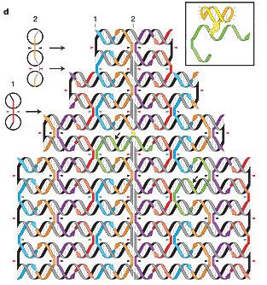
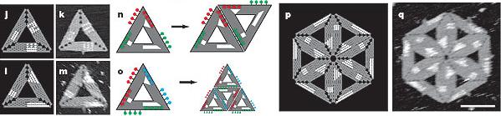
Programming the Physical World (DNA)
How do we program DNA?
  Self-assemble into arbitrary useful structures?
  Perform specific functions in cells?
  …becoming a problem of information and computation
[Winfree & Rothemund,
CALTECH]

Slide 20
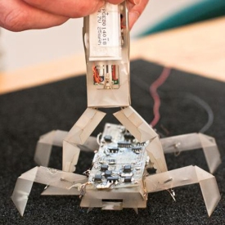
Printable Programmable Robots (Machines)
Print out mechanisms
With integrated
  Mechanics
  Sensing, actuation
  Electronics
  Computation
  http://ppm.csail.mit.edu
  MIT, Penn, Harvard

Slide 21
It gets Easier
3D Printing, contract manufacturing
  Low volume production, mechanical things
Processors – deploy code
FPGAs, FPAA, PSoC – deploy circuits
Internet – transfer designs, orders, advertise
FedEx – global shipment
Lowering Barriers
  Production, distribution, deployment

Slide 22
Limits?
What can’t we capture and reproduce from bits?

Slide 23
Clarke’s Laws
When a distinguished but elderly scientist states that something is possible, he is almost certainly right.
When he states that something is impossible, he is very probably wrong. The only way of discovering the limits of the possible is to venture a little way past them into the impossible.
Any sufficiently advanced technology is indistinguishable from magic.

Slide 24
Administrative Interlude: Final
Part 2

Slide 25
Final
Final Office Hours: (see piazza)
  Sunday 5/2, Monday 5/3, Tuesday 5/4
Final: Wednesday (5/5) Online
  Regulations posted
    Like Midterm
    12 hour window
  15% of grade
  Comprehensive (intent…does tend to weight 2nd half)
  Last few years final and answers linked to syllabus
    Probably mix ideas from first and second half

Slide 26
Final Topics
Pre Midterm
Data representation in bits
Sounds waves
Sampling
Quantization
Nyquist
Lossy/lossless compression
Common case
Frequency domain
Psychoacoustics
Perceptual coding
Post midterm
Combinational Logic
Finite-State Machines
Stored-Program Processors
Processing Requirements
Process Virtualization
Networking
Sensing, Actuation, Control
User Interface
Intellectual Property

Slide 27
Engineering Disciplines

Slide 28
Understanding
Computer Engineering
Electrical Engineering
Computer Science
Systems Science and Engineering

Slide 29
Information as Unifier
EE
  Signal processing, control
  Electrical systems to process
CIS
  Algorithms, software, strategy
MEAM
  Capture, reproduce, control
BE
  Cellular behavior, synthetic Biology
SSE
  Resuable math and information processing

Slide 30
Data Science and Machine Learning
How do we make sense of raw data?
Turn it into useful information?
Use it to control things?
Automate the processing and adaptation (learning)
Mathematics developed in
  EE, Systems, Statistics, Operations Management, …
Implemented in
  Programming languages and algorithms – CIS
Implemented on and enabled by
  Computer hardware designed and optimized by CMPEs
Enables
  Autonomous Vehicles, Robots, Assistance, Business, Science, Engineering, ….

Slide 31
Processing for Machine Learning
At core Linear Algebra
  Dot Products
  Matrix Operations
    matrix-vector multiplication, matrix-matrix multiplication
Same computation we have been using for Audio processing
  Dot Products, Fourier Transforms
Hardware we explored in Lab 7, 8 postlabs is a relevant starting point
Learn more: ESE539

Slide 32
Topic | CSCI | CMPE | EE | SSE
Analog Circuits |  | ESE215 | ESE215
Compress | CIS121 | CIS121
Nyquist, Fourier |  |  | ESE224, ESE325 | ESE224, ESE325
Optimization | CIS320 | (many) |  | ESE204
Digital Logic | CIS240 | CIS240, ESE370, ESE532
Processor | CIS471 | CIS471
OS | CIS380 | CIS380
Embedded, Actuation |  | ESE350 ESE421 CIS441 | ESE350 ESE421 | ESE350 ESE421
IP |  | EAS545 | ESE545 | ESE545
Networking |  | ESE407 or CIS553 | ESE407 | ESE407
UI |  |  |  | ESE543

Slide 33
(Notes for previous slide)
Bold – required
Not bold – restricted elective
Simplified to fit on one slide
  (e.g. should show many more analog circuits courses as restricted-electives for EE)

Slide 34
Holistic/Unified Engineering
Today’s devices and products crosscutting
Fewer that fit in one silo
Harder to draw boundary

Slide 35
What’s Next?

Slide 36
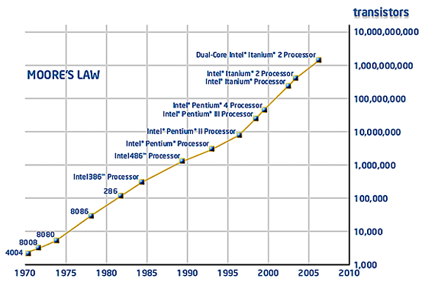
“Moore’s Law” Today
Exponential growth in Integrated Circuit (IC) capacity
Driven by a geometric shrink in transistor feature size
Pitch
Gate

Slide 37
Moore’s Law Enabled
MP3 players
Smart phones and tablets
Digital cameras
Digital video recorders and players
Realistic Games
Skype, Zoom
DNA sequencing
Autonomous Vehicles
Alexa, Siri
Ubiquitous Machine Learning, Data Analytics

Slide 38
Continued Scaling
What will continued Moore’s Law Scaling enable next?

Slide 39
Parting Thought
From 1st computer to PCs in 30 years
  Eniac 1946→ Apple 1976
From first PCs to iPhone next 30 years
  Apple 1976→iPhone 2007
What will next 30 years hold?
  Beginning of your career
What will you imagine, create, enable?

Slide 40
Lab Due
Note: Lab due Thursday (by midnight)
  Last day of classes (not have due during reading period)
Remember Lecture and Lab feedback form

